Slide 1

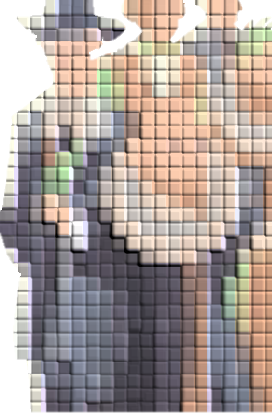
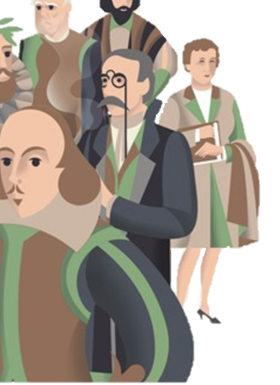

Text Complexity Portuguese PT
Motivation
Methodology
Results | Applications
Rui P. Duarte
Data Analytics | Remote Part-Time | 2020/2021

Slide 2
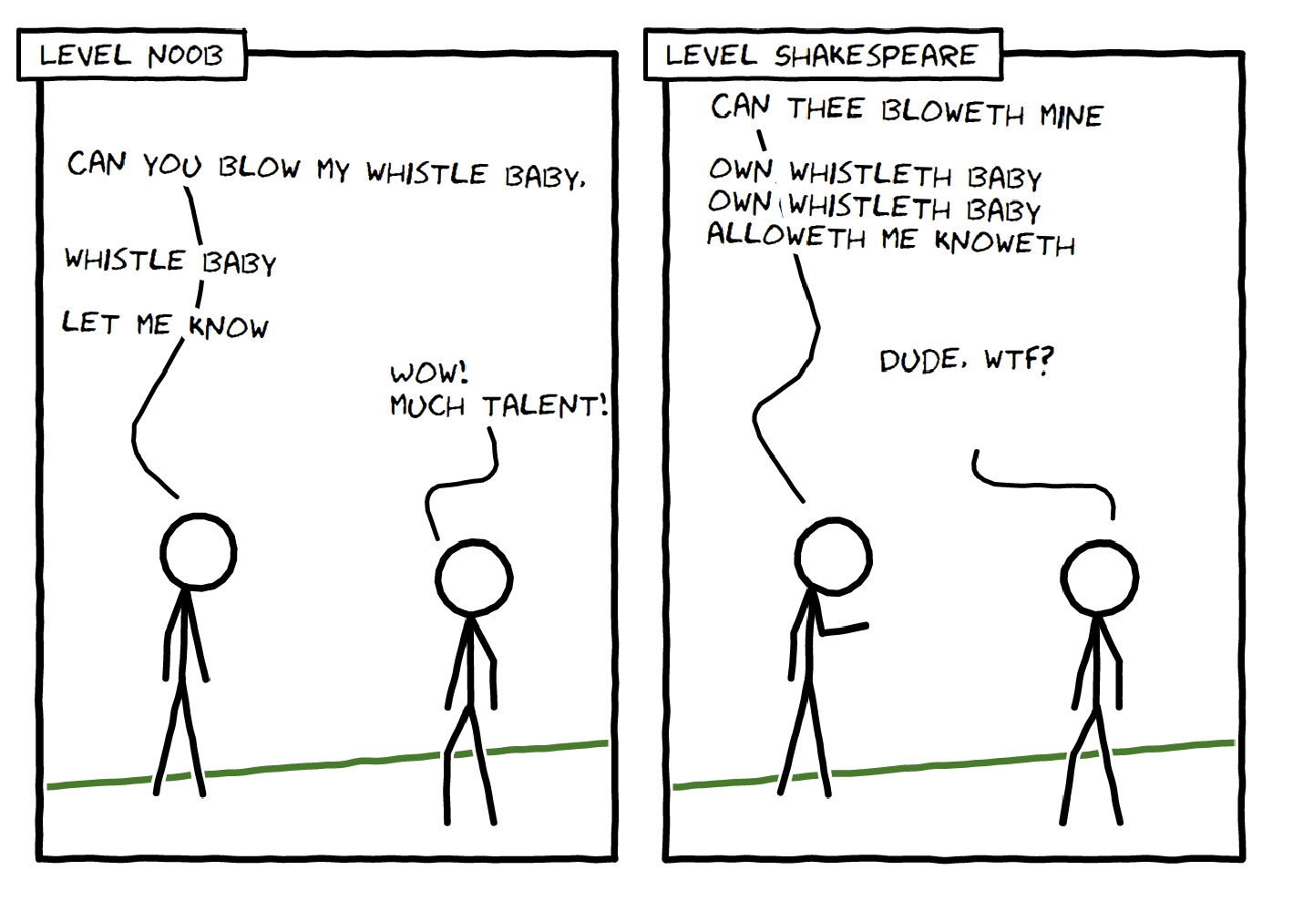
I had a lovely time throughout schooling reading…
Motivation
?
Are schools' readings based on how “difficult” they are?
?
If I can’t under understand newspapers news, is it my fault?
“Level Shakespeare” may provide for pleasant reading. “Level Noob” is much better at conveying information.
Rui P. Duarte
Data Analytics | Remote Part-Time | 2020/2021

Slide 3


Methodology
A look at the first two sentences of two texts
1st Grade: A Flor vai ver o Mar – Alves Redol
O Boi é bom. É bom e tem os pés e as mãos no chão.
The Ox is good. It is good and has its feet and hands on the ground.
12th Grade: Memorial do Convento – José Saramago
D. João, quinto do nome na tabela real, irá esta noite ao quarto de sua mulher, D. Maria Ana Josefa, que chegou há mais de dois anos da Áustria para dar infantes à coroa portuguesa e até hoje ainda não emprenhou. Já se murmura na corte, dentro e fora do palácio, que a rainha, provavelmente, tem a madre seca, insinuação muito resguardada de orelhas e bocas delatoras e que só entre íntimos se confia.
Dom João, the fifth monarch so named on the royal list, will pay a visit this night to the bedchamber of Queen, Dona Maria Ana Josefa, who arrived more than two years ago from Austria to provide heirs for the Portuguese crown, and so far has shown no signs of becoming pregnant. Already there are rumours at the court, both within and without the royal palace, that the Queen is barren, an insinuation that is carefully guarded from hostile ears and tongues and confided only to intimates.
Rui P. Duarte
Data Analytics | Remote Part-Time | 2020/2021

Slide 4
Methodology
A look at the first two sentences of two texts
1st Grade: A Flor vai ver o Mar – Alves Redol
What popped to my mind immediately.
The first text has two very small sentences.
There is not a single word with more than four letters on the first text!
The words are simple on the first text (not complex).
The second phrase on the second text has no subject.
The words are repeated a lot on the first text.
There are very few adjectives in the second text.
[…]
O Boi é bom. É bom e tem os pés e as mãos no chão.
The Ox is good. It is good and has its feet and hands on the ground.
12th Grade: Memorial do Convento – José Saramago
D. João, quinto do nome na tabela real, irá esta noite ao quarto de sua mulher, D. Maria Ana Josefa, que chegou há mais de dois anos da Áustria para dar infantes à coroa portuguesa e até hoje ainda não emprenhou. Já se murmura na corte, dentro e fora do palácio, que a rainha, provavelmente, tem a madre seca, insinuação muito resguardada de orelhas e bocas delatoras e que só entre íntimos se confia.
Dom João, the fifth monarch so named on the royal list, will pay a visit this night to the bedchamber of Queen, Dona Maria Ana Josefa, who arrived more than two years ago from Austria to provide heirs for the Portuguese crown, and so far has shown no signs of becoming pregnant. Already there are rumours at the court, both within and without the royal palace, that the Queen is barren, an insinuation that is carefully guarded from hostile ears and tongues and confided only to intimates.
Rui P. Duarte
Data Analytics | Remote Part-Time | 2020/2021

Slide 5

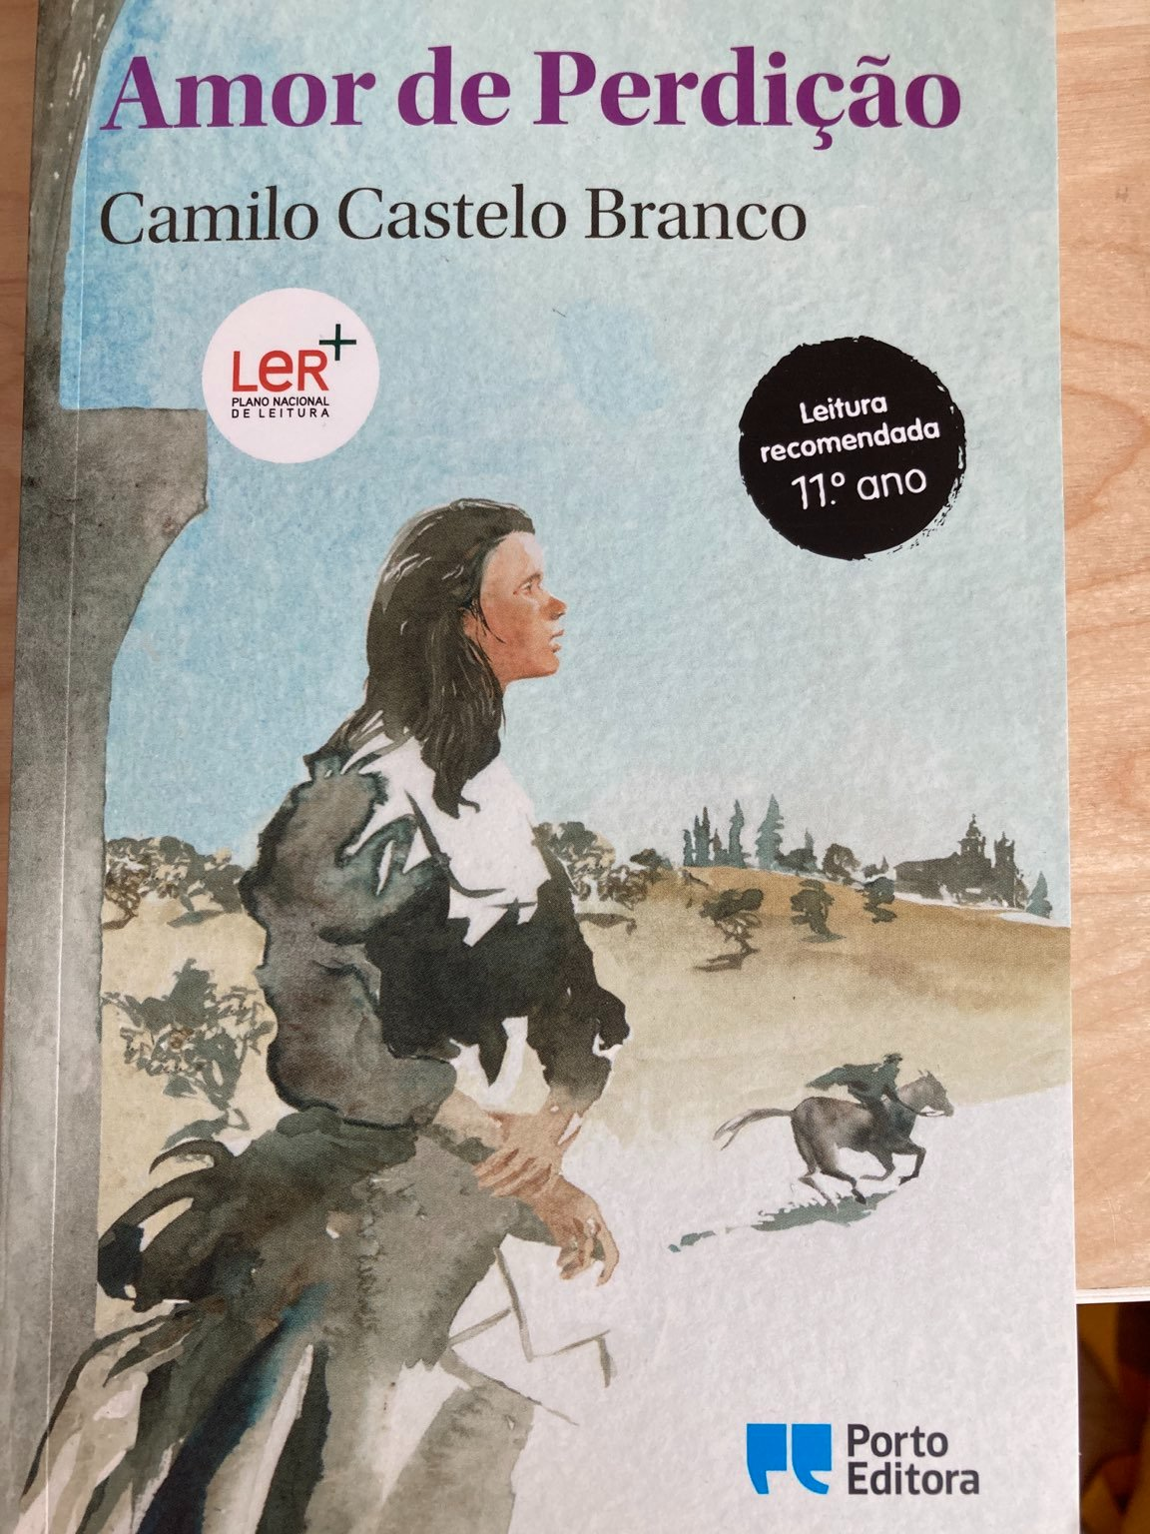


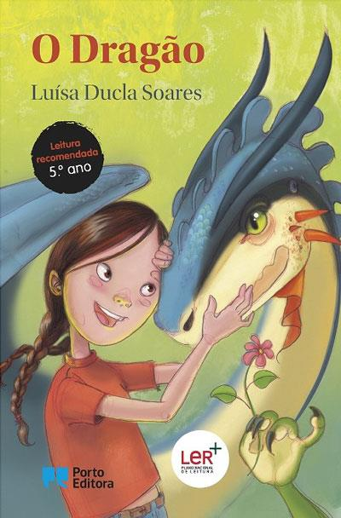
Methodology
Where is my data ?
This is my (really) raw data.
This is my Y-variable.
Rui P. Duarte
Data Analytics | Remote Part-Time | 2020/2021

Slide 6
Methodology
Where are my features ?
Dimension
Lexical
Morphological
Synthatic
Words per Sentence
Syllables per Word
Polysyllables per Word
Simple Word List:
1000 Simplest Words in ES
(Self-Translated)
Simple Word List:
Dale-Chall
(Translated by Filipe)
Unique Words Per Word
Unique W. Concentration Index
Verbs per word
Nouns per word
Adjective per word
SVO’s Identified
Consecutive SVOs
Inspired by:
A bunch of papers 2000-2010
Inspired by:
Inspired by:
Inspired by:
Flesch
Reading
Ease
(1975)
New
Dale
Chall
(1969)
Random websites with text descriptions
SMOG
Index
(1969)
49 Books into +- 600 Rows Pandas DataFrame
No topic modelling
It would not serve me if I wanted to apply it to new texts which are not recommended books.
Rui P. Duarte
Data Analytics | Remote Part-Time | 2020/2021

Slide 7
Methodology
Finding the model
Random Forests
Support Vector Regression
Gradient Boosting
[ … ]
XGBoost
(test) MAE
>+ 1
Resampling:
Oversampling underrepresented grades
Down sampling overrepresented grades.
All hyperparameters grid searched.
(test) MAE
0.6332
(out 12 grades)
Rui P. Duarte
Data Analytics | Remote Part-Time | 2020/2021

Slide 8

Results | Applications
Real Y vs Prediction Y
Real Y | Pred. Y | Real Y | Pred. Y | Real Y | Pred. Y | Real Y | Pred. Y | Real Y | Pred. Y | Real Y | Pred. Y
1 | 1,01 | 4 | 4,25 | 5 | 5,36 | 7 | 7,78 | 8 | 7,82 | 9 | 6,73
1 | 1,02 | 4 | 4,01 | 5 | 4,99 | 7 | 6,21 | 8 | 6,37 | 9 | 8,86
2 | 2,00 | 4 | 4,01 | 5 | 5,19 | 7 | 5,62 | 8 | 9,42 | 9 | 9,01
2 | 2,01 | 5 | 8,76 | 6 | 4,50 | 7 | 6,51 | 8 | 8,07 | 9 | 7,77
2 | 2,02 | 5 | 6,99 | 6 | 5,15 | 7 | 6,31 | 8 | 9,21 | 9 | 8,17
2 | 2,00 | 5 | 5,37 | 6 | 6,67 | 7 | 7,16 | 8 | 8,91 | 11 | 9,09
2 | 2,01 | 5 | 5,89 | 6 | 5,43 | 7 | 8,61 | 8 | 8,10 | 11 | 7,24
2 | 2,02 | 5 | 5,14 | 6 | 5,98 | 7 | 6,41 | 8 | 8,18 | 11 | 8,03
2 | 2,12 | 5 | 5,44 | 6 | 5,92 | 7 | 6,85 | 9 | 7,01 | 11 | 8,97
3 | 3,17 | 5 | 5,61 | 6 | 9,94 | 7 | 6,14 | 9 | 8,55 | 11 | 9,03
3 | 2,99 | 5 | 5,67 | 6 | 7,01 | 7 | 7,89 | 9 | 8,91 | 12 | 11,47
3 | 3,32 | 5 | 5,82 | 6 | 7,67 | 7 | 6,91 | 9 | 9,04 | 12 | 12,01
4 | 4,04 | 5 | 6,14 | 6 | 5,80 | 7 | 6,42 | 9 | 8,96 | 12 | 11,98
4 | 4,01 | 5 | 5,88 | 6 | 6,33 | 7 | 6,81 | 9 | 8,10 | 12 | 11,84
4 | 4,00 | 5 | 6,10 | 6 | 7,73 | 7 | 8,33 | 9 | 8,63 | 12 | 11,91
4 | 4,03 | 5 | 6,46 | 6 | 5,87 | 7 | 6,48 | 9 | 8,02 | 12 | 11,69
4 | 4,00 | 5 | 6,18 | 7 | 7,74 | 8 | 7,81 | 9 | 8,32 | 12 | 11,43
4 | 4,05 | 5 | 5,67 | 7 | 5,76 | 8 | 6,75 | 9 | 8,43 | 12 | 11,47
 |  |  |  | 7 | 5,24 | 8 | 7,88 | 9 | 7,86 | 12 | 11,85
If it were a classification problem:
Accurate Prediction
?
1-Year Diference
Are schools' readings based on how “difficult” they are?
2+Year Diference
Yes! Less so for older students.
Rui P. Duarte
Data Analytics | Remote Part-Time | 2020/2021
Notes:
MAE disregarding first two columns of the table: 0.817105

Slide 9





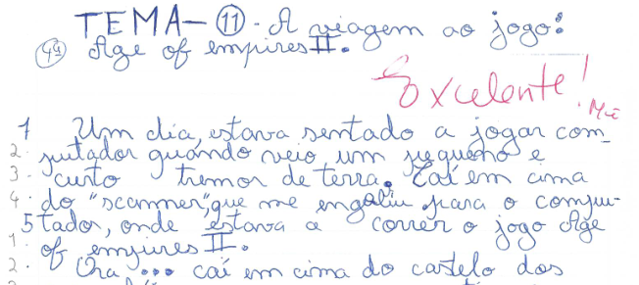
Results | Applications
Uses outside the book world
Sample of
~60 financial articles.
IQR: 3.8 – 5.1
Mean: 4.6
Random bits of texts of the last “Boletim Económico”
Mean: 3.6
Essays of a couple of 8-11 year olds (nephews… and myself and my mother!)
Mean: 5.2
*These are very small samples, hence “insights” and not “findings/conclusions”.
Rui P. Duarte
Data Analytics | Remote Part-Time | 2020/2021

Slide 10
Results | Applications
Uses outside the book world
Insights
What kids can read and what kids can write is substantially different. We teach kids to interpret art, yet we want them to focus of intelligibility for a long (long) while.
No adult, trying to convey information in an accurate way, writes like books for grades 1 and 2 are written, nor like books for 9+ grades are written.
It appears to be possible to do a metric following this overall methodology that provides an accurate figure for describing text complexity.
However, a larger sample of PNL books (+€) would be necessary and likely the model should only be training on books grade 3 through grade 9. And the lower the better the score would be! That is, information would be conveyed in a clearer way.
Newspapers may be able to reduce text complexity, but overall, they seem to be OK. Which means either the complexity comes from context/jargon or…
It might be really my problem…!
?
If I can’t under understand newspapers news, is it my fault?
Rui P. Duarte
Data Analytics | Remote Part-Time | 2020/2021

Slide 11
Annex
NLP – Python Packages/Tools
As is:
NLPy_Port [NLTK based] - https://github.com/NLP-CISUC/NLPyPort
Spacy
Adapted:
PE2LGP – https://github.com/mattgoncalves/PE2LGP
Separasilabas – https://github.com/amunozf/separasilabas
Most relevant article/paper read:
Classificador de textos para o ensino de português como segunda língua
Pedro dos Santos Lopes Curto
Dissertação para obtenção do Grau de Mestre em Engenharia Informática e de Computadores
Novembro 2014
Rui P. Duarte
Data Analytics | Remote Part-Time | 2020/2021

