Slide 1



uRos 2021: “Network Visualization of Multi-data Sources using R”
Scientific Session: BIG DATA
Rui ALVES
Shirley ORTEGA-AZURDUY
Christina PIERRAKOU
Statistics Netherlands
Hellenic Statistical Authority

Slide 2
https://github.com/ruialv/VizNet-uRos2021
Scientific Session: BIG DATA
Visit the github page and download the R script or the html file

Slide 3
Contents
1. Context
2. Problem definition
3. Technical requirements (How it works)
4. visNetwork as tool for Innovation of Tourism Statistics
5. Conclusions
6. Future work

Slide 4
The context
[ESSnet2018] ESSnet on Big Data 2018 -2020 - Eurostat grant ESTAT-PA11-2018-8 Multipurpose statistics and efficiency gains in production.
https://ec.europa.eu/eurostat/cros/content/essnet-big-data-i_en#WP7_Multiple_domains
ESSnet Big Data II WPJ – Innovative Tourism Statistics - Task 1C
https://ec.europa.eu/eurostat/cros/content/WPJ_Innovative_tourism_statistics_en
Notes:
ESSnet: Network of ESS organizations within the European Statistical System.
An ESSnet project is:"A network of several ESS organisations aimed at providing results that will be beneficial to the whole ESS".

Slide 5








The context
Objective
WPJ Innovative Tourism Statistics
Develop a conceptual framework and setting up a prototype of Tourism Information and Monitoring System
Notes:
[note: this was taken from the WPJ BDES 2020 presentation]

Slide 6
The context
Supporting statistical production in the field of tourism by integrating various big data sources with administrative registers and statistical databases using innovative statistical methods.
data discrepancies
incoherent concepts
indirect relations between sources
redundancies of information
Combining multi-purpose (administrative), survey and Webscraping-data
Notes:
[note: this was taken from the WPJ BDES 2020 presentation]

Slide 7
The Problem
How to get rapid overview of the data sources types
How to trace back and forward where sources are used and to which end
a) Identify/Visualize which other countries use the same (or similar) sources
b) Understand the different purposes leading to the use of an specific source
c) Be able to directly browse into the external sources and get new insights
Need to support production process to assess potential efficiency gains
Notes:
Why do we need a network tool?

Slide 8
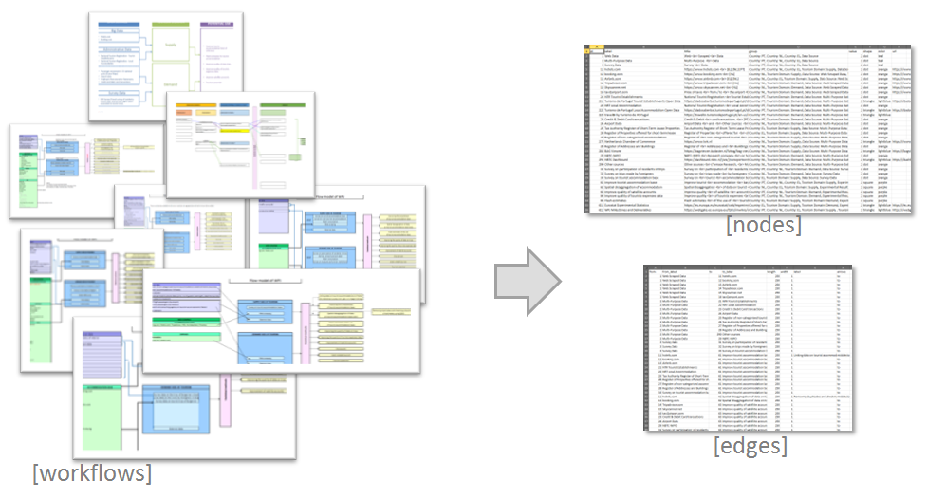
The Problem
Multiple individual workflows do not give the full picture

Slide 9
The Solution: Interactive network visualisation

Slide 10
What's the importance of booking.com? How many countries use it? To what results?

Slide 11
How many countries use airbnb?

Slide 12
How many data sources are used to improve quality of tourist expenses data?

Slide 13
How does it work?

Slide 14
How does it work?
R Script
Self-contained (data is embedded)
dput {base} R command that conveniently recreates an object, such as a dataframe.
Commented (useful to understand what the script is doing)
Organized in an outline layout (useful to navigate the code)
Show Document Outline: Ctrl+Shift+O
Tips & tricks
digest2int {digest} R command that calculates integer hash of an arbitrary string. Good to create ID’s from labels (long text strings such as the nodes labels)

Slide 15
How does it work? visNetworkEditor{visNetwork}

Slide 16
R Packages
dplyr
Hadley Wickham, Romain François, Lionel Henry and Kirill Müller (2021). dplyr: A Grammar of Data Manipulation. R package version 1.0.7 htttps://CRAN.R-project.org/package=dplyr
visNetwork
Almende B.V. and Contributors, Benoit Thieurmel and Titouan Robert (2021). visNetwork: Network Visualization using 'vis.js' Library. Rpackage version 2.1.0. https://CRAN.R-project.org/package=visNetwork
rstudioapi
Kevin Ushey, JJ Allaire, Hadley Wickham and Gary Ritchie (2020). rstudioapi: Safely Access the RStudio API. R package version 0.13. https://CRAN.R-project.org/package=rstudioap
digest
Dirk Eddelbuettel with contributions by Antoine Lucas, Jarek Tuszynski, Henrik Bengtsson, Simon Urbanek, Mario Frasca, Bryan Lewis, Murray Stokely, Hannes Muehleisen, Duncan Murdoch, Jim Hester, Wush Wu, Qiang Kou, Thierry Onkelinx, Michel Lang, Viliam Simko, Kurt Hornik, Radford Neal, Kendon Bell, Matthew de Queljoe, Ion Suruceanu, Bill Denney, Dirk Schumacher and Winston Chang. (2021). digest: Create Compact Hash Digests of R Objects. R package version 0.6.28. https://CRAN.R-project.org/package=digest

Slide 17
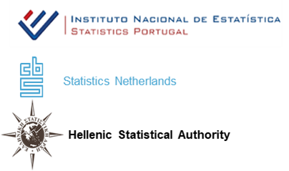
Thank you for your attention
Scientific Session: BIG DATA
rui.alves@ine.pt

Slide 18
DEMO

Slide 19
“The Solution”
Typical Policy-related Questions
What’s the impact / importance of e.g. booking.com website?
How many countries use it?
Which results depend on it?
How many countries use Airbnb as a data source?
How many data sources are used to Improve Quality of Tourist Expenses Data?

Slide 20
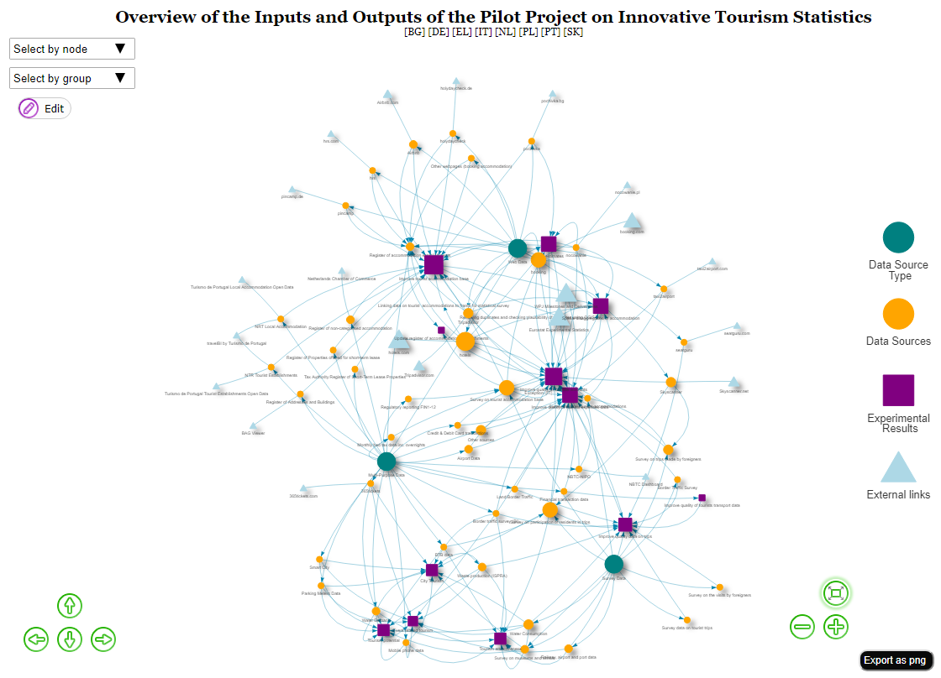
Complex and dynamic relationships (v.Beta2)
At European level
3
46
12
19

Slide 21
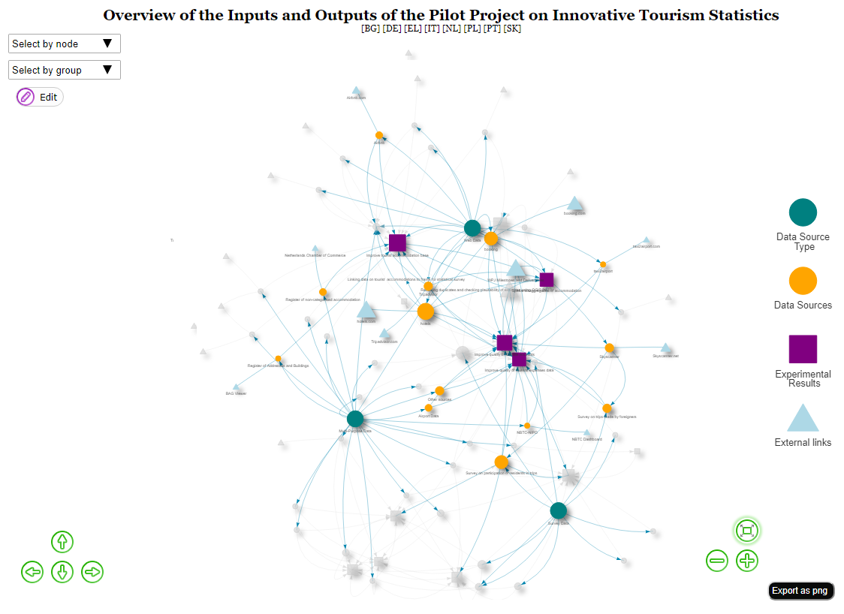

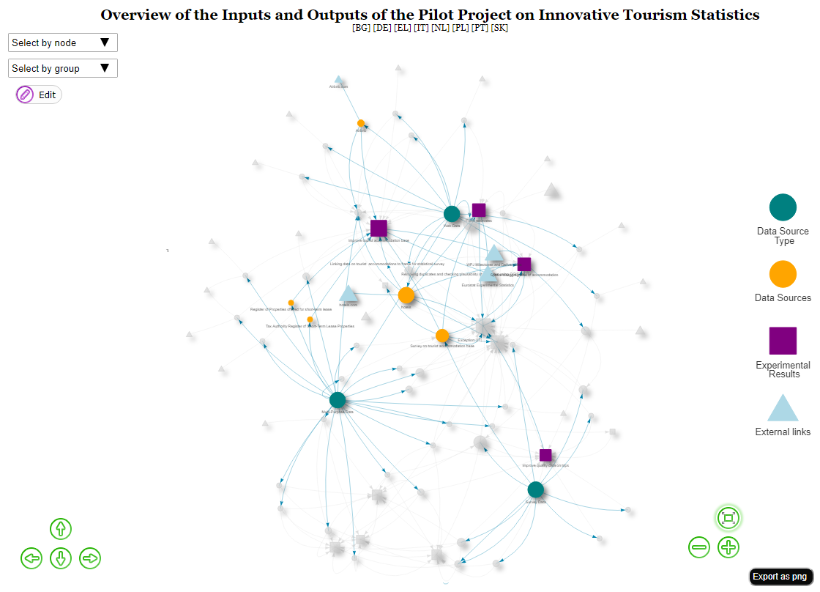

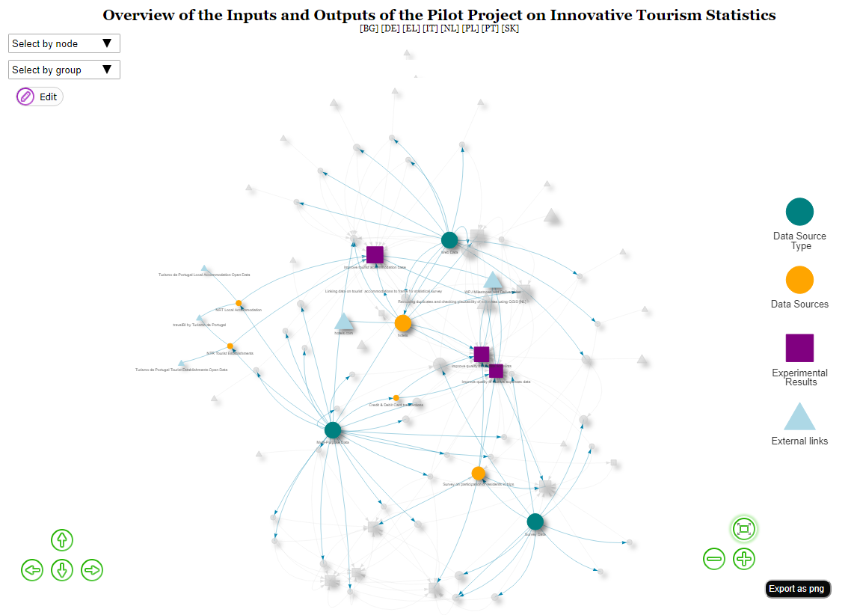

visNetwork flow as analytical tool to support policy making
Did you know that Statistics Netherlands focusses on improving the quality of tourists expenses data?
At national level
3
13
4
10
Did you know that
Statistics Greece focusses
on improving its
Tourism Accommodation Base?
3
5
3
4
Did you know that Statistics Portugal uses
Open Data to improve its
Tourism Accommodations Base?
3
5
3
5

Slide 22


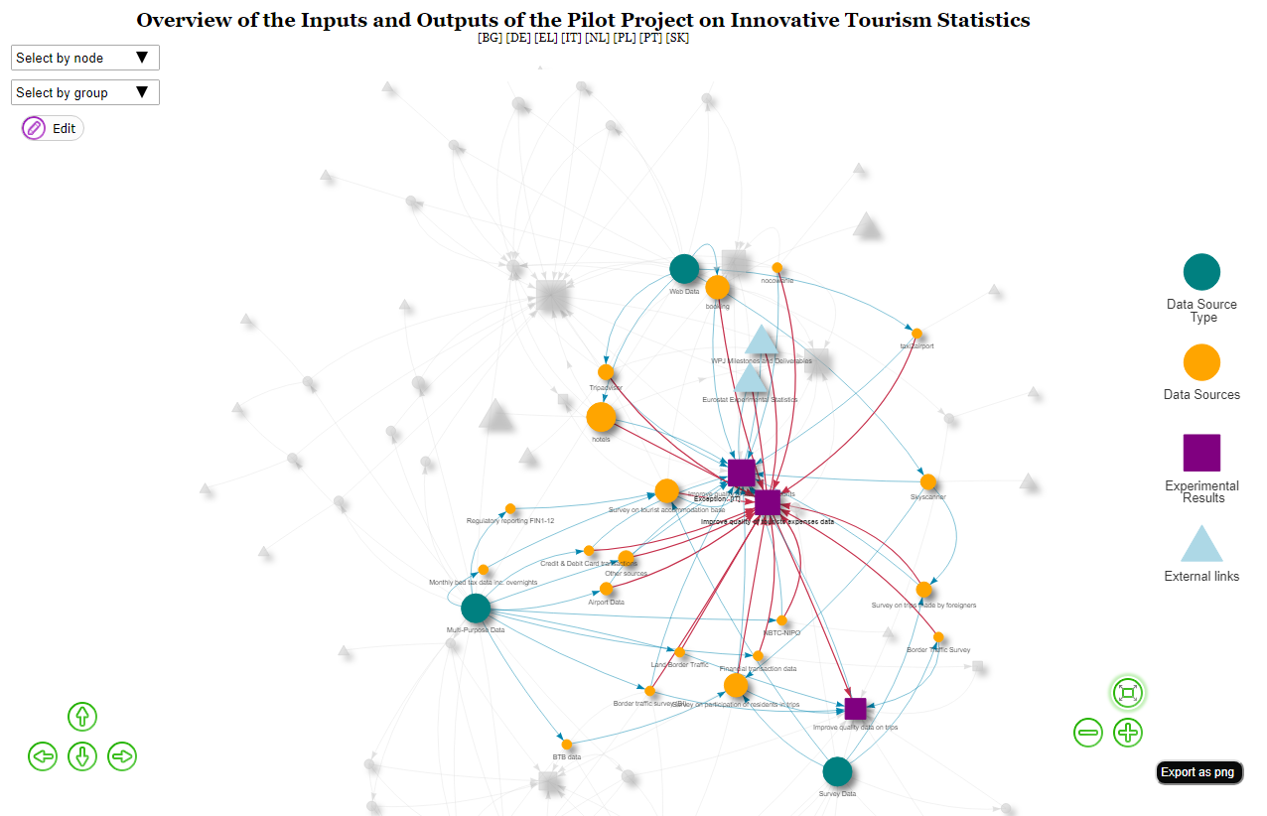


VisNetwork allows to get a rapid overview about topics of interest
Per topic: Improve quality of tourists expenses data
Did you know that Statistics Netherlands
shares the goal of improving quality of tourists
expenses data with other 5 ESSnet-countries?
3
20
3
2

