Slide 1
COMP 7250 Project
Bag of Tricks for Effective Training
Group 2 | 24435015 He Rui

Slide 2
Introduction
Part 2 Classifier
Problem
Training deep neural networks can be very time-consuming, especially for complex models like ResNet.
Optimization
Given the CIFAR-10 dataset and a standard ResNet18 architecture.
Our goal is reducing training time by different tricks, while still remaining high accuracy
Notes:
I tried to change the structure and modify the parameters of CNN. And I wonder if I use more training data, or if I use the data in the same distribution with the real one, will the performance close to the real one? However, the answer is no, which means, the Generator did not fully learn the data structure. The real data structure is more complex than our synthetics, the simple CNN and those pre-trained models showed similar performance, a standard CNN is enough to handle this.

Slide 3
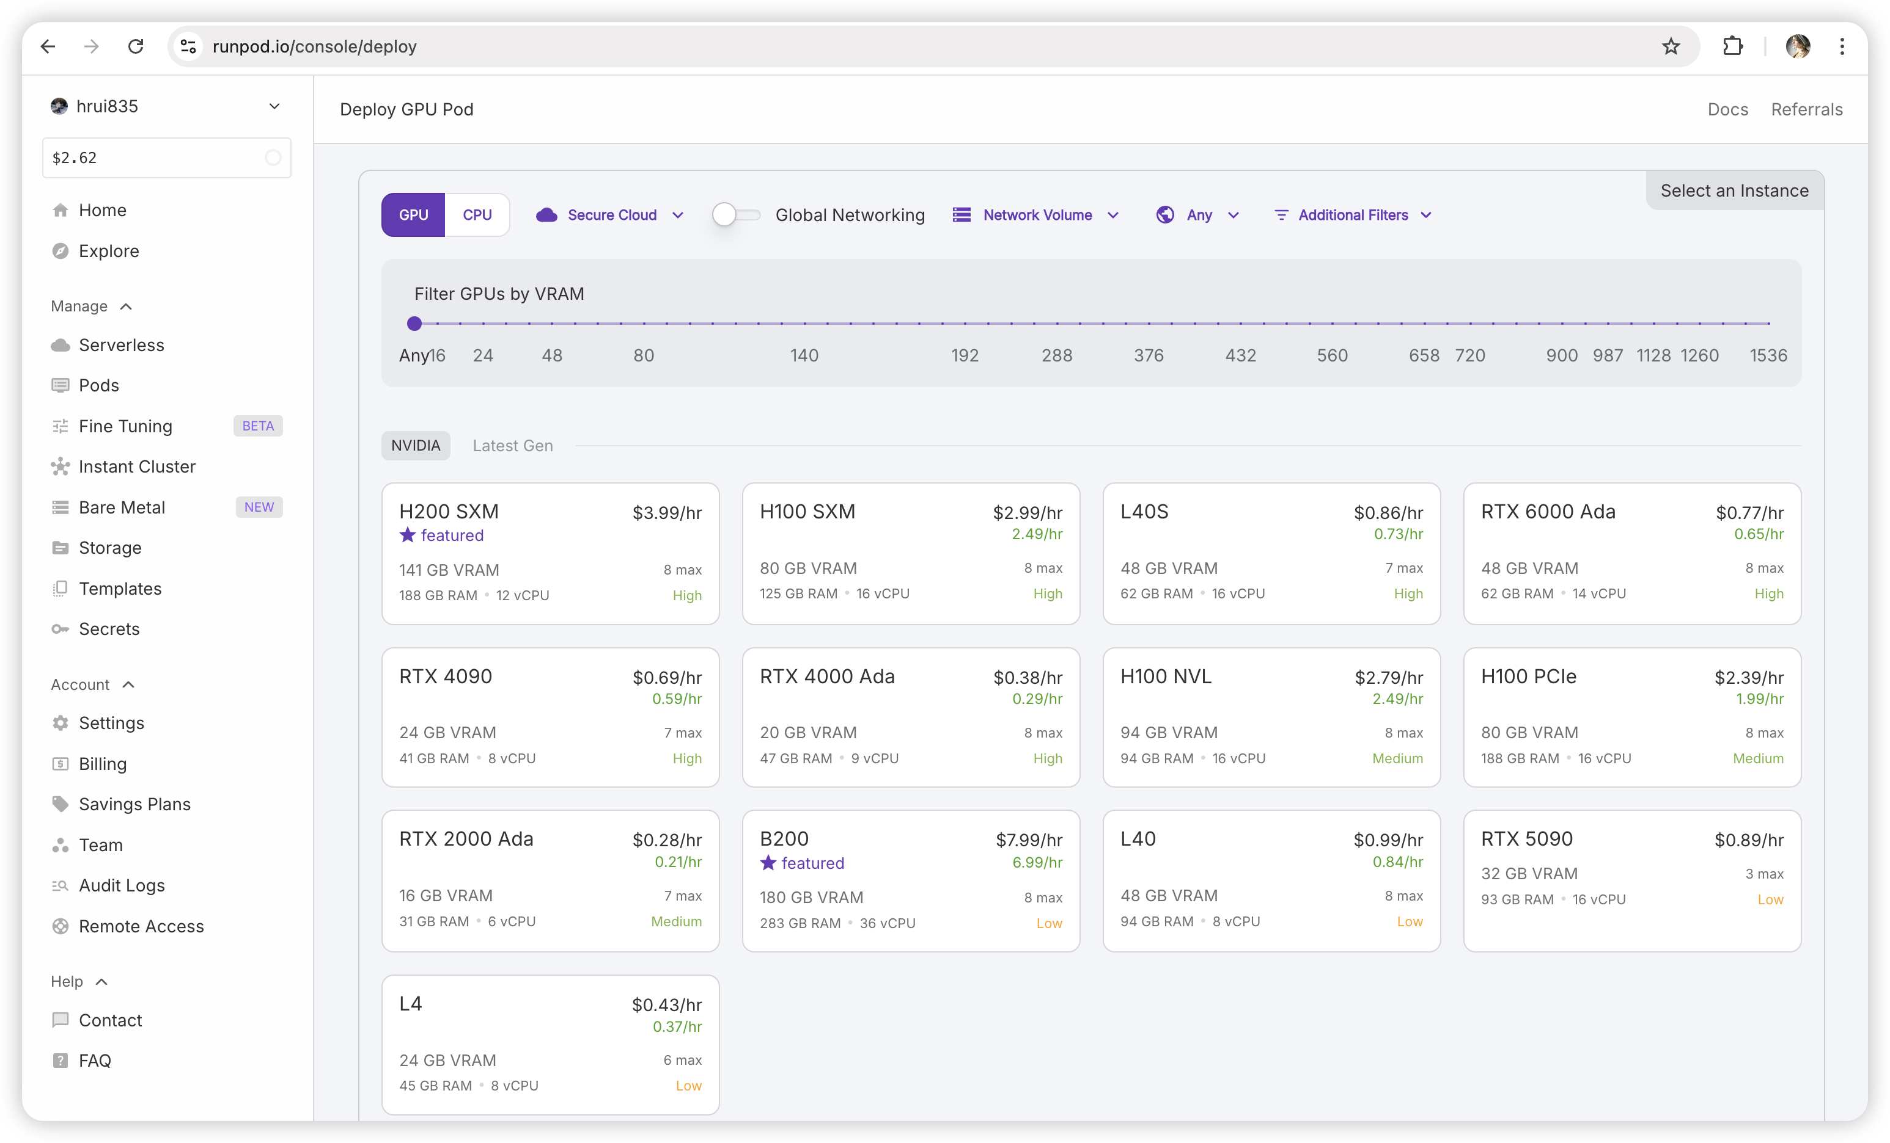
Methodology
Part 2 Classifier
Experimental Setup
Part 2 Classifier
Conducted on a single GPU with
• GPU: 1 × RTX 3070 (16GB VRAM)
• CPU: 16 vCPUs, 31GB RAM
• Dataset: CIFAR-10
• Model: ResNet18
• Frameworks: PyTorch, PyTorch Lightning, TensorBoard (Python3.12)
rent from runpod.io

Slide 4
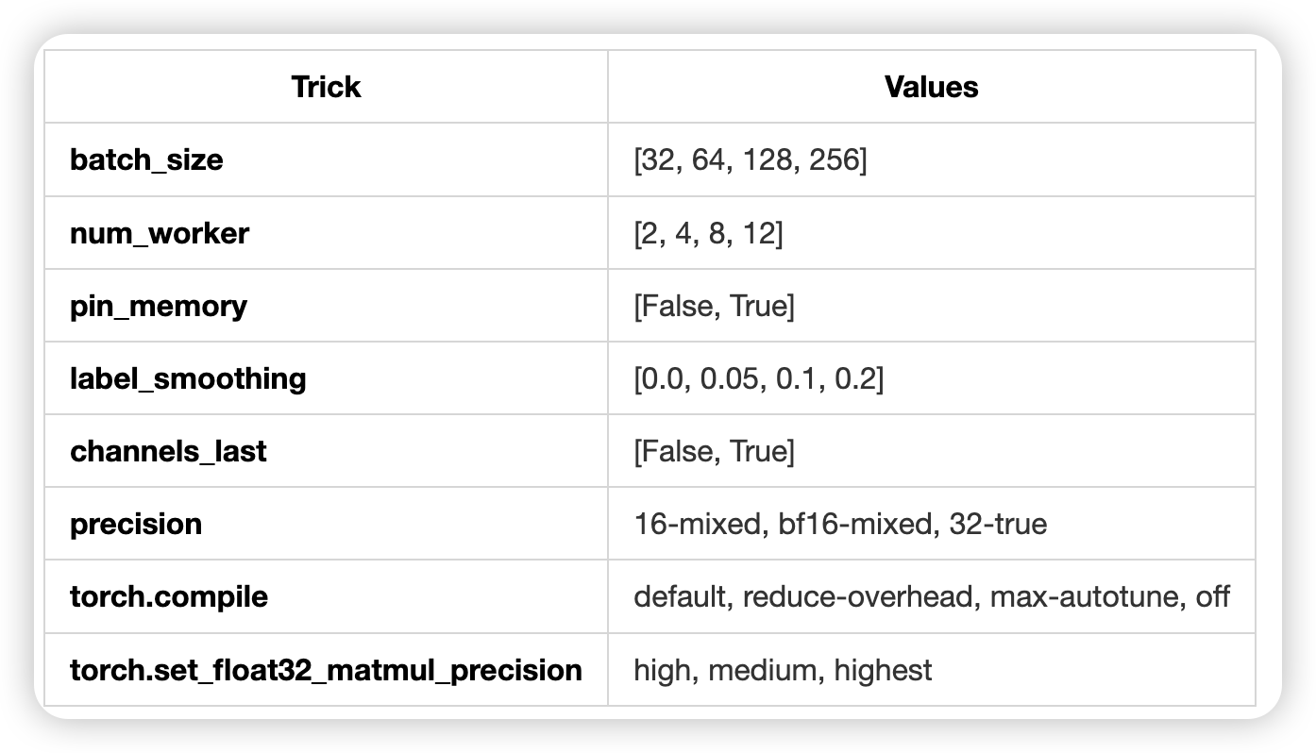
Methodology
Part 2 Classifier
Hyperparameters and Tricks
Part 2 Classifier
baseline
• batch_size = 32
• num_worker = 2
• max_epoch =100
• early_stop = 10
at each run
only one trick one value was applied
26 run finished in 30 hours

Slide 5
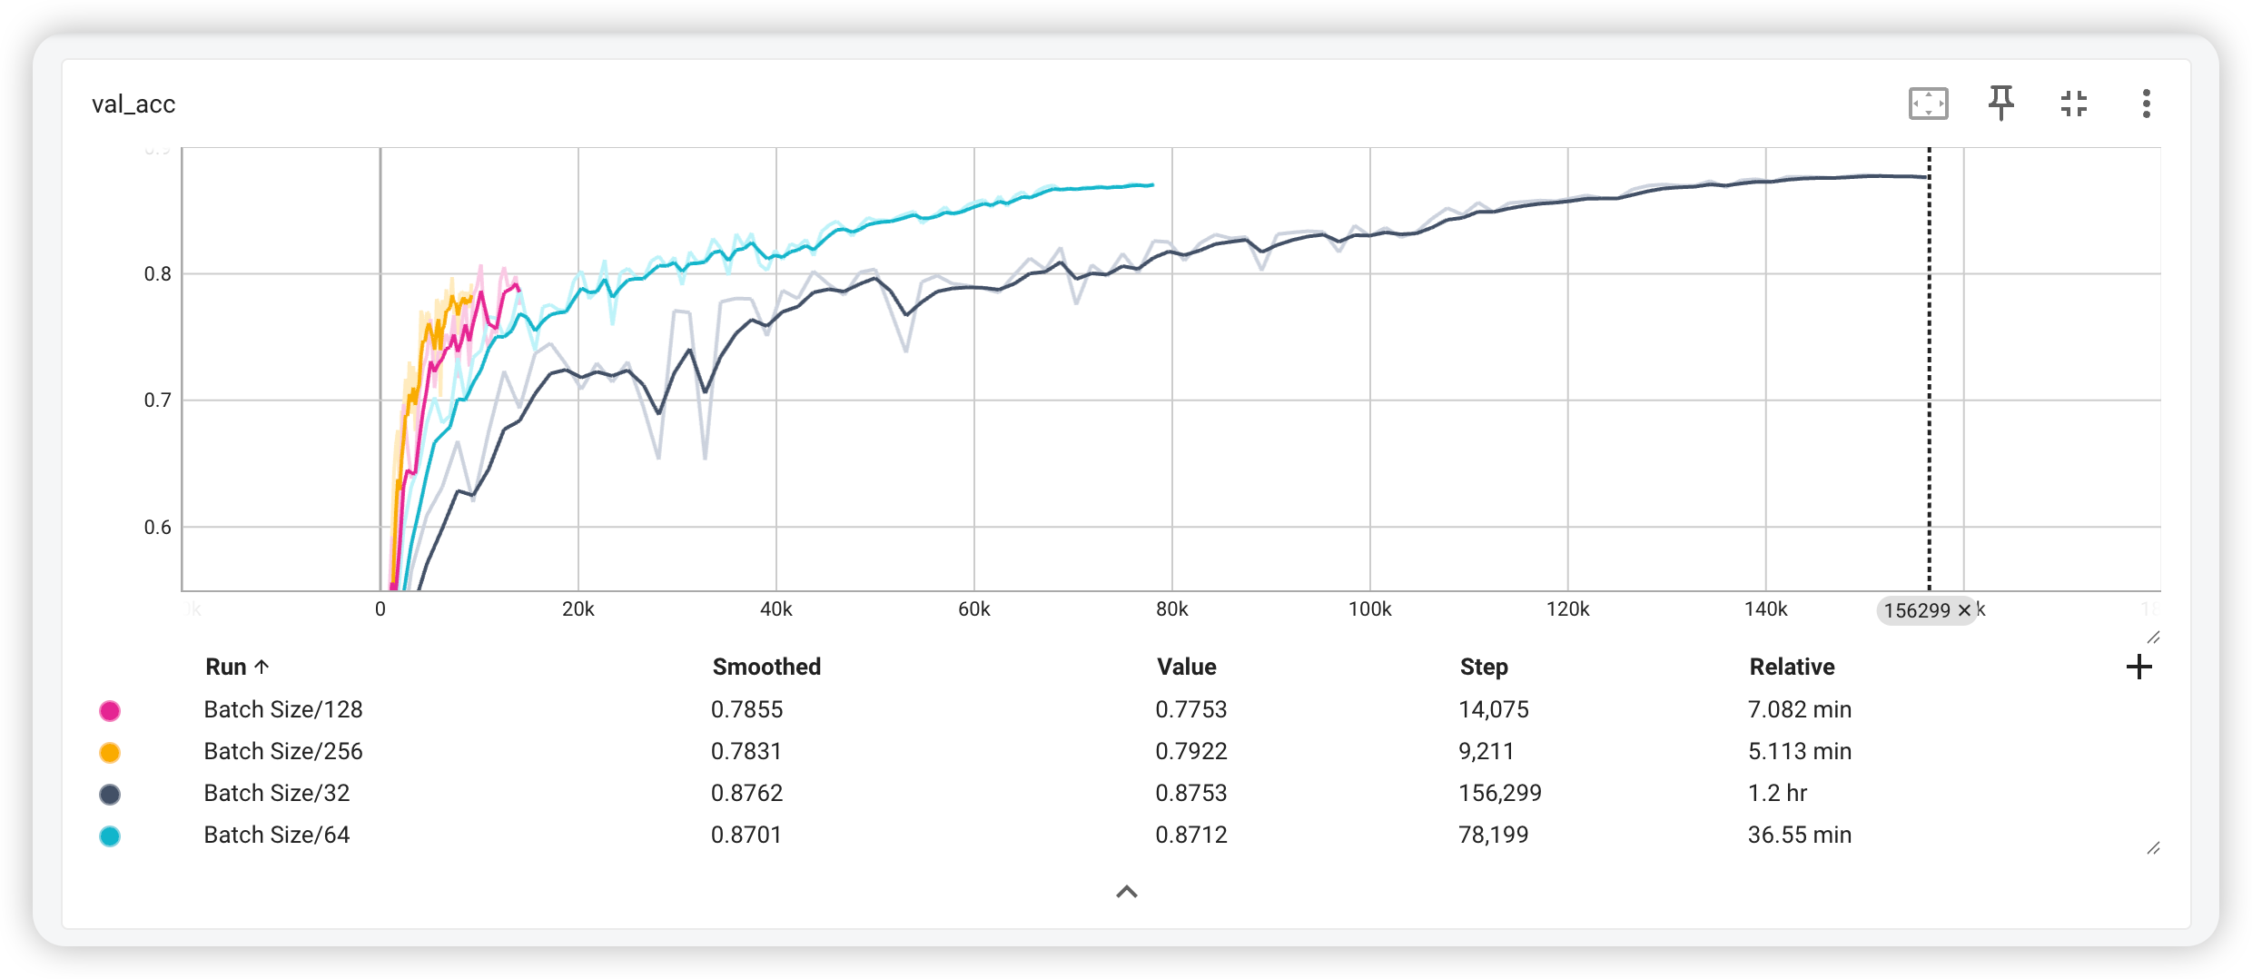
Experimental Results · Batch Size
Part 2 Classifier
Part 2 Classifier
Problem
batchsize 64 achieve relative good results with short time

Slide 6
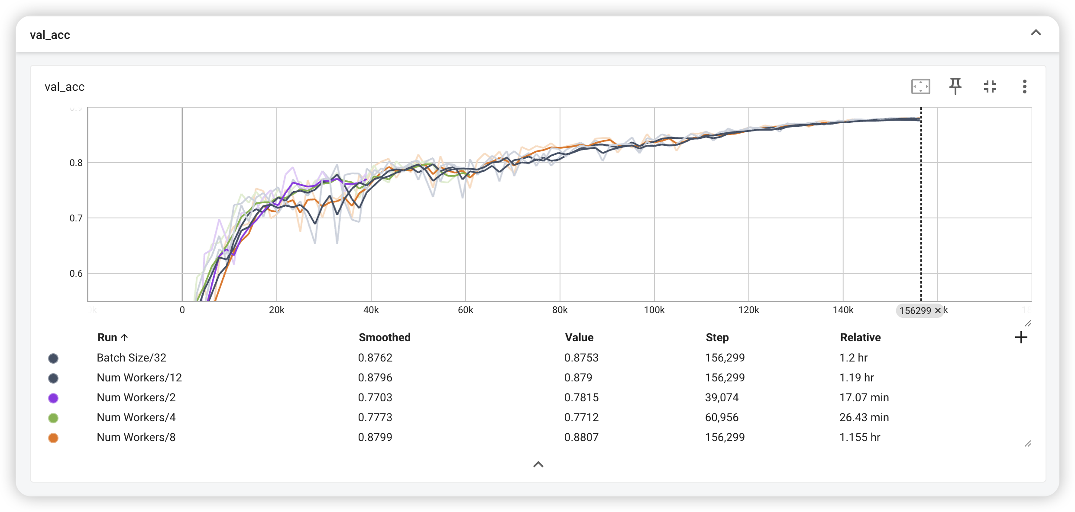
Experimental Results · Num Workers
Part 2 Classifier
Part 2 Classifier
Problem
Num Workers 2,4 early stop triggered. Others no significant difference

Slide 7
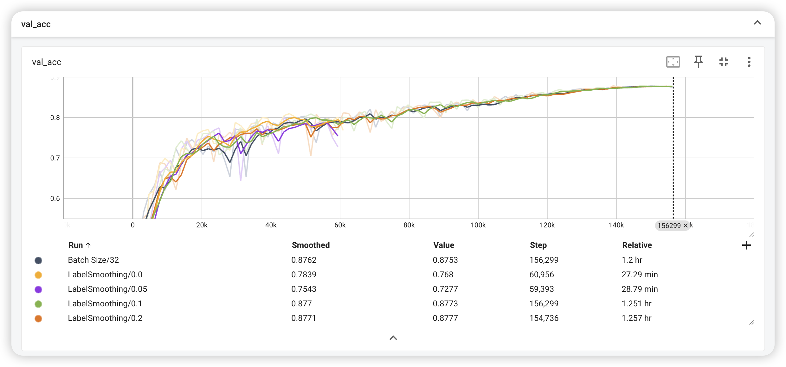
Experimental Results · Label Smoothing
Part 2 Classifier
Part 2 Classifier
Problem
Smoothing 0.0, 0.05, early stop. Others no significant difference on acc, little longer time

Slide 8
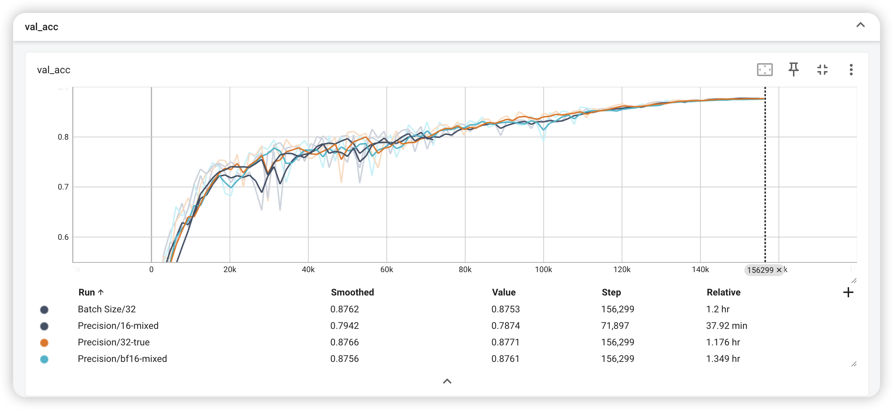
Experimental Results · Precision
Part 2 Classifier
Part 2 Classifier
Problem
bf16-mixed achieved approximately the same accuracy as 32-true, but resulted in 14.6% longer training time

Slide 9
Conclusion
Part 2 Classifier
• Batch size
has the most significant impact on both training time and val acc. larger size require less time, but smaller size generalize better.
• Num Workers
larger num of workers speeded up loading, num=8 (16 in total) perform best.
• TorchCompile
Enabling this feature may significantly increase training time.
It requires GPU support, PyTorch library compatibility, and proper model code optimization for JIT compilation
Part 2 Classifier
• Smoothing, Precision, Pin Memory, ChannelsLast
did not show noticeable difference.
• MatmulPrecision, ChannelsLast
require hardware, algorithm support

Slide 10
References
Part 2 Classifier
• Pytorch Lighting: https://lightning.ai/docs/pytorch/stable/
• Tricks: https://sh-tsang.medium.com/review-resnet-d-bag-of-tricks-for-image-classification-with-convolutional-neural-networks-7ee77669851b
Part 2 Classifier

