Slide 1

When AI-Washing Meets Initial Public Offerings
Rui Dai (University of South Florida), Gangxing (Gary) Guo and Bohui Zhang (CUHK-Shenzhen)
Presented by Rui Dai | 2026 FMA Annual Meeting | October 15, 2026
Notes:
Presenter affiliation verified October 13, 2026: https://ruidaiwrds.info/home and https://www.usf.edu/business/about/bios/dai-rui.aspx. Rui Dai is Assistant Professor of Finance, University of South Florida, and Research Affiliate, WRDS, University of Pennsylvania. FMA official program: https://www.fmaconferences.org/Tampa/TampaProgram.htm. Session 97, Financial News, Thursday October 15, 2026, 3:45–5:15 pm EDT (UTC−4), Westshore (Level 3), JW Marriott Tampa Water Street. Second paper listed. No paper-specific start time is published. Discussant: Chen Shen, Ontario Tech University. Beijing time: October 16, 3:45–5:15 am.

Slide 2
Background: Emerging AI disclosure in IPO prospectuses
AI is increasingly referenced by firms in the U.S. IPO market
  Mentions of AI in S-1 prospectuses have risen sharply over time
Difficulties in valuing AI create scope for potential overstatement
When AI-Washing Meets Initial Public Offerings | 2026 FMA Annual Meeting
1
Notes:
Source: supplied August 2026 manuscript, When AI-Washing Meets Initial Public Offerings. Original presentation design retained.

Slide 3
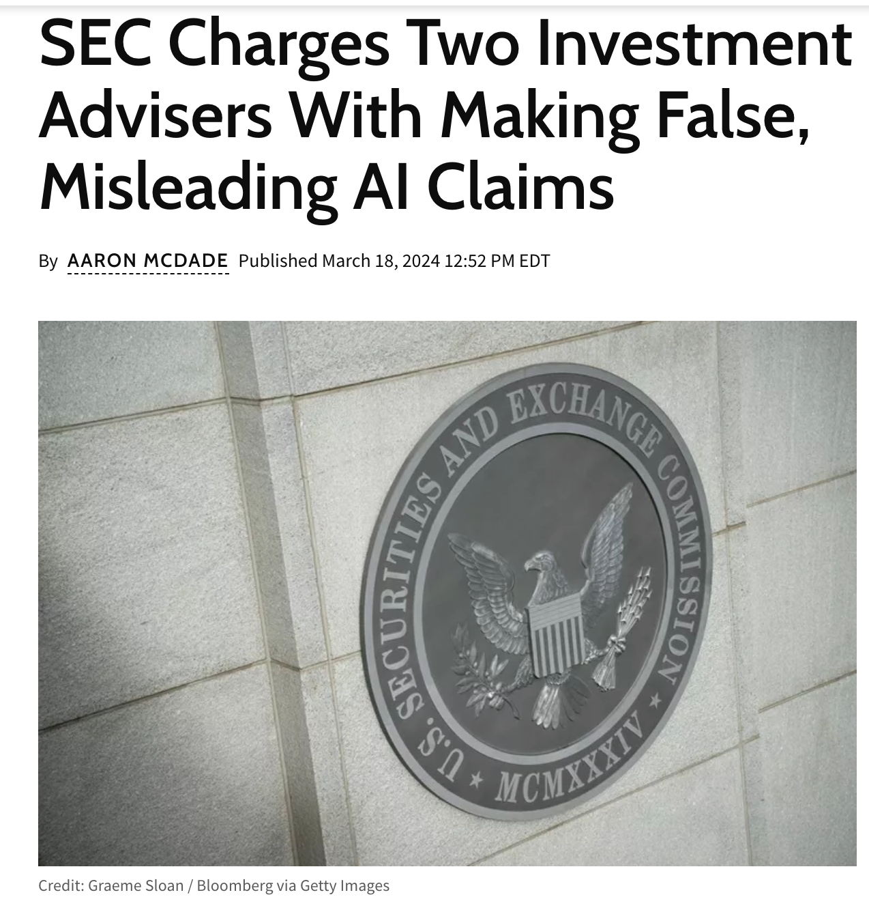
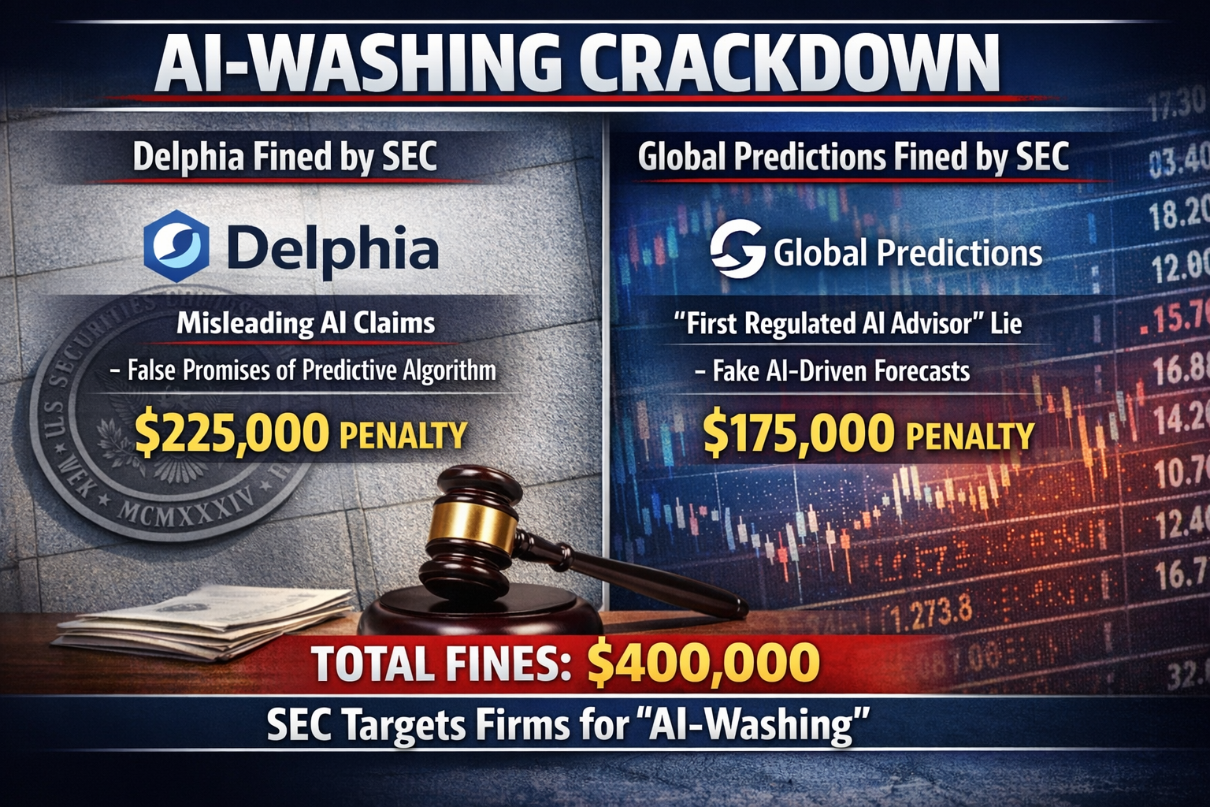
Background: SEC enforcement on AI washing
AI-washing (as defined by the SEC)
  Deceptive practices in which firms embellish or exaggerate their use of AI and its capabilities to attract investors by creating a facade of innovation and reliability
When AI-Washing Meets Initial Public Offerings | 2026 FMA Annual Meeting
2
Notes:
Source: supplied August 2026 manuscript, When AI-Washing Meets Initial Public Offerings. Original presentation design retained.

Slide 4
Research questions
Why IPOs? AI inputs are hard to observe, and issuers have no public track record
How prevalent is AI-washing in the IPO market?
How can we distinguish AI talk from observable AI investment?
S-1 disclosures vs. pre-IPO AI employees and AI patent filings
How do investors price this disclosure–input mismatch?
First-day returns and long-run stock performance
What explains the mispricing, and what curbs AI-washing?
When AI-Washing Meets Initial Public Offerings | 2026 FMA Annual Meeting
3
Notes:
About 1 minute. Why IPOs: algorithms, data and AI talent are hard to observe from outside, and an
IPO firm has little public history to check claims against (paper, Introduction). Capable firms may
even stay quiet to protect proprietary information (Bhattacharya and Ritter 1983), so disclosure and
investment can diverge in both directions. Then the four questions, which map one-to-one onto the
paper: measurement (Section 3), pricing (Section 4.1), channels (Section 4.2), regulation (Section 5).

Slide 5
Preview of findings
Prevalence: 107 of 1,671 IPOs (6.4%) are AI-washing; 14.3% of IPOs in 2023
Pricing: AI-washing IPOs earn 7.2 pp higher first-day returns, then underperform
−8.8 pp (2 years) and −13.9 pp (3 years) vs. non-AI IPOs
AI-investment IPOs: +10.2 pp and +22.0 pp; gap of 19.0 and 36.0 pp
Validation: AI talk fades after year 1; AI job postings (Lightcast) drop after lockup
Channels: valuation premium, verification difficulty, litigation risk
Discipline: less AI-washing under SEC scrutiny; AI-savvy intermediaries do not help
When AI-Washing Meets Initial Public Offerings | 2026 FMA Annual Meeting
4
Notes:
About 1.5 minutes. This is the whole paper in one slide; the rest of the talk follows it in order.
Sources: Introduction; Figure 1 (107 / 1,671 = 6.4%); Figure 2 Panel A (14.3% in 2023); Table 3
Panel A (7.2, 8.8, 13.9, 10.2, 22.0; the 19.0 and 36.0 pp gaps use unrounded estimates); Figures 3-4
(validation); Tables 6-8 (channels); Table 9 and Internet Appendix Table IA10 (regulation vs.
intermediaries).

Slide 6
Dataset
1,671 U.S. IPOs from 2010 to 2024
Exclude offer prices below $5, ADRs, REITs, closed-end funds, and issuers without first-day CRSP trading records (Lowry et al., 2017)
Main datasets
SDC Platinum and Jay Ritter: IPO characteristics and controls
CRSP/Compustat: stock returns, financials, and industry classifications
SEC EDGAR: S-1 filings, 10-K filings, and other disclosures
Revelio Labs: LinkedIn employee profiles (April 2025 snapshot)
Lightcast (formerly Burning Glass): AI job postings
USPTO AIPD: AI patent documents through 2023
When AI-Washing Meets Initial Public Offerings | 2026 FMA Annual Meeting
5
Notes:
Source: supplied August 2026 manuscript, When AI-Washing Meets Initial Public Offerings. Original presentation design retained.

Slide 7
Measuring AI talk and AI walk
AI talk: AI keyword mentions in the S-1 registration statement
97-term dictionary from prior studies; 57 terms appear in S-1s
AI walk 1 – human capital: AI-skilled employees at the listing date
Revelio Labs (LinkedIn); Babina et al. (2024) skills; STEM degree required
AI walk 2 – patents: AI patent filings in the three years before listing
USPTO AI Patent Dataset (0.93 threshold); KPSS links plus name matching
All inputs are dated no later than the listing date
When AI-Washing Meets Initial Public Offerings | 2026 FMA Annual Meeting
6
Notes:
About 1.5 minutes. Section 2.2.1. AI talk = count of dictionary terms in the S-1 (Appendix B lists the
97 terms; broad terms such as "machine learning" and "artificial intelligence" are over 70% of
mentions). AI walk 1 = employees with AI skills from the Babina et al. (2024, JFE) taxonomy, at the firm
on the listing date, interns excluded, at least one STEM degree and a minimum share of AI skills
(Internet Appendix Table IA2). AI walk 2 = AI patent filings (granted patents and pre-grant
publications) in the three years through listing, USPTO AIPD predict93_any_ai, matched with KPSS
PERMNO links plus verified assignee links; filing dates, not grant dates (Luong et al. 2017). Details
and the keyword list are in the appendix.

Slide 8
AI disclosure and AI inputs
Poisson regressions relate AI disclosures to pre-IPO AI employees and patents
E[AIWord | X] = exp(β₁ AIEmployee + β₂ AIPatent + Industry FE + Year FE)
Dep. Variable= | AIWord
Variable | (1) | (2) | (3) | (4) | (5) | (6)
AIEmployee | 0.093*** | 0.046*** |  |  | 0.077*** | 0.042***
 | (6.24) | (5.20) |  |  | (7.98) | (6.34)
AIPatent |  |  | 0.031*** | 0.012*** | 0.012*** | 0.005
 |  |  | (4.21) | (2.94) | (3.64) | (1.49)
Fixed Effects | No | Ind & Year | No | Ind & Year | No | Ind & Year
Observations | 1,671 | 1,660 | 1,671 | 1,660 | 1,671 | 1,660
Pseudo R2 | 8.1% | 32.1% | 4.6% | 31.0% | 8.6% | 32.2%
When AI-Washing Meets Initial Public Offerings | 2026 FMA Annual Meeting
7
Notes:
Source: supplied August 2026 manuscript, When AI-Washing Meets Initial Public Offerings. Original presentation design retained.

Slide 9
Classifying IPOs: AI talk vs. AI walk
AI Talk
No AI Talk
AI-investment IPOs 393 23.5%
 | AI-aligned IPOs 232 13.9% |  |  | AI-quiet IPOs 161 9.6%
AI-washing IPOs 107 6.4% |  |  | Non-AI IPOs 1,171 70.1%
AI Walk
No AI Walk
AI-washing: AI talk above the FF12 industry’s historical 95th percentile (2007 to t−1), with zero AI employees and zero AI patents. AI-investment: at least one AI employee or AI patent.
When AI-Washing Meets Initial Public Offerings | 2026 FMA Annual Meeting
8
Notes:
About 1 minute. Section 3.2-3.3, Figure 1. Three conditions for AI-washing: high AI talk relative to
the firm's own FF12 industry over an expanding window from 2007 to the year before the IPO, zero AI
employees, and zero AI patent filings. The zero-input requirement is deliberately strict, so firms
with any observable AI activity are not called AI-washing. 107 AI-washing (6.4%), 232 AI-aligned
(13.9%), 161 AI-quiet (9.6%; 41% of AI-investment IPOs say nothing about AI), 1,171 non-AI (70.1%).
This is a disclosure-input mismatch; it does not establish intent or legal misrepresentation.

Slide 10
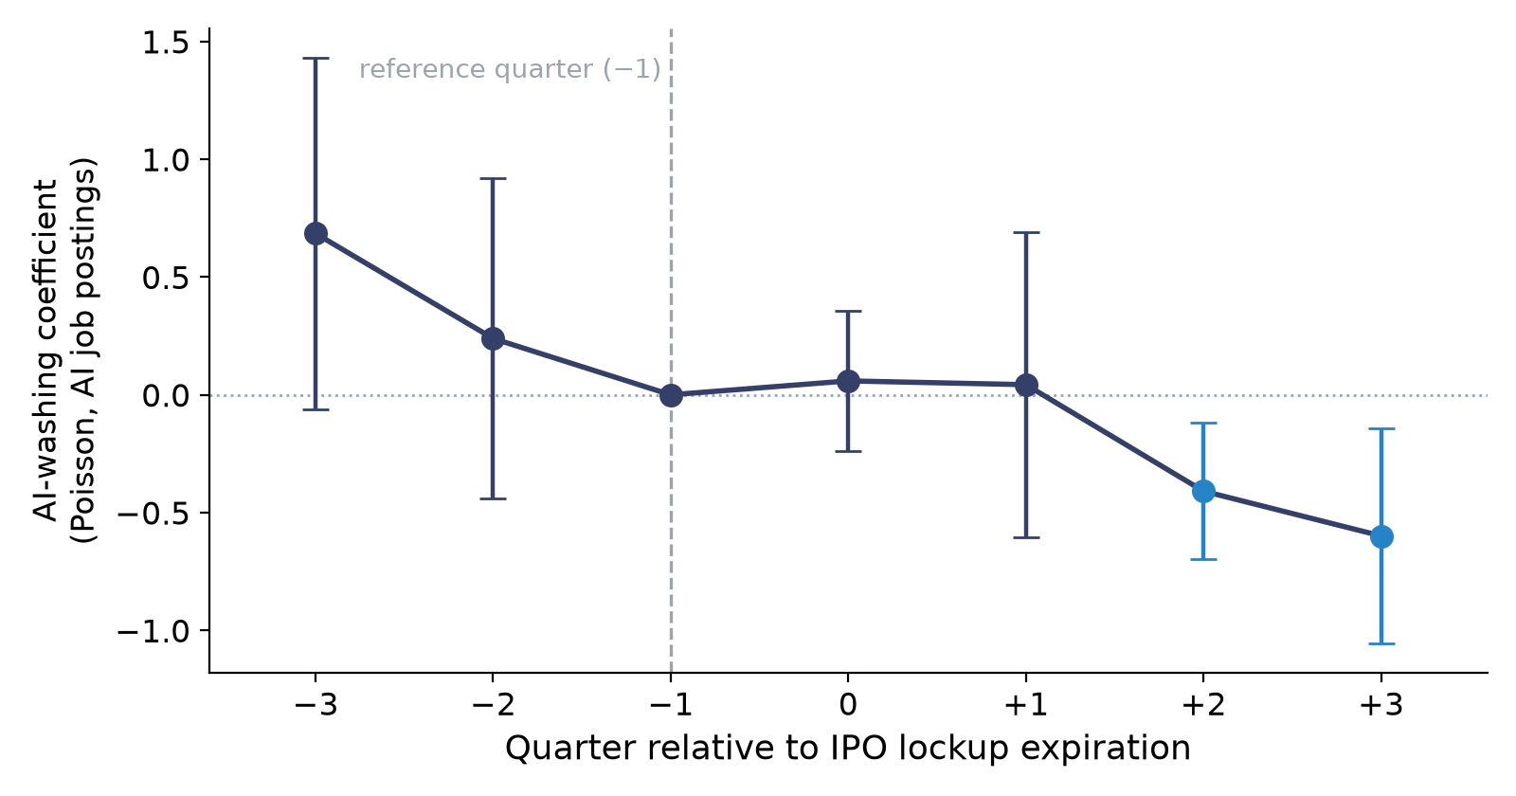
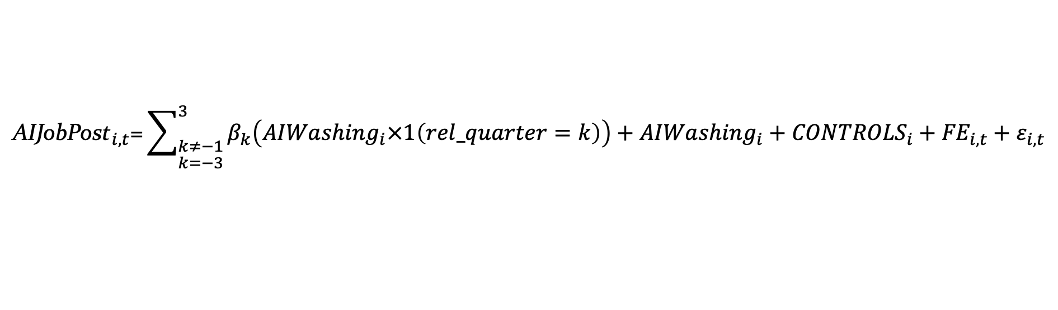
AI washing or AI failures?
We estimate a dynamic regression using an event window of [−3, +3] quarters around the expiration day, focusing on the subsample of AI-washing and AI-investment IPOs:
$$\begin{aligned}&{\text{AIJobPost}}_{i,t}\text{=}\sum_{\begin{aligned}&k≠−1 \\ &k=−3\end{aligned}}^{3}{β_{k}\left({AIWashing}_{i}×1\left(rel_quarter=k\right)\right)}+{AIWashing}_{i}+{CONTROLS}_{i}+{FE}_{i,t}+ε_{i,t} \\ &\#\end{aligned}$$
AI-washing firms post fewer AI jobs (Lightcast) in quarters +2 and +3.
A firm genuinely building AI has no reason to stop hiring just when insiders can start selling.
When AI-Washing Meets Initial Public Offerings | 2026 FMA Annual Meeting
9
Notes:
About 1 minute. Section 3.4.2, Figure 4 Panel A, Internet Appendix Table IA5. AI job postings are quarterly
counts of AI-related postings from Lightcast (formerly Burning Glass; paper Appendix A). Dynamic Poisson
regression of AI job postings on AIWashing x quarter relative to lockup expiration, quarters -3 to +3, quarter -1
omitted; AI-washing vs. AI-investment IPOs; industry x year-quarter and relative-quarter fixed effects;
industry-clustered standard errors. Quarters +2 and +3 are significantly negative. The point: if these
firms were genuinely building AI and simply failing, hiring would not drop exactly when insiders can
start selling. Pre-period caution: quarter -3 is positive and significant at 10% in IA5, so do not claim
every pre-period estimate is zero.

Slide 11
Baseline test
OLS regressions of long-run BHAR on AIWashing and AIInvestment
  Benchmark: Fama–French 5×5 size and book-to-market portfolios
$${BHAR}_{i,t}=β_{1}∗{AIWashing}_{i}+β_{2}{∗AIInvestment}_{i}+{CONTROLS}_{i}+{FE}_{i,t}+ε_{i,t}$$
Dep. Variable= | BHAR[0,1yr] | BHAR[0,2yr] | BHAR[0,3yr] |  | InitialReturn
Variable | (1) | (2) | (3) |  | (4)
AIWashing | -0.077 | -0.088** | -0.139*** |  | 0.072**
 | (-1.09) | (-2.35) | (-2.73) |  | (2.04)
AIInvestment | -0.022 | 0.102** | 0.220*** |  | 0.014
 | (-0.74) | (2.31) | (4.85) |  | (0.59)
Controls | Yes | Yes | Yes |  | Yes
Fixed Effects | Ind & Year | Ind & Year | Ind & Year |  | Ind & Year
Observations | 1,581 | 1,538 | 1,498 |  | 1,652
Adjusted R2 | 14.5% | 10.0% | 7.6% |  | 22.7%
Robust to calendar-time alphas (FF5: −1.49%/month over 24 months), propensity-score matching, entropy balancing, and excluding firms with third-party AI tools, suppliers or partners.
When AI-Washing Meets Initial Public Offerings | 2026 FMA Annual Meeting
10
Notes:
About 2 minutes. Table 3 Panel A. AIWashing: -0.077 (1 yr, n.s.), -0.088** (2 yr), -0.139*** (3 yr);
initial return +0.072**. AIInvestment: +10.2 pp (2 yr) and +22.0 pp (3 yr); the AIWashing vs.
AIInvestment difference is significant at 1% at both horizons. Industry-clustered t-statistics;
industry and year fixed effects. Robustness (bottom line): Table 4 calendar-time FF5 alphas of -1.49%
(24 months) and -1.13% (36 months) per month; Table 3 Panel B PSM -16.1 / -18.8 pp and entropy
balancing -12.8 / -19.6 pp; Table 5 drops firms with third-party AI tools (S-1 text), AI suppliers
(FactSet Supply Chain) or AI partners (RavenPack). Market-adjusted BHARs and other keyword thresholds:
Internet Appendix Tables IA6-IA7.

Slide 12
Post-IPO stock performance
Style-adjusted buy-and-hold abnormal returns for 1,671 U.S. IPOs, 2010–2024
When AI-Washing Meets Initial Public Offerings | 2026 FMA Annual Meeting
11
Notes:
Source: supplied manuscript, Figure 5. Data points reproduce the 16 trading-day horizons displayed in the Word chart. These descriptive portfolio paths differ from the controlled regression estimates.

Slide 13
Mechanisms: why do AI-washing IPOs underperform?
AI-washing at the IPO
Higher initial valuation
Unverified AI claims
after listing: 10-Ks, earnings calls, results
Worse long-run returns
Price correction
AI talk retreats after IPO
After listing, the AI story fades
Earnings calls: less AI talk after year 1 (Fig. 3A)
First 10-K: fewer AI words than the S-1 (IA9)
Year-2 calls: fewer AI words than the S-1 (IA9)
When AI-Washing Meets Initial Public Offerings | 2026 FMA Annual Meeting
12
Notes:
About 1.5 minutes: the intuition before the evidence. AI-washing claims raise the offer valuation. Because
the claims are unverified, the premium survives the IPO. After listing, 10-Ks, earnings calls and results
accumulate, the AI story retreats, prices correct, and long-run returns are worse.
The panel under the diagram is the direct evidence that the AI story retreats after listing:
- Earnings calls (Figure 3 Panel A): average AI keyword mentions in calls for post-IPO quarters 1-8.
Non-AI IPOs rarely mention AI; AI-investment IPOs keep talking about it; AI-washing IPOs mention AI more
than non-AI IPOs early on but fall below AI-investment IPOs in later quarters, particularly after the
fourth quarter.
- First 10-K vs S-1 (Internet Appendix Table IA9, Panel A): AIGapTenK = AI words in the first 10-K after a
full trading year minus AI words in the S-1, both restricted to Business, Risk Factors and MD&A (about 212
AI-related IPOs). AIWashing x LitRisk: -1.328 (t = -1.76) with the Kim-Skinner measure, -0.547 (t = -1.92)
with industry class actions.
- Year-2 earnings calls vs S-1 (IA9, Panel B): AIGapCall = AI-word intensity in calls in post-IPO quarters 5-8
relative to the S-1 (about 370 IPOs). AIWashing x LitRisk: -0.188 (t = -3.28) and -0.118 (t = -1.83).
- Read together: AI talk fades after the first year, and it fades most where unsupported claims carry the
most legal exposure (no safe harbor for IPO forward-looking statements). The next slide gives the
estimates behind each channel.

Slide 14
Mechanisms: the evidence
1 Valuation premium (Table 6)
2 Verification (Table 7)
3 Litigation risk (Table 8, IA9)
Measure: AIVal, how much the market rewards AI patents at listed peers in the same industry (3 years before the IPO)
Test: AI-washing × AIVal
P/S at the offer: +16.1∗∗∗ (t = 2.87)
2-year BHAR: −6.05∗∗∗ (t = −3.16)
3-year BHAR: −5.41∗ (t = −2.00)
Reading: AI-washers borrow the AI premium where AI is prized, then give it back
Measure: AIDistance, 1 − similarity of the S-1 Business section to AI patents (sentence embeddings)
Test: AI-washing × AIDistance
2-year BHAR: −1.31∗∗ (t = −2.19)
3-year BHAR: −1.43∗ (t = −1.98)
Distance alone: no effect
Reading: claims far from the business are hardest to check, so mispricing lasts longer
Measure: first-year litigation risk: Kim–Skinner (firm) and industry class actions (Donelson et al.)
Why IPOs: no safe harbor for forward-looking statements
2nd-year BHAR: −0.034∗∗∗ (KS), −0.048∗∗ (DFY)
AI words, first 10-K vs S-1: −1.33∗, −0.55∗
AI words, calls vs S-1: −0.19∗∗∗, −0.12∗
Reading: legal exposure makes the AI story unwind
When AI-Washing Meets Initial Public Offerings | 2026 FMA Annual Meeting
13
Notes:
About 2 minutes. Section 4.2; detailed tables are in the appendix.
- Valuation premium (Table 6): AI patent stock = a listed firm's AI patents over the past ten years, older
ones down-weighted 15% a year. AIVal = within each FF12 industry, over the three years before the IPO, how
much higher listed peers' market value is per unit of AI patent stock (controlling for size, ROA, R&D,
cash, advertising, sales growth): the market's price of AI in that industry. It is about peers, not the
IPO firm (AI-washing firms have no AI patents). AIWashing x AIVal is positive for relative P/S at issuance (column 2) and
negative for BHAR: -6.053 (2 years, column 4) and -5.407 (3 years, 10% level).
- Verification (Table 7): AIDistance = 1 - cosine similarity between the S-1 Business section and the
AI-patent corpus (all-mpnet-base-v2 embeddings). AIWashing x AIDistance: -1.313 (2 years, 5%),
-1.425 (3 years, 10%); AIDistance alone is insignificant, which argues against a generic firm-quality
story. It may also capture technological fit.
- Litigation risk (Table 8): no safe harbor for forward-looking statements in IPOs. LitRiskKS (Kim and
Skinner 2012, firm-level) and LitRiskDFY (industry class actions, Donelson et al. 2022), both over the
first post-IPO year, so the outcome is second-year BHAR [1,2yr]: -0.034 (t = -3.10) and -0.048
(t = -2.57). AI-washing firms facing more risk also cut AI words more in the first 10-K and in calls
(Internet Appendix Table IA9).

Slide 15
Who curbs AI-washing? Takeaways
Who curbs AI-washing?
Intermediaries: AI expertise of VCs, underwriters and auditors shows no reliable effect
SEC comment letters: more letters market-wide → less AI-washing, not less AI investment
SEC enforcement (March 18, 2024): AI-washing falls more where it was common
Takeaways
AI talk at the IPO is a weak signal unless backed by AI walk
The talk–walk mismatch predicts long-run underperformance
Regulators can check AI claims against observable inputs
When AI-Washing Meets Initial Public Offerings | 2026 FMA Annual Meeting
14
Notes:
About 2 minutes, then close. Section 5 and the Conclusion.
- Intermediaries (Internet Appendix Table IA10): VCAISkill, UWAIExp, AuditorAIExp all negative but
insignificant. Possible reasons: fees tied to proceeds, and certification focused on financials
rather than technology.
- Comment letters (Table 9 Panel A): ComLetter = ln(1 + SEC comment letters on IPO filings issued 12 to
6 months before the focal filing, market-wide). Coefficient -0.249 for AIWashing (column 2); no
negative effect on AIInvestment. Associational: the count also reflects IPO-market volume.
- Enforcement (Table 9 Panel B): sample from 2018; WashRatio from 2010-2017 by FF12 industry;
Post x WashRatio negative and significant. The post window is short (31 IPOs, 5 AI-washing).
- Contributions (appendix slide): IPO pricing and information quality; technology-wave enthusiasm (AI
needs human capital we can observe); strategic disclosure and "washing" (Baker et al. 2024; Duchin
et al. 2025).

Slide 16
Thank you!
Questions and comments welcome
Notes:
Source: supplied August 2026 manuscript, When AI-Washing Meets Initial Public Offerings. Original presentation design retained.

Slide 17
Appendix
Backup slides
Notes:
Appendix: backup slides for questions.

Slide 18
Why is AI washing special in IPOs?
Why AI capability is difficult to value at issuance
Algorithms, proprietary data, and specialized talent are difficult to observe.
AI investment can support growth and product innovation.
IPO research has limited granular evidence on pre-IPO technological inputs.
Why disclosures may diverge from observable investment
Limited public histories make AI claims difficult to verify at issuance.
Capable firms may also limit disclosure to protect proprietary information.
When AI-Washing Meets Initial Public Offerings | 2026 FMA Annual Meeting
A1
Notes:
Source: supplied August 2026 manuscript, When AI-Washing Meets Initial Public Offerings. Original presentation design retained.

Slide 19
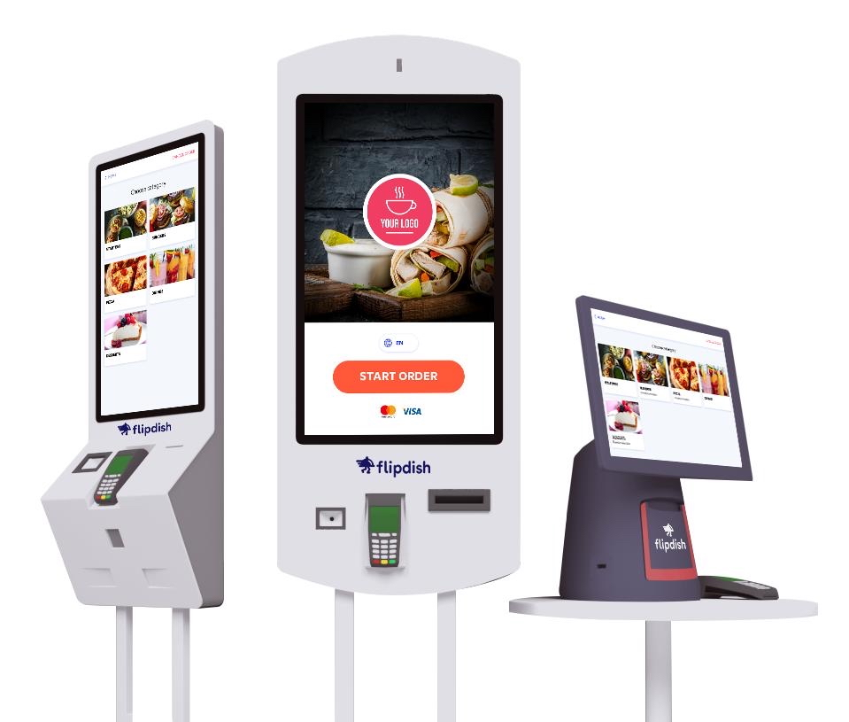
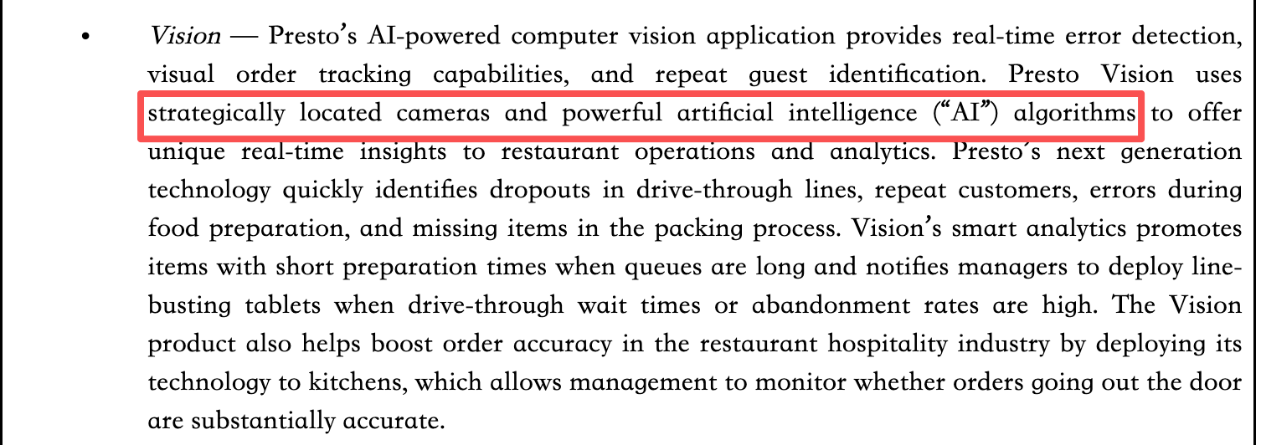
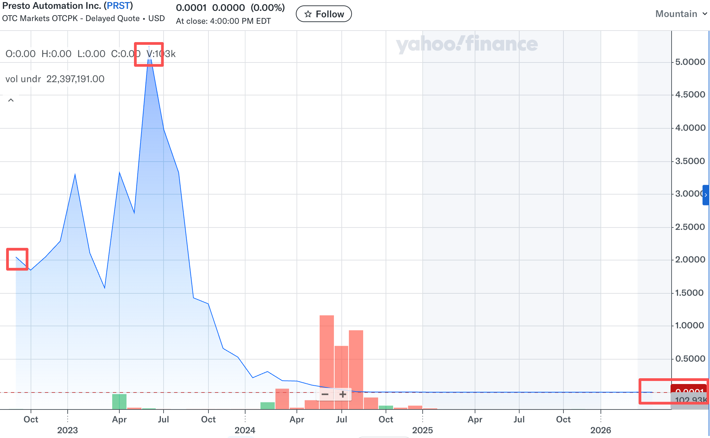
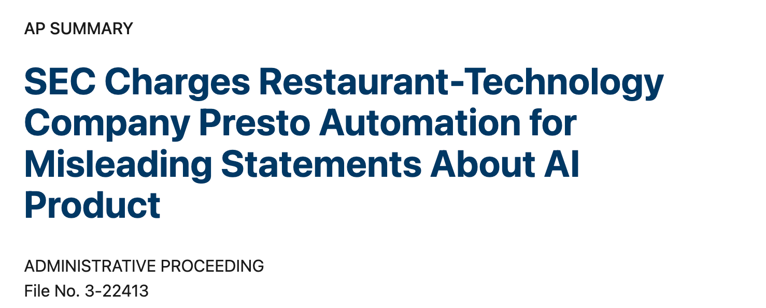
Anecdotal evidence: Presto Voice
Presto listed in September 2022 and promoted AI-powered restaurant technology
Its stock price peaked in mid-2023, then steadily declined and remained near zero
When AI-Washing Meets Initial Public Offerings | 2026 FMA Annual Meeting
A2
Notes:
Source: supplied August 2026 manuscript, When AI-Washing Meets Initial Public Offerings. Original presentation design retained.

Slide 20
Contributions
We propose one of the first systematic frameworks to identify AI-washing in the IPO process
ESG washing (Duchin et al., 2024 JF; Baker et al., 2024 JAR)
We extend traditional signaling theory by showing that AI labels are not reliable signals of firm quality or growth potential
Real AI investment is associated with high value growth (Babina et al., 2024 JFE)
AI-related narratives can be temporarily priced as signals (Beatty and Ritter, 1986 JFE; Rock, 1986 JFE; Ritter, 1991 JF)
We provide evidence supporting the need for ex-ante regulation of AI-related claims during IPOs
Disclosure litigation risk and legal exposure in IPO prospectuses (Lowry and Shu, 2002 JFE; Hanley and Hoberg, 2012 JFE)
When AI-Washing Meets Initial Public Offerings | 2026 FMA Annual Meeting
A3

Slide 21
AI talk: AI keyword-based algorithm
Our dictionary contains 97 AI-related terms, 57 of which appear in S-1 filings.
KEYWORD | KEYWORD | KEYWORD | KEYWORD
3d imaging | computer vision | machine learning | search algorithm
acoustic model | data fusion | maximum likelihood | semantics
active learning | deep learning | model selection | semi-supervised learning
ai strategy | dimensionality reduction | motion capture | sensor network
ai training | facial recognition | natural language processing | sentiment analysis
aiops | feature selection | network analysis | signal processing
artificial intelligence | gen ai | neural network | supervised learning
augmented reality | generative artificial intelligence | object oriented | support vector machine
automatic speech recognition | gesture recognition | object recognition | tensor flow
autonomous system | h2o.ai | optimal search | tokenization
azure ml | hierarchical clustering | pattern recognition | torch
bayesian optimization | image matching | predictive analytics | virtual agent
classification algorithm | image recognition | random forest
cluster analysis | intelligent agent | recommender system
collaborative system | language model | regression model
When AI-Washing Meets Initial Public Offerings | 2026 FMA Annual Meeting
A4
Notes:
Source: supplied August 2026 manuscript, When AI-Washing Meets Initial Public Offerings. Original presentation design retained.

Slide 22
AI talk: Top 20 most frequent AI keywords
When AI-Washing Meets Initial Public Offerings | 2026 FMA Annual Meeting
A5
Notes:
Source: supplied August 2026 manuscript, When AI-Washing Meets Initial Public Offerings. Original presentation design retained.

Slide 23
AI walk 1: AI human capital
Use employment histories from Revelio Labs’ LinkedIn data
Count employees who remain at the firm on the IPO listing date
Exclude interns who have not been formally hired
Identify AI skills using the taxonomy in Babina et al. (2024, JFE)
Reduce noise in self-reported profiles by requiring:
At least one STEM degree
A minimum share of AI-related skills among all reported skills
When AI-Washing Meets Initial Public Offerings | 2026 FMA Annual Meeting
A6
Notes:
Source: supplied August 2026 manuscript, When AI-Washing Meets Initial Public Offerings. Original presentation design retained.

Slide 24
AI walk 2: AI patents
Use the USPTO Artificial Intelligence Patent Dataset, which applies algorithms to identify AI patents
Define a patent as AI-related if its score exceeds the threshold of 0.93
Match patents to listing firms using both match-keys from Kogan et al. (2017 QJE) and fuzzy-name matching to cover both granted and pre-granted filings
Use the filing date (instead of the granted date) to determine innovation timing (Luong et al., 2017 JFQA)
Count AI patent filings within the three-year window prior to the listing date
When AI-Washing Meets Initial Public Offerings | 2026 FMA Annual Meeting
A7
Notes:
Source: supplied August 2026 manuscript, When AI-Washing Meets Initial Public Offerings. Original presentation design retained.

Slide 25
Our measures
AI talk: AI keyword mentions in S-1 registration statements
AI walk: AI employees at listing and AI patent filings in the prior three years
An AI-washing IPO meets all three conditions:
AI talk exceeds its FF12 industry’s historical 95th percentile (2007 to t − 1)
No observable AI employees at listing
No AI patent filings in the three years through listing
An AI-investment IPO has at least one AI employee or AI patent filing
Remaining issuers are non-AI IPOs
When AI-Washing Meets Initial Public Offerings | 2026 FMA Annual Meeting
A8
Notes:
Source: supplied manuscript, Section III. AI-washing is an empirical disclosure–input mismatch and does not establish managerial intent or legal misrepresentation. The 95th-percentile threshold uses the same FF12 industry, from 2007 through the year before the IPO.

Slide 26
Industry distribution of AI IPOs
When AI-Washing Meets Initial Public Offerings | 2026 FMA Annual Meeting
A9
Notes:
Source: supplied manuscript, Figure 2 Panel B. Includes Finance and Utilities, as in the current Word chart.

Slide 27
Summary statistics
Panel A1. Summary Statistics for First Day and Buy-and-hold Returns
 | N | Mean | STD | 10% | 25% | Median | 75% | 90%
BHAR[0,1yr] | 1,600 | -0.110 | 0.658 | -0.803 | -0.545 | -0.196 | 0.194 | 0.677
BHAR[1,2yr] | 1,491 | -0.094 | 0.626 | -0.768 | -0.489 | -0.179 | 0.170 | 0.562
BHAR[0,2yr] | 1,556 | -0.137 | 1.005 | -1.058 | -0.754 | -0.351 | 0.225 | 0.948
BHAR[0,3yr] | 1,515 | -0.172 | 1.297 | -1.278 | -0.946 | -0.490 | 0.235 | 1.255
InitialReturn | 1,671 | 0.197 | 0.327 | -0.083 | 0.000 | 0.109 | 0.308 | 0.603
Panel A2. Summary Statistics for AI-related Characteristics
 | N | Mean | STD | 10% | 25% | Median | 75% | 90%
AIWashing | 1,671 | 0.064 | 0.245 | 0.000 | 0.000 | 0.000 | 0.000 | 0.000
AIInvestment | 1,671 | 0.235 | 0.424 | 0.000 | 0.000 | 0.000 | 0.000 | 1.000
AIWord | 1,671 | 2.841 | 8.603 | 0.000 | 0.000 | 0.000 | 1.000 | 8.000
AIPatent | 1,671 | 1.530 | 6.050 | 0.000 | 0.000 | 0.000 | 0.000 | 3.000
AIEmployee | 1,671 | 0.500 | 2.280 | 0.000 | 0.000 | 0.000 | 0.000 | 1.000
When AI-Washing Meets Initial Public Offerings | 2026 FMA Annual Meeting
A10
Notes:
Source: supplied August 2026 manuscript, When AI-Washing Meets Initial Public Offerings. Original presentation design retained.

Slide 28
Summary statistics
Panel A3. Summary Statistics for Other Firm-level Characteristics
 | N | Mean | STD | 10% | 25% | Median | 75% | 90%
HighUW | 1,670 | 0.513 | 0.500 | 0.000 | 0.000 | 1.000 | 1.000 | 1.000
VC | 1,671 | 0.591 | 0.492 | 0.000 | 0.000 | 1.000 | 1.000 | 1.000
Big4 | 1,671 | 0.393 | 0.489 | 0.000 | 0.000 | 0.000 | 1.000 | 1.000
Proceeds (in millions) | 1,671 | 248.756 | 383.826 | 30.000 | 67.200 | 120.000 | 250.000 | 576.000
Age | 1,665 | 17.920 | 22.697 | 3.000 | 6.000 | 10.000 | 19.000 | 40.000
Assets (in millions) | 1,669 | 1414.601 | 4109.190 | 16.701 | 63.757 | 173.568 | 876.255 | 3414.723
Sales (in millions) | 1,668 | 652.544 | 1764.007 | 0.000 | 0.000 | 85.929 | 395.431 | 1596.681
Carve | 1,671 | 0.178 | 0.382 | 0.000 | 0.000 | 0.000 | 0.000 | 1.000
HighTech | 1,671 | 0.550 | 0.498 | 0.000 | 0.000 | 1.000 | 1.000 | 1.000
Biotech | 1,671 | 0.323 | 0.468 | 0.000 | 0.000 | 0.000 | 1.000 | 1.000
PrcRev | 1,671 | -0.013 | 0.139 | -0.214 | -0.077 | 0.000 | 0.071 | 0.143
Internet | 1,671 | 0.095 | 0.293 | 0.000 | 0.000 | 0.000 | 0.000 | 0.000
Overhang | 1,671 | 4.615 | 4.688 | 1.059 | 2.175 | 3.420 | 5.590 | 8.560
Primary | 1,671 | 0.328 | 0.470 | 0.000 | 0.000 | 0.000 | 1.000 | 1.000
PositiveEPS | 1,671 | 0.271 | 0.445 | 0.000 | 0.000 | 0.000 | 1.000 | 1.000
Second | 1,671 | 0.097 | 0.231 | 0.000 | 0.000 | 0.000 | 0.000 | 0.368
When AI-Washing Meets Initial Public Offerings | 2026 FMA Annual Meeting
A11
Notes:
Source: supplied August 2026 manuscript, When AI-Washing Meets Initial Public Offerings. Original presentation design retained.

Slide 29
Univariate test
Panel A. Non-AI versus AI-washing
(N = 1,278)
Panel B. AI-investment versus AI-washing (N = 500)
Variable | N | Mean | N | Mean | Diff. | t-stat
HighUW | 1,171 | 0.445 | 106 | 0.575 | -0.131 | -2.589***
VC | 1,171 | 0.599 | 107 | 0.701 | -0.102 | -1.619
Age | 1,165 | 2.488 | 107 | 2.513 | -0.026 | -0.270
Proceeds | 1,171 | 4.672 | 107 | 4.847 | -0.175 | -1.515
Sales | 1,168 | 3.330 | 107 | 4.182 | -0.852 | -2.907***
Assets | 1,169 | 5.226 | 107 | 5.398 | -0.172 | -0.794
HighTech | 1,171 | 0.495 | 107 | 0.495 | 0.000 | 0.000
Biotech | 1,171 | 0.398 | 107 | 0.271 | 0.127 | 2.585***
Internet | 1,171 | 0.035 | 107 | 0.150 | -0.115 | -5.555***
Second | 1,171 | 0.091 | 107 | 0.086 | 0.004 | 0.195
Big4 | 1,171 | 0.386 | 107 | 0.234 | 0.152 | 3.128***
PositiveEPS | 1,171 | 0.289 | 107 | 0.299 | -0.010 | -0.227
PrcRev | 1,171 | -0.029 | 107 | -0.011 | -0.019 | -1.332
Carve | 1,171 | 0.204 | 107 | 0.121 | 0.083 | 2.058**
Overhang | 1,171 | 4.014 | 107 | 6.841 | -2.827 | -6.058***
Primary | 1,171 | 0.353 | 107 | 0.187 | 0.166 | 3.482***
Variable | N | Mean | N | Mean | Diff. | t-stat
HighUW | 393 | 0.697 | 106 | 0.575 | 0.122 | 2.376**
VC | 393 | 0.814 | 107 | 0.701 | 0.113 | 2.067**
Age | 393 | 2.553 | 107 | 2.513 | 0.040 | 0.525
Proceeds | 393 | 5.340 | 107 | 4.847 | 0.493 | 3.975***
Sales | 393 | 4.975 | 107 | 4.182 | 0.793 | 3.002***
Assets | 393 | 5.719 | 107 | 5.398 | 0.321 | 1.611
HighTech | 393 | 0.728 | 107 | 0.495 | 0.232 | 4.650***
Biotech | 393 | 0.115 | 107 | 0.271 | -0.157 | -4.102***
Internet | 393 | 0.257 | 107 | 0.150 | 0.107 | 2.336**
Second | 393 | 0.119 | 107 | 0.086 | 0.033 | 1.273
Big4 | 393 | 0.455 | 107 | 0.234 | 0.222 | 4.204***
PositiveEPS | 393 | 0.211 | 107 | 0.299 | -0.088 | -1.918*
PrcRev | 393 | 0.037 | 107 | -0.011 | 0.048 | 3.141***
Carve | 393 | 0.115 | 107 | 0.121 | -0.007 | -0.200
Overhang | 393 | 5.799 | 107 | 6.841 | -1.042 | -1.893*
Primary | 393 | 0.293 | 107 | 0.187 | 0.106 | 2.190**
When AI-Washing Meets Initial Public Offerings | 2026 FMA Annual Meeting
A12
Notes:
Source: supplied August 2026 manuscript, When AI-Washing Meets Initial Public Offerings. Original presentation design retained.

Slide 30
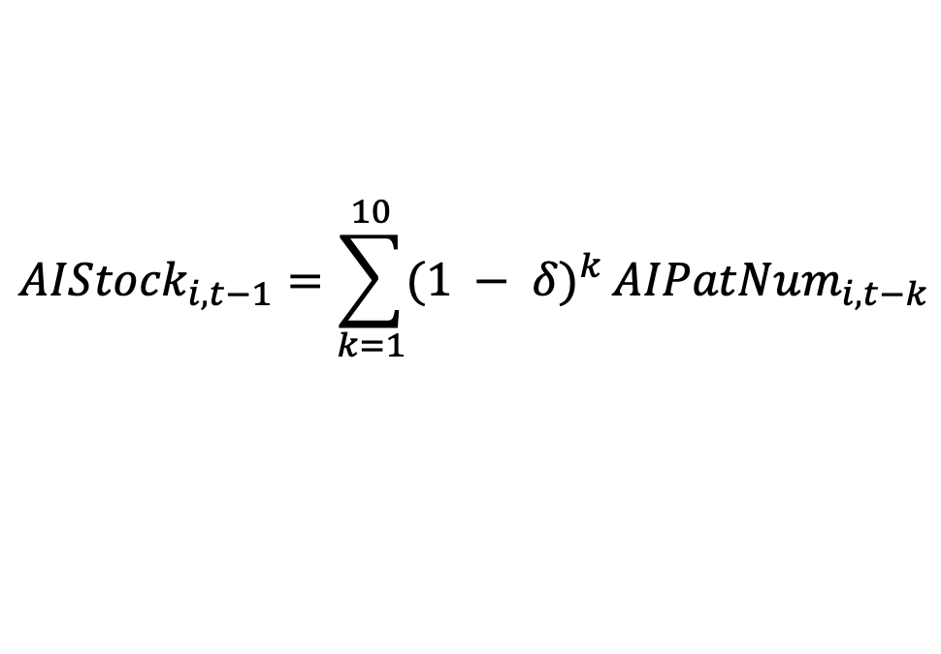
Mechanism 1: AI value creation
We first run regressions for each of the Fama–French 12 industries and each year to estimate the long-run market valuation of AI investment
After obtaining the industry-specific effects, we estimate the following equation:
$${AIStock}_{i,t−1}={\sum_{k=1}^{10}{{(1 − δ)}^{k}}AIPatNum}_{i, t−k}$$
$${lnMV}_{i, t}=β_{AIValue}∗{AIStock}_{i,t−1}+{CONTROLS}_{i,t−1}+{FE}_{i,t}+ε_{i,t}$$
$Y_{i,t}=β_{1}∗{AI_washing×Beta_AIValue}_{i,t}$ $+$ $β_{2}∗{AI_washing}_{i}+β_{3}∗{AI_invest}_{i}+$
$$β_{4}∗{Beta_AIValue}_{i,t} +{CONTROLS}_{i}+{FE}_{i,t}+ε_{i,t}$$
When AI-Washing Meets Initial Public Offerings | 2026 FMA Annual Meeting
A13

Slide 31
Mechanism 1: AI value premium
Dep. Variable= | P/S |  |  | BHAR[0,2yr] |  |  | BHAR[0,3yr]
Variable | (1) | (2) |  | (3) | (4) |  | (5) | (6)
AIWashing×AIVal |  | 16.105*** |  |  | -6.053*** |  |  | -5.407*
 |  | (2.87) |  |  | (-3.16) |  |  | (-2.00)
AIVal | -0.921 | -2.104 |  | 1.516 | 1.842 |  | 0.675 | 0.974
 | (-0.28) | (-0.64) |  | (0.95) | (1.10) |  | (0.17) | (0.25)
AIWashing | -0.356** | -0.465*** |  | -0.086** | -0.043 |  | -0.138** | -0.099
 | (-2.55) | (-2.98) |  | (-2.34) | (-1.30) |  | (-2.59) | (-1.58)
AIInvestment | -0.403*** | -0.412*** |  | 0.102** | 0.106** |  | 0.221*** | 0.224***
 | (-3.62) | (-3.72) |  | (2.33) | (2.39) |  | (4.91) | (5.05)
Controls | Yes | Yes |  | Yes | Yes |  | Yes | Yes
Fixed Effects | Ind & Year | Ind & Year |  | Ind & Year | Ind & Year |  | Ind & Year | Ind & Year
Observations | 605 | 605 |  | 1,538 | 1,538 |  | 1,498 | 1,498
Adjusted R2 | 24.0% | 24.2% |  | 10.0% | 10.0% |  | 7.4% | 7.4%
When AI-Washing Meets Initial Public Offerings | 2026 FMA Annual Meeting
A14
Notes:
Source: supplied manuscript, Table 6, all six specifications.

Slide 32
Mechanism 2: Verification difficulty
Verification is harder when a firm’s business is distant from AI
Compare the issuer’s S-1 Business section with the USPTO AI patent corpus.
Embed both corpora using a sentence-transformer model and compute 1 − cosine similarity.
Mean-center AIDistance, scale by its sample mean, and interact with AIWashing.
BHARi,t = β1AIWashing × AIDistancei,t + β2AIDistancei,t + β3AIWashingi + β4AIInvestmenti + Controlsi + FEi,t + εi,t
Interpretation
Greater technological distance is associated with more negative long-run returns for AI-washing IPOs.
Distance captures verification difficulty. It may also reflect low technological fit.
When AI-Washing Meets Initial Public Offerings | 2026 FMA Annual Meeting
A15

Slide 33
Mechanism 2: Verification difficulty
Dep. Variable= | BHAR[0,2yr] |  |  | BHAR[0,3yr]
Variable | (1) | (2) |  | (3) | (4)
AIWashing×AIDistance |  | -1.313** |  |  | -1.425*
 |  | (-2.19) |  |  | (-1.98)
AIDistance | -0.099 | 0.003 |  | -0.310 | -0.200
 | (-0.70) | (0.03) |  | (-1.25) | (-0.82)
AIWashing | -0.085** | -0.121** |  | -0.166*** | -0.209***
 | (-2.12) | (-2.37) |  | (-4.31) | (-4.69)
AIInvestment | 0.062 | 0.072 |  | 0.156*** | 0.167***
 | (1.12) | (1.38) |  | (3.23) | (3.44)
Controls | Yes | Yes |  | Yes | Yes
Fixed Effects | Ind & Year | Ind & Year |  | Ind & Year | Ind & Year
Observations | 1,410 | 1,410 |  | 1,375 | 1,375
Adjusted R2 | 8.7% | 8.7% |  | 6.2% | 6.2%
When AI-Washing Meets Initial Public Offerings | 2026 FMA Annual Meeting
A16
Notes:
Source: supplied manuscript, Table 7, all four specifications.

Slide 34
Mechanism 3: Litigation risk
Litigation risk measured over the first post-IPO year
LitRiskKS: Kim–Skinner (2012) predicted litigation exposure using firm characteristics, returns, volatility, skewness, and turnover.
LitRiskDFY: Disclosure-related class actions in the issuer’s FF12 industry, following Donelson et al. (2022).
BHAR[1, 2yr]i,t = β1AIWashing × LitRiski,t + β2LitRiski,t + β3AIWashingi + β4AIInvestmenti + Controlsi + FEi,t + εi,t
Further supportive evidence: Disclosure gap
AIGapi,t = β1AIWashing × LitRiski,t + β2LitRiski,t + β3AIWashingi + β4AIInvestmenti + Controlsi + FEi,t + εi,t
When AI-Washing Meets Initial Public Offerings | 2026 FMA Annual Meeting
A17
Notes:
Source: supplied manuscript, Section V.C. Litigation-risk proxies use first-year post-listing information and are not ex ante probabilities at issuance.

Slide 35
Mechanism 3: Litigation risk
Dep. Variable= | BHAR[1,2yr]
Variable | (1) | (2) | (3) | (4)
AIWashing×LitRiskKS |  | -0.034***
 |  | (-3.10)
AIWashing×LitRiskDFY |  |  |  | -0.048**
 |  |  |  | (-2.57)
LitRiskKS | -0.003 | -0.001
 | (-0.32) | (-0.08)
LitRiskDFY |  |  | 0.023** | 0.025***
 |  |  | (2.46) | (2.81)
AIWashing | 0.002 | -0.097 | 0.001 | 0.080
 | (0.05) | (-1.35) | (0.01) | (1.33)
AIInvestment | 0.075* | 0.074* | 0.069* | 0.063
 | (1.76) | (1.73) | (1.69) | (1.55)
Controls | Yes | Yes | Yes | Yes
Fixed Effects | Ind & Year | Ind & Year | Ind & Year | Ind & Year
Observations | 1,472 | 1,472 | 1,472 | 1,472
Adjusted R2 | 5.1% | 5.1% | 5.3% | 5.4%
When AI-Washing Meets Initial Public Offerings | 2026 FMA Annual Meeting
A18
Notes:
Source: supplied manuscript, Table 8, all four specifications. Outcome is second-year BHAR [1,2yr].

Slide 36
Mechanism 3: Post-IPO AI disclosure gaps
AI disclosure changes relative to the S-1, comparing AI-washing with AI-investment IPOs
10-K: matched Business, Risk Factors, and MD&A sections. Calls: quarters 5–8, scaled by words.
Dep. Variable= | AIGapTenK | AIGapTenK |  | AIGapCall | AIGapCall
Risk proxy | KS | DFY |  | KS | DFY
AIWashing × LitRisk | -1.328* | -0.547* |  | -0.188*** | -0.118*
 | (-1.76) | (-1.92) |  | (-3.28) | (-1.83)
LitRisk | 0.146 | 0.005 |  | 0.044 | 0.078**
 | (1.43) | (0.04) |  | (1.21) | (2.21)
AIWashing | -3.926 | 0.906 |  | -0.698*** | 0.131
 | (-1.35) | (1.31) |  | (-3.57) | (0.48)
Controls | Yes | Yes |  | Yes | Yes
Fixed Effects | Ind & Year | Ind & Year |  | Ind & Year | Ind & Year
Observations | 212 | 214 |  | 373 | 374
Adjusted R² | 3.6% | 1.7% |  | 12.8% | 13.4%
When AI-Washing Meets Initial Public Offerings | 2026 FMA Annual Meeting
A19
Notes:
Source: supplied manuscript, Internet Appendix Table IA9. Shows interaction specifications (3) and (5) for each panel. AIGapTenK compares common sections of 10-K and S-1. AIGapCall compares AI-word intensity in quarters 5–8 with the S-1.

Slide 37
Regulatory oversight of AI-washing
Pre-filing review environment
ComLetter = ln(1 + comment letters issued market-wide from 12 to 6 months before filing).
This measures broader SEC review activity, not review of the focal issuer.
Logit specifications control for issuer characteristics, industry, and year effects.
logit Pr(Yᵢ = 1) = α + β₁ ComLetterᵢ + γ′ Xᵢ + FEi,t + εi,t
SEC enforcement on misleading AI claims: March 18, 2024
Compare post-enforcement changes across industries with different 2010–2017 AI-washing exposure (Post × WashRatio).
Results indicate an association with regulatory scrutiny; they do not establish causality.
logit Pr(AIWashingᵢ = 1) = α + β₁(Postᵢ × WashRatioⱼ) + β₂ Postᵢ + β₃ WashRatioⱼ + γ′ Xᵢ + FE+ εi,t
When AI-Washing Meets Initial Public Offerings | 2026 FMA Annual Meeting
A20
Notes:
Source: supplied manuscript, Section VI and Table 9. ComLetter is market-level SEC comment-letter activity. The enforcement interaction is associational. Official SEC event: https://www.sec.gov/newsroom/press-releases/2024-36.

Slide 38
Regulatory oversight of AI-washing
Dep. Variable= | AIWashing |  |  | AIInvestment
Variable | (1) | (2) |  | (3) | (4)
ComLetter | -0.264*** | -0.249** |  | 0.082 | -0.044
 | (-3.57) | (-2.44) |  | (0.84) | (-0.58)
Controls | No | Yes |  | No | Yes
Fixed Effects | Ind & Year | Ind & Year |  | Ind & Year | Ind & Year
Observations | 1,445 | 1,436 |  | 1,524 | 1,515
Pseudo R² | 8.5% | 11.4% |  | 23.5% | 33.9%
SEC enforcement on March 18, 2024
Dep. Variable= | AIWashing
Variable | (1) | (2) | (3) | (4)
Post×WashRatio |  | -2.614*** | -3.000*** | -2.184**
 |  | (-3.19) | (-2.75) | (-2.26)
Post | 0.701** | 1.405*** | 1.686*** | 2.472
 | (2.06) | (3.79) | (3.23) | (1.62)
WashRatio | 0.548 | 0.621* | 0.520 | 0.364
 | (1.55) | (1.74) | (1.52) | (1.05)
Controls | No | No | Yes | Yes
Fixed Effects | No | No | No | Filing quarter
Observations | 748 | 748 | 735 | 692
Pseudo R² | 0.9% | 1.2% | 7.1% | 10.1%
When AI-Washing Meets Initial Public Offerings | 2026 FMA Annual Meeting
A21

