Slide 1
UCHICAGO PME
AI · MACHINE LEARNING
AI Training Materials for Molecular Engineering
Four teaching modules from tabular machine learning to multimodal extraction, to LLM fine tuning and image processing, built from published research and reproducible
Dr. Haihui Pu, Dr. Rui Ding, Rodrigo Ferreira August 28, 2026

Slide 2

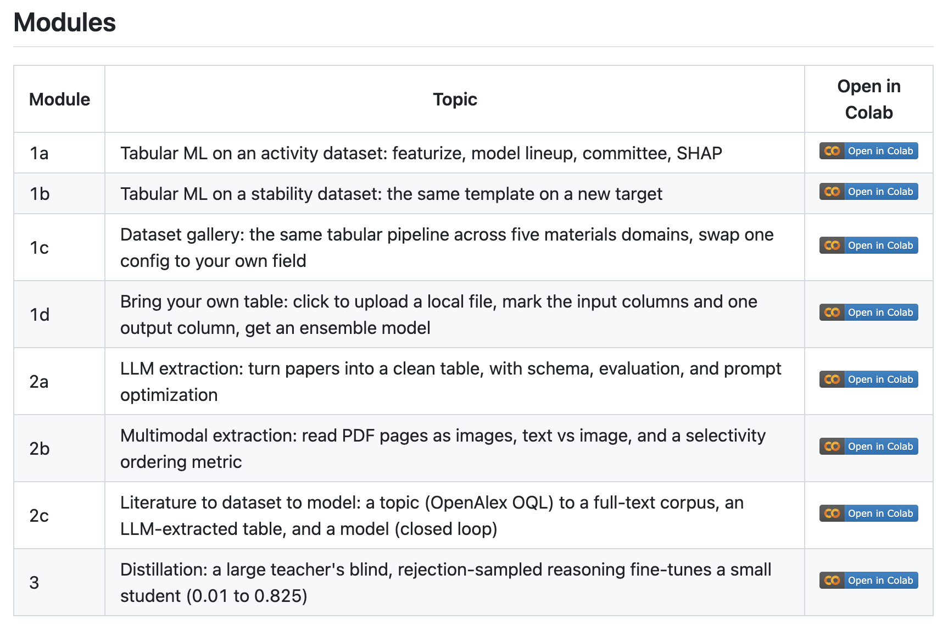

https://github.com/ruiding-uchicago/NRT_Training_Materials

Slide 3
MODULE 1A
/ TABULAR ML · ACTIVITY
Predict catalyst activity from a synthesis recipe
Mine literature records of acidic-OER electrocatalysts, then learn to predict overpotential η₁₀ (lower is better) from composition, synthesis, and testing conditions.
UChicago PME · AI Training
Module 1a — Activity

Slide 4
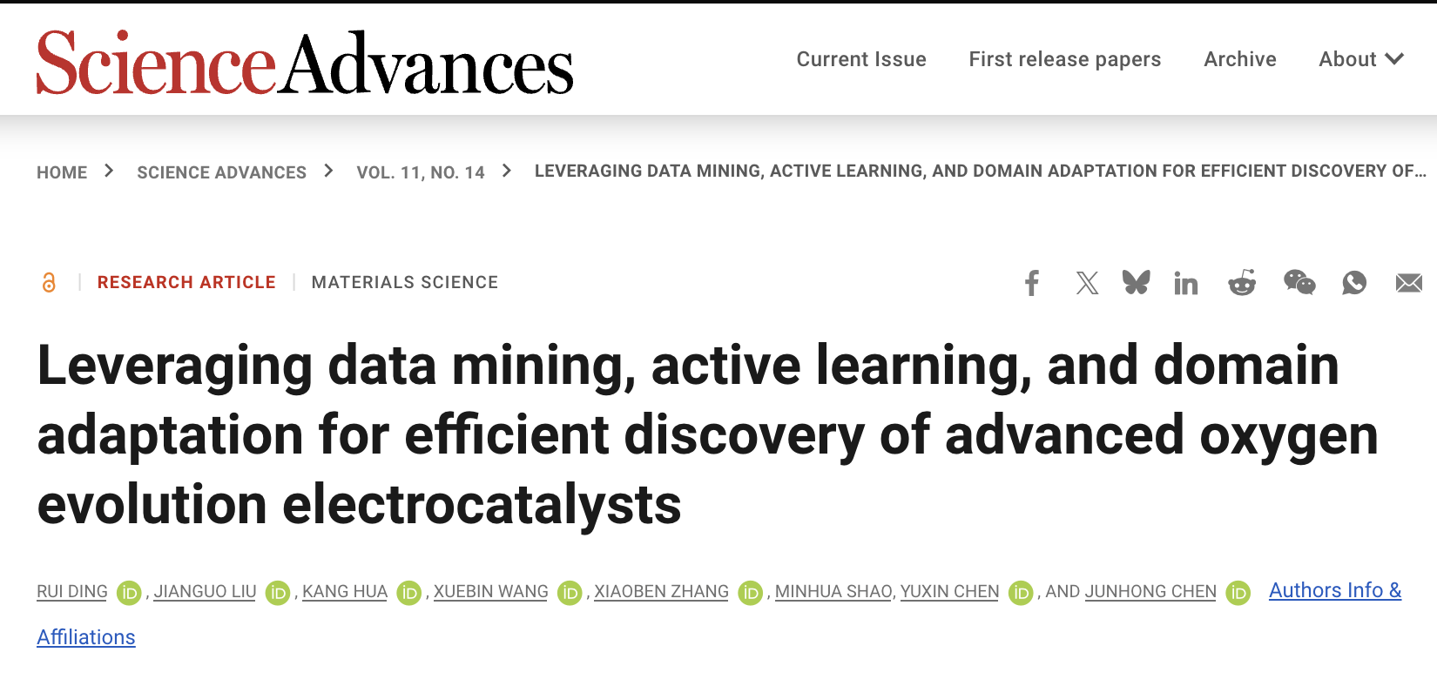
MODULE 1A
/ THE PIPELINE
Featurize the database, then climb the model ladder
1
Map elements to 8 atomic properties
atomic radius, electronegativity, d-electrons… instead of one-hot. The step that matters most.
The strong tabular baseline
Tree ensembles dominate small, wide scientific tables. XGBoost reaches test R² ≈ 0.84 on activity.
2
Walk the model ladder
linear → decision tree (overfits) → Random Forest & XGBoost → MLP → a committee with uncertainty.
linear
decision tree
random forest
xgboost
mlp
committee
3
Interpret with SHAP
find the driving factors and spot testing-condition confounders.
https://www.science.org/doi/full/10.1126/sciadv.adr9038
UChicago PME · AI Training
Module 1a — Activity

Slide 5
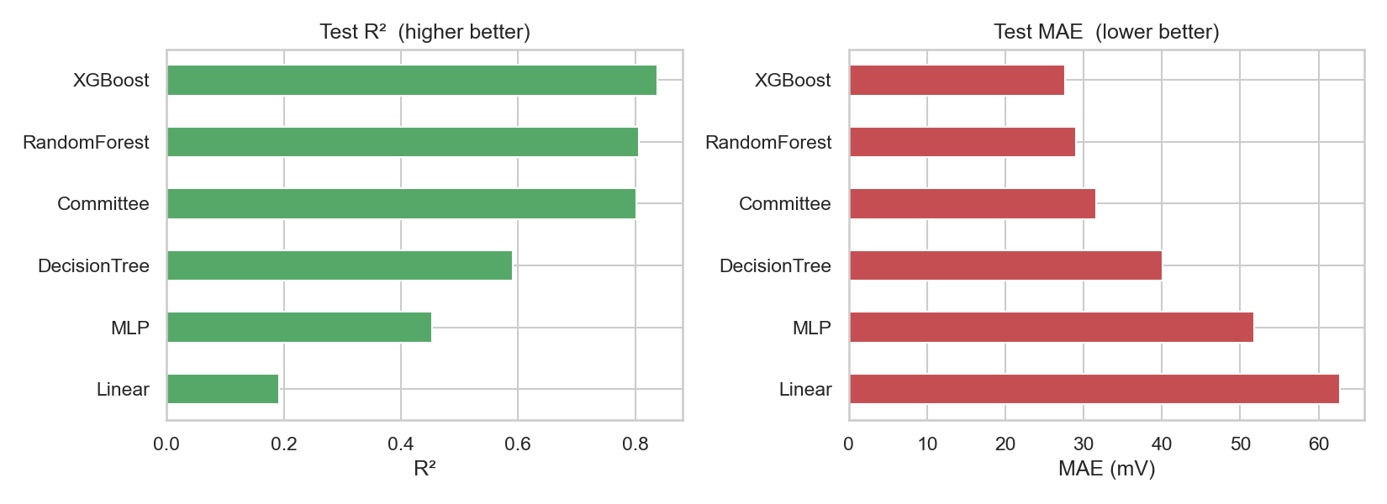
MODULE 1A
/ RESULTS
The models’ predicting performances
XGBOOST TEST R²
TEST MAE
0.84
27.8 mV
higher is better
lower is better
Linear and a lone decision tree perform bad; the tree ensembles and the committee cluster at the top.
Test R² (higher better) and MAE (lower better) across six models.
UChicago PME · AI Training
Module 1a — Activity

Slide 6
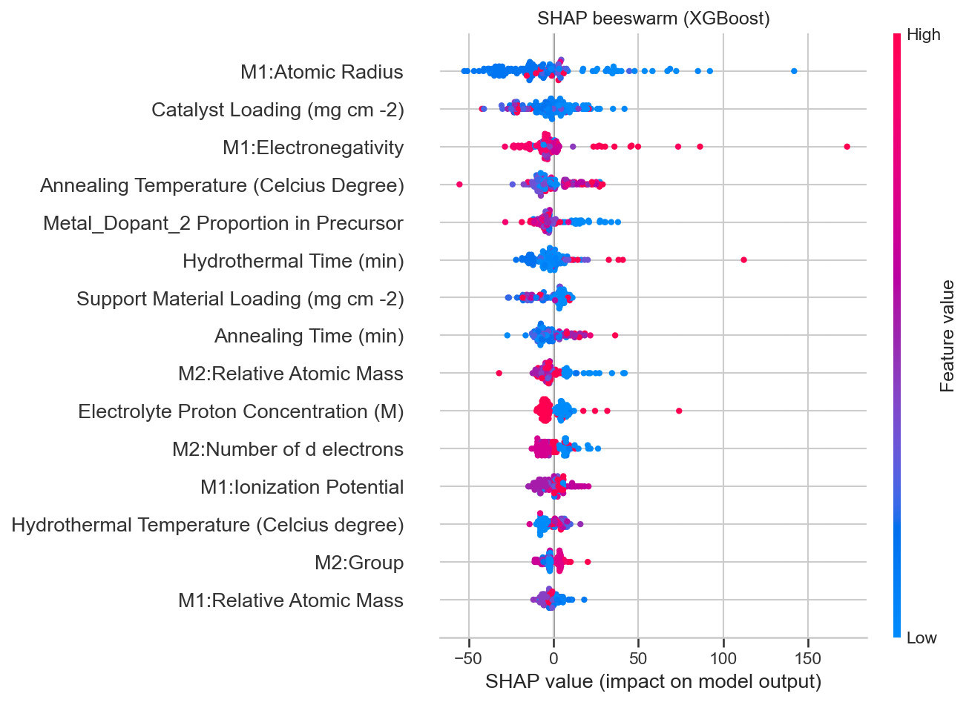
MODULE 1A
/ INTERPRETATION
Which factors drive performance?
SHAP attributes each prediction back to its features. Atomic radius, electronegativity, and catalyst loading lead.
Read it as a decision tool
Color is feature value; spread is impact. It tells you how importance a feature is and how it impacts the output
SHAP beeswarm illustrates feature impact on the XGBoost activity model.
UChicago PME · AI Training
Module 1a — Activity

Slide 7
MODULE 1B
/ TABULAR ML · STABILITY
The same template, a new target
Point the identical composition-to-property pipeline at stability namely predict catalyst performance decay rate, where lower means more stable.
UChicago PME · AI Training
Module 1b — Stability

Slide 8
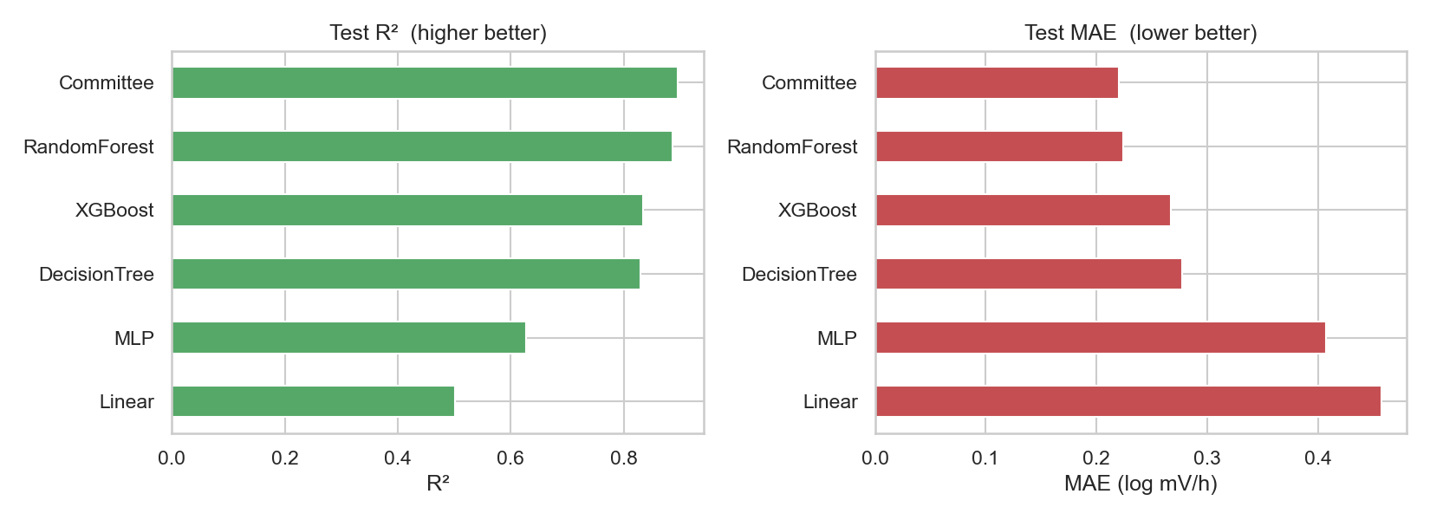
MODULE 1B
/ RESULTS
A new target, the same strong baseline
RF / COMMITTEE R²
0.90
stability is the easier target here
Random Forest and the committee reach R² ≈ 0.88–0.90：even stronger than activity, on a smaller table.
Test R² and MAE across models on the stability target.
UChicago PME · AI Training
Module 1b — Stability

Slide 9
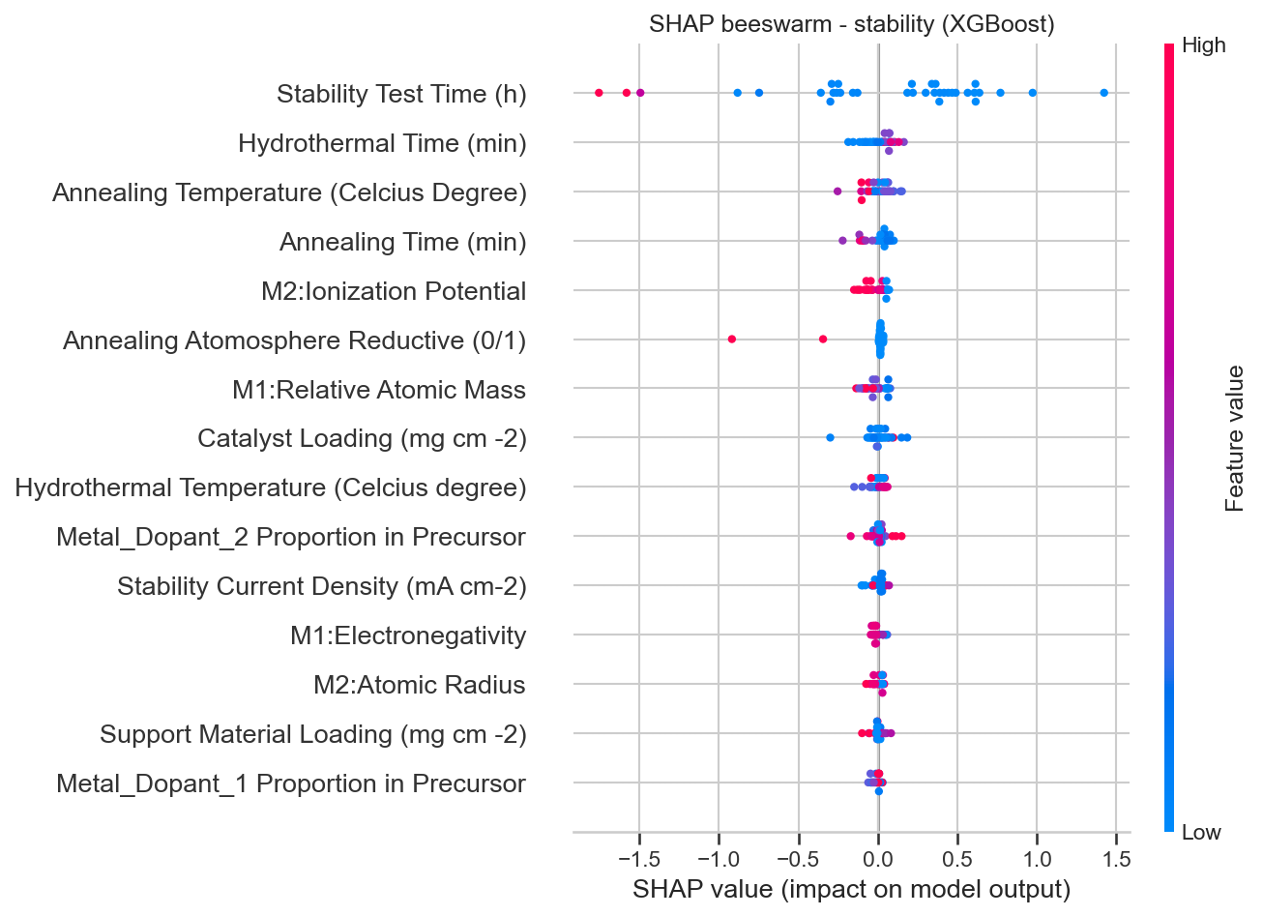
MODULE 1B
/ THE LESSON
Activity and stability are different problems
Comparing the two SHAP rankings shows they are governed by partly different factors. A model good at one is not automatically good at the other.
Reusing the template on a second target to learn what transfers and what doesn't.
SHAP beeswarm — drivers of the stability model.
UChicago PME · AI Training
Module 1b — Stability

Slide 10
MODULE 1C
/ DATASET GALLERY
One pipeline, five domains
A collection of other different chemistry/materials science related domains
UChicago PME · AI Training
Module 1b — Stability

Slide 11
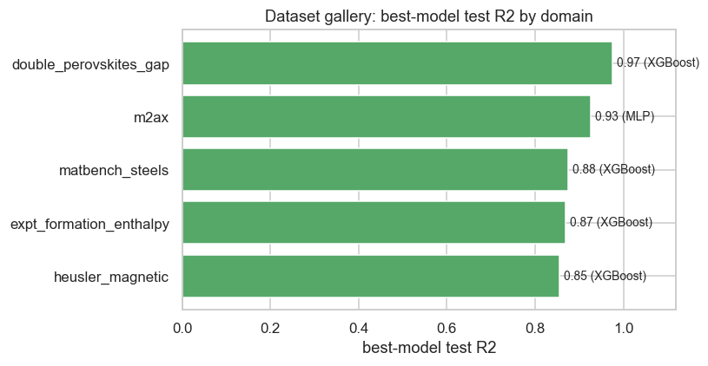
MODULE 1C
/ RESULTS
Composition features → Model ladder → SHAP
R²
0.86–0.98
Steels
MAX-phase ceramics
Double perovskites (PV)
Heusler magnets
Formation enthalpy
UChicago PME · AI Training
Module 1c — Dataset Gallery

Slide 12
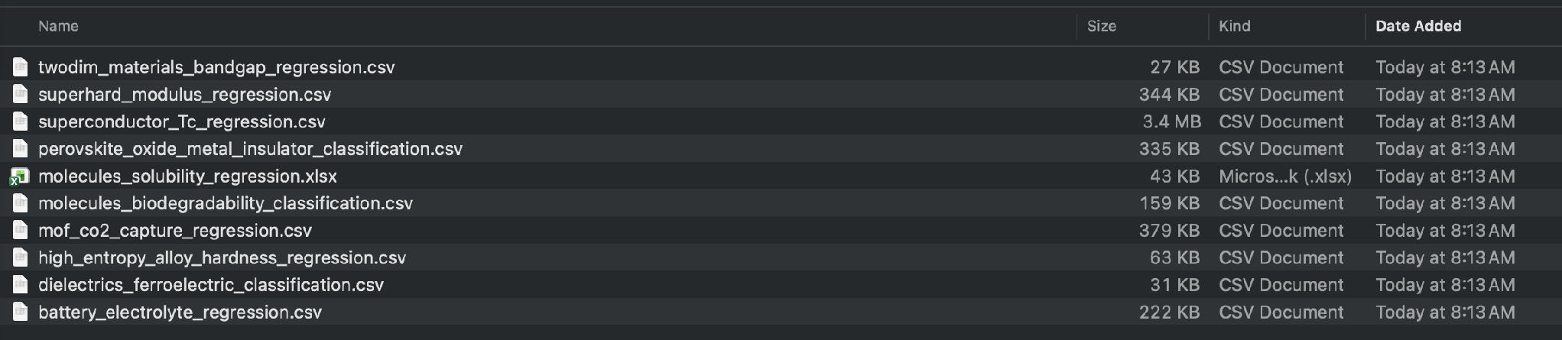
MODULE 1D
BRING YOUR OWN
UChicago PME · AI Training

Slide 13
Datasets — Module 1a / 1b (OER)
- R. Ding et al., "Leveraging data mining, active learning, and domain adaptation for efficient discovery of advanced oxygen evolution electrocatalysts," Science Advances
11, eadr9038 (2025). doi:10.1126/sciadv.adr9038 — DASH repo: https://github.com/ruiding-uchicago/DASH
Datasets — Module 1c (matminer dataset gallery)
- L. Ward et al., "Matminer: An open source toolkit for materials data mining," Comput. Mater. Sci. 152, 60–69 (2018). doi:10.1016/j.commatsci.2018.05.018
- A. Dunn et al., "Benchmarking materials property prediction methods: the Matbench test set…," npj Comput. Mater. 6, 138 (2020). doi:10.1038/s41524-020-00406-3 (source of
matbench_steels; data: Citrine Informatics)
- M. F. Cover et al., "A comprehensive survey of M2AX phase elastic properties," J. Phys.: Condens. Matter 21, 305403 (2009). doi:10.1088/0953-8984/21/30/305403
- G. Pilania et al., "Machine learning bandgaps of double perovskites," Sci. Rep. 6, 19375 (2016). doi:10.1038/srep19375
- Heusler magnetic properties — Citrine Informatics, "University of Alabama Heusler database," https://citrination.com/datasets/150561/
- G. Kim et al., "Experimental formation enthalpies for intermetallic phases and other inorganic compounds," Sci. Data 4, 170162 (2017). doi:10.1038/sdata.2017.162
Datasets — Module 1d (sample_data/, bring-your-own-table examples)
- Aqueous solubility (Delaney ESOL) — J. Delaney, J. Chem. Inf. Comput. Sci. 44, 1000 (2004); via DeepChem
- Li-battery electrolyte conductivity — CALiSol-23, Scientific Data 11, 750 (2024), CC BY. doi:10.1038/s41597-024-03575-8
- Superconductor critical temperature — K. Hamidieh, UCI Superconductivity dataset (2018)
- Superhard moduli — Mansouri Tehrani et al., JACS 140, 9844 (2018); matminer brgoch_superhard_training
- 2D-material band gap — K. Choudhary et al., Sci. Rep. 7, 5179 (2017); matminer jarvis_dft_2d
- Dielectric / ferroelectric — I. Petousis et al. (2017); matminer dielectric_constant
- Perovskite-oxide metal/insulator — A. Emery & C. Wolverton, Sci. Data 4, 170153 (2017); matminer wolverton_oxides
- Molecular biodegradability — K. Mansouri et al. (2013); UCI QSAR biodegradation
- High-entropy-alloy hardness — public dataset (Gupta, GitHub, 2022)
- MOF CO₂ uptake — CoRE MOF 2019: Y. G. Chung et al., J. Chem. Eng. Data 64, 5985 (2019); via R. Chakraborty, MOF_explore (GitHub)
Algorithms & software (all of Module 1)
- Random Forest — L. Breiman, Machine Learning 45, 5–32 (2001)
- Gradient-boosted trees (XGBoost) — T. Chen & C. Guestrin, KDD (2016)
- SHAP feature attribution — S. Lundberg & S.-I. Lee, NeurIPS (2017)
- scikit-learn — F. Pedregosa et al., JMLR 12, 2825 (2011)
- matminer / pymatgen (as above); pandas, NumPy, matplotlib

Slide 14
MODULE 2A
/ TEXT → DATASET
From papers to a clean dataset
Turn a corpus of papers into a validated table with an LLM.
With auto prompt optimization applied.
150 FET-biosensor papers
8 fields
UChicago PME · AI Training
Module 2a — Text to data

Slide 15
MODULE 2A
/ THE METHOD
A schema, three metrics, one loop
1
A Pydantic schema is the contract for a clean dataset: the fields, types, and units you want out.
Evaluation is the point
Without a held-out test set, every prompt change is a guess. With one, it's a decision.
2
Three kinds of metric : exact for categories, unit-normalized for numbers, an LLM judge for chemicals.
exact match
unit-normalized
LLM judge
3
train / val / test discipline turns prompt tweaks into measured decisions, the loop DSPy and TextGrad automate.
60 / 39 / 51 split
UChicago PME · AI Training
Module 2a — Text to data

Slide 16

MODULE 2A
/ THE METHOD
From unstructured publication text to structured knowledge
{
sensor_type: Gas ,
detect_target: Nitrogen Dioxide,
lower_detection_limit: 10 pb,
upper_detection_limit:1200 ppb,
probe_material: zinc oxide,
test_operating_temperature: 40 °C
…
…
}
prompt
UChicago PME · AI Training
Module 2a — Text to data

Slide 17
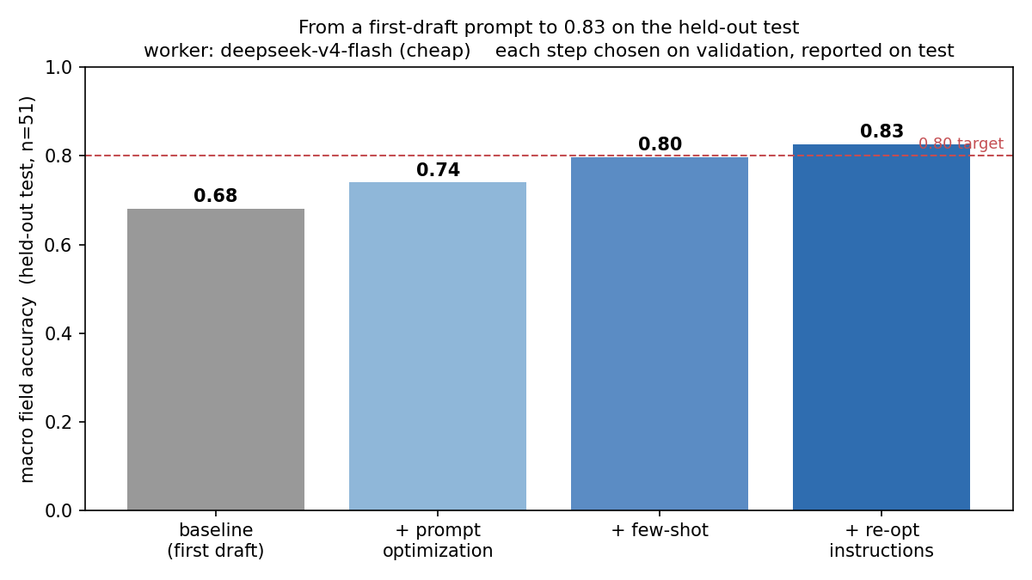
MODULE 2A
/ THE IMPROVEMENT
Stack the levers, climb the accuracy
HELD-OUT TEST ACCURACY
0.68 → 0.83
▲ +0.15 across three stacked levers
Prompt optimization on the training set
Few-shot examples from the worst failures
Test accuracy across prompt versions: baseline → optimized → few-shot → re-optimized.
A second optimization pass
UChicago PME · AI Training
Module 2a — Text to data

Slide 18
MODULE 2B
/ MULTIMODAL PDF
Read the page, beyond just the text
Feed a vision model rendered page images instead of linearized text. Same worker, same prompt, one variable changed, so any difference is the modality itself.
UChicago PME · AI Training
Module 2b — Multimodal PDF

Slide 19
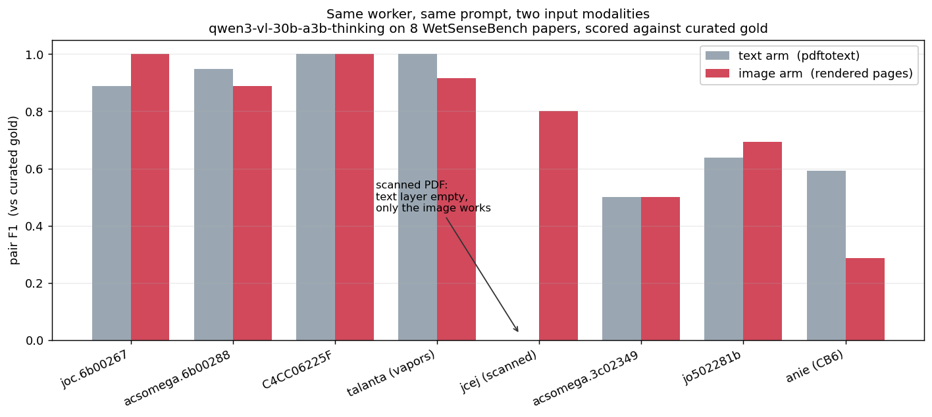
MODULE 2B
/ TEXT VS IMAGE
Same prompt, two inputs
TEXT
PRECISION
IMAGE
PRECISION
0.68
0.81
F1 0.68 vs 0.69
When the text layer fails
On the scanned paper, the text arm scores 0.00 in some situation
Text vs image extraction F1, pooled and per paper.
UChicago PME · AI Training
Module 2b — Multimodal PDF

Slide 20
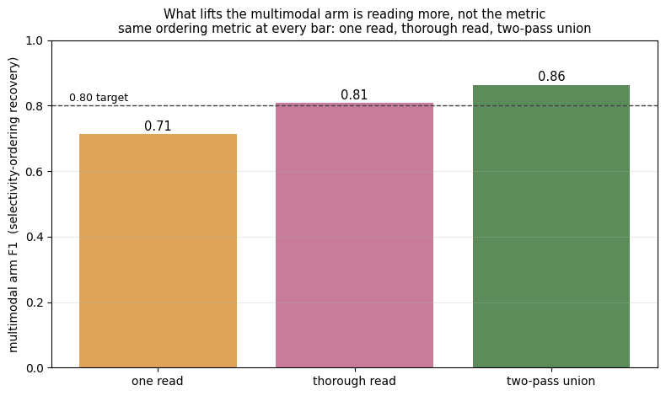
MODULE 2B
/ RAISING THE BAR
To a higher F1
MULTIMODAL F1
0.71 → 0.86
▲ +0.15 · recall 0.79 · precision 0.95
Selectivity-ordering recovery
A two-pass read with an exhaustive prompt (basic multi-agent)
F1 climb from 0.71 to 0.86 under selectivity-ordering recovery.
UChicago PME · AI Training
Module 2b — Multimodal PDF

Slide 21
MODULE 2C
/ TEXT → TWIN → TRANSLATION
Closing the Loop:
Text-Twin-Translation
A Whole Pipeline from Domain Corpus Harvesting to ML Modeling
UChicago PME · AI Training
Module 2c — Text to data

Slide 22

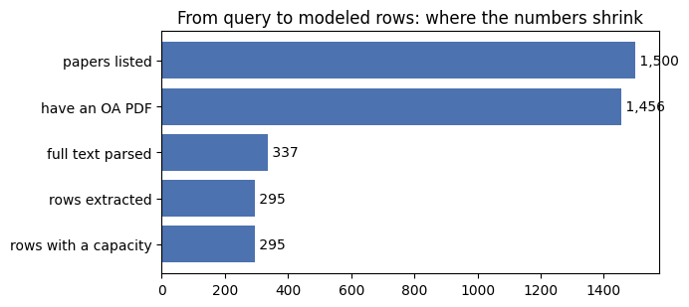
https://dl.acm.org/doi/10.1145/3770855.3819013
MODULE 2C
TEXT TWIN TRANSLATION
Battery Capacity Use Case: A Whole Pipeline
UChicago PME · AI Training

Slide 23
Module 2a — LLM text extraction
- Data / task: Rui Ding, Zixin Ding, Rodrigo Pires Ferreira, Yuxin Chen, Junhong Chen, "Text-Twin-Translation (T³): A Full-Stack Machine Learning Framework for Functional
Material-Device Systems Discovery," KDD '26 (2026)
- Models: DeepSeek (v4-flash as worker, v4-pro as prompt optimizer) via OpenRouter
- Software: pandas, matplotlib, requests, pydantic
Module 2b — Multimodal PDF extraction
- Data / task: WetSenseBench and the T³ project (R. Ding et al.; same as KDD '26 above); paper PDFs remain the property of their publishers
- Model: Qwen team qwen/qwen3-vl-30b-a3b-thinking via OpenRouter
- Software: poppler-utils (pdftotext / pdftoppm), Pillow, NumPy, pandas, matplotlib, requests, pydantic
Module 2c — Literature to dataset to model (closed loop)
- Literature metadata / search: OpenAlex API (data CC0, https://openalex.org)
- Full-text extraction: DeepSeek (v4-flash)
- Full-text PDFs come from open-access publishers and remain their property; harvested for noncommercial educational use
- Algorithms: Random Forest (Breiman, Machine Learning 45, 5–32, 2001); XGBoost (Chen & Guestrin, KDD, 2016)
- Software: PyMuPDF, requests, scikit-learn (Pedregosa et al., JMLR 12, 2825, 2011), pandas, NumPy, matplotlib

Slide 24
MODULE 3
/ DISTILATION & FINE TUNING
DISTILLATION AND FINE TUNING YOUR OWN Student LLM
We would teach a small model to reason from a large one
UChicago PME · AI Training
Module 2b — Multimodal PDF

Slide 25
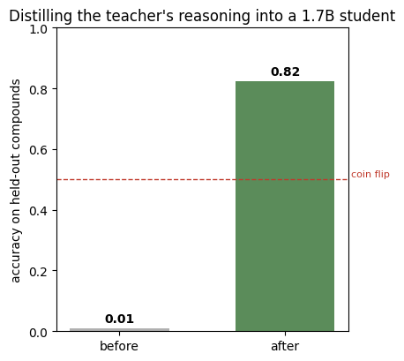


MODULE 3
/ DISTILLATION
Task: pick the better solvent for a compound (solubench, binary A/B, no reasoning given)
Teacher = DeepSeek v4-flash0731 writes the reasoning;
Student = Qwen3-1.7B,
The trap: show the teacher the answer → it rationalizes → student scores 0.41
The correct way: teacher answers blind, keep only the chains it gets right → 2114 real derivations
Test Set Result: student 0.01 → 0.825, matching the teacher's own 0.846 accuracy indicating real capability transfer
UChicago PME · AI Training
Module 3 — DISTILLATION

Slide 26
Module 3 — Reasoning distillation / fine-tuning
- Student model: Qwen3-1.7B (Qwen team); Teacher model: DeepSeek v4-flash
- Methods: LoRA — Hu et al., ICLR (2022); rejection sampling / STaR — Zelikman et al., NeurIPS (2022)
- Data: solubench (a public solubility benchmark); the reasoning chains and train/test split shipped here are generated by us from its answer-only data
- Software: PyTorch, Hugging Face Transformers, TRL, PEFT, datasets, pandas, matplotlib

Slide 27
MODULE 4
IMAGE PROCESSING
Image Processing via
Machine Learning
How to detect and track objects in a noisy data stream?
UChicago PME · AI Training
Module 4 - Image processing

Slide 28
MODULE 4
/ THE PHENOMENON
Detecting & tracking Pt dumbbells in a noisy movie
1
The phenomenon
Pt NPs micelles disassembling in liquid-phase transmission electron microscopy (LP-TEM) movies
Micelle breaks → Pt NPs scatter → Pt NPs bond → Pt dumbbells → dissociate → swap partners & re-assemble
Disclaimer: all data presented in this module is a courtesy of Dr. Xiaoben Zhang (post-doc @ Chen group)
UChicago PME · AI Training
Module 4 — Image Processing

Slide 29
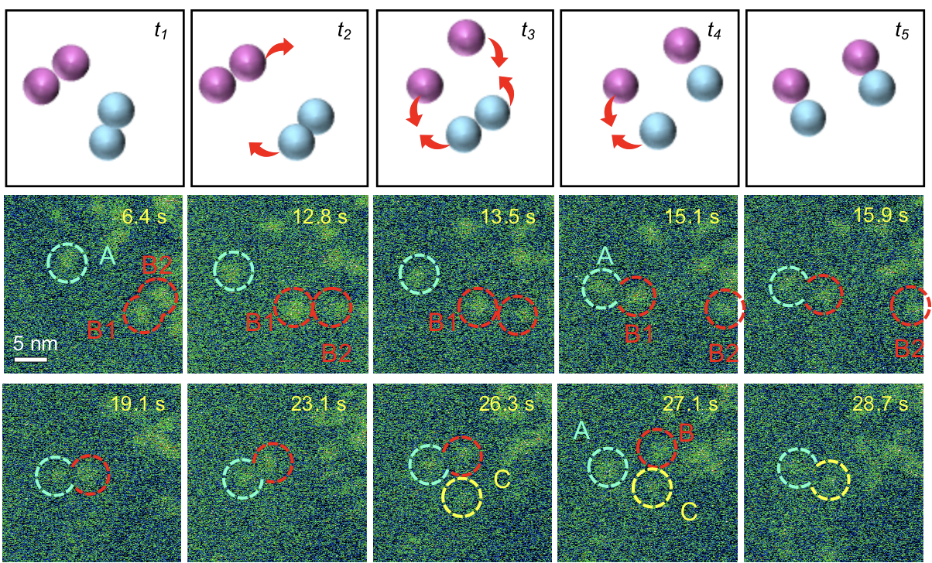
MODULE 4
/ THE PHENOMENON
Detecting & tracking Pt dumbbells in a noisy movie
1
The phenomenon
UChicago PME · AI Training
Module 4 — Image Processing

Slide 30
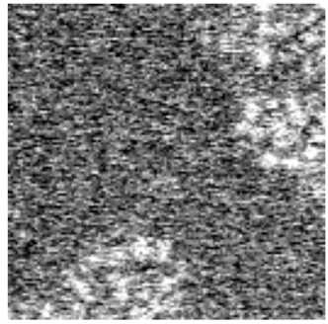
MODULE 4
/ THE PROBLEM
Detecting & tracking Pt dumbbells in a noisy movie
2
The problem
It’s very challenging to detect and keep track of those Pt dumbbells! Sample video.
UChicago PME · AI Training
Module 4 — Image Processing

Slide 31
MODULE 4
/ THE TASK
Detecting & tracking Pt dumbbells in a noisy movie
3
The task
Design a ML algorithm that:
takes the raw, noisy TEM frames
denoises the frames
detects when and where Pt dumbbells are formed
keeps track of the dumbbells
returns the dumbbells life statistics (mean lifetime and population over time)
UChicago PME · AI Training
Module 4 — Image Processing

Slide 32
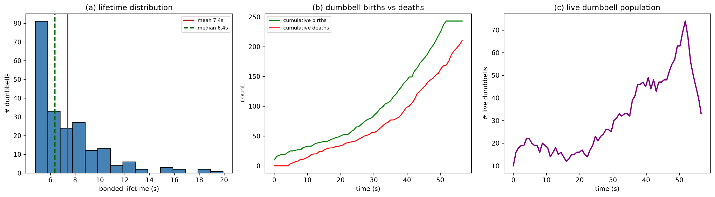
MODULE 4
/ THE TASK
Detecting & tracking Pt dumbbells in a noisy movie
3
The task (output video)
UChicago PME · AI Training
Module 4 — Image Processing

Slide 33
MODULE 4
/ THE MODEL
Detecting & tracking Pt dumbbells in a noisy movie
4
The model
The most important question to answer: what defines a dumbbell?
UChicago PME · AI Training
Module 4 — Image Processing

Slide 34
MODULE 4
/ THE MODEL
Detecting & tracking Pt dumbbells in a noisy movie
4
The model
The most important question to answer: what defines a dumbbell?
from experiments, it fundamentally depends on the distance and velocity of the particles
define bands/thresholds for distance and velocity correlation
which physical parameters define your problem? which values are acceptable?
UChicago PME · AI Training
Module 4 — Image Processing

Slide 35
MODULE 4
/ THE MODEL
Detecting & tracking Pt dumbbells in a noisy movie
4
The model
The most important question to answer: what defines a dumbbell?
A dumbbell is born if…
2.5 nm ≤ d ≤ 6.5 nm
mean velocity correlation vc ≥ 0.5
it persists for N consecutive frames
UChicago PME · AI Training
Module 4 — Image Processing

Slide 36
MODULE 4
/ THE MODEL
Detecting & tracking Pt dumbbells in a noisy movie
4
The model
The most important question to answer: what defines a dumbbell?
A dumbbell is born if…
2.5 nm ≤ d ≤ 6.5 nm
mean velocity correlation vc ≥ 0.5
it persists for N consecutive frames
A dumbbell dies if…
any of those conditions becomes false (e.g. d = 7 nm)
UChicago PME · AI Training
Module 4 — Image Processing

Slide 37
MODULE 4
/ THE VALIDATION
Detecting & tracking Pt dumbbells in a noisy movie
5
The validation
Our model seems reasonable. Is it really, though?
UChicago PME · AI Training
Module 4 — Image Processing

Slide 38
MODULE 4
/ THE VALIDATION
Detecting & tracking Pt dumbbells in a noisy movie
5
The validation
Our model seems reasonable. Is it really, though?
Ideally, you should have some ground truth (GT) data, i.e., high-confidence data that really represents your phenomenon.
UChicago PME · AI Training
Module 4 — Image Processing

Slide 39
MODULE 4
/ THE VALIDATION
Detecting & tracking Pt dumbbells in a noisy movie
5
The validation
Our model seems reasonable. Is it really, though?
Ideally, you should have some ground truth (GT) data, i.e., high-confidence data that really represents your phenomenon.
in our case, we have annotated dumbbell positions in a small portion of the TEM frames
we will run our model with those assumptions to see if our output correctly matches the annotated positions (GT data)
UChicago PME · AI Training
Module 4 — Image Processing

Slide 40
MODULE 4
/ THE VALIDATION
Detecting & tracking Pt dumbbells in a noisy movie
5
The validation
Our model seems reasonable. Is it really, though?
Ideally, you should have some ground truth (GT) data, i.e., high-confidence data that really represents your phenomenon.
in our case, we have annotated dumbbell positions in a small portion of the TEM frames
we will run our model with those assumptions to see if our output correctly matches the annotated positions (GT data)
PS1: in practice, we iterate/update the parameters until we match the GT data
PS2: what happens if you don’t have any GT data?
UChicago PME · AI Training
Module 4 — Image Processing

Slide 41
MODULE 4
/ THE WORKFLOW
Detecting & tracking Pt dumbbells in a noisy movie
6
The workflow
Raw
frame N
denoiser
Denoised
frame N
Detector model
Proposed
pairs(x,y)
no
Update frame N→N+1
Close to GT pairs(x,y)?
yes
UChicago PME · AI Training
Module 4 — Image Processing

Slide 42
MODULE 4
/ THE WORKFLOW
Detecting & tracking Pt dumbbells in a noisy movie
6
The workflow
denoiser
Detector model
*Gaussian filter
non-local means
wavelet/BayesShrink
1.draws boxes
2.checks for
physical constraints & permanence
UChicago PME · AI Training
Module 4 — Image Processing

Slide 43
MODULE 4
/ THE CODE
Detecting & tracking Pt dumbbells in a noisy movie
7
The code
Jupyter notebook on github!
UChicago PME · AI Training
Module 4 — Image Processing

Slide 44
MODULE 4
/ THE CODE
Detecting & tracking Pt dumbbells in a noisy movie
7
The code
How to do it yourself?
UChicago PME · AI Training
Module 4 — Image Processing

Slide 45
MODULE 4
/ THE CODE
Detecting & tracking Pt dumbbells in a noisy movie
7
The code
How to do it yourself?
Pick the best model you can (Claude Opus 5, Fable)
Think deeply about what truly defines your problem
Break it into small & verifiable pieces--always check if the output matches your intuition
If don’t have enough data, do simple things (e.g. linear regression, denoising, physical constraints)
If you do have enough data, try modern transformer-based methods: general purpose (e.g. YOLO, DINO, DETR) or domain-specific (e.g. Cellpose, Noise2Atom, U-Net)
UChicago PME · AI Training
Module 4 — Image Processing

