Slide 1
Applying Generative AI in Auditing with Python
WCARS 66
Francisco Cruz
(domain expertise support of Sérgio Pontes)

Slide 2
What is this session about
Highlight the potential of Generative AI applications for auditing purposes
Show how easy it is to create a proof-of-concept AI application using python
Provide you with access to applications so you can learn, adapt to your use case, or just play around

Slide 3
What is this session is not about
Python or Notebook course
AI course
Presenting infallible or enterprise-level applications
Stating that coding with python is as better solution in every case

Slide 4
Why do it with python?
Existing software may be expensive
Existing software may be not suitable for our use case
We have full control of what the application is doing
Data privacy and security concerns
Having fun and learn about a powerful toolset

Slide 5











Basic concepts
Generative AI – AI models that create content
Large Language Models (LLM) are a subset of Gen AI
LLM are non-deterministic and may hallucinate
Python
Notebook (Google Colab)
Python packages

Slide 6
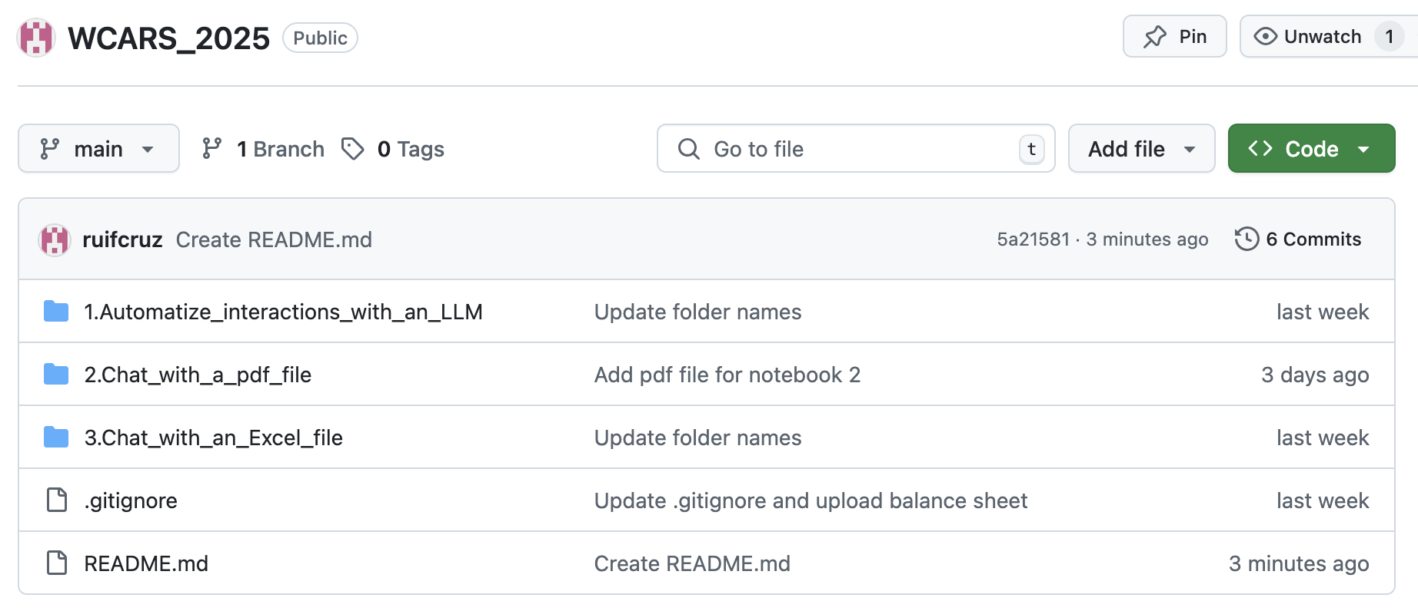
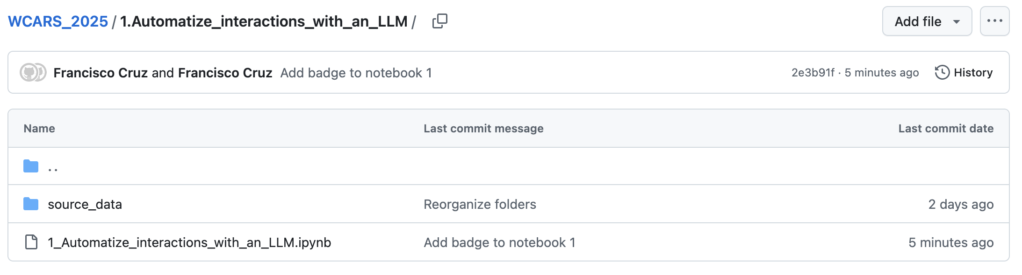
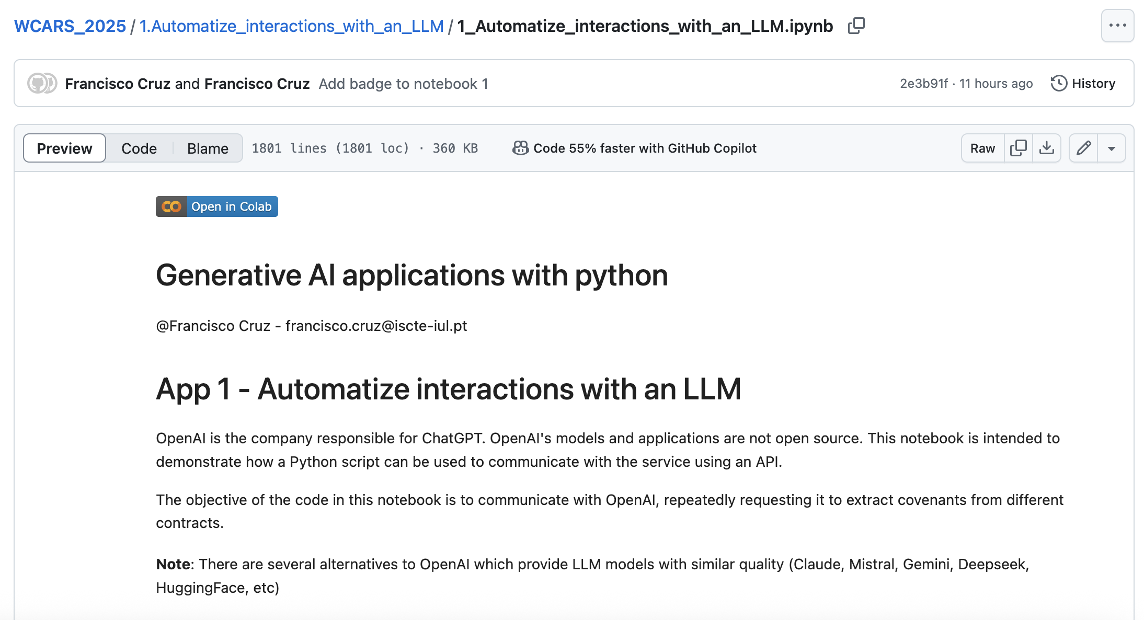
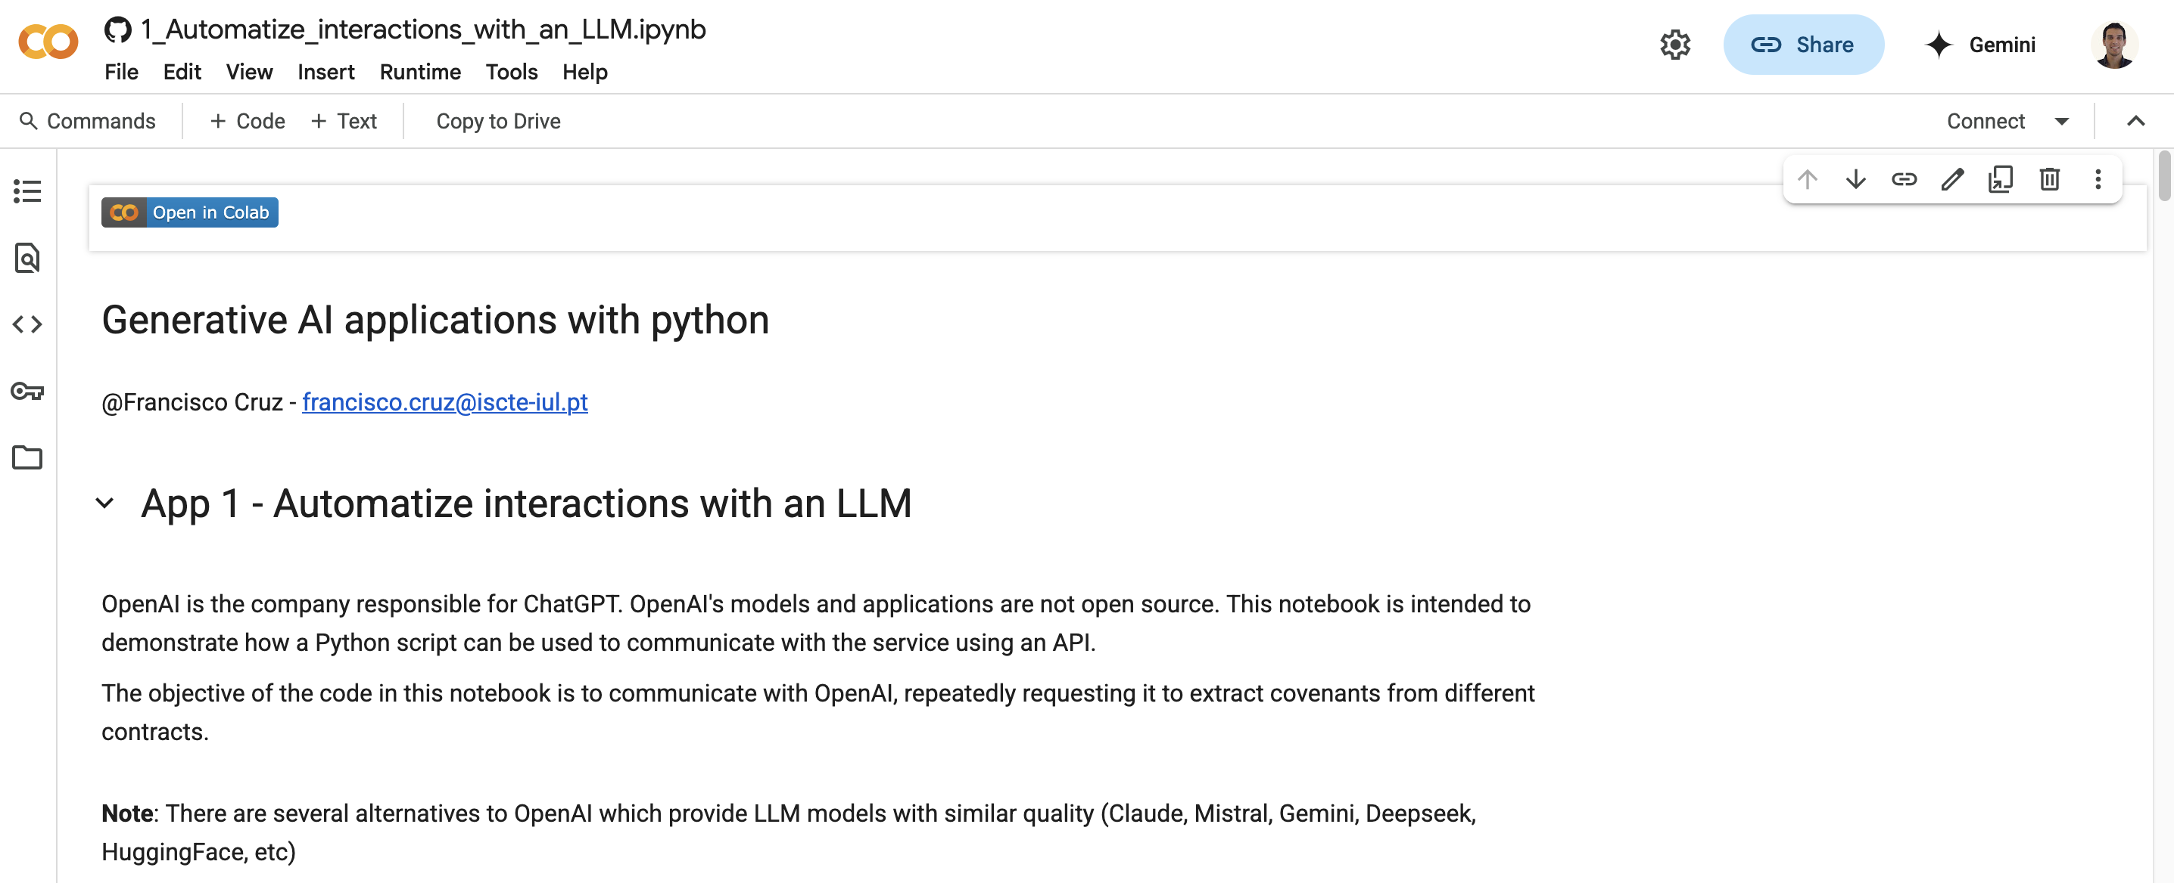
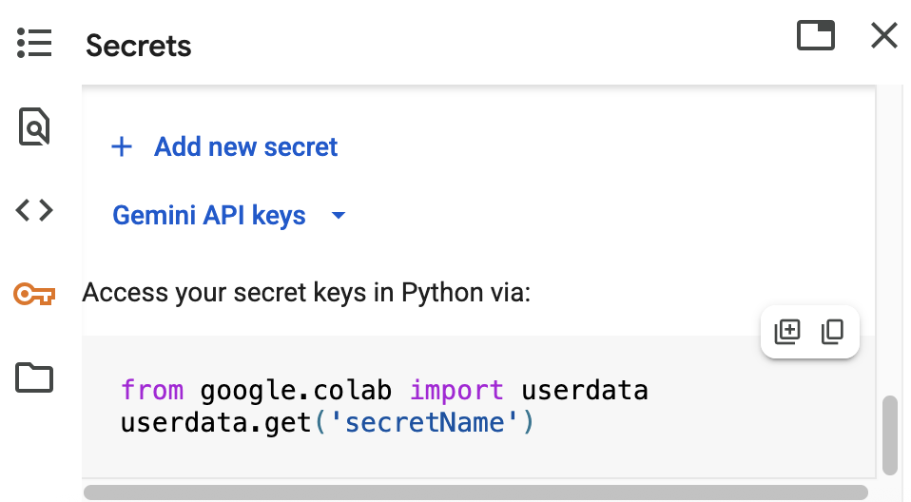
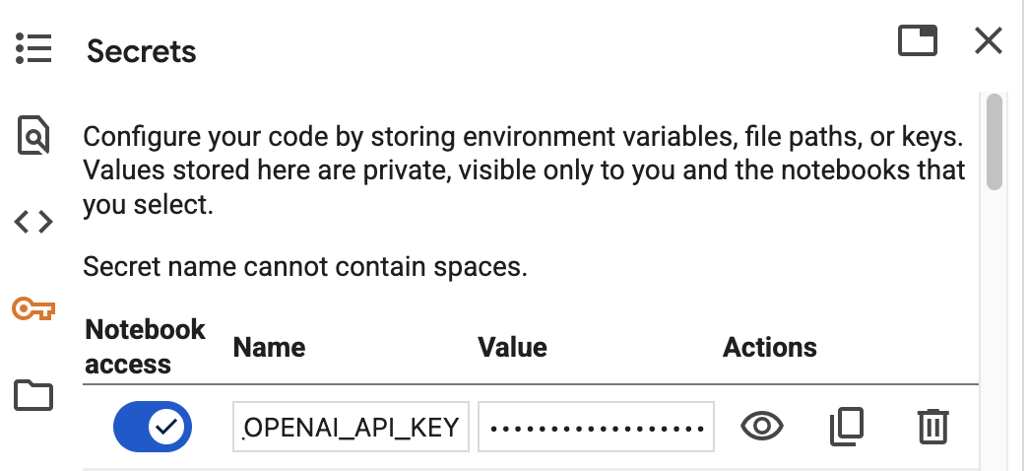
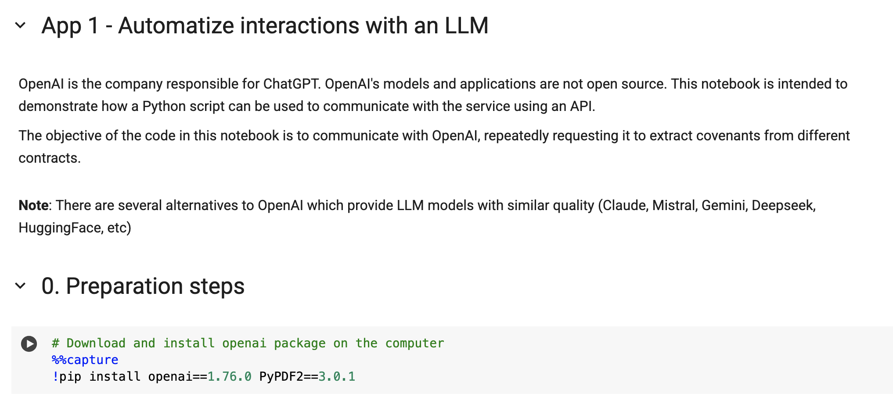
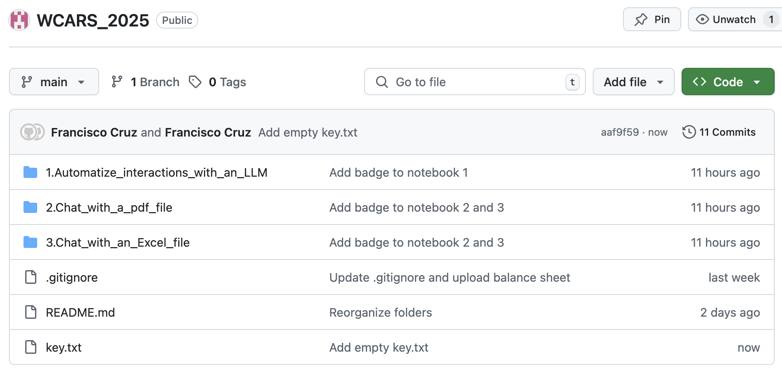
How to access and run the notebooks
Access github.com/ruifcruz/WCARS_2025
Open the folder of a use case and click the ipynb file
Click on “Open in Colab”
Log in to a google account (top-right corner)
Set up an Open AI key
  On the left side of the notebook, go to “Secrets”
  Click on “+ Add new secret”
  On “Name” paste OPENAI_API_KEY
  On “Value” paste the content of the file key.txt
  Make sure the switch “Notebook Access” is on
Go to the first cell with code and run it
  Click on the play button on the right side of the cell OR
  Press shift + enter

Slide 7

Application 1 – Automatize interactions with an LLM
Web
Browser
API
Server
LLM
Model
Colab
Notebook

Slide 8



Application 2 – Chat with a PDF file
”Who is the first party of the contract?”
User
LLM
Model
“To which contract are you referring to?”
Retrieval Augmented Generation
PDF
file
Vector
Database
”Answer to the following question based on the provided context.
QUESTION: Who is the first party of the contract?
CONTEXT:
This Contract is entered into by and between:
Lender: Nova Capital Investments, Inc., with registered office at 100 Market St., Suite 400, San Francisco, CA 94105, represented by James Turner, CEO.
Borrower: GreenTech Solutions Ltd., with registered office at 45 Innovation Drive, Austin, TX 78701, represented by Laura Chen, CFO. “
”Who is the first party of the contract?”
User
LLM
Model
“The first party of the contract is Nova Capital Investments, Inc. represented by James Turner”

Slide 9



Application 3 – Chat with an Excel file
” What is the highest debit amount for internal expenses?”
User
LLM
Model
“I am sorry I don’t have context to answer that”
SQL Agent
Excel
table
SQL Agent
” What is the highest debit amount for internal expenses?”
Get tables
User
LLM
Model
Get schema
Tables: balance_sheet
SQL
database
The highest debit amount for internal expenses is 342.81
Run query
"Account" INTEGER,
"Description" TEXT,
"Month_Debit" REAL,
"Month_Credit" REAL,
"Debit" REAL,
"Credit" REAL,
"Debtor" REAL,
"Creditor" REAL,
"Net" REAL
SELECT MAX(Debit)
FROM balance_sheet
WHERE Description LIKE
‘%Internal Expense%’
342.81

