Slide 1

QAMP Fall 2022 Building out Qiskit-QEC: XP Formalism
Members: Dhruv Bhatnagar, Ruihao Li
Mentors: Grace Harper (IBM), Drew Vandeth (IBM)

Slide 2
Big Picture
qiskit-community/qiskit-qec
Under development
Standard software tool
Allow rapid, reproducible implementation of ideas for quantum error correction (QEC)
Deliverables achieved
Representation for XP operators in BaseXPPauli class
Building XPPauli and XPPauliList classes
Implementing mod N arithmetic (generalized RREF form)
Future possibilities: XP codes, codespace search, tutorials …
QAMP project vision
Implement modularized version of XP formalism to be merged in qiskit-qec
Easy-to-use base code for researchers
Use existing Pauli classes as design reference
Use XPF package as unit tests
XP formalism for QEC codes
Mark Webster et al. (2022)
Generalization of standard Pauli stabilizer formalism to develop “improved” QEC codes
XPF package (Mark)

Slide 3
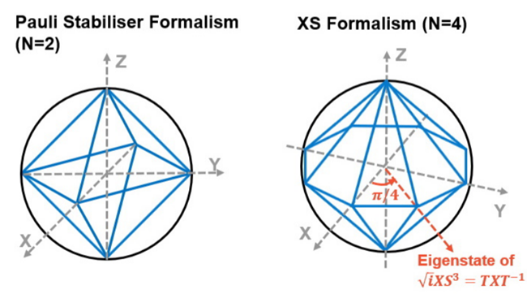


Quick overview: XP stabilizer formalism
M.A. Webster, B.J. Brown, and S.D. Bartlett. Quantum 6, 815 (2022).
https://github.com/m-webster/XPFpackage
Pauli Stabilizer Formalism
XP Formalism: To construct new QEC codes using fractional Z rotations to generate the stabilizer group

Slide 4
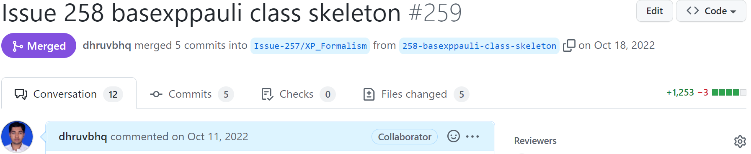


XP operators: BaseXPPauli class
BaseXPPauli class
Base functionality/algebra
Precision attribute
int64 numpy arrays to represent operators in generalized symplectic form
Generalized symplectic vector representation for XP operators, with an example.
XPPauli class
Single XP operator
XPPauliList class
List of XP operators

Slide 5
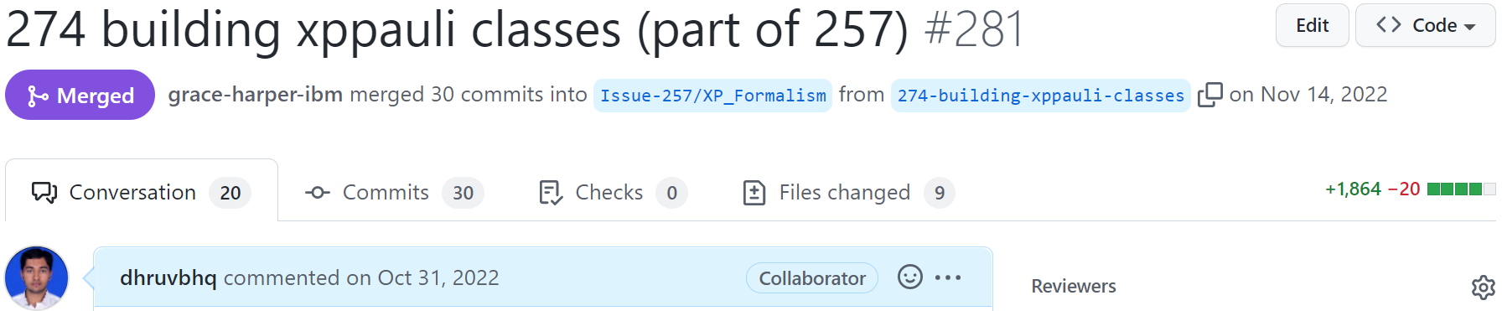
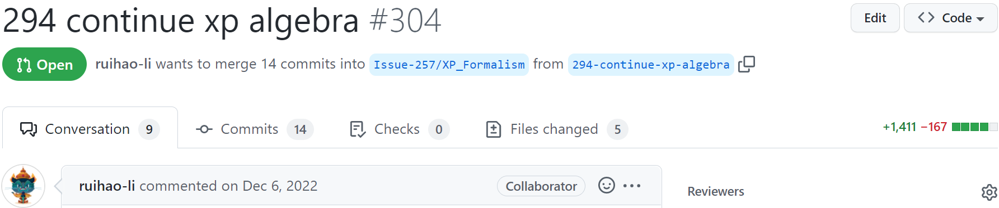
XP operator algebra implementation
Guiding principles
Higher level python method for the user
Checks and easy to use
Lower level python method
Functionality without checks
in-place option
Exceptions
e.g. Rescaling precision
Rewriting/refactoring XPF package
Tests
To compute stuff using XP operators
Determine unique vector representation of an XP operator
Determine if the operator is diagonal
Rescale operator precision
Calculate products, inverses, commutation relations of XP operators, and more

Slide 6
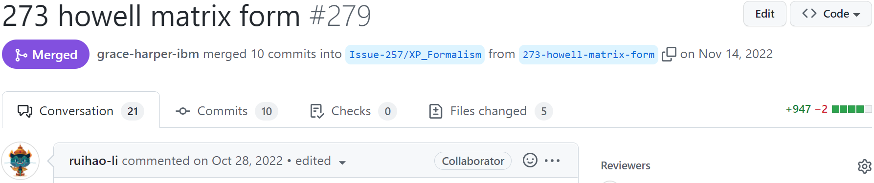
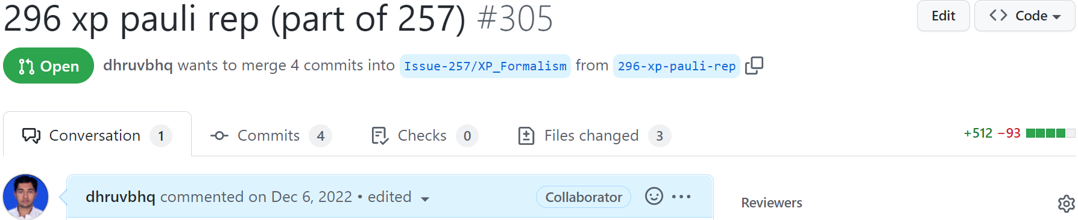
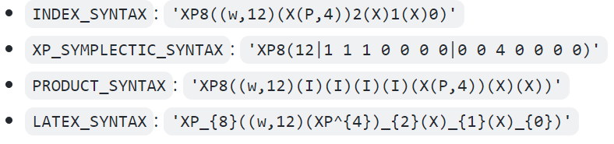
Modulo N arithmetic. String representations
Modular arithmetics on ring Z/nZ: reside in qiskit_qec/arithmetic/modn.py
Extended Euclidean algorithm for finding the greatest common divisor (gcd_ext)
Quotient (quo)
Divisor (div)
XP operator to string representation: reside in qiskit_qec/utils/xp_pauli_rep.py

Slide 7
Summary
The current implementation achieves:
Representing XP operators in the style of existing framework of qiskit-qec
Algebra of XP operators
Modulo N arithmetic, useful for further algorithms for XP codes
This serves as a base of methods to enable further implementation, like algorithms from XPF package for:
Whether a given set of generators identify a valid codespace, dimension of codespace, codewords
Which sets of operators stabilize the same codespace?
How do we find all transversal logical operators for a given code?

Slide 8
References
M.A. Webster, B.J. Brown, and S.D. Bartlett. Quantum 6, 815 (2022).
https://github.com/m-webster/XPFpackage
https://github.com/qiskit-advocate/qamp-fall-22/issues/15
https://www.qiskit.org

