Slide 1
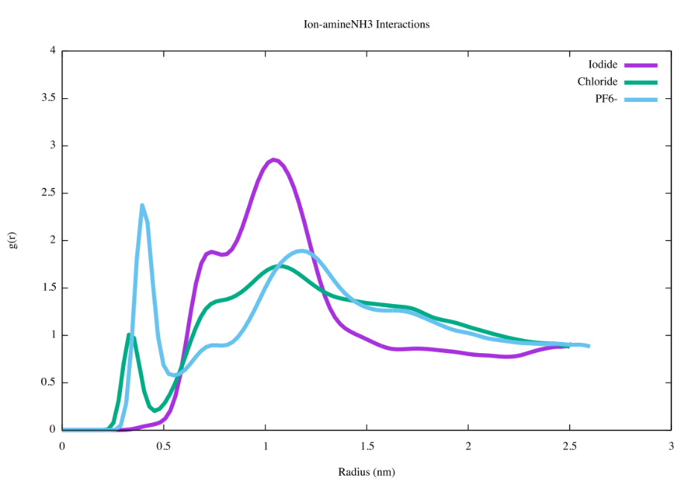
PMF contact energies explained
Iodide (I-)
Hexafluorophosphate (PF₆⁻)
Chloride (Cl-)
Based on the radial distribution/pair correlation function g(r).
  Measures density/aggregation as a function of distance, between two types of atoms/molecules/amino acids…whatever you want.
  If greater than 1, there is a greater than random chance that the interaction happens.
  Integrating the curve gives you “coordination numbers”- how many molecules are at a given distance – density
  On average, how many amino acids of type B surround type A?
  The solution basically leads back to every thermodynamic identity (free energy, potential energy, entropy, etc.)
I- 0.59
Cl- 0.59
PF6- 0.74

