Slide 1
Course Intro & Objectives
Chapter 1

Slide 2
Lecturers
Dan Forsyth – Section A
dan.forsyth@cc.gatech.edu
CCB 242 (use back stairs or elevator)
Caleb Southern – Section B
caleb.southern@gatech.edu
CCB 105

Slide 3
TA’s
Austin Adams
Cem Gokmen
Madeleine Brickell
Daniel Becker
James "Jim" Harris
Preston Olds
Joshua Viszlai
Madison Grams
Vivian De Sa Thiebaut
Sam Gilson
Hanwen "Michael" Xu
Jered Tupik
Minsung "Daniel" Jung
Clifford "Cliff" Panos
Lauren Chen
Shannon Ke
Bharat Srirangam
Jarrett Schultz
Office Hours and Contact Information on the Canvas CS2110 Home Page

Slide 4
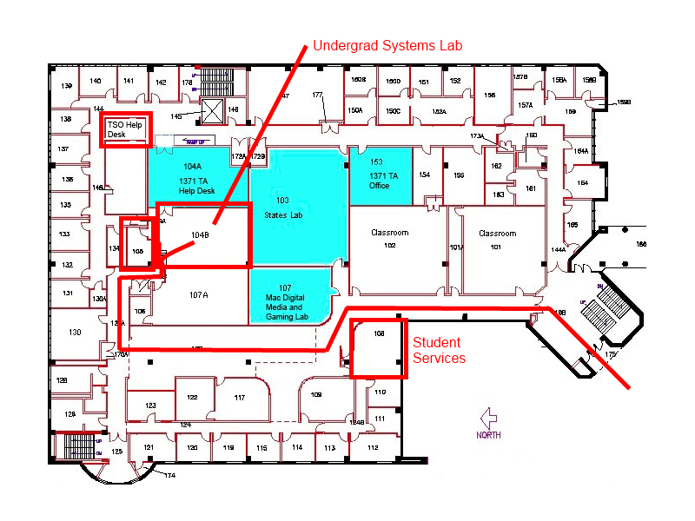
Caleb’s Office – CCB 105

Slide 5
Dan’s Office – CCB 242

Slide 6
Objectives
To understand the structure and operation of a modern computer from the ground up.
Understand basic hardware concepts: digital circuits, gates, bits, bytes, number representation
Understand the Von Neumann model and the structure and operation of a basic datapath

Slide 7
Objectives
Structure and function of machine language instructions
Structure and function of a symbolic assembly language
Basic concepts of computer systems such as the runtime stack, simple I/O devices
Introduce the C language with particular emphasis on the underlying assembly and machine language as well as interaction with hardware.

Slide 8
From the point of continuity (Kishore Ramachandran)
This sounds like a lot of work!
"Can't we make this fun, too?"

Slide 9
Organization
Lecture
Section A Tue/Thu 12:00-1:15PM
Section B Tue/Thu 3:00-4:15PM
Lab/Recitation = Lecitation
Mon/Wed
Mix of tutorial and evaluation
You are expected to attend
This is not a supplemental help session

Slide 10
Textbooks/Software
Required
Introduction to Computing Systems 2nd edition: Patt & Patel
The C Programming Language: Kernighan & Ritchie
Circuitsim (available online for free)
Recommended (If you want a Linux book)
Mastering Linux, First Edition: Paul Wang

Slide 11
Canvas
We will be using the Canvas LMS*
http://canvas.gatech.edu
Used for
Assignment distribution,
Assignment turn-in,
Grade display
*LMS - Learning Management System

Slide 12
Assignment Values
Item | Number (approx.) | Totals
Timed Labs | 5 | 24%
Homework | 11 | 22%
Labs | 12 | 5%
Quizzes | 6 | 24%
Final | 1 | 25%
TOTAL |  | 100%

Slide 13
Final Exam
IF YOU ARE LATE OR MISS THE FINAL EXAM YOU RECEIVE A ZERO

Slide 14
Homework
Roughly 1 per 7 days
Types of assignments
Logic Simulation
Machine Language programming
Assembly programming
C programming
Collaboration is allowed on Homework
You can share ideas but not source code!

Slide 15
Homework
Even though it looks like the homework doesn't count for many points nothing could be further from the truth!
You cannot and will not do well in lab and on tests if you do not have a deep understanding of how the homework works and is coded.
Questions will be taken directly from things covered in homework.

Slide 16
Academic Misconduct
Academic misconduct is taken very seriously in this class.
Quizzes, timed labs and the final examination are individual work.
Homework assignments are collaborative, In addition many if not all homework assignments will be evaluated via demo or code review. During this evaluation, you will be expected to be able to explain every aspect of your submission. Homework assignments will also be examined using electronic computer programs to find evidence of unauthorized collaboration.

Slide 17
Academic Misconduct
What is unauthorized collaboration? Each individual programming assignment should be coded by you. You may work with others, sharing ideas and even pseudo-code, but each student must turn in their own version of the assignment.
Submissions that are essentially identical will receive a zero and will be forwarded to the Dean of Students’ Office of Academic Integrity. Submissions whichare copies that have been superficially modified to conceal that they are copies will also be considered unauthorized collaboration.

Slide 18
Academic Misconduct
You are expressly forbidden to supply a copy of your homework to another student via electronic means. If you supply an electronic copy of your homework to another student and they are charged with copying you will also be charged. This includes storing your code on any site which would allow other parties to obtain your code such as but not limited to public repositories, etc.

Slide 19
Late Policy
You are responsible for turning in assignments on time. This includes allowing for unforeseen circumstances. You are also responsible for ensuring that what you turned in is what you meant to turn in. Each assignment will have an official due date and time and a 6-hour grace period. If an assignment is submitted during the grace period it will receive a 25% penalty. After the grace period absolutely no credit will be given. Therefore it is your responsibility to plan and insure that you have backups, early safety submissions, etc.

Slide 20
Final
The final exam is comprehensive

Slide 21
Need help?
Piazza!!!!
TAs
Instructor

Slide 22
Online Resources
Via Canvas

Slide 23
End of Semester
There is no time available to review your final at the end of the semester.
We do not review finals or discuss grades over break.
You have the entire next semester you are on campus to review your final and all grades and have any problem fixed.

Slide 24
Why CS2110?
New course
Eliminate disconnect between ECE2030 and CS2130
Learn C in context of hardware
C is not a high level language!
C is a relatively cross-platform compatible hyper assembler!
Used for systems programming
Misused by many!
If you understand the hardware the language loses a lot of its black magic!

Slide 25
Big Ideas

Slide 26
Big Idea #1: All computers can compute the same kinds of things
We call this Turing-equivalence
Just about everything that we use for computation can be proved capable of solving the same set of problems.
That includes Turing machines, stored program computers (and their programming languages), regular expressions, automata theory, formal grammars, etc.

Slide 27
Big Idea #2: Abstraction: Layers Making the Electrons Work
Level 5
Problem-oriented language level
Translation (compiler)
Level 4
Assembly language level
Translation (assembler)
Level 3
Operating system machine level
Partial interpretation (operating system)
Level 2
Instruction set architecture level
Interpretation (microprogram) or direct execution
Level 1
Microarchitecture level
Hardware
Level 0
Digital logic level
From Structured Computer Organization, Tanenbaum & Austin, 6th ed

Slide 28
Big Idea #2: Abstraction: Layers Making the Electrons Work
Problems
Algorithms
Language
Machine (ISA) Architecture
Microarchitecture
Circuits
Devices
5-3
2
1
0
From Introduction to Computing Systems, Patt and Patel, 2ed.

Slide 29
Big Idea #3 Binary
Binary is “better” than decimal for electronic computing.
Why?
Lots of small physical and economic reasons:
It’s easier to determine presence/absence of current rather than magnitude.
Can use lower voltages to distinguish only 0/1 instead of 0/1/2/3/4/5/6/7/8/9, so less power.
Binary-coded decimal math takes more circuitry than pure binary.

Slide 30
Big Idea #4: Computers Store Unsigned Whole Numbers
Computers can’t store the mathematical abstraction called a “number”. Why?
How many digits can a “number” have? How would you build that?
So everything in a computer is a finite-sized representation of something outside.
A bunch of binary digits (bits) is always interpretable as an unsigned whole number.
So we can always claim the bits stored in a computer represent a positive whole number.
Is that the end of the story? Stay tuned.

Slide 31
Questions?

Slide 32
Things to do
Get the textbooks.
Start reading!

Slide 33
And now for something completely different...

Slide 34
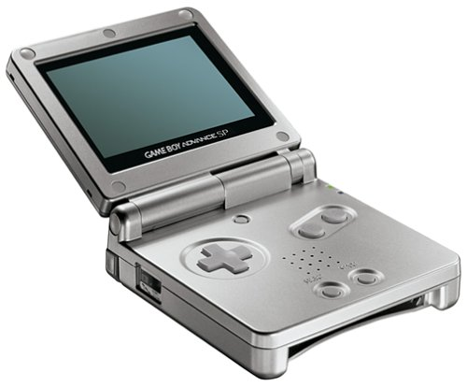
Nintendo GameBoy Advance

Slide 35
And now for something really new and different...

Slide 36
History of Computers
I am old
Computers are not that old
So I have personally seen some of the development of Computer Technology
Plus I have studied the history of technology and computers
And I would include this in lecture but
It's not really part of the class and we are a little pressed for time

Slide 37
A Special Lecture
I am going to present the history of Computer Technology from my perspective.
The lecture will be Tuesday, January 17th starting at 6:05
Attendance is voluntary and nothing in the lecture will be on any test or quiz or the final.

Slide 38
Questions?

