Slide 1
Datatypes II
Chapter 2

Slide 2
Outline
Logical Operations on Bits
AND, OR, NOT, XOR, (NAND, NOR)
Other Representations
Bit vectors
Floating Point
ASCII
Hexadecimal
Octal

Slide 3
AND | 0 | 1
0
1

Slide 4
AND | 0 | 1
0 | 0 | 0
1 | 0 | 1

Slide 5
Truth Table
A | B | A AND B A & B AB
0 | 0
0 | 1
1 | 0
1 | 1

Slide 6
Truth Table
A | B | A AND B A & B AB
0 | 0 | 0
0 | 1 | 0
1 | 0 | 0
1 | 1 | 1

Slide 7
Bitwise AND
0101 AND 0110 (5 & 6)
0101
0110
0100

Slide 8
A | B | A OR B A | B A + B
0 | 0
0 | 1
1 | 0
1 | 1

Slide 9
A | B | A OR B A | B A + B
0 | 0 | 0
0 | 1 | 1
1 | 0 | 1
1 | 1 | 1

Slide 10
Bitwise OR
0101 OR 0110 (5 | 6)
0101
0110
0111

Slide 11
A | NOT A ~A A’
0
1

Slide 12
A | NOT A ~A A’
0 | 1
1 | 0

Slide 13
Bitwise NOT (Complement)
NOT 0101 ~5
0101
1010

Slide 14
A | B | A XOR B A ^ B
0 | 0
0 | 1
1 | 0
1 | 1

Slide 15
A | B | A XOR B A ^ B
0 | 0
0 | 1
1 | 0
1 | 1

Slide 16
A | B | A XOR B A ^ B
0 | 0 | 0
0 | 1 | 1
1 | 0 | 1
1 | 1 | 0

Slide 17
Bitwise XOR
0101 XOR 0110 5^6
0101
0110
0011

Slide 18
A | B | A NAND B ~(A & B)
0 | 0
0 | 1
1 | 0
1 | 1

Slide 19
A | B | A NAND B ~(A & B)
0 | 0 | 1
0 | 1 | 1
1 | 0 | 1
1 | 1 | 0

Slide 20
Bitwise NAND
0101 NAND 0110 No C Operator
~(5 & 6)
0101
0110
1011

Slide 21
A | B | A NOR B ~(A | B)
0 | 0
0 | 1
1 | 0
1 | 1

Slide 22
A | B | A NOR B ~(A | B)
0 | 0 | 1
0 | 1 | 0
1 | 0 | 0
1 | 1 | 0

Slide 23
Bitwise NOR
0101 NOR 0110 No C Operator
~(5 | 6)
0101
0110
1000

Slide 24
How Many?
How many boolean functions do you think there are?
How can you prove it?

Slide 25
All the Boolean Functions?
P | Q | FALSE | P AND Q | ~(P -> Q) P AND ~Q | P | ~(Q -> P) ~P AND Q | Q | P != Q P XOR Q | P OR Q
0 | 0 | 0 | 0 | 0 | 0 | 0 | 0 | 0 | 0
0 | 1 | 0 | 0 | 0 | 0 | 1 | 1 | 1 | 1
1 | 0 | 0 | 0 | 1 | 1 | 0 | 0 | 1 | 1
1 | 1 | 0 | 1 | 0 | 1 | 0 | 1 | 0 | 1
P | Q | P NOR Q | P == Q P XNOR Q | ~Q | Q -> P P OR ~Q | ~P | P -> Q ~P OR Q | P NAND Q | TRUE
0 | 0 | 1 | 1 | 1 | 1 | 1 | 1 | 1 | 1
0 | 1 | 0 | 0 | 0 | 0 | 1 | 1 | 1 | 1
1 | 0 | 0 | 0 | 1 | 1 | 0 | 0 | 1 | 1
1 | 1 | 0 | 1 | 0 | 1 | 0 | 1 | 0 | 1

Slide 26
Left Shift
0101 Leftshift 10 5 << 2
Before 0101
After 0100

Slide 27
Right Shift
0101 Rightshift 10 5 >> 2
Before 0101
After 0001

Slide 28
Note Well
1101 Rightshift 10 ? >> 2
Before 1101
After 0011 or
1111

Slide 29
How would you negate in 2’s complement using bitwise operators and the plus operator?

Slide 30
How would you negate using bitwise operators and the plus sign?
~x+1

Slide 31
Other Representations

Slide 32
Bit Vectors

Slide 33
Bit Vectors
Sometimes for reasons of space efficiency we can effectively store a group of booleans packed together in a single byte/word/etc.
7
6
5
4
3
2
1
0
0
0
1
0
0
1
0
0
Item 5 in use
Item 2 in use

Slide 34
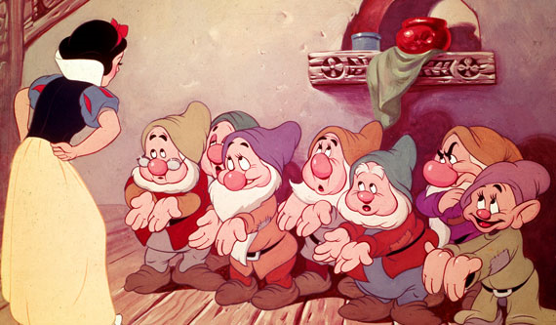

Slide 35
Bit Vectors
How do we manipulate the individual bits in the bit vector?
Example how do we set bit 6?
How do we clear bit 2?
How do we toggle a bit?
How do we test a bit?
7
6
5
4
3
2
1
0
0
0
1
0
0
1
0
0

Slide 36
Manipulating Bits
Often we use a constant (a.k.a. mask) with a boolean function
Identity: 1111₂& wxyz₂ == wxyz₂ (clear)
So put a zero in any bit you want to clear
1101₂ & wxyz₂ == wx0z₂
Identity: 0000₂ | wxyz₂ == wxyz₂ (set)
So put a one in any bit you want to set
0100₂ | wxyz₂ == w1yz₂
Invert: 1111₂ ^ wxyz₂ = w’x’y’z’ ₂ (toggle)
So put a one in any bit you want to toggle
1000₂ ^ wxyz₂ == w’xyz₂

Slide 37
More Manipulating Bits
To put a one in position in a mask, shift left
1 << 3 == 1000₂
To test a bit, clear all the rest
0010₂ & wxyz₂ == 00y0₂
Now you can test 00y0₂ == 0000₂
To put a one in position in a mask, shift left
1 << 3 == 1000₂
To put a zero in position in a mask, put a one in that position and complement
~(1 << 3) == 0111₂
(creates as many leading ones as you need)

Slide 38
Hexadecimal & Octal

Slide 39
Difficult
Using binary numbers is both a blessing a curse!
One can examine directly any particular bit
Reading, writing, etc. prone to error

Slide 40
Solution
Turns out that mathematics has an answer for us
Group bits and assign a single digit to represent each group
How big should each group be?

Slide 41
Use a Base That’s a Power of 2!
Base 2³, a.k.a. Base 8, a.k.a. Octal!
Use the digits 0 – 7 and group bits in 3s
00111010100101₂ = 07245₈
14 bits in 5 octal digits!
And it works backwards, too!
Base 2 | 00 | 111 | 010 | 100 | 101
Base 8 | 0 | 7 | 2 | 4 | 5
Base 8 | 6 | 4 | 3 | 0 | 2
Base 2 | 110 | 100 | 011 | 000 | 010

Slide 42
Use a Base That’s a Power of 2!
Base 2⁴, aka Base 16, aka Hexadecimal!
Use the digits 0 – 15 and group bits in 4s
Oops! Digits 10-15! We’ll just use A-F.
10001111001111000001₂ = 8F3C1₁₆
And it too works backwards:
Base 2 | 1000 | 1111 | 0011 | 1100 | 0001
Base 16 | 8 | F | 3 | C | 1
Base 16 | F | 0 | 0 | D | 5
Base 2 | 1111 | 0000 | 0000 | 1101 | 0101

Slide 43
In Java (and C)
Constant integers
456 is decimal
0456 is octal
0x456 is hexadecimal
This notation often shows up instead of subscripts!

Slide 44
ASCII

Slide 45
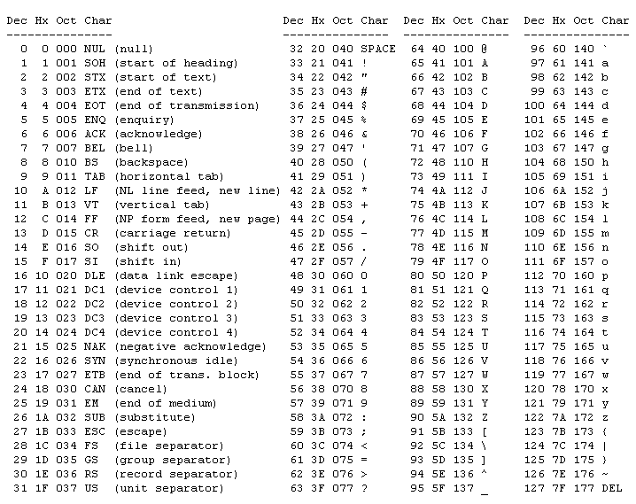
Why
two
codes?
Why
is
this
at
the
end?
What about these?

Slide 46
Fun ASCII Facts
‘A’ = 65 = 41₁₆ = 0100 0001
‘a’ = 97 = 61₁₆ = 0110 0001
‘0’ = 48 = 30₁₆ = 0011 0000
‘1’ = 49 = 31₁₆ = 0011 0001
‘2’ = 50 = 32₁₆ = 0011 0010
…
‘9’ = 57 = 39₁₆ = 0011 1001

Slide 47
Fun ASCII Facts
‘A’ = 65 = 41₁₆ = 0100 0001
Ctl-A = SOH = 1 = 1₁₆ = 0000 0001
…
‘J’ = 74 = 4A₁₆ = 0100 1010
Ctl-J = LF = 10 = A₁₆ = 0000 1010
…
‘M’ = 77 = 4D₁₆ = 0100 1101
Ctl-M = CR = 13 = D₁₆ = 0000 1101

Slide 48
Floating Point

Slide 49
Historically
The Indiana Legislature once passed legislation declaring that the value of π was exactly 3

Slide 50
Historically
Initially hardware manufacturers used whatever they thought was appropriate given their market and/or technology required.
IBM, DEC, CDC, etc. each had their own formats and in fact multiple formats
Typical implementations might range from 32 up to 128 bits. Common to find multiple formats available (i.e. float and double)
1985 IEEE published Floating Point Standard
ANSI/IEEE Standard 754-1985, Standard for Binary Floating Point Arithmetic

Slide 51
How would you do it?

Slide 52
Scientific Notation
Sign of
Exponent
-6.023 x 10⁻²³
Exponent
Sign
Normalized
Mantissa
?
Base

Slide 53
Binary Floating Point Representation
Same basic idea as scientific notation
Modifications and improvements based on a long history: IEEE-754 standard
Precise representation at the bit level
Precise behavior of arithmetic operations
Efficiency (Space & Time)
Additional requirements
Special values: not-a-number, +/-infinity, etc.
Correct rounding
Sortable without FP hardware
3

Slide 54
IEEE-754
31
30 23
22 0
0
00000000
00000000000000000000000
s
i
g
n
exponent
mantissa (significand)
(-1)^{S} * 1.M * 2 ^{E-127}
Sign
1 is understood
Mantissa (w/o leading 1)
Base
Exponent

Slide 55
IEEE-754
0
00000000
00000000000000000000000
s
i
g
n
exponent
mantissa (significand)
(-1)^{S} * 1.M * 2 ^{E-127}
Can any of these equal 0?

Slide 56
So how can we represent 0?
0
00000000
00000000000000000000000
s
i
g
n
exponent
mantissa (significand)
(-1)^{S} * 1.M * 2 ^{E-127}
E == 0
0 < E < 255
E == 255
M==0
0
Powers
of
Two
∞
M!=0
Non-normalized
typically
underflow
Ordinary
Old
Numbers
Not
A
Number

Slide 57
Can be written...
0
00000000
00000000000000000000000
s
i
g
n
exponent
mantissa (significand)
(-1)^{S} * 2 ^{E-127} * 1.M
E == 0
0 < E < 255
E == 255
M==0
0
Powers
of
Two
∞
M!=0
Non-normalized
typically
underflow
Ordinary
Old
Numbers
Not
A
Number

Slide 58
0 00000000 00000000000000000000000
1 00000000 00000000000000000000000
= 0
= -0
0
00000000
00000000000000000000000
s
i
g
n
exponent
mantissa (significand)
(-1)^{S} * 2 ^{E-127} * 1.M
E == 0
0 < E < 255
E == 255
M==0
0
Powers
of
Two
∞
M!=0
Non-normalized
typically
underflow
Ordinary
Old
Numbers
Not
A
Number

Slide 59
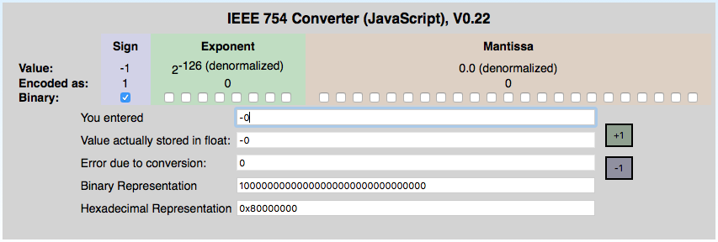
Perhaps Some Automation?
https://www.h-schmidt.net/FloatConverter/IEEE754.html

Slide 60
0 11111111 00000000000000000000000
1 11111111 00000000000000000000000
= Infinity
= -Infinity
0
00000000
00000000000000000000000
s
i
g
n
exponent
mantissa (significand)
(-1)^{S} * 2 ^{E-127} * 1.M
E == 0
0 < E < 255
E == 255
M==0
0
Powers
of
Two
∞
M!=0
Non-normalized
typically
underflow
Ordinary
Old
Numbers
Not
A
Number

Slide 61
0 11111111 00000100000000000000000
1 11111111 00100010001001010101010
= NaN
= NaN
0
00000000
00000000000000000000000
s
i
g
n
exponent
mantissa (significand)
(-1)^{S} * 2 ^{E-127} * 1.M
E == 0
0 < E < 255
E == 255
M==0
0
Powers
of
Two
∞
M!=0
Non-normalized
typically
underflow
Ordinary
Old
Numbers
Not
A
Number

Slide 62
0 10000000 00000000000000000000000
= +1 * 2⁽¹²⁸⁻¹²⁷⁾ * 1.0
= 2
0
00000000
00000000000000000000000
s
i
g
n
exponent
mantissa (significand)
(-1)^{S} * 2 ^{E-127} * 1.M
E == 0
0 < E < 255
E == 255
M==0
0
Powers
of
Two
∞
M!=0
Non-normalized
typically
underflow
Ordinary
Old
Numbers
Not
A
Number

Slide 63
0 10000001 10100000000000000000000
1 10000001 10100000000000000000000
= +1 * 2⁽¹²⁹⁻¹²⁷⁾ * 1.101
= -1 * 2⁽¹²⁹⁻¹²⁷⁾ * 1.101
= 6.5
= -6.5
0
00000000
00000000000000000000000
s
i
g
n
exponent
mantissa (significand)
(-1)^{S} * 2 ^{E-127} * 1.M
E == 0
0 < E < 255
E == 255
M==0
0
Powers
of
Two
∞
M!=0
Non-normalized
typically
underflow
Ordinary
Old
Numbers
Not
A
Number

Slide 64
Edge case for tiny numbers: E==0 is special, so 2⁻¹²⁶ is smallest exponent; we use underflow case for anything smaller, like 2⁻¹²⁷; note E==0 is computed as E==1
0 00000001 00000000000000000000000
0 00000000 10000000000000000000000
= +1 * 2⁽¹⁻¹²⁷⁾ * 1.0
= +1 * 2⁽⁻¹²⁶⁾ * 0.1
= 2⁽⁻¹²⁶⁾
= 2⁽⁻¹²⁷⁾
0
00000000
00000000000000000000000
s
i
g
n
exponent
mantissa (significand)
(-1)^{S} * 2 ^{E-127} * 1.M
E == 0
0 < E < 255
E == 255
M==0
0
Powers
of
Two
∞
M!=0
Non-normalized
typically
underflow
Ordinary
Old
Numbers
Not
A
Number

Slide 65
0 00000000 00000000000000000000001
= +1 * 2⁽⁻¹²⁶⁾ * 0.00000000000000000000001
= 2⁽⁻¹⁴⁹⁾ (Smallest positive value)
0
00000000
00000000000000000000000
s
i
g
n
exponent
mantissa (significand)
(-1)^{S} * 2 ^{E-127} * 1.M
E == 0
0 < E < 255
E == 255
M==0
0
Powers
of
Two
∞
M!=0
Non-normalized
typically
underflow
Ordinary
Old
Numbers
Not
A
Number

Slide 66
0
00000000
00000000000000000000000
s
i
g
n
exponent
mantissa (significand)
(-1)^{S} * 2 ^{E-127} * 1.M
0 11111111 00000100000000000000000 = NaN
1 11111111 00100010001001010101010 = NaN
0 11111111 00000000000000000000000 = Infinity
0 10000001 10100000000000000000000 = +1 * 2⁽¹²⁹⁻¹²⁷⁾ * 1.101 = 6.5
0 10000000 00000000000000000000000 = +1 * 2⁽¹²⁸⁻¹²⁷⁾ * 1.0 = 2
0 00000001 00000000000000000000000 = +1 * 2⁽¹⁻¹²⁷⁾ * 1.0 = 2⁽⁻¹²⁶⁾
0 00000000 10000000000000000000000 = +1 * 2⁽⁻¹²⁶⁾ * 0.1 = 2⁽⁻¹²⁷⁾
0 00000000 00000000000000000000001
= +1 * 2⁽⁻¹²⁶⁾ * 0.00000000000000000000001
= 2⁽⁻¹⁴⁹⁾ (Smallest positive value)
0 00000000 00000000000000000000000 = 0
1 00000000 00000000000000000000000 = -0
1 10000001 10100000000000000000000 = -1 * 2⁽¹²⁹⁻¹²⁷⁾ * 1.101 = -6.5
1 11111111 00000000000000000000000 = -Infinity

Slide 67
Smallest positive normalized number
0 00000001 00000000000000000000000 = +1 * 2⁽¹⁻¹²⁷⁾ * 1.0 = 2⁽⁻¹²⁶⁾
0
00000000
00000000000000000000000
s
i
g
n
exponent
mantissa (significand)
(-1)^{S} * 2 ^{E-127} * 1.M
E == 0
0 < E < 255
E == 255
M==0
0
Powers
of
Two
∞
M!=0
Non-normalized
typically
underflow
Ordinary
Old
Numbers
Not
A
Number

Slide 68
Next smallest positive number below 2-126
0 00000000 11111111111111111111111
= +1 * 2⁽⁻¹²⁶⁾ * 0.11111111111111111111111
0
00000000
00000000000000000000000
s
i
g
n
exponent
mantissa (significand)
(-1)^{S} * 2 ^{E-127} * 1.M
E == 0
0 < E < 255
E == 255
M==0
0
Powers
of
Two
∞
M!=0
Non-normalized
typically
underflow
Ordinary
Old
Numbers
Not
A
Number

Slide 69
Why not E=-127?
0 00000001 00000000000000000000000 = +1 * 2⁽¹⁻¹²⁷⁾ * 1.0 = 1.0 x 2⁽⁻¹²⁶⁾
0 00000000 11111111111111111111111
= +1 * 2⁽⁻¹²⁶⁾ * 0.11111111111111111111111
0 00000000 00001000000000000000000
= +1 + 2⁽⁻¹²⁶⁾ * 0.00001 = 2⁽⁻¹³¹⁾
If exponent was -127
2⁽⁻¹²⁷⁾ * 0.11111111111111111111111 or
2⁽⁻¹²⁶⁾ * 0.011111111111111111111111
E == 0
M!=0
Non-normalized
typically
underflow

Slide 70
Conversion
In CS 1331 we noted:
float f;
int i;
f = i;
i = (int)f;
What does this imply?
Converting floats to ints we may lose information
Converting ints to floats we may lose information
Converting either way we may lose information

Slide 71
#include <stdio.h>
int main()
{
float f;
int i = 1234567897;
int j;
f = i;
j = (int)f;
printf("i = %d f = %f j = %d\n", i, f, j);
return 0;
}
$ ./demo
i = 1234567897 f = 1234567936.000000 j = 1234567936

Slide 72
Reality
Int: 0000000000000000000000000000000
Float: 0 00000000 0000000000000000000000

Slide 73
IEEE-754 Double
0
1 11
12 63
0
000...00
000000000...00000000000
s
i
g
n
exponent
mantissa (significand)
(-1)^{S} * 1.M * 2 ^{E-1023}
Sign
1 is understood
Mantissa (w/o leading 1)
Base
Exponent

Slide 74
Specials
0
1 11
12 63
0
00000000
00000000000000000000000
s
i
g
n
exponent
mantissa (significand)
(-1)^{S} * 1.M * 2 ^{E-1023}
E == 0
0 <E< 2047
E == 2047
M==0
0
Powers
of
Two
∞
M!=0
Non-normalized
typically
underflow
Ordinary
Old
Numbers
Not
A
Number

Slide 75
Double (64 bits)
31
Int: 0000000000000000000000000000000
Double: 0 000...00 000000000...0000000000
11
52

Slide 76
#include <stdio.h>
int main()
{
double d;
int i = 1234567897;
int j;
d = i;
j = (int)d;
printf("i = %d d = %f j = %d\n", i, d, j);
return 0;
}
./demo
i = 1234567897 d = 1234567897.000000 j = 1234567897

Slide 77
Comparing FP Numbers
The layout of the formula allows certain operations (like > ) to be performed with no conversion
Compare:
3.67 x 10¹⁴
2.89 x 10¹⁶
Note the one with the bigger exponent must be bigger. You don't need to look at the mantissa.

Slide 78
Comparing FP Numbers
Examine signs
If different “+” number is bigger
If both “+” compare magnitudes, bigger magnitude is bigger number
If both “-” compare magnitudes, smaller magnitude is bigger number

Slide 79
Bitwise Review
Can only be applied to integral operands
that is, char, short, int and long
(signed or unsigned)
& Bitwise AND
| Bitwise OR
^ Bitwise XOR
<< Shift Left
>> Shift Right
~ 1’s Complement (Inversion)

Slide 80
Bitwise Quiz
1 && 2
True! (1)
1 & 2
0
x << -2 Legal?
No!
x << 2 Write it another way?
x * 4
What does right shifting do to signed vars?
depends
x = x & ~077
Sets last six bits of x to zero!

Slide 81
Bitwise Quiz
Why is x = x & ~077 better than
x = x & 0177700
First one is independent of word length
(no extra cost...evaluated at compile time)
What does this do?
(x >> (p+1-n)) & ~(~0 << n);
/* getbits: get n bits from position p */
unsigned getbits(unsigned x, int p, int n)
{
return (x >> (p+1-n)) & ~(~0 << n);
}

Slide 82
Why is x = x & ~077 better than x = x & 0177700
x = 1010101010101010
077 = 0000000000111111
~077 = 1111111111000000
x = 1010101010101010
~077 = 1111111111000000
1010101010000000
&

Slide 83
Why is x = x & ~077 better than x = x & 0177700
x = 1010101010101010
0177700 = 1111111111000000
x = 1010101010101010
0177700 = 1111111111000000
1010101010000000
&

Slide 84
But what if the word size is bigger than 16 bits?

Slide 85
Why is x = x & ~077 better than x = x & 0177700
x = 11110000111100001010101010101010
077 = 00000000000000000000000000111111
~077 = 11111111111111111111111111000000
x = 11110000111100001010101010101010
~077 = 11111111111111111111111111000000
11110000111100001010101010000000
&

Slide 86
Why is x = x & ~077 better than x = x & 0177700
x = 11110000111100001010101010101010
0177700 = 00000000000000001111111111000000
x = 11110000111100001010101010101010
0177700 = 00000000000000001111111111000000
00000000000000001010101010000000
&

Slide 87
/* getbits: get n bits from position p */ unsigned getbits(unsigned x, int p, int n) { return (x >> (p+1-n)) & ~(~0 << n); }
3322222222221111111111
10987654321098765432109876543210
00101010100100101010101101010101
(x >> (p+1-n)) ==> (x >> (15+1-3))
(x >> 13)
00000000000000010101010010010101
~0
11111111111111111111111111111111
~0 << n ==> ~0 << 3
11111111111111111111111111111000
~(~0 << 3)
00000000000000000000000000000111
&

Slide 88
Questions?

