Slide 1
Digital Logic I

Slide 2
Outline
Transistors
Logic Gates
NOT, OR, NOR, AND, NAND
DeMorgan's Law
Larger Gates
Combinational Logic Circuits
Decoder, MUX, Full Adder, PLA,
Logical Completeness
Basic Storage Elements
R-S Latch, Gated D latch, Register

Slide 3
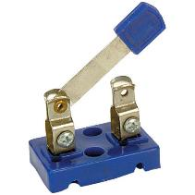

Nomenclature
Open Switch
No current can flow
Closed Switch
Current can flow

Slide 4
Our Story Begins

Slide 5
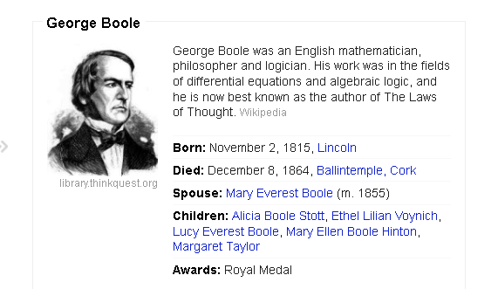
Boolean Algebra

Slide 6
Communication at a Distance

Slide 7
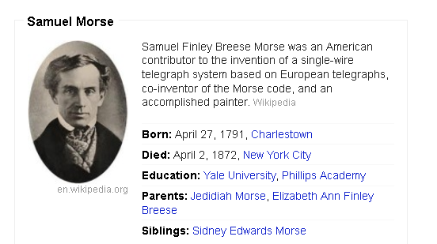
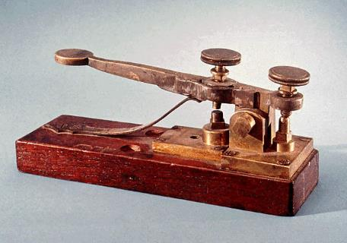
Telegraph

Slide 8
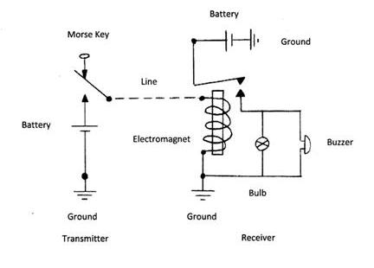

Slide 9
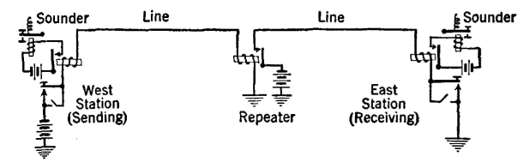
Repeater

Slide 10
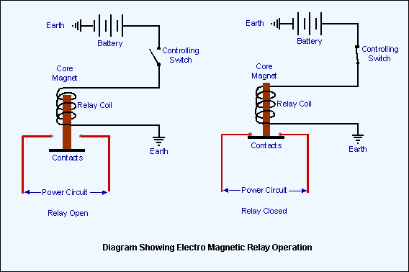
Relay
Normally
Open

Slide 11
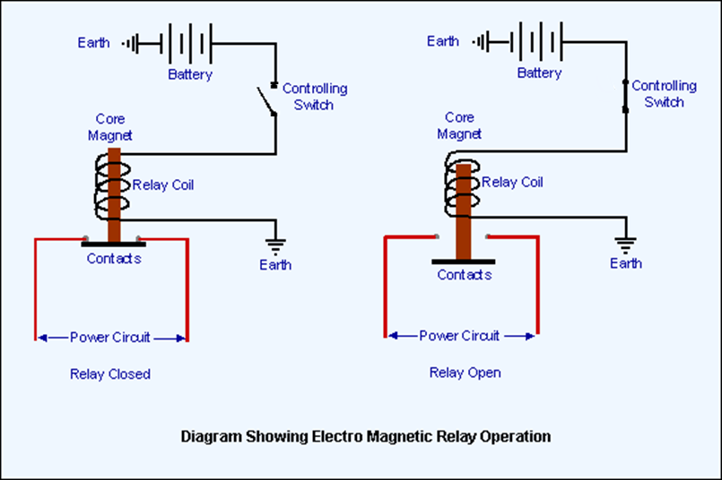
Relay
Normally
Closed

Slide 12
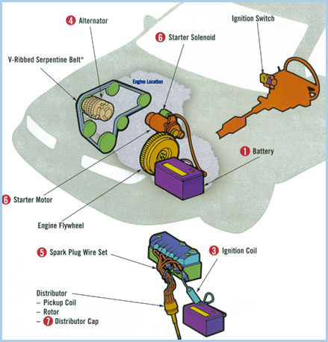

Slide 13
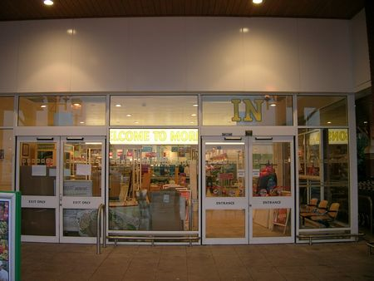
Safety First

Slide 14
How do we make it work?
Someone
is standing
in door
swing area
sensor
Someone
wants to go
into store
sensor
JUICE
MOTOR

Slide 15
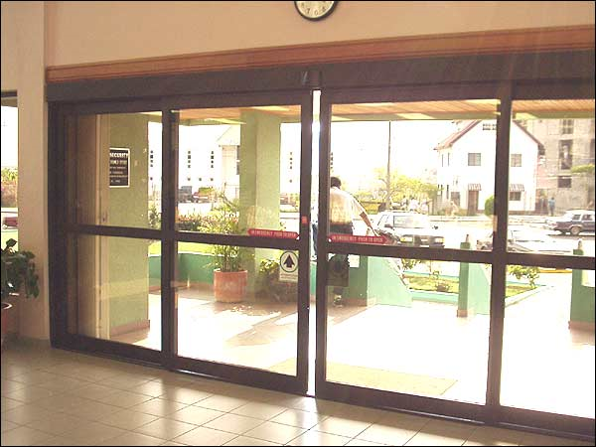

Slide 16
How do we make it work?
Someone
wants to go
into store
sensor
Someone
wants to leave
store
sensor
JUICE
MOTOR

Slide 17
Reach Out and Touch Someone
Problem: How do you talk to someone who is very far away?

Slide 18
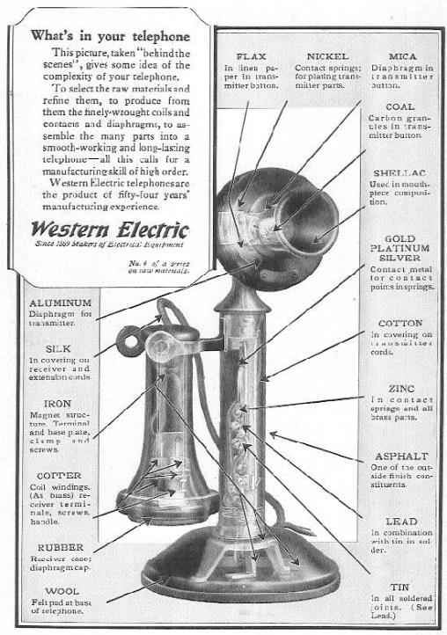

Slide 19
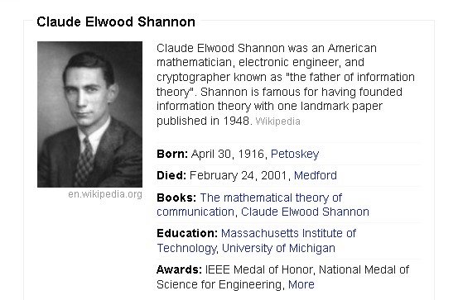
Claude Shannon

Slide 20
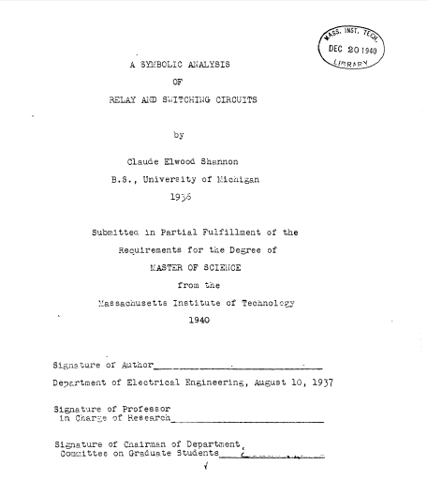
Claude
Shannon’s
Masters
Thesis

Slide 21
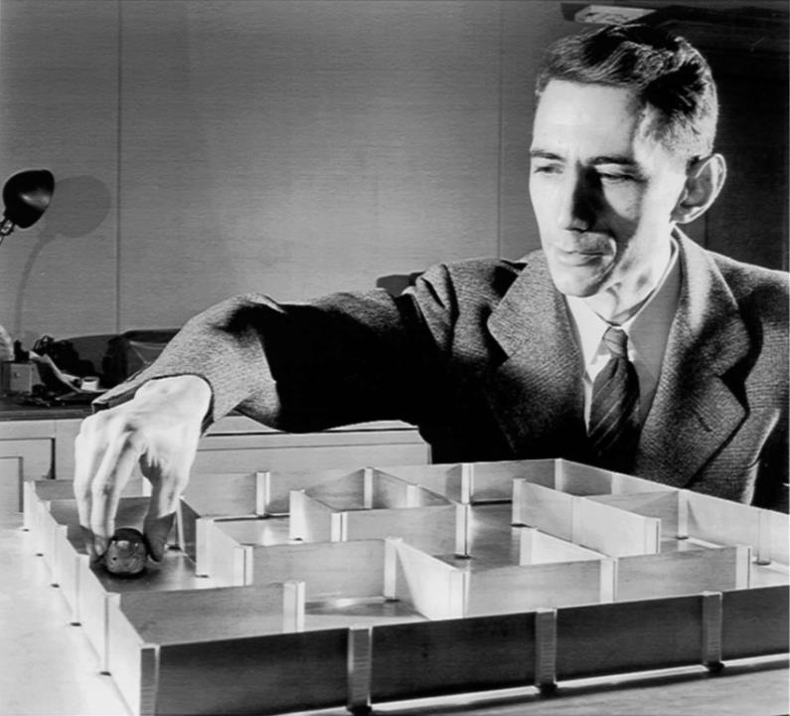

Slide 22
But...
Relays are
Slow
Good for hundreds of thousands of cycles
Wear out
Big
Noisy
So...

Slide 23
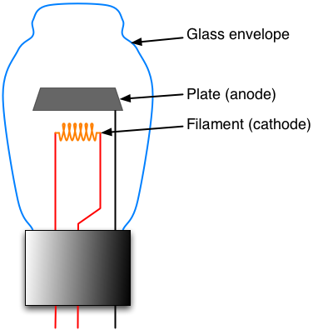
Tubes
Diode

Slide 24
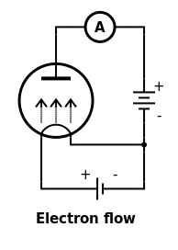
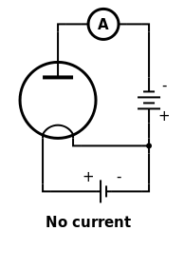
Edison Effect (Thermionic Emission)
User:Omegatron - https://secure.wikimedia.org/wikipedia/commons/wiki/File:Edisoneffect.png

Slide 25
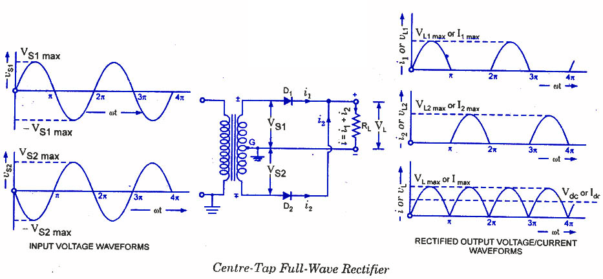

Slide 26
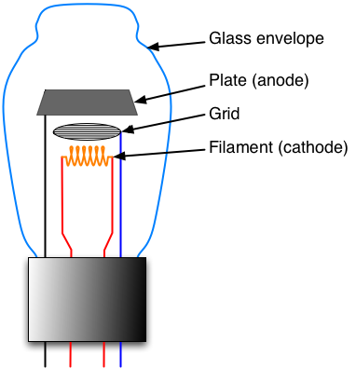
Tubes
Triode

Slide 27
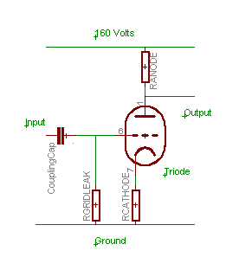

Slide 28
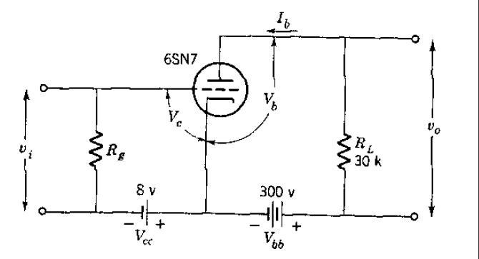

Slide 29
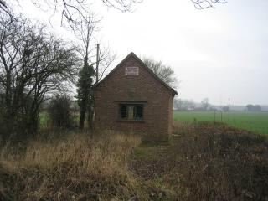

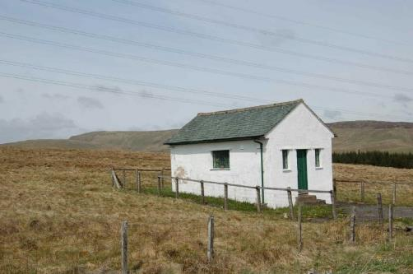
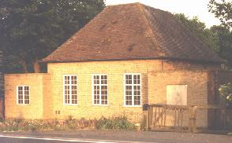

Slide 30
Vacuum Tubes
Used as
Switches
Amplifiers
In
Radio
Television
Stereo
Radar
Computers

Slide 31
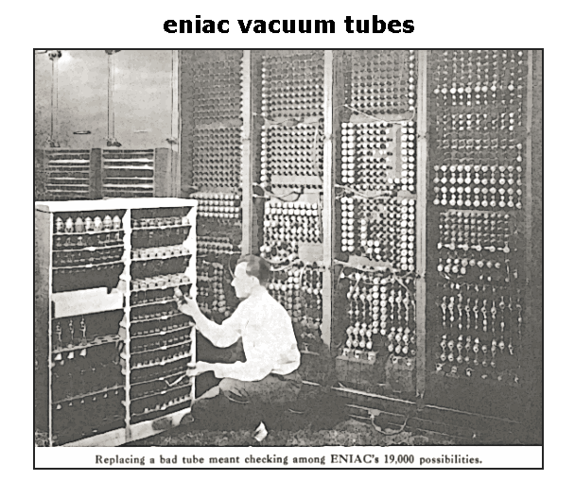

Slide 32
But…
Tubes are
Hot
High power consumption
High voltages
Unreliable
Expensive
Consist of many individual components
So...

Slide 33
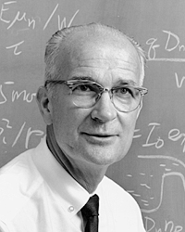
William Shockley
Born February 13, 1910 Greater London, England, UK
Died August 12, 1989 (aged 79) Stanford, California, US
Nationality American
Alma mater MIT, Caltech
Known for
Point-contact transistor and BJT
Shockley diode equation
Read-Shockley equation
Shockley–Ramo theorem
Haynes-Shockley experiment
Shockley–Queisser limit
Awards
Nobel Prize in Physics (1956)
Comstock Prize in Physics (1953)
Oliver E. Buckley Condensed Matter Prize (1953)
Wilheln Exner Medal (1963)
IEEE Medal of Honor (1980)

Slide 34
So to save money...
OFF
N
+
P
N

Slide 35
Transistors
ON
N
+
P
N
+

Slide 36
Different Switches
OFF
OFF
+
+
A physical switch
An electronic switch

Slide 37
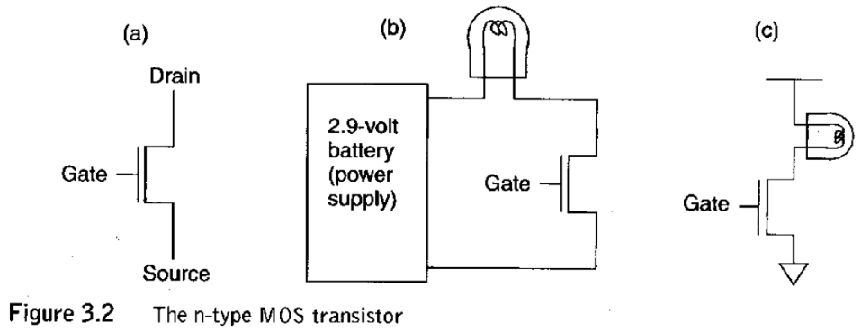
Transistors & Circuits

Slide 38
Complementary Transistors
Source
Source
Gate
Gate
Drain
Drain
n-Type MOS
p-Type MOS

Slide 39
Common Misconception: Digital Wires Have Just 2 States!
A wire with some designated voltage (e.g. +2.9 volts) can represent a logical 1.
A wire with some designated voltage (e.g. 0 volts or ground) can represent a logical 0.
A wire that is not connected to 2.9 volts or ground is said to be floating or in a high impedance state and its value can randomly vary from a logical 0 to 1.

Slide 40




Transistor Comparison
n-Type
(normally open)
p-Type
(normally closed)
2.9 volts
2.9 volts
(normally)
without power
to the gate
0 volts
0 volts
? volts
2.9 volts
2.9 volts
2.9 volts
with power
to the gate
2.9 volts
2.9 volts
2.9 volts
? volts

Slide 41
N-type MOS FET*
GND
GND
V_{cc}
Source
Gate
Drain
P-type substrate
N-type
*Metal Oxide Semiconductor Field Effect Transistor

Slide 42
Gate Closed
GND
GND
V_{cc}
Source
Gate
Drain
-
-
-
P-type substrate
N-type
Channel

Slide 43
Gate Open
GND
V_{cc}
V_{cc}
Source
Gate
Drain
-
-
-
P-type substrate
N-type
Channel

Slide 45
Nomenclature
Open Switch
No current can flow
Closed Switch
Current can flow

Slide 46
N-Type MOS
Source
Gate
Drain

Slide 47

CircuitSim N-Type MOS
Source
Gate
Drain

Slide 48
OFF
+

Slide 49
OFF
+
NORMALLY OPEN
How does transistor behave
when gate is at ground?
Actually

Slide 50
+V
ON
+V
With the supply voltage applied to the device the transistor acts like a closed or connected switch

Slide 51
+V
OFF
Open

Slide 52
P-Type MOS
Source
Gate
Drain

Slide 53

CircuitSim P-Type MOS
Source
Gate
Drain

Slide 54
ON
+
NORMALLY CLOSED
How does transistor behave
when gate is at ground?
Actually

Slide 55
+V
OFF
+V
With the supply voltage applied to the device the transistor acts like a open or disconnected switch

Slide 56
+V
ON
Closed

Slide 57
Inverter (Not)

Slide 58
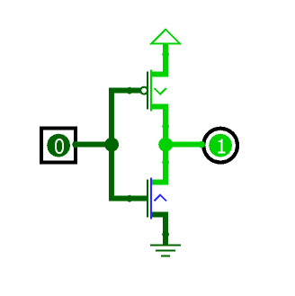
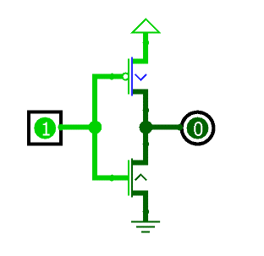
CircuitSim Inverter

Slide 59
NOR

Slide 60
OR

Slide 61
NAND

Slide 62
AND

Slide 63
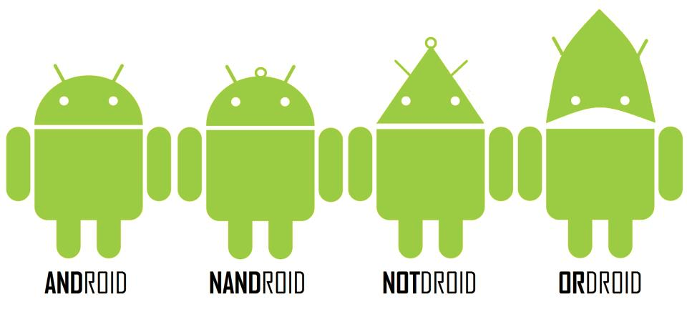

Slide 64


Slide 65
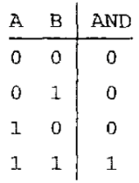
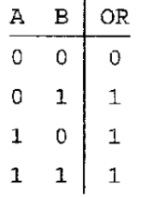
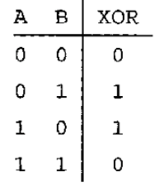
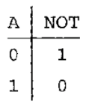




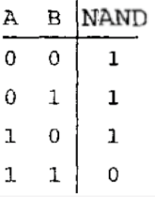
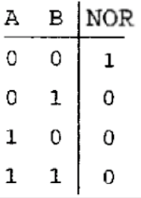


Logical Operations Revisited

Slide 66
Boolean Gate Representation

Slide 67
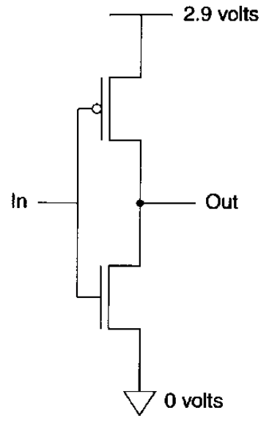
NOT Gate (Inverter)

Slide 68
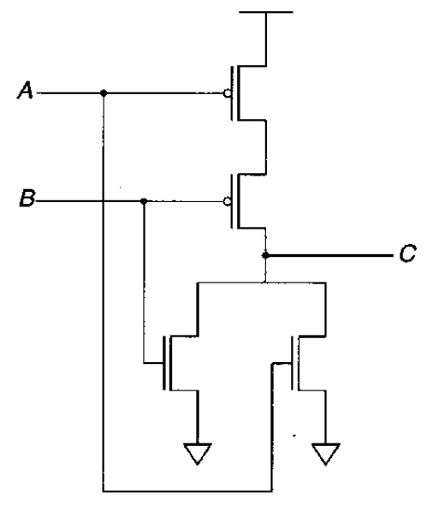
NOR Gates...

Slide 69
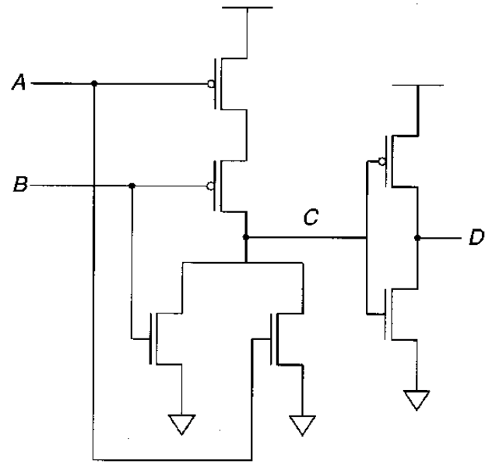
… OR Gates

Slide 70
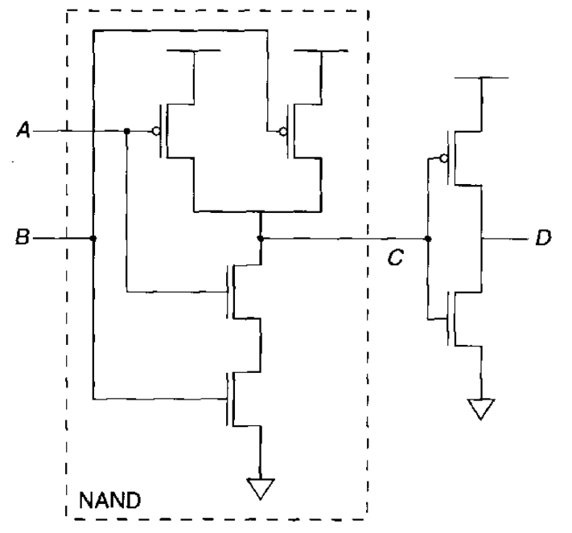
NAND and AND Gates

Slide 71
But...
Discrete transistors
Are still big
Use a lot of material to build
Use a lot of power (and hence generate a lot of heat); however smaller transistors need smaller amounts of power
Need a lot of individual connections, all of which are prone to failure
Are so useful that we need lots of them
So...

Slide 72
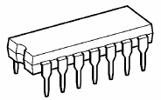
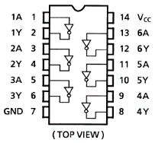
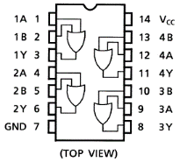
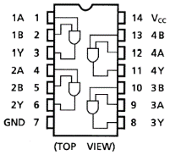
Digital Logic: Building Blocks
The basic digital logic building blocks are available as pre-packaged self-contained integrated circuits.
These chips are fast, inexpensive and easy to work with.
Each chip contains 1-6 gates. Complicated designs can require thousands of gates and hundreds of chips.
6 NOT Gates
74HC04
4 OR Gates
74HC32
4 AND Gates
74HC08

Slide 73
DeMorgan's Law
(A'B')' = A+B
(A'+B')' = AB
A | B | A' | B' | A'B' | (A'B')' | A'+B' | (A'+B')' | A+B | AB
0 | 0 | 1 | 1 | 1 | 0 | 1 | 0 | 0 | 0
0 | 1 | 1 | 0 | 0 | 1 | 1 | 0 | 1 | 0
1 | 0 | 0 | 1 | 0 | 1 | 1 | 0 | 1 | 0
1 | 1 | 0 | 0 | 0 | 1 | 0 | 1 | 1 | 1

Slide 74
Conte Bubble Theorem

Slide 75
Larger gates
A
B
C
A
B
C
ABC
A(BC)

Slide 76
Larger gates
A
B
C
D
A
B
C
D
(A(B(CD)))
ABCD
A
B
C
D
((AB)(CD))

Slide 77
Larger gates
A
B
A
B
C
C
A B C (ABC)’ (AB)’ ((AB)’C)’
0 0 0 1 1 1
0 0 1 1 1 0
0 1 0 1 1 1
0 1 1 1 1 0
1 0 0 1 1 1
1 0 1 1 1 0
1 1 0 1 0 1
1 1 1 0 0 1

Slide 78
Larger gates
A
B
A
B
C
C
A B C (ABC)’ (AB)’ AB ABC (ABC)’
0 0 0 1 1 0 0 1
0 0 1 1 1 0 0 1
0 1 0 1 1 0 0 1
0 1 1 1 1 0 0 1
1 0 0 1 1 0 0 1
1 0 1 1 1 0 0 1
1 1 0 1 0 1 0 1
1 1 1 0 0 1 1 0

Slide 79
Fan-In and Fan-Out
Fan In 3
Fan Out 2

Slide 80
Warning
Important concept approaching!

Slide 81
Combinational Logic
A combination of AND, OR, NOT (plus NAND & NOR)
Same inputs always produce same output

Slide 82
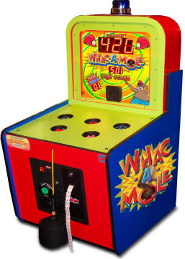

Slide 83

Fun!

Slide 84
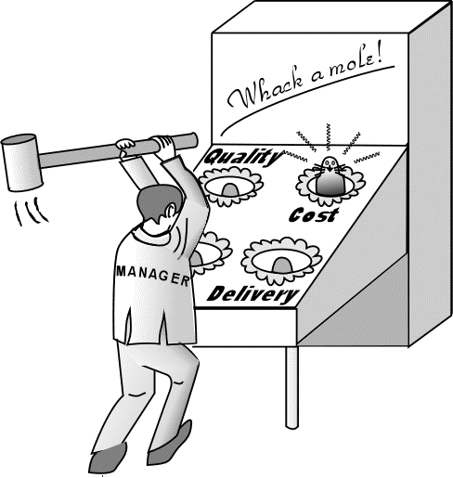

Slide 85

Problem
You have an n bit binary number which signifies which mole is selected. How do we electrically actuate the desired mole?
[Csim]

Slide 86
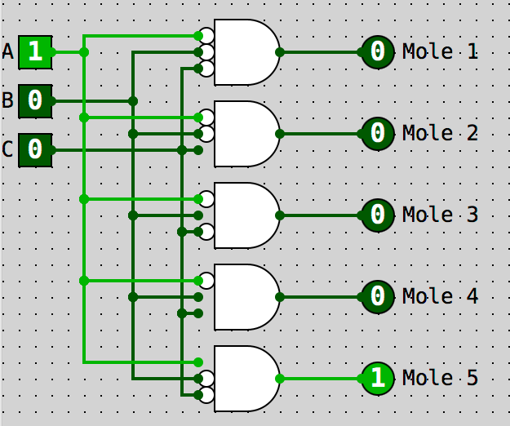
Decoder

Slide 87
Question
If you had a decoder with a 5 bit input (i.e. a 5 bit binary number) how many outputs would the decoder have?
5
10
16
32
64

Slide 88
Question
If you had a decoder with n input bits (i.e. an n bit binary number) how many outputs would the decoder have?
2n
n²
2^{n}
Cannot determine
4

Slide 89
Problem
You have s signals and you want to use the logical value on one of them determined by a set of n control wires
m
n
out

Slide 90
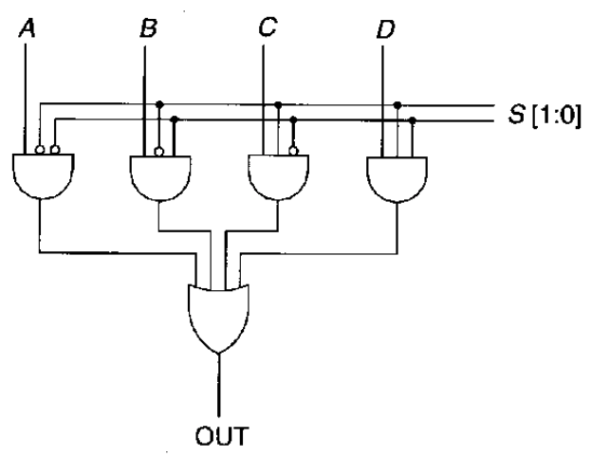
Multiplexers

Slide 91
Question
The basic multiplexor has
n outputs, n control lines, 2^{n} inputs
1 output, 2n control lines, n inputs
1 output, n control lines, 2^{n} inputs
2^{n} outputs, 2 control lines, n inputs
1 output, 4 control lines, 2 inputs

Slide 92
Problem
No one will buy your new computer design unless it can do at least some math, say, like adding!

Slide 93
Simple Adder
A
B
OUT

Slide 94
Half Adder
A
B
Carry OUT
OUT

Slide 95
Full Adder
A
B
Carry OUT
Carry IN
OUT

Slide 96
Truth
A | B | Carry In | Out | Carry Out
0 | 0 | 0
0 | 0 | 1
0 | 1 | 0
0 | 1 | 1
1 | 0 | 0
1 | 0 | 1
1 | 1 | 0
1 | 1 | 1

Slide 97
Truth
A | B | Carry In | Out | Carry Out
0 | 0 | 0 | 0 | 0
0 | 0 | 1 | 1 | 0
0 | 1 | 0 | 1 | 0
0 | 1 | 1 | 0 | 1
1 | 0 | 0 | 1 | 0
1 | 0 | 1 | 0 | 1
1 | 1 | 0 | 0 | 1
1 | 1 | 1 | 1 | 1

Slide 98
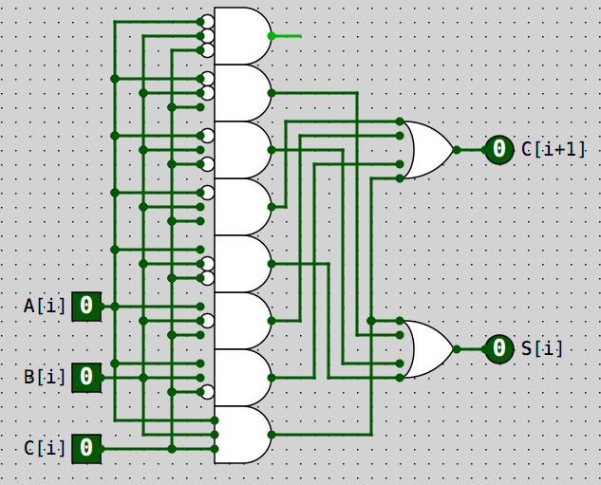
Full Adder
Don’t really need this gate

Slide 99
The No Thinking Method!
Go buy a full-adder IC chip from Frys.

Slide 100
Boolean Simplification

Slide 101





Boolean Simplification
DeMorgan’s Laws

Slide 102
AB + A’ → B + A’
A | B | AB | A’ | AB+A’ | B+A’
0 | 0 | 0 | 1 | 1 | 1
0 | 1 | 0 | 1 | 1 | 1
1 | 0 | 0 | 0 | 0 | 0
1 | 1 | 1 | 0 | 1 | 1

Slide 103
Consider This Circuit
A | B | C | OUT
0 | 0 | 0 | 1
0 | 0 | 1 | 1
0 | 1 | 0 | 0
0 | 1 | 1 | 0
1 | 0 | 0 | 1
1 | 0 | 1 | 1
1 | 1 | 0 | 0
1 | 1 | 1 | 0

Slide 104

Implement the Truth Table

Slide 105
Classic Simplification
F = A’B’C’ + A’B’C + AB’C’ + AB’C
F = A’B’(C’+C) + AB’(C’+C)
F = A’B’ + AB’
F = B’(A’+A)
F = B’

Slide 106

Quite a Simplification, No?

Slide 107
Something to Note
We are used to writing sum-of-products with algebraic polynomials, e.g.
X³ + 4X² + 2X + 12
Turns out that truth tables (and other forms) naturally yield boolean expressions in sum-of-products form, e.g.
ABC + ABC’ + A’BC + A’B’C’
This turns out to be very convenient for implementing circuits

Slide 108
Equivalence!
Boolean Expression
Truth Table
Combinational Circuit
Karnaugh Map
You can change between ANY of these forms without losing information!

Slide 109
Karnaugh Maps
Resources:
http://electronics-course.com/karnaugh-map
http://www.32x8.com/circuits7

Slide 110
Question
Can you convert
A Karnaugh map to a combinational circuit?
A truth table to a Karnaugh map
A truth table to a combinational circuit?
A Boolean expression into a Karnaugh map?
A Boolean expression into a truth table?
A truth table into a Boolean expression?

Slide 111
Truth Table
A | OUT
0 | x
1 | y

Slide 112
1 Variable Karnaugh Map
A’ | A
What is the output if A is false? | What is the output if A is true?
What does it mean if both boxes contain 1?

Slide 113
1 Variable Karnaugh Map
A’ | A
x | y
What does it mean if both boxes contain 1?

Slide 114
Map: OUT = A’
A’ | A

Slide 115
Truth Table: OUT = A’
A | OUT
0 | 1
1 | 0

Slide 116
Map: OUT = A’
A’ | A
1 | 0

Slide 117
2-Variable Truth Table
A | B | OUT
0 | 0 | X₀
0 | 1 | X₁
1 | 0 | X₂
1 | 1 | X₃

Slide 118
2-Variable K-Map
 | B’ | B
A’ | What is the output if both A and B are false? | What is the output if A is false and B is true?
A | What is the output if A is true and B is false? | What is the output if both A and B are true?

Slide 119
2-Variable K-Map
 | B’ | B
A’ | X₀ | X₁
A | X₂ | X₃

Slide 120
Map: OUT = A’B’ + AB
 | B’ | B
A’
A

Slide 121
Map: OUT = A’B’ + AB
 | B’ | B
A’ | 1 | 0
A | 0 | 1
Can this expression be simplified?

Slide 122
Map: OUT = A’B’ + AB’
 | B’ | B
A’
A

Slide 123
Map: OUT = A’B’ + AB’
 | B’ | B
A’ | 1 | 0
A | 1 | 0
Can this expression be simplified?

Slide 124
Segue
Suppose you had to give a series of 3 bit codes to disarm the detonation sequence of a nuclear device you were sitting on.
There would be 8 codes and they had to go in a certain sequence picked by you.
Any deviation would result in an immediate detonation of the nuclear device
What codes in what order do you use?

Slide 125
Classic Sequence
000
001
010
011
100
101
110
111

Slide 126
Gray Code Sequence
000 001 011 010 110 111 101 100

Slide 127
Optical Encoder
0
1
2
3
4
5
6
7

Slide 128
Gray Code Optical Encoder
0
1
2
3
4
5
6
7

Slide 129

3-bit Gray Code
000 001 011 010 110 111 101 100

Slide 130
2-bit Gray Code
00 01 11 10

Slide 131
4-bit Gray Code
0000 0001 0011 0010 0110 0111 0101 0100 1100 1101 1111 1110 1010 1011 1001 1000

Slide 132
3-Variable Truth Table
A | B | C | OUT
0 | 0 | 0 | X₀
0 | 0 | 1 | X₁
0 | 1 | 0 | X₂
0 | 1 | 1 | X₃
1 | 0 | 0 | X₄
1 | 0 | 1 | X₅
1 | 1 | 0 | X₆
1 | 1 | 1 | X₇

Slide 133
Map: A’B’C + A’BC + ABC
 | B’C’ (00) | B’C (01) | BC (11) | BC’ (10)
A’ (0) | X₀ | X₁ | X₃ | X₂
A (1) | X₄ | X₅ | X₇ | X₆

Slide 134
Map: A’B’C + A’BC + ABC
 | B’C’ | B’C | BC | BC’
A’ | 0 | 1 | 1 | 0
A | 0 | 0 | 1 | 0
Can this expression be simplified?

Slide 135
Map: A’B’C + A’BC + ABC
 | B’C’ | B’C | BC | BC’
A’ | 0 | 1 | 1 | 0
A | 0 | 0 | 1 | 0
Can this expression be simplified?

Slide 136
Simplifying
A’B’C + A’BC + ABC
Result of removing a variable
A’C(B’ + B) + ABC
A’C + ABC

Slide 137
Map: A’C + ABC
 | B’C’ | B’C | BC | BC’
A’ | 0 | 1 | 1 | 0
A | 0 | 0 | 1 | 0
Can this expression be simplified: A’C + BC

Slide 138
Simplifying
A’B’C + A’BC + ABC
Result of removing a variable
A’C(B’ + B) + ABC
A’C + ABC
C(A’ + AB)
C(A’+B)
A’C + BC

Slide 139
Map: A’B’C’ + ABC’ + AB’C’ + A’BC’
 | B’C’ | B’C | BC | BC’
A’ | X₀ | X₁ | X₃ | X₂
A | X₄ | X₅ | X₇ | X₆

Slide 140
Map: A’B’C’ + ABC’ + AB’C’ + A’BC’
 | B’C’ | B’C | BC | BC’
A’ | 1 | 0 | 0 | 1
A | 1 | 0 | 0 | 1
Can this expression be simplified?

Slide 141

Wrap!!!

Slide 142
Map: A’B’C’ + ABC’ + AB’C’ + A’BC’
 | B’C’ | B’C | BC | BC’
A’ | 1 | 0 | 0 | 1
A | 1 | 0 | 0 | 1
Expression simplifies to C’

Slide 143
4-Variable Truth Table
A | B | C | D | OUT
0 | 0 | 0 | 0
0 | 0 | 0 | 1
0 | 0 | 1 | 0
0 | 0 | 1 | 1
0 | 1 | 0 | 0
0 | 1 | 0 | 1
0 | 1 | 1 | 0
0 | 1 | 1 | 1
1 | 0 | 0 | 0
1 | 0 | 0 | 1
1 | 0 | 1 | 0
1 | 0 | 1 | 1
1 | 1 | 0 | 0
1 | 1 | 0 | 1
1 | 1 | 1 | 0
1 | 1 | 1 | 1

Slide 144

4-Variable K-Map
 | C’D’ | C’D | CD | CD’
A’B’
A’B
AB
AB’

Slide 145
4-Variable Truth Table
A | B | C | D | OUT
0 | 0 | 0 | 0 | 1
0 | 0 | 0 | 1 | 0
0 | 0 | 1 | 0 | 1
0 | 0 | 1 | 1 | 0
0 | 1 | 0 | 0 | 0
0 | 1 | 0 | 1 | 0
0 | 1 | 1 | 0 | 0
0 | 1 | 1 | 1 | 0
1 | 0 | 0 | 0 | 1
1 | 0 | 0 | 1 | 0
1 | 0 | 1 | 0 | 1
1 | 0 | 1 | 1 | 0
1 | 1 | 0 | 0 | 0
1 | 1 | 0 | 1 | 0
1 | 1 | 1 | 0 | 0
1 | 1 | 1 | 1 | 0

Slide 146
Map: A’B’C’D’ + AB’CD’ + AB’C’D’ + A’B’CD’
 | C’D’ | C’D | CD | CD’
A’B’
A’B
AB
AB’

Slide 147
Map: A’B’C’D’ + AB’CD’ + AB’C’D’ + A’B’CD’
 | C’D’ | C’D | CD | CD’
A’B’ | 1 |  |  | 1
A’B
AB
AB’ | 1 |  |  | 1
Can this expression be simplified?

Slide 148
Map: A’B’C’D’ + AB’CD’ + AB’C’D’ + A’B’CD’
 | C’D’ | C’D | CD | CD’
A’B’ | 1 |  |  | 1
A’B
AB
AB’ | 1 |  |  | 1
Simplifies to B’D’

Slide 149
Each Pair Eliminates 1 Variable
 | C’D’ | C’D | CD | CD’
A’B’
A’B | 1 |  |  | 1
AB |  | 1
AB’ |  | 1
Simplifies to A’BD’ + AC’D

Slide 150
Eliminates 2 Variables
 | C’D’ | C’D | CD | CD’
A’B’
A’B
AB |  | 1 | 1
AB’ |  | 1 | 1
Simplifies to AD

Slide 151
Eliminates 3 Variables
 | C’D’ | C’D | CD | CD’
A’B’ | 1 |  |  | 1
A’B | 1 |  |  | 1
AB | 1 |  |  | 1
AB’ | 1 |  |  | 1
Simplifies to D’

Slide 152
Eliminates 3 Variables
 | C’D’ | C’D | CD | CD’
A’B’
A’B | 1 | 1 | 1 | 1
AB | 1 | 1 | 1 | 1
AB’
Simplifies to B

Slide 153
Don’t care: Eliminates 3 Variables
 | C’D’ | C’D | CD | CD’
A’B’
A’B | 1 | 1 | 1 | 1
AB | X | 1 | 1 | 1
AB’ | X

Slide 154
Five Variable
E' | C’D’ | C’D | CD | CD’
A’B’
A’B
AB
AB’
E | C’D’ | C’D | CD | CD’
A’B’
A’B
AB
AB’

Slide 155
6 Variable
 | F’ | F
E’
E
 | C’D’ | C’D | CD | CD’
A’B’
A’B
AB
AB’
 | C’D’ | C’D | CD | CD’
A’B’
A’B
AB
AB’
 | C’D’ | C’D | CD | CD’
A’B’
A’B
AB
AB’
 | C’D’ | C’D | CD | CD’
A’B’
A’B
AB
AB’

Slide 156
Same Data, Different Form
Combinational Logic Circuit
Boolean Expression
Truth Table
Karnaugh Map

Slide 157
TRUTH
TABLE
CIRCUIT
KARNAUGH
MAP
BOOLEAN
EXPRESSION

Slide 158
PLA/PGA
Given a truth table we can implement it using output using a series of NOT gates, AND gates and then OR gates (remember sum-of-products?)
We need 2^{n} AND gates where n is the number of inputs
How many rows does the truth table have?
We need one OR gate for each output
General purpose Programmable Logic Array or Programmable Gate Array devices exist for this purpose

Slide 159
Interconnections

Slide 160
Warning
Another big concept approaching!

Slide 161
Combinational vs. Sequential Logic
Combinational
Combination of AND, OR, NOT (plus NAND & NOR)
Same inputs always produce same output
Analogous to cheap bicycle lock
Sequential
Requires storage elements
Output depends on inputs plus state
Analogous to a RLR combination lock
Used to build memory & state machines

Slide 162

So What is State?

Slide 163

State or No State?

Slide 164
Sequential Logic Circuit
Input
Combinational
Logic Circuit
Output
???
Storage
Elements

Slide 165
Basic Storage
Consider:

Slide 166

R/S Latch

Slide 167
Question
What happens if both inputs to the R/S latch are 0?

Slide 168
Gated D Latch
The RS Latch can be set or cleared but what if we want to record the value on the input?
Value of
Interest
Stored
Value
Control

Slide 169

Gated D Latch

Slide 170

Register
Basically an array of Gated D latches!

Slide 171
Questions

