Slide 1
Digital Logic II
Chapter 3

Slide 2
So what are we doing?

Slide 3
Outline
Sequential Logic Circuits
Memory
Address space, Addessability, 2² x 3 bit mem.
Examples, State, FSM's, Example Implementation
Datapath of the LC-3

Slide 4
Memories (or How is This Different From a Register?)

Slide 5
Definitions
Address Space -- How many addresses?
Addressability -- How big is each memory location?

Slide 6
Question
A maxed out 32-bit processor would have an address space and an addressability of
32 bits/32 bits
4 GB (2³²)/8 bits
2³² words/1,2 or 4 bytes
110 GB/32 MB

Slide 7
Memory
Basic Building Blocks
Register
Gated D Latch
Decoder
Multiplexors

Slide 8
Memory
Looking from the outside, what do we need?

Slide 9
Memory
Looking from the outside, what do we need?
ADDR
IN
WE
OUT

Slide 10

Memory

Slide 11

Mattel
Listens
to
CS2110
!!!
Barbie
Careers
Game
Developer
Doll
2016

Slide 12
A 2²x3-bit Word Memory

Slide 13
Sequential Logic Circuits, Now That We Have Storage

Slide 14
Compare and Contrast
Combinational Logic Circuits
Make decisions
Same inputs always produce same output
Depends on what is happening now
Sequential Logic Circuits
Make decisions and store information
Output depends on inputs AND state
Depends on what has happened in the past as well as what is happening now

Slide 15
Sequential Logic Circuit
Input
Combinational
Logic Circuit
Output
Storage
Elements

Slide 16
Back to the Latch
Consider the Gated D latch…
It is simple and simple is what you want if you are going to implement a memory using 4 billion of them
But there is a drawback…
A Gated D Latch is a level-triggered device, that is, it will store whatever value is present on the input when the write enable goes from true to false

Slide 17
Clocked Logic
To make the job of designing digital circuits easier it would be useful to be able to synchronize the operation using a clock
But, there’s an issue when outputs are used as inputs to the same circuit element....

Slide 18
Clock Edges
Register outputs its inputs.
Write
Enable
Register records what is presented on its input.
Register outputs what was recorded when WE fell to 0.
Now we just connect the clock to Write Enable....

Slide 19
The Problem
12
5
Register
7
Register
5
7
Adder
12
And here we stay until the clock transitions
Clock signal Low
Registers output recorded value

Slide 20
The Problem
12
17
?
5
Register
7
Register
12
17
?
5
?
17
12
7
Adder
?
12
17
And here we stay until the clock transitions
Clock signal High
Registers output recorded value

Slide 21
The Problem
?
5
Register
?
Register
5
?
Adder
?
And what value is in the register?
Clock signal LOW
Registers output recorded value

Slide 22
Possible Solution?
12
12
Register
12
Stay in this state until the clock transitions
5
Register
7
Register
5
7
Adder
12
Clock signal Low

Slide 23
Possible Solution?
17
12
12
Register
12
Stay in this state until the clock transitions
5
Register
12
Register
5
12
7
Adder
17
12
Clock signal High

Slide 24
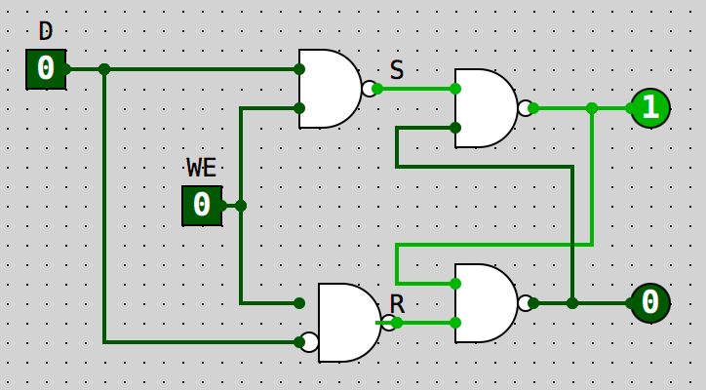
Master-Slave Flip Flop
Remember our Gated D Latch?
Master
Slave
Gated D Latch
Gated D Latch

Slide 25
Clock Edges and Master-Slave
Slave register outputs its inputs.
Master register outputs what was recorded when WE rose to 1.
Master register records what is presented on its input.
Write
Enable
Slave register records what is presented on its input.
Slave register outputs what was recorded when WE fell to 0.
Master register outputs its inputs.
Now we just connect Write Enable to the clock….

Slide 26

A Confusion of Terminology
Patt Book
CircuitSim
Gated D Latch
Input
Output
Write Enable
D Flip Flop
D
Q
Clock Notch (>)
Q’
1
0
Enable

Slide 27
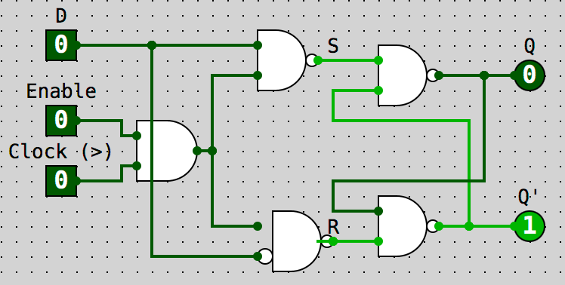
How Does Enable Work?

Slide 28
Now For Finite State Machines

Slide 29
Sequential Logic Circuit
Input
Combinational
Logic Circuit
Output
Storage
Elements

Slide 30
Concept of State
Vending Machines
Adding Machines
Traffic Signal Controls
Parking Lot Controls
Combination Locks
Computers
Garage Door Openers

Slide 31
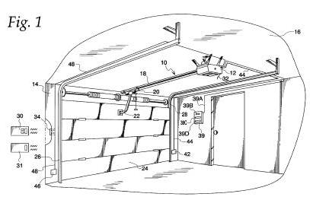

Slide 32
My Garage Door
L₁
L₂
The
Button

Slide 33
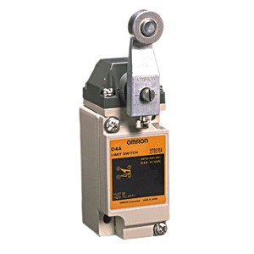
My Garage Door
L₁
L₂
The
Button

Slide 34
My Garage Door
L₁
L₂
mmmm
Motor Running
The
Button

Slide 35
My Garage Door
L₁
L₂
"Click"
The
Button

Slide 36
My Garage Door
L₁
L₂
mmmm
The
Button

Slide 37
My Garage Door
L₁
L₂
mmmm
The
Button

Slide 38
My Garage Door
L₁
L₂
mmmm
The
Button

Slide 39
My Garage Door
L₁
L₂
mmmm
The
Button

Slide 40
My Garage Door
L₁
L₂
mmmm
The
Button

Slide 41
My Garage Door
L₁
L₂
The
Button

Slide 42
My Garage Door
L₁
L₂
"Click"
The
Button

Slide 43
My Garage Door
L₁
L₂
mmmm
The
Button

Slide 44
My Garage Door
L₁
L₂
mmmm
The
Button

Slide 45
My Garage Door
L₁
L₂
mmmm
The
Button

Slide 46
My Garage Door
L₁
L₂
mmmm
The
Button

Slide 47
My Garage Door
L₁
L₂
mmmm
The
Button

Slide 48
My Garage Door
L₁
L₂
mmmm
The
Button

Slide 49
My Garage Door
L₁
L₂
The
Button

Slide 50

How can we describe the control logic?

Slide 51
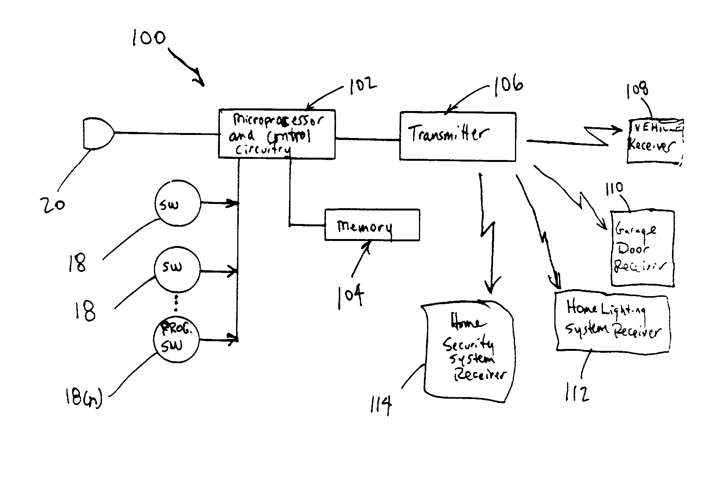

Slide 52
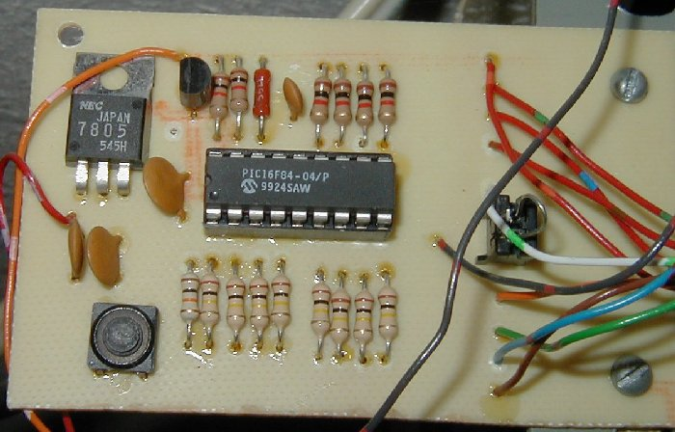

Slide 53
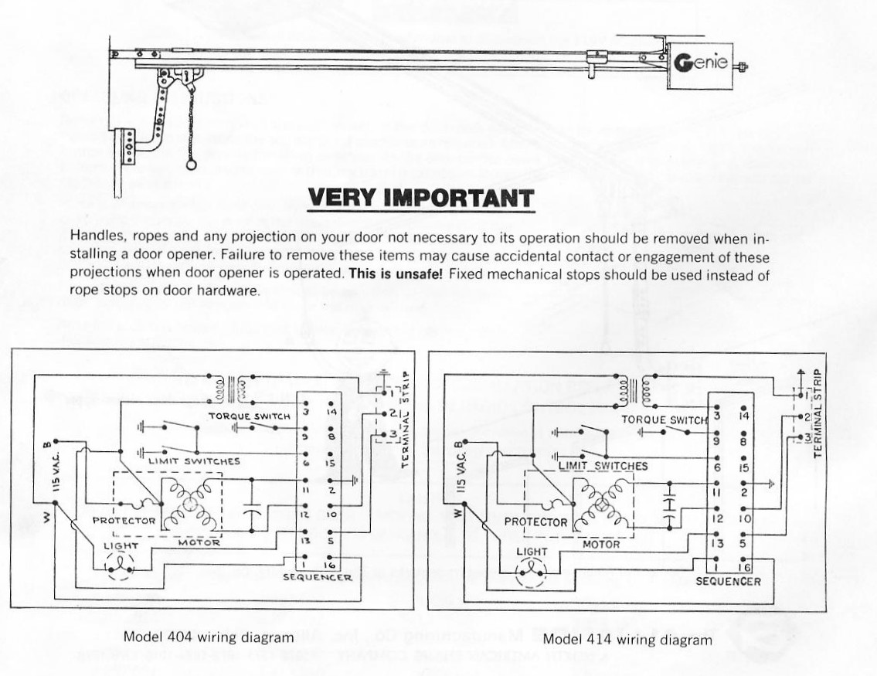

Slide 54
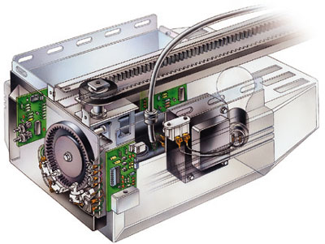

Slide 55
How can we describe the control logic?
A Finite State Machine (FSM) Diagram!

Slide 56
State Machine
Motor
Up
Stop
Start
Motor
Down
Enough States?

Slide 57
State Machine
Motor
Up
PB
Stop
(Up Next)
Stop
(Down
Next)
Start
Motor
Down
Assume we start
with the door down
ready to go up

Slide 58
State Machine
Motor
Up
PB
L₂
Stop
(Up Next)
Stop
(Down
Next)
Start
Motor
Down

Slide 59
State Machine
Motor
Up
PB
L₂
Stop
(Up Next)
Stop
(Down
Next)
Start
Motor
Down
PB

Slide 60
State Machine
Motor
Up
PB
L₂
Stop
(Up Next)
Stop
(Down
Next)
Start
Motor
Down
L₁
PB
Okay?

Slide 61
My Garage Door
L₁
L₂
The
Button

Slide 62
My Garage Door
L₁
L₂
"Click"
The
Button

Slide 63
My Garage Door
L₁
L₂
mmmm
The
Button

Slide 64
My Garage Door
L₁
L₂
mmmm
The
Button

Slide 65
My Garage Door
L₁
L2
mmmm
"Click"
The
Button

Slide 66
My Garage Door
L₁
L₂
The
Button

Slide 67
My Garage Door
L₁
L₂
mmmm
"Click"
The
Button

Slide 68
My Garage Door
L₁
L₂
mmmm
The
Button

Slide 69
My Garage Door
L₁
L₂
mmmm
The
Button

Slide 70
My Garage Door
L₁
L₂
mmmm
The
Button

Slide 71
My Garage Door
L₁
L₂
The
Button

Slide 72
State Machine
Motor
Up
PB
L₂
Stop
(Up Next)
Stop
(Down
Next)
Start
Motor
Down
L₁
PB

Slide 73
State Machine
Motor
Up
PB
L₂
Stop
(Up Next)
PB
Stop
(Down
Next)
Start
Motor
Down
L₁
PB

Slide 74
State Machine
Motor
Up
PB
L₂
PB
OR
Stop
(Up Next)
Stop
(Down
Next)
Start
Motor
Down
L₁
PB

Slide 75
State Machine
Motor
Up
PB
L₂
PB
OR
Stop
(Up Next)
Stop
(Down
Next)
Start
PB
Motor
Down
L₁
OR
PB

Slide 76
Suppose we wish to build a circuit to control our garage door?

Slide 77
What do we need?
Something to hold state
Combinational logic
Reset button
Limit switches
The Pushbutton
Handle being in no state! i.e. Startup
What keeps you in a state?

Slide 78
State Machine
Motor
Up
PB
L₂
PB
PB
OR
Stop
(Up Next)
Stop
(Down
Next)
PB
PB
and
L₂
PB
and
L₁
Start
PB
Motor
Down
L₁
OR
PB

Slide 79
State Machine
Motor
Up
L₂
PB
OR
PB
and
L₂
PB
PB
PB
Stop
(Up Next)
Stop
(Down
Next)
PB
and
L₁
PB
PB
Motor
Down
Start
L₁
OR

Slide 80
Sequential Logic Circuit
Input
Combinational
Logic Circuit
Output
Storage
Elements

Slide 81
Sequential Logic Circuit
Storage
Elements
Combinational
Logic Circuit
Input
Output

Slide 82
State Machine Circuit
Storage
Element
INPUTS
N₀
N₁
N₂
REGISTER
P
L₁
_{L2}
Combinational logic
(details follow)
?
?
?
?
Out
C₀
C₁
C₂

Slide 83
What happens if we just hold down the pushbutton?

Slide 84
State Machine
Motor
Up
L₂
PB
Dummy
PB
OR
PB
and
L₂
PB
PB
PB
Stop
(Up Next)
Stop
(Down
Next)
PB
and
L₁
PB
PB
Motor
Down
Start
L₁
OR

Slide 85
State Machine
Motor
Up
L₂
PB
Dummy
PB
OR
Dummy
PB
and
L₂
PB
PB
PB
PB
Stop
(Up Next)
Stop
(Down
Next)
PB
and
L₁
Dummy
Dummy
PB
PB
PB
Motor
Down
Start
PB
L₁
OR

Slide 86
State Machine
Motor
Up
L₂
Dummy
Dummy
PB
PB
OR
PB
PB
PB
and
L₂
PB
PB
PB
PB
Stop
(Up Next)
Stop
(Down
Next)
PB
and
L₁
PB
PB
PB
PB
Motor
Down
Start
Dummy
Dummy
PB
PB
L₁
OR

Slide 87
State Machine Circuit

Slide 88

My Garage Door
L1
L2
mmmm
The
Button

Slide 89
My Garage Door
L1
L2
mmmm
The
Button
IR
IR

Slide 90
State Machine
IR
Motor
Up
PB
L2
PB
OR
Stop
(Up Next)
Stop
(Down
Next)
IR
Start
PB
Motor
Down
L1
OR
PB

Slide 91
Another Way

Slide 92
State Machine
Motor
Up
001
010
L₂
Dummy
011
Dummy
PB
PB
OR
PB
PB
PB
and
L₂
PB
PB
PB
PB
100
Stop
(Up Next)
Stop
(Down
Next)
000
PB
and
L₁
PB
PB
PB
PB
Motor
Down
Start
Dummy
Dummy
PB
PB
111
L₁
OR
101
110

Slide 93
P | L₁ | L₂ | C₂ | C₁ | C₀ | N₂ | N₁ | N₀ | U | D
0 | x | x | 0 | 0 | 0 | 0 | 0 | 0 | 0 | 0
1 | x | x | 0 | 0 | 0 | 0 | 0 | 1 | 0 | 0
0 | x | x | 0 | 0 | 1 | 0 | 1 | 0 | 0 | 0
1 | x | x | 0 | 0 | 1 | 0 | 0 | 1 | 0 | 0
0 | x | 0 | 0 | 1 | 0 | 0 | 1 | 0 | 1 | 0
x | x | 1 | 0 | 1 | 0 | 0 | 1 | 1 | 1 | 0
1 | x | x | 0 | 1 | 0 | 0 | 1 | 1 | 1 | 0
0 | x | x | 0 | 1 | 1 | 1 | 0 | 0 | 0 | 0
1 | x | x | 0 | 1 | 1 | 0 | 1 | 1 | 0 | 0
0 | x | x | 1 | 0 | 0 | 1 | 0 | 0 | 0 | 0
1 | x | x | 1 | 0 | 0 | 1 | 0 | 1 | 0 | 0
0 | x | x | 1 | 0 | 1 | 1 | 1 | 0 | 0 | 0
1 | x | x | 1 | 0 | 1 | 1 | 0 | 1 | 0 | 0

Slide 94
P | L₁ | L₂ | C₂ | C₁ | C₀ | N₂ | N₁ | N₀ | U | D
0 | 0 | x | 1 | 1 | 0 | 1 | 1 | 0 | 0 | 1
1 | x | x | 1 | 1 | 0 | 1 | 1 | 1 | 0 | 1
x | 1 | x | 1 | 1 | 0 | 1 | 1 | 1 | 0 | 1
0 | x | x | 1 | 1 | 1 | 0 | 0 | 0 | 0 | 0
1 | x | x | 1 | 1 | 1 | 1 | 1 | 1 | 0 | 0

Slide 95
N₂ = ~P~C₂C₁C₀
+ ~PC₂~C₁~C₀
+ PC₂~C₁~C₀
+ ~PC₂~C₁C₀
+ PC₂~C₁C₀
+ ~P~L₁C₂C₁~C₀
+ PC₂C₁~C₀
+ L₁C₂C₁~C₀
+ PC₂C₁C₀

Slide 96
N₂ = ~P~C₂C₁C₀
+ ~PC₂~C₁~C₀
+ PC₂~C₁~C₀
+ ~PC₂~C₁C₀
+ PC₂~C₁C₀
+ ~P~L₁C₂C₁~C₀
+ PC₂C₁~C₀
+ L₁C₂C₁~C₀
+ PC₂C₁C₀

Slide 97
N₂ = ~P~C₂C₁C₀
+ C₂~C₁~C₀
+ C₂~C₁C₀
+ ~P~L₁C₂C₁~C₀
+ PC₂C₁~C₀
+ L₁C₂C₁~C₀
+ PC₂C₁C₀

Slide 98
N₂ = ~P~C₂C₁C₀
+ C₂~C₁~C₀
+ C₂~C₁C₀
+ ~P~L₁C₂C₁~C₀
+ PC₂C₁~C₀
+ L₁C₂C₁~C₀
+ PC₂C₁C₀

Slide 99
N₂ = ~P~C₂C₁C₀
+ PC₂C₁C₀
+ C₂~C₁~C₀
+ C₂~C₁C₀
+ ~P~L₁C₂C₁~C₀
+ PC₂C₁~C₀
+ L₁C₂C₁~C₀

Slide 100
N₂ = ~P~C₂C₁C₀
+ PC₂C₁C₀
+ C₂~C₁~C₀
+ C₂~C₁C₀
+ ~P~L₁C₂C₁~C₀
+ PC₂C₁~C₀
+ L₁C₂C₁~C₀

Slide 101
N₂ = ~P~C₂C₁C₀
+ PC₂C₁C₀
+ C₂~C₁~C₀
+ C₂~C₁C₀
+ ~P~L₁C₂C₁~C₀
+ (P+L₁)C₂C₁~C₀

Slide 102
N₂ = ~P~C₂C₁C₀
+ PC₂C₁C₀
+ C₂~C₁~C₀
+ C₂~C₁C₀
+ ~P~L₁C₂C₁~C₀
+ (P+L₁)C₂C₁~C₀

Slide 103
N₂ = ~P~C₂C₁C₀
+ PC₂C₁C₀
+ C₂~C₁
+ ~P~L₁C₂C₁~C₀
+ (P+L₁)C₂C₁~C₀

Slide 104
N₂ = ~P~C₂C₁C₀
+ PC₂C₁C₀
+ C₂~C₁
+ ~P~L₁C₂C₁~C₀
+ (P+L₁)C₂C₁~C₀

Slide 105
N₂ = ~P~C₂C₁C₀
+ PC₂C₁C₀
+ C₂~C₁
+ ((~P~L₁)+(P+L₁))C₂C₁~C₀

Slide 106
N₂ = ~P~C₂C₁C₀
+ PC₂C₁C₀
+ C₂~C₁
+ (~P~L₁+P+L₁)C₂C₁~C₀

Slide 107
N₂ = ~P~C₂C₁C₀
+ PC₂C₁C₀
+ C₂~C₁
+ C₂C₁~C₀

Slide 108
N₂ = ~P~C₂C₁C₀
+ PC₂C₁C₀
+ C₂~C₁
+ C₂C₁~C₀
N₂ = ~P~C₂C₁C₀+PC₂C₁C₀+C₂~C₁+C₂C₁~C₀

Slide 109
N₂=~P~C₂C₁C₀+PC₂C₁C₀+C₂~C₁+C₂C₁~C₀
 | C₁’C₀’ | C₁’C₀ | C₁C₀ | C₁C₀’
P’C₂’
P’C₂
PC₂
PC₂’

Slide 110
N₂=~P~C₂C₁C₀+PC₂C₁C₀+C₂~C₁+C₂C₁~C₀
 | C₁’C₀’ | C₁’C₀ | C₁C₀ | C₁C₀’
P’C₂’ |  |  | 1
P’C₂ | 1 | 1 |  | 1
PC₂ | 1 | 1 | 1 | 1
PC₂’

Slide 111
N₂=~P~C₂C₁C₀+PC₂C₁C₀+C₂~C₁+C₂C₁~C₀
 | C₁’C₀’ | C₁’C₀ | C₁C₀ | C₁C₀’
P’C₂’ |  |  | 1
P’C₂ | 1 | 1 |  | 1
PC₂ | 1 | 1 | 1 | 1
PC₂’

Slide 112
N₂=~P~C₂C₁C₀+PC₂C₁C₀+C₂~C₁+C₂C₁~C₀
 | C₁’C₀’ | C₁’C₀ | C₁C₀ | C₁C₀’
P’C₂’ |  |  | 1
P’C₂ | 1 | 1 |  | 1
PC₂ | 1 | 1 | 1 | 1
PC₂’
N₂=~P~C₂C₁C₀+PC₂+C₂~C₁+C₂C₁~C₀

Slide 113
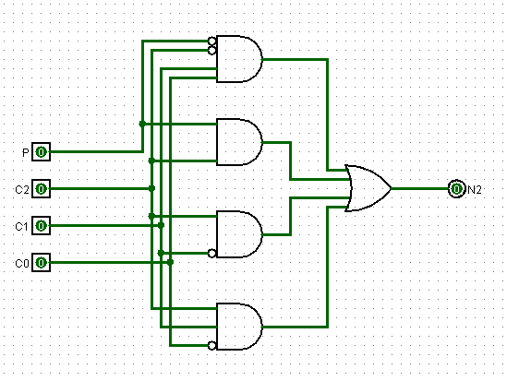
N₂=~P~C₂C₁C₀+PC₂+C₂~C₁+C₂C₁~C₀

Slide 114
One more
U = P’L₂’C₂’C₁C₀’ + L₂C₂’C₁C₀’ + PC₂’C₁C₀’

Slide 115
A + A’B = AB
U = P’L₂’C₂’C₁C₀’ + L₂C₂’C₁C₀’ + PC₂’C₁C₀’

Slide 116
A + A’ = 1
U = L₂’C₂’C₁C₀’ + L₂C₂’C₁C₀’ + PC₂’C₁C₀’

Slide 117
A + A = A
U = C₂’C₁C₀’ + C₂’C₁C₀’ + PC₂’C₁C₀’

Slide 118
A + AB = A
U = C₂’C₁C₀’ + PC₂’C₁C₀’

Slide 119
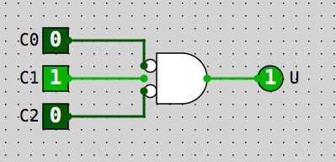
At last!
U = C₂’C₁C₀’

Slide 120
Questions?

Slide 121
Two Kinds of State Machines!
One Hot
Binary Encoded
One bit per state
Only one bit is on at a time
Faster
Requires more flip flops
States progress 00001»00010»00100» 01000»10000
Encode state as a binary number
Use a decoder to generate a line for each state
Slower
More complicated
States progress 000»001»010»011»100
Which did we just use to implement the garage door opener?

Slide 122
LC-3 Datapath

Slide 123
gateMARMUX
gatePC
16
DR
3
REG
FILE
SR2 SR1
OUT OUT
MARMUX
MARMUX
LD.PC
PC
16
PCMUX
+1
16
16
2
LD.REG
PCMUX
16
SR2
3
3
SR1
ZEXT
ADDR2MUX
+
[7:0]
2
ADDR1MUX
ADDR2MUX
ADDR1MUX
16
16
16
[10:0]
SEXT
16
16
16
16
16
0
16
[4:0]
SEXT
[8:0]
SEXT
FINITE
STATE
MACHINE
SR2MUX
[5:0]
SEXT
N
Z
P
LD.CC
B
A
2
ALU
LD.IR
IR
LOGIC
R
16
16
gateALU
16
16
GateMDR
16
16
LD.MDR
MDR
MEMORY
MAR
LD.MAR
INPUT
OUTPUT
MEM.EN, R.W

Slide 124
gateMARMUX
gatePC
16
DR
3
REG
FILE
SR2 SR1
OUT OUT
MARMUX
MARMUX
LD.PC
PC
16
PCMUX
+1
16
16
2
LD.REG
PCMUX
16
SR2
3
3
SR1
ZEXT
ADDR2MUX
+
[7:0]
2
ADDR1MUX
ADDR2MUX
ADDR1MUX
16
16
16
[10:0]
SEXT
16
16
16
16
16
0
16
[4:0]
SEXT
[8:0]
SEXT
FINITE
STATE
MACHINE
SR2MUX
[5:0]
SEXT
N
Z
P
LD.CC
B
A
2
ALU
LD.IR
IR
LOGIC
R
16
16
gateALU
16
16
GateMDR
16
MUXES
16
LD.MDR
MDR
MEMORY
MAR
LD.MAR
INPUT
OUTPUT
MEM.EN, R.W

Slide 125
gateMARMUX
gatePC
16
DR
3
REG
FILE
SR2 SR1
OUT OUT
MARMUX
MARMUX
LD.PC
PC
16
PCMUX
+1
16
16
2
LD.REG
PCMUX
16
SR2
3
3
SR1
ZEXT
ADDR2MUX
+
[7:0]
2
ADDR1MUX
ADDR2MUX
ADDR1MUX
16
16
16
[10:0]
SEXT
16
16
16
16
16
0
16
[4:0]
SEXT
[8:0]
SEXT
FINITE
STATE
MACHINE
SR2MUX
[5:0]
SEXT
N
Z
P
LD.CC
B
A
2
ALU
LD.IR
IR
LOGIC
R
16
16
gateALU
16
16
GateMDR
16
STATE
16
LD.MDR
MDR
MEMORY
MAR
LD.MAR
INPUT
OUTPUT
MEM.EN, R.W

Slide 126
gateMARMUX
gatePC
16
DR
3
REG
FILE
SR2 SR1
OUT OUT
MARMUX
MARMUX
LD.PC
PC
16
PCMUX
+1
16
16
2
LD.REG
PCMUX
16
SR2
3
3
SR1
ZEXT
+
[7:0]
ADDR2MUX
2
ADDR1MUX
ADDR2MUX
ADDR1MUX
16
16
16
[10:0]
SEXT
16
16
16
16
16
0
16
[4:0]
SEXT
[8:0]
SEXT
FINITE
STATE
MACHINE
SR2MUX
[5:0]
SEXT
N
Z
P
LD.CC
B
A
2
ALU
LD.IR
IR
LOGIC
R
16
16
gateALU
16
16
GateMDR
16
ALU
TYPE
16
LD.MDR
MDR
MEMORY
MAR
LD.MAR
INPUT
OUTPUT
MEM.EN, R.W

Slide 127
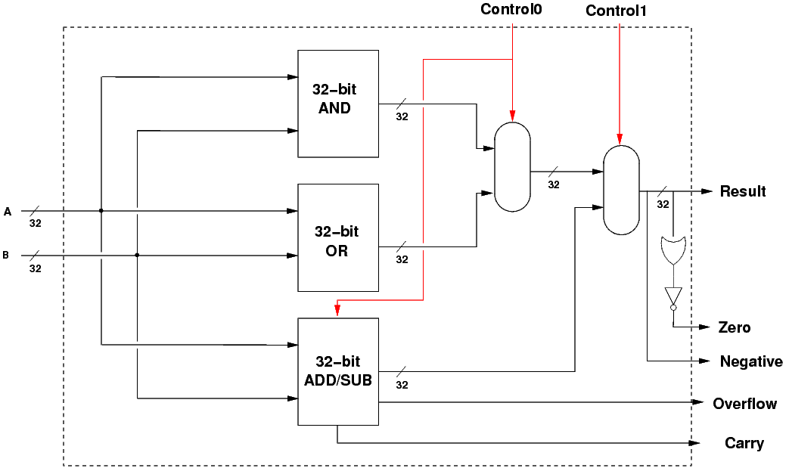
Toy ALU
http://minnie.tuhs.org/CompArch/Tutes/week02.html

Slide 128
gateMARMUX
gatePC
16
DR
3
REG
FILE
SR2 SR1
OUT OUT
MARMUX
MARMUX
LD.PC
PC
16
PCMUX
+1
16
16
2
LD.REG
PCMUX
16
SR2
3
3
SR1
ZEXT
+
[7:0]
ADDR2MUX
2
ADDR1MUX
ADDR2MUX
ADDR1MUX
16
16
16
[10:0]
SEXT
16
16
16
16
16
0
16
[4:0]
SEXT
[8:0]
SEXT
FINITE
STATE
MACHINE
SR2MUX
[5:0]
SEXT
N
Z
P
LD.CC
B
A
2
ALU
LD.IR
IR
LOGIC
R
16
16
gateALU
16
16
GateMDR
16
FUNC
UNITS
16
LD.MDR
MDR
MEMORY
MAR
LD.MAR
INPUT
OUTPUT
MEM.EN, R.W

Slide 129
gateMARMUX
gatePC
16
DR
3
REG
FILE
SR2 SR1
OUT OUT
MARMUX
MARMUX
LD.PC
PC
16
PCMUX
+1
16
16
2
LD.REG
PCMUX
16
SR2
3
3
SR1
ZEXT
ADDR2MUX
+
[7:0]
2
ADDR1MUX
ADDR2MUX
ADDR1MUX
16
16
16
[10:0]
SEXT
16
16
16
16
16
0
16
[4:0]
SEXT
[8:0]
SEXT
FINITE
STATE
MACHINE
SR2MUX
[5:0]
SEXT
N
Z
P
LD.CC
B
A
2
ALU
LD.IR
IR
LOGIC
R
16
16
gateALU
16
16
GateMDR
16
CONTROL
16
LD.MDR
MDR
MEMORY
MAR
LD.MAR
INPUT
OUTPUT
MEM.EN, R.W

Slide 130
Tri State Buffer
CONTROL | INPUT | OUTPUT
0 | 0 | Z
0 | 1 | Z
1 | 0 | 0
1 | 1 | 1
OUTPUT
CONTROL
INPUT

Slide 131
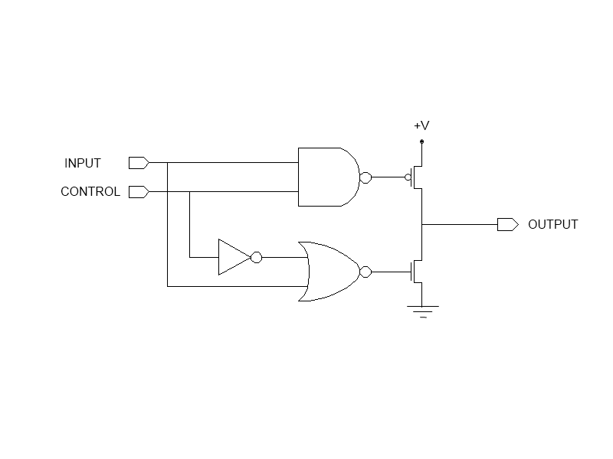
Tri State Buffer

Slide 132


Slide 133
gateMARMUX
gatePC
16
DR
3
REG
FILE
SR2 SR1
OUT OUT
MARMUX
MARMUX
LD.PC
PC
16
PCMUX
+1
16
16
2
LD.REG
PCMUX
16
SR2
3
3
SR1
ZEXT
ADDR2MUX
+
[7:0]
2
ADDR1MUX
ADDR2MUX
ADDR1MUX
16
16
16
[10:0]
SEXT
16
16
16
16
16
0
16
[4:0]
SEXT
[8:0]
SEXT
FINITE
STATE
MACHINE
SR2MUX
[5:0]
SEXT
N
Z
P
LD.CC
B
A
2
ALU
LD.IR
IR
LOGIC
R
16
16
gateALU
16
16
GateMDR
16
16
LD.MDR
MDR
MEMORY
MAR
LD.MAR
INPUT
OUTPUT
MEM.EN, R.W

Slide 134
16
3
16
+1
16
16
2
16
3
3
+
[7:0]
2
16
16
16
[10:0]
16
16
16
16
16
0
16
[8:0]
[4:0]
[5:0]
2
B
A
LD.IR
R
16
16
16
16
16
16

Slide 135
Questions?

Slide 137
DATAIN
WRITE
ENABLE
DECODER
ADDRESS
MUX
MUX
MUX
MUX
DATAOUT

