Slide 1
The LC-3 Part I
Chapter 5

Slide 2
Outline
The ISA: Overview
Memory, Registers, Instruction Set, Opcodes, Datatypes, Addressing Modes, Condition Codes
Operate Instructions
ADD, AND, NOT
Data Movement Instructions
PC-Relative Mode, Indirect Mode, Base+Offset Mode, Immediate Mode, Examples

Slide 3
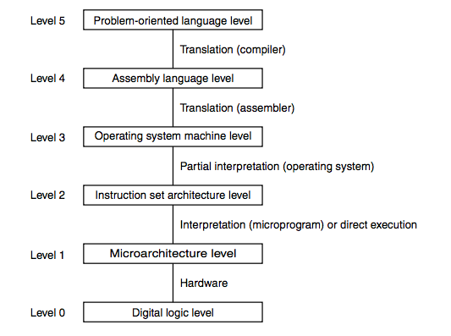
Road Map

Slide 4
Question
If you don’t want the execution to proceed to the next instruction what must be changed?
Instruction Register (IR)
Memory Address Register (MAR)
Memory Data Register (MDR)
Program Counter (PC)

Slide 5
Instruction Set Architecture
The ISA specifies all the information about the computer that the software needs to be aware of.
Who uses an ISA?
What is specified?

Slide 6
Who uses an ISA?
Machine language programmers
Assembly language programmers
Compiler writers
High-level language programmers interested in performance, debugging, etc.

Slide 7
What Is Specified?
Memory organization
Registers
Instruction set
Opcodes
Data types
Addressing modes

Slide 8
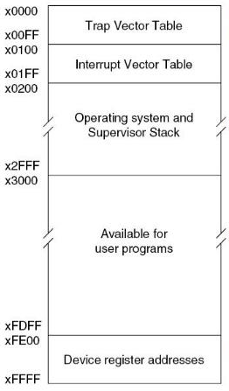
LC-3 Memory Organization
Address space
16 bit addresses
0-65535
x0-xFFFF
Addressability
16 bits
Word Addressable/Byte Addressable?
Strictly word addressable with 16 bit words.

Slide 9
LC-3 Registers
General Purpose Registers
Is the PC considered to be a GPR?
Question:
Yes
No
Conventions
3

Slide 10
LC-3 Registers
General Purpose Registers
8 General Purpose Registers
R0 - R7
Is the PC considered to be a GPR?
No
Conventions
Certain Registers will have designated purposes

Slide 11
LC-3 Instruction Set
Instruction
Op Code
Operands
Instruction Set
Op Codes
Operate
Data movement
Control
Data Types
Addressing Modes

Slide 12
How Many Instructions?
Lots
CISC (Complex Instruction Set Computer)
Intel X86, DEC VAX, IBM Z-series
Do as much as you can in a single instruction.
Relatively easy to write efficient machine code by hand.
Few
RISC (Reduced Instruction Set Computer)
ARM, PowerPC, MIPS, LC-3
Expose as much as you can to the compiler so that it can optimize.
Hard to write efficient machine code by hand.

Slide 13
Terminology
Patt
Gated D Latch
Master-Slave Flip-flop
Circuitsim
Register (with level-triggered setting)
D Flip-Flop
-or-
Register (with edge-triggered setting)

Slide 14
Meet the LC-3 Instruction Set
16-bit instructions
4 bits for opcode
How many instructions?
15 – one is reserved for future use.

Slide 15
ADD+
0001
DR
SR1
0
00
SR2
ADD+
0001
DR
SR1
1
imm5
AND+
0101
DR
SR1
0
00
SR2
AND+
0101
DR
SR1
1
imm5
BR
0000
n
z
p
PCoffset9
JMP
1100
000
BaseR
000000
JSR
0100
1
PCoffset11
JSRR
0100
0
00
BaseR
000000
LD+
0010
DR
PCoffset9
LDI+
1010
DR
PCoffset9
+ Indicates instructions that modify condition codes

Slide 16
LDR+
0110
DR
BaseR
offset6
LEA+
1110
DR
PCoffset9
NOT+
1001
DR
SR
111111
RET
1100
000
111
000000
RTI
1000
000000000000
ST
0011
SR
PCoffset9
STI
1011
SR
PCoffset9
STR
0111
SR
BaseR
offset6
TRAP
1111
0000
trapvect8
reserved
1101
+ Indicates instructions that modify condition codes

Slide 17
And the LC-3 Assembly Language
What is it?
A symbolic representation of the binary machine language
Instructions are one-to-one between AL and ML
AL contains some assembler directives that start with “.”
Assembler will look up opcodes for us
Assembler will allow us to name memory addresses
We’ll talk about how an assembler works a bit later

Slide 18
Addressing Modes
Where can operands be found?
1. In the instruction (Literal or Immediate)
2. In registers
3. In memory

Slide 19
Addressing Modes
Immediate or Literal
Register
PC-relative
Indirect
Base + Offset
Each instruction usually allows a subset of addressing modes (a frequently observed characteristic of a RISC architecture)

Slide 20
ADD+
0001
DR
SR1
0
00
SR2
register
ADD+
0001
DR
SR1
1
imm5
immediate
AND+
0101
DR
SR1
0
00
SR2
register
AND+
0101
DR
SR1
1
imm5
immediate
BR
0000
n
z
p
PCoffset9
PC relative
JMP
1100
000
BaseR
000000
register
JSR
0100
1
PCoffset11
PC relative
JSRR
0100
0
00
BaseR
000000
register
LD+
0010
DR
PCoffset9
PC relative
LDI+
1010
DR
PCoffset9
indirect
+ Indicates instructions that modify condition codes

Slide 21
LDR+
0110
DR
BaseR
offset6
base + offset
LEA+
1110
DR
PCoffset9
PC relative
NOT+
1001
DR
SR
111111
register
RET
1100
000
111
000000
none
RTI
1000
000000000000
none
ST
0011
SR
PCoffset9
PC relative
STI
1011
SR
PCoffset9
Indirect
STR
0111
SR
BaseR
offset6
base + offset
TRAP
1111
0000
trapvect8
none
reserved
1101
TBD
+ Indicates instructions that modify condition codes

Slide 22
Where’s the Operand?
Addressing Mode | Operand
Immediate | SEXT(IR[4:0])
Register | Use the contents of the specified register
PC-relative | Compute PC + SEXT(IR[8:0]) or SEXT(IR[10:0]) and dereference -- remember that PC is already incremented by this time in the instruction cycle
Indirect | Compute PC-relative address as above and dereference twice
Base + Offset | Compute specified register + SEXT(IR[5:0]) and dereference
* Dereference : Interpret what you have as a memory address and fetch

Slide 23
Condition Codes
N - Negative
Z - Zero
P - Positive
When is the condition code register set?
During EXECUTE when LD.CC is high
How are they used?
There are 3 bits in the BR instruction that are ANDed with the NZP condition code bits. If any bits are on, the branch is taken

Slide 24
gateMARMUX
gatePC
16
DR
3
REG
FILE
SR2 SR1
OUT OUT
MARMUX
MARMUX
LD.PC
PC
16
PCMUX
+1
16
16
2
LD.REG
PCMUX
16
SR2
3
3
SR1
ZEXT
ADDR2MUX
+
[7:0]
2
ADDR1MUX
ADDR2MUX
ADDR1MUX
16
16
16
[10:0]
SEXT
16
16
16
16
16
0
16
[4:0]
SEXT
[8:0]
SEXT
FINITE
STATE
MACHINE
SR2MUX
[5:0]
SEXT
N
Z
P
LD.CC
B
A
2
ALU
LD.IR
IR
LOGIC
R
16
16
gateALU
16
16
GateMDR
16
16
LD.MDR
MDR
MEMORY
MAR
LD.MAR
INPUT
OUTPUT
MEM.EN, R.W

Slide 25
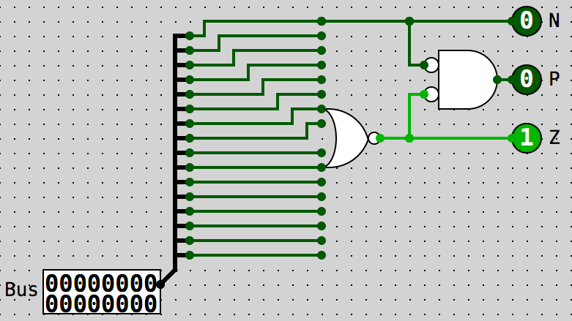
Condition Code Logic

Slide 26
Let’s Look at an Instruction
NOT
Addressing mode?
Immediate or Literal
Register
PC-relative
Indirect
Base + Offset
An example
NOT R3,R3 1001 011 011 111111
NOT+
1001
DR
SR
111111

Slide 27
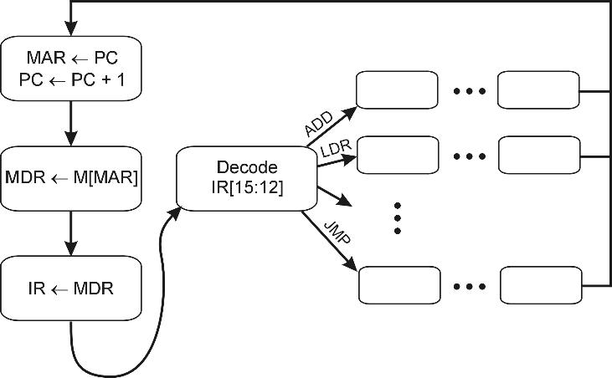
What Makes the Fetch-Execute Cycle Happen?
The control unit.
It turns on the appropriate control signals as it steps through each state.
18
1
32
6
33
35
12
A more complete state diagram is in Appendix C.
It will be more understandable after Chapter 5.

Slide 28
EXECUTE State for NOT
001001 ( State 9 ) 0 0 J=18
LD.REG LD.CC GateALU SR1MUX=1 ALUK=2
NOTE:
SR1MUX=1 means use IR[8:6] as SR1
(see p.574)

Slide 29
gatePC
16
3
3
REG
FILE
SR2 SR1
OUT OUT
Control
LD.PC
PC
DR
PCMUX
+1
2
LD.REG
PCMUX
EXECUTE
16
3
3
3
SR2
SR1
16
16
16
FINITE
STATE
MACHINE
SR2MUX
Processor
N
Z
P
LD.CC
B
A
NOT
2
NOT
2
ALU
LD.IR
IR
R
LOGIC
16
gateALU
16
16
16
GateMDR
16
INPUT
OUTPUT
16
KBDR
DDR
LD.MDR
MDR
MEMORY
MAR
LD.MAR
KBSR
DSR
MEM.EN, R.W

Slide 30
Operate Instructions
ADD, AND
Addressing Mode?
ADD+
0001
DR
SR1
0
00
SR2
ADD+
0001
DR
SR1
1
imm5
AND+
0101
DR
SR1
0
00
SR2
AND+
0101
DR
SR1
1
imm5
Immediate or Literal
Register
PC-relative
Indirect
Base + Offset

Slide 31
EXECUTE States for ADD & AND
000001 ( State 1 ) 0 0 J=18
LD.REG LD.CC GateALU SR1MUX=1
000101 ( State 5 ) 0 0 J=18
LD.REG LD.CC GateALU SR1MUX=1 ALUK=1
NOTE:
SR1MUX=1 means use IR[8:6] as SR1
(see p.574)
SR2MUX select is NOT IR[5]

Slide 32
Example
ADD R3,R3,R2
0001 011 011 000 010
ADD R3,R3,#2
0001 011 011 1 00010

Slide 33
gateMARMUX
gatePC
16
3
3
REG
FILE
SR2 SR1
OUT OUT
MARMUX
MARMUX
LD.PC
PC
DR
16
PCMUX
+1
16
16
2
LD.REG
PCMUX
3
16
3
3
2
SR1
ZEXT
SR2
ADDR2MUX
+
[7:0]
2
ADDR1MUX
ADDR2MUX
ADDR1MUX
16
16
16
[10:0]
SEXT
16
16
16
16
16
0
16
[4:0]
SEXT
[8:0]
SEXT
FINITE
STATE
MACHINE
IR[5]
SR2MUX
[5:0]
SEXT
N
Z
P
LD.CC
B
A
0 or 1
2
ALU
LD.IR
IR
LOGIC
R
16
16
gateALU
16
16
GateMDR
16
16
LD.MDR
MDR
MEMORY
MAR
LD.MAR
INPUT
OUTPUT
MEM.EN, R.W

Slide 34
What can you do with ADD, AND and NOT

Slide 35
What can you do with ADD, AND and NOT
Add
And
Not
Subtract
Or
Clear a register
Copy from one register to another
Increment a register by n, -16<n<15

Slide 36



Control Instructions
JMP
1100
000
BaseR
000000
register
Set PC to contents of BaseR
BR
0000
n
z
p
PCoffset9
PC relative
Add offset to PC if condition matches
JSR
0100
1
PCoffset11
PC relative
JSRR
0100
0
00
BaseR
000000
register
Save PC in R7, then add PCoffset11 or set to BaseR
RET
1100
000
111
000000
none
Set PC to contents of R7 (a.k.a. JMP R7)
+ Indicates instructions that modify condition codes

Slide 37
Data Movement Instructions
Should be read from the standpoint of the registers
LOAD something into this register
STORE this register into memory
In other words, STORE instructions are BACKWARDS! Read them left-to-right.

Slide 38
Data Movement Instructions
LD+
0010
DR
PCoffset9
LDI+
1010
DR
PCoffset9
LDR+
0110
DR
BaseR
offset6
LEA+
1110
DR
PCoffset9
ST
0011
SR
PCoffset9
STI
1011
SR
PCoffset9
STR
0111
SR
BaseR
offset6

Slide 39
Basic Format
Op
DR or SR
Address generation bits
These encode information on
how to form a 16 bit address
or a register address.
You’ll see this described as
“OP2” in the LC-3 diagrams.

Slide 40
Data Movement Instructions
PC-Relative Addressing
LD+
0010
DR
PCoffset9
ST
0011
SR
PCoffset9
Limitations?

Slide 41
LD Example
Addr Content Tag Op Operands
.orig x3000
3000 0015 A .fillw 21 3001 27FE LD R3,A
0010 011 1 1111 1110 LD R3 -2
What happens when we execute at x3001?

Slide 42
gateMARMUX
gatePC
16
1
3
3
REG
FILE
SR2 SR1
OUT OUT
MARMUX
MARMUX
LD.PC
PC
DR
16
PCMUX
+1
16
16
2
LD.REG
PCMUX
16
SR2
3
3
SR1
ZEXT
ADDR2MUX
+
[7:0]
2
1
1
ADDR1MUX
ADDR2MUX
ADDR1MUX
16
16
16
[10:0]
SEXT
16
16
16
16
16
0
16
[4:0]
SEXT
[8:0]
SEXT
FINITE
STATE
MACHINE
SR2MUX
[5:0]
SEXT
N
Z
P
LD.CC
B
A
2
ALU
LD.IR
IR
LOGIC
R
16
16
gateALU
16
16
GateMDR
16
16
LD.MDR
MDR
MEMORY
MAR
LD.MAR
INPUT
OUTPUT
MEM.EN, R.W

Slide 43
Data Movement Instructions
Base + Offset
LDR+
0110
DR
BaseR
offset6
STR
0111
SR
BaseR
offset6

Slide 44
Data Movement Instructions
Indirect Mode
LDI+
1010
DR
PCoffset9
STI
1011
SR
PCoffset9

Slide 45
Data Movement Instructions
Immediate Mode
LEA+
1110
DR
PCoffset9
No memory access!

Slide 46
Compare and Contrast
LEA RD←PC + 1 + PCOffset9
LD RD←M[PC + 1 + PCOffset9]
LDI RD←M[M[PC + 1 + PCOffset9]]
LDR RD←M[RB+Offset6]

Slide 47
Loads
LEA: Puts the address represented by some label into memory
LD: Puts the contents of some label (address) into a register
LDI: Puts the contents of memory location whose address is stored in memory at some label into a register
LDR: Puts the contents of the effective address into a register. The effective address is computed by adding the base register to the offset which is the offset6 immediate operand

Slide 48
Stores
ST: Puts the contents of a register into an address specified by a label (address).
STI: Puts the contents of a register into a memory location whose address is stored in memory at some label
STR: Puts the contents of the source register into memory at some effective address. The effective is calculated by adding the base register to the offset6 immediate operand.

Slide 49
A word of advice
Probably the most confusing thing for the new assembly language programmer is the confusion between memory addresses and memory contents.
Why?
Consider
int x = 10;
x = x + 2;
What exactly is x?
Is the first “x” different from the second “x”?

Slide 50
Example
GPR's
x0000
x1000
LD
0010
DR
PCoffset9
x2000
x0001
x3000
x4000
PC->
x3000: 0010 010 000000111
x3008: 0000 0000 0000 0001
EA=x3001+x7
x5000
x6000
x7000

Slide 51
Example
GPR's
x0000
x1000
LDI
1010
DR
PCoffset9
x2000
x3000
x002a
x4000
x5000
PC->
x3000: 1010 011 000000111
x3008: 0011 0000 0001 0000
x3010: 0000 0000 0010 1010
EA=M[x3001+x7]
x6000
EA=x3010
x7000

Slide 52
Example
GPR's
x0000
x1000
STR
0111
SR
BaseR
offset6
x2000
x3010
x4000
PC->
x3000: 0111 110 011 000011
x3010: 0000 0000 0010 1010
x3011: 0000 0000 0000 0000
x3012: 0000 0000 0000 1111
x3013: 0000 0000 1111 0000
EA=X3010+x3
x5000
x6000
x7000
x3013: 0110 0000 0000 0000

Slide 53
Example
GPR's
x0000
x1000
x2000
LEA+
1110
DR
PCoffset9
x0000
x3010
x4000
PC->
x3000: 1110 011 0 0000 1111
x3010: 0000 0000 0010 1010
x3011: 0000 0000 0000 0000
x3012: 0000 0000 0000 1111
x3013: 0000 0000 1111 0000
EA=x3001+xF
x5000
x6000
x7000

Slide 54
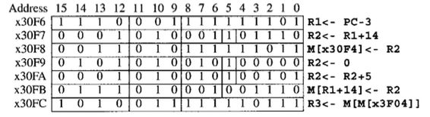
Example
Opcodes
ADD 0x1
LEA 0xE
ST 0x3
AND 0x5
STR 0x7
LDI 0xA
LEA R1,#-3
ADD R2,R1,#14
ST R2,#-5
AND R2,R1,#0
ADD R2,R2,#5
STR R2,R1,14
LDI R3,#-9
R1 R2 R3 x30f4 x3102
x30f4 - - - -
x3102
x3102
0
5
5
5

Slide 55
Questions?

Slide 56
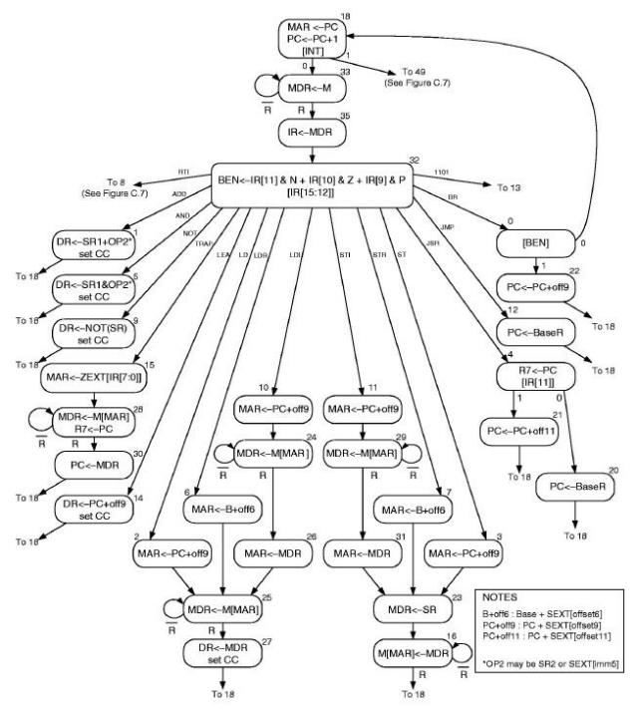
LC-3 as a Finite State Machine p. 568, Fig C.3

Slide 57
Diagrams From Patt
P. 571 Fig C.4 – the control structure
P. 584 Fig C.9 – the control store
P. 572 Table C.1 – the control store contents
P. 573 Figure C.5 – the microsequencer

Slide 58
Sequential Logic Circuit
Input
Combinational
Logic Circuit
Output
Storage
Elements

Slide 59
The Control Structure
6
Control Store
(Memory)
2⁶ X 49 bits
39 (bits 10-49)
Control Signals (e.g. LD.PC, LD.CC, ALUK, GATE.ALU)
10 (IRD, COND[0-2], J[0-5])
INT
Microsequencer
R
IR[15:12], IR[11]
BEN
PSR[15]
(See diagram on subsequent slide)
6 (next state)
Six-bit register
(Think “MAR for the Control Store”)

Slide 60
The Control Structure (the way Patt shows it)
(See diagram on subsequent slide)
Where do these go??
Next State

Slide 61
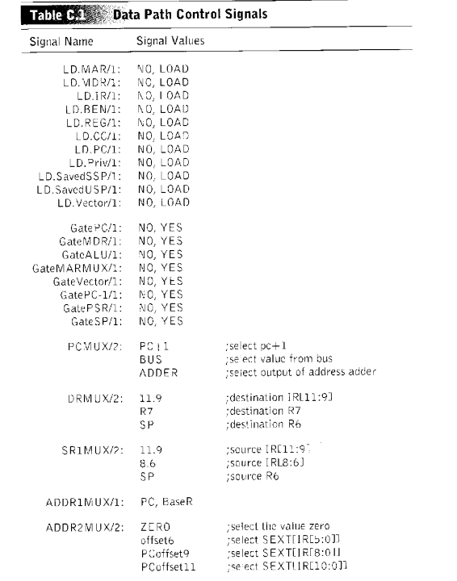
Data Path Control Signals

Slide 62
Contents of the Control Store

Slide 63
First Execute State for Each Opcode
State | IRD | COND
000000 ( State 0 ) | 0 | 2 | J=18
000001 ( State 1 ) | 0 | 0 | J=18 | LD.REG | LD.CC | GateALU | SR1MUX=1
000010 ( State 2 ) | 0 | 0 | J=25 | LD.MAR | GateMARMUX | ADDR2MUX=2 | MARMUX
000011 ( State 3 ) | 0 | 0 | J=23 | LD.MAR | GateMARMUX | ADDR2MUX=2 | MARMUX
000100 ( State 4 ) | 0 | 3 | J=20
000101 ( State 5 ) | 0 | 0 | J=18 | LD.REG | LD.CC | GateALU | SR1MUX=1 | ALUK=1
000110 ( State 6 ) | 0 | 0 | J=25 | LD.MAR | GateMARMUX | ADDR1MUX | ADDR2MUX=1 | MARMUX
000111 ( State 7 ) | 0 | 0 | J=23 | LD.MAR | GateMARMUX | ADDR1MUX | ADDR2MUX=1 | MARMUX
001000 ( State 8 ) | 0 | 4 | J=36 | LD.MAR | GateALU | SR1MUX=2 | ALUK=3
001001 ( State 9 ) | 0 | 0 | J=18 | LD.REG | LD.CC | GateALU | SR1MUX=1 | ALUK=2
001010 ( State 10 ) | 0 | 0 | J=24 | LD.MAR | GateMARMUX | ADDR2MUX=2 | MARMUX
001011 ( State 11 ) | 0 | 0 | J=29 | LD.MAR | GateMARMUX | ADDR2MUX=2 | MARMUX
001100 ( State 12 ) | 0 | 0 | J=18 | LD.PC | GateALU | PCMUX=1 | SR1MUX=1 | ALUK=3
001101 ( State 13 ) | 0 | 4 | J=37 | LD.MDR | LD.Priv | LD.Vector | GatePSR | VectorMUX=2
001110 ( State 14 ) | 0 | 0 | J=18 | LD.REG | LD.CC | GateMARMUX | ADDR2MUX=2 | MARMUX
001111 ( State 15 ) | 0 | 0 | J=28 | LD.MAR | GateMARMUX
For the other 48 states, see figurec9v2.xls on Canvas

Slide 64
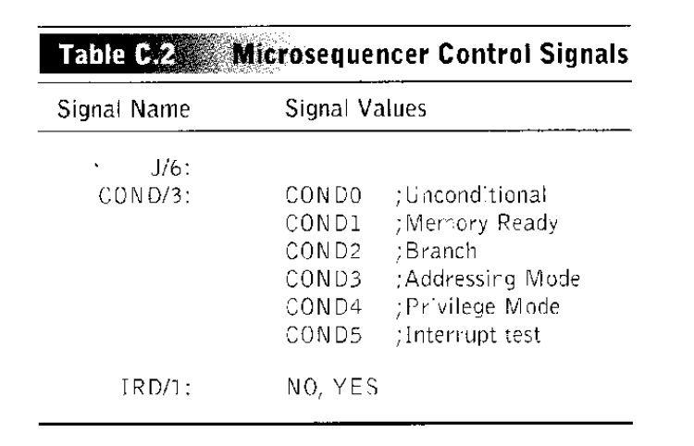
Micro-sequen-cer Control Signals

Slide 65
Finding the Next Microinstruction
The 10 bits that determine the next state:
IRD – a one-bit mux control that gates either IR[15:12] or the combination of COND and J back to the microsequencer as the next state
COND[2:0] allows one bit of J[5:0] to be set based on a specific signal
J[5:0] – a six-bit number that is the address of the next state (if not modified by COND)
000 | Unconditional | 011 | Addressing Mode
001 | Memory Ready | 100 | Privilege mode
010 | Branch | 101 | Interrupt present

Slide 66
The Micro-Sequen-cer

Slide 67
Fetch Stage Example
State 18 starts the fetch
MAR <- PC
PC <- PC + 1
COND5 and J=33 (if interrupt go to 49)
State 33 waits for read complete
Assert MEM.EN
MDR <- MEM[MAR]
COND1 and J=33 (if R go to state 35)
State 35 moves the instruction to IR
IR <- MDR
COND0 and J=32 so next state is 32

Slide 68
Fetch Stage Microcode
State | IRD | CONDx
( State 18 ) | 0 | 5 | J=33 | LD.MAR | LD.PC | GatePC
( State 33 ) | 0 | 1 | J=33 | LD.MDR | MEM.EN
( State 35 ) | 0 | 0 | J=32 | LD.IR | GateMDR

Slide 69
Branch Example
State 32 does the decode
BEN <- IR[11] & N | IR[10] & Z | IR[9] & P
State 32 has IRD=1 for next state
State 0 is chosen for a BRx instruction
State 0 has J=18 and COND2 for next state
The next state will be 18 if BEN is 0 or 22 (18 + 4) if BEN is 1
State 22 changes the PC
PC <- PC + off9
State has J=18 and COND0
So next state is 18
State 18 starts the fetch cycle again

Slide 70
Microcode for the Example
State | IRD | CONDx
( State 32 ) | 1 | 0 | J=0 | LD.BEN
( State 0 ) | 0 | 2 | J=18
( State 22 ) | 0 | 0 | J=18 | LD.PC | GateMARMUX | PCMUX=2 | ADDR2MUX=2
FYI, there is a single-bit BEN flip-flop with write-enable signal LD.BEN
This register is where the calculation of BEN is stored

Slide 71
Note that the state diagram shows the register transfers done in each word/state in the microcode! In other words, this is the microcode in a readable form! p. 568, Fig C.3

Slide 72
Some Things to Notice
BR instruction has opcode 0000
It’s execution takes us to state 0
CS[0] has COND=010, J=010010 (i.e. the control store word 0 has the above values)
The next state will be either 18 if BEN’ or 22 if BEN
CS[33] has COND=001, J=100001
If memory is not ready, R’, then next state is 33 or if R, then next state is 35

Slide 73
More Things to Note
CS[32] has IRD=1
Next state is from 0 to 15 depending on IR[15:12]
JSR instructions, opcode 0100 starts at CS[4] with COND=011, J=010100
Next state is 20 if IR[11]==0 or 21 if IR[11]==1
State 21 executes PC:=PC+offset
State 20 executes PC:=BaseR
ALUK is set to
00 (ADD) in CS[1]
01 (AND) in CS[5]
10 (NOT) in CS[9]
11 (PASSA) everywhere else

Slide 74
Which Came First?
(a) The data path diagram
(b) The FSM graph
(c) The microcode
(d) The instruction set

Slide 75
Questions?

