Slide 1
Input/Output
Chapter 8

Slide 2
Outline
I/O Basics
Device Registers, Memory Mapped I/O vs. Special I/O Instrs., Asynchronous vs. Synchronous, Interrupt Driven cs. Polling
Keyboard Input
Monitor Output
More Sophisticated Input
Implementation of Memory Mapped I/O

Slide 3

Synchronicity
Asynchronous
Electronic, mechanical and human speed
Speed mismatch
Handshaking: Ready bit
Synchronous
Processor operation
Certain kinds of high speed I/O

Slide 4
Transfer Timing
I/O events generally happen much slower than CPU cycles.
Synchronous
data supplied at a fixed, predictable rate
CPU reads/writes every X cycles
Asynchronous
data rate less predictable
CPU must synchronize with device, so that it doesn’t miss data or write too quickly

Slide 5
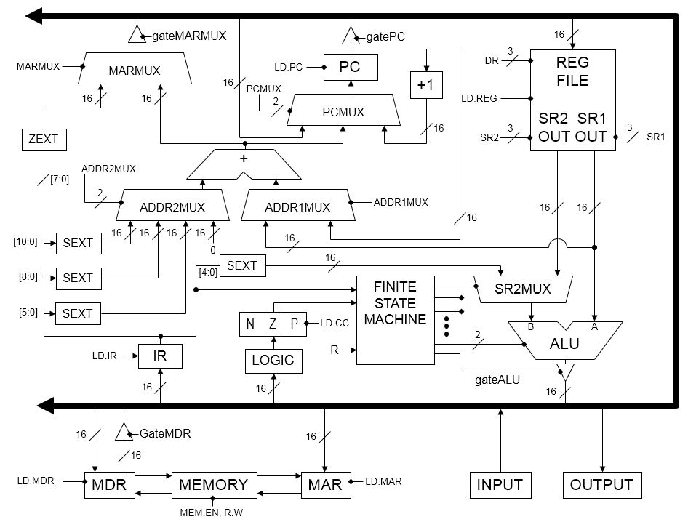
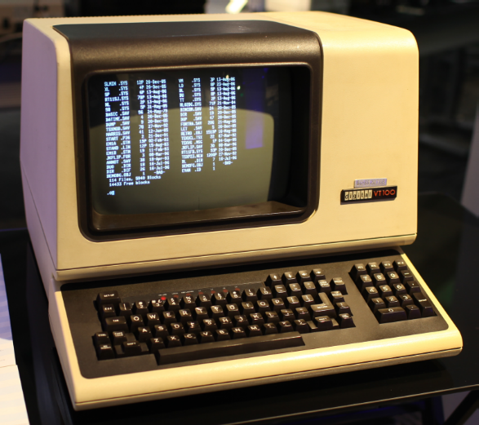

How do we do I/O?

Slide 6
How we do I/O

Slide 7
Device Registers
Data registers: Used for the actual transfer of data i.e. character code
Status registers: Information the device is telling us
Control registers: Allows us to set changeable device characteristics
Device registers are often part of the i/o device itself

Slide 8
Device Registers
Options
May be memory mapped. That is the device register has a memory address
May have special I/O instructions

Slide 9
Memory Mapped vs. Special I/O Instructions
If device registers are located at valid memory addresses, how can we access them?
How can they be located at valid memory addresses?
"The very old PDP-8 (from DEC, light years ago—1965) is an example of a computer that used special I/O instructions."

Slide 10
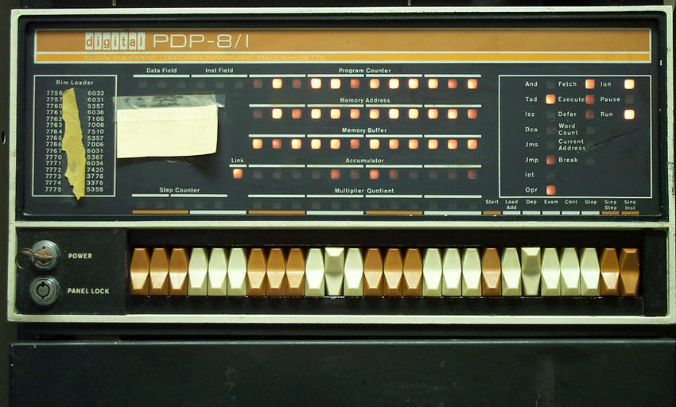

Slide 11

Bootstrapping
While pulling on bootstraps may help with putting on one's boots, it's impossible to lift oneself up like that. Nonetheless the fanciful idea is a great visual and it gave birth to the idiom "to pull oneself up by one's (own) bootstraps", meaning to better oneself with one's own efforts, with little outside help. It probably originated from the tall tales of Baron Münchausen who claimed to have lifted himself (and his horse) up from the swamp by pulling on his own hair. In computing, booting or bootstrapping is to load a fixed sequence of instructions in a computer to initiate the operating system. Earliest documented use: 1891.

Slide 12
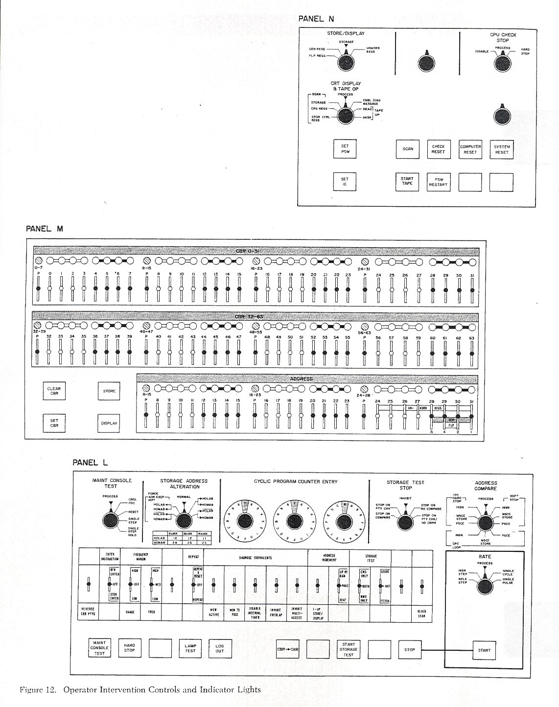
More Front Panels

Slide 13
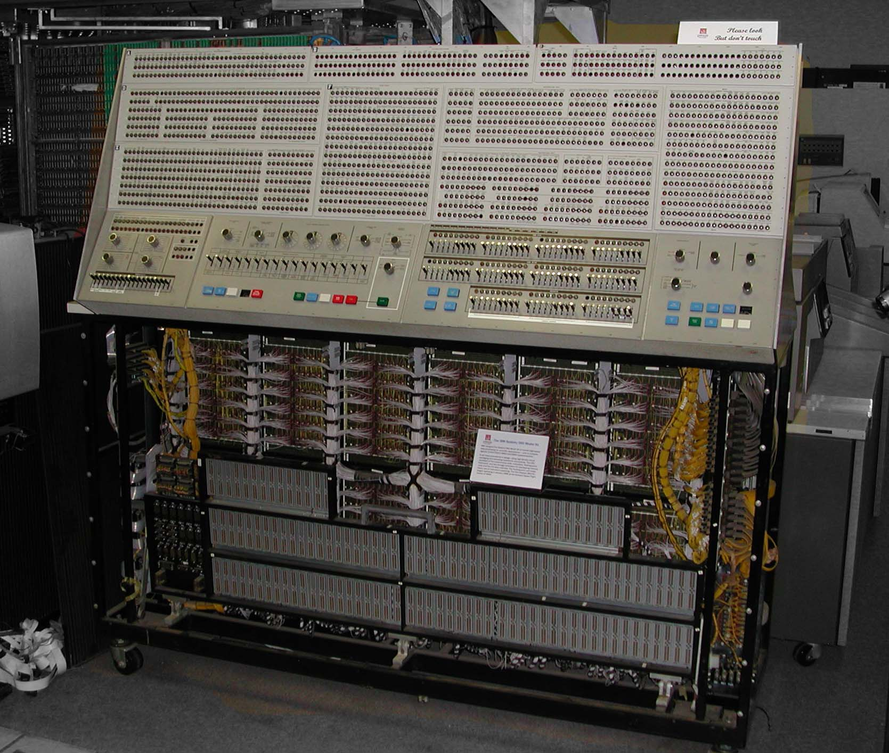
IBM S/360 Model 91

Slide 14
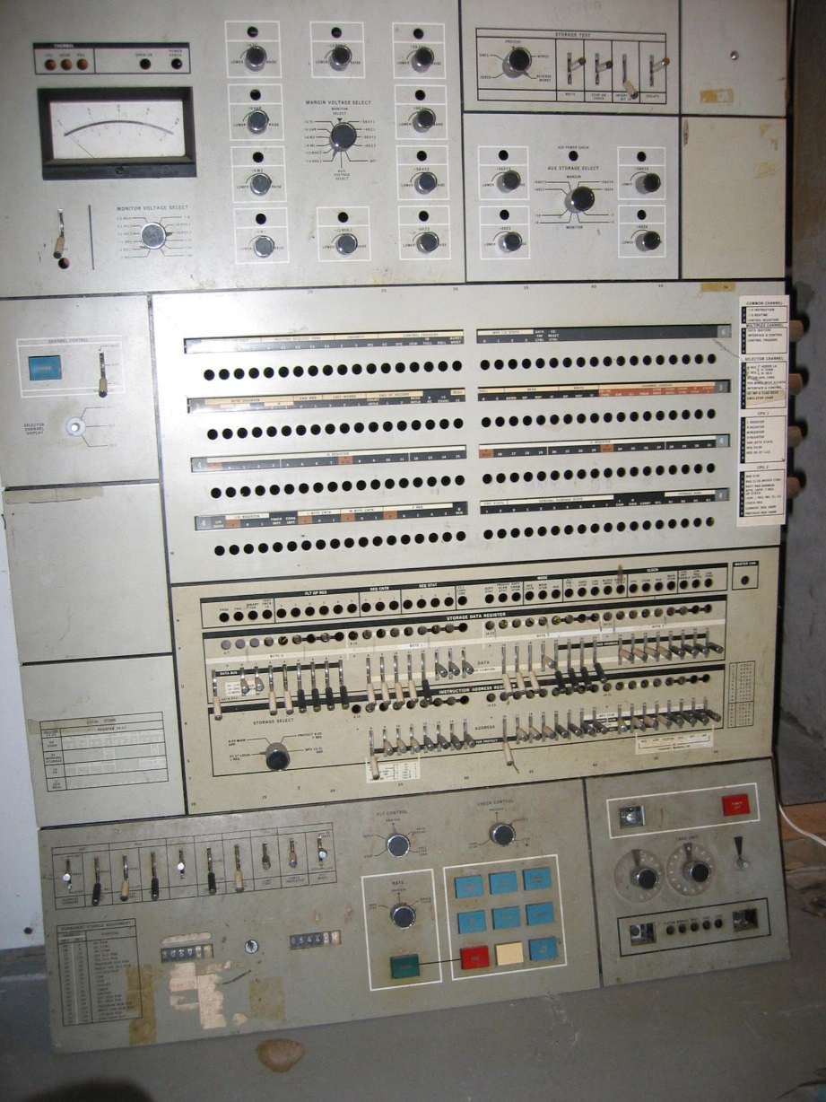
S/360

Slide 15
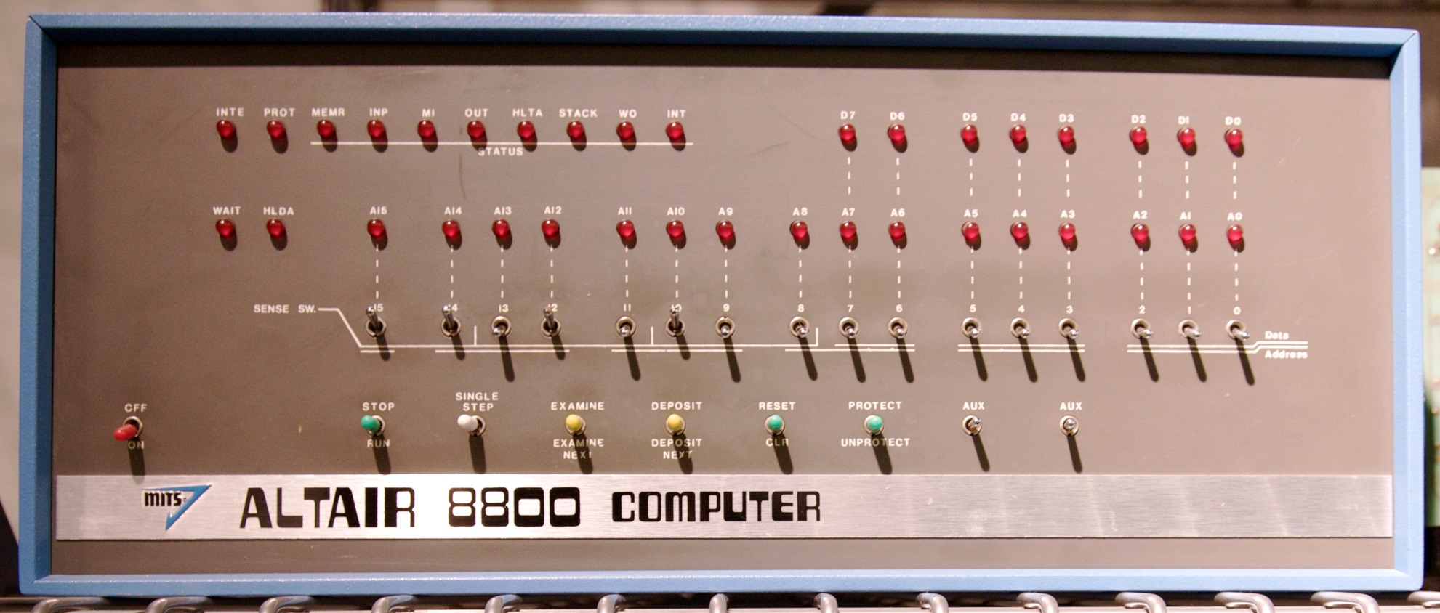
Altair 8800

Slide 16
LC-3 Address Space
x0000
xFDFF
xFE00 = 1111 1110 0000 0000
Device registers
How many?
xFFFF

Slide 17
Interrupt-Driven vs. Polling
Interrupt-driven
Excuse me but I've just given you a character
Polling
Has a character been typed?
Has a character been typed?
Has a character been typed?
Has a character been typed?
Has a character been typed?
Has a character been typed?

Slide 18
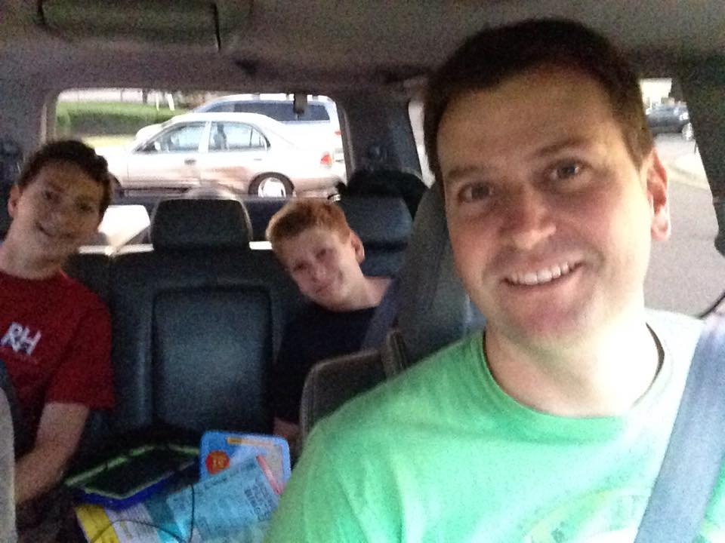
Family Vacation!

Slide 19
Keyboard Input
KBSR (xFE00)
Only uses 1 bit. Why bit 15 instead of 0?
Bit 15 is set when a character is available
KBDR (xFE02)
Really only need 8 bits but 16 easier
This location is read-only
Reading clears KBSR

Slide 20
.orig x3000
ld r4, term
lea r2, buffer ; Initialize buffer pointer
start ldi r1, kbsrA ; See if a char is there
BRzp start
ldi r0, kbdrA ; get the character
str r0, r2, 0 ; Store it in buffer
not r0, r0 ; Tricky 1s-complement subtract
add r0, r0, r4 ; to check for termination
not r0, r0 ; Turn -0 to +0 if equal
brZ quit
add r2, r2, 1 ; Increment buffer pointer
br start ; Do it again!
quit halt
term .fill x001A ; CTRL/Z
kbsrA .fill xfe00
kbdrA .fill xfe02
buffer .blkw x0100
.end

Slide 21
.orig x3000
ld r4, term
lea r2, buffer ; Initialize buffer pointer
start ldi r1, kbsrA ; See if a char is there
BRzp start
ldi r0, kbdrA ; get the character
str r0, r2, 0 ; Store it in buffer
not r0, r0 ; Tricky 1s-complement subtract
add r0, r0, r4 ; to check for termination
not r0, r0 ; Turn -0 to +0 if equal
brZ quit
add r2, r2, 1 ; Increment buffer pointer
br start ; Do it again!
quit halt
How about this instead of the red code?
not r0, r0 ; R0 – R4 == 0?
add r0, r0, #1
add r0, r0, r4

Slide 22
Memory Mapped Input
Gate
MDR
16
MDR
LD.MDR
MAR
LD.MAR
R.W/READ
16
INPUT
ADDRESS
CONTROL
LOGIC
MEMORY
KBSR
KBDR
16
2
2
MEM.EN,
R.W
INMUX

Slide 23
Monitor Output
DSR (xFE04)
Transferring a character to DDR clears DSR
When monitor is finished processing a character it sets DSR bit 15
"Please sir, may I have another?"
DDR (xFE06)
Transfer character to this address to print it on the monitor

Slide 24
.orig x3000
lea r2, buffer ; Initialize buffer ptr
start ldr r0, r2, 0 ; Get char into r0
brZ quit ; Terminate on null
sti r0, ddrA ; Send R0 to monitor
wait ldi r3, dsrA ; Are we done?
brZP wait
add r2, r2, 1 ; Move buffer ptr over 1
br start
quit halt
dsrA .fill xfe04
ddrA .fill xfe06
buffer .stringz "Hello, World!"
.end

Slide 25
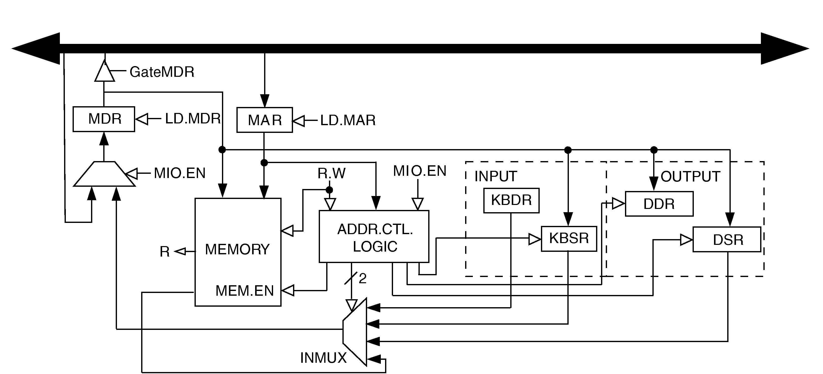
Full Implementation of LC-3 Memory-Mapped I/O
Because of interrupt enable bits, status registers (KBSR/DSR) must be written, as well as read.

Slide 26
Interrupt Driven I/O
Will be discussed after we cover the stack

Slide 27
Questions?

