Slide 1
TRAP Routines and Subroutines
Chapter 9

Slide 2
Outline
LC-3 TRAP Routines
Intro, TRAP Mechanism, TRAP Instruction, Complete Mechanism, TRAP Routines for I/O, TRAP Routine for Halting, Saving and Restoring Registers
Subroutines
Call/Return Mechanism, JSR(R) Instruction, TRAP Routine for Character Input (revisit), PUTS: Write string to monitor, Library Routines,

Slide 3
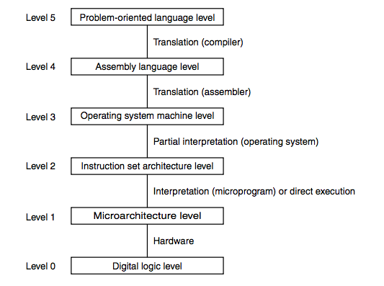
Road Map

Slide 4
Operating System Calls
Certain operations require specialized knowledge and protection:
specific knowledge of I/O device registers and the sequence of operations needed to use them
I/O and memory resources shared among multiple users/programs; a mistake could affect lots of other users/processes!
Not every programmer knows (or wants to know) this level of detail
Provide service routines or system calls (part of operating system) to safely and conveniently perform low-level, privileged operations

Slide 5
TRAP Instruction
Modern computers contain hardware and software protection schemes to prevent user programs from accidentally (or maliciously) interfering with proper system function.
We won't go into the details of this in CS2110
Suffice it to say, we need a way to communicate with the operating system which might be anywhere in memory

Slide 6
Why TRAP?

Slide 7
System Call
1. User program invokes system call.
2. Operating system code performs operation.
3. Returns control to user program.
In LC-3, this is done through the TRAP mechanism.

Slide 8
LC-3 TRAP Mechanism
1. A set of service routines.
part of operating system -- routines start at arbitrary addresses (convention is that system code is between x0200 and x3000)
up to 256 routines
2. Table of starting addresses.
stored at x0000 through x00FF in memory
called System Control Block in some architectures
3. TRAP instruction.
used by program to transfer control to operating system
8-bit trap vector names one of the 256 service routines
4. A linkage back to the user program.
want execution to resume immediately after the TRAP instruction
R7 gets the return address, just like in JSR

Slide 9
LC-3 Trap
That’s a lot of words! What do they mean!
Think of TRAP as just an indirect JSR with a choice of memory location from 0 through 255 (i.e. trapvect).
All the TRAP instruction does:
R7 = PC
PC = Mem[trapvect]

Slide 10
TRAP Instruction
Trap vector
identifies which system call to invoke
8-bit index into table of service routine addresses
in LC-3, this table is stored in memory at 0x0000 – 0x00FF
8-bit trap vector is zero-extended into 16-bit memory address
Where to go
lookup starting address from table; place in PC
How to get back
save address of next instruction (current PC) in R7

Slide 11
Executing a TRAP Instruction
TRAP
1111
0000
trapvect8
Zero extend trapvect8 to 16 bits and load into MAR
Read memory into MDR
R7 ← PC (The Linkage)
PC ← MDR

Slide 12
Common LC-3 Trap Numbers
TRAP
1111
0000
trapvect8
Vector | Routine
x23 | IN - input a character from the keyboard (R0)
x21 | OUT - output a character to the monitor (R0)
x25 | HALT - halt the program
See Table A.2 p 543

Slide 13
Question???
What happens if there is no HALT instruction?
Nothing, the processor will stop when it runs out of instructions
A memory boundary trap will occur
The processor will start to execute your data
Zombies will try and kill you

Slide 14
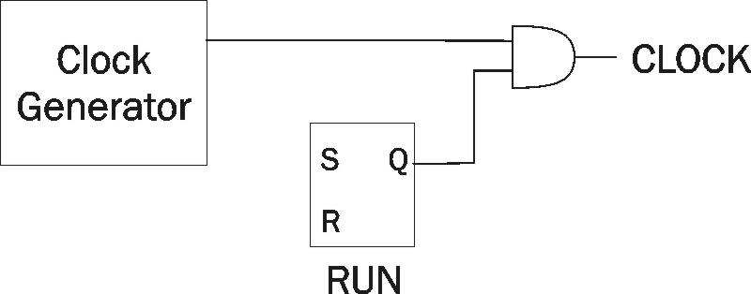
Stopping the Clock
The LC-3 FSM will repeat instruction processing sequence as long as clock is running.
If not processing instructions from your application, then it is processing instructions from the Operating System (OS).
No sense wasting a scarce opcode for HALT when we can use a trap routine in the OS that resets the RUN register to 0.
To stop the computer:
AND the clock generator signal with ZERO
When FSM stops seeing the CLOCK signal, it stops processing.

Slide 15
Trap Service Routines
The assembler will recognize aliases for certain predefined trap instructions
TRAP x20 GETC
TRAP x21 OUT
TRAP x22 PUTS
TRAP x23 IN
TRAP x24 PUTSP
TRAP x25 HALT

Slide 16
HOW DO WE GET BACK?

Slide 17
Compare & Contrast
JMP
1100
000
BaseR
000000
RET
1100
000
111
000000

Slide 18
Saving & Restoring Registers
Why should we save a register?
When should we save a register?
Who should save the register?
3

Slide 19
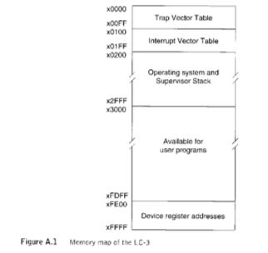
Memory Map of the LC-3

Slide 20
In the same vein...
Why do we have functions, methods, subroutines, procedures, etc.?

Slide 25
Call/Return Mechanism
JSR
0100
1
PCoffset11
JSRR
0100
0
00
BaseR
000000
RET
1100
000
111
000000

Slide 26
What does JSR do?
JSR
0100
1
PCoffset11

Slide 27
What does JSR do?
JSR
0100
1
PCoffset11
R7 <- PC
PC <- PC + PCOffset11
(remember, PC has been incremented in the Fetch cycle)

Slide 28
What does JSRR do?
JSRR
0100
0
00
BaseR
000000

Slide 29
What does JSRR do?
JSRR
0100
0
00
BaseR
000000
R7 <- PC
PC <- BaseR

Slide 30
What does RET do?
RET
1100
000
111
000000

Slide 31
What does RET do?
Jumps to R7
RET
1100
000
111
000000

Slide 32
Assembly
jsr sub
sub xxx xxx xxx
...
...
...
ret
ld R2, far
jsrr r2
far .fill sub
...
...
sub xxx xxx xxx
ret

Slide 33
TRAP vs JSR(R)
TRAP
Uses trap vector table
(Can get to from anywhere)
Normally do system functions
I/O
Written very carefully!
Typically tied into some sort of system protection mechanism
JSR(R)
Nearby (JSR)
Anywhere (JSRR)
with some work
Routine abstraction
Code reuse/libraries
No protection mechanism

Slide 34
Questions?

