Slide 1
Dynamic Allocation
Chapter 19
Section 19.4

Slide 2
Handling Persistent Data

Slide 3
Persistent Data I
char *foo(void)
{
static char ca[10];
return ca;
}
Anyone calling this function now has access to ca in this block. Could be dangerous. Why?
Note that this approach is not dynamic

Slide 4
Example
char *strFromUnsigned(unsigned u)
{
static char strDigits[] = “?????”;
char *pch;
pch = &strDigits[5];
do
*--pch = (u % 10) + '0';
while((u /= 10) > 0);
return pch;
}

Slide 5
Problem in use
strHighScore = strFromUnsigned(HighScore);
.
.
.
strThisScore = strFromUnsigned(ThisScore);

Slide 6
Persistent Data II
char *foo(void)
{
char ca[10];
return ca;
}
Since ca was allocated on stack during function call pointer returned is now pointing to who-knows-what
Bad

Slide 7
Persistent Data III
char *foo(void)
{
char *ca = malloc(...);
/* error checking but no free */
return ca;
}
This actually works, but the caller needs to know that they’re responsible for the free()

Slide 8
Memory Leaks
Memory leaks occur when the programmer loses track of memory allocated by malloc or other functions that call malloc
void foo(void)
{
char *ca = malloc(...);
/* no free */
return;
}
Bad

Slide 9
Memory Management
Some functions that call malloc
calloc
strdup
regcmp
others...
C doesn’t do automatic memory management for efficiency reasons
If you want to manage memory...do it yourself!

Slide 10
Calloc() & Realloc()
void *calloc(size_t num, size_t size);
Find space for num new allocations
Initialize all blocks to zero (0)
Not much to discuss…
void *realloc(void *ptr, size_t size);
Find space for new allocation
Copy original data into new space
Free old space
Return pointer to new space

Slide 11
Realloc
ptr = realloc(ptr, num_bytes);
What it does (conceptually)
Find space for new allocation
Copy original data into new space
Free old space
Return pointer to new space

Slide 12
Realloc
ptr
in-use
Before
in-use
After
ptr

Slide 13
Realloc: What might happen
ptr
unused
Before
ptr
After

Slide 14
Realloc
Realloc may return
same pointer
different pointer
NULL
Is this a good idea?
cp = realloc(cp, n);
Yes
No
Sometimes

Slide 15
Realloc
Is this a good idea?
cp = realloc(cp, n);
No!
If realloc returns NULL cp is lost
Memory Leak!

Slide 16
How to do it properly
void *tmp;
if((tmp = realloc(cp,...)) == NULL)
{
/* realloc error */
}
else
{
cp = tmp;
free(tmp);
}
NO!

Slide 17
Additional Information
realloc(NULL, n) ≡ malloc(n);
realloc(cp, 0) ≡ free(cp);
These can be used to make realloc work in a single loop design to build a dynamic structure such as a linked list.

Slide 18
Example
int size = 0; /* Size of "array" */
int *ip = NULL; /* Pointer to "array" */
int *temp;
int i;
char buffer[80];
while(fgets(buffer, 80, stdin) != NULL) {
buffer[strlen(buffer) - 1] = '\0';
size++;
if( (temp = realloc(ip, size*sizeof(*temp))) == NULL)
{
fprintf(stderr, "Realloc failure\n");
exit(EXIT_FAILURE);
}
ip = temp;
ip[size - 1] = strtol(buffer, NULL, 10);
}

Slide 19
But If You Exit on Failure…
int size = 0; /* Size of "array" */
int *ip = NULL; /* Pointer to "array" */
int *temp;
int i;
char buffer[80];
while(fgets(buffer, 80, stdin) != NULL) {
buffer[strlen(buffer) - 1] = '\0';
size++;
if( (tempip = realloc(ip, size*sizeof(*temp))) == NULL)
{
fprintf(stderr, "Realloc failure\n");
exit(EXIT_FAILURE);
}
ip = temp;
ip[size - 1] = strtol(buffer, NULL, 10);
}

Slide 20
Dynamic Allocation What can go wrong?
Allocate a block and lose it by losing the value of the pointer
Allocate a block of memory and use the contents without initialization
Read or write beyond the boundaries of the block
Free a block but continue to use the contents
Call realloc to expand a block of memory and then – once moved – keep using the old address
FAIL TO NOTICE ERROR CONDITIONS

Slide 21
Questions?

Slide 22
Malloc Implementation

Slide 23
Outline
K&R Malloc Implementation
Headers, Structs and Unions
Heap Layout
Allocating the Correct Amount of Memory
malloc(): Getting the memory for work
free(): Recycling the memory when done
morecore(): OS requests for real memory

Slide 24
Memory Management
The K&R implementations of malloc() and free() are deliberately simple
Not necessarily the most efficient, and certainly not the only way:
http://codinghighway.com/2013/07/13/the-magic-of-wrappers/
http://www.inf.udec.cl/~leo/Malloc_tutorial.pdf
https://danluu.com/malloc-tutorial/

Slide 25
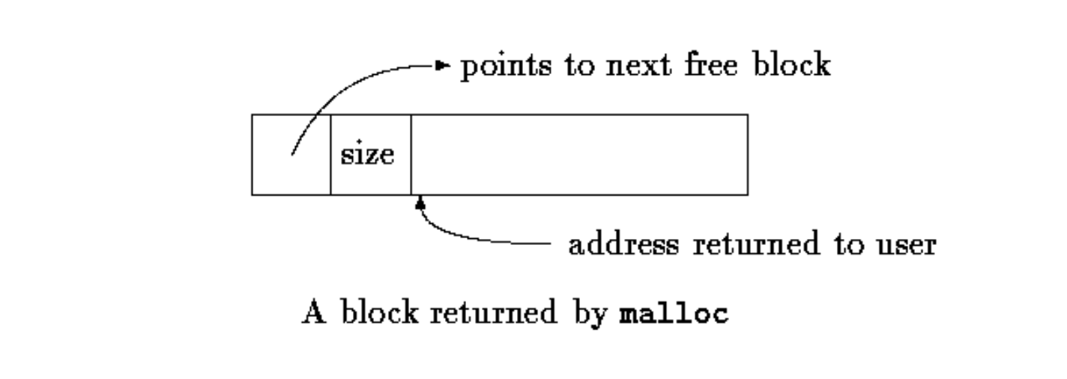
Section of K&R Code
typedef long Align; // for alignment to long boundary
union header // block header:
{
struct
{
union header *ptr; // location of the next block
unsigned size; // size of this block
} s;
Align x; // force alignment
};
typedef union header Header;
typedef Header

Slide 26
Returned by Malloc
typedef Header
If the variable Header *p; points to the beginning of a block, where does &p[1] point?

Slide 27
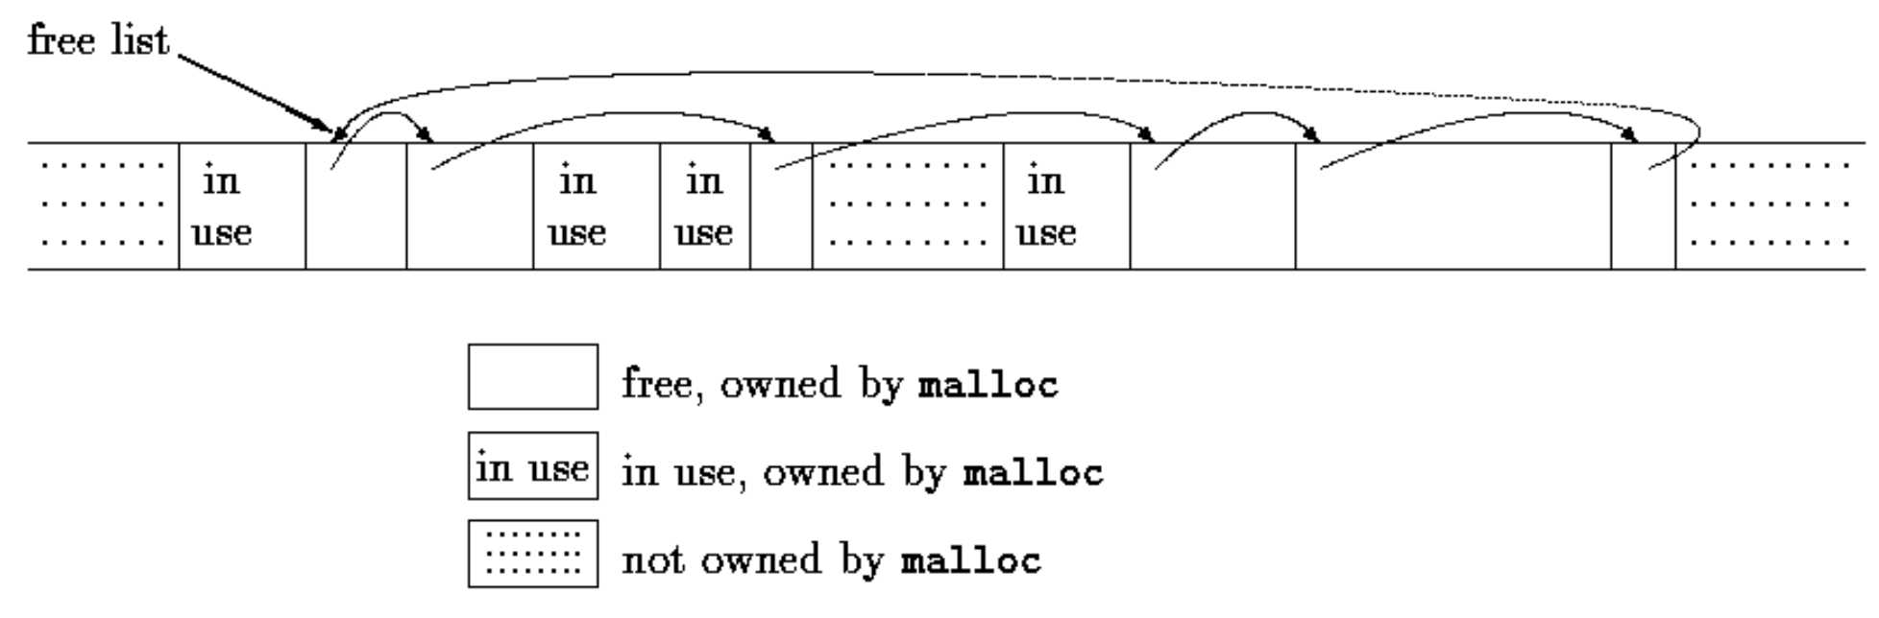
Heap Layout
K&R ch. 8
One of those free blocks has user data size 0 and isn’t in the heap, so it is never handed over by malloc().

Slide 28
Section of K&R Code
static Header base; // empty list to get started with
static Header *freep = NULL; // start of free list
void *malloc(unsigned nbytes);
/* malloc: general-purpose storage allocator */
void *malloc(unsigned nbytes)
{
Header *p, *prevp;
Header *morecore(unsigned);
unsigned nunits;
nunits = (nbytes+sizeof(Header)-1)/sizeof(Header) + 1;
The key here is alignment with the Header’s size
You need (just) enough bytes to cover the program’s request and the header information while supporting the free list structure (metadata)
Suppose that the Header consists of 8 bytes [sizeof(Header) = 8]
Take a look at different requests for sizes as represented by nbytes
nbytes | 7 | 8 | 9 | 15 | 16 | 17
nunits | 2 | 2 | 3 | 3 | 3 | 4

Slide 29
Section of malloc() Code
if ((prevp = freep) == NULL) // no free list yet
{
base.s.ptr = freep = prevp = &base;
base.s.size = 0;
}
base
0
s
ptr
size
freep *
NULL
&base
p *
prevp *
NULL
&base

Slide 30
Section of malloc() Code
for (p = prevp->s.ptr; ; prevp = p, p = p->s.ptr)
{
if (p->s.size >= nunits) // big enough
{
if (p->s.size == nunits) // exactly
prevp->s.ptr = p->s.ptr;
else // allocate tail end
{
p->s.size -= nunits;
p += p->s.size;
p->s.size = nunits;
}
freep = prevp;
return (void *)(p+1);
}
if (p == freep) // wrapped around free list
if ((p = morecore(nunits)) == NULL)
return NULL; // none left
}
prevp
p
freep

Slide 31
Section of K&R Code
if (p->s.size == nunits) // exactly
prevp->s.ptr = p->s.ptr;
else // allocate tail end
{
p->s.size -= nunits;
p += p->s.size;
p->s.size = nunits;
}
freep = prevp;
return (void *)(p+1);
freep *
(void *)(p+1)
prevp
p
2
p
7
1
10
3
7
5
Let nunits = 7, and follow how the free block is identified and returned

Slide 32
Section of free() Code
/* free: put block ap in free list */
void free(void *ap)
{
Header *bp, *p;
bp = (Header *)ap - 1; // point to block header
for (p = freep; !(bp > p && bp < p->s.ptr); p = p->s.ptr)
if (p >= p->s.ptr && (bp > p || bp < p->s.ptr))
break; // freed block at start of end of arena
if (bp + bp->s.size == p->s.ptr) // join to upper
. . .
if (p + p->s.size == bp)
. . .
freep = p;
bp
p
p->s.ptr
freep

Slide 33
Returned by Malloc
typedef Header
If the variable void *ap; points to the address returned to the user, where does &((Header *)ap)[-1] point?

Slide 34
Section of free() Code 2
if (bp + bp->s.size == p->s.ptr) // join to upper
{
bp->s.size += p->s.ptr->s.size;
bp->s.ptr = p->s.ptr->s.ptr;
}
else
bp->s.ptr = p->s.ptr;
p
if
bp
2
3
3
10
7
4
p
bp
6
else
1
3
7
4

Slide 35
Section of free() Code 3
if (p + p->s.size == bp) /* join to lower nbr */
{
p->s.size += bp->s.size;
p->s.ptr = bp->s.ptr;
}
else
p->s.ptr = bp;
p
if
2
bp
3
13
3
10
7
4
p
2
bp
6
else
1
3
7
4

Slide 36
Section of morecore() Code
#define NALLOC 1024 // minimum #units to request
/* morecore: ask system for more memory */
Header *morecore(unsigned nu)
{
char *cp, *sbrk(int);
Header *up;
if (nu < NALLOC)
nu = NALLOC;
cp = sbrk(nu * sizeof(Header));
if (cp == (char *) -1) // no space at all
return NULL;
up = (Header *) cp;
up->s.size = nu;
free((void *)(up + 1));
return freep;
}

Slide 37
Section of morecore() Code 2
cp = sbrk(nu * sizeof(Header));
if (cp == (char *) -1) // no space at all
return NULL;
sbrk() is a Linux system call to obtain more memory.
It works at the top of the heap to acquire n bytes more space from the OS
It returns a pointer to the new space or -1 if no space is available
The -1 is an odd historical artifact
Stack
Add’l Heap
Heap
Data
return pointer from sbrk()
Code

Slide 38
Memory Management
What were the equivalents of malloc and free in Java? Python?
How can we “automatically” collect garbage?
Mark & Sweep Techniques
Reference Counting Techniques
And many, many others...

