Slide 1
Search Algorithms for Discrete Optimization Problems
Ananth Grama, Anshul Gupta, George Karypis, and Vipin Kumar
To accompany the text ``Introduction to Parallel Computing'',
Addison Wesley, 2003.

Slide 2
Topic Overview
Discrete Optimization - Basics
Sequential Search Algorithms
Parallel Depth-First Search
Parallel Best-First Search
Speedup Anomalies in Parallel Search Algorithms

Slide 3
Discrete Optimization - Basics
Discrete optimization forms a class of computationally expensive problems of significant theoretical and practical interest.
Search algorithms systematically search the space of possible solutions subject to constraints.

Slide 4
Definitions
A discrete optimization problem can be expressed as a tuple (S, f). The set is a finite or countably infinite set of all solutions that satisfy specified constraints.
The function f is the cost function that maps each element in set S onto the set of real numbers R.
The objective of a DOP is to find a feasible solution x_{opt}, such that f(x_{opt}) ≤ f(x) for all x ∈ S.
A number of diverse problems such as VLSI layouts, robot motion planning, test pattern generation, and facility location can be formulated as DOPs.

Slide 5


Discrete Optimization: Example
In the 0/1 integer-linear-programming problem, we are given an m×n matrix A, an m×1 vector b, and an n×1 vector c.
The objective is to determine an n×1 vector whose elements can take on only the value 0 or 1.
The vector must satisfy the constraint
and the function
must be minimized.

Slide 6
Discrete Optimization: Example
The 8-puzzle problem consists of a 3×3 grid containing eight tiles, numbered one through eight.
One of the grid segments (called the ``blank'') is empty. A tile can be moved into the blank position from a position adjacent to it, thus creating a blank in the tile's original position.
The goal is to move from a given initial position to the final position in a minimum number of moves.

Slide 7
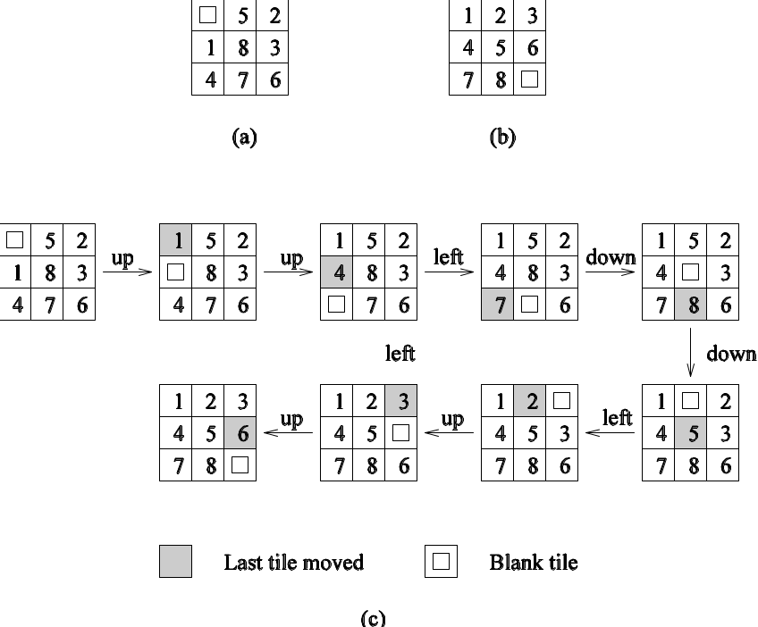
Discrete Optimization: Example
An 8-puzzle problem instance: (a) initial configuration; (b) final configuration; and (c) a sequence of moves leading from the initial to the final configuration.

Slide 8
Discrete Optimization Basics
The feasible space S is typically very large.
For this reason, a DOP can be reformulated as the problem of finding a minimum-cost path in a graph from a designated initial node to one of several possible goal nodes.
Each element x in S can be viewed as a path from the initial node to one of the goal nodes.
This graph is called a state space.

Slide 9
Discrete Optimization Basics
Often, it is possible to estimate the cost to reach the goal state from an intermediate state.
This estimate, called a heuristic estimate, can be effective in guiding search to the solution.
If the estimate is guaranteed to be an underestimate, the heuristic is called an admissible heuristic.
Admissible heuristics have desirable properties in terms of optimality of solution (as we shall see later).

Slide 10
Discrete Optimization: Example
An admissible heuristic for 8-puzzle is as follows:
Assume that each position in the 8-puzzle grid is represented as a pair.
The distance between positions (i,j) and (k,l) is defined as |i - k| + |j - l|. This distance is called the Manhattan distance.
The sum of the Manhattan distances between the initial and final positions of all tiles is an admissible heuristic.

Slide 11
Parallel Discrete Optimization: Motivation
DOPs are generally NP-hard problems. Does parallelism really help much?
For many problems, the average-case runtime is polynomial.
Often, we can find suboptimal solutions in polynomial time.
Many problems have smaller state spaces but require real-time solutions.
For some other problems, an improvement in objective function is highly desirable, irrespective of time.

Slide 12
Sequential Search Algorithms
Is the search space a tree or a graph?
The space of a 0/1 integer program is a tree, while that of an 8-puzzle is a graph.
This has important implications for search since unfolding a graph into a tree can have significant overheads.

Slide 13
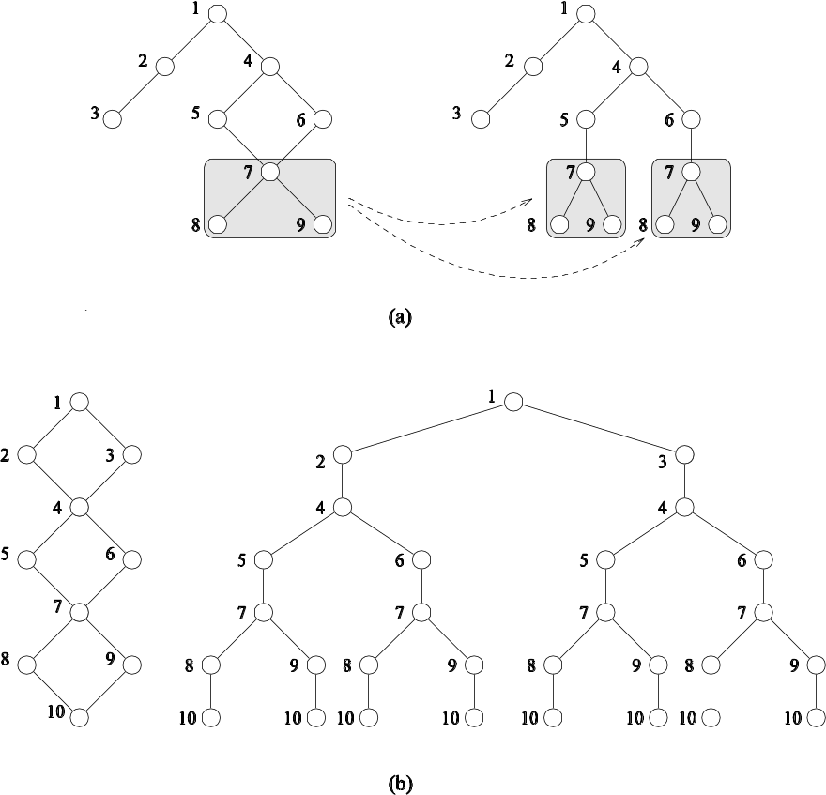
Sequential Search Algorithms
Two examples of unfolding a graph into a tree.

Slide 14
Depth-First Search Algorithms
Applies to search spaces that are trees.
DFS begins by expanding the initial node and generating its successors. In each subsequent step, DFS expands one of the most recently generated nodes.
If there exists no success, DFS backtracks to the parent and explores an alternate child.
Often, successors of a node are ordered based on their likelihood of reaching a solution. This is called directed DFS.
The main advantage of DFS is that its storage requirement is linear in the depth of the state space being searched.

Slide 15
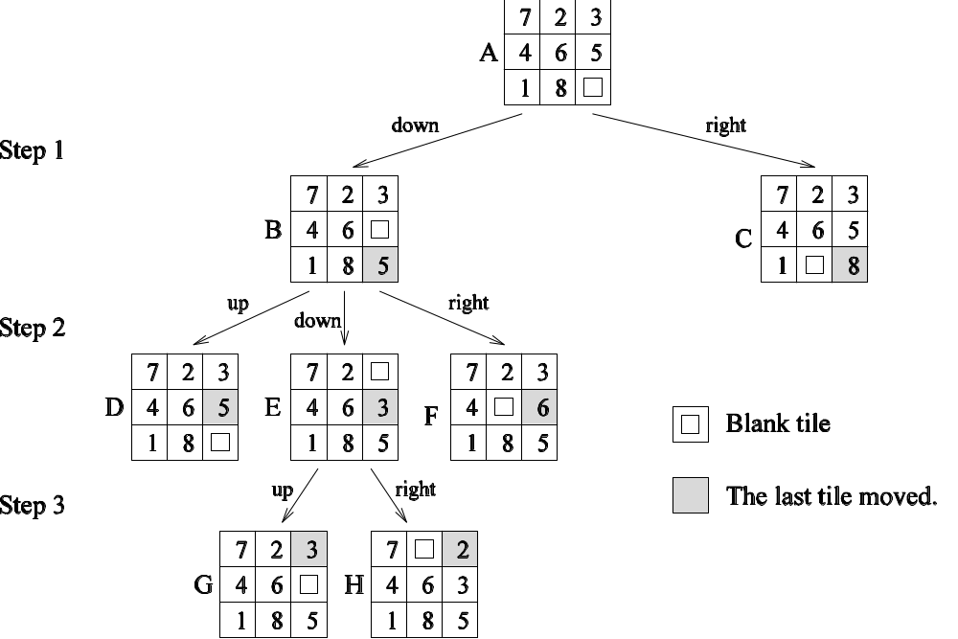
Depth-First Search Algorithms
States resulting from the first three steps of depth-first search applied to an instance of the 8-puzzle.

Slide 16
DFS Algorithms: Simple Backtracking
Simple backtracking performs DFS until it finds the first feasible solution and terminates.
Not guaranteed to find a minimum-cost solution.
Uses no heuristic information to order the successors of an expanded node.
Ordered backtracking uses heuristics to order the successors of an expanded node.

Slide 17
Depth-First Branch-and-Bound (DFBB)
DFS technique in which upon finding a solution, the algorithm updates current best solution.
DFBB does not explore paths that are guaranteed to lead to solutions worse than current best solution.
On termination, the current best solution is a globally optimal solution.

Slide 18
Iterative Deepening Search
Often, the solution may exist close to the root, but on an alternate branch.
Simple backtracking might explore a large space before finding this.
Iterative deepening sets a depth bound on the space it searches (using DFS).
If no solution is found, the bound is increased and the process repeated.

Slide 19
Iterative Deepening A* (IDA*)
Uses a bound on the cost of the path as opposed to the depth.
IDA* defines a function for node x in the search space as l(x) = g(x) + h(x). Here, g(x) is the cost of getting to the node and h(x) is a heuristic estimate of the cost of getting from the node to the solution.
At each failed step, the cost bound is incremented to that of the node that exceeded the prior cost bound by the least amount.
If the heuristic h is admissible, the solution found by IDA* is optimal.

Slide 20
DFS Storage Requirements and Data Structures
At each step of DFS, untried alternatives must be stored for backtracking.
If m is the amount of storage required to store a state, and d is the maximum depth, then the total space requirement of the DFS algorithm is O(md).
The state-space tree searched by parallel DFS can be efficiently represented as a stack.
Memory requirement of the stack is linear in depth of tree.

Slide 21
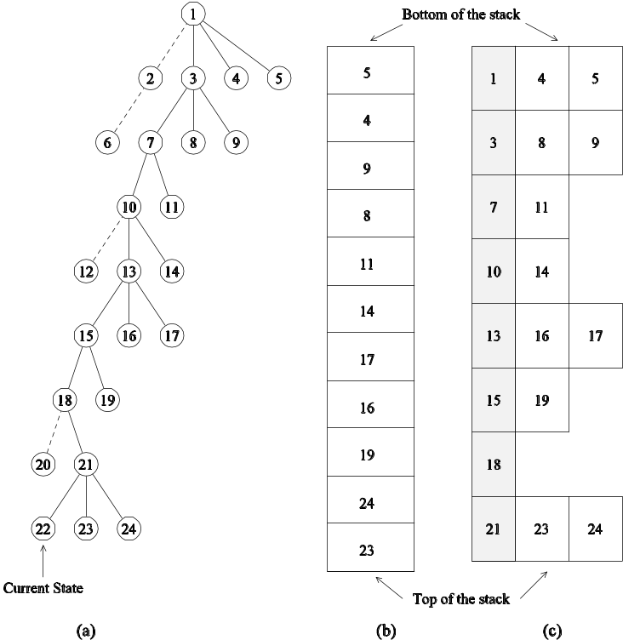
DFS Storage Requirements and Data Structures
Representing a DFS tree: (a) the DFS tree; Successor nodes shown with dashed lines have already been explored; (b) the stack storing untried alternatives only; and (c) the stack storing untried alternatives along with their parent. The shaded blocks represent the parent state and the block to the right represents successor states that have not been explored.

Slide 22
Best-First Search (BFS) Algorithms
BFS algorithms use a heuristic to guide search.
The core data structure is a list, called Open list, that stores unexplored nodes sorted on their heuristic estimates.
The best node is selected from the list, expanded, and its off-spring are inserted at the right position.
If the heuristic is admissible, the BFS finds the optimal solution.

Slide 23
Best-First Search (BFS) Algorithms
BFS of graphs must be slightly modified to account for multiple paths to the same node.
A closed list stores all the nodes that have been previously seen.
If a newly expanded node exists in the open or closed lists with better heuristic value, the node is not inserted into the open list.

Slide 24
The A* Algorithm
A BFS technique that uses admissible heuristics.
Defines function l(x) for each node x as g(x) + h(x).
Here, g(x) is the cost of getting to node x and h(x) is an admissible heuristic estimate of getting from node x to the solution.
The open list is sorted on l(x).
The space requirement of BFS is exponential in depth!

Slide 25
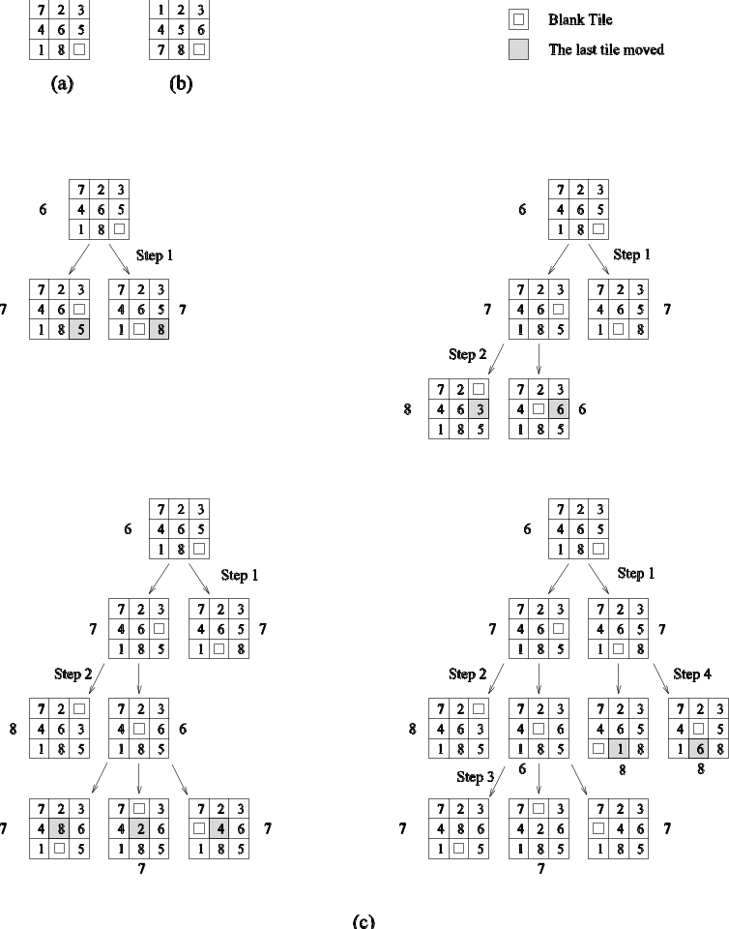
Best-First Search: Example
Applying best-first search to the 8-puzzle: (a) initial configuration; (b) final configuration; and (c) states resulting from the first four steps of best-first search. Each state is labeled with its -value (that is, the Manhattan distance from the state to the final state).

Slide 27
Search Overhead Factor
The amount of work done by serial and parallel formulations of search algorithms is often different.
Let W be serial work and W_{P} be parallel work. Search overhead factor s is defined as W_{P}/W.
Upper bound on speedup is p×(W/W_{P}).

Slide 28
Parallel Depth-First Search
How is the search space partitioned across processors?
Different subtrees can be searched concurrently.
However, subtrees can be very different in size.
It is difficult to estimate the size of a subtree rooted at a node.
Dynamic load balancing is required.

Slide 29
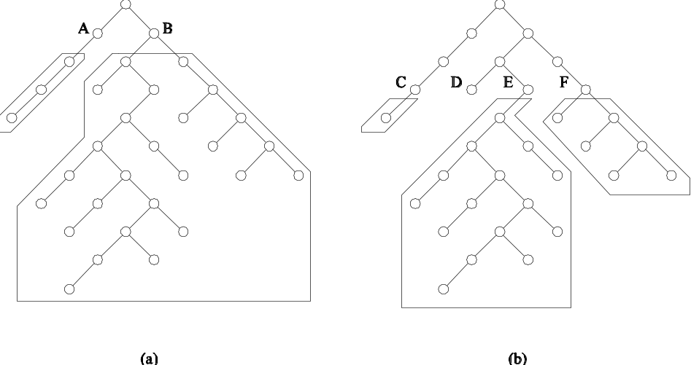
Parallel Depth-First Search
The unstructured nature of tree search and the imbalance resulting from static partitioning.

Slide 30
Parallel Depth-First Search: Dynamic Load Balancing
When a processor runs out of work, it gets more work from another processor.
This is done using work requests and responses in message passing machines and locking and extracting work in shared address space machines.
On reaching final state at a processor, all processors terminate.
Unexplored states can be conveniently stored as local stacks at processors.
The entire space is assigned to one processor to begin with.

Slide 31
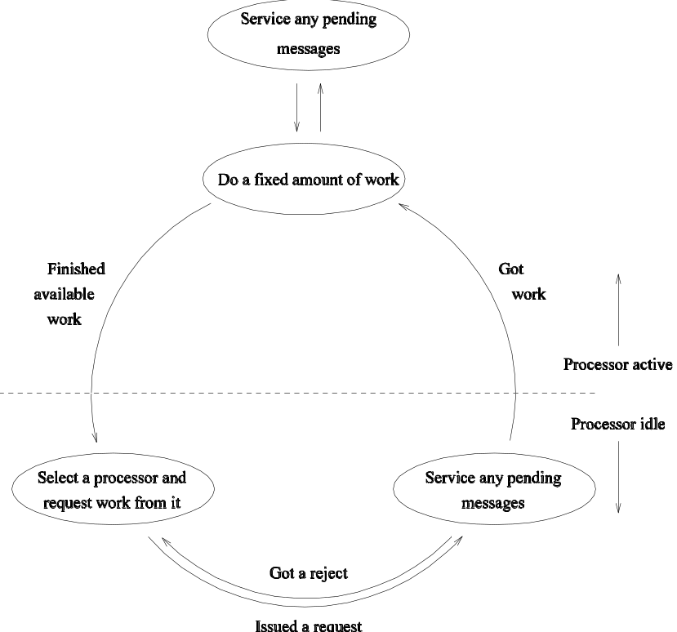
Parallel Depth-First Search: Dynamic Load Balancing
A generic scheme for dynamic load balancing.

Slide 32
Parameters in Parallel DFS: Work Splitting
Work is split by splitting the stack into two.
Ideally, we do not want either of the split pieces to be small.
Select nodes near the bottom of the stack (node splitting), or
Select some nodes from each level (stack splitting).
The second strategy generally yields a more even split of the space.

Slide 33
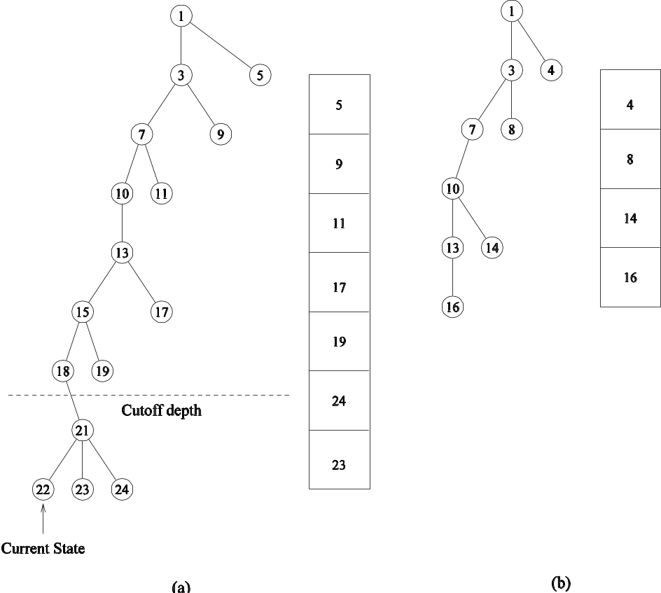
Parameters in Parallel DFS: Work Splitting
Splitting the DFS tree: the two subtrees along with their stack representations are shown in (a) and (b).

Slide 34
Load-Balancing Schemes
Who do you request work from? Note that we would like to distribute work requests evenly, in a global sense.
Asynchronous round robin: Each processor maintains a counter and makes requests in a round-robin fashion.
Global round robin: The system maintains a global counter and requests are made in a round-robin fashion, globally.
Random polling: Request a randomly selected processor for work.

Slide 35
Analyzing DFS
We can’t compute, analytically, the serial work W or parallel time. Instead, we quantify total overhead T_{o} in terms of W to compute scalability.
For dynamic load balancing, idling time is subsumed by communication.
We must quantify the total number of requests in the system.

Slide 36
Analyzing DFS: Assumptions
Work at any processor can be partitioned into independent pieces as long as its size exceeds a threshold ε.
A reasonable work-splitting mechanism is available.
If work w at a processor is split into two parts ψw and (1 - ψ)w, there exists an arbitrarily small constant α (0 < α ≤ 0.5), such that ψw > αw and (1 - ψ)w > αw.
The costant α sets a lower bound on the load imbalance from work splitting.

Slide 37
Analyzing DFS
If processor P_{i} initially had work w_{i}, after a single request by processor P_{j} and split, neither P_{i} nor P_{j} have more than (1 - α)w_{i} work.
For each load balancing strategy, we define V(P) as the total number of work requests after which each processor receives at least one work request (note that V(p) ≥ p).
Assume that the largest piece of work at any point is W.
After V(p) requests, the maximum work remaining at any processor is less than (1 - α)W; after 2V(p) requests, it is less than (1 - α)²W.
After (log_{1/1(1- α )}(W/ε))V(p) requests, the maximum work remaining at any processor is below a threshold value ε.
The total number of work requests is O(V(p)log W).

Slide 38




Analyzing DFS
If t_{comm} is the time required to communicate a piece of work, then the communication overhead is given by
T₀ = t_{comm}V(p)log W (1)
The corresponding efficiency E is given by

Slide 39
Analyzing DFS: for Various Schemes
Asynchronous Round Robin: V(p) = O(p²) in the worst case.
Global Round Robin: V(p) = p.
Random Polling: Worst case V(p) is unbounded. We do average case analysis.

Slide 40
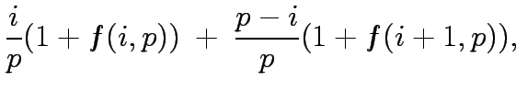

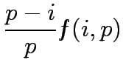
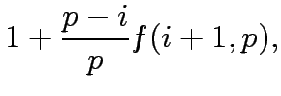

for Random Polling
Let F(i,p) represent a state in which i of the processors have been requested, and p - i have not.
Let f(i,p) denote the average number of trials needed to change from state F(i,p) to F(p,p) (V(p) = f(0,p)).

Slide 41
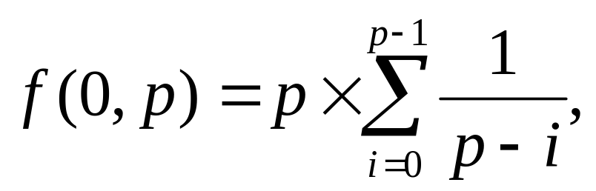
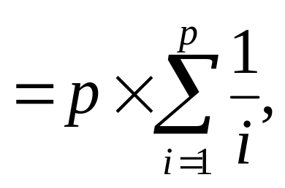
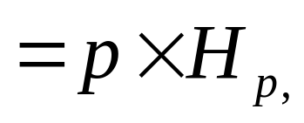
for Random Polling
We have:
As p becomes large, H_{p} ≃ 1.69ln p (where ln p denotes the natural logarithm of p ). Thus, V(p) = O(plog p).

Slide 42
Analysis of Load-Balancing Schemes
If t_{comm} = O(1) , we have,
T₀ = O(V(p)log W). (2)
Asynchronous Round Robin: Since V(p) = O(p²), T₀ = O(p²log w). It follows that:
W = O(p²log(p²log W)),
= O(p²log p + p²log log W)
= O(p²log p)

Slide 43
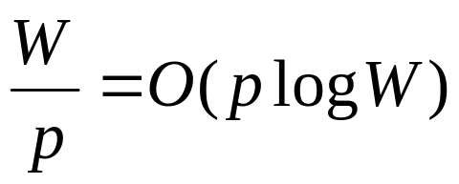
Analysis of Load-Balancing Schemes
Global Round Robin: Since V(p) = O(p), T₀ = O(plog W). It follows that W = O(plog p).
However, there is contention here! The global counter must be incremented O(plog W) times in O(W/p) time.
From this, we have:
(3)
and W = O(p²log p).
The worse of these two expressions, W = O(p²log p) is the isoefficiency.

Slide 44
Analysis of Load-Balancing Schemes
Random Polling: We have V(p) = O(plog p), T_{o} = O(plog plogW)
Therefore W = O(plog²p).

Slide 45
Analysis of Load-Balancing Schemes: Conclusions
Asynchronous round robin has poor performance because it makes a large number of work requests.
Global round robin has poor performance because of contention at counter, although it makes the least number of requests.
Random polling strikes a desirable compromise.

Slide 46
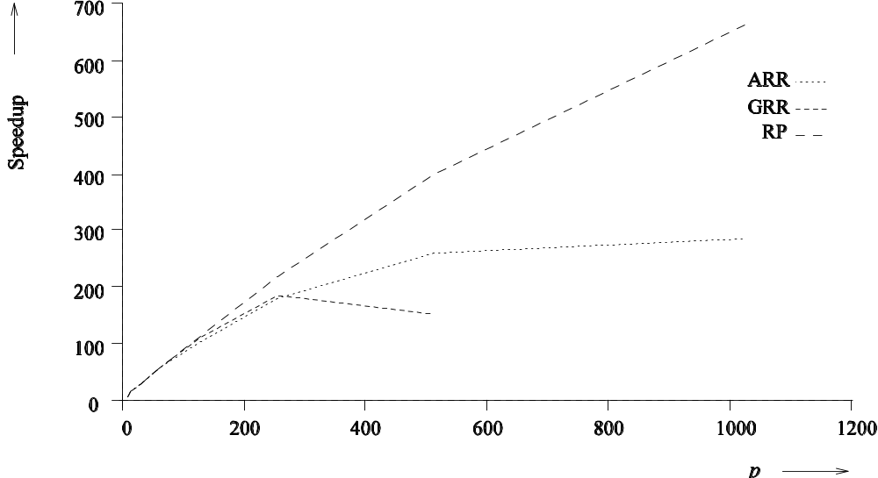
Experimental Validation: Satisfiability Problem
Speedups of parallel DFS using ARR, GRR and RP load-balancing schemes.

Slide 47
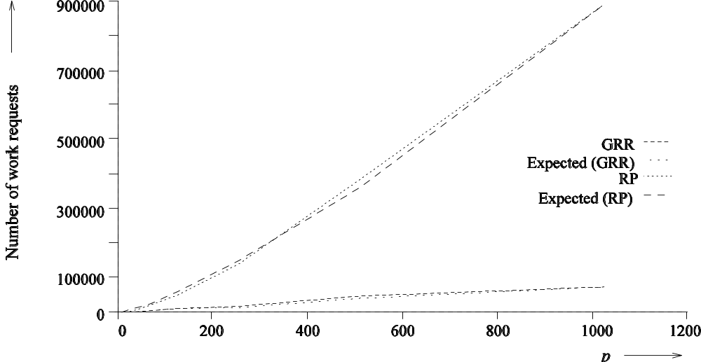
Experimental Validation: Satisfiability Problem
Number of work requests generated for RP and GRR and their expected values ( and respectively).

Slide 48
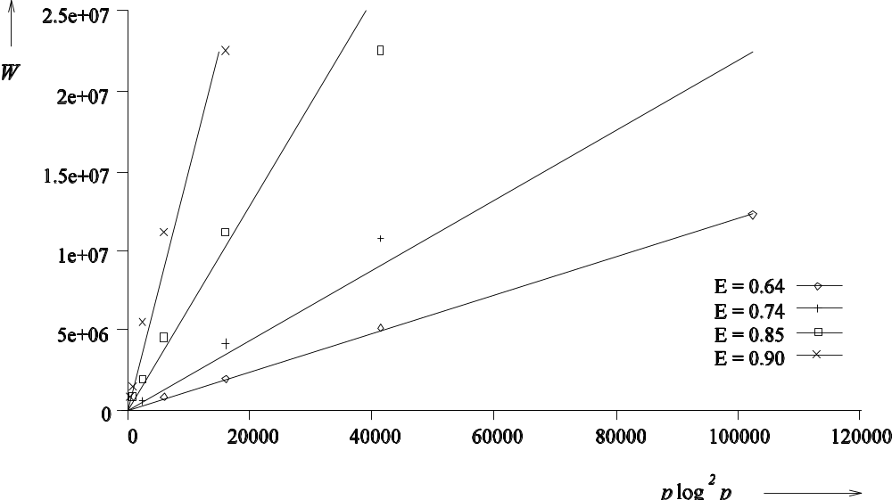
Experimental Validation: Satisfiability Problem
Experimental isoefficiency curves for RP for different efficiencies.

Slide 49
Termination Detection
How do you know when everyone's done?
A number of algorithms have been proposed.

Slide 50
Dijkstra's Token Termination Detection
Assume that all processors are organized in a logical ring.
Assume, for now that work transfers can only happen from P_{i} to P_{j} if j > i.
Processor P₀ initiates a token on the ring when it goes idle.
Each intermediate processor receives this token and forwards it when it becomes idle.
When the token reaches processor P₀, all processors are done.

Slide 51
Dijkstra's Token Termination Detection
Now, let us do away with the restriction on work transfers.
When processor P₀ goes idle, it colors itself green and initiates a green token.
If processor P_{j} sends work to processor P_{i} and j > i then processor P_{j} becomes red.
If processor P_{i} has the token and P_{i} is idle, it passes the token to P_{i+1}. If P_{i} is red, then the color of the token is set to red before it is sent to P_{i+1}. If P_{i} is green, the token is passed unchanged.
After P_{i} passes the token to P_{i+1}, P_{i} becomes green .
The algorithm terminates when processor P₀ receives a green token and is itself idle.

Slide 52
Tree-Based Termination Detection
Associate weights with individual workpieces. Initially, processor P₀ has all the work and a weight of one.
Whenever work is partitioned, the weight is split into half and sent with the work.
When a processor gets done with its work, it sends its parent the weight back.
Termination is signaled when the weight at processor P₀ becomes 1 again.
Note that underflow and finite precision are important factors associated with this scheme.

Slide 53
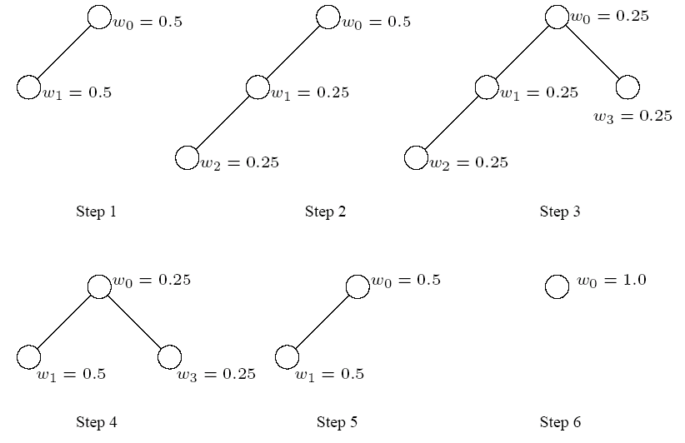
Tree-Based Termination Detection
Tree-based termination detection. Steps 1-6 illustrate the weights at various processors after each work transfer

Slide 54
Parallel Formulations of Depth-First Branch-and-Bound
Parallel formulations of depth-first branch-and-bound search (DFBB) are similar to those of DFS.
Each processor has a copy of the current best solution. This is used as a local bound.
If a processor detects another solution, it compares the cost with current best solution. If the cost is better, it broadcasts this cost to all processors.
If a processor's current best solution path is worse than the globally best solution path, only the efficiency of the search is affected, not its correctness.

Slide 55
Parallel Formulations of IDA*
Two formulations are intuitive.
Common Cost Bound: Each processor is given the same cost bound. Processors use parallel DFS on the tree within the cost bound. The drawback of this scheme is that there might not be enough concurrency.
Variable Cost Bound: Each processor works on a different cost bound. The major drawback here is that a solution is not guaranteed to be optimal until all lower cost bounds have been exhausted.
In each case, parallel DFS is the search kernel.

Slide 56
Parallel Best-First Search
The core data structure is the Open list (typically implemented as a priority queue).
Each processor locks this queue, extracts the best node, unlocks it.
Successors of the node are generated, their heuristic functions estimated, and the nodes inserted into the open list as necessary after appropriate locking.
Termination signaled when we find a solution whose cost is better than the best heuristic value in the open list.
Since we expand more than one node at a time, we may expand nodes that would not be expanded by a sequential algorithm.

Slide 57
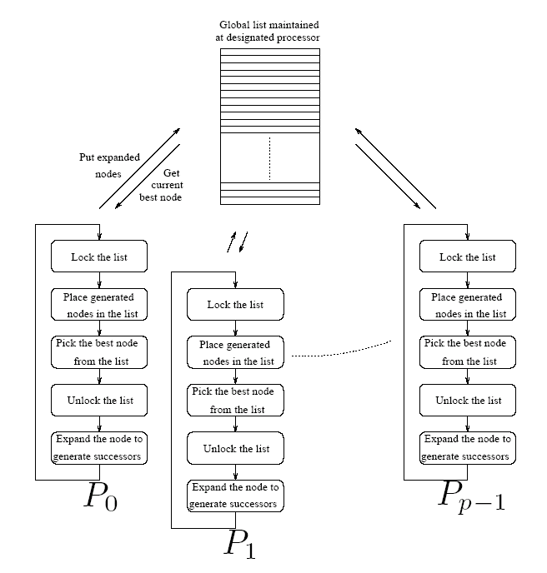
Parallel Best-First Search
A general schematic for parallel best-first search using a centralized strategy. The locking operation is used here to serialize queue access by various processors.

Slide 58
Parallel Best-First Search
The open list is a point of contention.
Let t_{exp} be the average time to expand a single node, and t_{access} be the average time to access the open list for a single-node expansion.
If there are n nodes to be expanded by both the sequential and parallel formulations (assuming that they do an equal amount of work), then the sequential run time is given by n(t_{access}+ t_{exp}).
The parallel run time will be at least nt_{access}.
Upper bound on the speedup is (t_{access}+ t_{exp})/t_{access}

Slide 59
Parallel Best-First Search
Avoid contention by having multiple open lists.
Initially, the search space is statically divided across these open lists.
Processors concurrently operate on these open lists.
Since the heuristic values of nodes in these lists may diverge significantly, we must periodically balance the quality of nodes in each list.
A number of balancing strategies based on ring, blackboard, or random communications are possible.

Slide 60
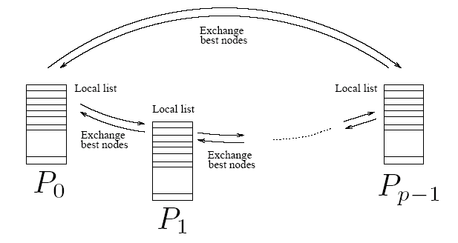
Parallel Best-First Search
A message-passing implementation of parallel best-first search using the ring communication strategy.

Slide 61
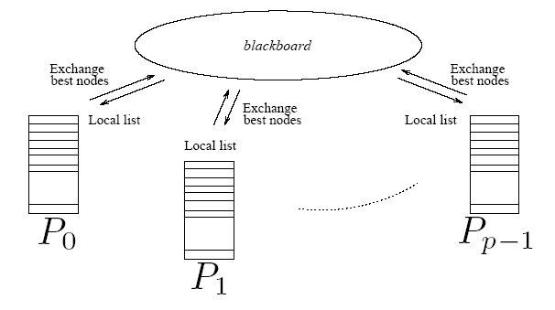
Parallel Best-First Search
An implementation of parallel best-first search using the blackboard communication strategy.

Slide 62
Parallel Best-First Graph Search
Graph search involves a closed list, where the major operation is a lookup (on a key corresponding to the state).
The classic data structure is a hash.
Hashing can be parallelized by using two functions - the first one hashes each node to a processor, and the second one hashes within the processor.
This strategy can be combined with the idea of multiple open lists.
If a node does not exist in a closed list, it is inserted into the open list at the target of the first hash function.
In addition to facilitating lookup, randomization also equalizes quality of nodes in various open lists.

Slide 63
Speedup Anomalies in Parallel Search
Since the search space explored by processors is determined dynamically at runtime, the actual work might vary significantly.
Executions yielding speedups greater than p by using p processors are referred to as acceleration anomalies. Speedups of less than p using p processors are called deceleration anomalies.
Speedup anomalies also manifest themselves in best-first search algorithms.
If the heuristic function is good, the work done in parallel best-first search is typically more than that in its serial counterpart.

Slide 64
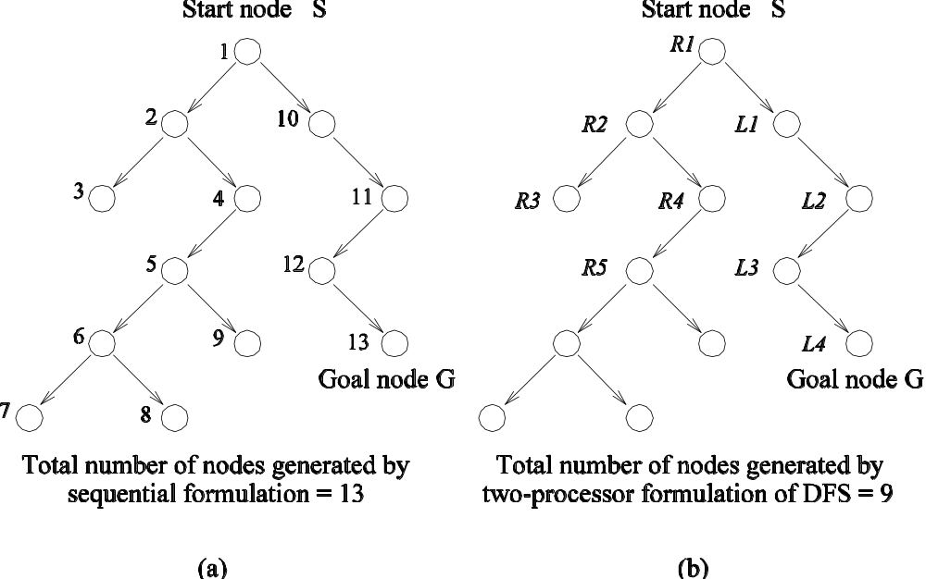
Speedup Anomalies in Parallel Search
The difference in number of nodes searched by sequential and parallel formulations of DFS. For this example, parallel DFS reaches a goal node after searching fewer nodes than sequential DFS.

Slide 65
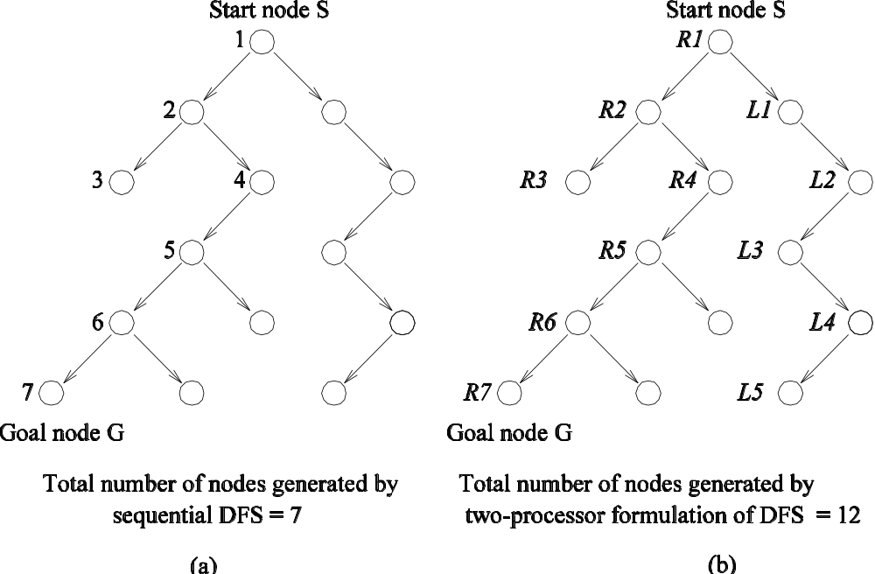
Speedup Anomalies in Parallel Search
A parallel DFS formulation that searches more nodes than its sequential counterpart

