Slide 1
Sorting Algorithms
Ananth Grama, Anshul Gupta, George Karypis, and Vipin Kumar
To accompany the text ``Introduction to Parallel Computing'',
Addison Wesley, 2003.

Slide 2
Topic Overview
Issues in Sorting on Parallel Computers
Sorting Networks
Bubble Sort and its Variants
Quicksort
Bucket and Sample Sort
Other Sorting Algorithms

Slide 3
Sorting: Overview
One of the most commonly used and well-studied kernels.
Sorting can be comparison-based or noncomparison-based.
The fundamental operation of comparison-based sorting is compare-exchange.
The lower bound on any comparison-based sort of n numbers is Θ(nlog n) .
We focus here on comparison-based sorting algorithms.

Slide 4
Sorting: Basics
What is a parallel sorted sequence? Where are the input and output lists stored?
We assume that the input and output lists are distributed.
The sorted list is partitioned with the property that each partitioned list is sorted and each element in processor P_{i}'s list is less than that in P_{j}'s list if i < j.

Slide 5
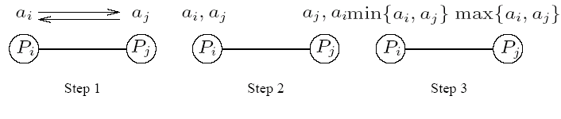
Sorting: Parallel Compare Exchange Operation
A parallel compare-exchange operation. Processes P_{i} and P_{j} send their elements to each other. Process P_{i} keeps min{a_{i},a_{j}}, and P_{j} keeps max{a_{i}, a_{j}}.

Slide 6
Sorting: Basics
What is the parallel counterpart to a sequential comparator?
If each processor has one element, the compare exchange operation stores the smaller element at the processor with smaller id. This can be done in t_{s} + t_{w} time.
If we have more than one element per processor, we call this operation a compare split. Assume each of two processors have n/p elements.
After the compare-split operation, the smaller n/p elements are at processor P_{i} and the larger n/p elements at P_{j}, where i < j.
The time for a compare-split operation is (t_{s}+ t_{w}n/p), assuming that the two partial lists were initially sorted.

Slide 7
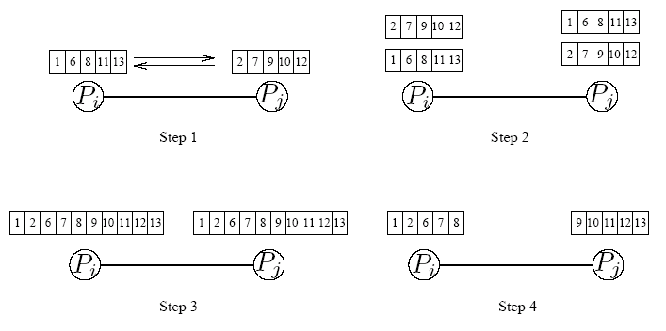
Sorting: Parallel Compare Split Operation
A compare-split operation. Each process sends its block of size n/p to the other process. Each process merges the received block with its own block and retains only the appropriate half of the merged block. In this example, process P_{i} retains the smaller elements and process P_{i} retains the larger elements.

Slide 8
Sorting Networks
Networks of comparators designed specifically for sorting.
A comparator is a device with two inputs x and y and two outputs x' and y'. For an increasing comparator, x' = min{x,y} and y' = min{x,y}; and vice-versa.
We denote an increasing comparator by ⊕ and a decreasing comparator by Ө.
The speed of the network is proportional to its depth.

Slide 9
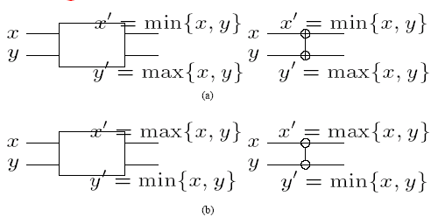
Sorting Networks: Comparators
A schematic representation of comparators: (a) an increasing comparator, and (b) a decreasing comparator.

Slide 10
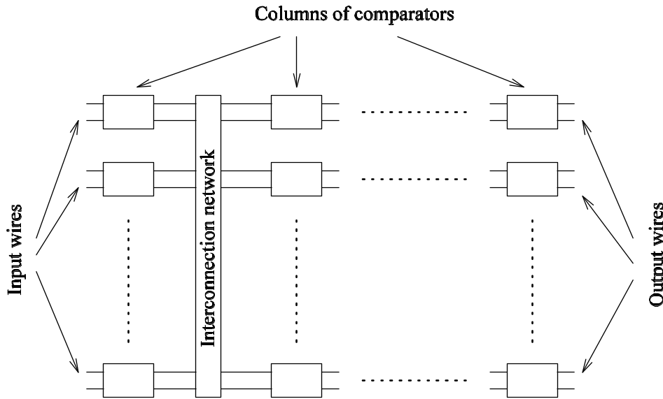
Sorting Networks
A typical sorting network. Every sorting network is made up of a series of columns, and each column contains a number of comparators connected in parallel.

Slide 11
Sorting Networks: Bitonic Sort
A bitonic sorting network sorts n elements in Θ(log²n) time.
A bitonic sequence has two tones - increasing and decreasing, or vice versa. Any cyclic rotation of such networks is also considered bitonic.
⟨1,2,4,7,6,0⟩ is a bitonic sequence, because it first increases and then decreases. ⟨8,9,2,1,0,4⟩ is another bitonic sequence, because it is a cyclic shift of ⟨0,4,8,9,2,1⟩.
The kernel of the network is the rearrangement of a bitonic sequence into a sorted sequence.

Slide 12
Sorting Networks: Bitonic Sort
Let s = ⟨a₀,a₁,…,a_{n-1}⟩ be a bitonic sequence such that a₀ ≤ a₁ ≤ ··· ≤ a_{n/2-1} and a_{n/2} ≥ a_{n/2+1} ≥ ··· ≥ a_{n-1}.
Consider the following subsequences of s:
s₁ = ⟨min{a₀,a_{n/2}},min{a₁,a_{n/2+1}},…,min{a_{n/2-1},a_{n-1}}⟩
s₂ = ⟨max{a₀,a_{n/2}},max{a₁,a_{n/2+1}},…,max{a_{n/2-1},a_{n-1}}⟩
(1)
Note that s₁ and s₂ are both bitonic and each element of s₁ is less than every element in s₂.
We can apply the procedure recursively on s₁ and s₂ to get the sorted sequence.

Slide 13
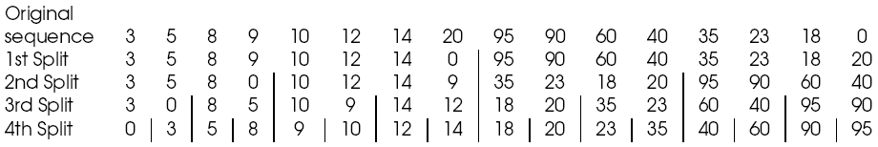
Sorting Networks: Bitonic Sort
Merging a 16-element bitonic sequence through a series of log 16 bitonic splits.

Slide 14
Sorting Networks: Bitonic Sort
We can easily build a sorting network to implement this bitonic merge algorithm.
Such a network is called a bitonic merging network.
The network contains log n columns. Each column contains n/2 comparators and performs one step of the bitonic merge.
We denote a bitonic merging network with n inputs by ⊕BM[n].
Replacing the ⊕ comparators by Ө comparators results in a decreasing output sequence; such a network is denoted by ӨBM[n].

Slide 15
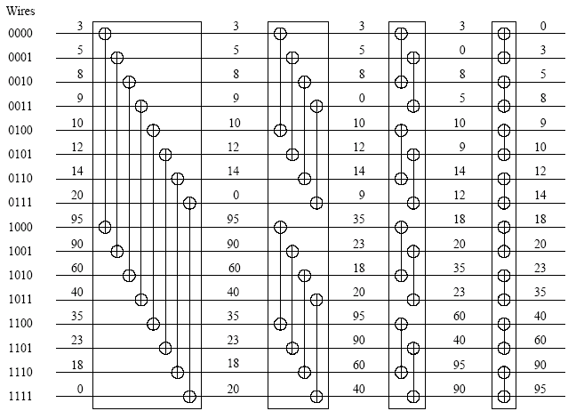
Sorting Networks: Bitonic Sort
A bitonic merging network for n = 16. The input wires are numbered 0,1,…, n - 1, and the binary representation of these numbers is shown. Each column of comparators is drawn separately; the entire figure represents a ⊕BM[16] bitonic merging network. The network takes a bitonic sequence and outputs it in sorted order.

Slide 16
Sorting Networks: Bitonic Sort
How do we sort an unsorted sequence using a bitonic merge?
We must first build a single bitonic sequence from the given sequence.
A sequence of length 2 is a bitonic sequence.
A bitonic sequence of length 4 can be built by sorting the first two elements using ⊕BM[2] and next two, using ӨBM[2].
This process can be repeated to generate larger bitonic sequences.

Slide 17
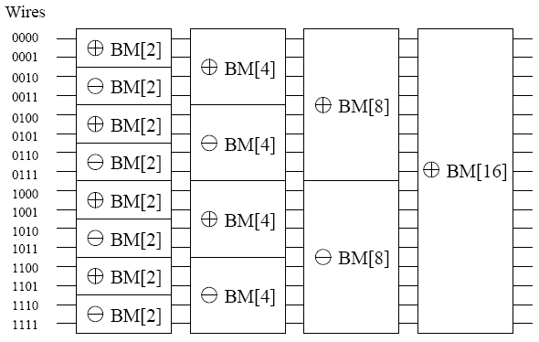
Sorting Networks: Bitonic Sort
A schematic representation of a network that converts an input sequence into a bitonic sequence. In this example, ⊕BM[k] and ӨBM[k] denote bitonic merging networks of input size k that use ⊕ and Ө comparators, respectively. The last merging network (⊕BM[16]) sorts the input. In this example, n = 16.

Slide 18
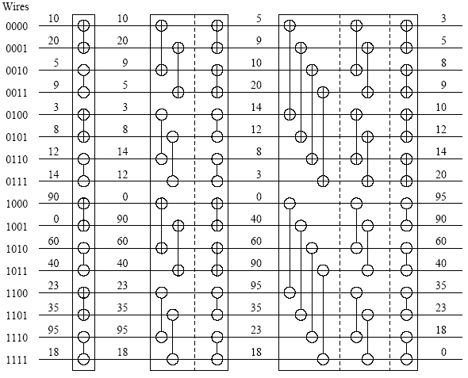
Sorting Networks: Bitonic Sort
The comparator network that transforms an input sequence of 16 unordered numbers into a bitonic sequence.

Slide 19
Sorting Networks: Bitonic Sort
The depth of the network is Θ(log² n).
Each stage of the network contains n/2 comparators. A serial implementation of the network would have complexity Θ(nlog² n).

Slide 20
Mapping Bitonic Sort to Hypercubes
Consider the case of one item per processor. The question becomes one of how the wires in the bitonic network should be mapped to the hypercube interconnect.
Note from our earlier examples that the compare-exchange operation is performed between two wires only if their labels differ in exactly one bit!
This implies a direct mapping of wires to processors. All communication is nearest neighbor!

Slide 21
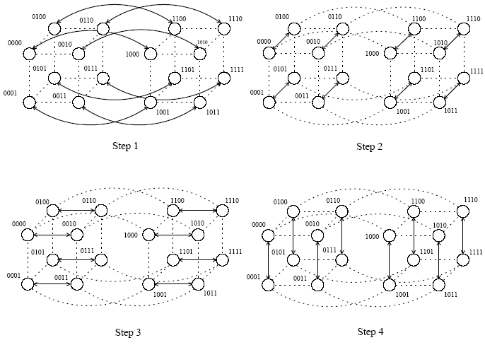
Mapping Bitonic Sort to Hypercubes
Communication during the last stage of bitonic sort. Each wire is mapped to a hypercube process; each connection represents a compare-exchange between processes.

Slide 22
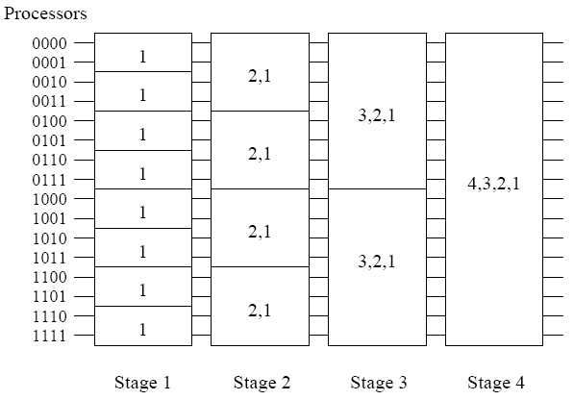
Mapping Bitonic Sort to Hypercubes
Communication characteristics of bitonic sort on a hypercube. During each stage of the algorithm, processes communicate along the dimensions shown.

Slide 23
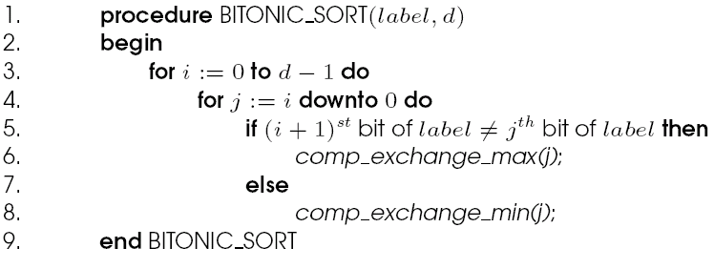
Mapping Bitonic Sort to Hypercubes
Parallel formulation of bitonic sort on a hypercube with n = 2^{d} processes.

Slide 24
Mapping Bitonic Sort to Hypercubes
During each step of the algorithm, every process performs a compare-exchange operation (single nearest neighbor communication of one word).
Since each step takes Θ(1) time, the parallel time is
T_{p} = Θ(log²n) (2)
This algorithm is cost optimal w.r.t. its serial counterpart, but not w.r.t. the best sorting algorithm.

Slide 25
Mapping Bitonic Sort to Meshes
The connectivity of a mesh is lower than that of a hypercube, so we must expect some overhead in this mapping.
Consider the row-major shuffled mapping of wires to processors.

Slide 26
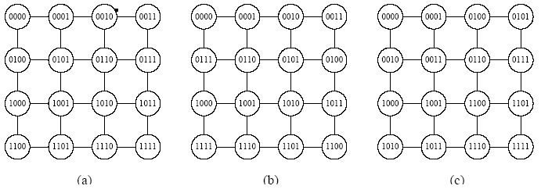
Mapping Bitonic Sort to Meshes
Different ways of mapping the input wires of the bitonic sorting network to a mesh of processes: (a) row-major mapping, (b) row-major snakelike mapping, and (c) row-major shuffled mapping.

Slide 27
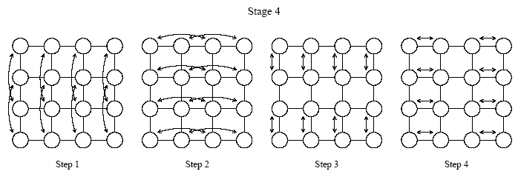
Mapping Bitonic Sort to Meshes
The last stage of the bitonic sort algorithm for n = 16 on a mesh, using the row-major shuffled mapping. During each step, process pairs compare-exchange their elements. Arrows indicate the pairs of processes that perform compare-exchange operations.

Slide 28


Mapping Bitonic Sort to Meshes
In the row-major shuffled mapping, wires that differ at the i^{th} least-significant bit are mapped onto mesh processes that are 2^{⎣(i-1)/2⎦} communication links away.
The total amount of communication performed by each process is . The total computation performed by each process is Θ(log²n).
The parallel runtime is:
This is not cost optimal.

Slide 29
Block of Elements Per Processor
Each process is assigned a block of n/p elements.
The first step is a local sort of the local block.
Each subsequent compare-exchange operation is replaced by a compare-split operation.
We can effectively view the bitonic network as having (1 + log p)(log p)/2 steps.

Slide 30
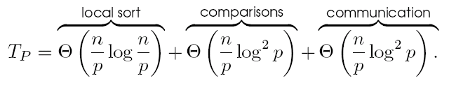

Block of Elements Per Processor: Hypercube
Initially the processes sort their n/p elements (using merge sort) in time Θ((n/p)log(n/p)) and then perform Θ(log²p) compare-split steps.
The parallel run time of this formulation is
Comparing to an optimal sort, the algorithm can efficiently use up to processes.
The isoefficiency function due to both communication and extra work is Θ(p^{log p}log²p) .

Slide 31
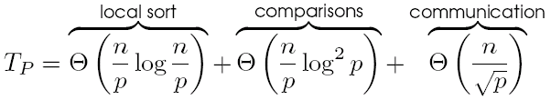

Block of Elements Per Processor: Mesh
The parallel runtime in this case is given by:
This formulation can efficiently use up to p = Θ(log²n) processes.
The isoefficiency function is

Slide 32
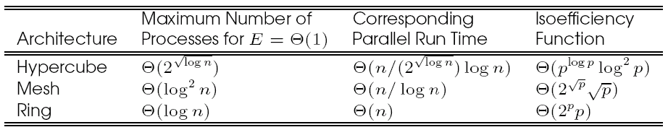
Performance of Parallel Bitonic Sort
The performance of parallel formulations of bitonic sort for n elements on p processes.

Slide 33
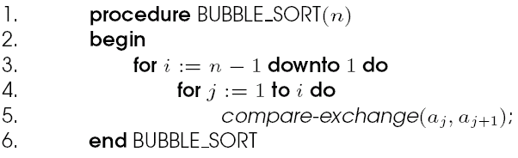
Bubble Sort and its Variants
The sequential bubble sort algorithm compares and exchanges adjacent elements in the sequence to be sorted:
Sequential bubble sort algorithm.

Slide 34
Bubble Sort and its Variants
The complexity of bubble sort is Θ(n²).
Bubble sort is difficult to parallelize since the algorithm has no concurrency.
A simple variant, though, uncovers the concurrency.

Slide 35
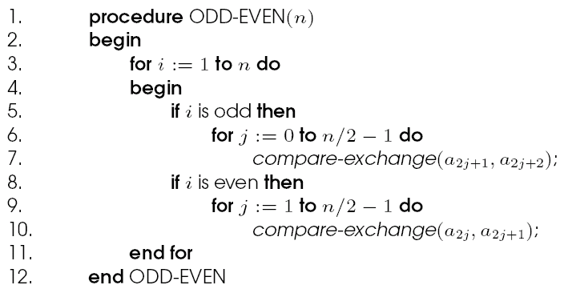
Odd-Even Transposition
Sequential odd-even transposition sort algorithm.

Slide 36
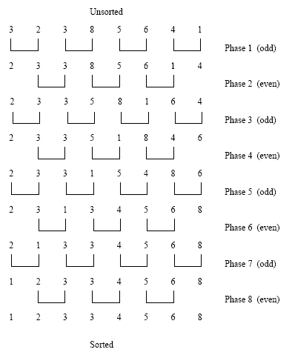
Odd-Even Transposition
Sorting n = 8 elements, using the odd-even transposition sort algorithm. During each phase, n = 8 elements are compared.

Slide 37
Odd-Even Transposition
After n phases of odd-even exchanges, the sequence is sorted.
Each phase of the algorithm (either odd or even) requires Θ(n) comparisons.
Serial complexity is Θ(n²).

Slide 38
Parallel Odd-Even Transposition
Consider the one item per processor case.
There are n iterations, in each iteration, each processor does one compare-exchange.
The parallel run time of this formulation is Θ(n).
This is cost optimal with respect to the base serial algorithm but not the optimal one.

Slide 39
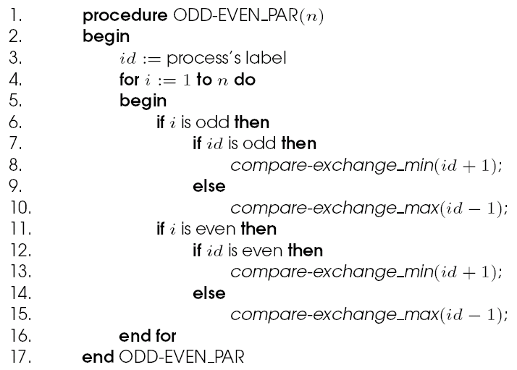
Parallel Odd-Even Transposition
Parallel formulation of odd-even transposition.

Slide 40
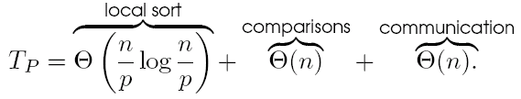
Parallel Odd-Even Transposition
Consider a block of n/p elements per processor.
The first step is a local sort.
In each subsequent step, the compare exchange operation is replaced by the compare split operation.
The parallel run time of the formulation is

Slide 41
Parallel Odd-Even Transposition
The parallel formulation is cost-optimal for p = O(log n).
The isoefficiency function of this parallel formulation is Θ(p2^{p}).

Slide 42
Shellsort
Let n be the number of elements to be sorted and p be the number of processes.
During the first phase, processes that are far away from each other in the array compare-split their elements.
During the second phase, the algorithm switches to an odd-even transposition sort.

Slide 43
Parallel Shellsort
Initially, each process sorts its block of n/p elements internally.
Each process is now paired with its corresponding process in the reverse order of the array. That is, process P_{i}, where i < p/2, is paired with process P_{p-i-1}.
A compare-split operation is performed.
The processes are split into two groups of size p/2 each and the process repeated in each group.

Slide 44
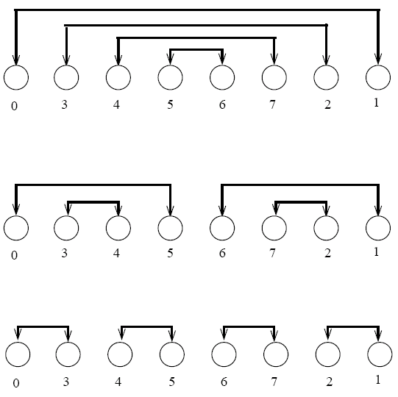
Parallel Shellsort
An example of the first phase of parallel shellsort on an eight-process array.

Slide 45
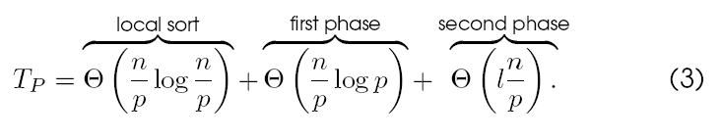
Parallel Shellsort
Each process performs d = log p compare-split operations.
With O(p) bisection width, each communication can be performed in time Θ(n/p) for a total time of Θ((nlog p)/p).
In the second phase, l odd and even phases are performed, each requiring time Θ(n/p).
The parallel run time of the algorithm is:

Slide 46
Quicksort
Quicksort is one of the most common sorting algorithms for sequential computers because of its simplicity, low overhead, and optimal average complexity.
Quicksort selects one of the entries in the sequence to be the pivot and divides the sequence into two - one with all elements less than the pivot and other greater.
The process is recursively applied to each of the sublists.

Slide 47
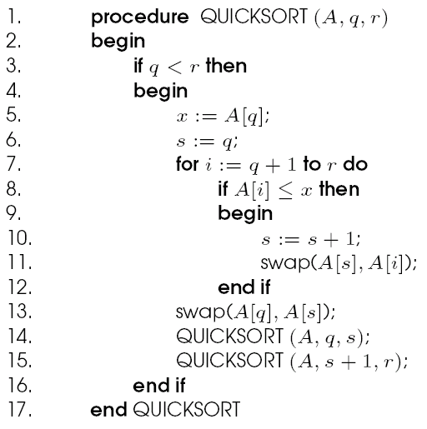
Quicksort
The sequential quicksort algorithm.

Slide 48
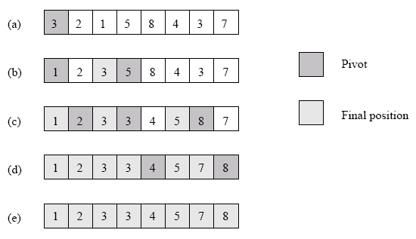
Quicksort
Example of the quicksort algorithm sorting a sequence of size n = 8.

Slide 49
Quicksort
The performance of quicksort depends critically on the quality of the pivot.
In the best case, the pivot divides the list in such a way that the larger of the two lists does not have more than αn elements (for some constant α).
In this case, the complexity of quicksort is O(nlog n).

Slide 50
Parallelizing Quicksort
Lets start with recursive decomposition - the list is partitioned serially and each of the subproblems is handled by a different processor.
The time for this algorithm is lower-bounded by Ω(n)!
Can we parallelize the partitioning step - in particular, if we can use n processors to partition a list of length n around a pivot in O(1) time, we have a winner.
This is difficult to do on real machines, though.

Slide 51
Parallelizing Quicksort: PRAM Formulation
We assume a CRCW (concurrent read, concurrent write) PRAM with concurrent writes resulting in an arbitrary write succeeding.
The formulation works by creating pools of processors. Every processor is assigned to the same pool initially and has one element.
Each processor attempts to write its element to a common location (for the pool).
Each processor tries to read back the location. If the value read back is greater than the processor's value, it assigns itself to the `left' pool, else, it assigns itself to the `right' pool.
Each pool performs this operation recursively.
Note that the algorithm generates a tree of pivots. The depth of the tree is the expected parallel runtime. The average value is O(log n).

Slide 52
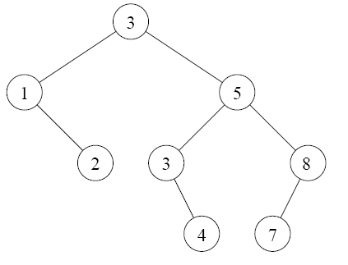
Parallelizing Quicksort: PRAM Formulation
A binary tree generated by the execution of the quicksort algorithm. Each level of the tree represents a different array-partitioning iteration. If pivot selection is optimal, then the height of the tree is Θ(log n), which is also the number of iterations.

Slide 53
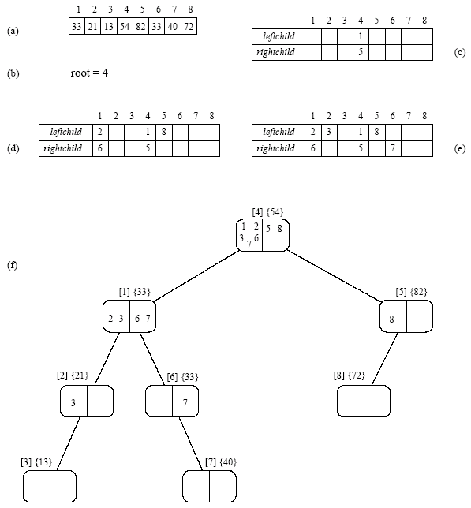
Parallelizing Quicksort: PRAM Formulation
The execution of the PRAM algorithm on the array shown in (a).

Slide 54
Parallelizing Quicksort: Shared Address Space Formulation
Consider a list of size n equally divided across p processors.
A pivot is selected by one of the processors and made known to all processors.
Each processor partitions its list into two, say L_{i} and U_{i}, based on the selected pivot.
All of the L_{i} lists are merged and all of the U_{i} lists are merged separately.
The set of processors is partitioned into two (in proportion of the size of lists L and U). The process is recursively applied to each of the lists.

Slide 55
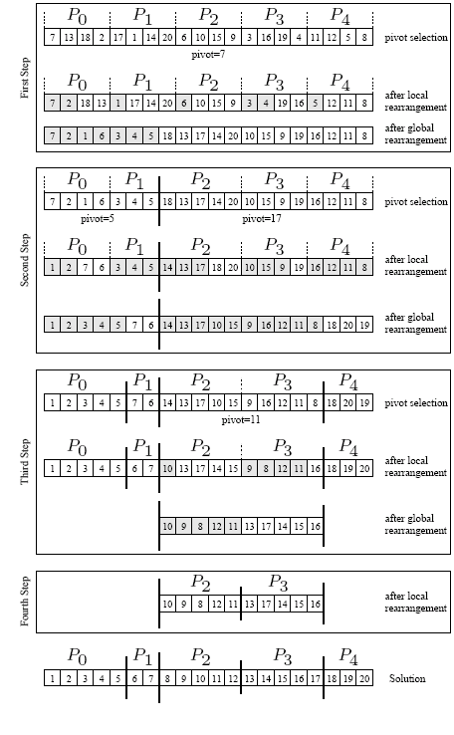
Shared Address Space Formulation

Slide 56
Parallelizing Quicksort: Shared Address Space Formulation
The only thing we have not described is the global reorganization (merging) of local lists to form L and U.
The problem is one of determining the right location for each element in the merged list.
Each processor computes the number of elements locally less than and greater than pivot.
It computes two sum-scans to determine the starting location for its elements in the merged L and U lists.
Once it knows the starting locations, it can write its elements safely.

Slide 57
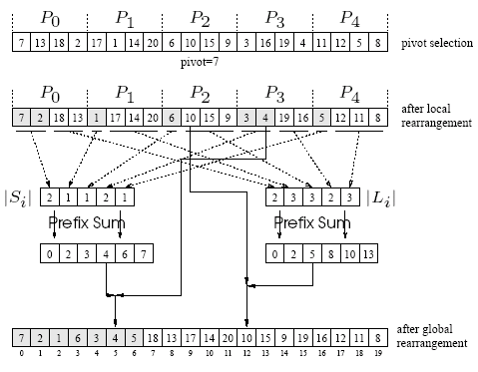
Parallelizing Quicksort: Shared Address Space Formulation
Efficient global rearrangement of the array.

Slide 58
Parallelizing Quicksort: Shared Address Space Formulation
The parallel time depends on the split and merge time, and the quality of the pivot.
The latter is an issue independent of parallelism, so we focus on the first aspect, assuming ideal pivot selection.
The algorithm executes in four steps: (i) determine and broadcast the pivot; (ii) locally rearrange the array assigned to each process; (iii) determine the locations in the globally rearranged array that the local elements will go to; and (iv) perform the global rearrangement.
The first step takes time Θ(log p), the second, Θ(n/p) , the third, Θ(log p) , and the fourth, Θ(n/p).
The overall complexity of splitting an n-element array is Θ(n/p) + Θ(log p).

Slide 59
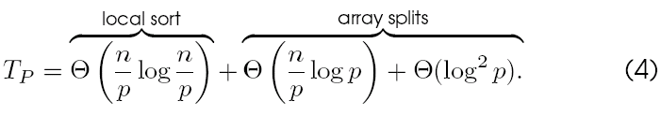
Parallelizing Quicksort: Shared Address Space Formulation
The process recurses until there are p lists, at which point, the lists are sorted locally.
Therefore, the total parallel time is:
The corresponding isoefficiency is Θ(plog²p) due to broadcast and scan operations.

Slide 60
Parallelizing Quicksort: Message Passing Formulation
A simple message passing formulation is based on the recursive halving of the machine.
Assume that each processor in the lower half of a p processor ensemble is paired with a corresponding processor in the upper half.
A designated processor selects and broadcasts the pivot.
Each processor splits its local list into two lists, one less (L_{i}), and other greater (U_{i}) than the pivot.
A processor in the low half of the machine sends its list U_{i} to the paired processor in the other half. The paired processor sends its list L_{i}.
It is easy to see that after this step, all elements less than the pivot are in the low half of the machine and all elements greater than the pivot are in the high half.

Slide 61
Parallelizing Quicksort: Message Passing Formulation
The above process is recursed until each processor has its own local list, which is sorted locally.
The time for a single reorganization is Θ(log p) for broadcasting the pivot element, Θ(n/p) for splitting the locally assigned portion of the array, Θ(n/p) for exchange and local reorganization.
We note that this time is identical to that of the corresponding shared address space formulation.
It is important to remember that the reorganization of elements is a bandwidth sensitive operation.

Slide 62
Bucket and Sample Sort
In Bucket sort, the range [a,b] of input numbers is divided into m equal sized intervals, called buckets.
Each element is placed in its appropriate bucket.
If the numbers are uniformly divided in the range, the buckets can be expected to have roughly identical number of elements.
Elements in the buckets are locally sorted.
The run time of this algorithm is Θ(nlog(n/m)).

Slide 63
Parallel Bucket Sort
Parallelizing bucket sort is relatively simple. We can select m = p.
In this case, each processor has a range of values it is responsible for.
Each processor runs through its local list and assigns each of its elements to the appropriate processor.
The elements are sent to the destination processors using a single all-to-all personalized communication.
Each processor sorts all the elements it receives.

Slide 64
Parallel Bucket and Sample Sort
The critical aspect of the above algorithm is one of assigning ranges to processors. This is done by suitable splitter selection.
The splitter selection method divides the n elements into m blocks of size n/m each, and sorts each block by using quicksort.
From each sorted block it chooses m – 1 evenly spaced elements.
The m(m – 1) elements selected from all the blocks represent the sample used to determine the buckets.
This scheme guarantees that the number of elements ending up in each bucket is less than 2n/m.

Slide 65
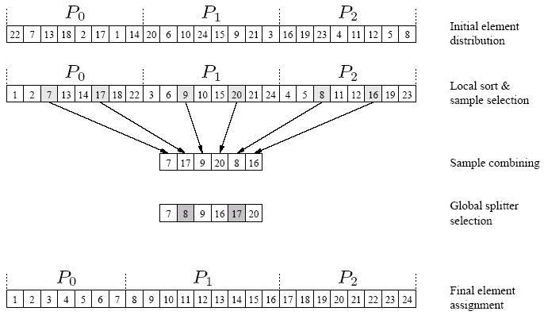
Parallel Bucket and Sample Sort
An example of the execution of sample sort on an array with 24 elements on three processes.

Slide 66
Parallel Bucket and Sample Sort
The splitter selection scheme can itself be parallelized.
Each processor generates the p – 1 local splitters in parallel.
All processors share their splitters using a single all-to-all broadcast operation.
Each processor sorts the p(p – 1) elements it receives and selects p – 1 uniformly spaces splitters from them.

Slide 67
Parallel Bucket and Sample Sort: Analysis
The internal sort of n/p elements requires time Θ((n/p)log(n/p)), and the selection of p – 1 sample elements requires time Θ(p).
The time for an all-to-all broadcast is Θ(p²), the time to internally sort the p(p – 1) sample elements is Θ(p²log p), and selecting p – 1 evenly spaced splitters takes time Θ(p).
Each process can insert these p – 1splitters in its local sorted block of size n/p by performing p – 1 binary searches in time Θ(plog(n/p)).
The time for reorganization of the elements is O(n/p).

Slide 68
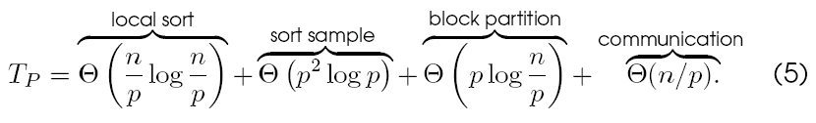
Parallel Bucket and Sample Sort: Analysis
The total time is given by:
The isoefficiency of the formulation is Θ(p³log p).

