Slide 1
Dynamic Programming
Ananth Grama, Anshul Gupta, George Karypis, and Vipin Kumar
To accompany the text ``Introduction to Parallel Computing'', Addison Wesley, 2003

Slide 2
Topic Overview
Overview of Serial Dynamic Programming
Serial Monadic DP Formulations
Nonserial Monadic DP Formulations
Serial Polyadic DP Formulations
Nonserial Polyadic DP Formulations

Slide 3
Overview of Serial Dynamic Programming
Dynamic programming (DP) is used to solve a wide variety of discrete optimization problems such as scheduling, string-editing, packaging, and inventory management.
Break problems into subproblems and combine their solutions into solutions to larger problems.
In contrast to divide-and-conquer, there may be relationships across subproblems.

Slide 4
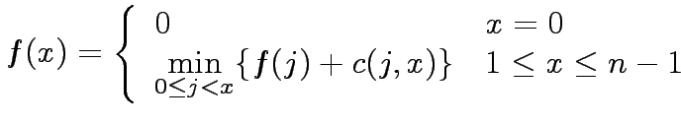
Dynamic Programming: Example
Consider the problem of finding a shortest path between a pair of vertices in an acyclic graph.
An edge connecting node i to node j has cost c(i,j).
The graph contains n nodes numbered 0,1,…, n-1, and has an edge from node i to node j only if i < j. Node 0 is source and node n-1 is the destination.
Let f(x) be the cost of the shortest path from node 0 to node x.

Slide 5
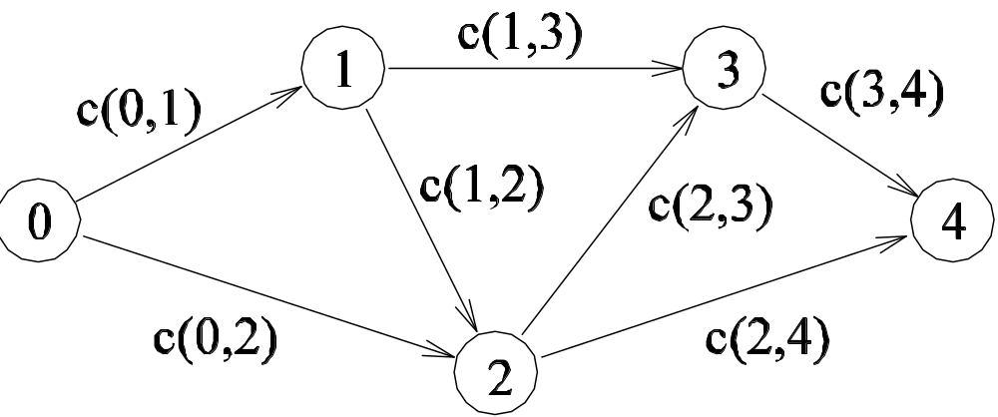

Dynamic Programming: Example
A graph for which the shortest path between nodes 0 and 4 is to be computed.

Slide 6

Dynamic Programming
The solution to a DP problem is typically expressed as a minimum (or maximum) of possible alternate solutions.
If r represents the cost of a solution composed of subproblems x₁, x₂,…, x_{l}, then r can be written as
Here, g is the composition function.
If the optimal solution to each problem is determined by composing optimal solutions to the subproblems and selecting the minimum (or maximum), the formulation is said to be a DP formulation.

Slide 7
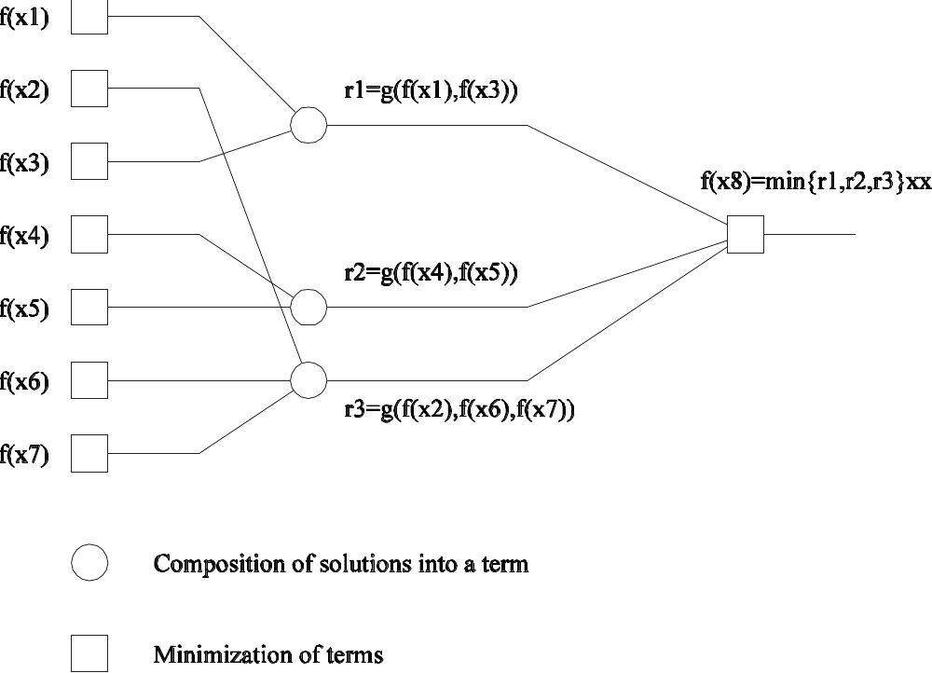
Dynamic Programming: Example
The computation and composition of subproblem solutions to solve problem f(x₈).

Slide 8
Dynamic Programming
The recursive DP equation is also called the functional equation or optimization equation.
In the equation for the shortest path problem the composition function is f(j) + c(j,x). This contains a single recursive term (f(j)). Such a formulation is called monadic.
If the RHS has multiple recursive terms, the DP formulation is called polyadic.

Slide 9
Dynamic Programming
The dependencies between subproblems can be expressed as a graph.
If the graph can be levelized (i.e., solutions to problems at a level depend only on solutions to problems at the previous level), the formulation is called serial, else it is called non-serial.
Based on these two criteria, we can classify DP formulations into four categories - serial-monadic, serial-polyadic, non-serial-monadic, non-serial-polyadic.
This classification is useful since it identifies concurrency and dependencies that guide parallel formulations.

Slide 10
Serial Monadic DP Formulations
It is difficult to derive canonical parallel formulations for the entire class of formulations.
For this reason, we select two representative examples, the shortest-path problem for a multistage graph and the 0/1 knapsack problem.
We derive parallel formulations for these problems and identify common principles guiding design within the class.

Slide 11
Shortest-Path Problem
Special class of shortest path problem where the graph is a weighted multistage graph of r + 1 levels.
Each level is assumed to have n levels and every node at level i is connected to every node at level i + 1.
Levels zero and r contain only one node, the source and destination nodes, respectively.
The objective of this problem is to find the shortest path from S to R.

Slide 12
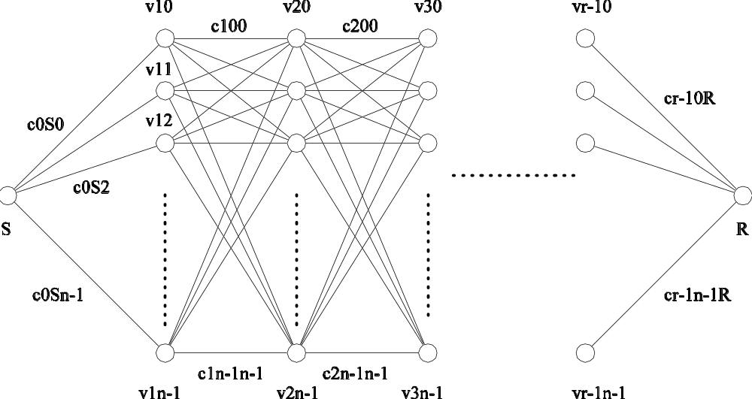
Shortest-Path Problem
An example of a serial monadic DP formulation for finding the shortest path in a graph whose nodes can be organized into levels.

Slide 13
Shortest-Path Problem
The i^{th} node at level l in the graph is labeled v_{i}^{l} and the cost of an edge connecting v_{i}^{l} to node v_{j}^{l+1} is labeled c_{i}^{l}_{,j.}
The cost of reaching the goal node R from any node v_{i}^{l} is represented by C_{i}^{l}.
If there are n nodes at level l, the vector
[C₀^{l}, C₁^{l,…,} _{Cn}^{l}₋₁]^{T} is referred to as C^{l}. Note that
C₀ = [C₀⁰].
We have C_{i}^{l} = min {(c_{i}^{l}_{,j} + C_{j}^{l+1}) | j is a node at level l + 1}

Slide 14

Shortest-Path Problem
Since all nodes v_{j}^{r-1} have only one edge connecting them to the goal node R at level r, the cost C_{j}^{r-1} is equal to c_{j}^{r},⁻_{R}¹.
We have:
Notice that this problem is serial and monadic.

Slide 15
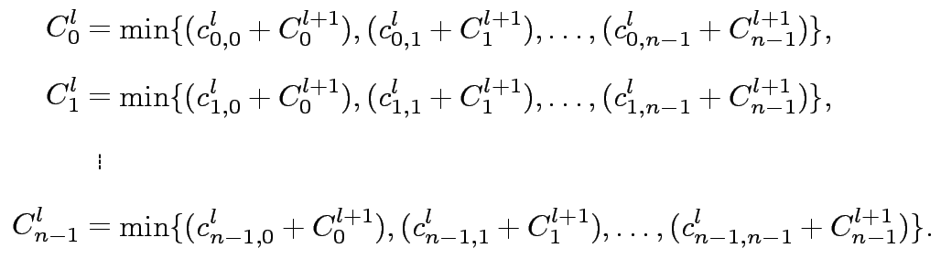
Shortest-Path Problem
The cost of reaching the goal node R from any node at level l is (0 < l < r – 1) is

Slide 16

Shortest-Path Problem
We can express the solution to the problem as a modified sequence of matrix-vector products.
Replacing the addition operation by minimization and the multiplication operation by addition, the preceding set of equations becomes:
where C^{l} and C^{l+1} are n x 1 vectors representing the cost of reaching the goal node from each node at levels l and l + 1.

Slide 17
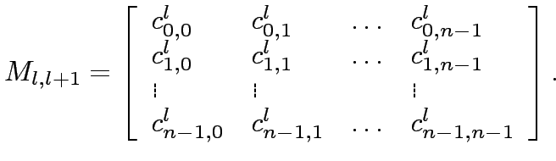
Shortest-Path Problem
Matrix M_{l,l+1} is an n x n matrix in which entry (i, j) stores the cost of the edge connecting node i at level l to node j at level l + 1.
The shortest path problem has been formulated as a sequence of r matrix-vector products.

Slide 18
Parallel Shortest-Path
We can parallelize this algorithm using the parallel algorithms for the matrix-vector product.
Θ(n) processing elements can compute each vector C^{l} in time Θ(n) and solve the entire problem in time Θ(rn).
In many instances of this problem, the matrix M may be sparse. For such problems, it is highly desirable to use sparse matrix techniques.

Slide 19
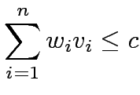
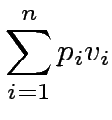
0/1 Knapsack Problem
We are given a knapsack of capacity c and a set of n objects numbered 1,2,…,n. Each object i has weight w_{i} and profit p_{i}.
Let v = [v₁, v₂,…, v_{n}] be a solution vector in which v_{i} = 0 if object i is not in the knapsack, and v_{i} = 1 if it is in the knapsack.
The goal is to find a subset of objects to put into the knapsack so that
(that is, the objects fit into the knapsack) and
is maximized (that is, the profit is maximized).

Slide 20
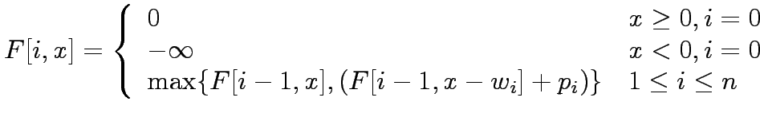
0/1 Knapsack Problem
The naive method is to consider all 2^{n} possible subsets of the n objects and choose the one that fits into the knapsack and maximizes the profit.
Let F[i,x] be the maximum profit for a knapsack of capacity x using only objects {1,2,…,i}. The DP formulation is:

Slide 21
0/1 Knapsack Problem
Construct a table F of size n x c in row-major order.
Filling an entry in a row requires two entries from the previous row: one from the same column and one from the column offset by the weight of the object corresponding to the row.
Computing each entry takes constant time; the sequential run time of this algorithm is Θ(nc).
The formulation is serial-monadic.

Slide 22
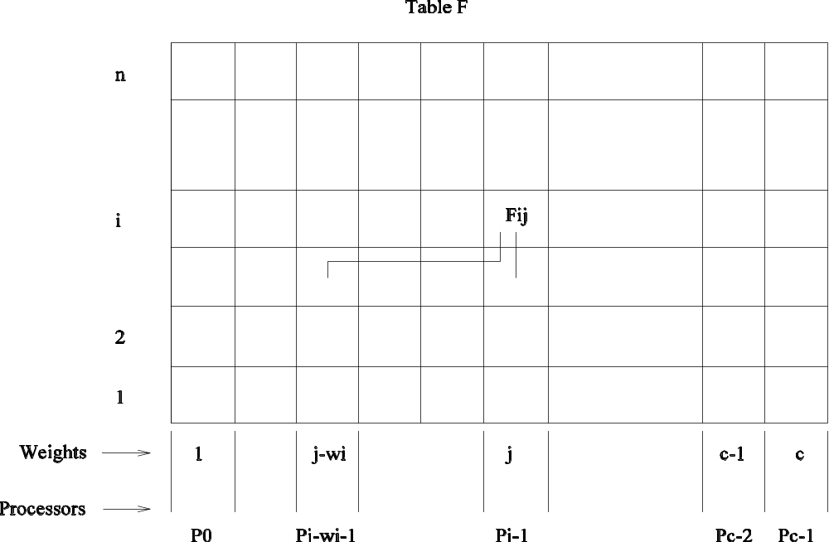
0/1 Knapsack Problem
Computing entries of table F for the 0/1 knapsack problem. The computation of entry F[i,j] requires communication with processing elements containing entries F[i-1,j] and F[i-1,j-w_{i}].

Slide 23
0/1 Knapsack Problem
Using c processors in a PRAM, we can derive a simple parallel algorithm that runs in O(n) time by partitioning the columns across processors.
In a distributed memory machine, in the j^{th} iteration, for computing F[j,r] at processing element P_{r-1}, F[j-1,r] is available locally but F[j-1,r-w_{j}] must be fetched.
The communication operation is a circular shift and the time is given by (t_{s} + t_{w}) log c. The total time is therefore t_{c} + (t_{s} + t_{w}) log c.
Across all n iterations (rows), the parallel time is O(n log c). Note that this is not cost optimal.

Slide 24
0/1 Knapsack Problem
Using p-processing elements, each processing element computes c/p elements of the table in each iteration.
The corresponding shift operation takes time (2t_{s} + t_{w}c/p), since the data block may be partitioned across two processors, but the total volume of data is c/p.
The corresponding parallel time is n(t_{c}c/p + 2t_{s} + t_{w}c/p), or O(nc/p) (which is cost-optimal).
Note that there is an upper bound on the efficiency of this formulation.

Slide 25
Nonserial Monadic DP Formulations: Longest-Common-Subsequence
Given a sequence A = <a₁, a₂,…, a_{n}>, a subsequence of A can be formed by deleting some entries from A.
Given two sequences A = <a₁, a₂,…, a_{n}> and B = <b₁, b₂,…, b_{m}>, find the longest sequence that is a subsequence of both A and B.
If A = <c,a,d,b,r,z> and B = <a,s,b,z>, the longest common subsequence of A and B is <a,b,z>.

Slide 26
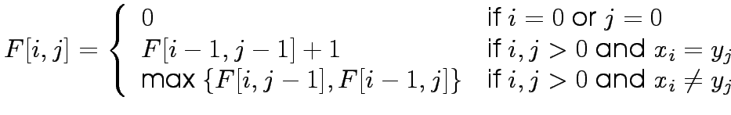
Longest-Common-Subsequence Problem
Let F[i,j] denote the length of the longest common subsequence of the first i elements of A and the first j elements of B. The objective of the LCS problem is to find F[n,m].
We can write:

Slide 27
Longest-Common-Subsequence Problem
The algorithm computes the two-dimensional F table in a row- or column-major fashion. The complexity is Θ(nm).
Treating nodes along a diagonal as belonging to one level, each node depends on two subproblems at the preceding level and one subproblem two levels prior.
This DP formulation is nonserial monadic.

Slide 28
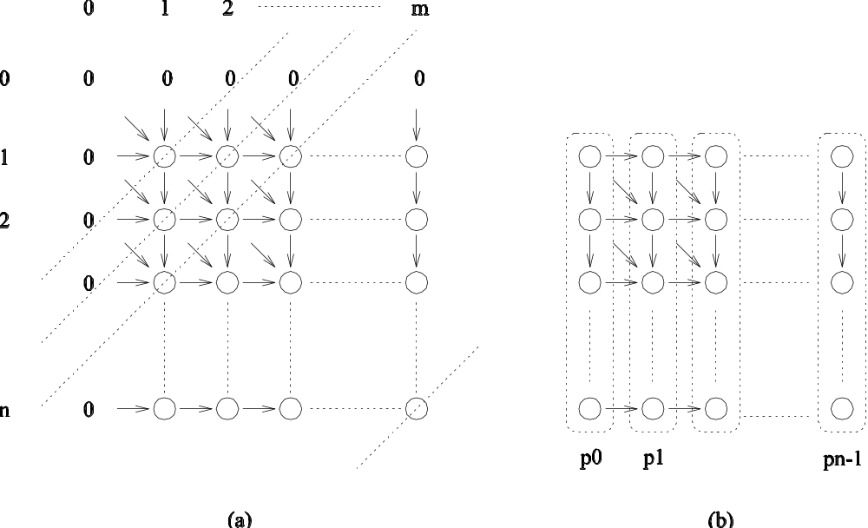
Longest-Common-Subsequence Problem
(a) Computing entries of table for the longest-common-subsequence problem. Computation proceeds along the dotted diagonal lines. (b) Mapping elements of the table to processing elements.

Slide 29
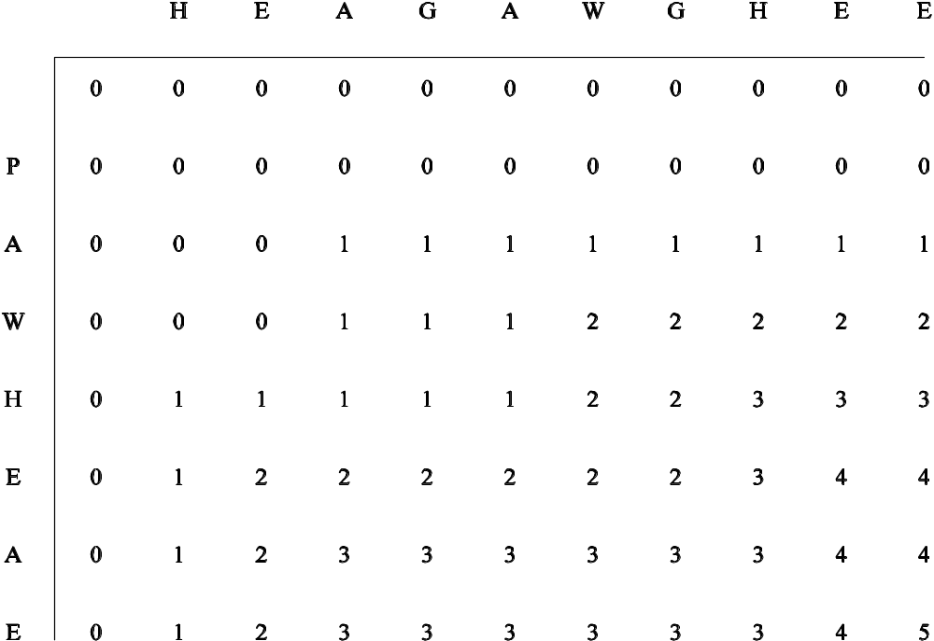
Longest-Common-Subsequence: Example
Consider the LCS of two amino-acid sequences H E A G A W G H E E and P A W H E A E. For the interested reader, the names of the corresponding amino-acids are A: Alanine, E: Glutamic acid, G: Glycine, H: Histidine, P: Proline, and W: Tryptophan.
The F table for computing the LCS of the sequences. The LCS is A W H E E.

Slide 30
Parallel Longest-Common-Subsequence
Table entries are computed in a diagonal sweep from the top-left to the bottom-right corner.
Using n processors in a PRAM, each entry in a diagonal can be computed in constant time.
For two sequences of length n, there are 2n-1 diagonals.
The parallel run time is Θ(n) and the algorithm is cost-optimal.

Slide 31

Parallel Longest-Common-Subsequence
Consider a (logical) linear array of processors. Processing element P_{i} is responsible for the (i+1)^{th} column of the table.
To compute F[i,j], processing element P_{j-1} may need either F[i-1,j-1] or F[i,j-1] from the processing element to its left. This communication takes time t_{s} + t_{w}.
The computation takes constant time (t_{c}).
We have:
Note that this formulation is cost-optimal, however, its efficiency is upper-bounded by 0.5!
Can you think of how to fix this?

Slide 32
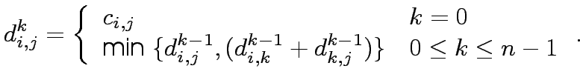
Serial Polyadic DP Formulation: Floyd's All-Pairs Shortest Path
Given weighted graph G(V,E), Floyd's algorithm determines the cost d_{i,j} of the shortest path between each pair of nodes in V.
Let d_{i}^{k}_{,j} be the minimum cost of a path from node i to node j, using only nodes v₀,v₁,…,v_{k-1}.
We have:
Each iteration requires time Θ(n²) and the overall run time of the sequential algorithm is Θ(n³).

Slide 33
Serial Polyadic DP Formulation: Floyd's All-Pairs Shortest Path
A PRAM formulation of this algorithm uses n² processors in a logical 2D mesh. Processor P_{i,j} computes the value of d_{i}^{k}_{,j} for k=1,2,…,n in constant time.
The parallel runtime is Θ(n) and it is cost-optimal.
The algorithm can easily be adapted to practical architectures, as discussed in our treatment of Graph Algorithms.

Slide 34
Nonserial Polyadic DP Formulation: Optimal Matrix-Parenthesization Problem
When multiplying a sequence of matrices, the order of multiplication significantly impacts operation count.
Let C[i,j] be the optimal cost of multiplying the matrices A_{i},…A_{j}.
The chain of matrices can be expressed as a product of two smaller chains, A_{i},A_{i+1},…,A_{k} and A_{k+1},…,A_{j}.
The chain A_{i},A_{i+1},…,A_{k} results in a matrix of dimensions r_{i-1} x r_{k}, and the chain A_{k+1},…,A_{j} results in a matrix of dimensions r_{k} x r_{j}.
The cost of multiplying these two matrices is r_{i-1}r_{k}r_{j}.

Slide 35
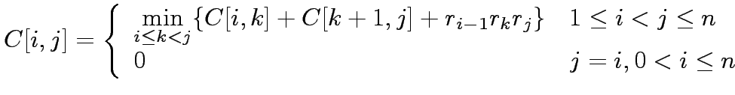
Optimal Matrix-Parenthesization Problem
We have:

Slide 36
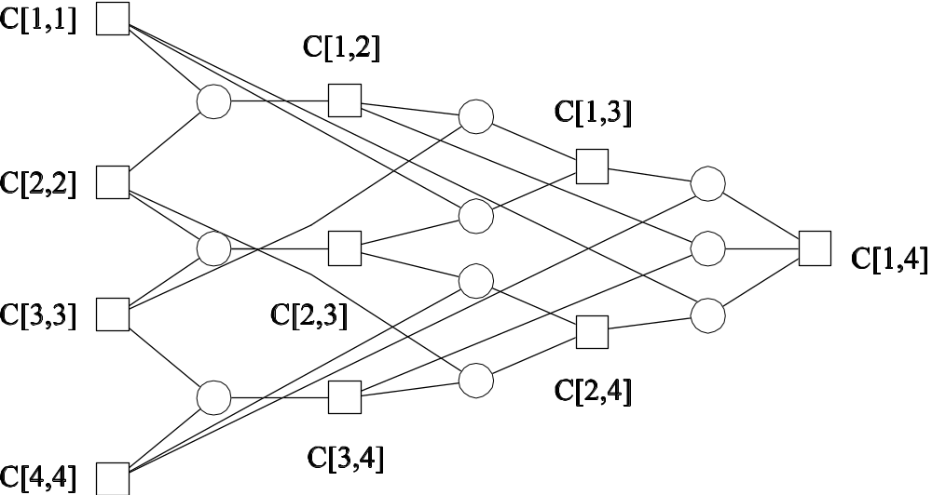
Optimal Matrix-Parenthesization Problem
A nonserial polyadic DP formulation for finding an optimal matrix parenthesization for a chain of four matrices. A square node represents the optimal cost of multiplying a matrix chain. A circle node represents a possible parenthesization.

Slide 37
Optimal Matrix-Parenthesization Problem
The goal of finding C[1,n] is accomplished in a bottom-up fashion.
Visualize this by thinking of filling in the C table diagonally. Entries in diagonal l corresponds to the cost of multiplying matrix chains of length l+1.
The value of C[i,j] is computed as min{C[i,k] + C[k+1,j] + r_{i-1}r_{k}r_{j}}, where k can take values from i to j-1.
Computing C[i,j] requires that we evaluate (j-i) terms and select their minimum.
The computation of each term takes time t_{c}, and the computation of C[i,j] takes time (j-i)t_{c}. Each entry in diagonal l can be computed in time lt_{c}.

Slide 38
Optimal Matrix-Parenthesization Problem
The algorithm computes (n-1) chains of length two. This takes time (n-1)t_{c}; computing n-2 chains of length three takes time (n-2)t_{c}. In the final step, the algorithm computes one chain of length n in time (n-1)t_{c}.
It follows that the serial time is Θ(n³).

Slide 39
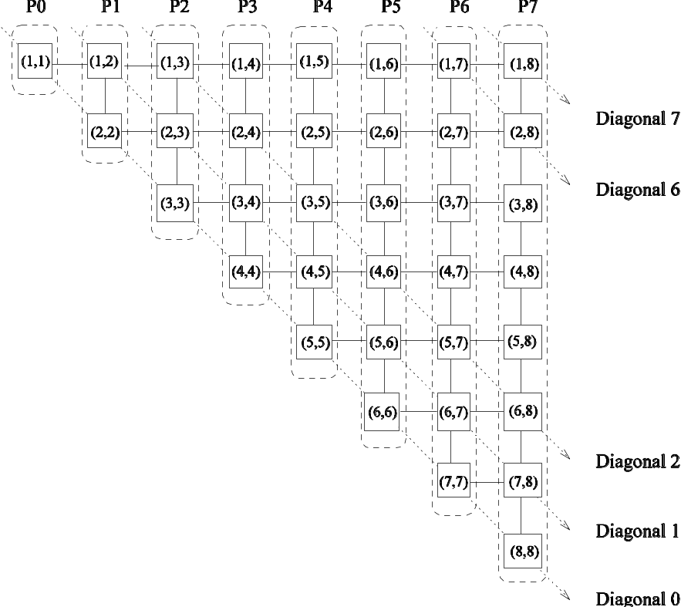
Optimal Matrix-Parenthesization Problem
The diagonal order of computation for the optimal matrix-parenthesization problem.

Slide 40
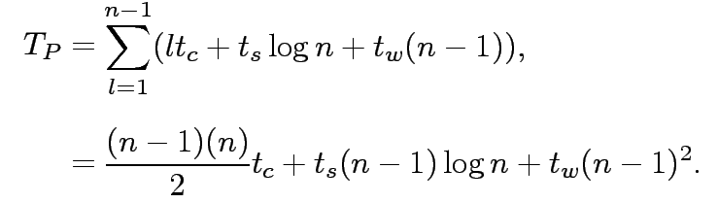
Parallel Optimal Matrix-Parenthesization Problem
Consider a logical ring of processors. In step l, each processor computes a single element belonging to the l^{th} diagonal.
On computing the assigned value of the element in table C, each processor sends its value to all other processors using an all-to-all broadcast.
The next value can then be computed locally.
The total time required to compute the entries along diagonal l is lt_{c}+t_{s}log n+t_{w}(n-1).
The corresponding parallel time is given by:

Slide 41

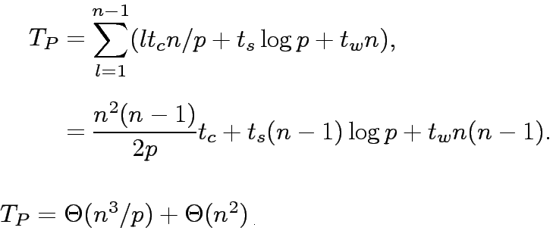
Parallel Optimal Matrix-Parenthesization Problem
When using p (<n) processors, each processor stores n/p nodes.
The time taken for all-to-all broadcast of n/p words is
and the time to compute n/p entries of the table in the l^{th} diagonal is lt_{c}n/p.
This formulation can be improved to use up to n(n+1)/2 processors using pipelining.

Slide 42
Discussion of Parallel Dynamic Programming Algorithms
By representing computation as a graph, we identify three sources of parallelism: parallelism within nodes, parallelism across nodes at a level, and pipelining nodes across multiple levels. The first two are available in serial formulations and the third one in non-serial formulations.
Data locality is critical for performance. Different DP formulations, by the very nature of the problem instance, have different degrees of locality.

