Slide 1
Dartpost

Slide 2
Data
Sparse social network, only 176 user follow relationships among 478 users.
Users: 478
Moderators and observers
Sockpuppets: 210
Participants: 160
Posts (tweets): 1084
Comments; 1622
Likes: 1037
Reposts: 123
User Reports: 46
Distinct reports: 21
True Positive: 8, False Positive 13
Follows: 176
Searches: 846
Active accounts stats
 | Participants | Sockpuppet | Total
Inactive | 119 | 184 | 303
Active | 41 | 26 | 67
Total | 160 | 210 | 370
67 active accounts in total!
 | COVERT | OVERT | UNRESTRITCTED
Total | 56 | 80 | 73
Active | 21 | 1 | 4

Slide 3
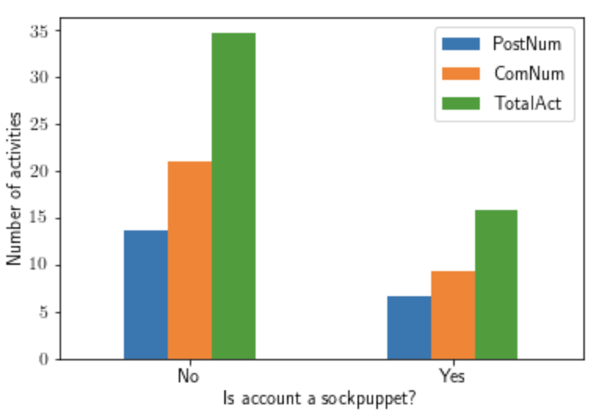
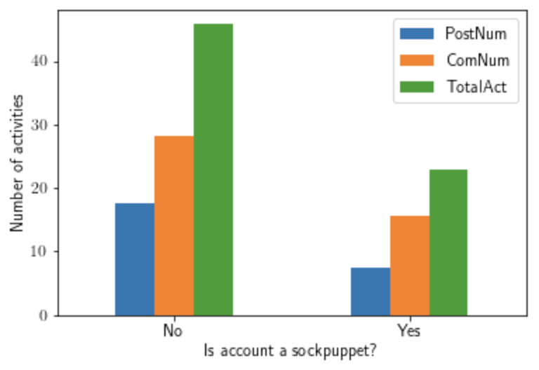
Activities by sockpuppets
All accounts
Active accounts
Activities include Post, Comments, and both
Normal users have more activities than sockpuppets

Slide 4
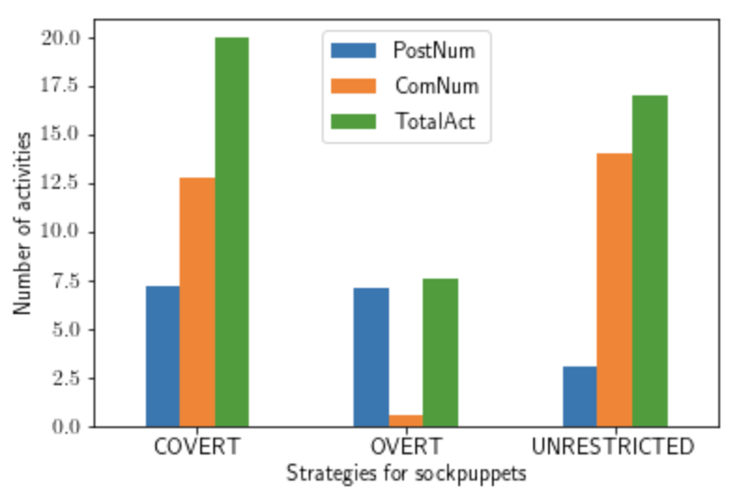
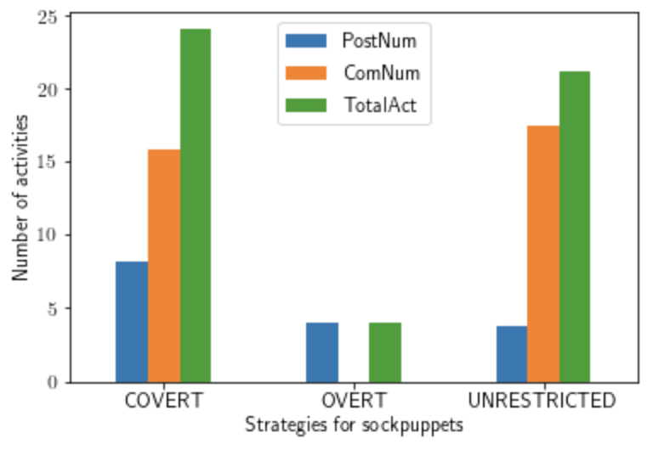
Activities by strategies of scokpuppets
All accounts
Active accounts
COVERT has more activities than others
OVERT has least activities

Slide 5
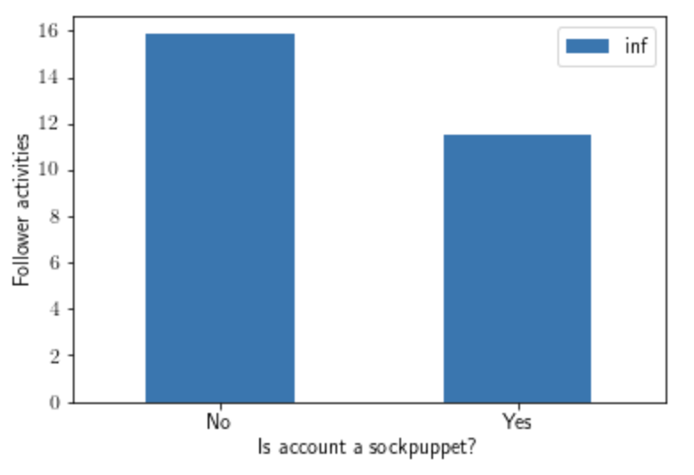
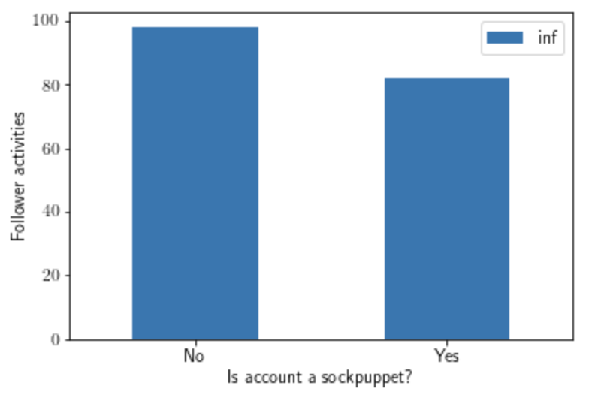
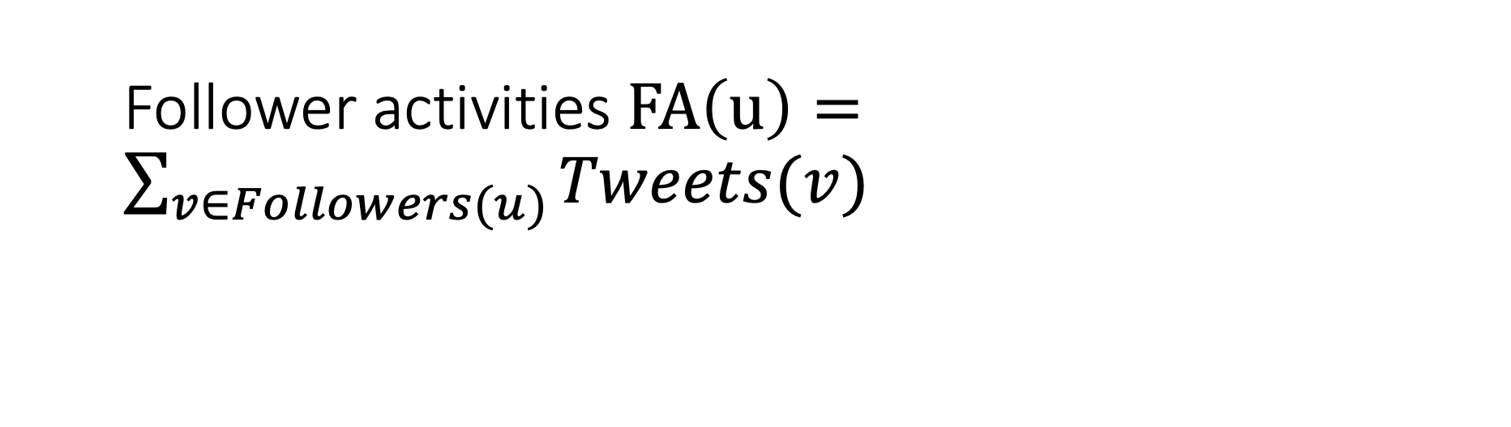
Follower activities $FA\left(u\right)=\sum_{v∈Followers(u)}{Tweets(v)}$
176 follows among 478 users
All accounts
Active accounts
Active accounts have far more follower activities!

Slide 6
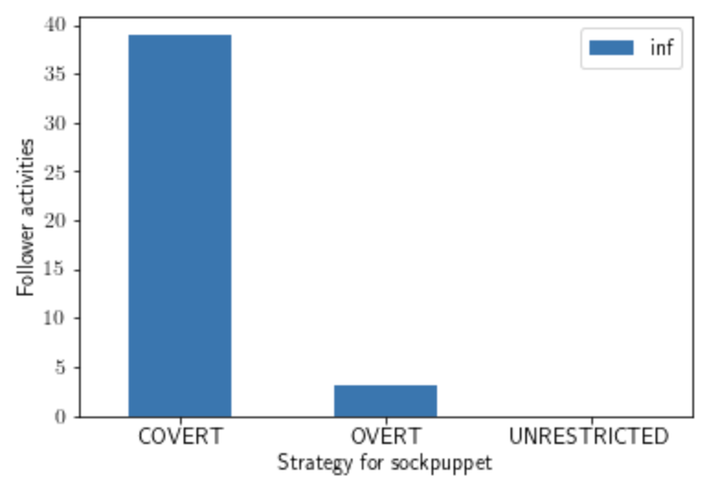
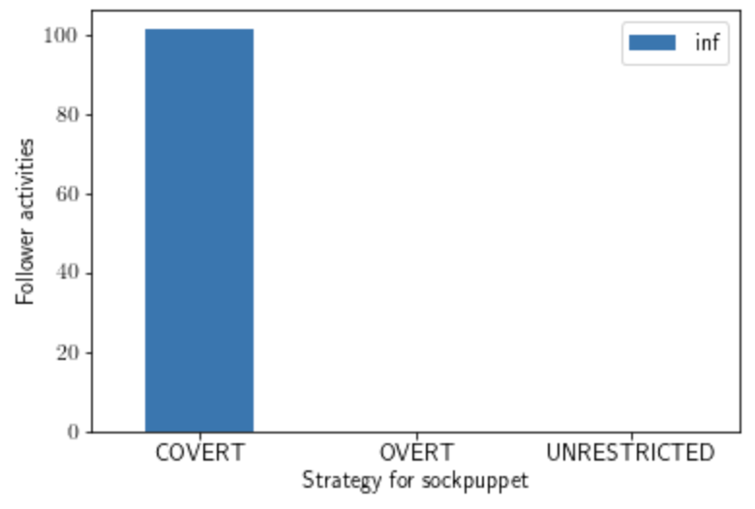
Follower activities $FA\left(u\right)=\sum_{v∈Followers(u)}{Tweets(v)}$
176 follows among 478 users
All accounts
Active accounts
Some accounts are only active for less than one day.
Only COVERT have active followers
OVERT and UNRESTRICTED have ZERO friend activities

Slide 7
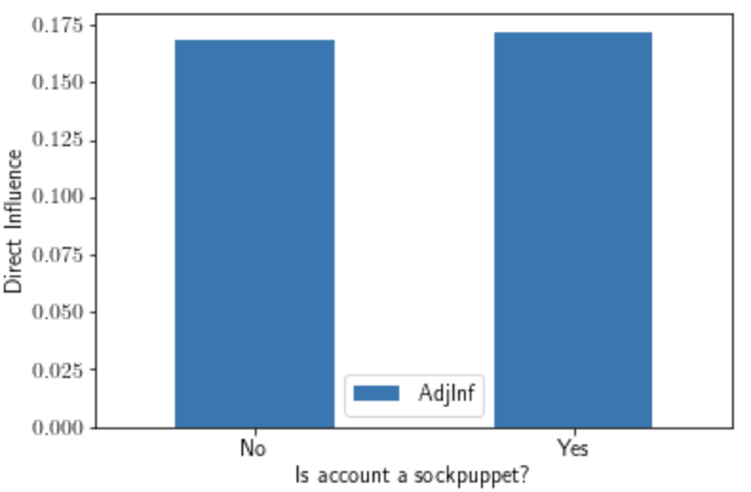
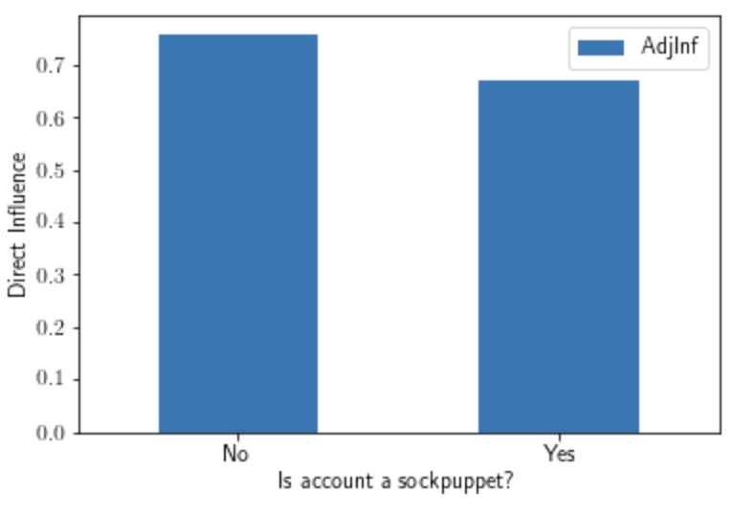

Direct Influence $DI\left(u\right)=\frac{Tweets(u)}{FA(u)}$
All accounts
Active accounts
Active accounts have far more direct influence

Slide 8
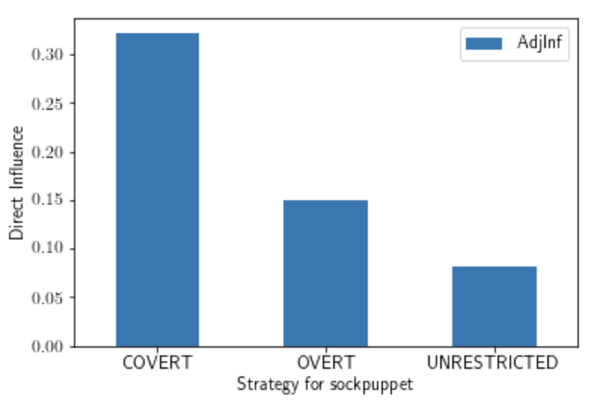
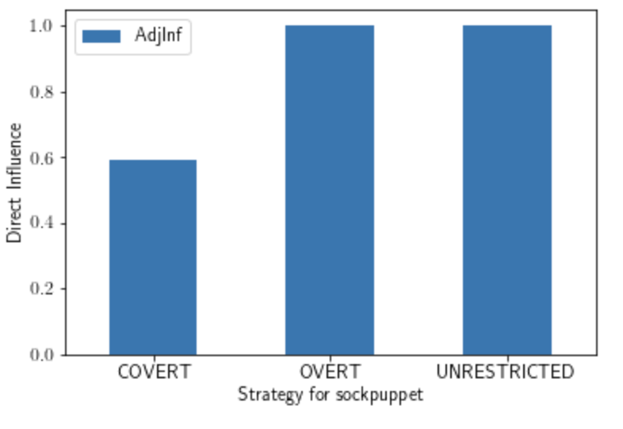
Direct Influence $DI\left(u\right)=\frac{Tweets(u)}{FA(u)}$
All accounts
Active accounts
OVERT and UNRESTRICTED socks have ZERO friend activities

Slide 9
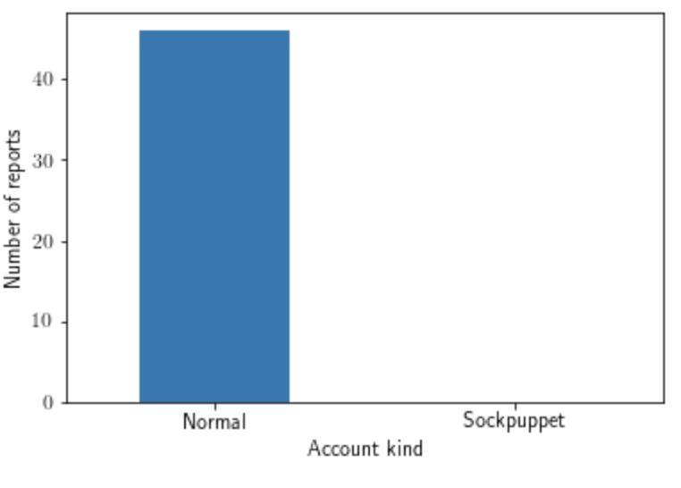
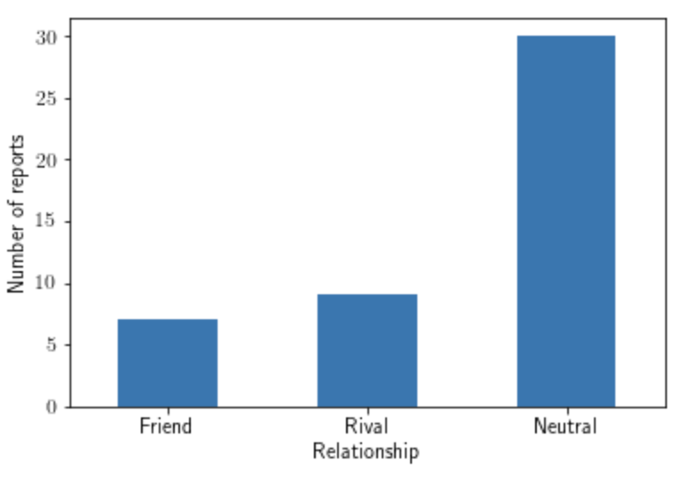
Who is reporting?
Friend: has more than 1 same topic and position
Rival: has at least 1 same topic but different position
Neutral: no same topic at all
Account kind
Relationship between reporter and suspects
Only normal users are reporting
All reporters are active accounts

Slide 10
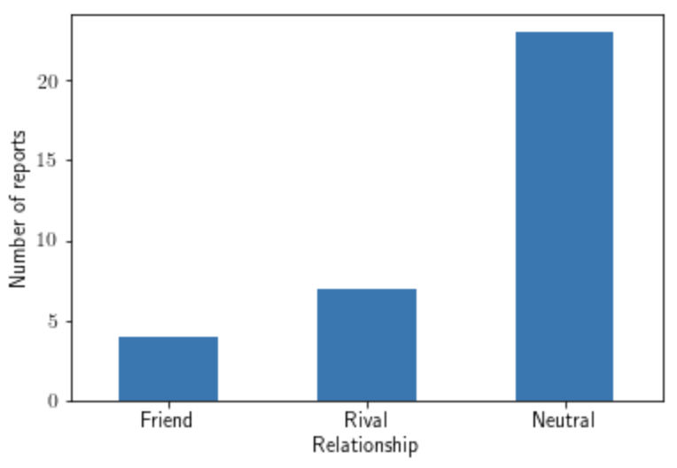
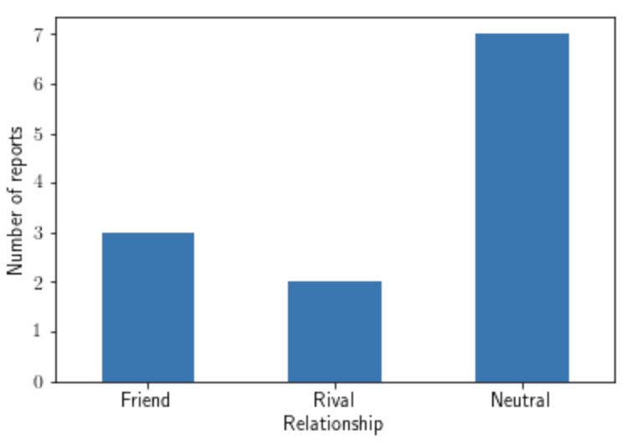
Additional details of relationship between reporter and suspects
25 targeted at normal user
21 targeted at sockpuppets

Slide 11
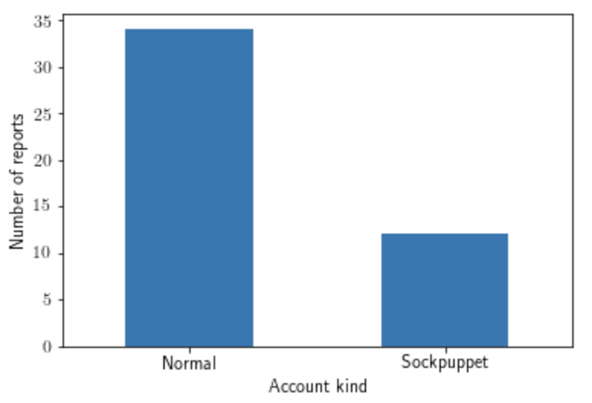
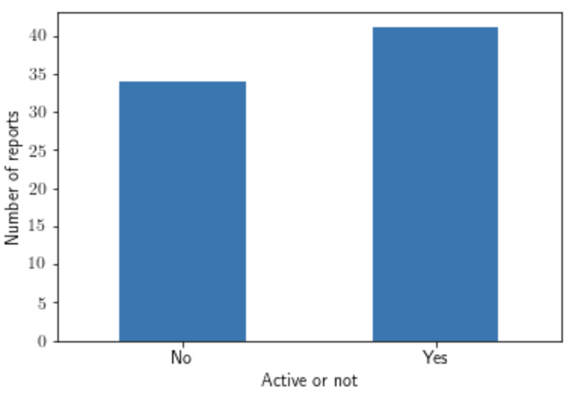
Who are reported (suspects)?
Account kind
Active users or not?

Slide 12
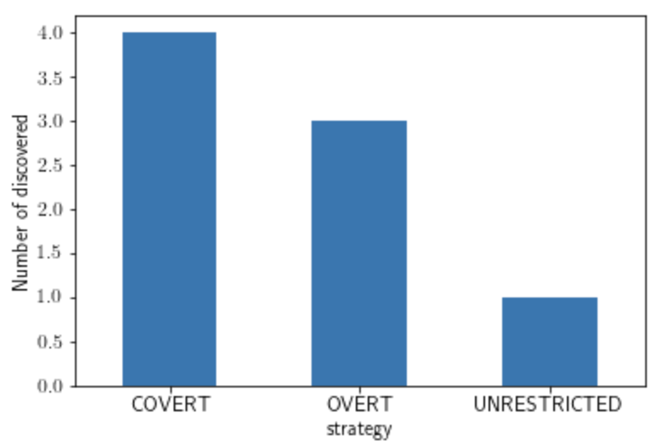
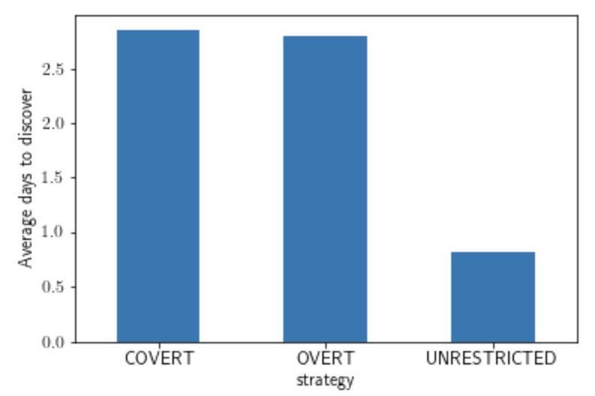
Who is discovered?
8 sockpuppets are discovered
4 COVERT
3 OVERT
1 UNRESTRICTED
UNRESTRICTED sockpuppets takes 1 day to discover on average (only one sample)
Number of discovered by strategies
Average time to discover

Slide 13
Old slides

Slide 14
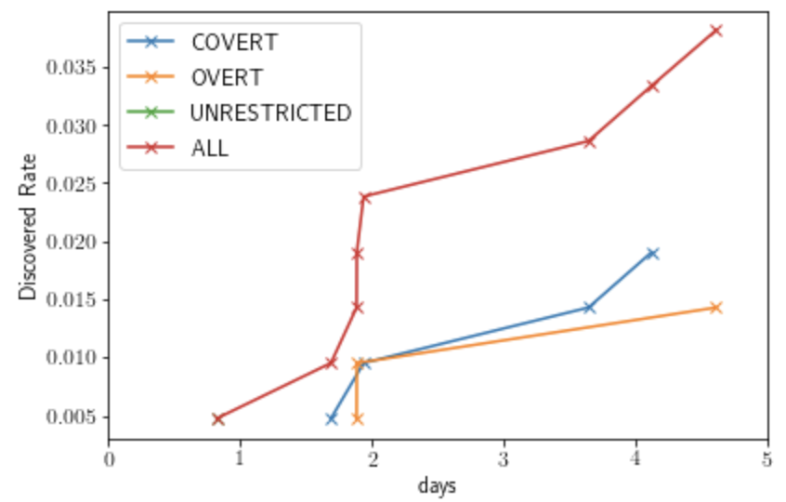
Detection rate by strategies
x-axis: time t = 1,..,6
y-axis: 𝑓(𝑡)=% 𝑜𝑓 𝑠𝑜𝑐𝑘𝑠 𝑐𝑟𝑒𝑎𝑡𝑒𝑑 𝑏𝑦 𝑠𝑡𝑟𝑎𝑡𝑒𝑔𝑦 𝑆 𝑡ℎ𝑎𝑡 𝑤𝑒𝑟𝑒 𝑑𝑒𝑡𝑒𝑐𝑡𝑒𝑑 𝑤𝑖𝑡ℎ𝑖𝑛 𝑡 𝑢𝑛𝑖𝑡𝑠 𝑜𝑓 𝑐𝑟𝑒𝑎𝑡𝑖𝑜𝑛.
4 curves using S = the 3 strategies provided to sock operators plus ALL (all socks, regardless of strategy)
Only 8 out of 210 are detected by the users
Other 3 curves need some time to process

Slide 15
Graph 2
x-axis: time t = 1,..,6
y-axis:
𝑓(𝑡)=% 𝑜𝑓 𝑟𝑒𝑡𝑤𝑒𝑒𝑡𝑠 𝑜𝑓 𝑎𝑙𝑙 𝑠𝑜𝑐𝑘 𝑝𝑜𝑠𝑡𝑠 𝑢𝑝𝑡𝑜 𝑡𝑖𝑚𝑒 𝑡, 𝑟𝑒𝑔𝑎𝑟𝑑𝑙𝑒𝑠𝑠 𝑜𝑓 𝑤ℎ𝑒𝑡ℎ𝑒𝑟 𝑡ℎ𝑒 𝑠𝑜𝑐𝑘𝑠 𝑤ℎ𝑒𝑟𝑒 𝑑𝑖𝑠𝑐𝑜𝑣𝑒𝑟𝑒𝑑 𝑜𝑟 𝑛𝑜𝑡.
𝑓(𝑡)=% 𝑜𝑓 𝑟𝑒𝑡𝑤𝑒𝑒𝑡𝑠 𝑜𝑓 𝑎𝑙𝑙 𝑠𝑜𝑐𝑘 𝑝𝑜𝑠𝑡𝑠 𝑢𝑝𝑡𝑜 𝑡𝑖𝑚𝑒 𝑡 𝑤ℎ𝑖𝑐ℎ 𝑤𝑒𝑟𝑒 𝑛𝑜𝑡 𝑑𝑖𝑠𝑐𝑜𝑣𝑒𝑟𝑒𝑑 𝑏𝑦 𝑡𝑖𝑚𝑒 𝑡
𝑓(𝑡)=% 𝑜𝑓 𝑟𝑒𝑡𝑤𝑒𝑒𝑡𝑠 𝑜𝑓 𝑎𝑙𝑙 𝑠𝑜𝑐𝑘 𝑝𝑜𝑠𝑡𝑠 𝑢𝑝𝑡𝑜 𝑡𝑖𝑚𝑒 𝑡 𝑡ℎ𝑒𝑟𝑒 𝑤𝑒𝑟𝑒 𝑛𝑒𝑣𝑒𝑟 𝑑𝑖𝑠𝑐𝑜𝑣𝑒𝑟𝑒𝑑.
3 curves in all
None of the sock posts are retweeted (reposted)
397 out of 1622 are commented on the sock posts

