Slide 1
Dartpost

Slide 2
Data
Users: 478
Sockpuppets: 210
Posts (tweets): 1084
Comments; 1622
Likes: 1037
Reposts: 123
User Reports: 46
Distinct reports: 21
True Positive: 8, False Positive 13
Follows: 176
Searches: 846

Slide 3
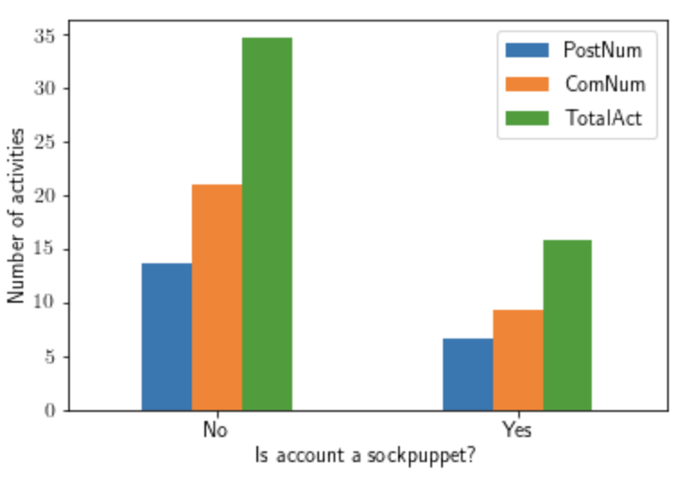
Activities by sockpuppets
Activities include Post, Comments, and both
Normal users have more activities than sockpuppets

Slide 4
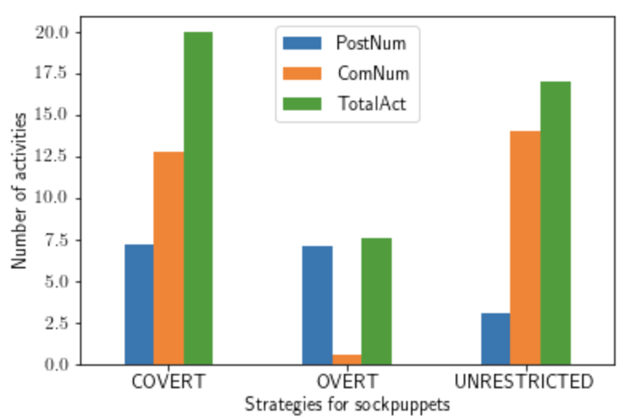
Activities by strategies of scokpuppets
COVERT has more activities than others
OVERT has least activities

Slide 5
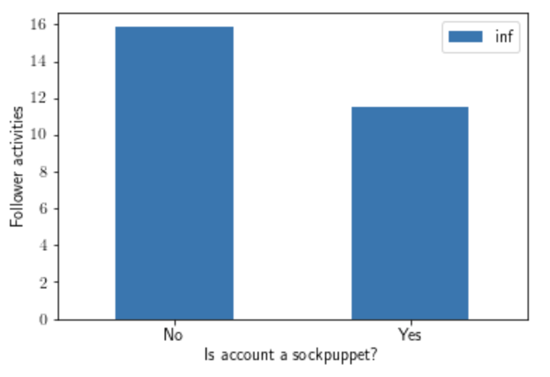
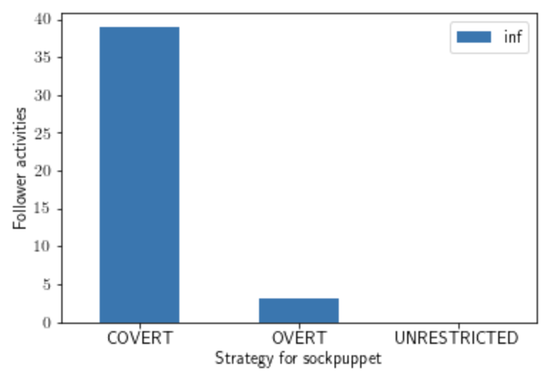
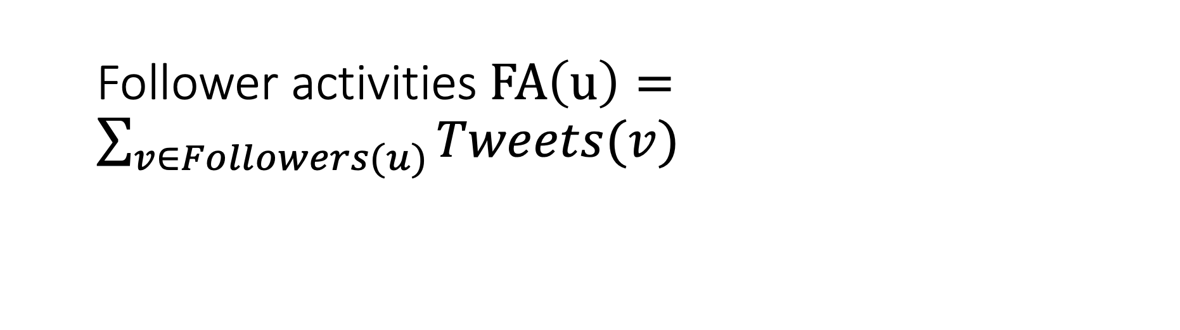
Follower activities $FA\left(u\right)=\sum_{v∈Followers(u)}{Tweets(v)}$
Followers for COVERT has activities, which are also likely to be sockpuppets

Slide 6
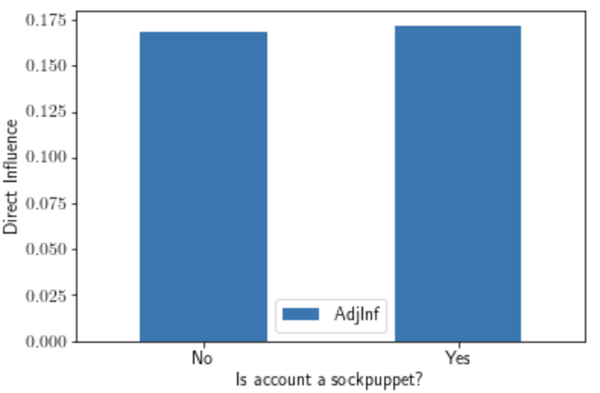
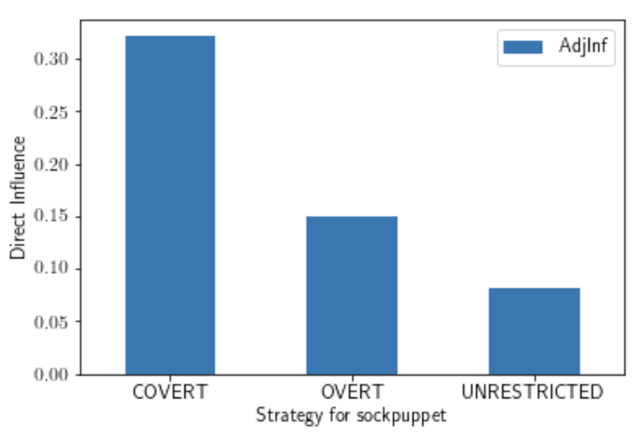

Direct Influence $DI\left(u\right)=\frac{Tweets(u)}{FA(u)}$
Hard to distinguish sockpuppets or normal users by direct influence
COVERT has most direct influence

Slide 7
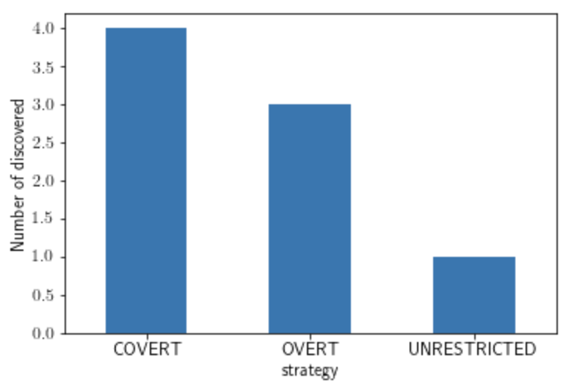
Number of discovered by strategies
8 sockpuppets are discovered
4 COVERT
3 OVERT
1 UNRESTRICTED

Slide 8
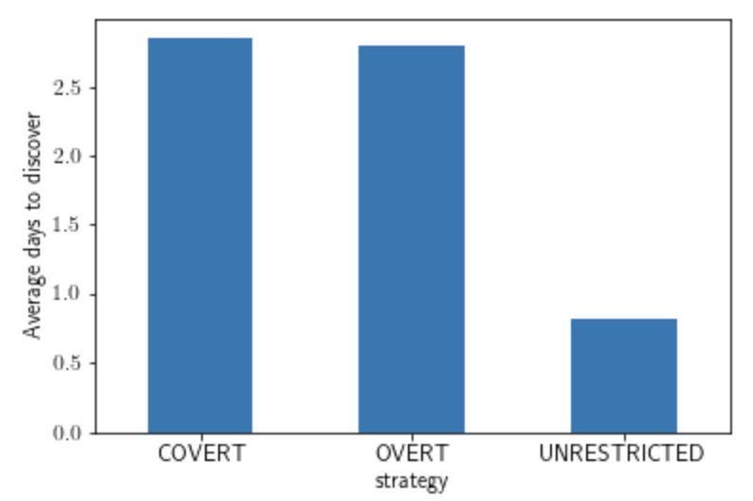
Average time to discover
UNRESTRICTED sockpuppets takes 1 day to discover on average (only one sample)

Slide 10
Old slides

Slide 11
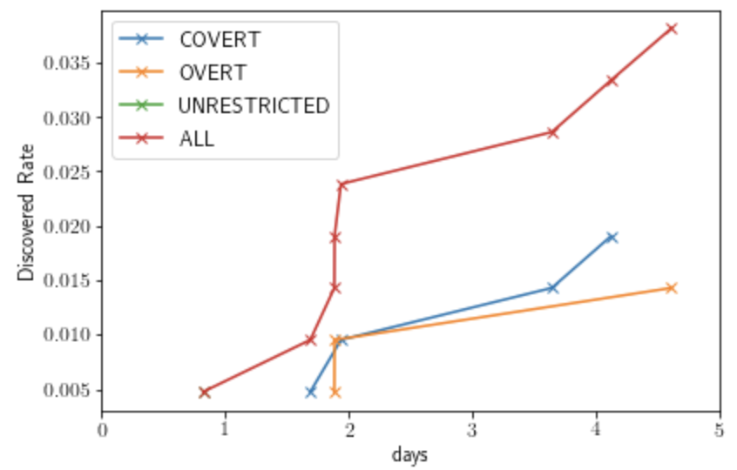
Detection rate by strategies
x-axis: time t = 1,..,6
y-axis: 𝑓(𝑡)=% 𝑜𝑓 𝑠𝑜𝑐𝑘𝑠 𝑐𝑟𝑒𝑎𝑡𝑒𝑑 𝑏𝑦 𝑠𝑡𝑟𝑎𝑡𝑒𝑔𝑦 𝑆 𝑡ℎ𝑎𝑡 𝑤𝑒𝑟𝑒 𝑑𝑒𝑡𝑒𝑐𝑡𝑒𝑑 𝑤𝑖𝑡ℎ𝑖𝑛 𝑡 𝑢𝑛𝑖𝑡𝑠 𝑜𝑓 𝑐𝑟𝑒𝑎𝑡𝑖𝑜𝑛.
4 curves using S = the 3 strategies provided to sock operators plus ALL (all socks, regardless of strategy)
Only 8 out of 210 are detected by the users
Other 3 curves need some time to process

Slide 12
Graph 2
x-axis: time t = 1,..,6
y-axis:
𝑓(𝑡)=% 𝑜𝑓 𝑟𝑒𝑡𝑤𝑒𝑒𝑡𝑠 𝑜𝑓 𝑎𝑙𝑙 𝑠𝑜𝑐𝑘 𝑝𝑜𝑠𝑡𝑠 𝑢𝑝𝑡𝑜 𝑡𝑖𝑚𝑒 𝑡, 𝑟𝑒𝑔𝑎𝑟𝑑𝑙𝑒𝑠𝑠 𝑜𝑓 𝑤ℎ𝑒𝑡ℎ𝑒𝑟 𝑡ℎ𝑒 𝑠𝑜𝑐𝑘𝑠 𝑤ℎ𝑒𝑟𝑒 𝑑𝑖𝑠𝑐𝑜𝑣𝑒𝑟𝑒𝑑 𝑜𝑟 𝑛𝑜𝑡.
𝑓(𝑡)=% 𝑜𝑓 𝑟𝑒𝑡𝑤𝑒𝑒𝑡𝑠 𝑜𝑓 𝑎𝑙𝑙 𝑠𝑜𝑐𝑘 𝑝𝑜𝑠𝑡𝑠 𝑢𝑝𝑡𝑜 𝑡𝑖𝑚𝑒 𝑡 𝑤ℎ𝑖𝑐ℎ 𝑤𝑒𝑟𝑒 𝑛𝑜𝑡 𝑑𝑖𝑠𝑐𝑜𝑣𝑒𝑟𝑒𝑑 𝑏𝑦 𝑡𝑖𝑚𝑒 𝑡
𝑓(𝑡)=% 𝑜𝑓 𝑟𝑒𝑡𝑤𝑒𝑒𝑡𝑠 𝑜𝑓 𝑎𝑙𝑙 𝑠𝑜𝑐𝑘 𝑝𝑜𝑠𝑡𝑠 𝑢𝑝𝑡𝑜 𝑡𝑖𝑚𝑒 𝑡 𝑡ℎ𝑒𝑟𝑒 𝑤𝑒𝑟𝑒 𝑛𝑒𝑣𝑒𝑟 𝑑𝑖𝑠𝑐𝑜𝑣𝑒𝑟𝑒𝑑.
3 curves in all
None of the sock posts are retweeted (reposted)
397 out of 1622 are commented on the sock posts

