Slide 1
nopCommerce
Assignment 01: Observability in the Wild
AS, 2025/2026
Rui Machado - 113765

Slide 2
The Goal
Add observability to nopCommerce's order flow with zero changes to method signatures or existing behaviour.
Distributed Tracing
Metrics
Dashboards
PII Protection
Jaeger via OTLP
Prometheus histograms & counters
Grafana (auto-provisioned)
Redaction before export

Slide 3
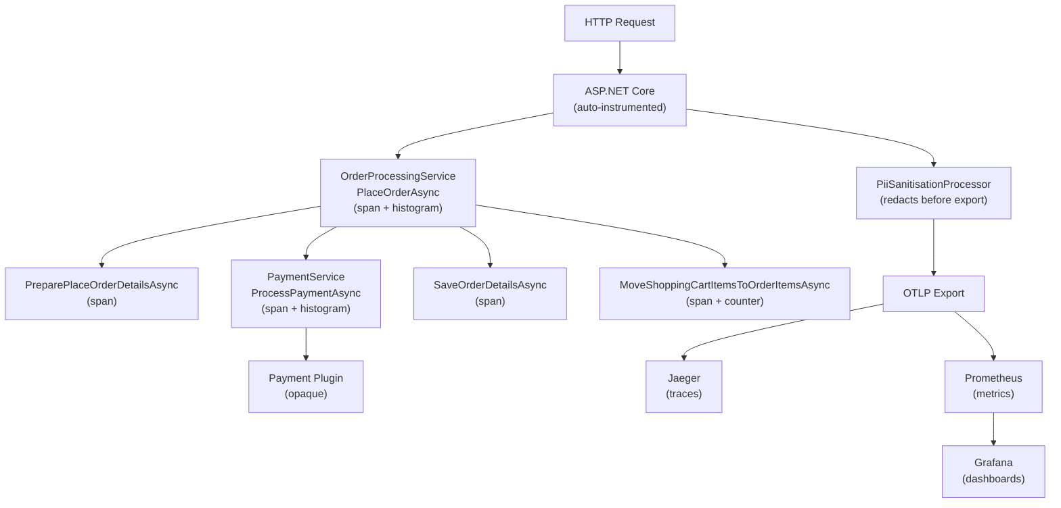
Architecture

Slide 4
Instrumentation Decisions
Spans
Metrics
PlaceOrderAsync
Root span for the full order flow
PreparePlaceOrderDetailsAsync
Validation & data gathering
ProcessPaymentAsync
Payment gateway call
SaveOrderDetailsAsync
Database persistence
MoveCartItemsToOrderItemsAsync
Cart-to-order conversion
order.processing_duration
Histogram: end-to-end order time
payment.gateway_duration
Histogram: payment latency
inventory.adjustment_failures
Counter: stock adjustment errors

Slide 5
Surgical Approach
1
Zero signature changes
2
Single shared definitions file
All spans and metrics are defined in a single file, keeping instrumentation centralised instead of scattered across services
3
INopStartup integration
OpenTelemetry is registered through nopCommerce's own startup interface at Order = -1, loading before all other services without touching existing startup code
4
SDK-layer PII protection
PiiSanitisationProcessor intercepts every span before export and redacts sensitive tags, so no per-service sanitisation logic is needed

Slide 6
Why Inline Instrumentation?
Chosen approach: inline spans inside existing methods
Decorator Pattern
Rejected
nopCommerce registers concrete classes in DI, not interfaces. Other code depends on the specific class by name. Swapping in a wrapper would break those dependencies. Would require refactoring the entire DI setup.
DiagnosticSource / DiagnosticListener
Rejected
Separates span logic into a listener, but still requires inline changes to emit events. Adds infrastructure complexity that only pays off at 20+ methods. For 5 methods, the overhead is not justified.
Inline (using var activity = ...)
Chosen
Minimal changes: two lines per method. No-op when no listener is registered. No new dependencies. No refactoring of existing architecture. Pragmatic choice for 5 methods.

Slide 7
PII Protection
Single enforcement point: PiiSanitisationProcessor
How it works
Extends BaseProcessor<Activity>, runs on every span before export
Scans all tag keys against a pattern list (email, name, phone, card, address, ...)
Matching tags are replaced with [REDACTED]
No per-service logic required. One class handles all PII across the application

Slide 8
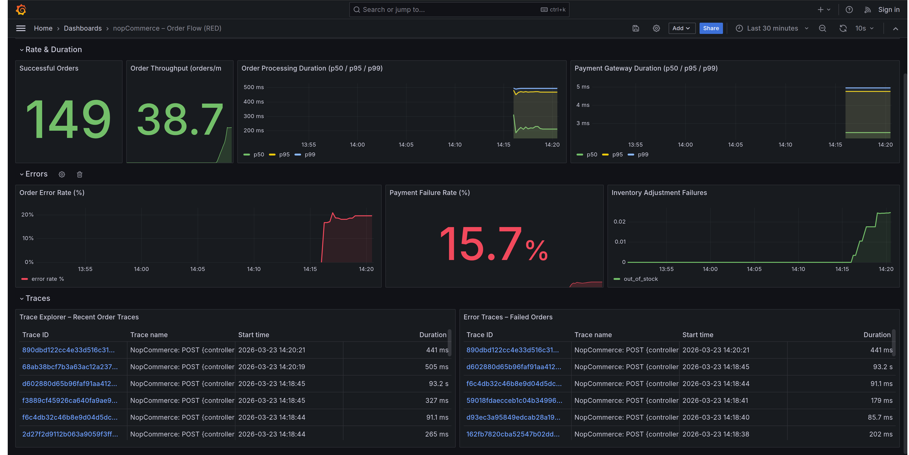
Dashboard

Slide 9
Architectural Critique
What Helped
What Hindered
Layered architecture
Shared diagnostics file, no circular deps
Well-decomposed methods
Natural span boundaries
INopStartup interface
Pure-additive registration at Order = -1
Virtual methods on concrete classes
Decorator pattern impractical
Dual control-flow in PlaceOrderAsync
Duplicated metric recording
Opaque payment plugins
Plugin internals invisible to spans

Slide 10
Thank You
Questions?
https://github.com/ruimachado23/as-assignment01

