Slide 1
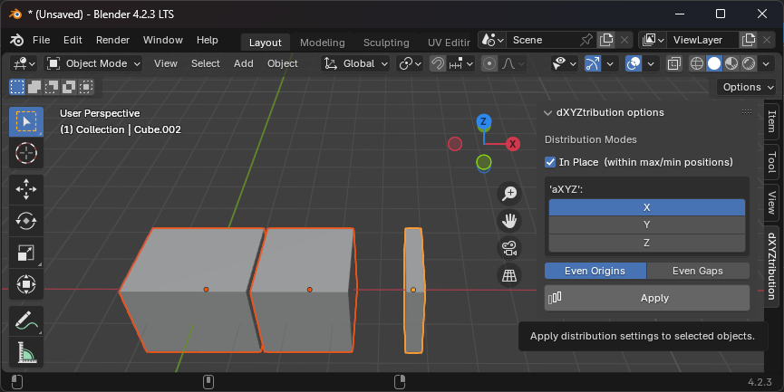
Even distances
Remain fixed

Slide 2
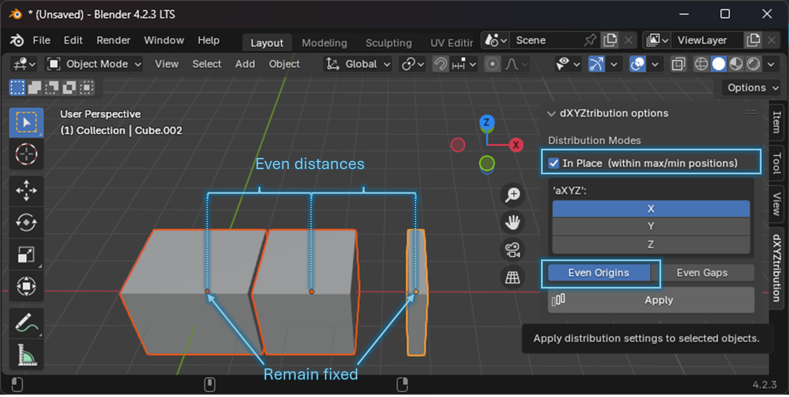

Slide 3
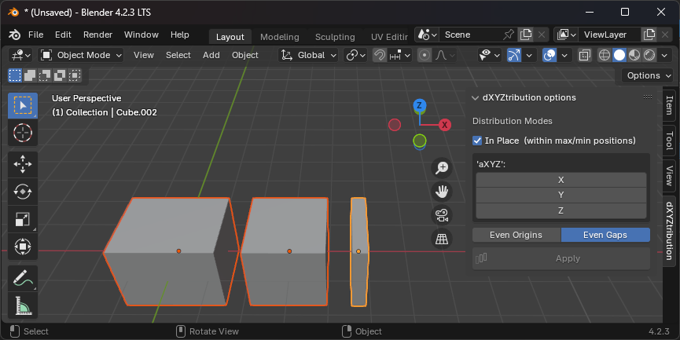
Even gaps
Remain fixed

Slide 4
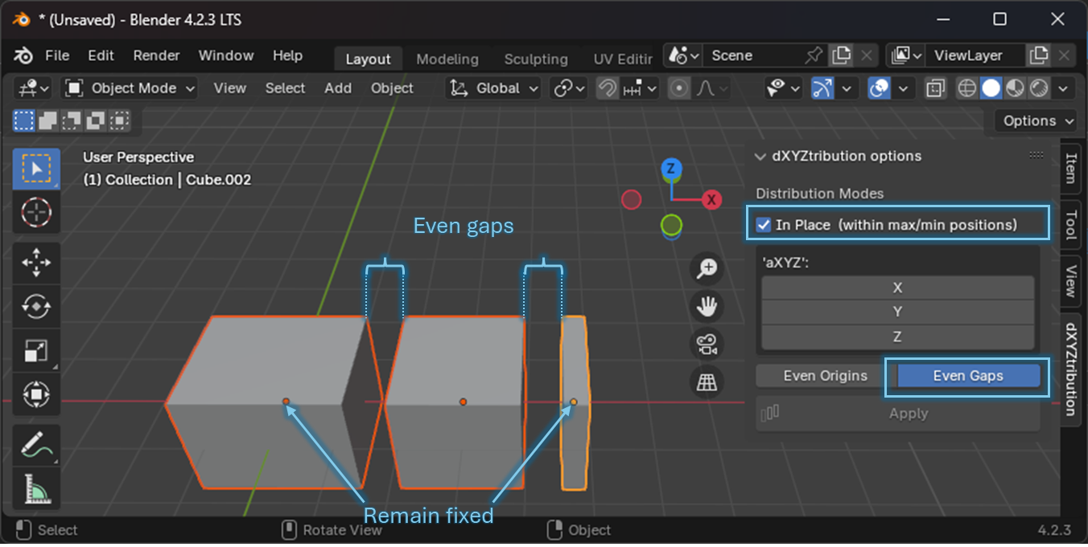

Slide 5
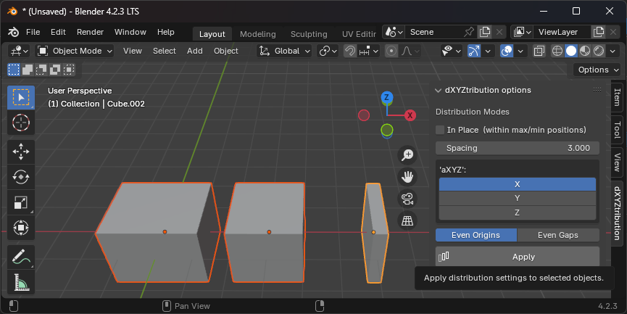
Even distances = User specified
Remain fixed

Slide 6
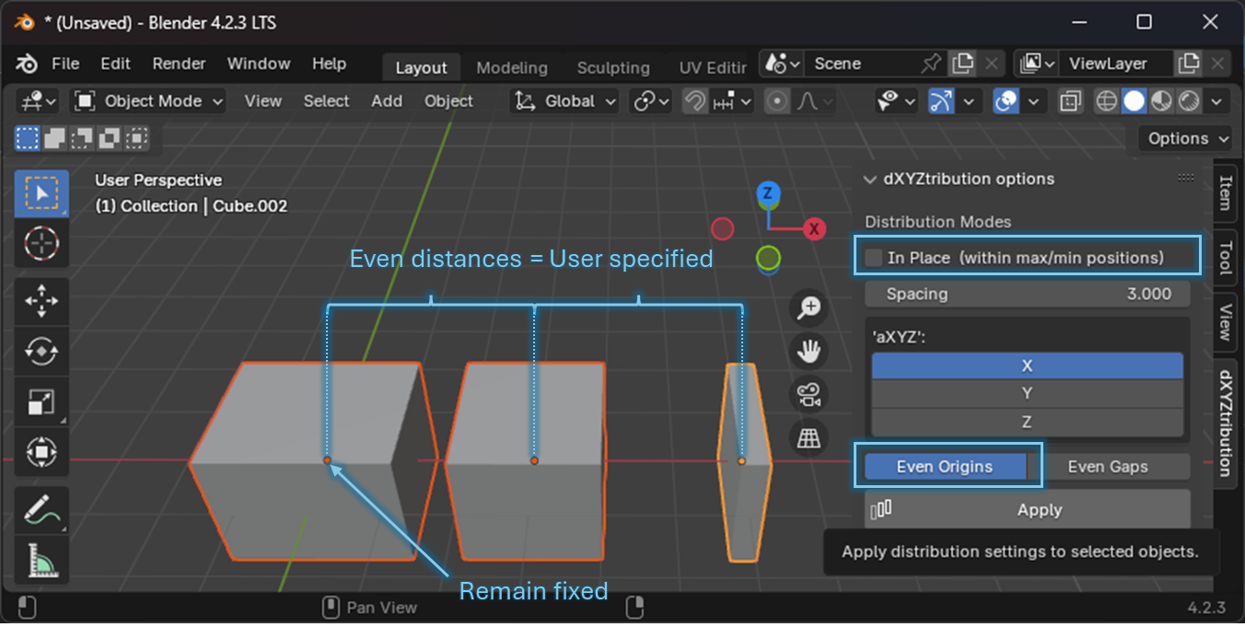

Slide 7
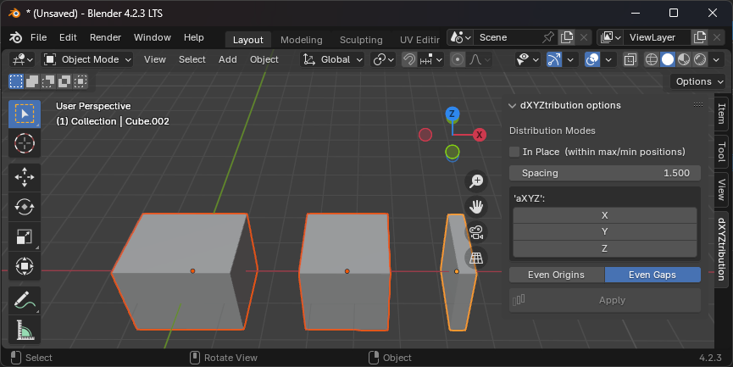
Even gaps = User specified
Remain fixed

Slide 8
