Slide 1
IIIF Mid-Term Presentation
One Door to a Scattered Heritage
boheng.shang@epfl.ch

Slide 2
Modular IIIF Harvesting Pipeline
Aim: Collect scattered heritage resources and deliver linked images, metadata and institutional reference texts for downstream OCR work
Module 1
Module2
Module3
Module4
Provider Census and Selection
Endpoint Accessibility Checker
IIIF Manifest Discovery
Manifest Fetcher and Validator
Provider Selection and Endpoint Checks
Retrieval and Validation
Manifest Discovery
Module 7
Module8
Module 5
Module6
Provider Census and Selection
Endpoint Accessibility Checker
Rights Classification
Metadata and Reference Extraction
Data Export and Resource Download
Validation, Rights Classification

Slide 3
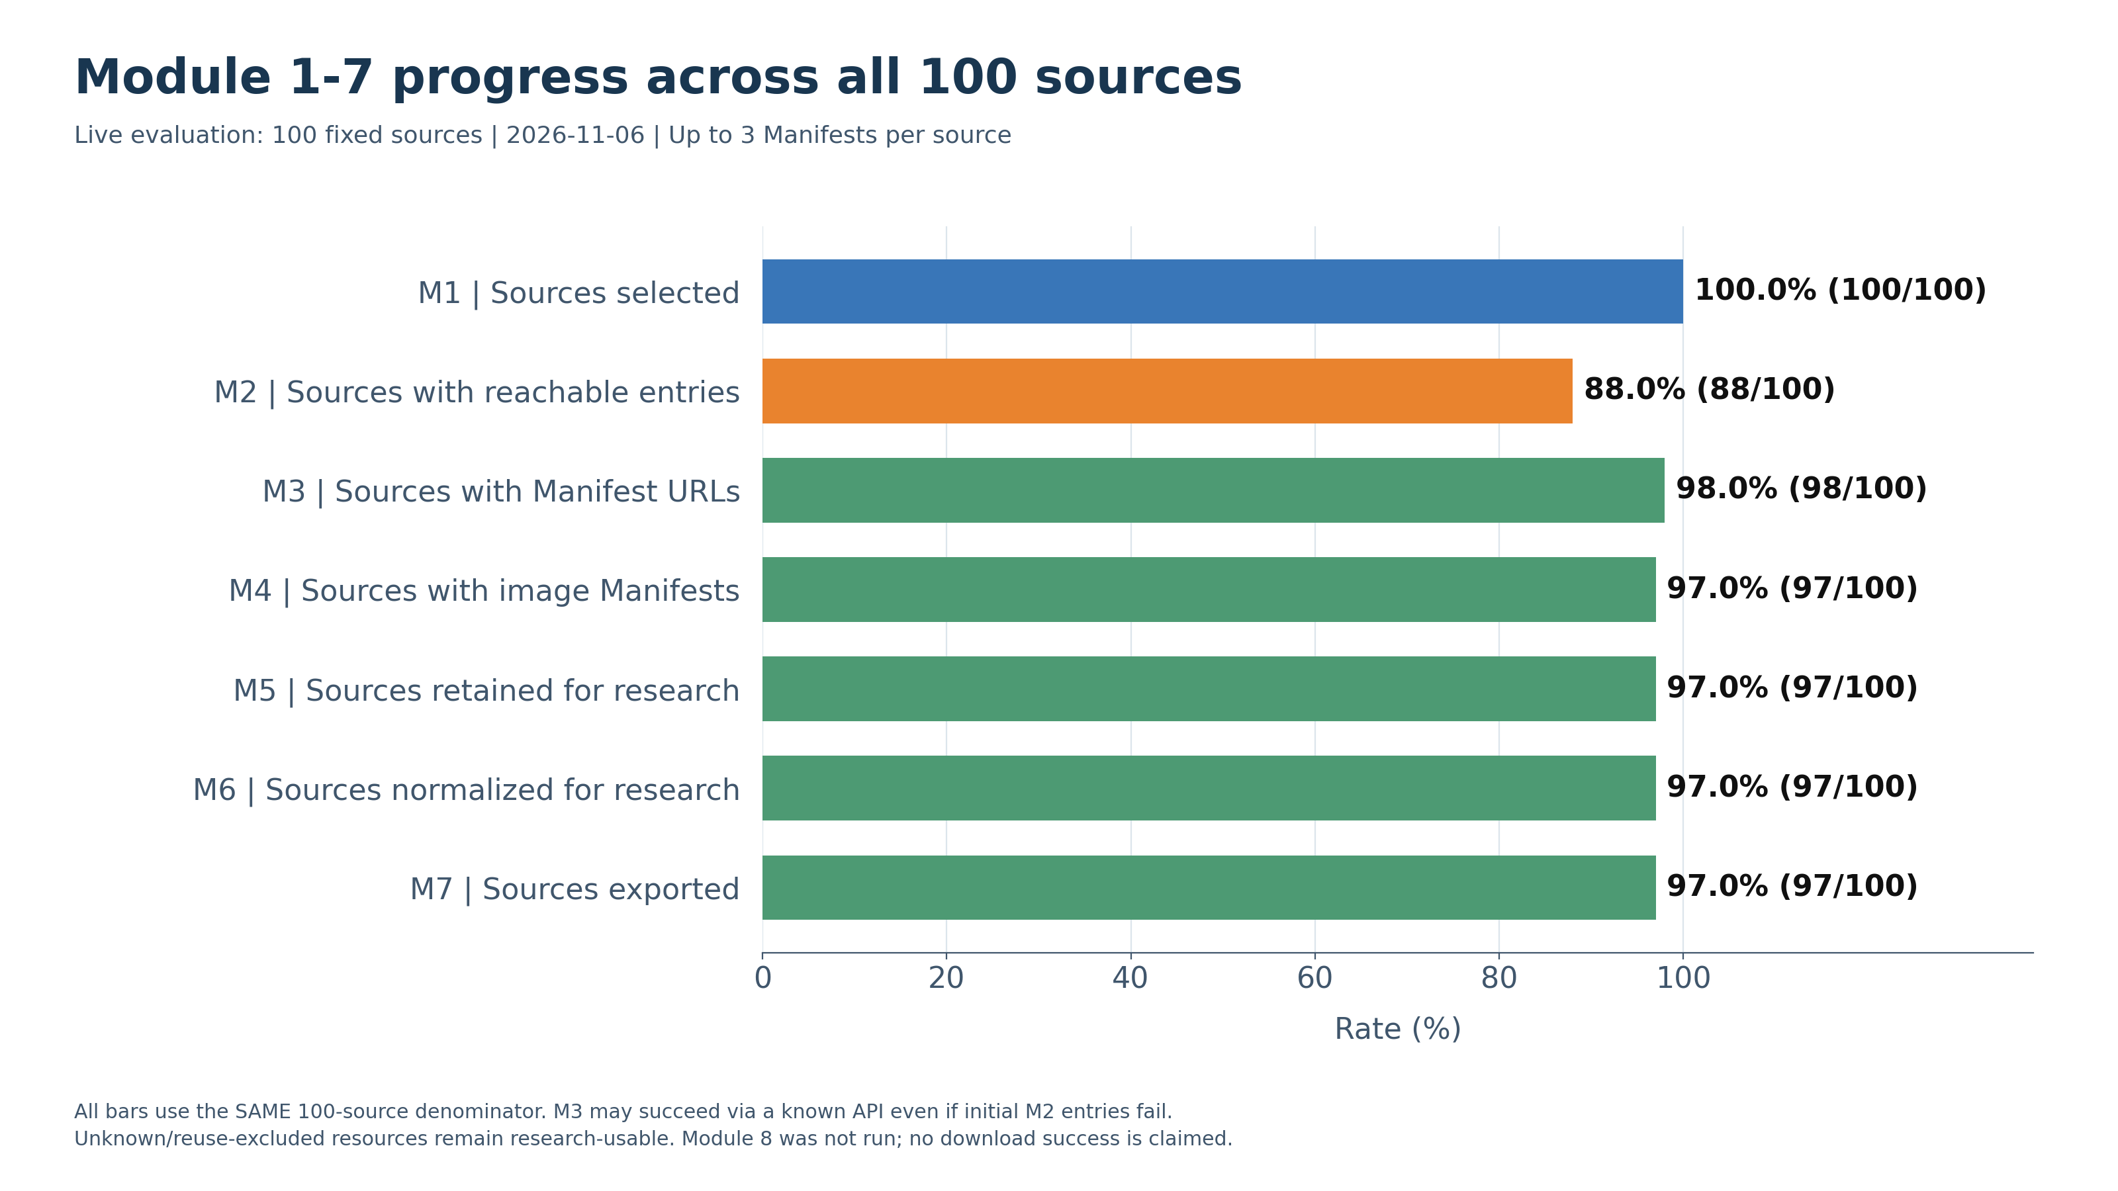
Modular IIIF Harvesting Pipeline Experiment
Experimental Setup
Sources: A fixed set of 100 previously validated sources, containing 139 candidate endpoints.
Sampling limit: At most 3 Manifests per source were selected for downstream processing.
Pipeline scope: Modules 1–7 were executed; Module 8 downloads were excluded.
Execution: Manifests were freshly retrieved using existing discovery methods and saved configurations.
Evaluation: Source-level success rates use the same denominator of 100.
Results
Manifest discovery: 98/100 sources yielded Manifest URLs.
Exported data: 275 document records, representing 269 distinct Manifest URLs, and 44,915 image associations.
Research retention: All 275 accepted records were retained, including unknown-rights and public-reuse-excluded records.
Unsuccessful cases: Two sources encountered request failures; one yielded only non-image Manifest samples.

Slide 4
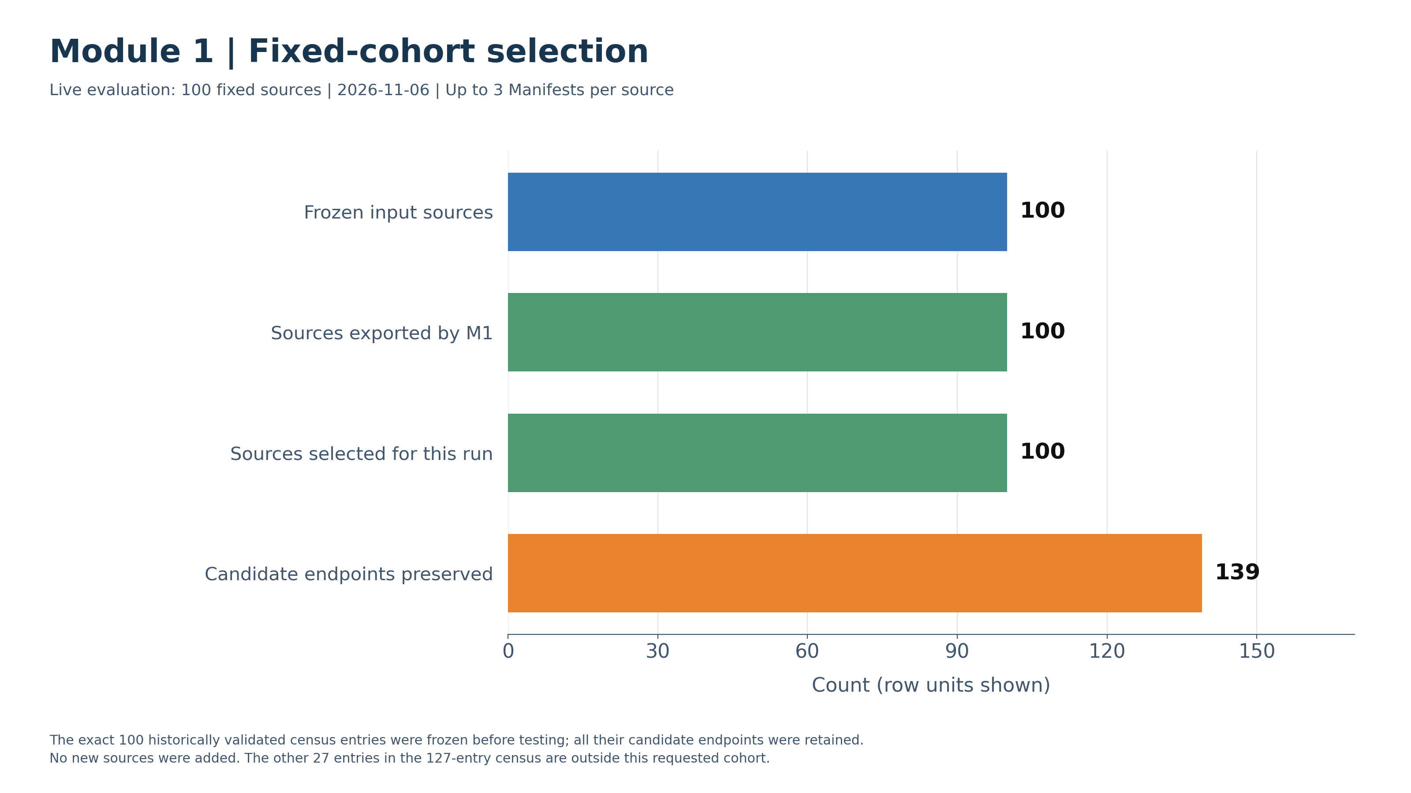
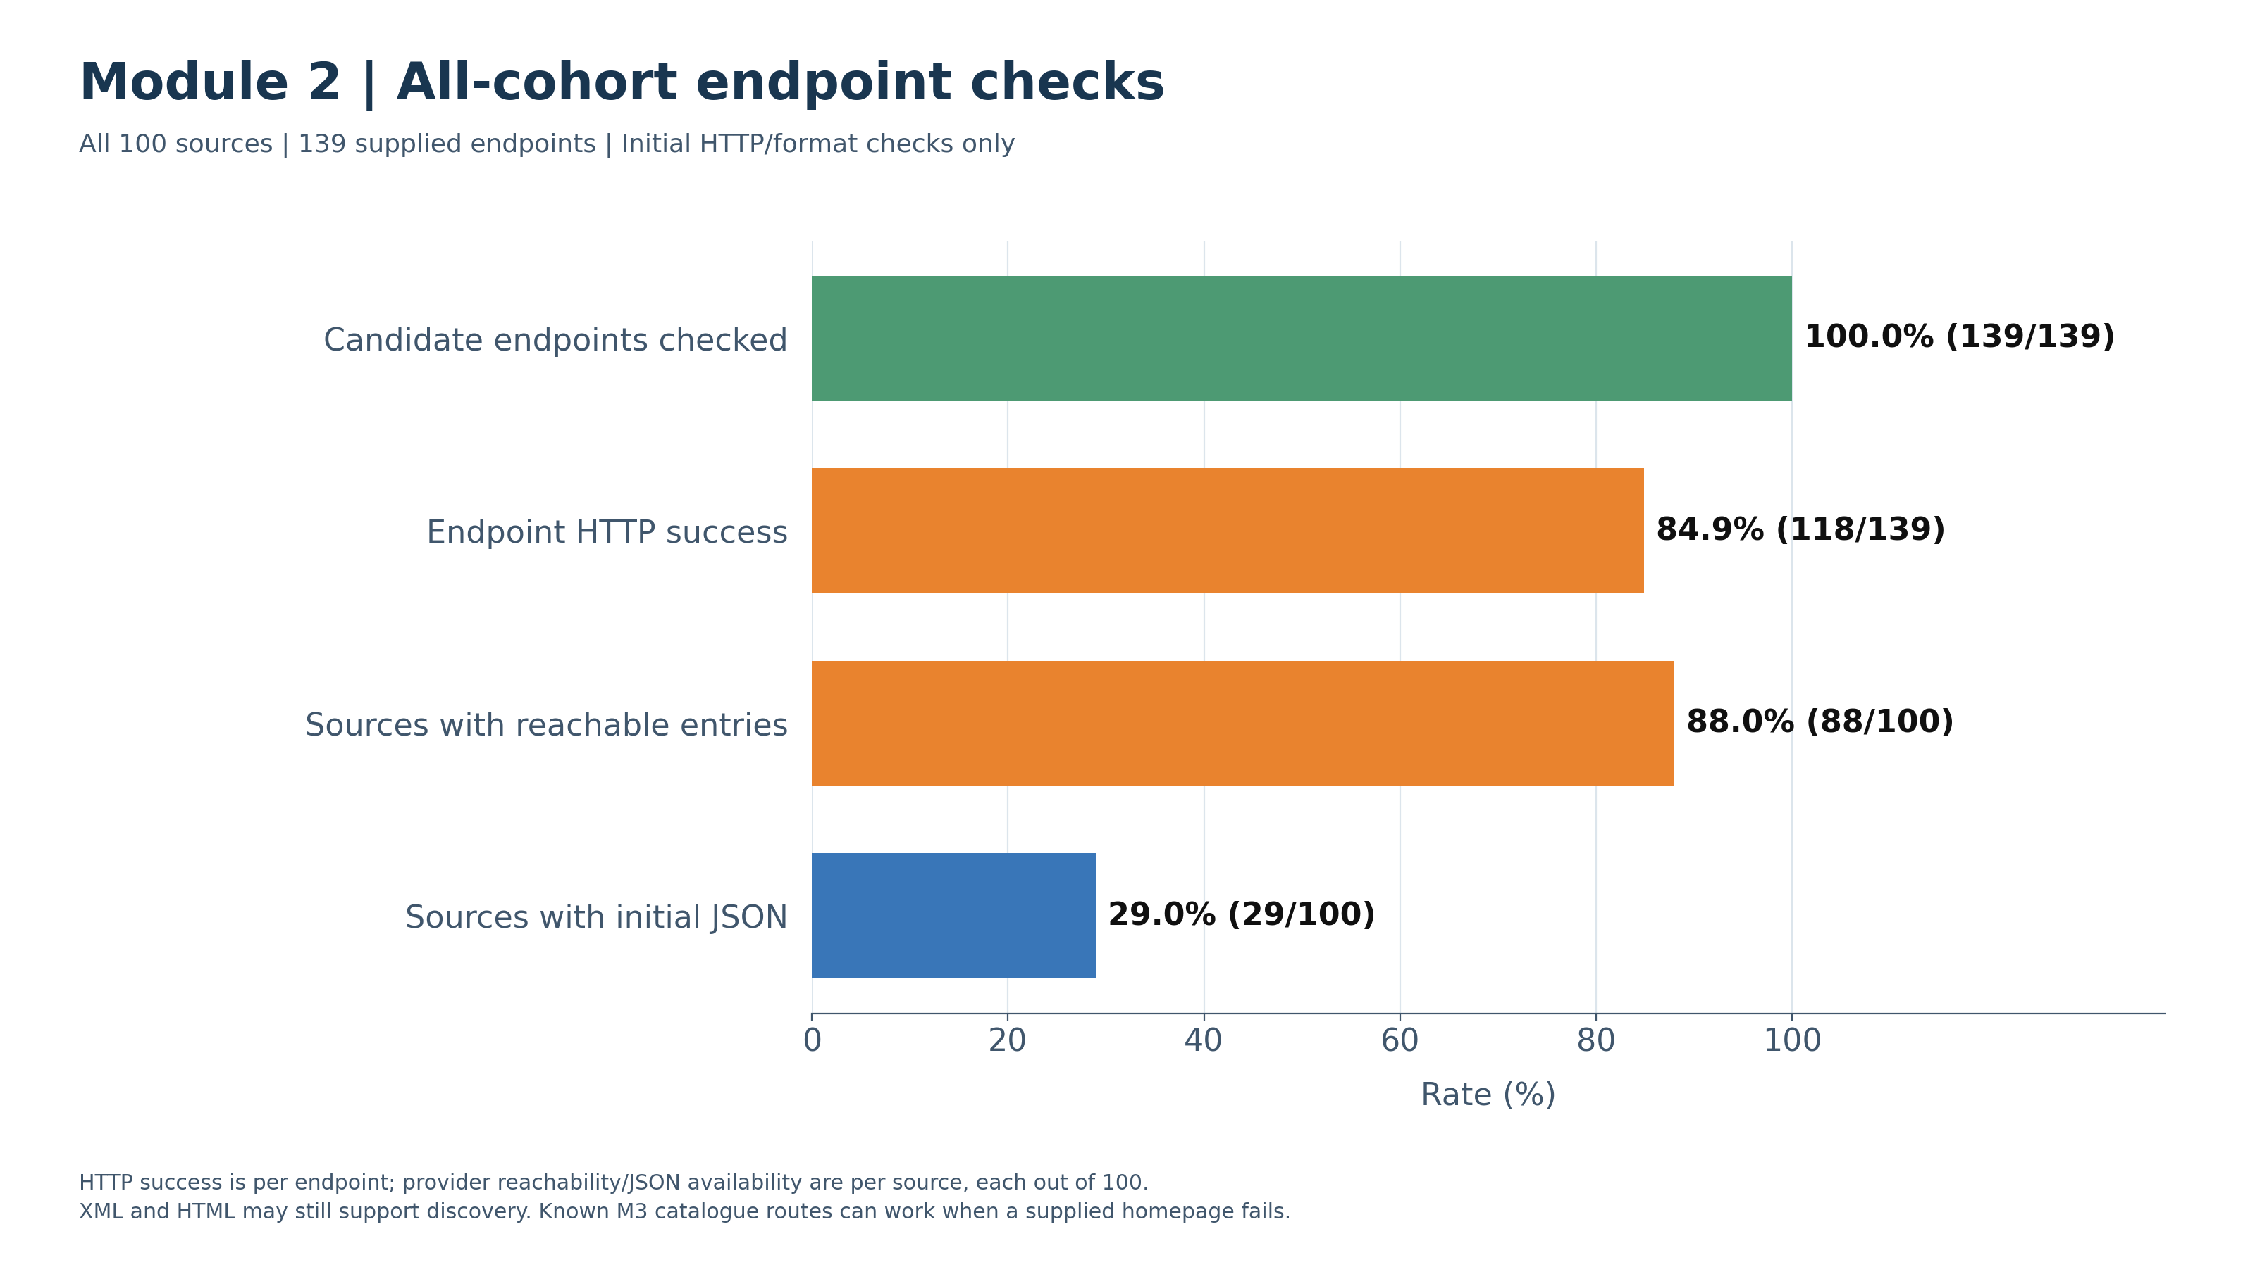
Module 1 and Module 2
Module1 function -> Merge Sources; Preserve Endpoints; Select Providers
Module2 function -> Check All Endpoints; Record HTTP, Content Type and JSON Results
Module 1 successfully selected and exported all 100 sources, preserving 139 candidate endpoints. No source-selection or export failures occurred. Endpoint accessibility is assessed separately in Module 2.
Module 2 checked all 139 endpoints. 118 endpoints returned successful HTTP responses (84.9%), and 88 of the 100 sources had at least one reachable supplied endpoint.

Slide 5
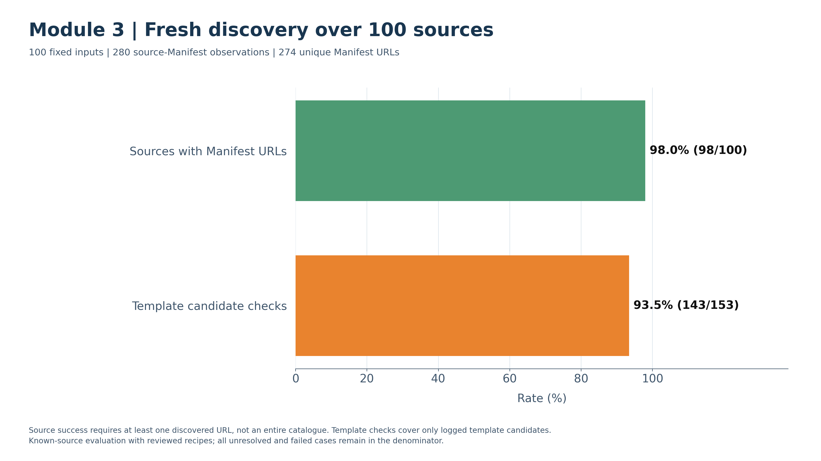
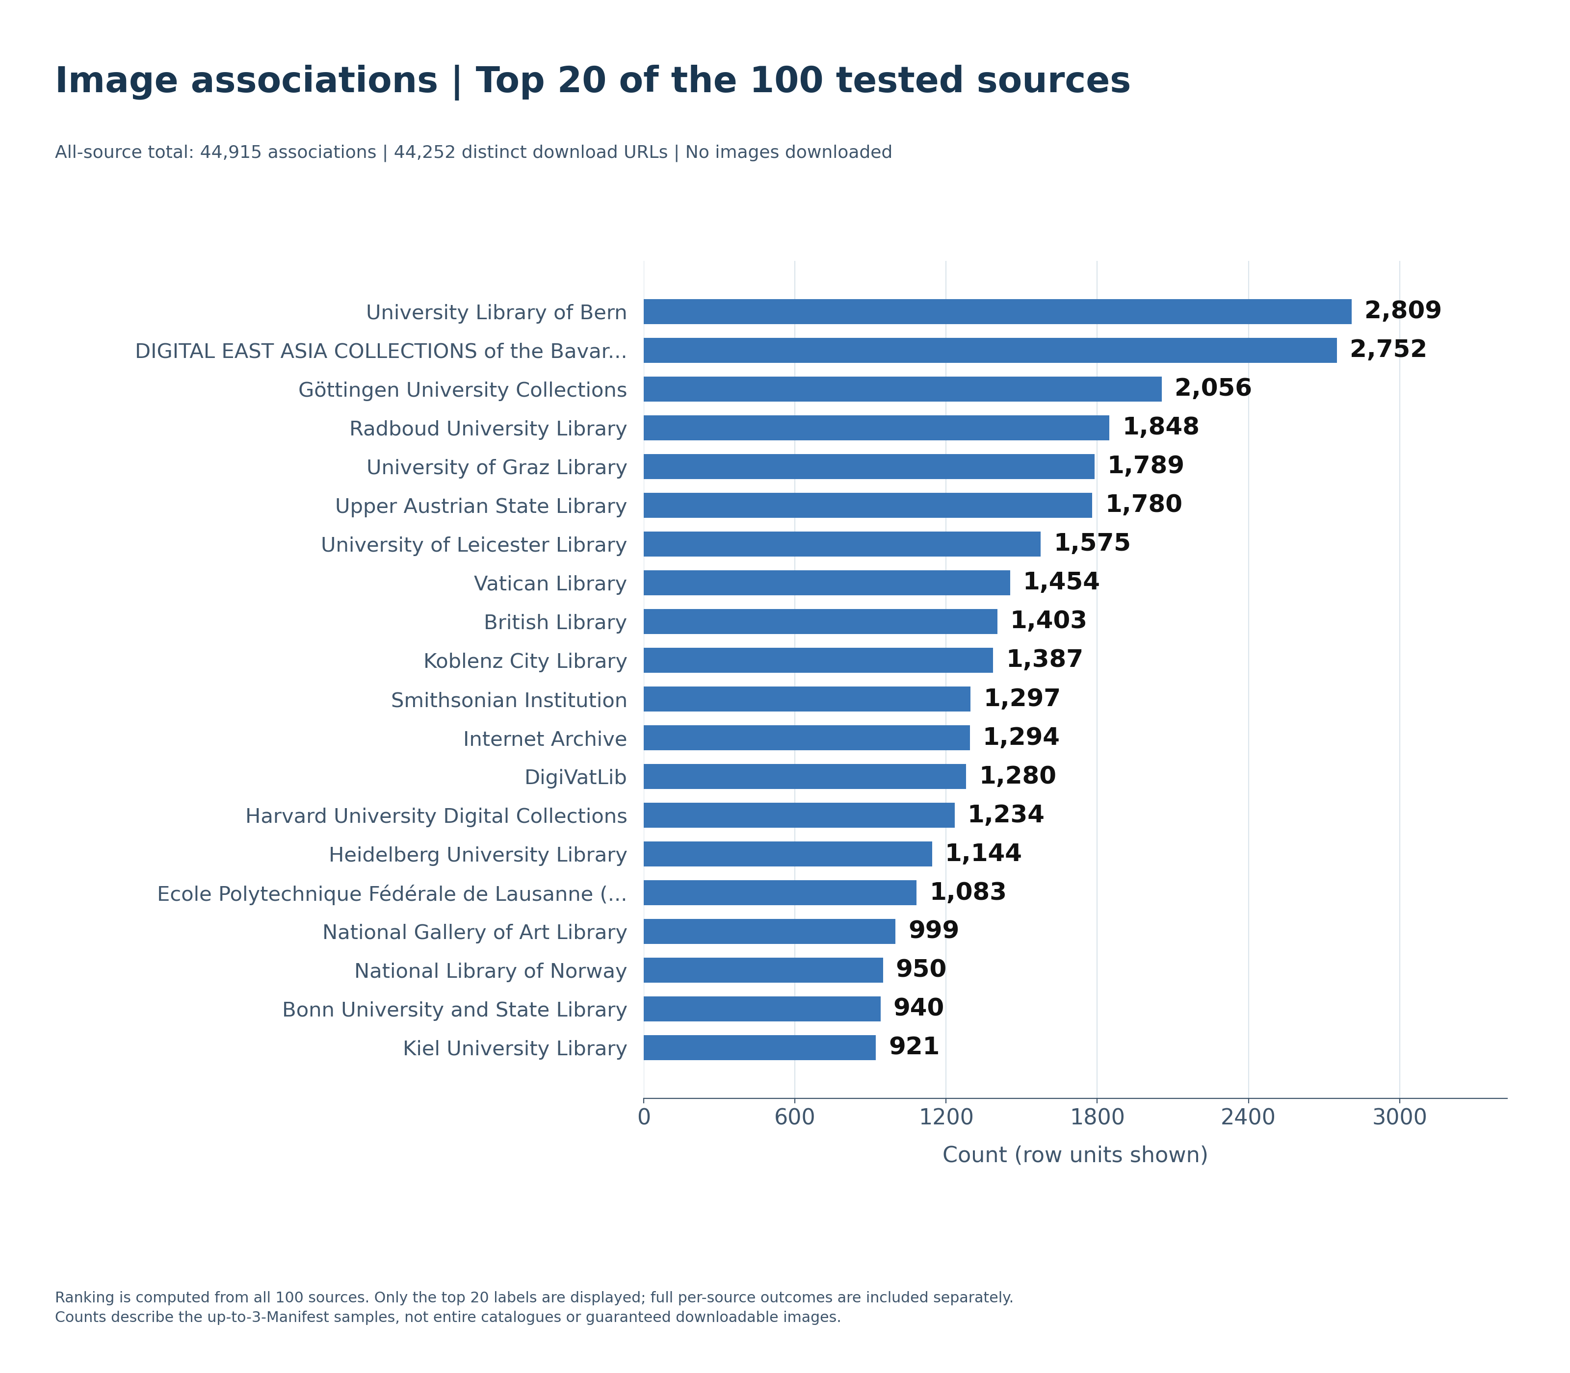
Module 3
Module3 function -> Find Manifest URLs via IIIF, Web Pages and Catalogue APIs
A reachable institutional homepage does not necessarily provide an immediately traversable Manifest catalogue.
Discovery combines native IIIF traversal with catalogue APIs, HTML extraction and configurable URL templates.
98/100 sources yielded Manifest URLs in the current run.
280 source–Manifest observations represented 274 distinct Manifest URLs.
Historical investigations had already validated Manifest access for all 100 selected sources.
Image yield varies substantially between the sampled sources because a Manifest can represent a single image or a multi-page document. These counts describe the up-to-three-Manifest samples, not entire institutional collections.

Slide 6
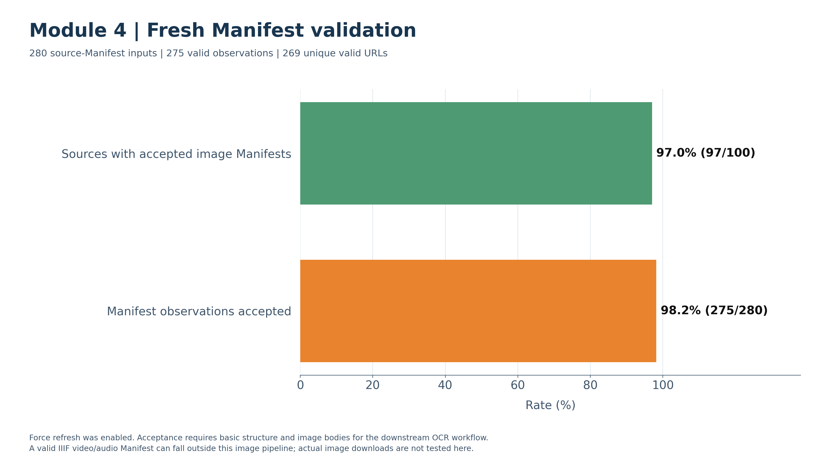
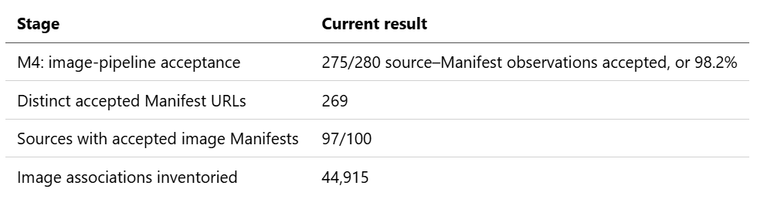
Module 4
Module4 function -> Fetch Manifest JSON; Validate Structure; Inventory Images
275/280 source–Manifest observations were accepted for the image pipeline (98.2%).
Accepted records represent 269 distinct Manifest URLs from 97/100 sources.
Retain the raw Manifest and validation evidence for inspection and downstream extraction.
Five of the 280 observations were not accepted by Module 4: three Northwestern Manifests had no image bodies, one Austrian National Library request returned HTTP 400, and one Trier Seminary Library request returned HTTP 404. Austria and Trier still contributed other valid records.
The Northwestern samples were not accepted for image extraction; the absence of image bodies alone does not establish that their IIIF Manifests are invalid.

Slide 7
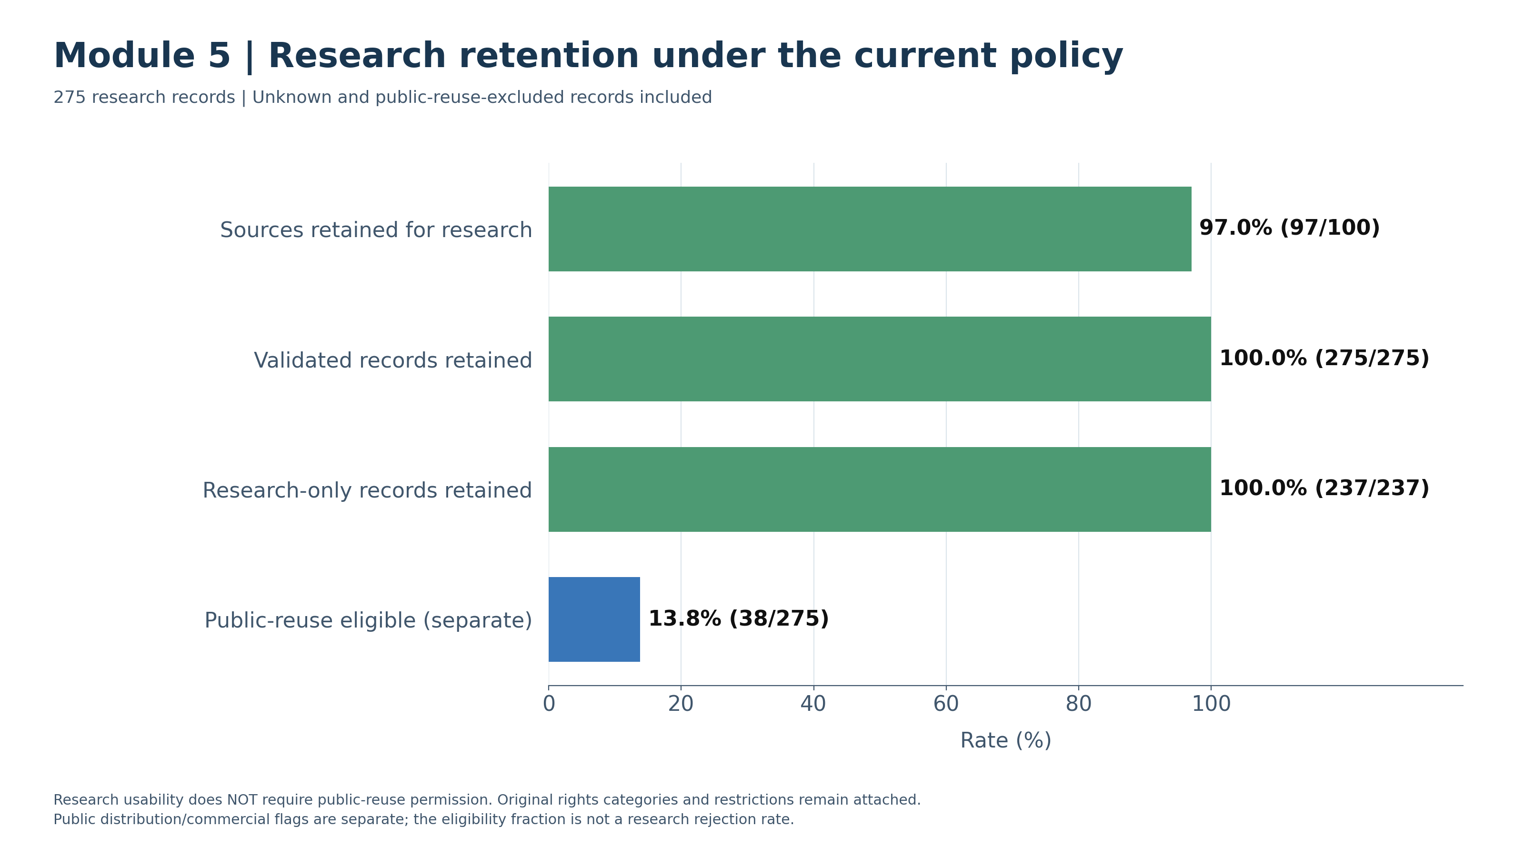
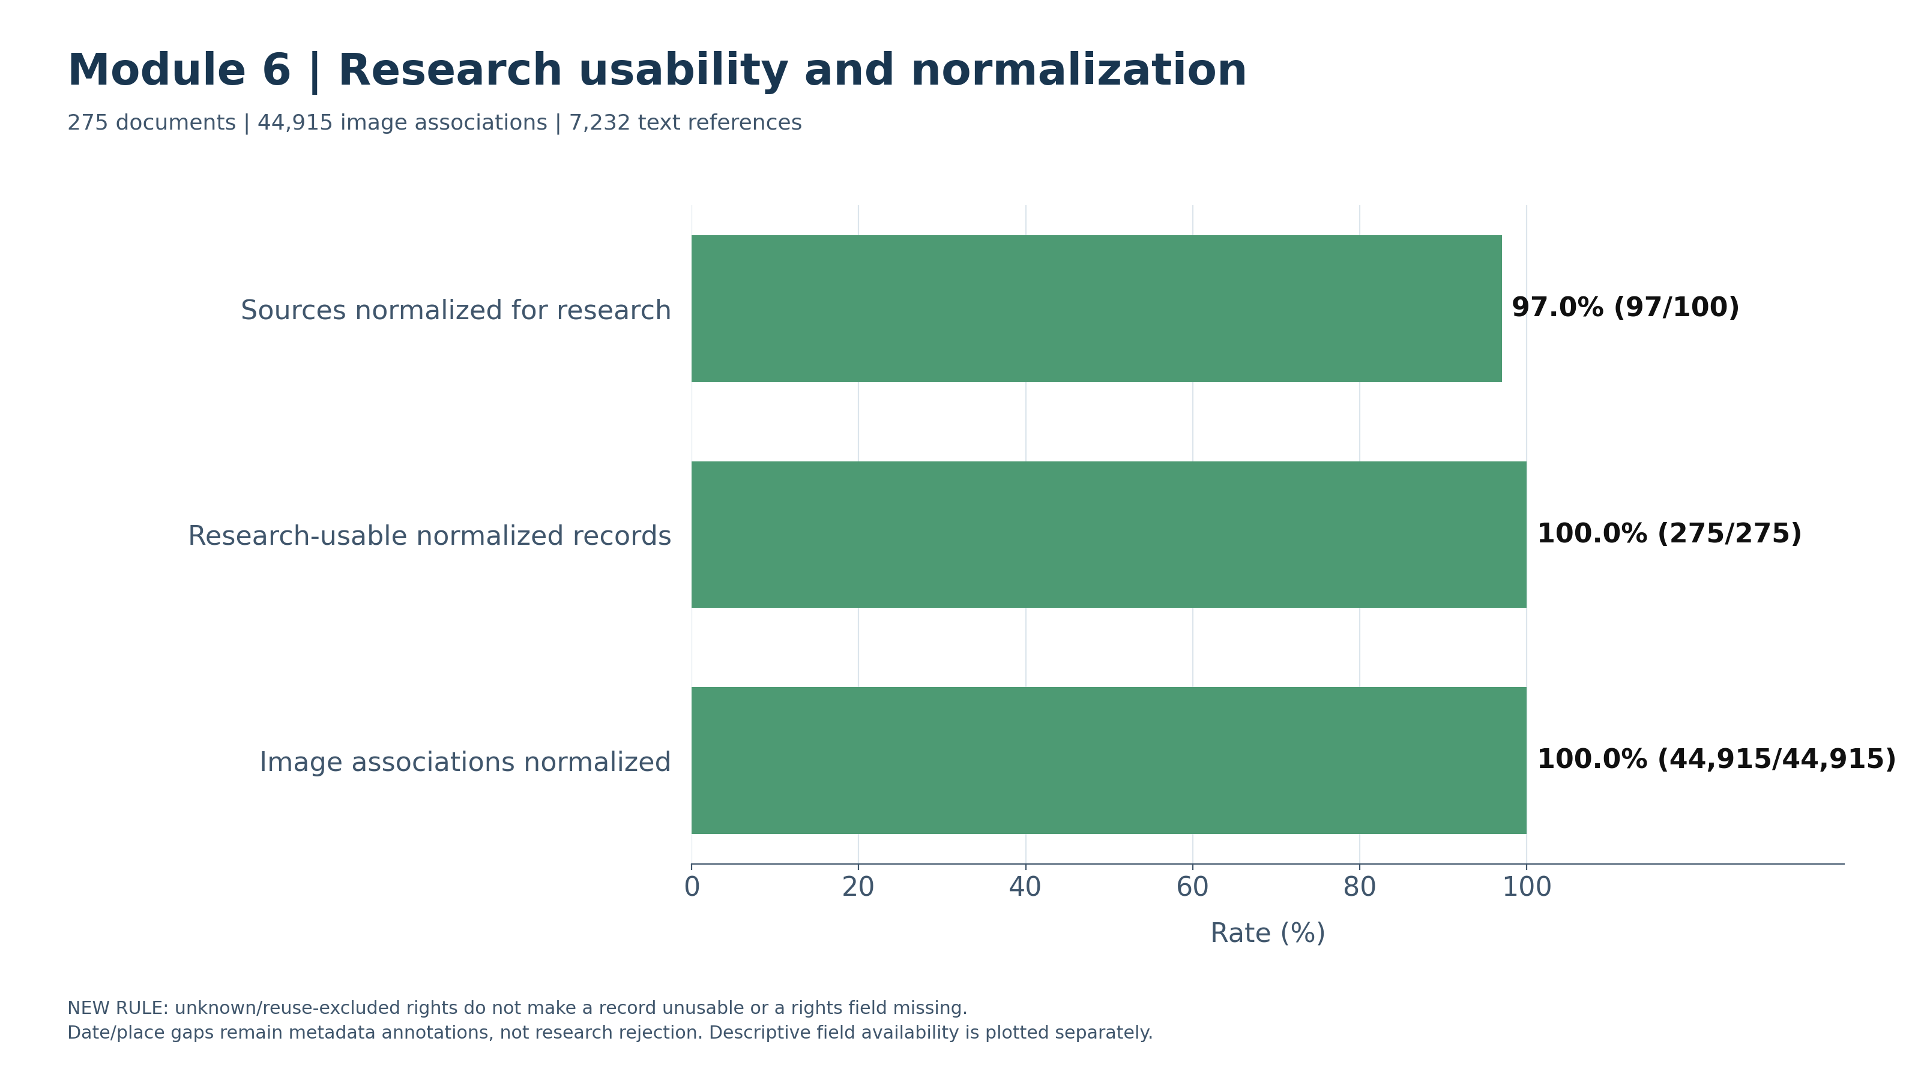
Module 5 and module 6
Module5 function -> Preserve Rights Statements; Classify Reuse; Retain Research Records
Module6 function -> Normalize Metadata; Link Images to Text References
All 275 accepted records were retained and normalized for research, including 132 unknown-rights records.
The output preserves 44,915 image associations and 7,232 institutional reference descriptors.
Missing dates or places remain explicit and do not block research output.
The blue bar shows that 38 of the 275 records are classified as eligible for public reuse, while all 275 remain available for research under the project policy but there is not clear right clarification

Slide 8
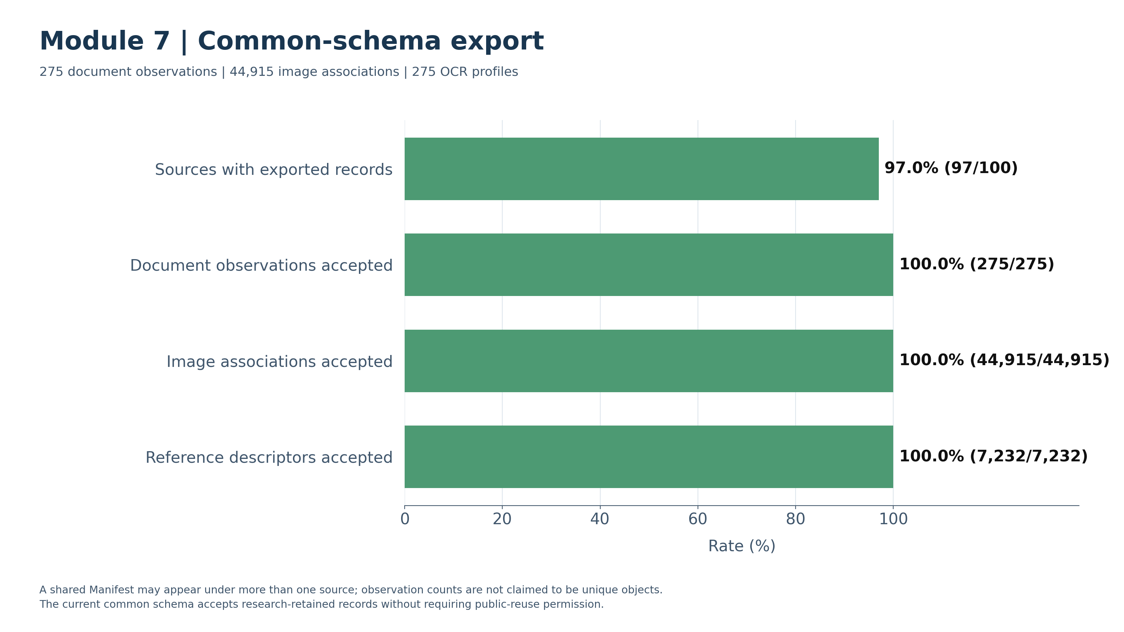
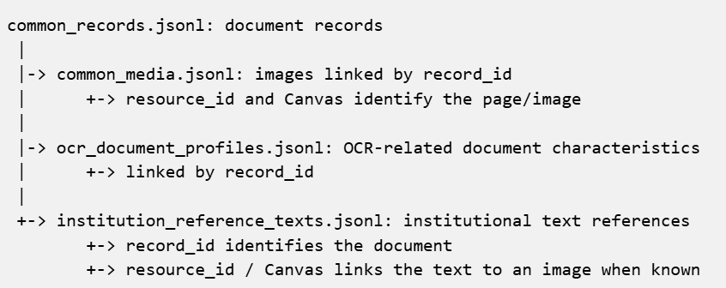
Module 7 and Module 8
Module7 function -> Validate and Export Linked Records and OCR Profiles
Module8 function -> Download Images and Linked JSON; Retrieve Available Reference Texts
The current run exported 275 document records, 44,915 image associations and 275 OCR profiles.
5,783 image records have declared page-level text references.
The output links each document to its images, OCR-related characteristics and available institutional reference texts through shared document and page identifiers.

Slide 9
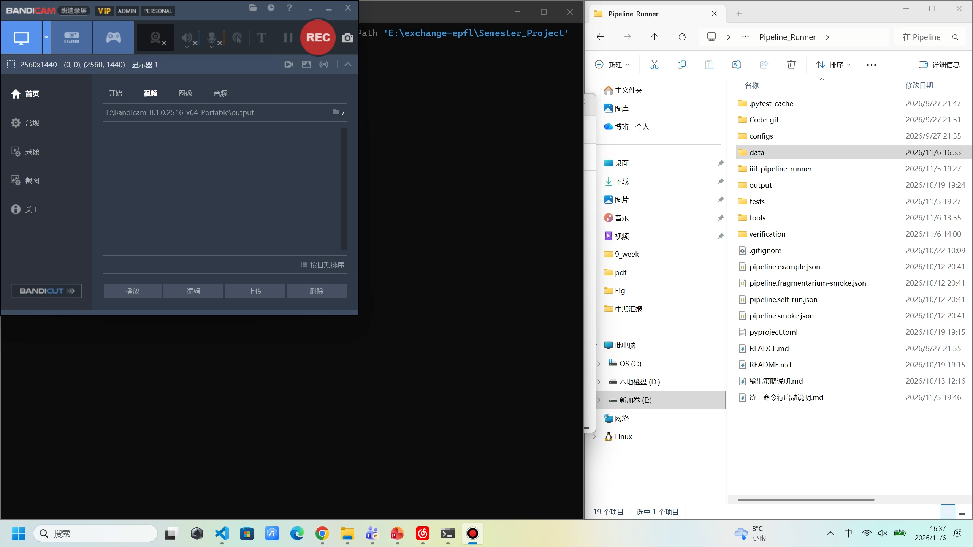
Pipeline running demo

Slide 10
Next Steps: LLM Discovery and Visual Interface
LLM-Assisted Discovery
Visual Interface
Aim： Reduce manual effort when adding unfamiliar sources.
Aim: Make the pipeline easier to run and inspect.
Investigate official guides and catalogue APIs.
Propose discovery routes and validate Manifests.
Save verified recipes for later reuse.
Evaluate success rates and costs on unseen sources.
Select sources, modules and download settings.
Start the pipeline without terminal commands.
Monitor progress, errors and statistics.
Browse images, metadata and reference texts.

Slide 11
THANKS

Slide 12
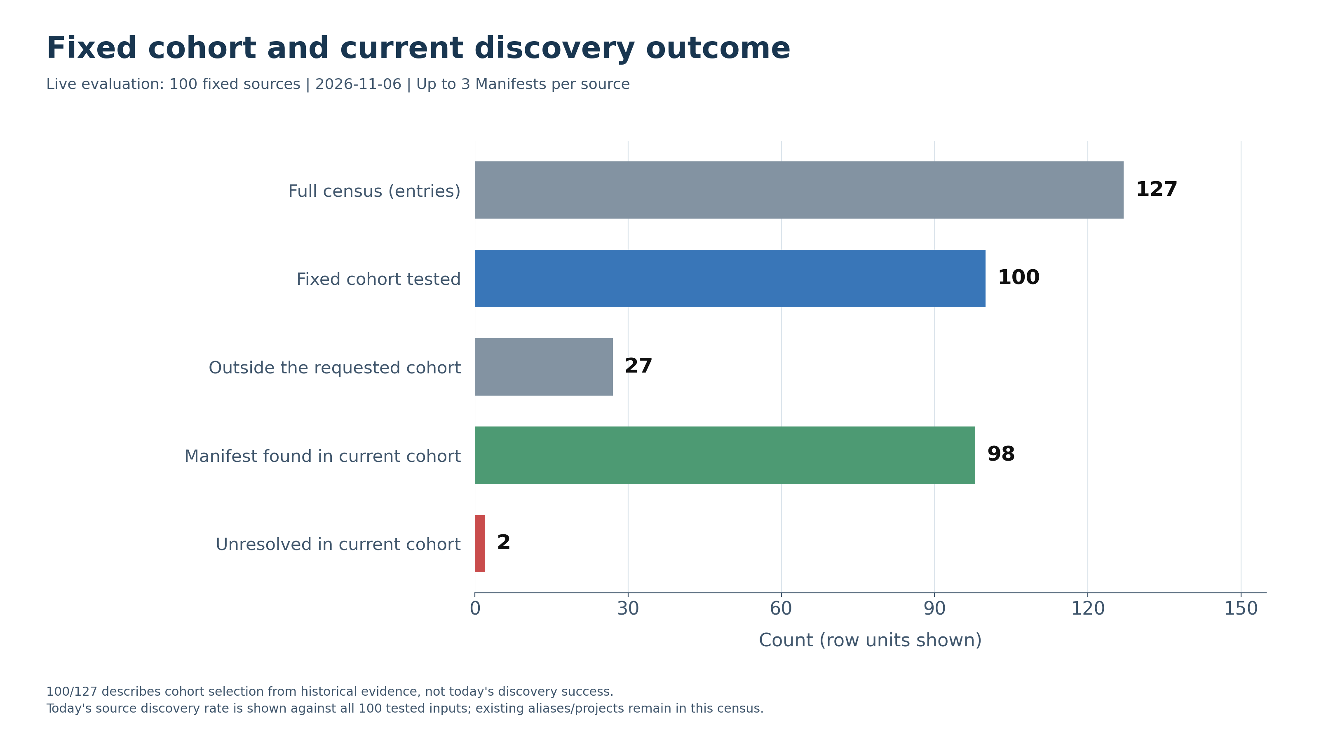
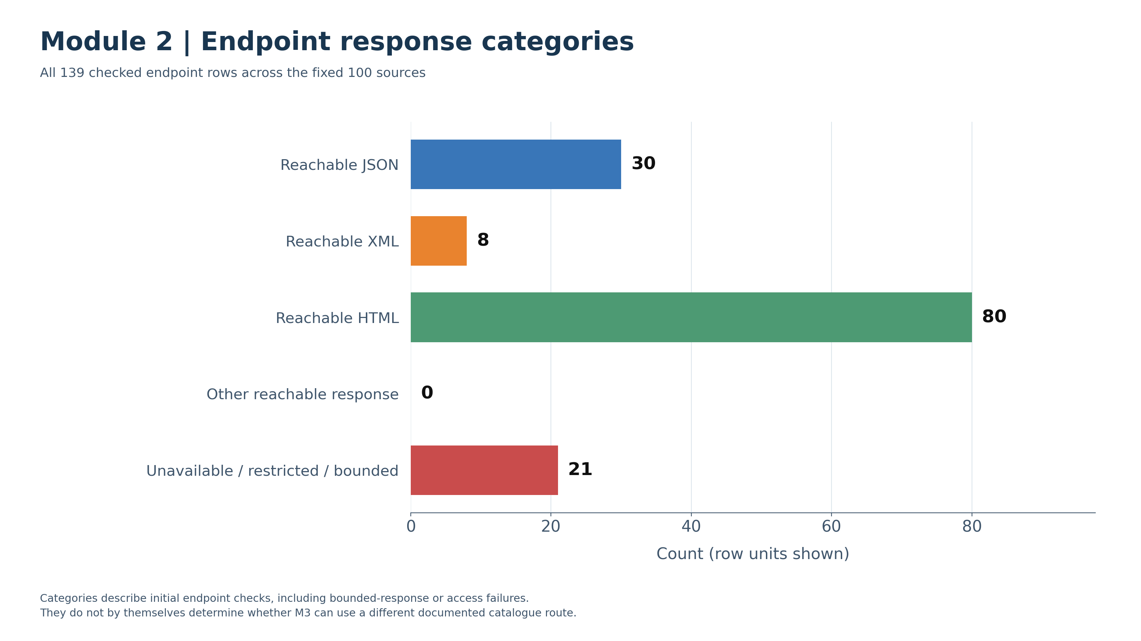
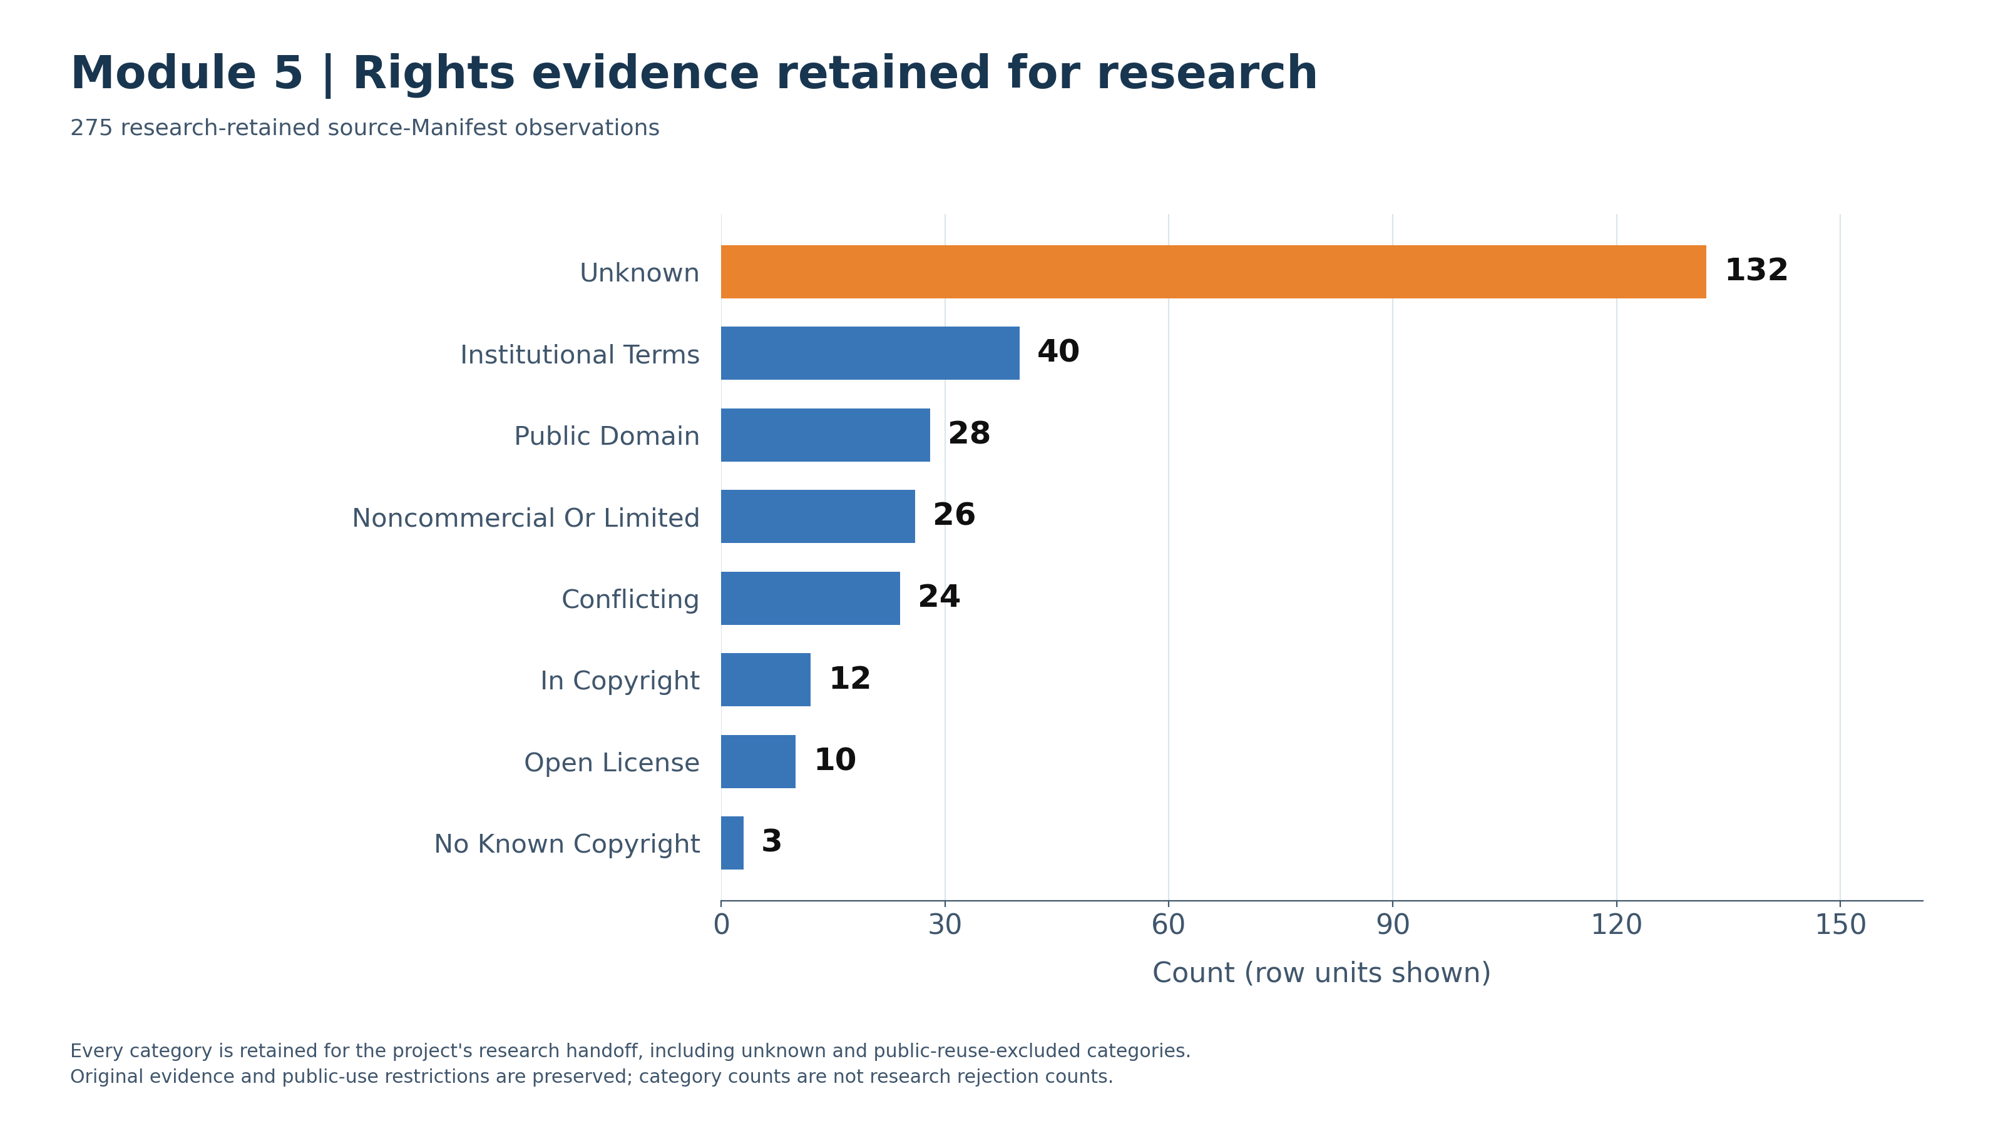
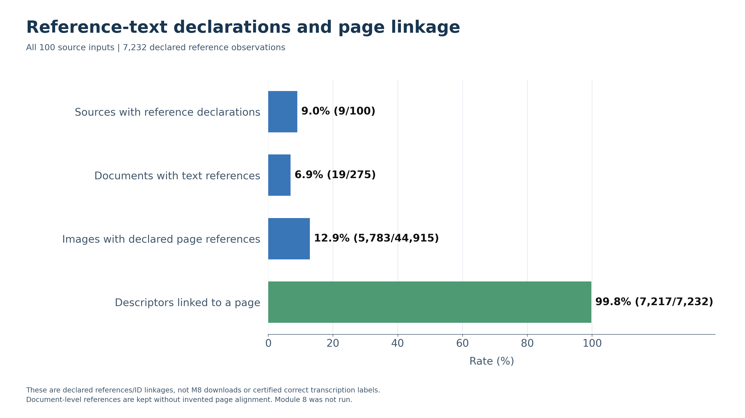
Optional Fig Ilustration

Slide 13
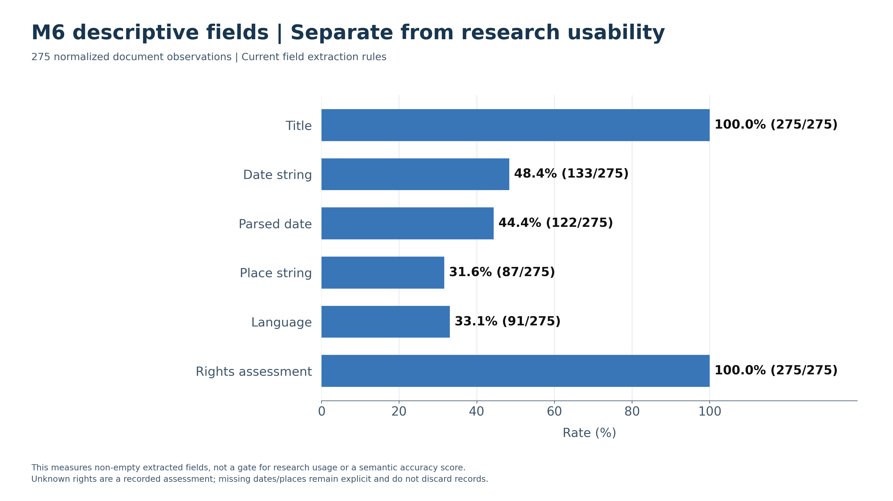
Optional Fig Ilustration

