Slide 1
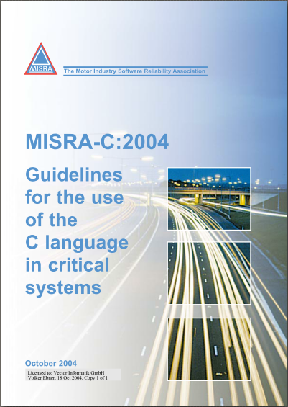
MISRA-C:2004
Infrastructure and Usage @ PES

Slide 2
Agenda
 | MISRA-C:2004 1
> | Motivation 3
 | MISRA – the Basics 9
 | MISRA Infrastructure @ PES 21
 | Code Annotation 28
 | Applying MISRA-C Analysis 36
 | Working with the Results 45
 | HIS Code Metrics 49
 | 53

Slide 3
Motivation
C
“C is not the language to write reliable and safe software”
Some disadvantages of C:
Some language behavior is undefined and unspecified → results in Compiler implementation specific behavior: → E.g. integer division: -5 / 3 = -1 remainder -2 or -2 remainder 1
Many operator precedence levels – not all are intuitive → Side effects of operands at logical operations: if (a > 0 || b-- < 10) { … }
No strongly typed language → e.g. “integer promotion” issue → Who can explain this issue? (→ example)
No runtime checking (divide by zero, overflow, validity of pointers, array bound errors, …)
But: C programs can also be laid out in a structured and comprehensible manner → “MISRA C” helps to prevent pitfalls of C

Slide 4
Motivation
MISRA-C
MISRA C is a software development standard for the C programming language developed by MISRA (Motor Industry Software Reliability Association)
Its aims on code safety, portability and reliability in the context of embedded systems
First edition "Guidelines for the use of the C language in vehicle based software“ is known as MISRA-C:1998
Second edition "Guidelines for the use of the C language in critical systems“ is known as MISRA-C:2004 → PES is applying MISRA-C:2004
Third edition MISRA-C:2012 released since 03/2013
Not used at PES due to: all rules re-numbered and reorganized, i.e. not compatible to MISRA-C:2004 → all analysis and justification to be repeated
Note: “MISRA-C++:2008” is C++ only

Slide 5
Motivation
OEM and TIER1
OEMs
Require the use of MISRA-C analysis to improve the reliability and quality of the software in their ECUs
Thus TIER1 are in charge to use MISRA and analysis and justify the deviations in their ECU projects
Analysis results are checked by OEMs during ECU quality gates
Also force their StandardSoftware suppliers to apply MISRA → us!
TIER1
Apply MISRA analysis to improve their own software reliability and quality
Have issues and efforts with justifying MISRA deviations in third-party software (like ours!)
Usually they try to argue that the third-party software supplier has own reports → that is the reason they ask us to deliver such reports to them

Slide 6
Motivation
PES
Why applying MISRA-C:2004 analysis at PES?
It’s a state-of-the-art technology to improve and measure software “quality” → all our customers see this as a “basic” when developing software for the motor industry
PES is developing portable and reliable software now for many years – therefore when introducing MISRA-C analysis a couple of years ago we did not find many issues in our software – but:
we are also not perfect ;-) and thus we should try to use all methods that help us to prevent issues in our products
the analysis and justification process is nowadays mostly automated so the remaining effort is to analyze and correct or justify the deviations → we can focus on (a specific aspect of) our code quality
We simply need the reports to show our spend efforts in that area for OEM, TIER1 and other Q assessments (see first point on this slide) …

Slide 7
Motivation
ISO26262
ISO 26262, Part 6: Product development: software level Table 1- Topics to be covered by modeling and coding guidelines:
Technique/Measure ASIL A ASIL B ASIL C ASIL D
Use of languages subsets ++ ++ ++ ++
The objectives of method “Use of languages subsets” are
Exclusion of ambiguously defined language constructs which might be interpreted differently by different modelers,
programmers, code generators or compilers.
Exclusion of language constructs which from experience easily lead to mistakes, for example assignments in conditions
or identical naming of local and global variables.
Exclusion of language constructs which might result in unhandled run-time errors.
As a result of this definition, MISRA is the (for us) only available concept to cover such requirements
++ = explicitly required

Slide 8
Agenda
 | MISRA-C:2004 1
 | Motivation 3
> | MISRA – the Basics 9
 | MISRA Infrastructure @ PES 21
 | Code Annotation 28
 | Applying MISRA-C Analysis 36
 | Working with the Results 45
 | HIS Code Metrics 49
 | 53

Slide 9
MISRA – the Basics
Rule Format
Rule <number> (<category>): <requirement text>
“required” or “advisory”
<group prefix>.<group member suffix>
These categories are NOT used by PES because the HIS “subset” requires all rules
“group” relates to a C language specific topic – some examples will follow on the next slides
Example:
Rule 2.2 (required): Source code shall only use /* ... */ style comments.

Slide 10
MISRA – the Basics
Portability specific groups
1.1 (req) All code shall conform to ISO 9899:1990
→ ISO compliance limits
1.x Environment
1.2 (req) No reliance shall be placed on undefined or unspecified behavior.
→ behavior may differ between compilers
2.x Language extensions
2.1 (req) Assembly language shall be encapsulated and isolated.
2.2 (req) Source code shall only use /* ... */ style comments.
-> do not use C++ comments //
3.x Documentation
3.4 (req) All uses of the #pragma directive shall be documented and explained.
This group is partially out of scope because the compiler is pre-scribed by the user

Slide 11
MISRA – the Basics
Type system related
5.x Identifiers
5.1 (req) Identifiers (internal and external) shall not rely on the significance of more than 31 characters.
→ old compiler and readability topic
6.x Types
6.3 (adv) typedefs that indicate size and signedness should be used in place of the basic types.
→ use sintx and uintx
8.x Declarations and Definitions
8.10 (req) All declarations and definitions of objects or functions at file scope shall have internal linkage unless external linkage is required.
8.11 (req) The static storage class specifier shall be used in definitions and declarations of objects and functions that have internal linkage.
→ reduce the scope if possible
→ several other rules to assure unambiguity – this is normally already handled by the compiler

Slide 12
MISRA – the Basics
Conversions and Expressions
10.x Arithmetic type conversions
10.1 (req) The value of an expression of integer type shall not be implicitly converted to a different underlying type
→ use explicit cast – beware of integral promotion
10.6 (req): A “U” suffix shall be applied to all constants of unsigned type.
11.2 (req) Conversions shall not be performed between a pointer to object and any type other than an integral type, another pointer to object type or a pointer to void.
→ avoid dangerous pointer casts (alignment and type compatibility issues may occur)
11.x Pointer type conversions
12.1 (adv) Limited dependence should be placed on C’s operator precedence rules in expressions.
Do you know the C precedence rules? Better use additional parenthesis.
12.x Expressions

Slide 13
MISRA – the Basics
Rule 10.5 and integer promotion
Rule 10.5: If the bitwise operators ~ and << are applied to an operand […], the result shall be immediately cast to the underlying type of the operand.
Example: C code on 16-bit processor: uint8 result_8; uint8 port = 0x5aU; result_8 = (~port) >> 4;
Expected result: port → 01011010 ~port → 10100101 (~port) >> 4 → 00001010 result_8 = → 00001010
Consideration of MISRA-C rule 10.5: result_8 = ((uint8)(~port)) >> 4; ~port → 11111111 10100101 (uint8)(~port) → 10100101 result_8 = → 00001010
Integer Promotion before inversion
Actual result: port → 01011010 ~port → 11111111 10100101 (~port) >> 4 → 00001111 11111010 result_8 = → 11111010
0x5aU – decimal 90 ~ – bitwise inversion >> – bitwise right shift

Slide 14
MISRA – the Basics
Control flow related
13.x Control statement expressions
13.5 (req) The three expressions of a for statement shall be concerned only with loop control.
14.4 (req) The goto statement shall not be used.
14.5 (req) The continue statement shall not be used.
→ “jumps” in the code may cause bad readability
14.10 (req) All if ... else if constructs shall be terminated with an else clause.
→ defensive programming
14.x Control flow
15.2 (req) An unconditional break statement shall terminate every non-empty switch clause.
→ do not use “fall through” to improve readability
15.x Switch statements
16.2 (req) Functions shall not call themselves, either directly or indirectly.
→ avoid recursions
16.10 (req) If a function returns error information, then that error information shall be tested.
16.x Functions

Slide 15
MISRA – the Basics
Pointers and unions
17.x Pointers and arrays
17.1 (req) Pointer arithmetic shall only be applied to pointers that address an array or array element.
→ defensive programming – ISO26262: “limited use of pointers”
17.6 (req) The address of an object with automatic storage shall not be assigned to another object that may persist after the first object has ceased to exist.
→ use pointers to local variables with care
18.x Structures and unions
18.3 (req) An area of memory shall not be reused for unrelated purposes.
→ defensive programming
18.4 (req) Unions shall not be used.
→ some acceptable exceptions are explained in the MISRA-C specification

Slide 16
MISRA – the Basics
Preprocessor
19.x Preprocessing directives
19.6 (req) #undef shall not be used.
→ avoid confusion
19.7 (adv) A function should be used in preference to a function-like macro.
→ usually difficult to follow this rule for efficiency reasons
19.15 (req) Precautions shall be taken in order to prevent the contents of a header file being included twice.
→ double include prevention

Slide 17
MISRA – the Basics
Common reasons for deviations (1)
Rule | Description | Deviation Reason
1.1 | All code shall conform to ISO–C | a) Need compiler extensions for HW access b) ISO compliance limits cannot be followed in complex AUTOSAR SW architecture
3.4 | Usage of #pragma directives | Can be necessary to implement AUTOSAR memmap concept depending on target platform
5.1 | Identifiers (internal and external) shall not rely on the significance of more than 31 characters | Identifiers in generated code are derived from OEM databases (where MISRA is not considered) and prefix rules have to be applied.
8.1 | global symbol only referenced in one translation unit | Actual usage of the software may differ from the MISRA test setup
14.1 | unreachable code - API function not used in project | s. 8.1
14.3 | empty statement must appear on a line on its own | Macros are used in different code variants, e.g. assertions

Slide 18
MISRA – the Basics
Common reasons for deviations (2)
Rule | Description | Deviation Reason
14.7 | single point of exit at end of function | Readability and / or efficiency
19.1 | Other preprocessor directive before #include | AUTOSAR memmap concept requires a #define before #include
19.4 | reserved C keywords or braces / parentheses in macro | efficiency
19.6 | #undef shall not be used | Required by AUTOSAR memmap concept
19.7 | function should be used instead of macro | efficiency
19.8 | A function-like macro shall not be invoked without all of its arguments | Required by AUTOSAR compiler abstraction concept
19.3 | Do not use # and ## operators | Some macros (e.g. signal access) need to ## operator
For more details check the deviation documents e.g. WI_MISRA_Compliance_MSR.pdf

Slide 19
MISRA – the Basics
Summary of rule sources and objectives targeting portability and reliability of the code:
Enforce ISO-C compliance
Avoid platform dependencies and language extensions
Avoid unspecified and undefined behavior
Improve readability
Defensive programming techniques
Requirements from safety standards
Make the code clear and explicit
Please have an own (deep!) view inside the MISRA Guidelines
https://vglobpessvn1.vg.vector.int/svn/Specifications/Standards/MISRA/MISRA-C_2004/trunk/misra_C_2004.pdf

Slide 20
Agenda
 | MISRA-C:2004 1
 | Motivation 3
 | MISRA – the Basics 9
> | MISRA Infrastructure @ PES 21
 | Code Annotation 28
 | Applying MISRA-C Analysis 36
 | Working with the Results 45
 | HIS Code Metrics 49
 | 53

Slide 21
MISRA Infrastructure @ PES
Some compilers and many tools like QA-C, PCLint, PolySpace, … offers MISRA-C analysis support
Each tool has more or less different coverage of MISRA-C rules
Each tool has different syntax to comment deviations
PES is using (only!) the tool QA-C for MISRA-C:2004 analysis
Commenting deviations in code is done with QA-C syntax
QA-C covers approx. 88% (125) rules by automated checks
16 MISRA rules are not checked automatically
→ 8 MISRA rules are voted to be “not applicable for PES”
→ 8 MISRA rules are to be checked by code inspection (see WI)

Slide 22
MISRA Infrastructure @ PES
Since 01/2010 adding justifications in the code is allowed
WI MISRA-C:2004 describes external (WORD based) and internal (code-based) justification methods
In Q4/2011 adding justifications in the code became mandatory
Valid for all MSR and newly developed CBD components
MSR release R3.13 is first release with most components supporting automated creation of MISRA reports including justification of deviations
When using CDK for MISRA analysis and code-based justifications, no additional WORD-based MISRA report is necessary!

Slide 23
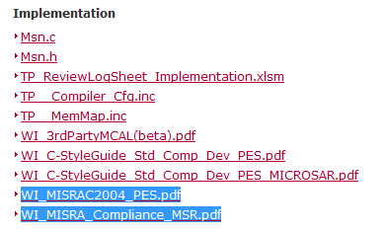
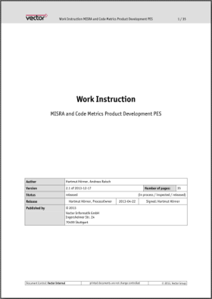
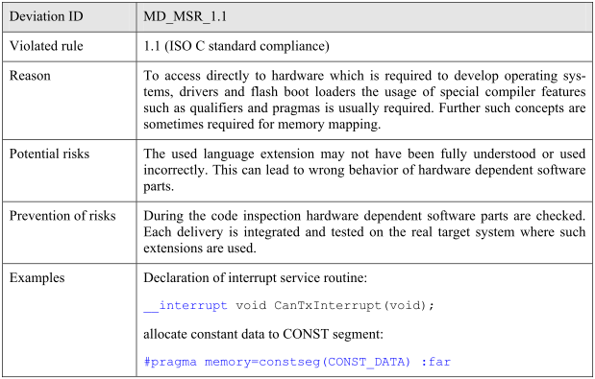
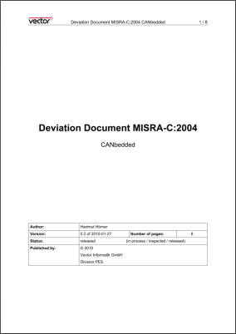
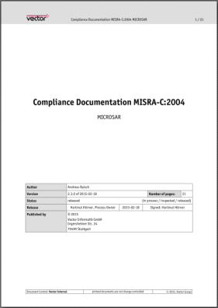
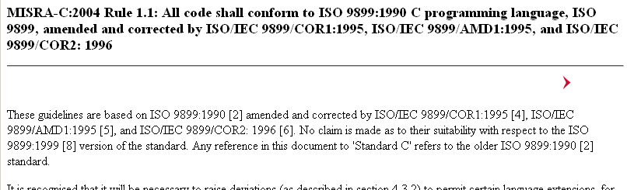

MISRA Infrastructure @ PES
Supporting documents
Documents are accessible via COMPONENT DEVELOPMENT PES (Intranet)
WI MISRA-C:2004
MISRA deviation documents for CBD and MSR
Typical deviations are explained here
List of MISRA rules
Full text of MISRA-C standard “at your fingertips”

Slide 24
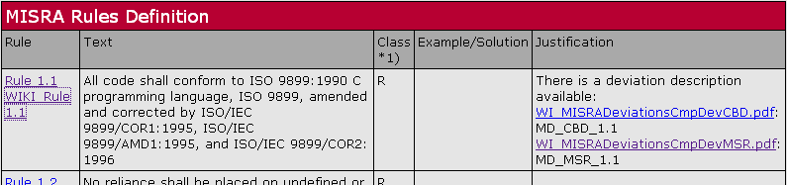
MISRA Infrastructure @ PES
CDK
CDK has additional features:
Automated creation of QA-C project and personality files
Command line usage of QA-C → no tool GUI to be used!
Analysis results are added to a HTML report → details next slide
Additional “QA-C Rules for Code Files: Message Reference” with
Explanation of QA-C additional warnings and errors
Explanation of MISRA rules
Links to deviation documents for MSR and CBD
WIKI link supported for each rule to enable developers to
comment the rules
share tips for justifications and/or how to solve the deviation

Slide 25
MISRA Infrastructure @ PES
CDK HTML Report
The HTML report created by CDK contains
a list of all MISRA-C deviations in <log>
voted “yellow/warning” or “red/error” if a deviation has no PRQA analysis marker
Target: empty <log> (“no findings”)
a MISRA analysis summary
“green/ok”, if deviation & justification found in code
“yellow/warning”, if deviation but no justification found
Target: no “yellow/warning” results in <summary>
a list of code metrics
including comparison to the HIS threshold values (“yellow/warning” if current value is out-of-HIS-range)

Slide 26
MISRA Infrastructure @ PES
Quick access
Code_Qac_MsgRef.html provides
QA-C rule original/complete text
MISRA rule original/complete text
link on rule-specific pages into PES WIKI
Link into WIKI enables everybody to support and annotate issues and information concerning used tooling, specific rule usage in our software and more.
Note: WIKI is not reviewed and released by QA. The user is responsible to validate the information before using it. In case of unclear information, contact the product architect for clarification.

Slide 27
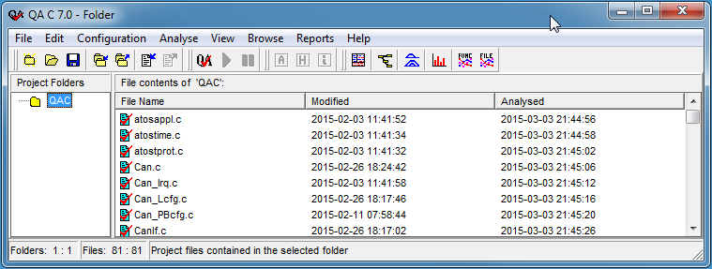
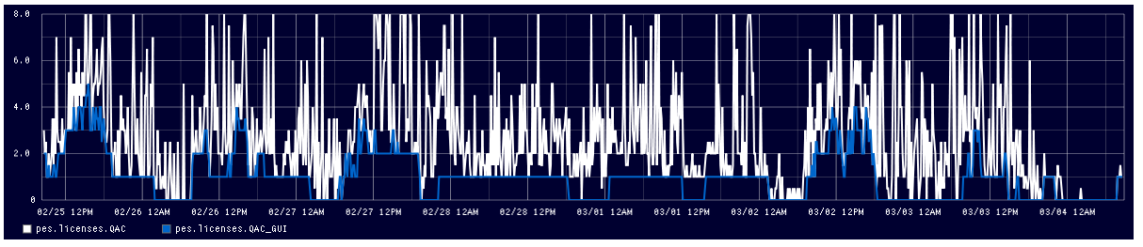
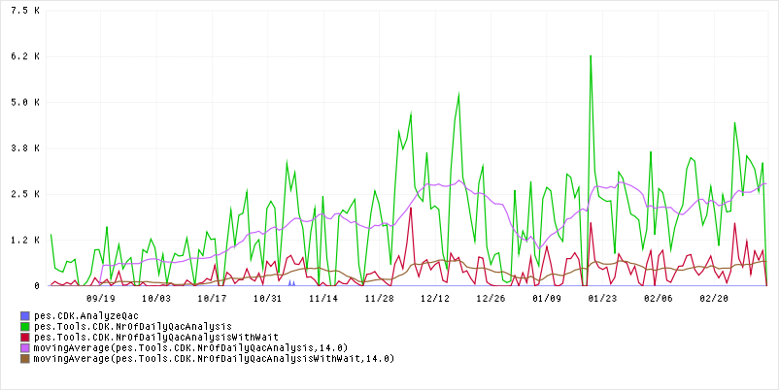
MISRA Infrastructure @ PES
PES uses 8 QA-C licenses (03/2015) – they are shared by ALL PES users
An open QA-C GUI locks a license and reduces tool availability for all others → close GUI when not used!!
License usage report file://///vi.vector.int/backup/PES/DevelopmentTools/GraphitePesLicensesView/index.html
White: license used
Blue: license used by GUI
CDK report file:///R:/CAN_Base/CANtate/zCDK/Data/CDK_DashBoard.html
Green: QA-C license requests
Red: denied requests caused by “no free license”
Violet and brown: average of last 14d

Slide 28
MISRA Infrastructure @ PES
Note:
lot of QA-C analysis are executed by automated test systems – licenses are used by night, too!
Use CDK wherever possible to optimize QA-C usage
Do not run unnecessary MISRA analysis (→ optimize your automated tests to save (license) resources, too)

Slide 29
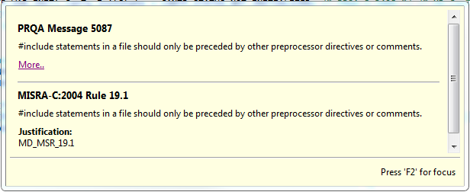

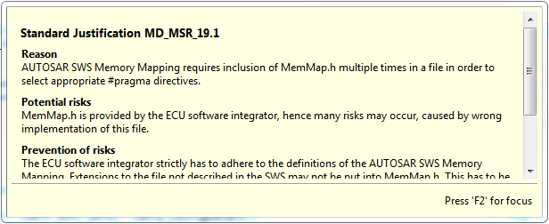
MISRA Infrastructure @ PES
Eclipse Plugin (03/2015)
The SafeBSW eclipse plugin supports direct access to MISRA information
Contact vistvi for details
\\vi.vector.int\Backup\PES\DevelopmentTools\DevSupportTools\PesEclipsePlugin
Notes:
Installation:
- Help->Install New Software
- Unter „Work with“ die folgende Updatesite eintragen und mit <Enter> bestätigen: \\vi.vector.int\Backup\PES\DevelopmentTools\DevSupportTools\PesEclipsePlugin
- Die “PES Development Addons” auswählen und den Wizard weiterklicken
- Die Warning bzgl. des unsigned contents kann mit „OK“ ignoriert werden
- Danach bitte den vorgeschlagenen Neustart von Eclipse mit „Yes“ bestätigen
- Unter Window->Preferences->C/C++->Editor bei „Documentation tool comments“ die Option “SafeBSW Doxygen” auswählen
Hinweise:
Als Design-Kommentare werden nur solche erkannt, die diesem Muster entsprechen: „#<nummer> <text>“.
Das Plugin nutzt den Abstract Syntax Tree (AST) von CDT. Daher sollten die Sourcefiles parsebar sein. Insbesondere die defines der Compilerabstraction müssen definiert sein.
Es handelt sich hier nur um eine Editierhilfe. Bitte prüft das Detailed Design, nachdem es vom Plugin modifiziert wurde.
Die „Kontrollstruktur“ der Detailed Design-Kommentare werden aus der Kontrollstruktur der Funktion extrahiert. Dies kann je nach aktiver Konfiguration mehr oder weniger gut funktionieren.

Slide 30
Agenda
 | MISRA-C:2004 1
 | Motivation 3
 | MISRA – the Basics 9
 | MISRA Infrastructure @ PES 21
> | Code Annotation 28
 | Applying MISRA-C Analysis 36
 | Working with the Results 45
 | HIS Code Metrics 49
 | 53

Slide 31
Code Annotation
QA-C provides mechanisms to prevent checking of rules, but …
… it is not recommended to use such methods
… MISRA-C analysis is to be executed without ANY suppression mechanism enabled to see all deviations (PES analysis rules in p_s file)
To mark a deviation as known, annotate it by one of this suppression mechanisms:
Single line suppression: /* PRQA S <rule> */
Range suppression using a tag: /* PRQA S <rule> <tag> */ … /* PRQA L:<tag> */
Range suppression using line counting: /* PRQA S <rule> <lines> */
Range suppressions should be prevented wherever possible
Annotated code is allowed to be delivered to the customers

Slide 32

Code Annotation
Wording @ PES
Code might deviate from MISRA rules
Developer fixes code or adds a PRQA marker into code → marks deviation as “known”
Developer adds justification into code → marks deviation as “known and justified”
→ QA-C detects it
→ Code is ready to create a MISRA deviation report with justifications!
Deviation
Analyze
Justify
Code
Known Deviation
Justification
TASK(TaskInit) { /../ }
/* PRQA S 1503 */
/* MD_MSR_14.1 */

Slide 33
Code Annotation
Example 1: Standard justification available and valid for the deviation
No need for detailed justification in code → reference standard justification
#define CANNM_START_SEC_VAR_NOINIT_8BIT
#include "MemMap.h" /* PRQA S 5087 */ /* MD_MSR_19.1 */
STATIC VAR( uint8, CANNM_VAR_NOINIT ) nmMinPnChannel;
#define CANNM_STOP_SEC_VAR_NOINIT_8BIT
#include "MemMap.h" /* PRQA S 5087 */ /* MD_MSR_19.1 */
Example 2: Component specific justification applied
Justification in code (e.g. at end of file)
case NM_STATE_READY_SLEEP: /* PRQA S 2003 */ /* MD_CanNm_2003 */
…
/* Justification for module-specific MISRA deviations:
MD_CanNm_2003: MISRA rule 15.2
Reason: Fall through used for code optimizations.
Risk: There is a risk that a fall through is overseen by a code …
Prevention: Fall through is marked with explicit comments to draw attention …

Slide 34
Code Annotation
Attention!
Some compilers (pre-processors) have issues when there is not at least one white-space between two consecutive comments!
#define CANNM_START_SEC_VAR_NOINIT_8BIT
#include "MemMap.h" /* PRQA S 5087 */ /* MD_MSR_19.1 */
This “ “ is mandatory and important!

Slide 35
Code Annotation
Adding Justifications
3b
You may also add component specific justifications above the location where the deviation occurs
Code …
… end of code
1
/* Justification text */ → will be put 1:1 into summary (not recommended way for justification!)
Detailed justification
2a
/* MD_MSR_xxx */ → will result in a link to standard MSR deviation document within summary section
Code with deviation
PRQA marker
Justification
TASK(TaskInit)
/* PRQA S 1503 */
/* … */
2b
/* MD_<CmpName>_<RuleNo> */ → will result in a link to a component specific justification text listed in report after summary section
3a
Add all component specific justifications at the end of the file
Detailed justification
MD_ = MISRA DEVIATION

Slide 36
Code Annotation
Detailed Justification
More than one justification can be added in the comment block
The concept supports the reuse of similar justifications for many locations but also a specific justification for each occurrence!
Simply use a different link identifier for different justifications
Recommended: Use the QA-C number for identification
E.g. /* PRQA S 2003 */ /* MD_CanNm_2003 */
CDK searches for such comment blocks
/* Justification for module-specific MISRA deviations:
MD_<CompName>_<RuleNo>: MISRA rule xx.y Reason: Explanation of reason for deviation on <RuleNo> Risk: Explanation of risk for <RuleNo> Prevention: Explanation how to prevent risk occurrence
MD_<CompName>_<OtherRuleNo>: MISRA rule xx.y Reason: Fall through used for code optimizations. Risk: There is a risk that a fall through is overseen by a code … Prevention: Fall through …
*/
MD_<CmpName>_<RuleNo> shall match to the justification in code → CDK searches for link!
Keywords “Reason:” “Risk:” and “Prevention:” are parsed by CDK and added to the report

Slide 37
Code Annotation
Adding Justifications
The MISRA analysis with CDK is a two step execution
Step 1 executes the MISRA analysis (runtime intensive)
Step 2 parses the code to update component specific justification text in MISRA report (fast)
If a deviation is found in Step 1 but no justification is in the code
add PRQA marker, link to justification and justification text → repeat Step 1
If the justification text is not sufficient
change the text and repeat only Step 2
Target of the MISRA analysis should be to have a “green” <log> in the report and all deviations with a justification in the <summary>

Slide 38
Agenda
 | MISRA-C:2004 1
 | Motivation 3
 | MISRA – the Basics 9
 | MISRA Infrastructure @ PES 21
 | Code Annotation 28
> | Applying MISRA-C Analysis 36
 | Working with the Results 45
 | HIS Code Metrics 49
 | 53

Slide 39
Applying MISRA-C Analysis
MISRA analysis is part of the release process of a component
If the analysis shows deviations, changes are often too late to be incorporated and have to be analyzed and justified instead
Due to improvements in the MISRA analysis tool chain, it is strongly recommended to run the MISRA analysis more frequently during the development cycle, e.g. each time when changing a bigger part of the code
Applying CDK for MISRA analysis a quick feedback is possible
Recommended: use CDK to create the HTML report and get rid of the WORD-based MISRA report → safes manual effort to create the justification document!

Slide 40
Applying MISRA-C Analysis
Component Level
The MISRA analysis shall be applied on
all static files of the component
all generated files of the component
at least one (maximum feature) configuration
You might have to remove test files from analysis to prevent MISRA warnings in that code (or you keep them MISRA clean, too)
If a component has many different features that can not be analyzed at once, try to apply the analysis on a basic set of configurations
set of configurations might be extended during the component life-time
some configurations might be frequently, some rarely checked

Slide 41
Applying MISRA-C Analysis
UseCases
Single C file
Due to mostly missing header files not a really good idea …
Hint: Msn_xys.c might include Msn_xy.h but only Msn_xys.h exists create Msn_xy.h that includes Msn_xys.h and so on …
Folder content
If folder contains all necessary .c and .h files → apply “CDK folder” → done
Hint: you may use a temporary folder that contains copies of all relevant files to get a quick analysis result
Tree content
If there is a tree containing all relevant files → best solution
Hint: Tree might contain unnecessary files that are not MISRA compliant and so the results will look worse than they are …!
Use a clearly defined set of files to be analyzed → next page

Slide 42
Applying MISRA-C Analysis
CDK – Analysis Setup
CDK supports three different ways to set up the MISRA analysis
Analysis based on a folder incl. all sub-folders
Pro: easy e.g. on component TSC folder or the whole tree
Con: applies analysis on ALL files in the folder → too much
Analysis based on a VisualStudio (.vcprj) project
Pro: easy if a .vcprj already exists
Con: applies analysis on ALL files in the .vcprj (maybe less than in the folder/tree but also on all includes ...)
Analysis based on a CDK TestPlan
Pro: exact list of files to be analyzed (.c and .h)
Pro: more than one analysis setup can be executed and merged
Con: TestPlan has to be created and configured

Slide 43
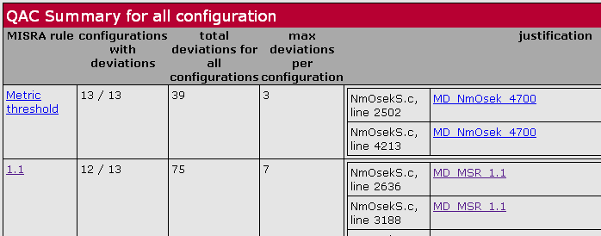
Applying MISRA-C Analysis
CDK – TestPlan based
CDK TestPlan is the recommended way to create the MISRA analysis with justification for a component release!
TestPlan supports multiple ways to execute more than one analysis and merge the results
As a result, the component test report will contain a separate section with MISRA analysis results per setup and a summary section that contains all deviations
A setup with more than one configuration can also be used to create the TestReport_MISRA.html
See e.g. https://vistrpscsvn1.vi.vector.int/svn/CANbedded/Nm/Nm_AsrNmDirOsek/trunk/_doc/30_ImplementationDocu/TestReport/TestReport_MISRA.html

Slide 44
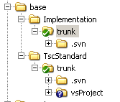
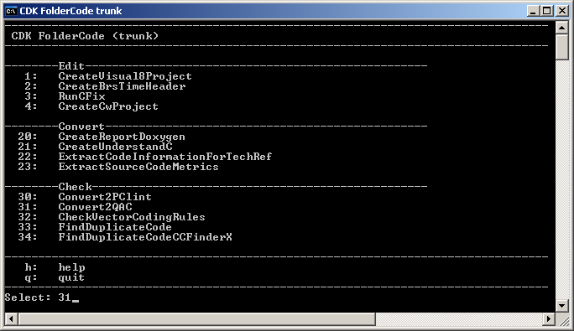
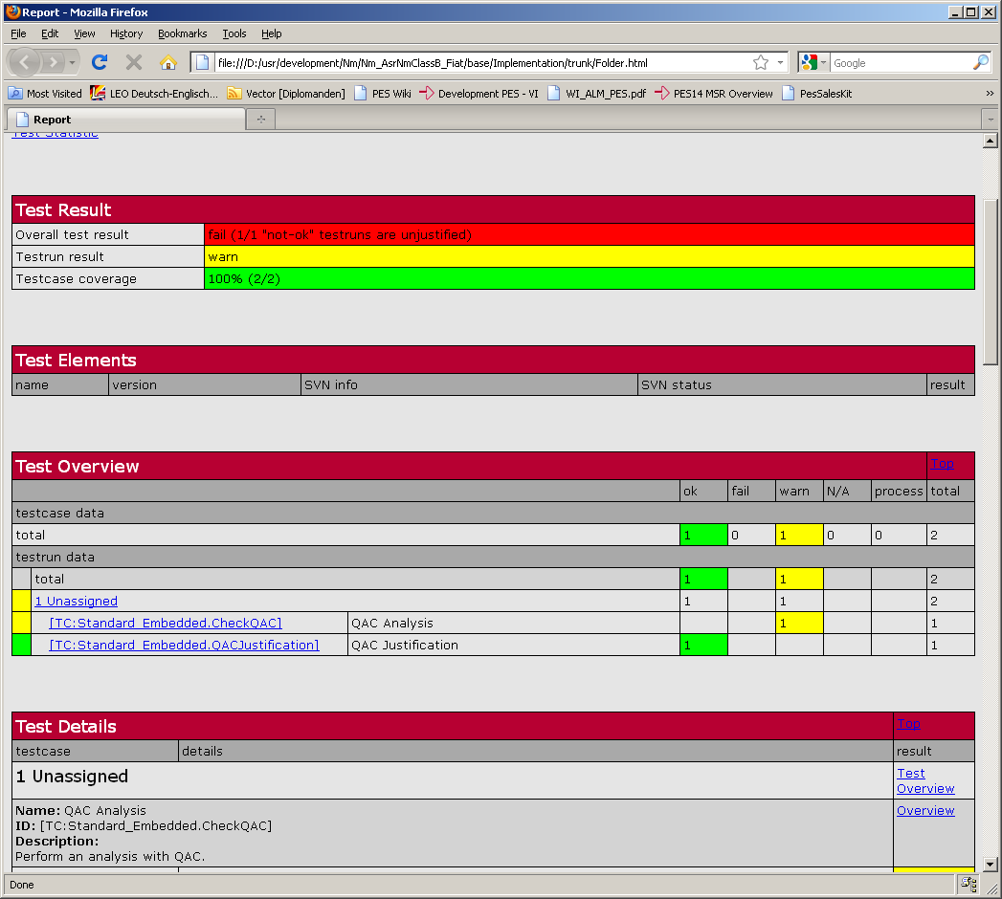

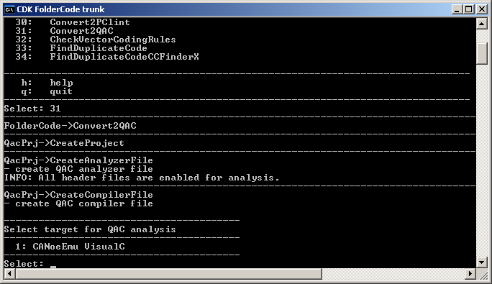
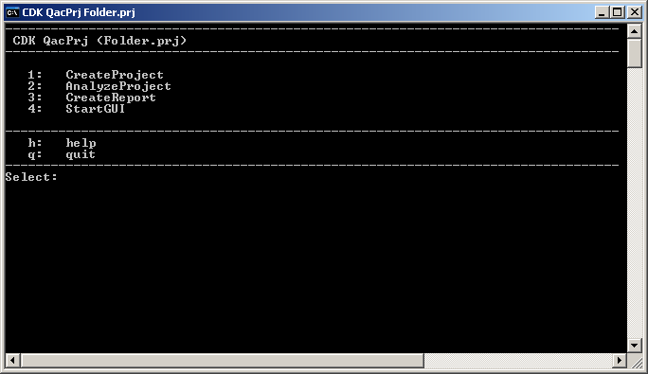
Applying MISRA-C Analysis
CDK – folder based
Use “CDK Folder Code …” for quick analysis setup
Step Analyze (2) and CreateReport (3) are independent
Start QA-C GUI (4) to use the tool (locks a QA-C license!)
Make sure there are no errors detected!

Slide 45
Applying MISRA-C Analysis
MAKESUPPORT 1/2
Create configuration with MakeSupport
“m qac” creates a new MISRA project
Important: The “personality data” in the makefile shall be up to date → use latest MAKESUPPORT
Run MISRA analysis from the command line
“m misra\*_report.txt” analyses the component *. (* = DRVCAN,...)
The component with all according files (*.h, *.c) are taken from the makefile.project.part.defines
The generated files are also part of the analysis
The result is stored in the file *_report.txt (* = DRVCAN,...)

Slide 46
Applying MISRA-C Analysis
MAKESUPPORT 2/2
Merge the results of multiple configurations
“m misra\DRVCAN_merge_reports” merges multiple \*_report.txt files to one result file QACtool.MergedReports.txt
The list of configurations must be defined in the table MISRA_REPORT_DIR_LST (makefile.config)
Incorporate result in test report http://www-serv.vi.vector.int/portal/medien/process_management/process_documents/pes/Development/Standard_Component_Development/TP_Dev_ProjectDocumentation/doc/30_ImplementationPhase/TestReport/TP_TestReportMISRA2004.doc

Slide 47
Agenda
 | MISRA-C:2004 1
 | Motivation 3
 | MISRA – the Basics 9
 | MISRA Infrastructure @ PES 21
 | Code Annotation 28
 | Applying MISRA-C Analysis 36
> | Working with the Results 45
 | HIS Code Metrics 49
 | 53

Slide 48
Working with the Results
MISRA-C Deviation
If MISRA-C analysis shows a deviation
Try to fix the deviation
This will prevent all efforts for justification and further discussions now and for all upcoming releases!
If a standard justification is available, check if a fix is really helpful!
If deviation can not be fixed: check if a standard justification is available and fits on the specific situation
If standard justification does not fit, use the WIKI to add and explain your use-case (this will help you and your colleagues)
If no standard justification is available: analyze the situation and create a specific justification
You may also consult your colleagues for their opinion
You may check the WIKI for hints of other users on that rule
You may add and explain your use-case in the WIKI to help others

Slide 49
Working with the Results
MISRA-C Deviation
Number of violated rules should always be reduced to a minimum!
Each accepted deviation has a deviation ID which can be referenced in the MISRA test report (e.g. MD_MSR_<rule_number>)
Example (status 5/2011) for a MISRA test report
https://vistrpscsvn1.vi.vector.int/svn/Presentations/SoftwareDevelopment/InternalTraining_MISRA_QAC/trunk/TestReport_MISRA.html
Example (status 5/2011) for a component test report incl. MISRA
https://vistrpscsvn1.vi.vector.int/svn/Presentations/SoftwareDevelopment/InternalTraining_MISRA_QAC/trunk/TestReport.html

Slide 50

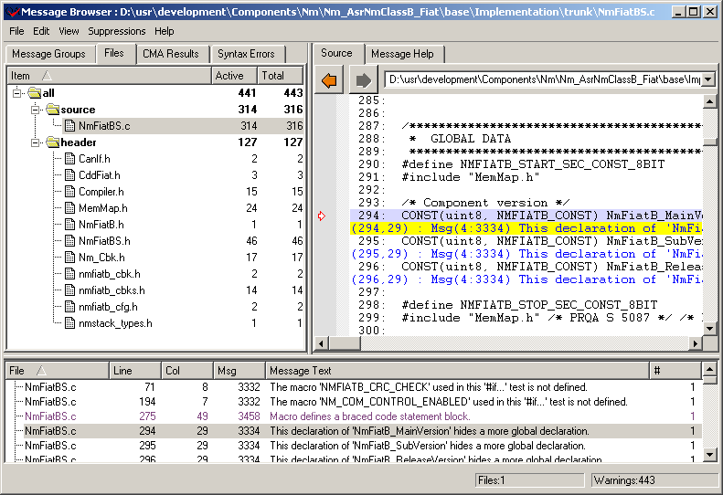
Working with the Results
How to trace into Code
To locate the code location, use
the CDK MISRA report file (line, column)
“file (otherfile.h file)” shows that the deviation is in a header file
the QA-C message browser

Slide 51
Agenda
 | MISRA-C:2004 1
 | Motivation 3
 | MISRA – the Basics 9
 | MISRA Infrastructure @ PES 21
 | Code Annotation 28
 | Applying MISRA-C Analysis 36
 | Working with the Results 45
> | HIS Code Metrics 49
 | 53

Slide 52
HIS Code Metrics
Basics
For code metrics and metric handling see detailed presentation CodeMetrics@PES

Slide 53
HIS Code Metrics
Basics
HIS code metrics
Code metrics are “expected to be necessary for good software quality”
First draft: 2005, latest release: 2008
Measuring the metrics + analyzing the result is an expected action (by our customers)
TIER1 have to comply to the HIS metrics and have to report deviations
PES software often exceeds the HIS metric thresholds
http://www.automotive-his.de → chapter “Software Test”
CDK is able to measure and report the HIS code metrics

Slide 54
HIS Code Metrics
HowTo
PES rule to handle the HIS code metrics requirements
Measure the metric
Analyze the results for effects and necessary counter measures
keep in mind the other requirements like “stick to the standards”, “minimized runtime”, “minimized code footprints”
Metric deviations can be used to set focus on specific areas of the code, e.g.
check if the design/coding is sufficient or not
what & where are the complex areas of your component
define code inspection areas based on code areas highlighted here
assign additional test cases on code areas highlighted here
…
Note: There are no formal rules how to handle and react on metric deviations → that might change in the (near) future with the upcoming “PES TestConcept”

Slide 55
Raisch, Andreas
Vector Informatik GmbH

