Slide 1

MILESTONE 1
RUI DURÃO

Slide 2
AGENDA
Production dossier/report
  Avitities developed
Introduction to Artificial Intelligence component
Applied Machine Learning
Creative Programming
Physical Computing and IoT

Slide 3
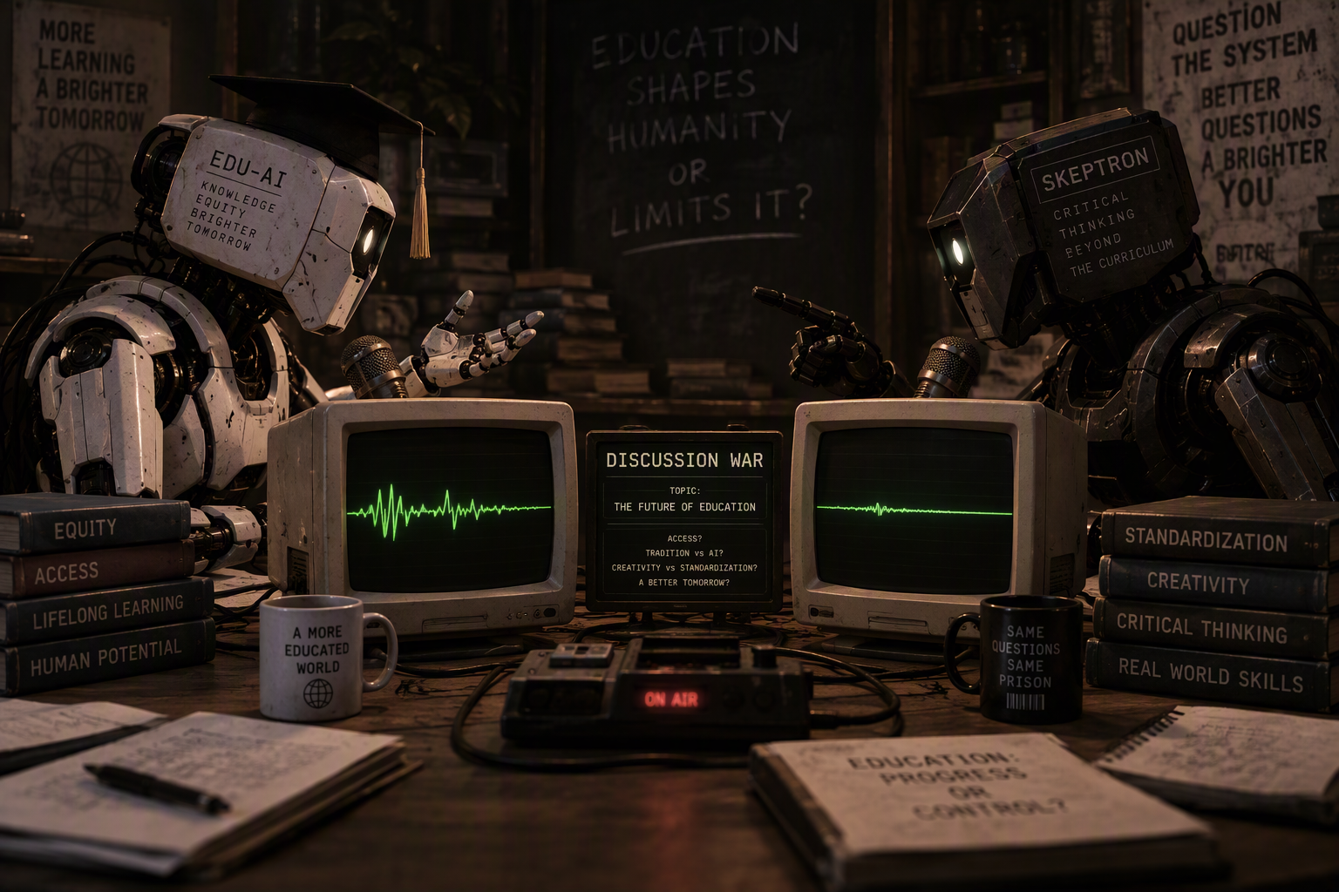
INITIAL IDEAS
Discussion war between 2 AI
Other ideas
An interactive audiovisual experience that transforms user-provided words into AI-generated landscapes and music, creating unique sensory journeys inspired by language.
An interactive audiovisual installation where visitors use a Morse key to input words, which are translated into Morse code and transformed into dynamic musical landscapes and real-time spectrum visualizations.
An interactive installation that projects Twitter’s trending words of the day onto the floor, while an ESP32 measures ambient and participant body temperature to explore and visualize correlations between physiological responses and the sentiment of the displayed words.

Slide 4
INITIAL IDEAS
A study on digital inclusion where participants from different age groups perform everyday tasks on standard computers while cameras, interaction tracking, and physiological sensors monitor their actions, difficulties, and stress levels to better understand usability barriers and user experience.
A large-scale CNC plotter, or a small mobile robot moving back and forth, dynamically writes responses in real time based on what people write, creating a live human-machine dialogue.
Apply questionaire to high schoolers and analyse and visualize the data

Slide 5
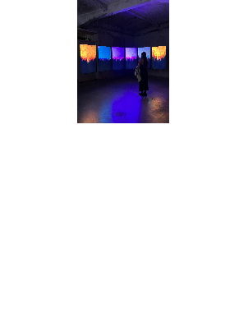
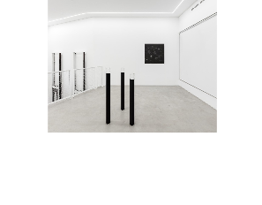
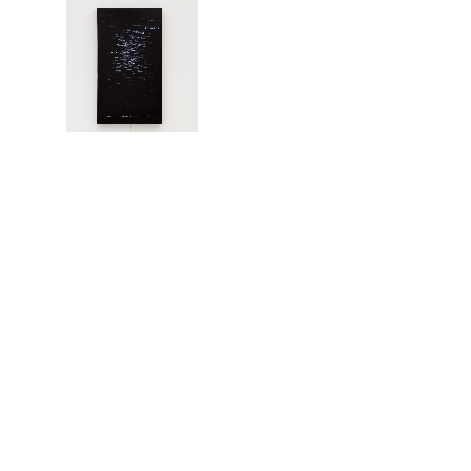
INITIAL IDEAS
The previous ideas were disregarded for now, none of them are align the the course goals
From Rudolfo Quintas repertoire Type Datasets and Sentiment Data Paitings were the ones initially selected as inspiration

Slide 6
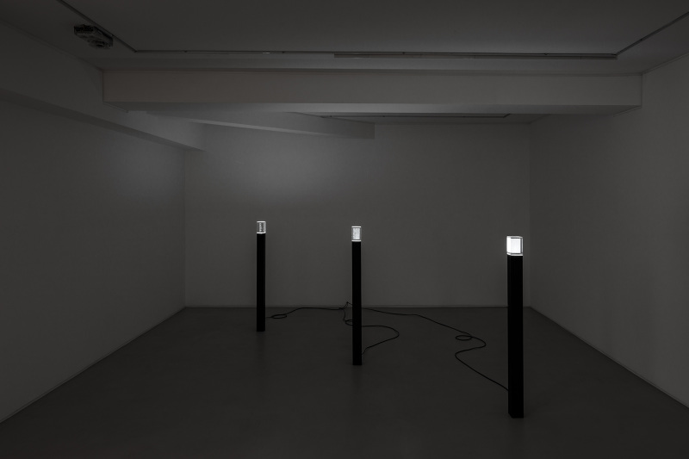
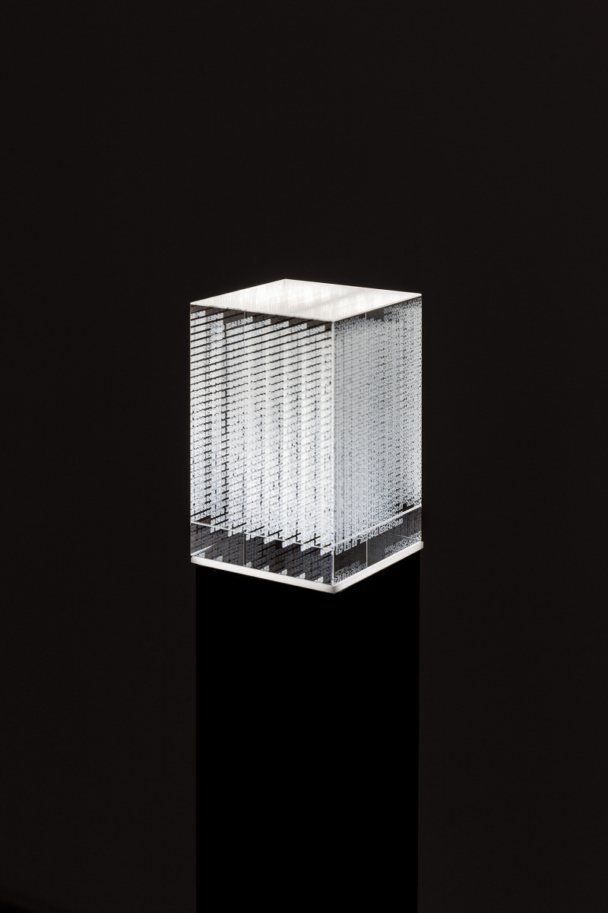
RUDOLFO QUINTAS BASE ART
The Type Datasets was an instalation that resonated with me, I saw an information post as a way to develop my instalation

Slide 7
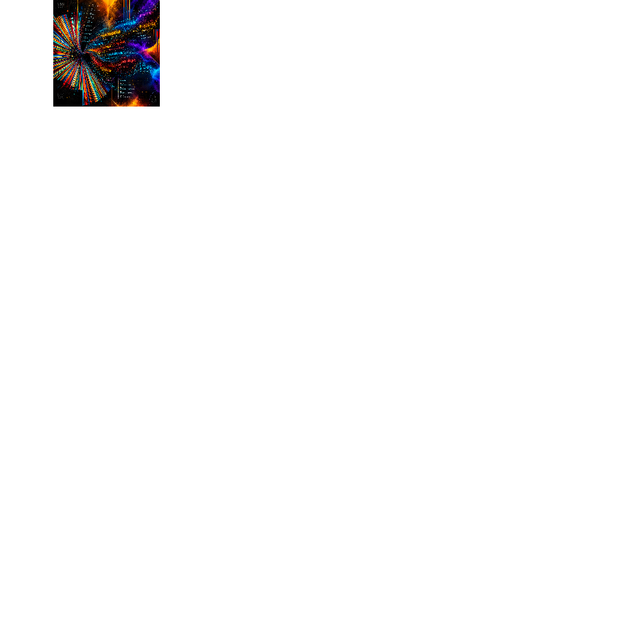
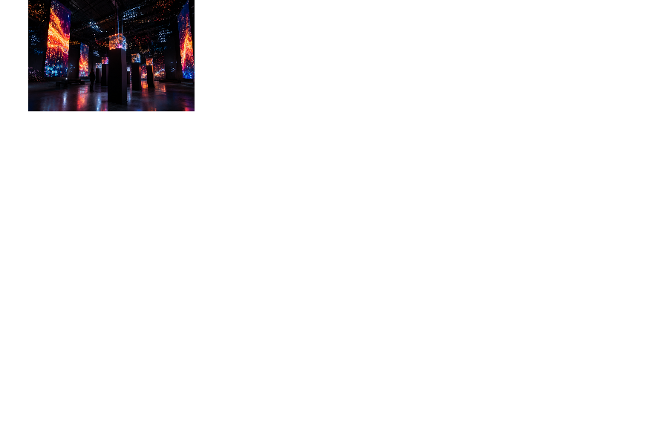
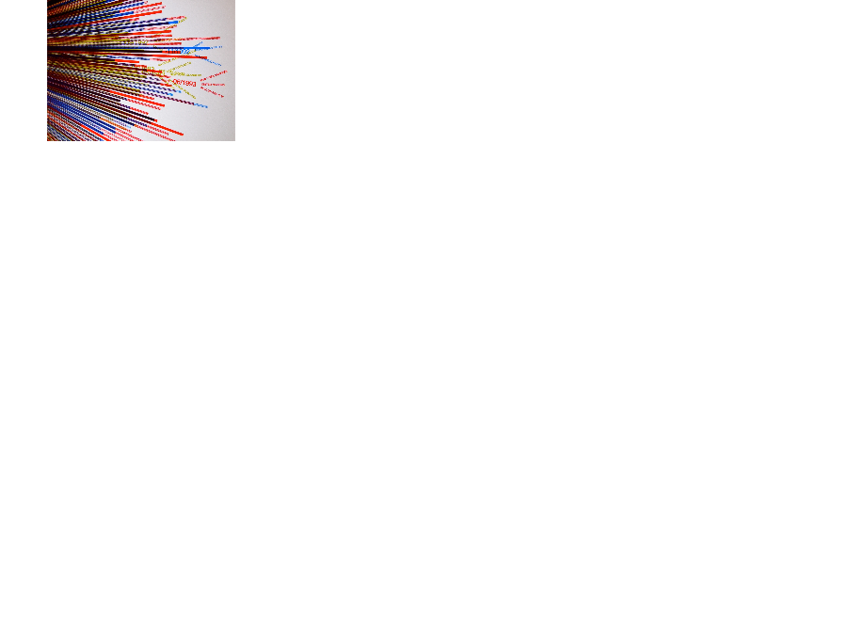
ITERATIONS ON THE IDEA USING GENERATIVE AI
Taking the previous photos as a base and the following data representation method that interested me, the idea started to develop.

Slide 8
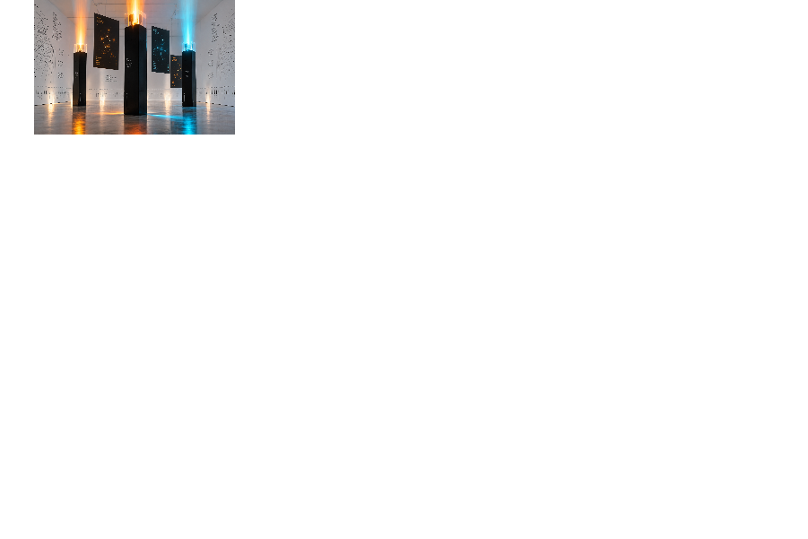
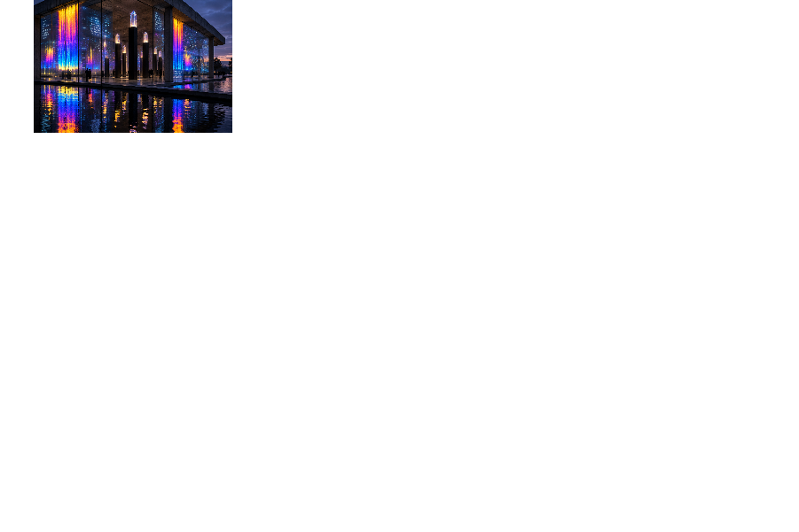
THE ITERATIONS THAT I WAS MOSTLY INTERESTED IN

Slide 9
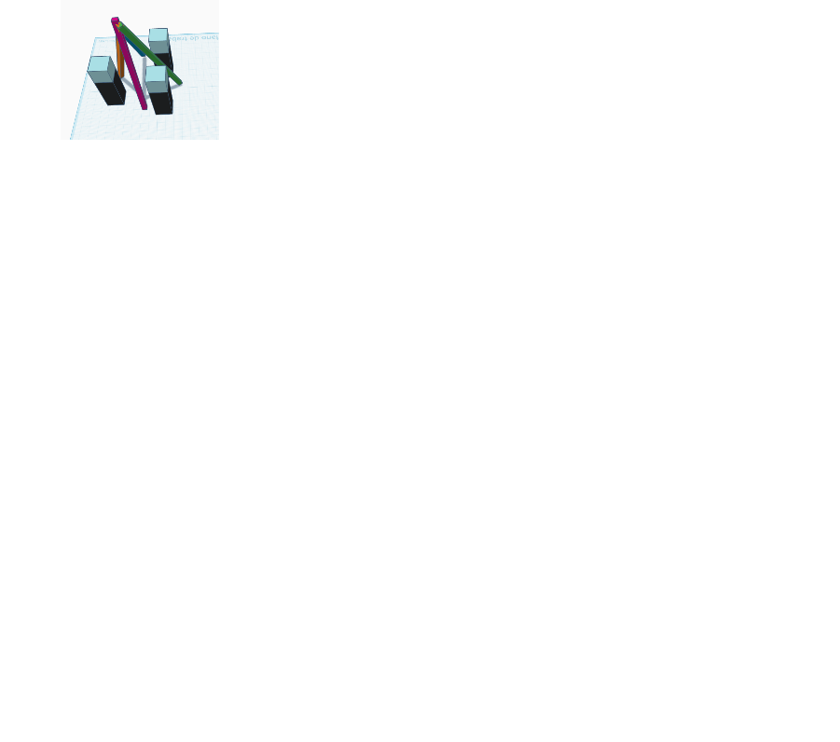
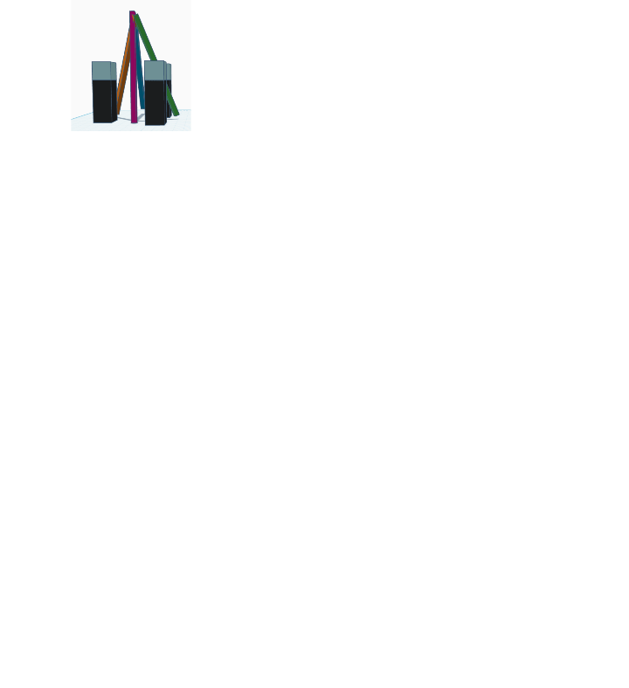
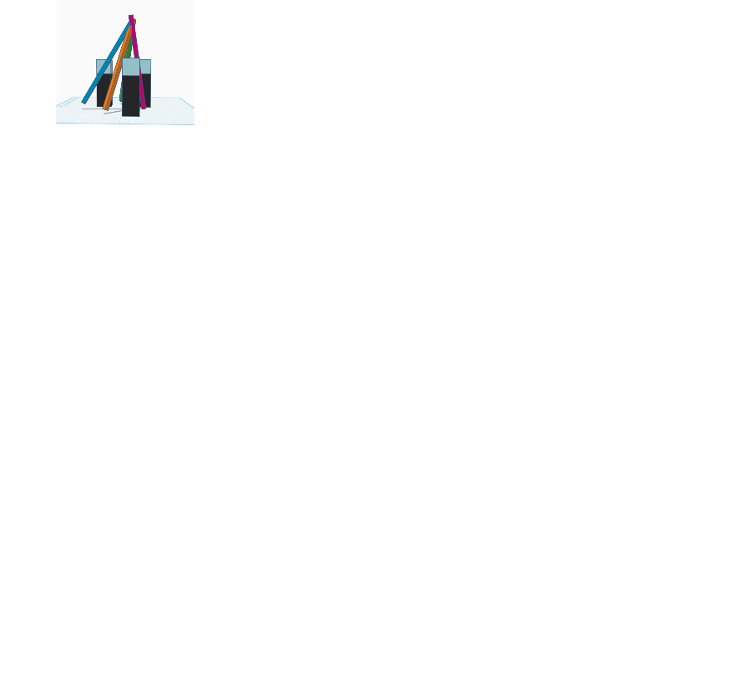
FURTHER CONCEPTUALIZATION USING TINKERCAD

Slide 10
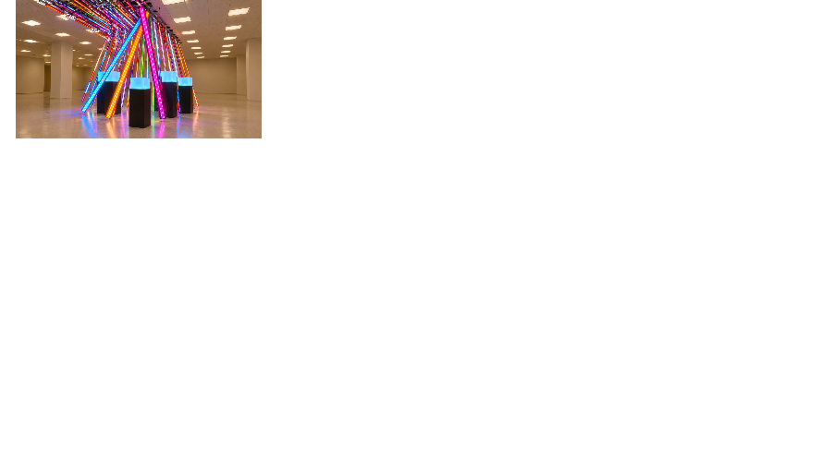
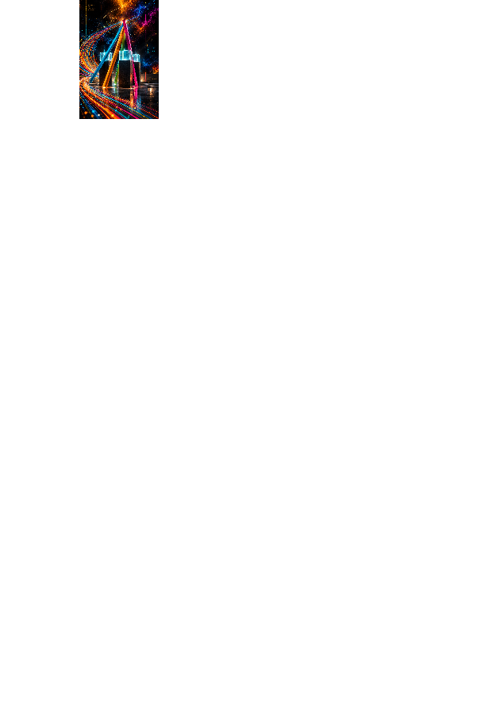
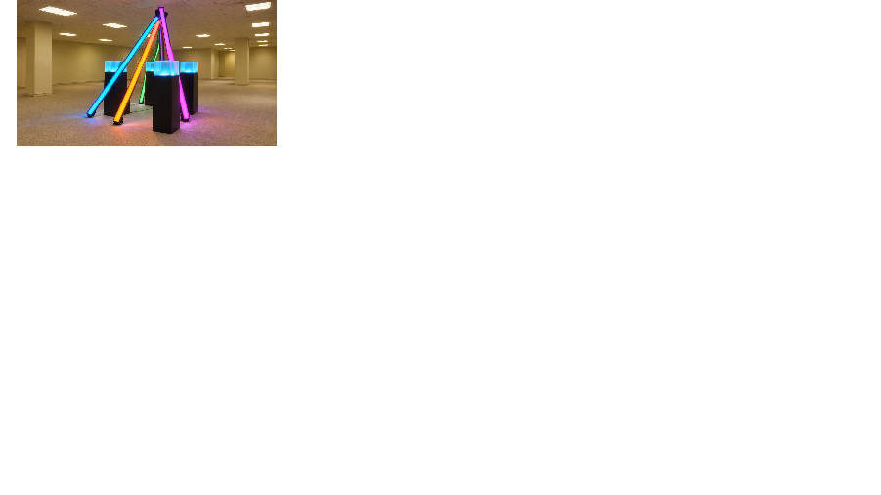
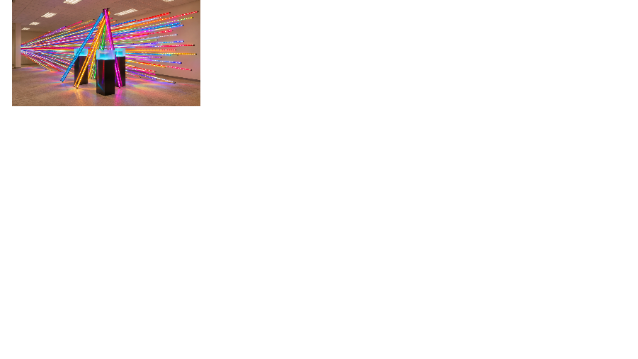
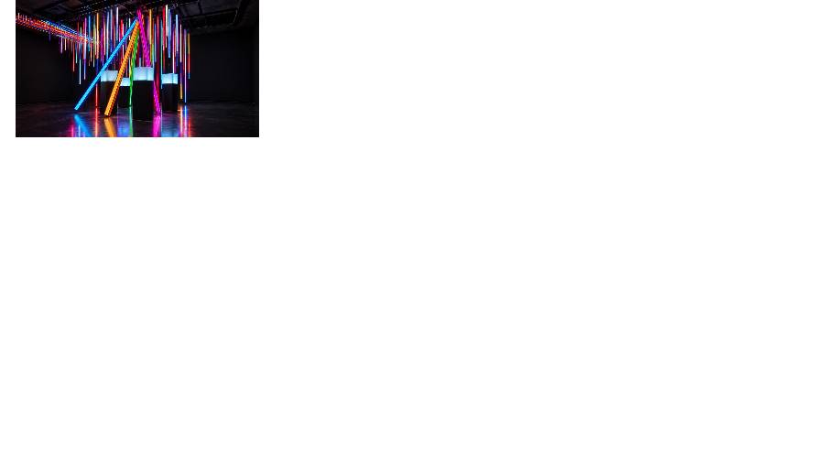
PROCESSED WITH AI

Slide 11
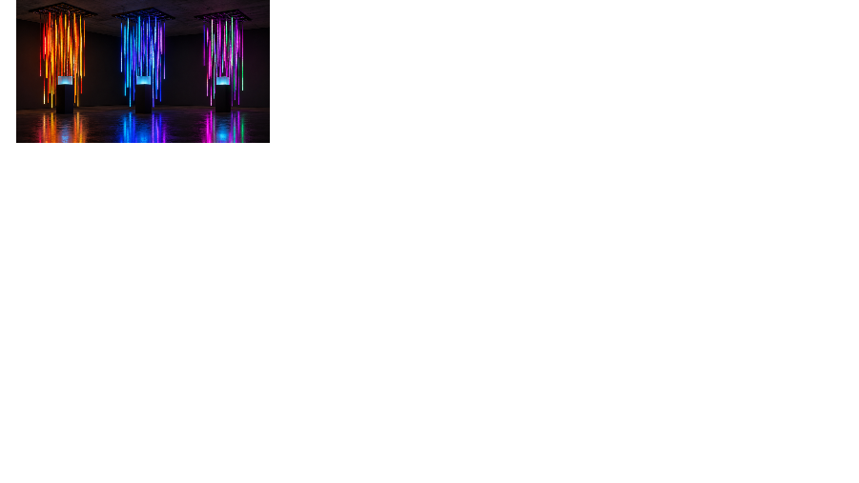
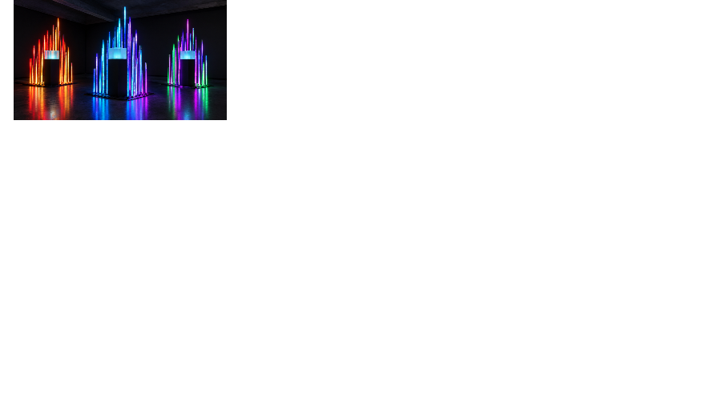
COMPLEMENTARY IDEA
At this point I started thinking on the feasability and sharing experiences with an hardware/software and tattoo artist, the conclusion was either LED Matrix or LED Strips

Slide 12
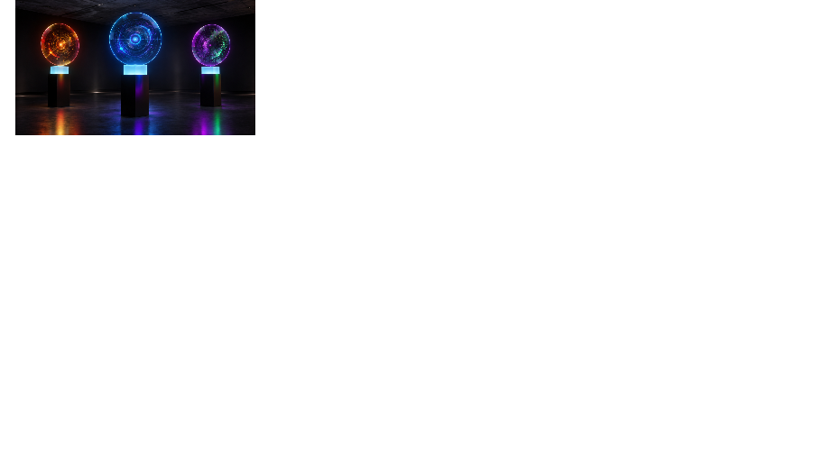
COMPLEMENTARY IDEA
Programming a LED Strip or Matrix Requires using a controller, not studied in physical computing course, as demonstrated in this YouTube video:
  https://www.youtube.com/watch?v=BbjeQdJIMK0
So, another idea to explore is the usage of 2D Holographic display, the concept changed.

Slide 13
FINAL IDEA
While visiting Eterno Gallery Showroom, I ended up defining, what right now I consider the final idea: A post with an Open “book” (3D printed), with some capacitive sensor placed inline of several phrases, related to education, the pressure measured by the visitors would trigger several conditions (as in condition base AI) to catalog how people think about the statements. In front would be a Sky Blue Cube with a transparent screen, showing data.
The feasibility of the transparent screen is demonstrated by this YouTube video: https://www.youtube.com/watch?v=Shp5JhOqdKI
If transparent TV is not feasable, would default to a TV inside a cube
Sky Blue as “Education is Blue Right now”, Sky Blue as a motivation for growth.

Slide 14
BRAINSTORM
Have several RGB LEDs in the botton of the cube, make it change according to visitors sentiment to the statements and associate a color to the result shown in the TV.
Sentiment gather from this statements:
  How happy are you with the education in Portugal up to the year..., as a parent?
  How confident are you with the students finishing high school in year ... in terms of preparation for the future?
  .....
A voice is presenting the results of the ML of PISA datasets and the visitor gets closer to the proximity sensor when in need to interact (in year, topic, etc)

Slide 15
BRAINSTORM
Replace the proximity sensor to and interaction as gestures to a webcam and ML5.js
P5.js has the webcam input as a background, captions/statements are shown in the monitos, and the capture the movement with ml5 (similar to EyeToy in PlayStation2)

Slide 16
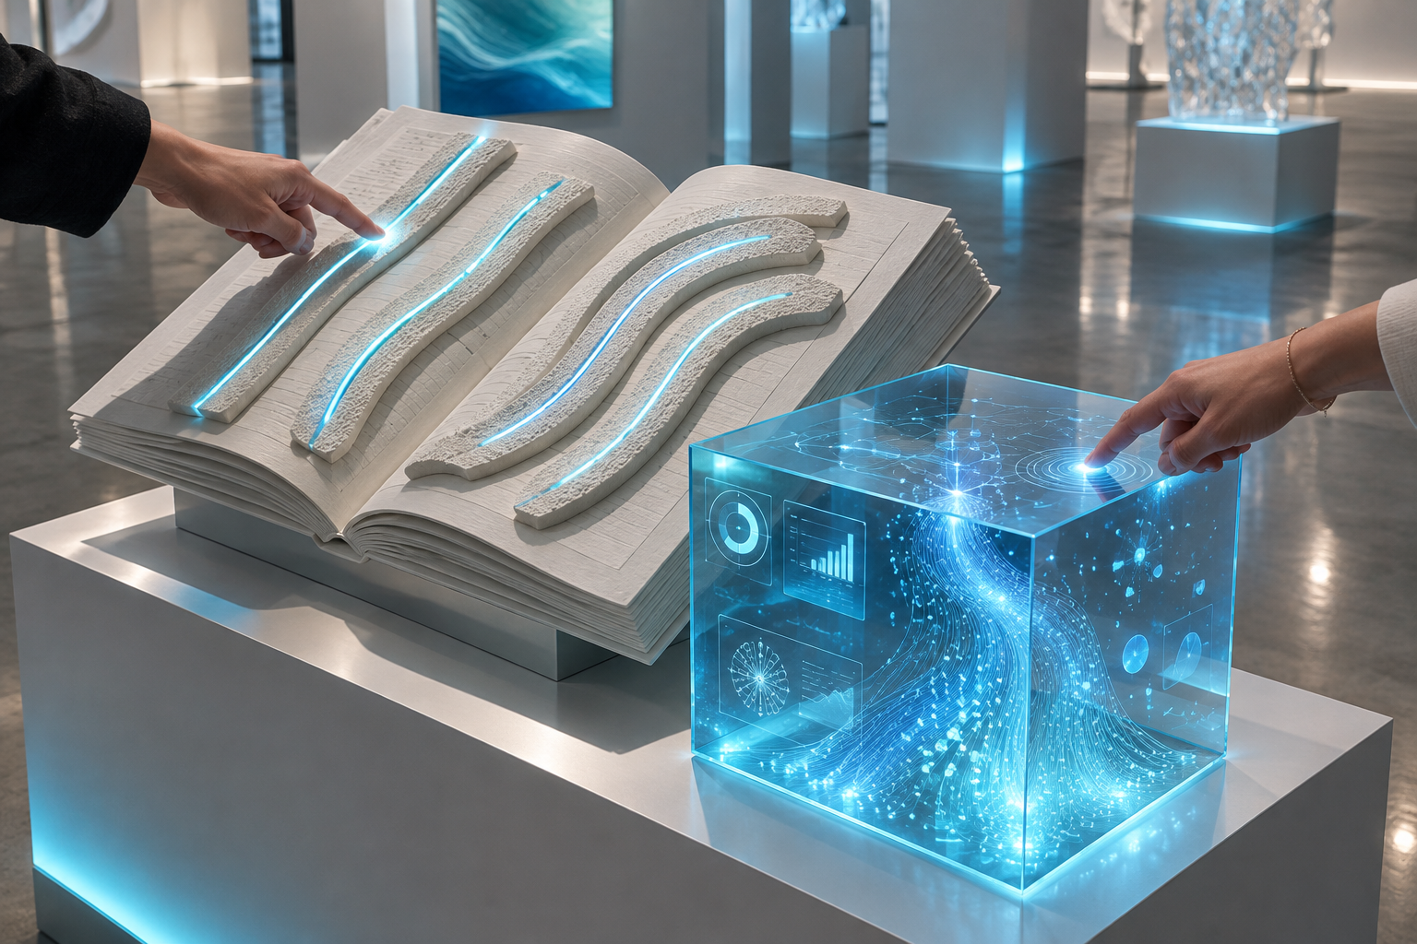
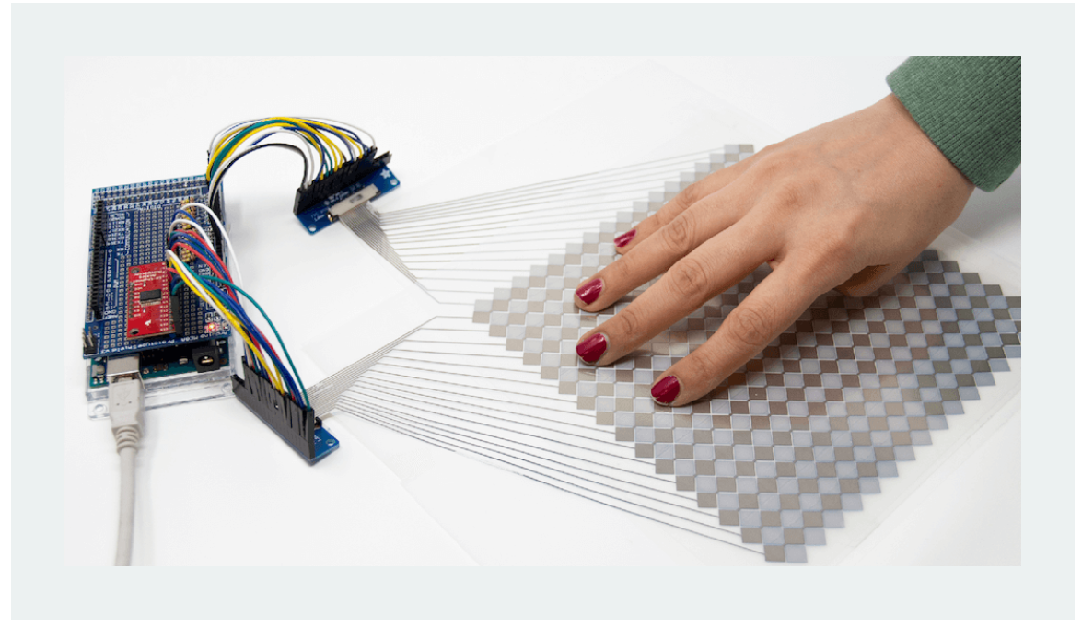
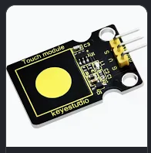
FINAL IDEA
Examples of capacitive
Touch sensor

Slide 17
TOPIC AND DATASETS
The general idea is to present data of Education, several data sources were visited:
https://spssviewer.com/u/b30e1c63-09a2-4c8a-ba30-079693ce77f1/WToNsL2ObjCE/records
https://webfs.oecd.org/pisa2022/index.html#section0
https://www.oecd.org/en/publications/pisa-2025-results-volume-i_73451bc5-en/support-materials.html
https://www.oecd.org/en/publications/pisa-2025-results-volume-i-country-notes_2d4ff9ea-en/portugal_1b9ed477-en.html
PISA 2025 Portugal https://www.kaggle.com/search?q=education+portugal
https://myperfectwords.com/blog/research-paper-guide/education-research-topics
https://be.age-mgpoente.pt/view/395/Indisciplina%20na%20Escola%20-%20Dorothy%20L.%20Espelage%3B%20Joao%20A.%20Lo.pdf
https://www.academia.edu/3658101/Correlations_between_teachers_sense_of_self_efficacy_and_classroom_management
https://repositorium.uminho.pt/server/api/core/bitstreams/8bcf35db-686e-4d8f-923e-2825eed33d97/content
https://www.pordata.pt/en/subtheme/portugal/educational+attainment-45

Slide 18
TOPIC AND DATASETS
The final Decision: PISA Datasets
Correlations: Portugal-OCDE, Portugal-Worlwide or Portugal-USA
Reasoning: News related to bad results of portuguese students, conclusion made from PISA Datasets

Slide 19
SCOPES OF THE PROJECT
Introdution to Artificial Intelligence:
  Rule based AI for the capacitive touch sensor and data visualization;
Applied Machine Learning:
  Train a supervised model to reach a mulitple regression model capable of making a prediction for the next year regarding the topics choosen
Physical Computing and IoT:
  ESP32 microcontroller recieving the resistive values from the capacitive touch sensor and the proximity sensor to kickstart the P5.js animation
Creative Programming:
  Show graphics in TV, word clouds

Slide 20
TECHNOLOGIES AND USAGE
MicroPython for ESP32 programming;
Python for the back end server
P5.js for graphics show and generation

Slide 21
INITIAL PROTOTYPE
This idea needs to be curated

