Slide 1
READING BETWEEN THE LINES
MILESTONE 1 – PROJECT 1 – MASTERS IN CREATIVE COMPUTER AND ARTIFICIAL INTELLIGENCE – 2026/2027
RUI DURÃO

Slide 2
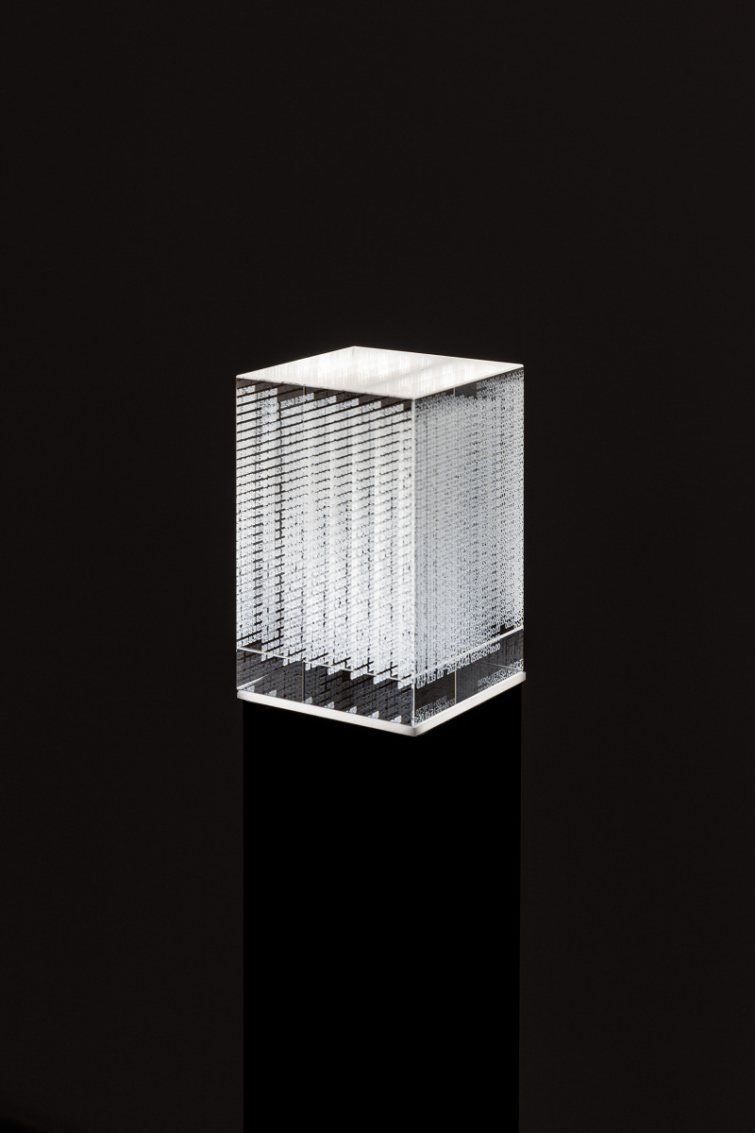
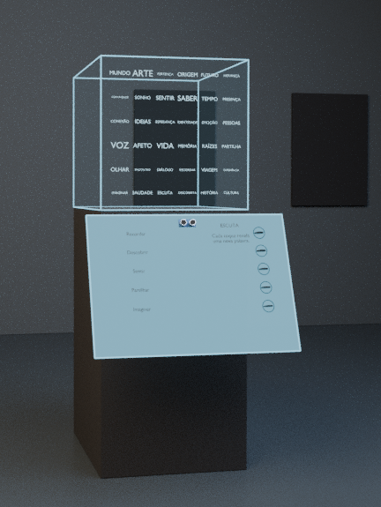
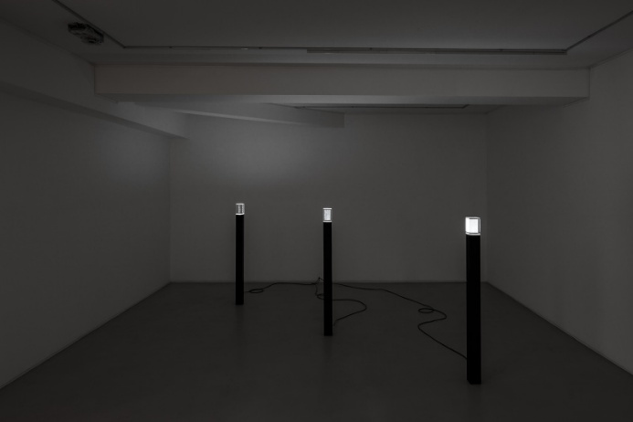
TYPE DATASETS
by Rudolfo Quintas
READING BETWEEN THE LINES
by Rui Durão

Slide 3
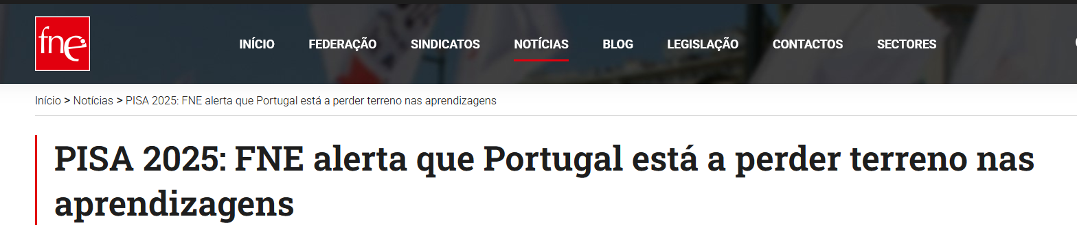
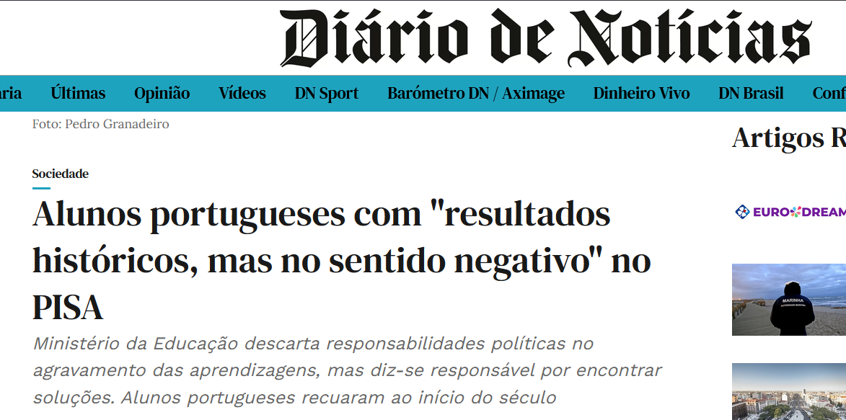
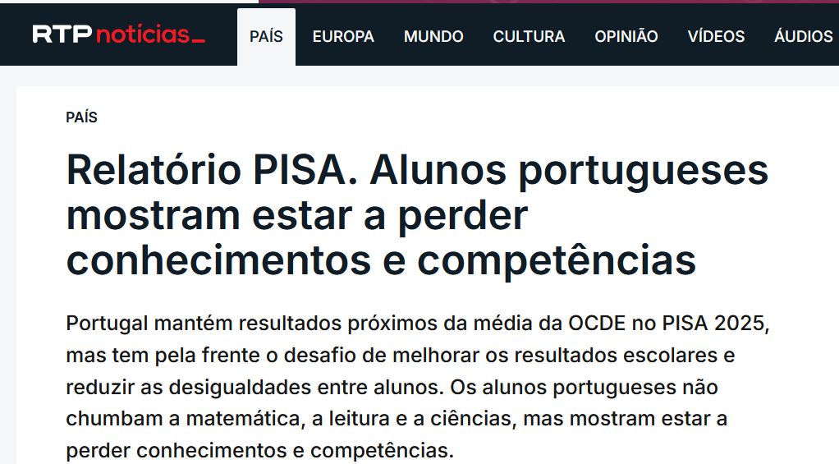
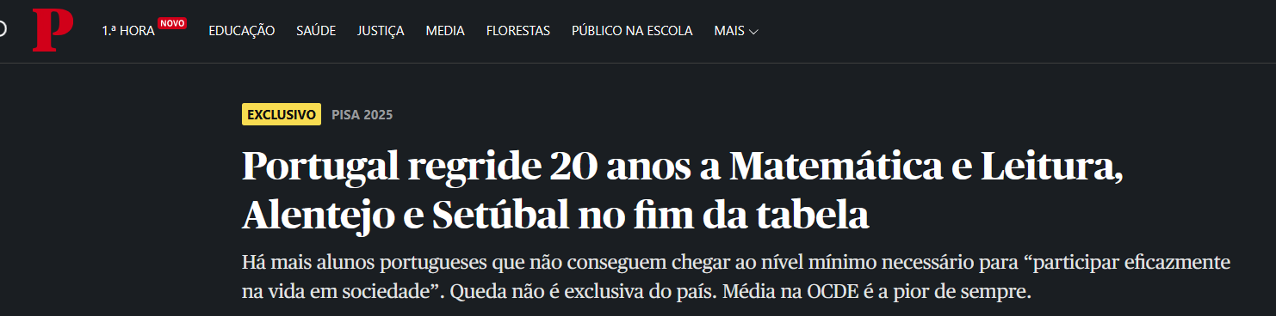

Slide 4
NEWS CLIPPINGS AS MOTIVATOR
Several news about bad results of portuguese students was a motivator for Education Topic of READING BETWEEN THE LINES installation

Slide 5
READING BETWEEN THE LINES
CONCEPT
Visitors explore their sentiments over education in Portugal, with data from PISA study.
While idle, the instalation narrate using texto-to-speech and word cloud, related to the state of education based on PISA data, from 2009 to 2025.
Visitors get closer, interrupt the narration and express their feelings over the data exposed.
Additional toggle will be added for future forecasting

Slide 6
SENTIMENT GATHERING
Acrylic transparente plaque, with engraved questions, for exemple:
  “As a parent, how satisfied are you with education in Portugal up to the selected year?”
  “How confident are you that students completing secondary school in the selected year are prepared for the future?”
  Additional questions exploring educational opportunities, learning experiences, and expectations.
And a pressure sensor to measure sentiment

Slide 7
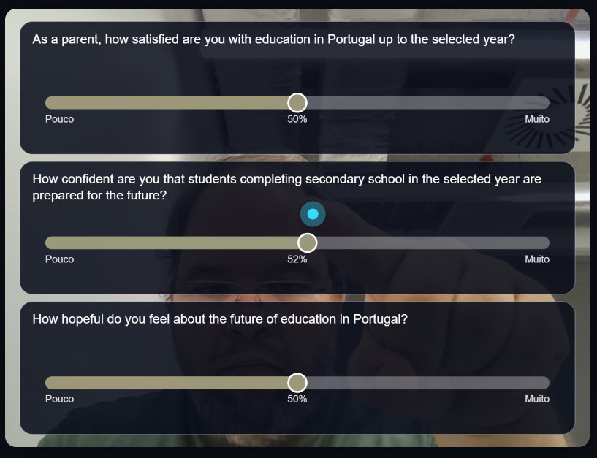
“MINORITY REPORT” STYLE ALTERNATIVE INTERACTION

Slide 8
Alternative interaction, not physical, with finger tracking, visitor can express their sentimento over the statements
This view is toggle when a person get closer to the ultrasonic sensor, stoping narration

Slide 9
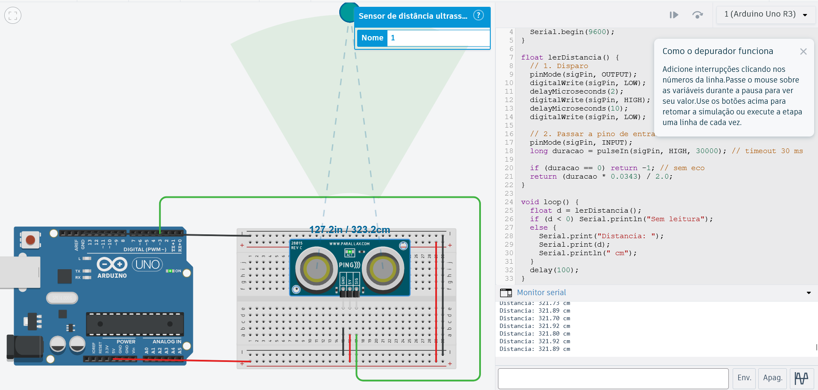
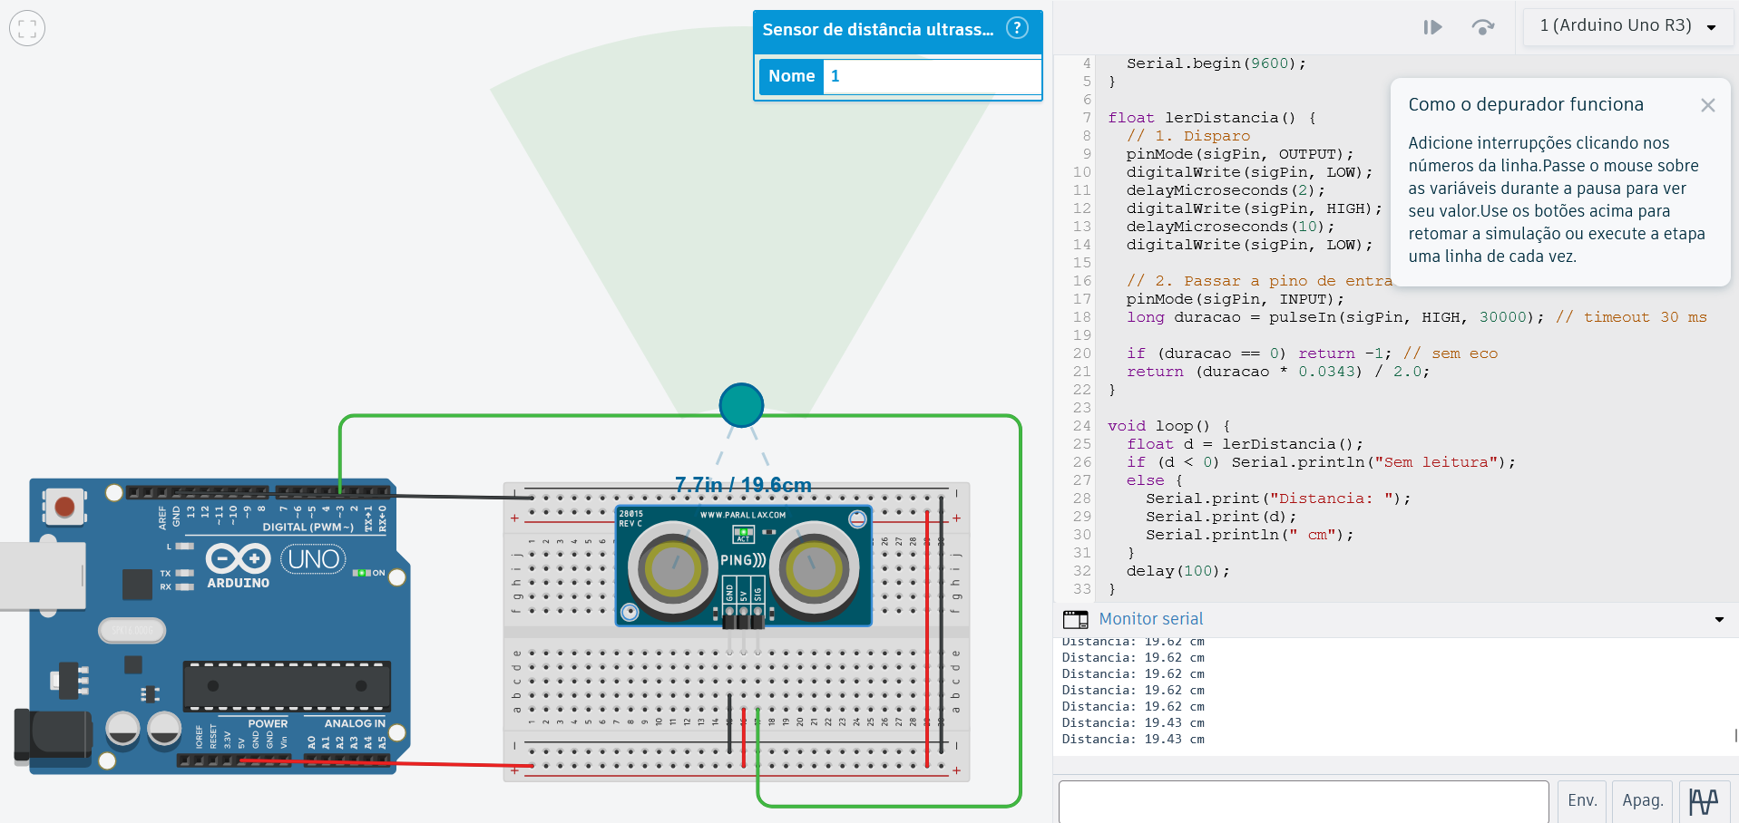
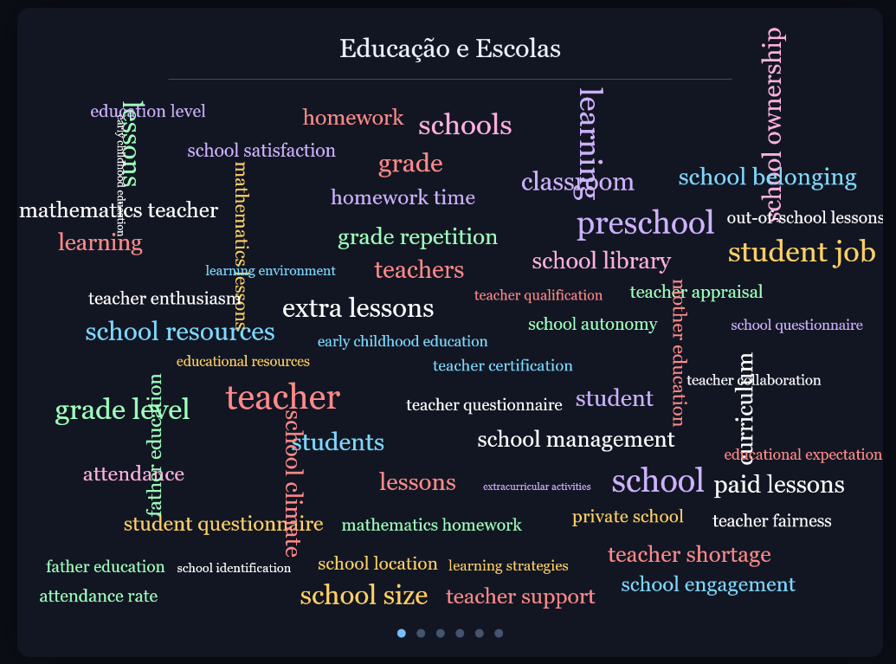
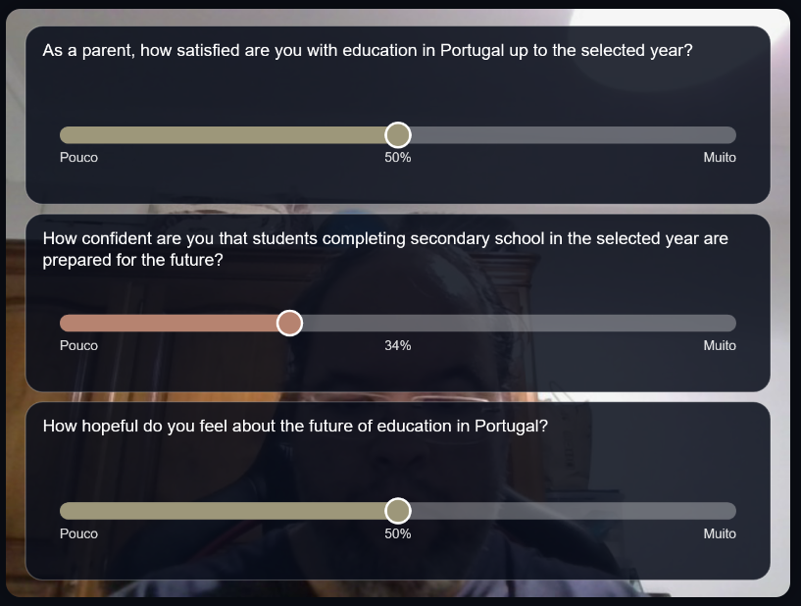
DEMO

Slide 10
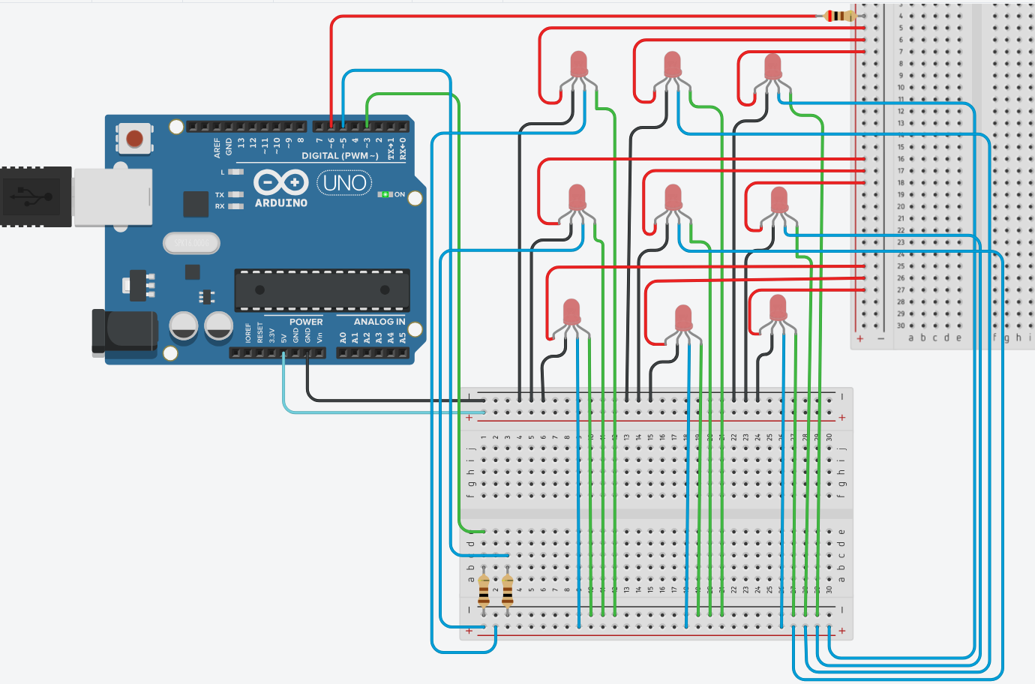

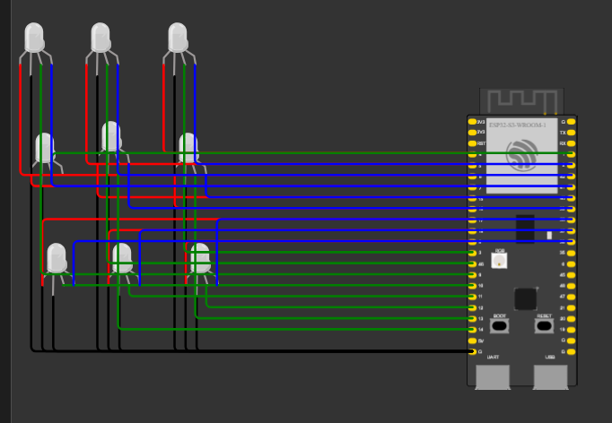
DEMO

Slide 11
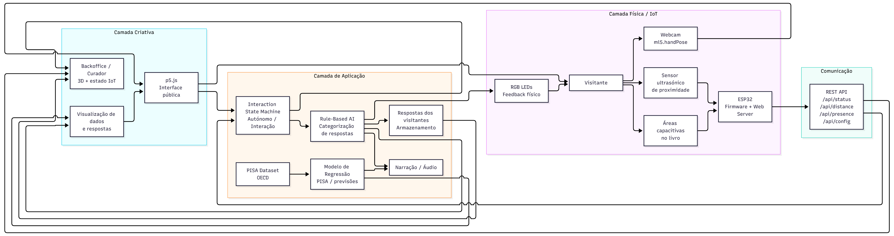
DATA AND COMPONENTS FLOW

Slide 12
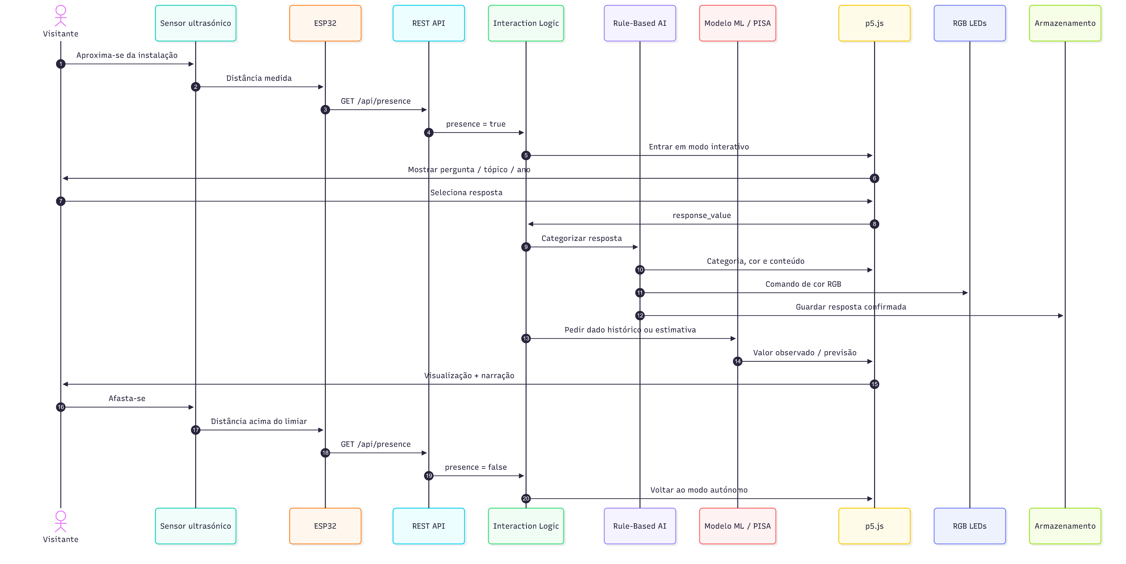
USE CASE

Slide 13
ACTION!! (VIDEO DEMO)

Slide 14
ROLES OF COURSES
Introduction to AI
Provide knowledge base to use pre-trained hand-tracking model to detect deliberate gestures and a rule-based system to translate those actions, along with selected topics and response values, into predefined opinion categories and coordinated visual, audio, and narrative feedback.
Applied Machine Learning
Provide base to use supervised multiple regression on OECD PISA-derived educational data to examine relationships between selected explanatory variables and a defined educational outcome, with its estimates—kept clearly separate from visitors’ perceptions—informing the installation’s p5.js visual and narrative content.

Slide 15
ROLES OF COURSES
Creative Programming
Translate educational data, visitor responses, and interaction states into a coherent p5.js-based visual experience—using ml5.js for machine-learning-supported interaction—that connects the acrylic plaque, illuminated cube, and screen content through typography, colour, animation, and data visualisation, while also providing a curator/backoffice interface for monitoring sensors, device states, and simulated interactions.
Physical Computing and IoT
Connect visitors, the physical installation, and the digital application by using an ESP32 to acquire ultrasonic proximity and capacitive touch inputs, transmit validated sensor data through a Wi-Fi REST API to the p5.js interaction logic, and control RGB lighting feedback, with further development required to complete touch input, lighting integration, and live end-to-end operation.

