Slide 1
Resource Containers: A new facility for resource management in server systems
Gaurav Banga, Peter Druschel, Jeffrey Mogul
OSDI’99

Slide 2
Resource Containers
Motivation?
Resource management in servers is important
Want to exert explicit control with policies (QoS)
Handle denial-of-service attacks
Scheduling must know which entities are doing work for which clients
Problems with existing approaches?
Protection domain and resource principal (logical task) combined in process abstraction
Time spent in kernel not charged to processes correctly

Slide 3
Background: High-Performance Server Architectures
Processes vs. threads vs. events

Slide 4
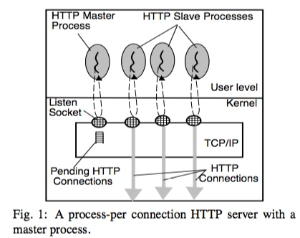
Master process hands off request to slave processes
Two approaches for slave processes?
Fork new slave for each new connection
Reuse pool of pre-forked processes
Problems with processes?
High context-switch cost
High IPC costs

Slide 5
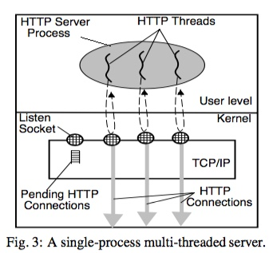
Variant with threads: New thread to accept each incoming request

Slide 6
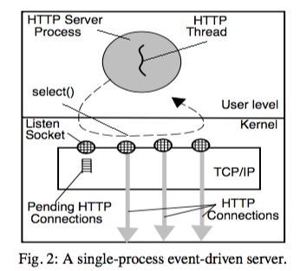
Events: Application loop decides which handler to run
Multiple threads for multiprocessor

Slide 7
Other complication: Dynamic requests
Cgi program: Untrusted code
Fork into separate process for protection (fault isolation)

Slide 8
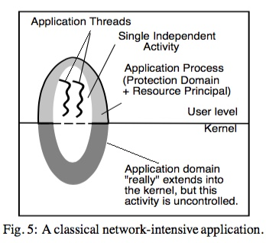
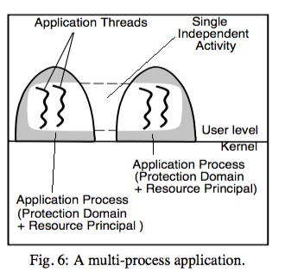
Three problems
Same processes handle different work over time (related to different clients, different priorities)
No kernel accounting
Network handling isn’t charged to responsible process
Work spread across multiple processes
Can’t associate cgi processes with activity

Slide 9
Resource Containers
Basic idea?
Separate notion of protection domain from resource principal
Thread binds to different RC over time depending on current activity

Slide 10
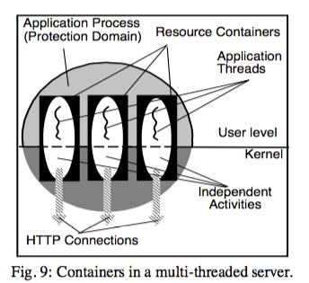
How to use r.c. with multiple threads?
Assign thread to desired RC for each new connection as soon as identified from request info (different RCs for different policies)
OS scheduler will appropriately schedule threads by priority/resource usage
Dynamic content?
Assign cgi process to RC for this connection

Slide 11
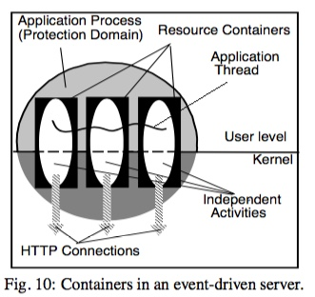
How to use r.c. with events?
Thread switches to desired r.c. as handle new events
No scheduling by OS
Resource containers just tracks accounting
App uses info to determine order to handle events
How does network activity interact with r.c.?
Specify the socket and R.C the activity belongs to ASAP

Slide 12
Applying Resource Containers to Web Server
How to use r.c. with multiple threads?
Assign thread to desired RC for each new connection as soon as identified (different RCs for different policies)
OS scheduler will appropriately schedule threads by priority/resource usage
Dynamic content?
Assign cgi process to RC for this connection
How to use r.c. with events?
Thread switches to desired r.c. as handle new events
No scheduling by OS
Resource containers just tracks accounting
App uses info to determine order to handle events
How does network activity interact with r.c.?
Specify the socket and R.C the activity belongs to ASAP

Slide 13
Resource Containers
Can binding of a thread change over time to different RCs? Why or not?
Yes; events or handing requests from different clients
Can multiple threads be bound to single RC at same time? Why or not?
Yes; each thread associated with same task
Problem: What if thread switches rapidly between RCs? Should thread be descheduled when associated with lower priority RC?
Theoretically, yes, but too costly to recompute thread priority, make scheduling decision, switch
What is approach in paper?
Compromise: Scheduler binding between thread and SET of RCs
Combine all RCs over which thread is currently multiplexed; Performed automatically thru observation (age out old ones); Ave priority?
What are the implications?
Not 100% accurate
Low & Hi priority tasks shouldn’t be handled by same thread

Slide 14
Experiments
Why do all of their experiments use requests to same 1KB file?
Hit in buffer cache
Do not have I/O incorporated
What is this experiment?
1 hi priority client, increase # low priority clients
Why can’t system w/o containers give good response time to high-priority client?
lots of work in kernel

Slide 15
Experiments: Denial of Service
What is a SYN attack?
Setup TCP connection w/ 3-way handshake
Client: sends SYN J
Server: Creates entry, responds with SYN K, ACK J+1, keep state for timeout (75 sec)
Client: ACK K+1
Malicious client does not send ACK, queue fills on server, can’t respond to any clients
How do RCs fix problem?
Notify app when SYN dropped to identify bad client
App isolates bad client to RC with low priority listen() socket
Still some processing needed, but much less

Slide 16
General Conclusions
Scheduling requires knowledge of which entities are doing work for different clients
Need to know how much resources are consumed for different tasks
Can approximate with some simple models
More difficult cases
Other resources: Memory and I/O CPU is always the easiest!
Distributed systems: associate tag with request, pass tag through distributed system
Batched work: Single I/O transactions contains writes from multiple tasks

