Slide 1
CS 736: Advanced Operating Systems Andrea Arpaci-Dusseau Lecture 2: File System Background Impact of Storage Characteristics on FFS, LFS
HDDs: What are their important performance characteristics?
FFS: What did FFS do to be disk-aware?
LFS: How can storage be treated as a log (sequential writing)?
Meta-goal: Everyone say something in large group; raise hand; have camera on “most of the time”
Thursday: Read RAID and RDP papers: Reliable Storage
Reading Groups based on Today’s Attendance
Project 1 Available
Project Groups based on Thursday’s Attendance
Notes:
Goal: Get everyone to speak to class in first two lectures; don’t want long-winded opinions in this course, but do want people to talk and show they are involved and what they understand
Do I have about 50 straight-forward questions in here?
Questions in this lecture today arerather straight-forward and don’t even correspond exactly to reading, so don’t have to feel bad if you do or don’t know answers.
I’m not going to track who talks today, this is really for your benefit so you feel comfortable.

Slide 2
Why Understand HDDs
Understand technology still influences current system software
How much knowledge should one layer use of layer beneath?
HDDs remains lower cost for large capacity than SSD

Slide 3
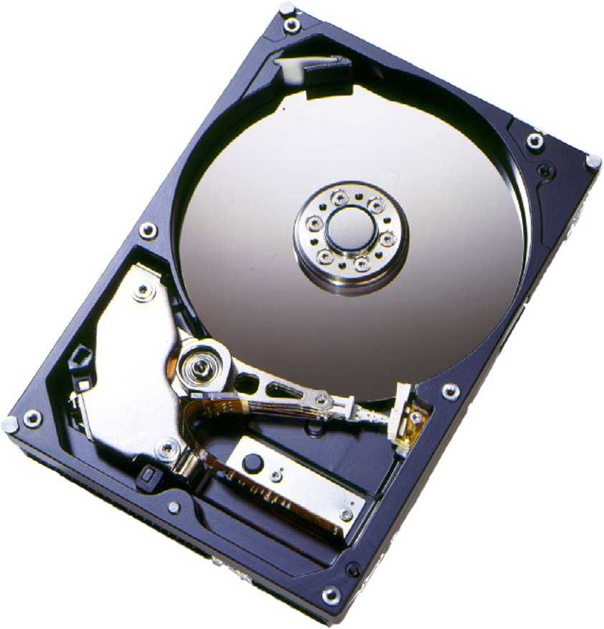
What is in a Hard Disk Drive (HDD)?
Electromechanical
Rotating disks
Arm assembly
Electronics
Disk controller
Cache
Interface controller

Slide 4
Disk Terminology
2?
spindle
Typical configurations: Platter diameters: 3.7”, 3.3”, 2.6”, 0.75” RPMs: 5400, 7200, 10000, 15000
Number of platters: 1-5
read/write head
3?
1?
3?
platter
4?
surface
7?
sector (512 bytes)
6?
5?
track
cylinder
Hypothetical disk:
# surfaces: 4
# tracks/surface: 16K
# sectors/track: 256
# bytes/sector: 512 bytes
What is the capacity?
4*16K*256*512 = 8GB
Blocks: Group of consecutive sectors
Sector also has overhead information
Error Correcting Codes (ECC)
Servo fields to properly position the head
Notes:
Amazing engineering: read spins above surface at height much less than thickness of human hair
Sectors are tiny…hard to figure out exactly which sector head is above at any instant in time
Deal with these platters wobbling slightly
ZBR (Zoned bit recording): More sectors on outer tracks

Slide 5
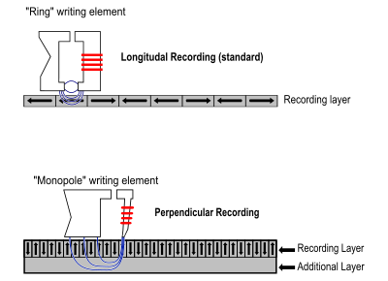
Why is Capacity Increasing?
BPI
Density is increasing; what else increases with density?
Density determines capacity and performance
How is density measured?
Linear density (Bits/inch or BPI)
Track density (Tracks/inch or TPI)
Areal Density = BPIxTPI
TPI
Longitudinal Recording
Magnetic domains oriented in the direction in which head travels
Perpendicular Recording
Soft underlayer (mirrors) write field and allows domains to be closer

Slide 6
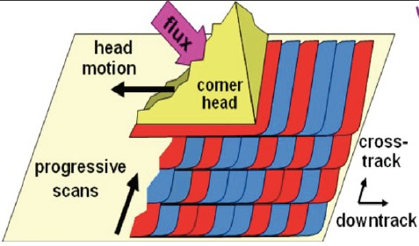
Increase Capacity with Shingled Disks
Observation: Writes are wider than reads and require gap to not interfere
SMR: Shingled Magnetic Recording – Increase density further
Allow writes to overlap one another
Must write to larger group (e.g., 256 MB)
Can still read smaller amount
Change interface → Change local file systems too?

Slide 7
Disk Performance
How long to read or write n sectors?
Positioning time + Transfer time (n)
Question: What is positioning time?
Positioning time: Seek time + Rotational Delay
Seek: Time to position head over destination cylinder
Rotation: Wait for sector to rotate underneath head
What is transfer time?
Transfer time: n / (RPM * bytes/track)
Typical access time?
Order of milliseconds (RAM? Nanoseconds!)
Notes:
Accessing a disk takes order of milliseconds

Slide 8
How long to seek?
Simple seek model – Linear in distance
Components of a seek:
Speedup
Arm accelerates
Coast
Arm moving at maximum velocity
Slowdown
Arm brought to rest near desired track
Settle
Head is adjusted to access desired location
Very short seeks (2-4 cylinders)
Dominates?
Short seeks (200-400 cylinders)
Dominates?
Longer seeks
Dominates?
With smaller platter-sizes and higher TPI?
Settle-time becoming more important
Settle-time
Speedup/Slowdown-time
Coast-time

Slide 9
Switching Time
Head Switch: Switch data channel from one surface to next in same cylinder
Vertical alignment of cylinders difficult at high TPI
Head might need to be repositioned during the switch
Can be 1/3-1/2 of settle-time
Track Switch: Position moves from last track of cylinder to first track of next cylinder
Almost same amount as the settle-time
At high TPI, head-switching and track-switching times are nearly the same

Slide 10
How to Optimize Settle Time?
1) Optimistic Positioning
Attempt read when head is near the desired track
ECC and sector ID determine if correct data was read
Not done for settle before write!
2) Track Skewing
Provides faster sequential access across track and cylinder boundaries
Skew logical sector zero of each track by worst-case head/track switch-time
Each zone has different skew factors

Slide 11
Interface: Data Layout
Logical blocks mapped to physical sectors on disk drive
Low-Level Layout Factors
Track Skewing
Sparing
Serpentine Layout
Logical view of disk by OS: Linear array (list) of blocks
D
D
A
A
A
D
B
B
B
B
C
C
C
B
B
D
B
D
traditional
surface serpentine
Zoned-Bit Recording (ZBR or multi-zone disk)
Outer tracks can hold more sectors due to larger perimeter
Outer zones experience higher data rates.

Slide 12
Zoned-Bit Recording
Outer tracks can hold more sectors due to larger perimeter
Per-track storage-allocation requires complex channel electronics
Tradeoff:
Group tracks in zones
Outer zones allocated more sectors than inner ones
Due to constant angular velocity, outer zones experience higher data rates.
Modern disks have about 30 zones

Slide 13
On-Disk Cache
Track buffer or larger segmented disk cache
Reads
Sequential reads: Actively reading disk data and placing in cache
Writes
What are 3 advantages of buffering writes in disk cache?
Time for write to cache is much faster than disk surface
Provides write-coalescing for better utilization of disk bandwidth
Many write requests enables disk scheduling opportunities
What is the disadvantage?
Reliability: What if power failure before write to surface?
Immediate Reporting: Writes are done as soon as they are written to cache
Disable Immediate Reporting if care about durability!
Will revisit this for crash consistency in OptFS…

Slide 14
Tagged Command Queuing
Disk can schedule multiple requests itself
Disks know low-level layout for best ordering
Names of disk scheduling algorithms?
SCAN and elevator
Handle requests in order by cylinder
Variation: C-SCAN: Start requests in same dir always
Shortest-seek-time-first (SSTF)
Shortest-positioning-time first (SPTF)
Take rotational delay into account as well

Slide 15
Drive Electronics
ECC
Appends ECC symbols, performs error-handling operations
Current disks employ Reed-Solomon codes
Servo Control
For necessary signal-processing for disk-rotation and head positioning
Needed due to motor variation, platter waviness (circumferentially and radially), stacking tolerances, vibrations, etc.

Slide 16
Reliability
Key metric – Mean-Time Between Failures (MTBF)
Typical MTBF for SCSI disk = 1,200,000 hours
Assumes “nominal” operating conditions
Environmental Factors Affecting Reliability?
Temperature
Reliability decreases with increase in temperature
15 C rise in room temp can double failure-rate
Vibrations
Caused by moving components nearby
Cause off-track errors that delay I/O or cause temporary errors
Worse at high TPI due to smaller tolerances
Server-disks designed for more vibration tolerance
Will revisit reliability when we discuss RAID

Slide 17
Energy Consumption
Energy consumption is important issue
How can you change disk to reduce power (with same capacity)?
Power proportional to: (# Platters)*(RPM)^{2.8}(Diameter)^{4.6}
reduce diameter while adding platters;
reduce platters or diameter while increasing density;
reduce RPM

Slide 18
Disk in Action

Slide 19
Fast File System: FFS
McKusick, M.K., Joy, W.N., Leffler, S.J., and Fabry, R.S. A Fast file System for UNIX ACM TOCS Vol. 2, No. 3, August 1984, pp. 181-197.
Why this paper?
SIGOPS Hall of Fame: Recognized by systems community as influential
This paper introduced techniques to make the file system “disk aware”, thus demonstrating the importance of understanding the interplay between hardware technology and file-system design. The structuring concept of the cylinder group, while simple, is found in some form in many current systems (including the widely-deployed Linux ext* family) and serves as an excellent example of the importance of locality in storage. The paper also introduced numerous functionality improvements, including symbolic links and atomic rename, which have since become commonplace features in modern file systems.
Good starter paper (already familiar with concepts)
Good background for basic file system design
Good example of measurement / implementation feedback loop

Slide 20
FFS Motivation
super block
inodes
Data Blocks
Original UNIX file system from Bell Labs
Simple and elegant
Problem: Achieves 20 Kb/sec
2% of disk maximum even for sequential file transfers!
Investigate causes of such poor performance…
Three high-level reasons…
Focus first on problems (not solutions)

Slide 21
Why such poor performance?
3) No locality in allocation to disk; Two problems?
I-nodes far from data blocks
Pay two seeks for every data transfer
I-nodes of files in directory not close together
Pay seek for every i-node (e.g., ls -l)
1) Blocks too small (512 bytes); Two problems?
Fixed costs per transfer
Seek time, rotational delay, computation
More indirect blocks needed for same size ﬁle
2) Poor freelist organization; Problem?
Consecutive file blocks not close together
Pay seek cost between even “sequential” file transfers

Slide 22
Problem 1: Block Size?
How does block size affect performance?
Try doubling it (from 512 bytes to 1KB)
Result: Performance more than doubled
Why double the performance?
Logically adjacent blocks were not physically adjacent
With half the blocks, only half as many seeks+rotations required
Why more than double the performance?
Larger blocks require fewer indirect blocks

Slide 23
Multi-Level Indexing
Dynamically allocate hierarchy of pointers to blocks as needed
Meta-data: Small number of pointers allocated statically
Additional pointers to blocks of pointers
inode
Data blocks
Data blocks
Data blocks
double indirect
indirect
indirect
triple indirect
Double block size: Reach 2x data directly inode; Indirect blocks fit 2x as many pointers

Slide 24
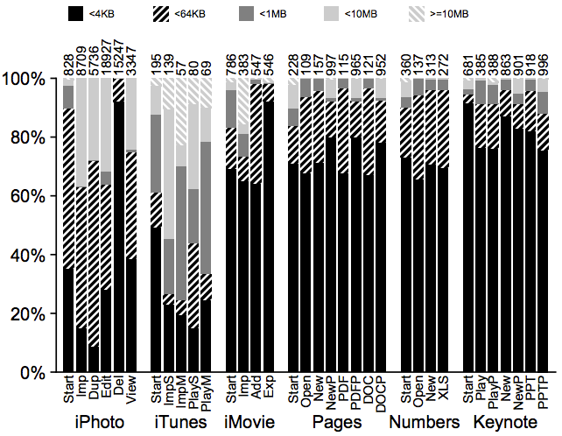
Technique: Larger Blocks
Observation: Doubling block size for old FS doubled performance
Why not make blocks huge?
Most file are very small, even today!
Leads to internal fragmentation

Slide 25
Cost of Larger Blocks
Lots of waste due to internal fragment in most blocks
Time vs. Space tradeoffs…

Slide 26
Large or Small blocks
Large blocks:
Improve performance
Waste space (most files are small)
Small blocks
Don’t waste as much space
Bad performance (more seeks)
How to get best of both worlds? Hybrid solution?

Slide 27
Solution: Fragments
Hybrid Solution
Combine best of large blocks and best of small blocks
Use large block when file is large enough
Introduce “fragment” for files that use parts of blocks
Only tail of file uses fragments
Block size = 4096
Fragment size = 1024
bitmap: 0000 0000 1111 0010
blk1 blk2 blk3 blk4
What about when files grow?
Must copy fragments to new block if no room to grow

Slide 28
File A, size 5KB
File B, size 2KB
AAAA
B
A
B

Slide 29
File A, size 6KB
File B, size 2KB
AAAA
B
A
B
A
append A to first file

Slide 30
File A, size 7KB
File B, size 2KB
AAAA
B
A
B
A
A
append A to first file
Not allowed to use fragments across multiple blocks!
What to do instead?

Slide 31
File A, size 8KB
File B, size 2KB
AAAA
B
B
AAAA
append A to first file, copy to fragments to new block

Slide 32
Information for Applications?
What might applications like to know?
Writing less than a full block is inefficient
Potentially requires moving fragments
Small writes don’t get full sequential bandwidth of disk
Solution: New API exposes optimal write size
Library enables caching writes in memory until large enough size

Slide 33
Problem 2: Aging
What is performance before/after aging?
Over time, files created and deleted, new files created in newly freed space
New FS: 17.5% of disk bandwidth
Few weeks old: 3% of disk bandwidth
Problem: FS becomes fragmented over time
Free list makes contiguous chunks hard to find

Slide 34
Problem 2: Aging?
Problem: FS becomes fragmented over time
Free list makes contiguous chunks hard to find

Slide 35
How Could FS Fix?
Hacky Solutions:
Periodically compact / defragment disk
Disadvantage: Disk not accessible during operation
Organize freelist by address; Disadvantages?
Costly to insert
Non-trivial to find N contiguous free blocks

Slide 36
Solution: Bitmaps
super block
bitmaps
inodes
Data Blocks
0
N
Bitmap 100100001101101011111
Use bitmaps (for inodes and data blocks) instead of free list
Bitmaps provides better speed, with more global view
Fast to update: Just flip single bit to change state from free to allocated or back
No sorting needed
Fast to do lookups: Reading one bitmap block gives state of many data blocks
Quickly find contiguous free blocks
How many bits can be stored in one 4KB block?
4KB * 8 bits / Byte = 4096 * 8 = 32768
1 bitmap block gives state of 32768 data blocks

Slide 37
Problem 3: Block Layout
Blocks laid out poorly
long distance between inodes / data
related inodes not close to one another

Slide 38
Layout Technique: Groups
S
B
I
D
S
B
I
D
S
B
I
D
…
0
group 1
G
group 2
2G
group 3
3G
Key idea: Keep inode close to data
Use groups across disks
Strategy: allocate inodes and related data blocks in same group

Slide 39
Layout Technique: Groups
In FFS, groups were ranges of cylinders
called cylinder group
In ext2, ext3, ext4 groups are ranges of blocks
called block group

Slide 40
Replicated Super Blocks
S
B
I
D
S
B
I
D
S
B
I
D
…
0
group 1
G
group 2
2G
group 3
3G
Is it useful to have multiple super blocks?
Yes, if some blocks (but not all) fail.

Slide 41
Problem
Replicated Super Blocks
Old FS: All super-block copies are on the top platter
Correlated failures! What if top platter damage?
Solution: for each group, store super-block at different offset

Slide 42
Smart Policy
S
B
I
D
S
B
I
D
S
B
I
D
…
0
group 1
G
group 2
2G
group 3
3G
Where should new inodes and data blocks go?

Slide 43
Layout Strategy
Put related pieces of data near each other (i.e., in same group)
Rules:
1. Put data blocks near inodes
2. Put inodes near directory entries
Problem: File system is one big tree
All directories and files have a common root.
All data in same FS is related in some way
Trying to put everything near everything else doesn’t make any choices!

Slide 44
Where to cut the tree and start
growing into another group?
B1
B2
file inode
dir inode
dir data
B3
break
many
B1
dir inode
pointer
B2
related
FFS puts dir inodes in a new group
“ls -l” is fast on directories with many files

Slide 45
Layout Strategy
File inodes: allocate in same group with dir
Dir inodes: allocate in new group
Which group to pick?
One with with fewer used inodes than average group
First data block: allocate near inode (same group)
Other data blocks: allocate near previous block (in case had to move groups)

Slide 46
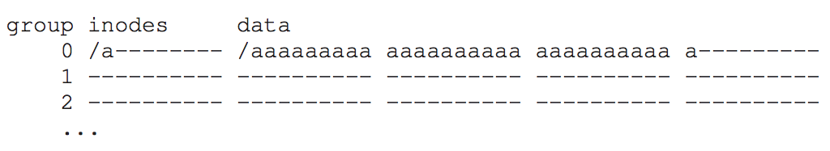
Problem: Large Files
Single large file can fill nearly all of a group
Displaces data for many small files
Most files are small!
Better to do one seek for one large file than
one seek for each of many small files

Slide 47
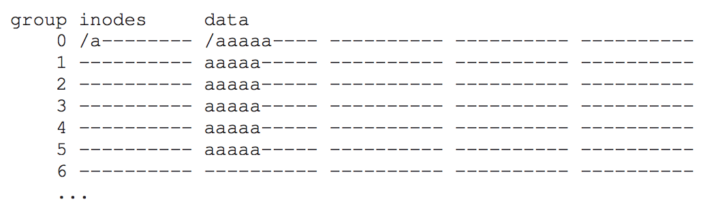
Splitting Large Files
Define “large” as requiring an indirect block
Starting at indirect (e.g., after first 48 KB) put blocks in a new block group
Each chunk corresponds to one indirect block
Block size 4KB, 4 byte per address => 1024 address per indirect
1024*4KB = 4MB contiguous “chunk”

Slide 48
Large files: where to cut the tree and start
growing into another group?
B1
B2
file inode
break
B3
B3
dir inode
dir data
Ind
many
break
B1
B4
dir inode
pointer
B2
related
Define “large” as requiring an indirect block
Starting at indirect (e.g., after 48 KB) put blocks in a new block group

Slide 49
Layout Policy Summary
File inodes: allocate in same group with dir
Dir inodes: allocate in new group with fewer used inodes than average group
First data block: allocate near inode
Other data blocks: allocate near previous block
Large file data blocks: after 48KB, go to new group.
Move to another group (w/ fewer than avg blocks) every subsequent chunk (e.g., 1MB or 4MB).

Slide 50
Group Descriptor (aka Summary Block)
How does file system know which new group to pick?
super block
summary
bitmaps
inodes
Data Blocks
0
G
Tracks number of free inodes and data blocks
Something else to update on writes

Slide 51
OTHER FFS FEATURES
FFS also introduced several new features:
long file names
atomic rename
symbolic links
large blocks (with libc buffering / fragments)

Slide 52
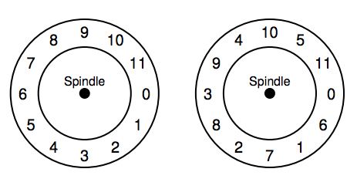
FFS: SECTOR placement
Similar to track skew in disks chapter
Modern disks:
Disk cache

Slide 53
FFS Summary
Met performance goal: Achieved 20-40% of disk bandwidth on large files
10x improvement over original Unix file system
Does not change over lifetime of FS
Especially good considering skip-sector allocation
Could not achieve better than 50% of peak
First disk-aware file system
Bitmaps, Locality groups, Smart allocation policy, Rotated superblocks
Inspired modern files systems, including ext2 and ext3
General
Know performance/reliability of underlying components
Measure your system to improve it!

Slide 54
Break for Reading Groups
Random group of about 6 people
Meet with at least one of these people each week for next two weeks
Can meet with more than one person at a time
Can meet with different people in group different times
Can meet once per week or more
Can meet before or after lecture
List who you met with in Canvas (due each week by Tuesday)
New random group in 2 weeks

Slide 55
LFS
Mendel Rosenblum, John K. Ousterhout. The Design and Implementation of a Log-Structured File System ACM TOCS 10(1), Feb 1992, pp 26--52. Why this paper?
SIGOPS Hall of Fame
The paper introduces log-structured file storage, where data is written sequentially to a log and continuously de-fragmented. The underlying ideas have influenced many modern file and storage systems like NetApp's WAFL file systems, Facebook's picture store, aspects of Google's BigTable, and the Flash translation layers found in SSDs.
Log structures are great match for devices that perform well for sequential writes (or large batched writes)
Other copy-on-write (COW) file systems: WAFL, ZFS, btrfs

Slide 56
Motivation
Technology motivation (1990s)?
Processors faster → more pressure on I/O
Seek time is not improving
Main memory is increasing → buffer cache
Absorbs many reads from disk
Perform writes in group
Workload motivation?
Many small files, many small meta-data intensive I/Os (creating and deleting files)
Weaknesses of existing “in-place” file systems?
Info allocated across disk (many seeks)
Synchronous writes to meta-data are expensive

Slide 57
LFS Performance Goal
Motivation:
Growing gap between sequential and random I/O performance
RAID-5 especially bad with small random writes
Idea: use disk purely sequentially
Easy for writes to use disk sequentially – why?
Can do all writes near each other to empty space – new copy
Works well with RAID-5 (large sequential writes)
Hard for reads – why?
User might read files X and Y not near each other on disk
Maybe not be too bad if disk reads are slow – why?
Memory sizes are growing (cache more reads)

Slide 58
LFS Strategy
File system buffers writes in main memory until “enough” data
How much is enough?
Enough to get good sequential bandwidth from disk (MB)
When might need to write out smaller segments?
Write buffered data sequentially to new segment on disk
Segment is some contiguous region of blocks
Never overwrite old info: old copies left behind
RAM:
disk:

Slide 59
LFS Data Structures (attempt 1)
S0
S1
S2
S3
What file system info is harder to find on disk now?
Inodes are no longer at fixed offset
Strawman Attempt 1: Use location on disk of inode instead of inode num in dir entry
Note: when update inode, inode name (location of inode) changes!!

Slide 60
Attempt 1: Inode Number is disk offset
Overwrite data in /file.txt
I2
Dir
I9
D
D’
root inode
root directory entries (inode ptrs are block numbers)
file inode
file data
How to update Inode 9 to point to new D’ ???

Slide 61
Attempt 1: Inode number is disk offset
Overwrite data in /file.txt
I2
Dir
I9
D
D’
Can LFS update Inode 9 to point to new D’?
NO! This would be a random write

Slide 62
Attempt 1: Inode number is disk offset
Overwrite data in /file.txt
I2
Dir
I9
D
D’
I9'
Dr’
I2'
old
new
Problem: Must update all structures in sequential order to log

Slide 63
Attempt 1: Problem w/ Inode Numbers
I2
Dir
I9
D
D’
I9'
Dr’
I2'
Problem: For every data update, must propagate updates up directory tree to root
Why? When inode copied, its location (inode name) changes
Solution: Keep inode names constant; don’t base inode name on offset
FFS found inodes with math. How in LFS?

Slide 64
Data Structures (attempt 2)
Inodes are no longer at fixed offset
Use imap structure to map: inode number => inode location on disk

Slide 65
Where to keep imap?
imap: inode number => inode location on disk
table of millions of entries (4 bytes each)
disk:
imap
S0
S1
S2
S3
Where can imap be stored???? Dilemma:
1. imap too large to keep in memory (and must be persistent)
2. don’t want random writes for imap (don’t go to beginning of disk each time)
Solution:
Write imap in segments
Keep pointers to pieces of imap in memory (crash? fix this later!)
segments

Slide 66
Solution: imap in Segments
memory:
ptrs to
imap pieces
Cached portion
of imap
disk:
S0
S1
S2
S3
Solution:
Write imap in segments
In memory: Keep pointers to pieces of imap (crash? fix this later!)
In memory: Keep recent accesses to imap cached

Slide 67
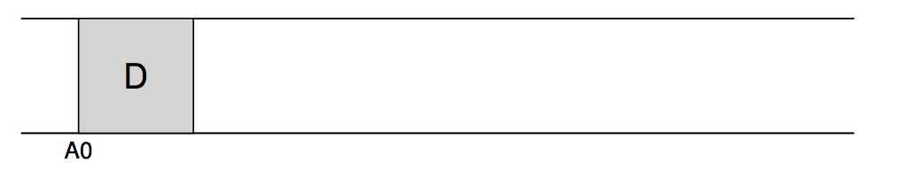
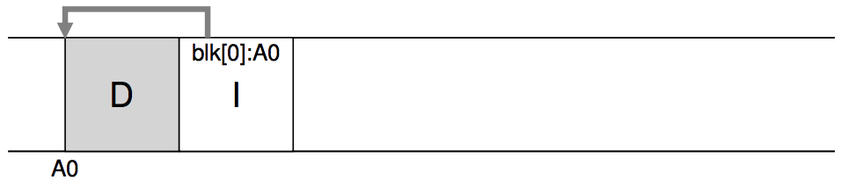
WHERE DO INODES GO?
Write out new copy of data, even if already allocated and just “overwriting” block of file with new data
(Would have been a simple data overwrite in FFS)
Will need to change pointers in inode if write data to new location

Slide 68
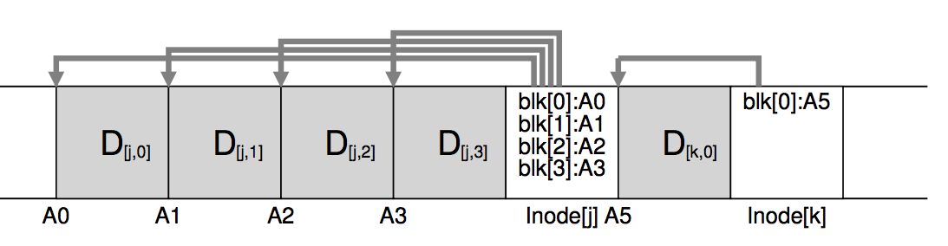
BUFFERED WRITES to segment
If some data in file has not changed, those data blocks will not be re-written
Pointers in inode may point to old data in other segments

Slide 69
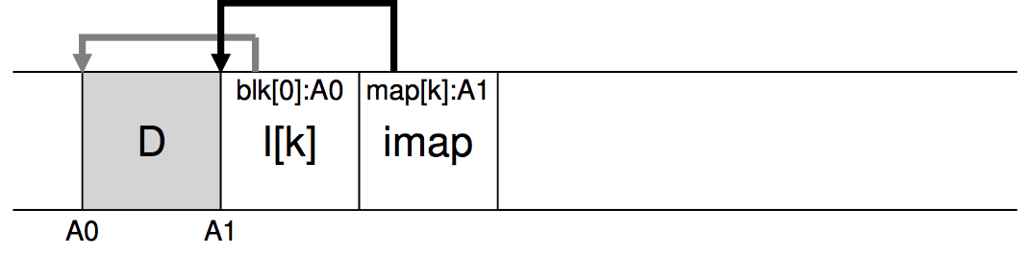
IMAP EXPLAINED

Slide 70
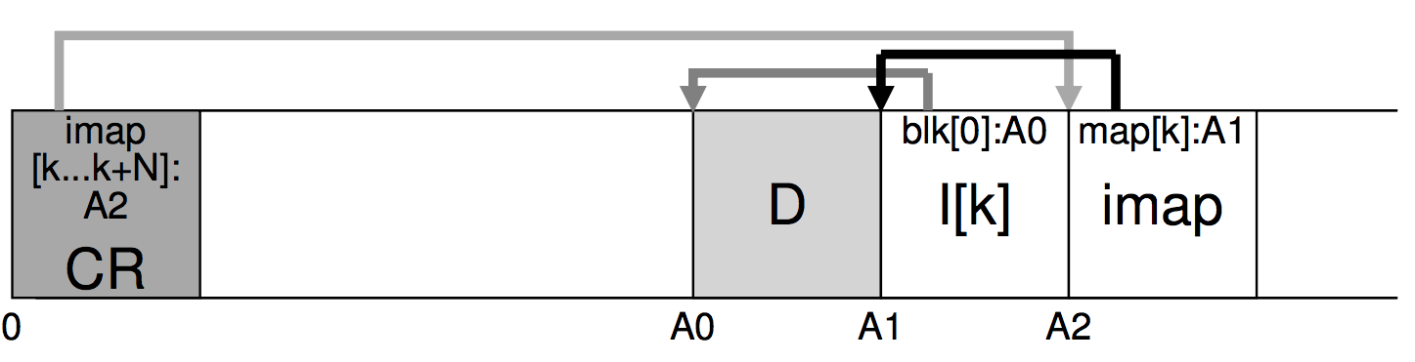
READING IN LFS
Read the Checkpoint region
Read all imap pointers, cache portion of imap in mem
To read a file:
Lookup inode location in imap
Read inode
Read the file block
Notes:
The first on-disk data structure we must read is the
checkpoint region. The checkpoint region contains pointers (i.e., disk addresses) to the entire inode map, and thus LFS then reads in the entire inode map and caches it in memory. After this point, when given an inode
number of a file, LFS simply looks up the inode-number to inode-diskaddress mapping in the imap, and reads in the most recent version of the
inode. To read a block from the file, at this point, LFS proceeds exactly
as a typical UNIX file system, by using direct pointers or indirect pointers
or doubly-indirect pointers as need be. In the common case, LFS should
perform the same number of I/Os as a typical file system when reading a
file from disk; the entire imap is cached and thus the extra work LFS does
during a read is to look up the inode’s address in the imap.

Slide 71
Other Issues
Crashes
Garbage Collection

Slide 72
Crash Recovery
What data needs to be recovered after a crash?
Need imap (lost in volatile memory)
Naive approach?
Scan entire disk to reconstruct imap pieces. Slow!
Better approach?
Occasionally checkpoint to known on-disk location pointers to imap pieces
How often to checkpoint?
Checkpoint often: random I/O
Checkpoint rarely: lose more data, recovery takes longer
Example: checkpoint every 30 secs

Slide 73
Checkpoint
memory:
ptrs to
imap pieces
after last
checkpoint
checkpoint
disk:
S0
S1
S2
S3
tail after last
checkpoint
Crash!

Slide 74
Reboot
memory:
ptrs to
imap pieces
checkpoint
disk:
S0
S1
S2
S3
tail after last
checkpoint

Slide 75
Reboot
memory:
ptrs to
imap pieces
Get pointers from
checkpoint
checkpoint
disk:
S0
S1
S2
S3
tail after last
checkpoint

Slide 76
Reboot
Scan segments after tail looking for imap pieces; → roll forward
memory:
ptrs to
imap pieces
checkpoint
disk:
S0
S1
S2
S3
tail after last
checkpoint

Slide 77
Checkpoint Summary
Checkpoint occasionally (e.g., every 30s)
Upon recovery:
- read checkpoint to find most imap pointers and segment tail
- find rest of imap pointers by reading past tail
What if crash during checkpoint?

Slide 78
Checkpoint Strategy
Have two checkpoint regions
Only overwrite one checkpoint at a time
Use checksum/timestamps to identify newest checkpoint
disk:
???
v2
S0
S1
S2
S3
writing

Slide 79
Other Issues
Crashes
Garbage Collection

Slide 80
What to do with old data?
Old versions of files → garbage
Approach 1: garbage is a feature!
Keep old versions in case user wants to revert files later
Versioning file systems
Example: Dropbox
Approach 2: garbage collection

Slide 81
Garbage Collection
Need to reclaim space:
1. When no more references (any file system)
2. After newer copy is created (COW file system)
LFS reclaims segments (not individual inodes and data blocks)
- Want future overwites to be to sequential areas
- Tricky, since segments are usually partly valid

Slide 82
Garbage Collection
60%
10%
95%
35%
disk segments:
USED
USED
USED
USED
FREE
FREE

Slide 83
Garbage Collection
60%
10%
95%
35%
95%
disk segments:
USED
USED
USED
USED
USED
FREE
compact 2 segments to one
When moving data blocks, copy new inode to point to it
When move inode, update imap to point to it

Slide 84
Garbage Collection
General operation: Pick M segments, compact into N (where N < M).
Mechanism: How does LFS know whether data in segments is valid?
Policy: Which segments to compact?

Slide 85
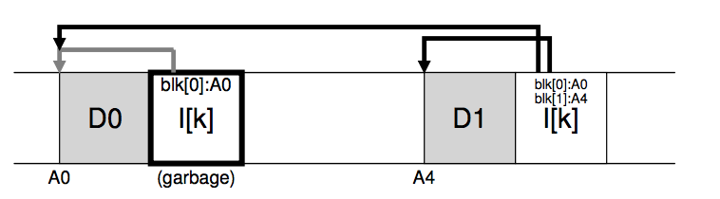
GARBAGE COLLECTION

Slide 86
Garbage Collection Mechanism
Is an inode the latest version?
Check imap to see if this inode is pointed to
Fast!
Is a data block the latest version?
Scan ALL inodes to see if any point to this data
Very slow!
How to track information more efficiently?
Segment summary lists inode and data offset corresponding to each data block in segment (reverse pointers)

Slide 87
Block Liveness
am i alive?
disk:
…
:D
…
SS
…

Slide 88
Block Liveness
imap
am i alive?
disk:
…
:D
…
SS
…
inode

Slide 89
Block Liveness
imap
am i alive?
disk:
…
:D
…
SS
…
inode
D’

Slide 90
Block Liveness
imap
am i alive?
disk:
…
:D
…
SS
…
inode
D’
Nope!

Slide 91
Block Liveness
imap
am i alive?
disk:
…
:(
…
SS
…
inode
D’
Nope!
Don’t have to copy this data block to new segment; just discard

Slide 92
Garbage Collection
General operation: Pick M segments, compact into N (where N < M).
Mechanism: Use segment summary, imap to determine liveness
Policy: Which segments to compact?
Greedy - Clean most empty first – not best simulation results
What is intuition of cost-benefit policy?
Be lazy for hot segments (better if wait until more die): 15% u
Be aggressive for cold segs (wasting space for long time): 75% u
40%
10%
95%
35%
disk segments:
USED
USED
USED
USED
FREE
FREE

Slide 93
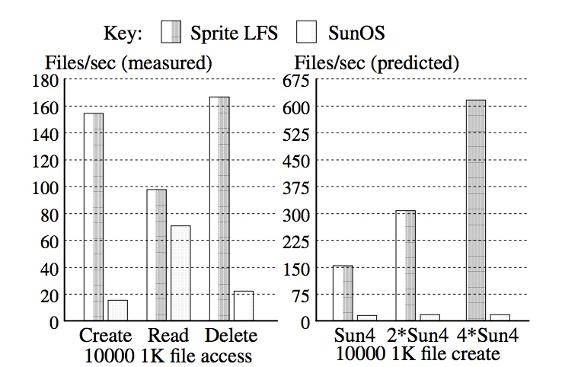
Small-File Performance

Slide 94
CS 736: Advanced Operating Systems Andrea Arpaci-Dusseau Lecture 2: File System Background Impact of Storage Characteristics on FFS, LFS
HDDs: What are their important performance characteristics?
FFS: What did FFS do to be disk-aware?
LFS: How can storage be treated as a log (sequential writing)?
Meta-goal: Everyone say something in large group; raise hand; have camera on “most of the time”
Thursday: Read RAID and RDP papers: Reliable Storage
Reading Groups based on Today’s Attendance
Project 1 Available
Project Groups based on Thursday’s Attendance
Notes:
Goal: Get everyone to speak to class in first two lectures; don’t want long-winded opinions in this course, but do want people to talk and show they are involved and what they understand
Do I have about 50 straight-forward questions in here?
Questions in this lecture today arerather straight-forward and don’t even correspond exactly to reading, so don’t have to feel bad if you do or don’t know answers.
I’m not going to track who talks today, this is really for your benefit so you feel comfortable.

Slide 95
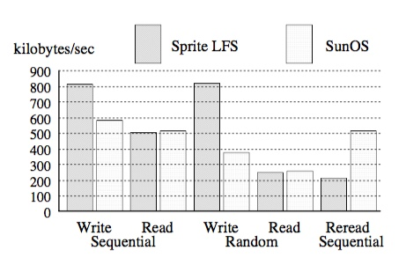
Logical vs Temporal Locality
LFS: Good random write performance;
Temporal Locality – Puts data where it’s fastest to write Assume future reads cached in memory
SunOS / Traditional in-place: Good reread sequential perf after write random; why?
Logical Locality - Put final location of data wherever file system chooses (usually in a place optimized for future reads)

Slide 96
LFS Conclusions
Writing sequentially to log matches performance characteristics of many storage devices
Disks, flash, SMR, distributed systems
Good for versioning as well
Improves performance of small, random, asynchronous writes
Watch out for synchronous operations
Cleaning overheads always an issue

