Slide 1
CS 736: Advanced Operating Systems Andrea Arpaci-Dusseau Lecture 3: Reliable Storage RAID and Row-Diagonal Parity
RAID: What are the characteristics of RAID-0, 1, 4, and 5?
Number of disk failures, effective capacity, throughput for read, write, random, sequential workloads
RDP: Why are multiple disk failures a concern? How does it work?
Meta-goal: Everyone say something in large group; raise hand; have camera on “most of the time”
Tuesday: Read iBench measurement paper (and catch up)
Reading Groups based on Tue 9/8’s Attendance; Groups set in Canvas – Meet before class on Tuesday!
Project 1 Available: TA Help Session tonight or tomorrow night; see Piazza; recorded; request CloudLab account!
Project Groups based on Thursday’s Attendance
Notes:
Goal: Get everyone to speak to class in first two lectures; don’t want long-winded opinions in this course, but do want people to talk and show they are involved and what they understand
Do I have about 50 straight-forward questions in here?
Questions in this lecture today arerather straight-forward and don’t even correspond exactly to reading, so don’t have to feel bad if you do or don’t know answers.
I’m not going to track who talks today, this is really for your benefit so you feel comfortable.

Slide 2
CS 736: Advanced Operating Systems Andrea Arpaci-Dusseau Lecture 4: Reliable Storage (RAID and Row-Diagonal Parity) + Workload characterization (iBench)
RAID: What are the characteristics of RAID-0, 1, 4, and 5?
Number of disk failures, effective capacity, throughput for read, write, random, sequential workloads
RDP: Why are multiple disk failures a concern? How does it work?
Meta-goal: Everyone say something in large group; raise hand; have camera on “most of the time”
iBench: Small group discussions using Canvas to organize; How can you use data in paper to answer different questions?
Thursday: Read 3 FAST papers – spend less time on each
Reading Groups: Meet with same set for 1 more week
Project 1 (due 2 weeks): TA session recorded; work with project group if desired! (compile same Linux version)
Notes:
Goal: Get everyone to speak to class in first two lectures; don’t want long-winded opinions in this course, but do want people to talk and show they are involved and what they understand
Do I have about 50 straight-forward questions in here?
Questions in this lecture today arerather straight-forward and don’t even correspond exactly to reading, so don’t have to feel bad if you do or don’t know answers.
I’m not going to track who talks today, this is really for your benefit so you feel comfortable.

Slide 3
Paper #1
Patterson, D., Gibson, G., and Katz, R., A Case for Redundant Arrays of Inexpensive Disks (RAID) Proceedings of the 1988 ACM SIGMOD Conference on Management of Data, Chicago IL, June 1988.
Why this paper?
SIGOPS Hall of Fame
“The paper shows how to achieve efficient, fault tolerant and highly available storage using cheap, unreliable components.”
RAIDs extremely important in industry
Paper defines levels and terminology; good analysis
Skip RAID levels 2 and 3; use different notation than paper

Slide 4
Motivation for Work?
CPUs getting faster at faster rate than disks
Moore’s Law?
CPU performance doubles every 18 months
Disks?
Seek + rotation improving 10% / year
Bandwidth: 40% / year
Applications dominated by I/O performance over time
Amdahl’s Law

Slide 5
Solution: RAID
RAID: Redundant Array of Inexpensive Disks
RAID is:
- transparent
- deployable
Application
Logical disk gives
- capacity
- performance
- reliability
FS
Fake Logical Disk
Build logical disk from many physical disks

Slide 6
Why Inexpensive Disks?
Alternative to RAID: buy an expensive, high-end disk
RAID Approach
Economies of scale! Commodity disks cost less
Can buy many commodity H/W components for same price as few high-end components
Write software to build high-quality logical devices from many cheap devices

Slide 7
General Strategy: MAPPING
Build fast, large disk from smaller disks
0
100
200
RAID
Disk
Disk
0
100
0
100

Slide 8
Main Problem?
Reliability! MTTF_{array} = MTTF_{disk} / # disks
Add redundancy in GROUP of disks to recover from one failure in group
MTTF_{group} =
MTTF_{disk}
1
*
G+C
Prob of failure before repair
G: Number of data disks in group
C: Number of check disks in group
P =
MTTR
MTTF_{disk}/(G+C-1)
MTTF_{RAID}= MTTF_{Group}
N_{G}
MTTF_{disk}²
(G+C)N_{G} * (G+C-1) * MTTR
How to make MTTF_{RAID} larger?

Slide 9
General Strategy: REDUNDANCY
Add even more disks for reliability
0
100
200
RAID
Disk
Disk
Disk
Disk
0
100
0
100
0
100
0
100

Slide 10
RAID Mapping
How should RAID map logical block addresses to physical block addresses?
Some similarity to virtual memory
Dynamic mapping (logical x sometimes maps to physical y and sometimes z):
Use data structure (array, hash table, tree)
Page tables
2) Static mapping (logical x always maps to physical y):
Use simple math
RAID

Slide 11
Redundancy
How many physical copies should RAID keep for every logical block?
Increase number of copies:
improves reliability (and maybe performance)
Decrease number of copies
improves space efficiency

Slide 12
Reasoning About RAID
1) RAID Level: system for mapping logical to physical blocks
2) Workload: types of reads/writes issued by applications (sequential vs. random)
3) Metric: capacity, reliability, performance

Slide 13
1) RAID Decisions
Which logical blocks map to which physical blocks on disks?
How to use extra physical blocks (if any)?
Different RAID levels make different trade-offs
RAID 0: Striping
RAID 1: Mirroring
RAID 4: Parity
RAID 5: Rotated Parity

Slide 14
2) Workloads
Reads
One operation (for latency)
Steady-state I/O (for throughput or bandwidth)
Sequential
Random
Writes
One operation (for latency)
Steady-state I/O (for throughput or bandwidth)
Sequential
Random

Slide 15
3) Metrics
Capacity: how much space is available to higher levels?
Reliability: how many disks can RAID safely lose? (assume fail stop!)
Performance: how long does each workload take?
Normalize each to characteristics of one disk
N := number of disks
C := capacity of 1 disk (500 GB?)
S := sequential throughput of 1 disk (100 MB/s?)
R := random throughput of 1 disk (5 MB/s?)
D := latency of one small I/O operation
Different notation than in RAID paper

Slide 16
RAID-0: Striping
Optimize for capacity. No redundancy
Logical Blocks:
0
1
2
3
4
5
6
7
0
1
2
3
0
1
2
3
Disk 0
0
2
4
6
Disk 1
1
3
5
7
Disk 0
Disk 1

Slide 17
RAID-0: 4 disks
Disk 0
0
4
8
12
Disk 1
1
5
9
13
Disk 2
2
6
10
14
Disk 3
3
7
11
15

Slide 18
RAID-0: 4 disks
Disk 0
0
4
8
12
Disk 1
1
5
9
13
Disk 2
2
6
10
14
Disk 3
3
7
11
15
stripe:
Given logical address A, find:
Disk = …
Offset = …
Given logical address A, find:
Disk = A % disk_count
Offset = A / disk_count

Slide 19
Real Systems: Chunk Size
Disk 0
0
4
8
12
Disk 1
1
5
9
13
Disk 2
2
6
10
14
Disk 3
3
7
11
15
Chunk size = 1
Simplification: assume chunk size of 1
Disk 0
0
1
8
9
Disk 1
2
3
10
11
Disk 2
4
5
12
13
Disk 3
6
7
14
15
Chunk size = 2
stripe:

Slide 20
RAID-0: Analysis
What is capacity?
How many disks can fail (no loss)?
Latency?
Throughput (sequential, random)?
N * C
0
D
N*S , N*R
Buying more disks improves throughput, but not latency!
N := number of disks
C := capacity of 1 disk
S := sequential throughput of 1 disk
R := random throughput of 1 disk
D := latency of one small I/O operation
Disk 0
0
4
8
12
Disk 1
1
5
9
13
Disk 2
2
6
10
14
Disk3
3
7
11
15

Slide 21
RAID-1: Mirroring
Logical Blocks:
0
1
2
3
0
1
2
3
0
1
2
3
Disk 0
Disk 1
Keep two copies of all data

Slide 22
RAID-01 vs RAID-10
RAID-01: mirror of stripes
0 1 2 3 0 1 2 3
RAID-10: stripe of mirrors
0 0 1 1 2 2 3 3
What happens if lose 1 disk?
Both RAID-01 and RAID-10 can tolerate 1 failure
RAID-10 can tolerate more combinations of 2 failures
Assume RAID-10 for RAID-1

Slide 23
Raid-1: Mirroring
Disk 0
0
2
4
6
Disk 1
0
2
4
6
Disk 2
1
3
5
7
Disk 3
1
3
5
7
How many disks can fail without losing any data?
Assume disks are fail-stop
- each disk works or it doesn’t
- system knows when disk fails
Tougher Errors:
- latent sector errors
- silent data corruption
Always handle 1 disk failure
May handle N/2 if to different replicas

Slide 24
RAID-1: Analysis
What is capacity?
How many disks can fail?
Latency (read, write)?
N/2 * C
1 (or maybe N / 2)
D
N := number of disks
C := capacity of 1 disk
S := sequential throughput of 1 disk
R := random throughput of 1 disk
D := latency of one small I/O operation
Disk 0
0
2
4
6
Disk 1
0
2
4
6
Disk 2
1
3
5
7
Disk 3
1
3
5
7

Slide 25
RAID-1: Throughput
What is steady-state throughput for
- random reads?
- random writes?
- sequential writes?
- sequential reads?
N * R
N/2 * R
N/2 * S
Book: N/2 * S (other models: N * S)
Disk 0
0
2
4
6
Disk 1
0
2
4
6
Disk 2
1
3
5
7
Disk 3
1
3
5
7

Slide 26
RAID-1
RAID-4
Reliability
RAID-0
Capacity

Slide 27
Raid-4 Strategy
Use one disk for parity
Intuition -- In algebra: Equation with N variables and N-1 are known, can often solve for unknown
Treat sectors across disks in a stripe as equation
Data on bad disk is the unknown in equation

Slide 28
RAID-4 with Parity
Disk 0
0
3
6
9
Disk 1
1
4
7
10
Disk 2
2
5
8
11
Disk 3
P0
P1
P2
P3
Data blocks on disks 0 – 2
Disk 3 for parity
Parity calculated over data blocks in stripe
P0 = B0 XOR B1 XOR B2

Slide 29
Parity Example: 1
Disk0
Disk1
Disk2
Disk3
Disk4
Stripe:
010
011
101
111
011
(parity)
Calculate parity from data blocks
Parity = D0 XOR D1 XOR D2 XOR D3
Even parity → Even number of 1s; Odd parity → Odd number of 1s

Slide 30
Parity Example: 1
Disk0
Disk1
Disk2
Disk3
Disk4
Stripe:
010
011
101
111
011
(parity)
Can reconstruct blocks of lost disk by taking XOR
D1 = D0 XOR D2 XOR D3
No difference in work for reconstructing data vs. parity

Slide 31
Updating Parity: XOR
If write “011” to block 0, how should parity be updated?
Additive approach: Read all other N-2 blocks in stripe and calculate new parity
Subtractive approach: Read old value at block 0
010
Read old value for parity
011
Calculate new parity
010
Write out new parity
→ 2 reads and 2 writes (1 read and 1 write to parity block)
Disk0
Disk1
Disk2
Disk3
Disk4
Stripe:
010
011
101
111
011
(parity)

Slide 32
RAID-4: Analysis
What is capacity?
How many disks can fail?
Latency (read, write)?
(N-1) * C
1
D, 2*D (read and write parity disk)
Disk 0
0
3
6
9
Disk 1
1
4
7
10
Disk 2
2
5
8
11
Disk 3
P0
P1
P2
P3
N := number of disks
C := capacity of 1 disk
S := sequential throughput of 1 disk
R := random throughput of 1 disk
D := latency of one small I/O operation

Slide 33
RAID-4: Throughput
how to avoid parity bottleneck?
What is steady-state throughput for
- sequential reads?
- sequential writes?
- random reads?
- random writes?
(N-1) * S
(N-1) * S (parity calculated for full stripe)
(N-1) * R
R/2 (read and write parity disk)
Disk 0
0
3
6
9
Disk 1
1
4
7
10
Disk 2
2
5
8
11
Disk 3
P0
P1
P2
P3
N := number of disks
C := capacity of 1 disk
S := sequential throughput of 1 disk
R := random throughput of 1 disk
D := latency of one small I/O operation

Slide 34
RAID-5
Disk0
Disk1
Disk2
Disk3
Disk4
-
-
-
-
P
-
-
-
P
-
-
-
P
-
-
…
Rotate parity across different disks
Where exactly do individual data blocks go?

Slide 35
Left-symmetric RAID-5
D0 D1 D2 D3 D4
0 1 2 3 P0
5 6 7 P1 4
10 11 P2 8 9
15 P3 12 13 14
P4 16 17 18 19
Pattern repeats…

Slide 36
RAID-5: Analysis
What is capacity?
How many disks can fail?
Latency (read, write)?
(N-1) * C
1
D, 2*D (read and write parity disk)
These metrics same as RAID-4…
Disk0
Disk1
Disk2
Disk3
Disk4
-
-
-
-
P
N := number of disks
C := capacity of 1 disk
S := sequential throughput of 1 disk
R := random throughput of 1 disk
D := latency of one small I/O operation
-
-
-
P
-
-
-
P
-
-
…

Slide 37
RAID-5: Throughput
Steady-state throughput for RAID-4
- sequential reads?
- sequential writes?
- random reads?
- random writes?
(N-1) * S
(N-1) * S (parity calculated for full stripe)
(N-1) * R
R/2 (read and write parity disk)
What is steady-state throughput for RAID-5?
- sequential reads?
- sequential writes?
- random reads?
- random writes?
Disk0
Disk1
Disk2
Disk3
Disk4
(N-1) * S
-
-
-
-
P
(N-1) * S
-
-
-
P
-
(N) * R
-
-
P
-
-
N * R/4 (each disk: 2 reads + 2 writes)
…

Slide 38
RAID Level Comparisons
 | Reliability | Capacity
RAID-0 | 0 | C*N
RAID-1 | 1 | C*N/2
RAID-4 | 1 | (N-1) * C
RAID-5 | 1 | (N-1) * C

Slide 39
RAID LEVEL Comparisons
 | Read Latency | Write Latency
RAID-0 | D | D
RAID-1 | D | D
RAID-4 | D | 2D
RAID-5 | D | 2D

Slide 40
RAID Level Comparisons
 | Seq Read | Seq Write | Rand Read | Rand Write
RAID-0 | N * S | N * S | N * R | N * R
RAID-1 | N/2 * S | N/2 * S | N * R | N/2 * R
RAID-4 | (N-1)*S | (N-1)*S | (N-1)*R | R/2
RAID-5 | (N-1)*S | (N-1)*S | N * R | N/4 * R
RAID-5 performs strictly better than RAID-4

Slide 41
RAID Level Comparisons
 | Seq Read | Seq Write | Rand Read | Rand Write
RAID-0 | N * S | N * S | N * R | N * R
RAID-1 | N/2 * S | N/2 * S | N * R | N/2 * R
RAID-5 | (N-1)*S | (N-1)*S | N * R | N/4 * R
RAID-0 is always fastest and has best capacity (but at cost of reliability)
RAID-1 better than RAID-5 for random workloads
RAID-5 better than RAID-1 for sequential workloads

Slide 42
RAID Summary
Block-based interface: Very deployable and popular storage solution due to transparency
Many engineering tradeoffs with RAID
Capacity, reliability, performance for different workloads
Can build RAID over any other block-based storage device
SSDs instead of HDDs! (treat as same or different?)

Slide 43
Paper #2
Row-Diagonal Parity for Double Disk Failure Correction, Peter Corbett, Bob English, Atul Goel, Tomislav Grcanac, Steven Kleiman, James Leong, and Sunitha Sankar, Proceedings USENIX Conference on File and Storage Technologies (FAST), March 2004
Why this paper?
FAST Test of Time Award
Extends RAID to handle two disk faults (RAID-6: others do too)
Simple, intuitive approach
Deployed by NetApp

Slide 44
Motivation for RDP?
Need to protect against double disk failures
Attractive properties of RDP?
Handles 2 disk failures (full or partial)
Stores user data in the clear (reads are straight-forward)
Simple XOR ops during parity construction and reconstruction
Easily implemented in dedicated hardware or in software

Slide 45
Two types of Disk Failures
Whole-disk failures
All data on disk becomes temporarily or permanently inaccessible
Due to disk or network
Assume whole failure is noticed
Require complete reconstruction of entire lost disk
Uninterrupted service difficult
Rate depends on MTTF (~500,000 hours)
Media failure
Individual sectors are inaccessible
Latent sector error
Silent data corruption
Encounter during write/read ops
Write: remap
Read: retry; data loss
Reconstruct only failed data
Bit error rate: 1 per 10¹⁴ bits read

Slide 46
Failure causes more Failures
Single whole-disk failure -> Degraded mode
Reconstruction causes surviving disks to be read in entirety
Stress to expose latent media failures in those disks
Whole-disk/whole-disk and whole-disk/media failure combinations are common
What can be done to prevent triggering latent sector errors during reconstruction?
Scrubbing: in background, read each sector, reconstruct and relocate any problems BEFORE full disk failure occurs

Slide 47
Failures are not independent
Disks in array typically same age, make/model, same usage pattern
All disks experience higher failure rates during beginning-of-life burn-in and end-of-life wear-out periods (bathtub curve)
Subject to same environment conditions (temperature, vibration, humidity)
Other reasons likely to see multiple errors?
Reconstruction time increases as disk capacity and number of disk increases
Using less expensive ATA disks (less performant and less reliable)

Slide 48
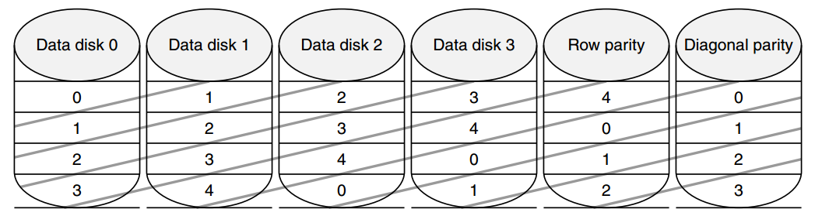
Row-Diagonal Parity Algorithm
RDP: Built on RAID-4 or RAID-5
Based on p, prime number > 2
P + 1 disks, p-1 data disks
Example: p = 5
Use XOR for parity
Figure shows diagonal of each block
Note: No parity for diagonal 4

Slide 49
Row-Diagonal Parity Algorithm
Intuition:
Row parity not useful for initial reconstruction
Each diagonal misses 1 disk (e.g., disk 2 doesn’t have diag 1), all diagonals miss different disk --> two diagonal parities not yet useful, but two touch just one “bad” disk

Slide 50
Row-Diagonal Parity Algorithm
0 not used

Slide 51
Row-Diagonal Parity Algorithm
2 not used

Slide 52
Row-Diagonal Parity Algorithm
Use row parity

Slide 53
Row-Diagonal Parity Algorithm
Use diagonal parity…

Slide 54
Row-Diagonal Parity Algorithm
Use row parity…
Same reconstruction occurs simultaneously across all RDP stripes

Slide 55
Performance Issues
Read performance is unaffected
How to best perform large sequential writes?
Write p-1 stripes at once for best performance (update row and diagonal parity at same time)
Partial stripe writes: Use combination of additive and subtractive

Slide 56
RDP over multiple raid groups
D0 | D1 | D2 | D3 | D4 | P | Da | Db | Dc | Dd | P | DiagP
0 | 1 | 2 | 3 | 4 | 5 | 6 | 7 | 8 | 9 |  | 0
1 | 2 | 3 | 4 | 5 | 6 | 7 | 8 | 9 |  | 0 | 1
2 | 3 | 4 | 5 | 6 | 7 | 8 | 9 |  | 0 | 1 | 2
3 | 4 | 5 | 6 | 7 | 8 | 9 |  | 0 | 1 | 2 | 3
4 | 5 | 6 | 7 | 8 | 9 |  | 0 | 1 | 2 | 3 | 4
5 | 6 | 7 | 8 | 9 |  | 0 | 1 | 2 | 3 | 4 | 5
6 | 7 | 8 | 9 |  | 0 | 1 | 2 | 3 | 4 | 5 | 6
7 | 8 | 9 |  | 0 | 1 | 2 | 3 | 4 | 5 | 6 | 7
8 | 9 |  | 0 | 1 | 2 | 3 | 4 | 5 | 6 | 7 | 8
9 |  | 0 | 1 | 2 | 3 | 4 | 5 | 6 | 7 | 8 | 9
12 disks
P = 11
Multiple parity blocks per row
Protect against single failures in group
Use diagonal parity for double failures in group

Slide 57
Write Performance: Measured
Alg | G(d+p) | Rate MB/s | Data Disks | Total Disks | Worst case? | Best case?
RAID-4 | 6x(7+1) | 158.3 | 42 | 48 | 1 | 6
RDP | 6x(7+2) | 149.1 | 42 | 54 | 2 | 12
RDP | 4x(10+2) | 155.1 | 40 | 48 | 2 | 8
RDP | 3x(14+2) | 157.2 | 42 | 48 | 2 | 6

Slide 58
Write Performance: Measured
Alg | G(d+p) | Rate MB/s | Data Disks | Total Disks | Worst case? | Best case?
RAID-4 | 6x(7+1) | 158.3 | 42 | 48 | 1 | 6
RDP | 6x(7+2) | 149.1 | 42 | 54 | 2 | 12
RDP | 4x(10+2) | 155.1 | 40 | 48 | 2 | 8
RDP | 3x(14+2) | 157.2 | 42 | 48 | 2 | 6

Slide 59
RDP Conclusions
Many RAID-6 encoding schemes for handling multiple disk failures beyond RDP
Applicable to distributed storage as well
Range from theoretical to practical
Neat focused implementation problem to optimize reconstruction
RDP on practical end; relatively straight-forward to implement
Used in NetApp products

Slide 60
CS 736: Advanced Operating Systems Andrea Arpaci-Dusseau Lecture 5: Workload characterization (iBench) + Archival storage (Snapmirror, Venti, Data Dedup)
iBench: How can you use data in paper to answer different questions?
Resume small group discussions using Canvas for Q&A;
30 minutes to finish “Quiz”; submit quiz; use that time to discuss “answers” in Canvas if desired
Archival storage: Techniques used in SnapMirror, Venti, DataDedup
CoW file systems, fingerprints, bloom filters, locality, caching
Questions now available in Canvas; cover less formally without slides…
Tuesday: Read 1 FAST paper – Caching: ARC
Reading Groups: Meet with same set for 1 more week
Project 1 (due <2 weeks): TA session recorded; work with project group if desired! (compile same Linux version)
Notes:
Goal: Get everyone to speak to class in first two lectures; don’t want long-winded opinions in this course, but do want people to talk and show they are involved and what they understand
Do I have about 50 straight-forward questions in here?
Questions in this lecture today arerather straight-forward and don’t even correspond exactly to reading, so don’t have to feel bad if you do or don’t know answers.
I’m not going to track who talks today, this is really for your benefit so you feel comfortable.

Slide 61

A file is Not a file: Understanding the I/O Behavior of Apple Desktop Applications
Tyler Harter, Chris Dragga, Michael Vaughn,
Andrea C. Arpaci-Dusseau, Remzi H. Arpaci-Dusseau
Department of Computer Sciences
University of Wisconsin-Madison
SOSP '11 Proceedings of the ACM Symposium on Operating Systems Principles

Slide 62
Why this paper?
Meta-issues
Best Paper from SOSP’11
Paper from UW-Madison
Technical Contributions
Many thorough measurements about current desktop workloads
Low-level data plus high-level summary observations
Incentive to think about implications for future file systems

Slide 63
Why study desktop applications?
Measurement drives file-system design
file systems must decide how to optimize
Great history - many past I/O studies
SOSP ’81: M. Satyanarayanan. A Study of file Sizes and Functional Lifetimes.
Influenced AFS and Code (read later)
SOSP ’85:, Ousterhout et al. A Trace-Driven Analysis of Name and Attribute Caching in a Distributed System.
SOSP ’91: M. Baker et al. Measurements of a Distributed System.
SOSP ’99: W. Vogels. file system usage in Windows NT 4.0.
There is still uncharted territory
Little focus on home users
Little focus on individual applications
More study can inform the design of the next generation of file systems

Slide 64
A case study: saving a document
Application: Pages 4.0.3
From Apple’s iWork suite
Document processor (like MS Word)
One simple task (from user’s perspective):
Create a new document
Insert 15 JPEG images (each ~2.5MB)
Save to the Microsoft DOC format

Slide 65






iBench Task Suite
iLife suite (multimedia)
iPhoto 8.1.1
iTunes 9.0.3
iMovie 8.0.5
iWork (like MS Office)
Pages 4.0.3 (Word)
Numbers 2.0.3 (Excel)
Keynote 5.0.3 (PowerPoint)
Automate 34 typical tasks: Importing photos, playing songs, editing movies,
typing documents, making charts, displaying a slideshow
Collect I/O traces : Use DTrace to instrument kernel
System-call level traces reveal application behavior
Record I/O events: open, close, read, write, fsync, etc.

Slide 66
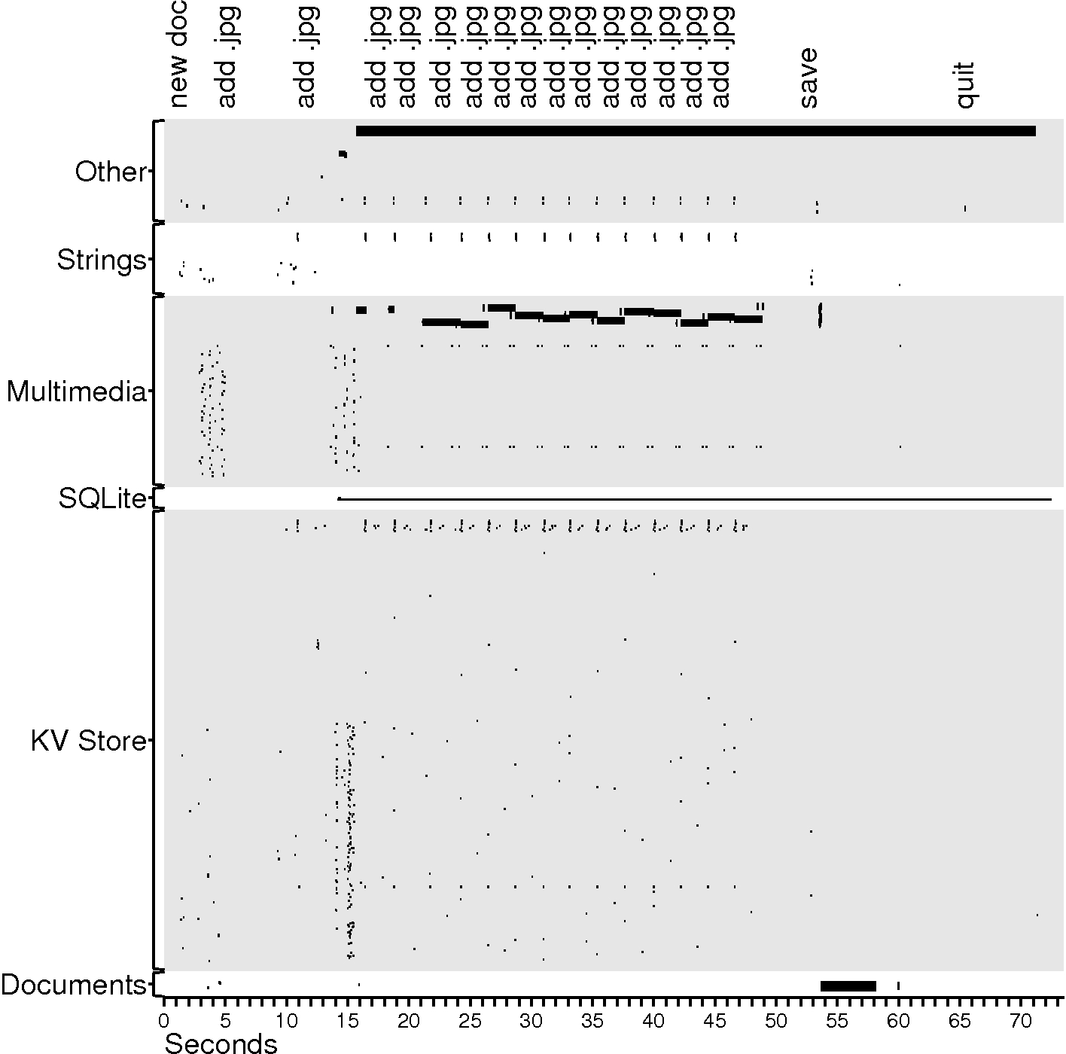
files
small I/O
big I/O

Slide 67
Case study observations
Auxiliary files dominate
Task’s purpose: create 1 file; observed I/O: 385 files are touched
218 KV store files + 2 SQLite files:
Personalized behavior (recently used lists, settings, etc)
118 multimedia files:
Rich graphical experience
25 Strings files:
Language localization
17 Other files:
Auto-save file and others

Slide 68
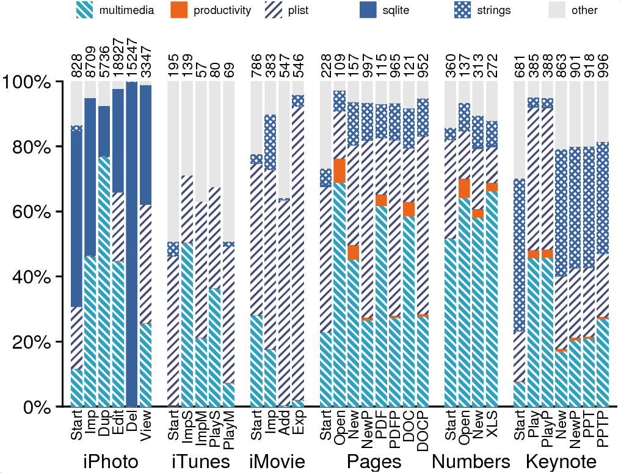
Files opened

Slide 69
General observations
Auxiliary files dominate
Lots of helper files
With hundreds of helper files, how can we minimize disk seeks?

Slide 70
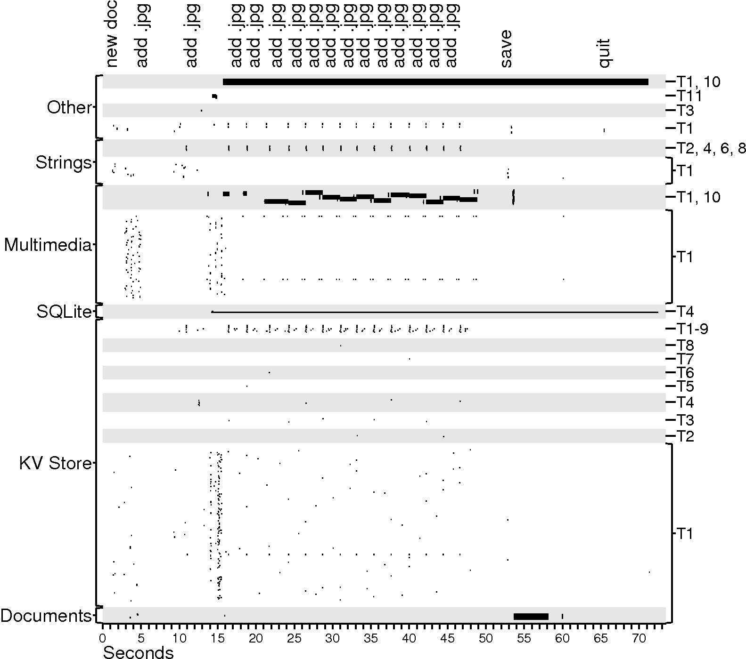
files
Threads
small I/O
big I/O

Slide 71
Case study observations
Auxiliary files dominate
Multiple threads perform I/O
Interactive programs must avoid blocking

Slide 72
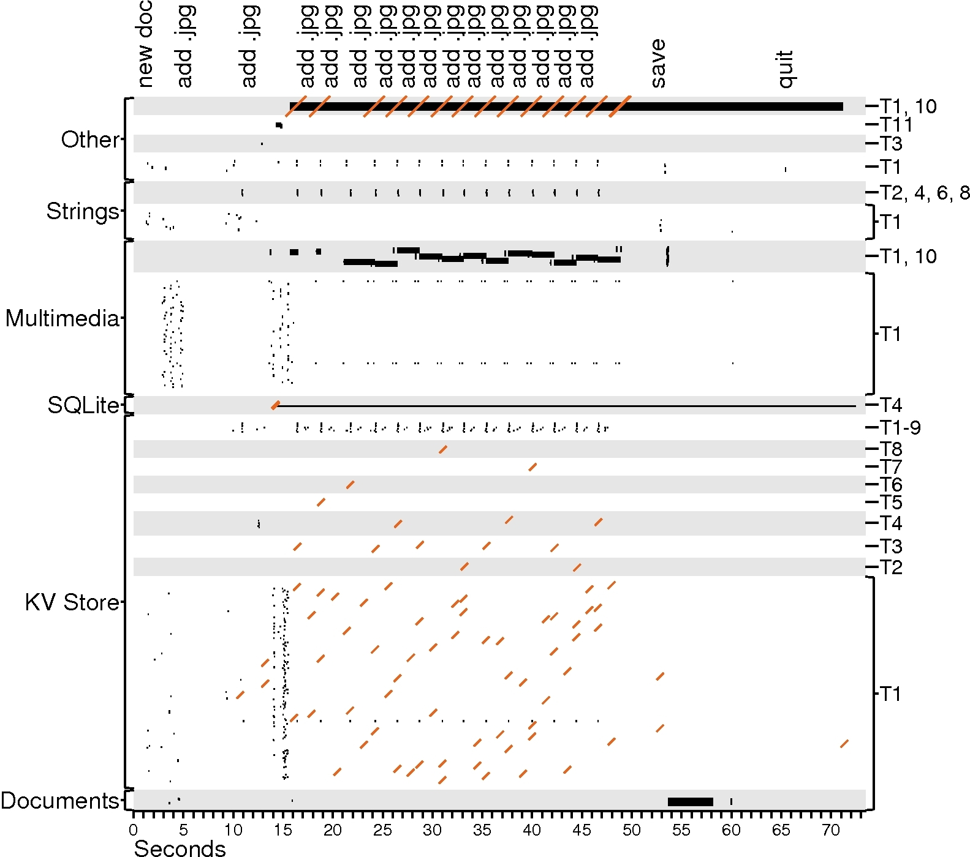
files
Threads
small I/O
big I/O
fsync

Slide 73
Case study observations
Auxiliary files dominate
Multiple threads perform I/O
Writes are often forced
KV-store + SQLite durability
Auto-save file

Slide 74
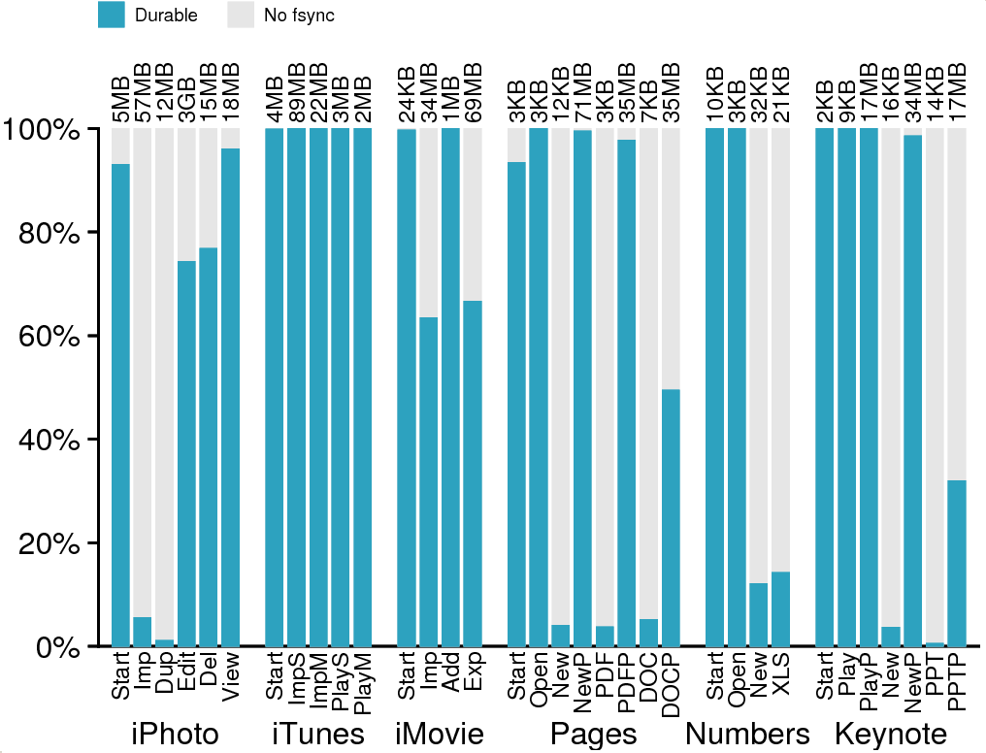
Write I/O bytes

Slide 75
General observations
Writes are often forced
Renders write buffering ineffective
Can hardware help?
What do applications need? Durability? Ordering?

Slide 76
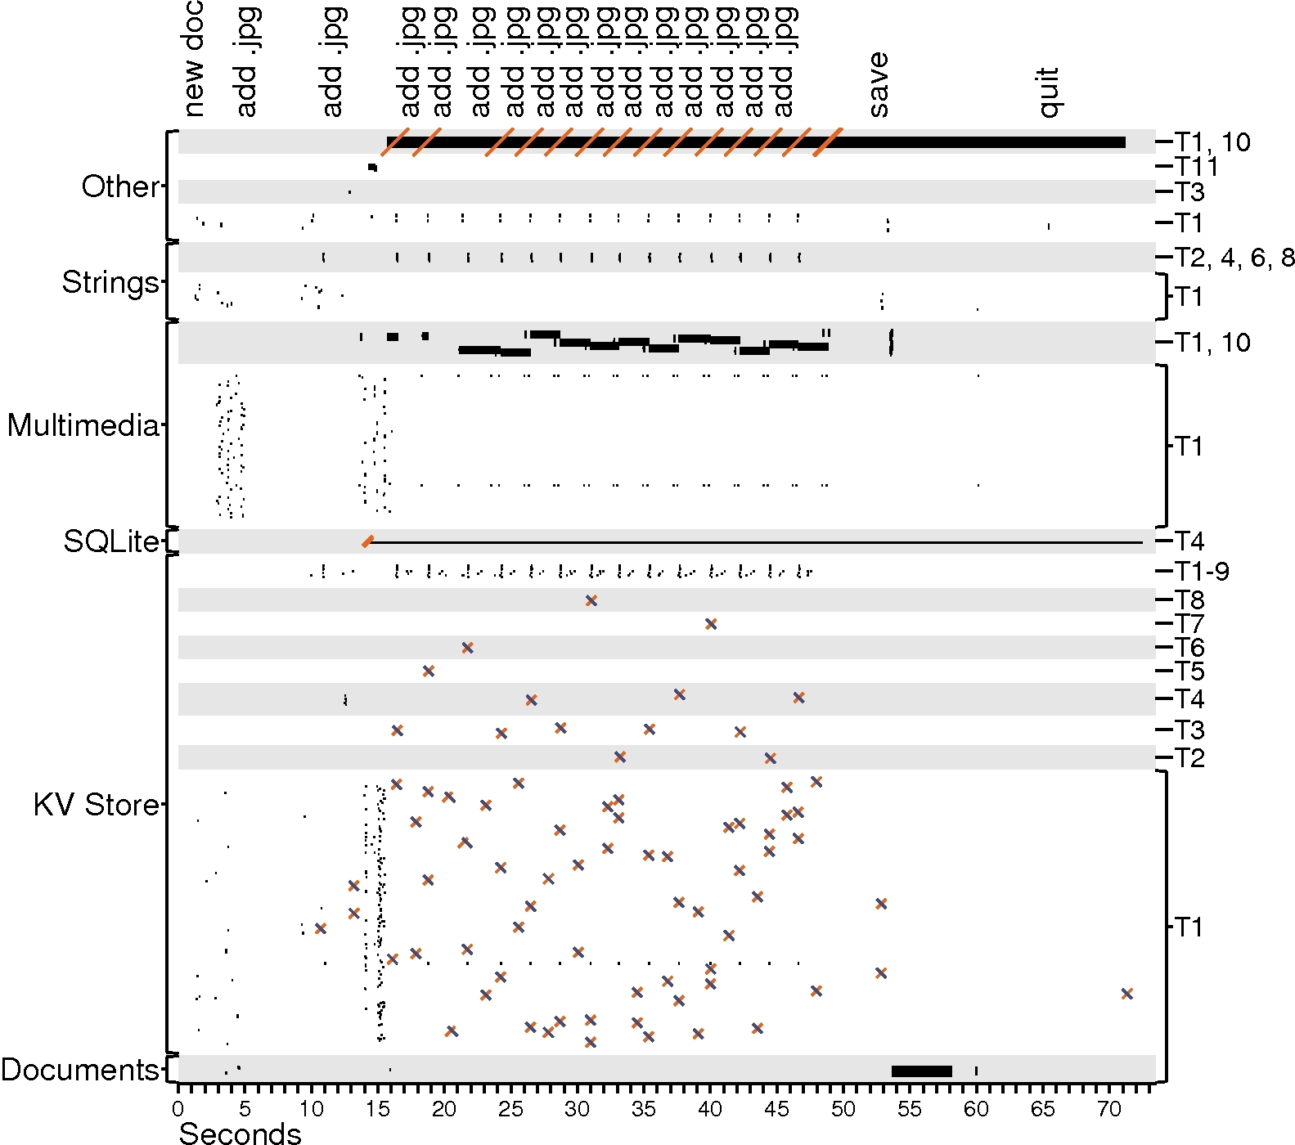
files
Threads
small I/O
big I/O
fsync
rename

Slide 77
Case study observations
Auxiliary files dominate
Multiple threads perform I/O
Writes are often forced
Renaming is popular
Often used for key-value store
Makes updates atomic

Slide 78
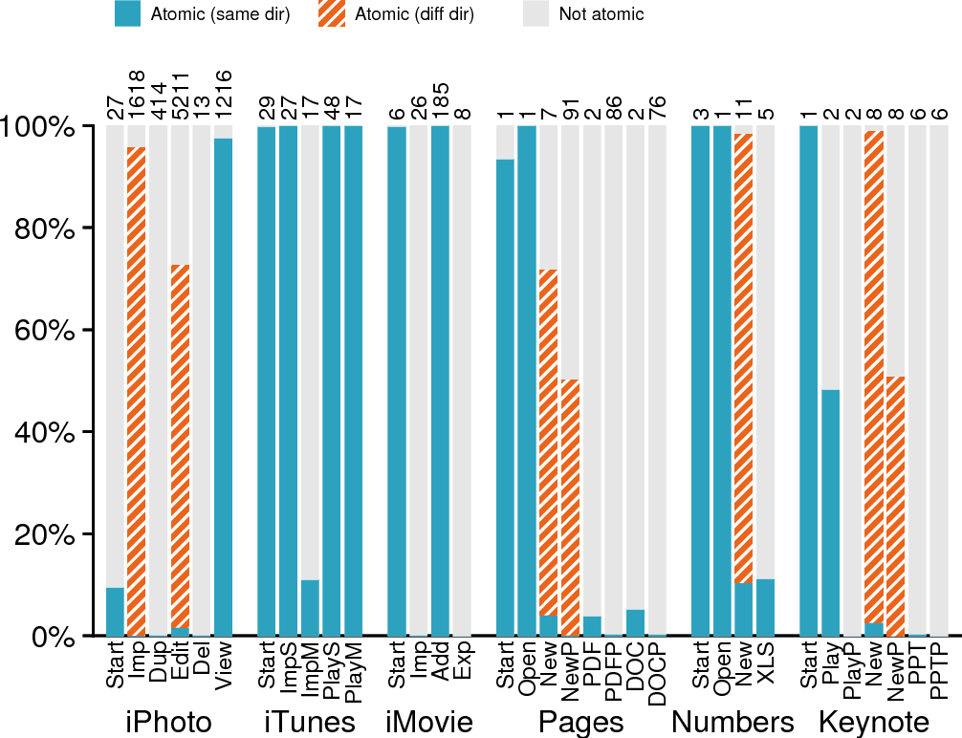
Locality
Implications
Write I/O bytes

Slide 79
General observations
Renaming is popular
How should directory-locality heuristics adapt?
Do we need atomicity APIs?

Slide 80
files
Threads
small I/O
big I/O
fsync
rename

Slide 81
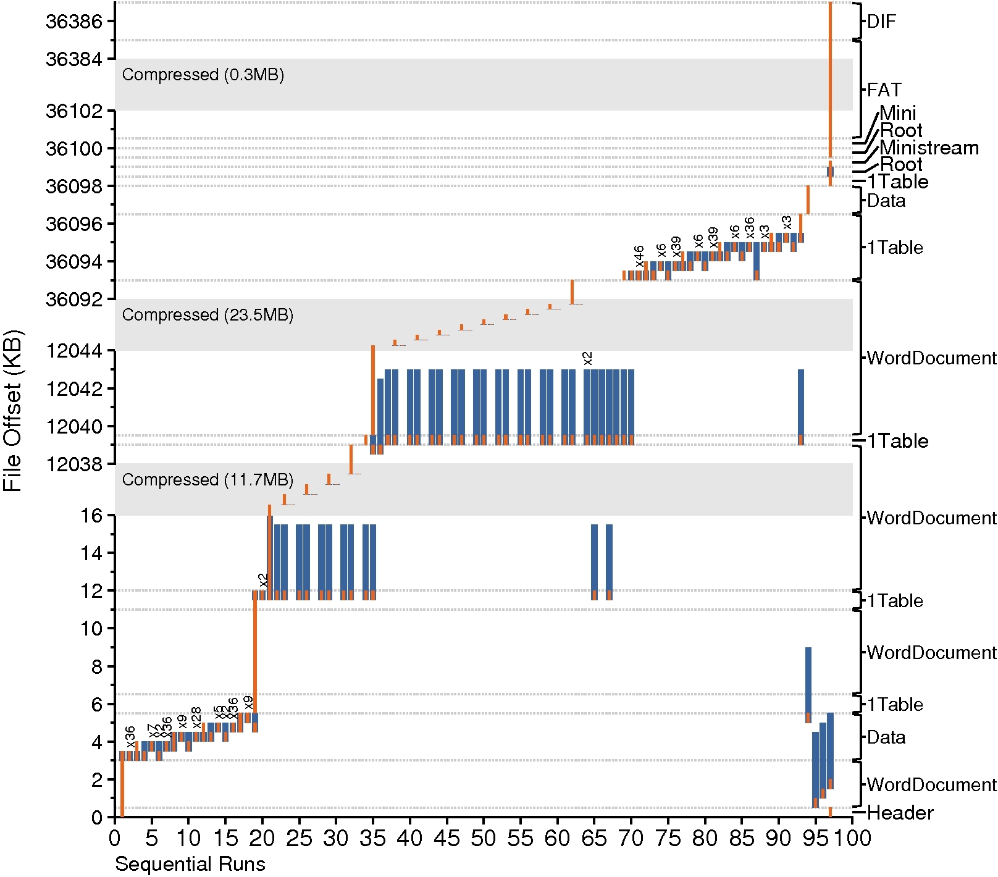
Writing the
DOC file
read
write

Slide 82
Case study observations
Auxiliary files dominate
Multiple threads perform I/O
Writes are often forced
Renaming is popular
A file is not a file
DOC format is modeled after a FAT file system
Multiple “sub-files”
Application manages space allocation

Slide 83
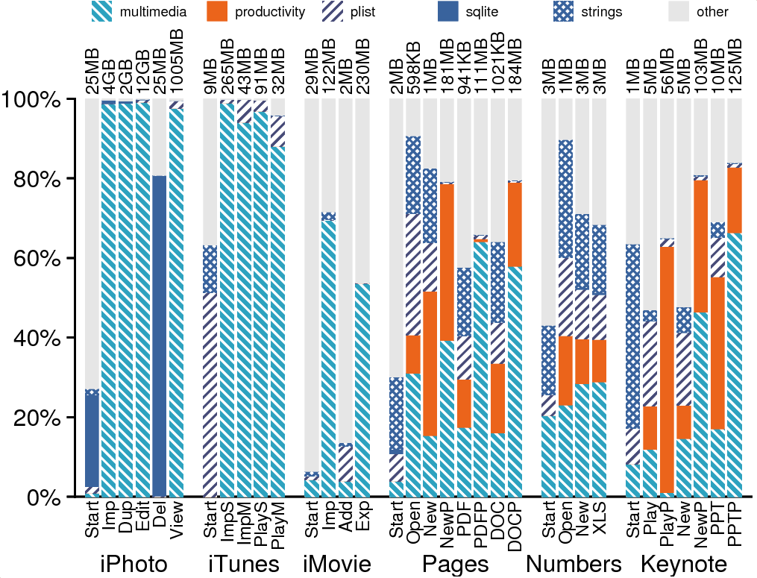
Mostly Complex
files
files, (weighted by I/O)

Slide 84
General observations
A file is not a file
Complex files have a significant presence
Should file system be aware of structure within a file?
How can file system allocate space for sub files in complex files?

Slide 85
Writing the
DOC file
read
write

Slide 86
Case study observations
Auxiliary files dominate
Multiple threads perform I/O
Writes are often forced
Renaming is popular
A file is not a file
Sequential access is not sequential
Multiple sequential runs in a complex file => random accesses

Slide 87
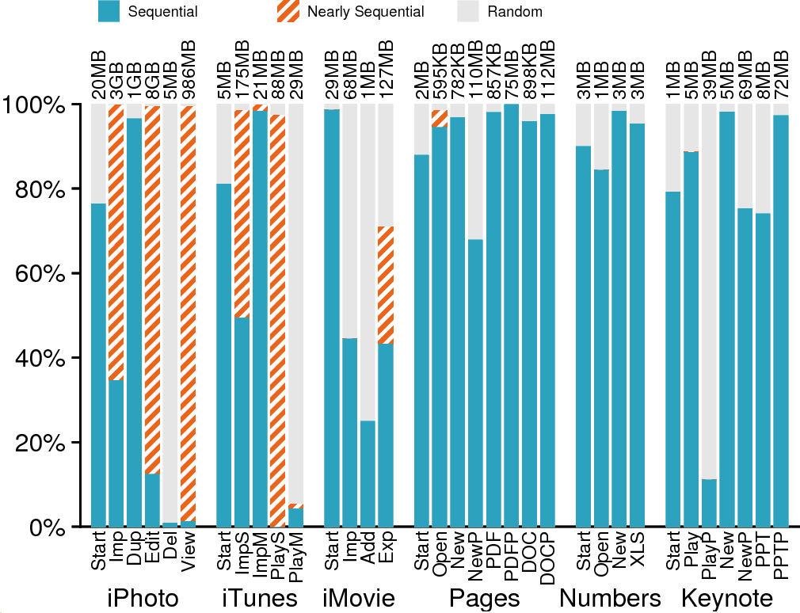
Prefetching
Implications
Read I/O bytes

Slide 88
General observations
Auxiliary files dominate
A file is not a file
Sequential access is not sequential
How can we prefetch intelligently based on patterns?

Slide 89
Writing the
DOC file
read
write

Slide 91
Case study observations
Auxiliary files dominate
Multiple threads perform I/O
Writes are often forced
Renaming is popular
A file is not a file
Sequential access is not sequential
Frameworks influence I/O
Example: update value in page function
Cocoa, Carbon are a substantial part of application

Slide 92
Conclusion: how has the world changed?
In the past, applications:
Used the file-system API directly
Performed simple tasks well
Chained together for more complex actions
Today, we see:
Applications are graphically rich, multifunctional monoliths
“#include <Cocoa/Cocoa.h> reads 112,047 lines from 689 files” ~ Rob Pike ‘10
They rely heavily on I/O libraries
Application
file System
Developer’s Code
Cocoa, Carbon,
and other frameworks
file System

