Slide 1
Announcements
Mini-Project 1: Sanity-checking grades; will release very soon
Mini-Project 2:
A wide range of reported progress
Extend deadline to Monday night (from Friday night)
Will release project report details soon
Midterm Exam
Yes, it was very time-constrained
Numerical grades may be low, but letter grades at end of semester are generous
Final exam: Must be on zoom to hear announcements
Reading Groups
Please continue; if want to form new group, please do; if want introductions, please ask

Slide 2
Scheduler Activations: Effective Kernel Support for the User-Level Management of Parallelism
Anderson, T., Bershad, B., Lazowska, E., and Levy, H. ACM Transactions on Computer Systems, Vol. 10, No. 1, February 1992, pp. 53-79.

Slide 3
Why reading this paper?
Problem Area:
Important to handle high-concurrency workloads
Good explanation of issues of user and kernel-level threads
Good example of problems that occur when information and control is distributed across different layers

Slide 4
Background
What are some advantages of user-level threads (vs. kernel-level only)?
Fast thread management operations, including context-switches
Don’t enter kernel
No protection switch across threads
No checking of parameters
Flexible – specific policy for application
No cost for features not needed for specific application
Simpler policies, such as non-preemptive
Operation | User-level Threads | Kernel-level Threads | Ultrix Processes
Null fork | 34 us | 948 us | 11.3 ms
Signal-wait | 37 us | 441 us | 1.84 ms

Slide 5
Background
What are some problems with user-level threads (when implemented on kernel-level threads)?
Kernel threads block and are preempted without notifying user
If user-level thread blocks (page fault or I/O), lose kernel thread
Common solution?
Create more kernel threads than physical processors
If one kernel thread blocks, more are available
Problem?
With many, OS determines which thread runs, extra context switches
Kernel threads scheduled obliviously to user-level thread state
Preempted user-level thread could hold lock, others uselessly spin-wait

Slide 6
Scheduler Activations
Approach?
Each application given virtual multiprocessor
Applications? What info do they need to be given?
How many and which processors it has
what do they control?
Complete control over which threads run on which processor
OS? What info does OS need to be given?
Know how many processors would be useful to each application (overly simplified…)
what does OS control?
Complete control over which processors are given to which application
Vectored events from OS allows user-level thread system to reconsider its scheduling decisions

Slide 7
Scheduler Activation: Three Roles
Vessel (execution context) for running user-level threads
User-level stack and kernel stack
Just like kernel thread
Notifies user-level thread system of kernel events
Provides space in kernel to save context when thread is stopped by kernel (similar to thread or process control block, PCB)

Slide 8
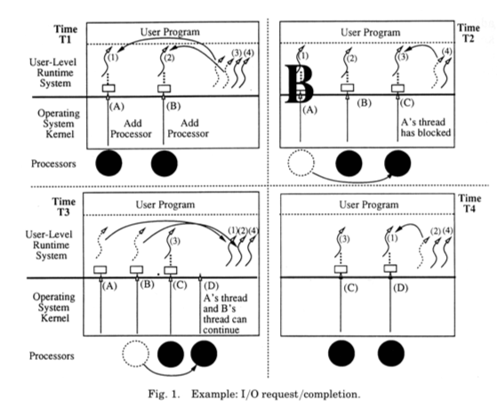
What is happening in 4 time periods?
Can user-level library always schedule the thread it desires?
No -- T3: Higher-priority thread preempted (t2 instead of t3)
Wants t1 and t2 to run
What interface is needed to fix this?
Tell OS to preempt specific SA
Notes:
T1: add two processors, user-level library picks two threads
T2: Thread 1 on SA A blocks, notified of that with a new SA C; library picks to run t3 on SA C
T3: Thread 1 finishes I/O, to notify, take SA from B anduse SA D to tell library both 1 and 2 can continue
T4: Use SA D to run t1

Slide 9
Implement threads on scheduler activations…
What does your library need to do on thread_create()?
Add new thread to ready list (user-level structure)
Maybe tell kernel “add more processors”
How might the kernel respond and then the library?
Could ignore
Could upcall to lib “add this processor”
Library: Pick ready thread, load thread state into SA, let run
When might library avoid interacting with the kernel?
Avoid interactions if costly overhead…
Lib does not ask for more process if outstanding request for more

Slide 10
Thread library continued…
What does your library do in thread_exit()?
Free old thread in user-level thread list
Put new thread from user-level ready list on that SA
When will your library interact with the kernel?
If no threads on ready queue, tell kernel “processor idle”

Slide 11
Thread library continued…
What happens if processor is removed from your application?
Receive “processor has been preempted” upcall
Must use processor to send upcall, so TWO threads are preempted
How should the user-level thread library respond?
Library chooses which of two threads to continue
What will happen if last processor is removed?
Can’t notify at that time, must wait until have processor added again
Why not just skip notification completely?
Library may want to know which processors it has been allocated

Slide 12
Critical Sections
What is bad about preempting threads in critical sections?
Next thread trying to acquire lock wastes CPU spin-waiting
Straight-forward approach to ensure this doesn’t happen?
Thread manager: don’t preempt threads in critical sections
Set flag in c.s.; when want to preempt, check flag before switching and allow to continue if in c.s.; mark wanted to preempt
When done with every c.s., check if wanted to preempt, if so, go to library to preempt
Problems: Slows down every critical section in common case
How does their implementation make this case fast? (Neat detail…)
Make copy of all low-level critical sections; modify copy so returns control to library
When want to preempt, check if in known PC range for critical section
If yes, run copy instead…

Slide 13
Future Work
Can we apply scheduler activations to other resources?
Apply to other concurrency models (e.g., events, SEDA) besides threads?

Slide 14
Conclusion
Neat idea for multithreaded applications to manage their own resources
Unsolved problems
How to determine how many processors to give to each application?
How to use scheduler activations with events and SEDA architecture?
Variations have been implemented, but not maintained
Kernel-thread pools work fairly well for wide variety of applications

