Slide 1
Dynamic Software Updates for Java: A VM-Centric Approach
Suriya Subramanian, Michael Hicks and Kathryn S McKinley

Slide 2
Motivation
Software is imperfect
Bug fixes, new features modify deployed systems
Halting deployed system
  Safety concerns
  Revenue loss

Slide 3
Solutions
Load-balancing
  Not general purpose
  Requires redundant hardware
Dynamic software updating (DSU)

Slide 4
DSU requirements
Safe
Flexible
Efficient

Slide 5
Current state of the art
Significant progress towards practical DSU for C and C++ --- server upgrades, OS upgrades
Work on DSU for managed languages lags behind
  Too simplistic
  Impose high overhead during normal execution
  Not on realistic applications

Slide 6
Jvolve
Dynamic Software Updating (DSU) system for Java
Built into JikesRVM
Modest extensions to existing VM features
Imposes no additional overhead

Slide 7
Outline
Introduction
Updating model in Jvolve
VM-supported DSU
Applications
Conclusion

Slide 8
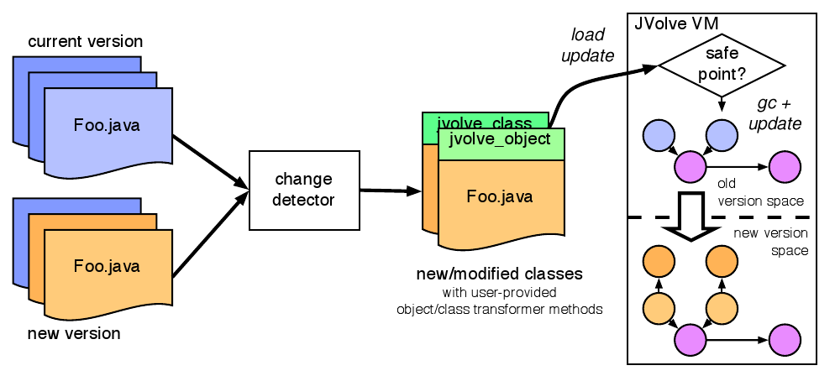
Updating model - Developer's view

Slide 9
Jvolve update model
Code
  Old code before the update
  New code after the update
Data
  Representation consistency (all values of a type correspond to latest version)
  Invoke a transformation function to convert object from old version to new version

Slide 10
Supported updates
Changes to body of a method
Class signature updates
  Add, remove, change the type signature of fields and methods
Changes can occur at any level of class hierarchy
Supports common refactorings

Slide 11
Example of a change
public class User {
private String username, domain, password;
private EmailAddress[] forwardAddresses;
private String[] forwardAddresses;
public void getForwardedAddresses() { ... }
public void setForwardedAddresses(String[] f) {...}
}
public class ConfigurationManager {
private User loadUser(...) {
...
User user = new User(...);
String[] f = ...;
EmailAddress[] f = ...;
user.setForwardedAddresses(f);
return user;
}
}

Slide 12
Object transformers
public class v_1_3_1_User {
private String username, domain, password;
private String[] forwardAddresses;
}
public class User {
...
public static void jvolve_class() { ... }
public static void jvolve_object(User to, v_1_3_1_User from) {
to.username = from.username;
to.domain = from.domain;
to.password = from.password;
to.forwardAddresses = null;
}
}

Slide 13
Object transformers
public class v_1_3_1_User {
private String username, domain, password;
private String[] forwardAddresses;
}
public class User {
...
public static void jvolve_class() { ... }
public static void jvolve_object(User to, v_1_3_1_User from) {
to.username = from.username;
to.domain = from.domain;
to.password = from.password;
// Setting forwardedAddresses
int l = from.forwardAddresses.length;
to.forwardAddresses = new EmailAddress[l];
for (int i = 0; i < l; i++) {
to.forwardAddresses[i] =
new EmailAddress(from.forwardAddresses[i]);
}
}
}

Slide 14
Outline
Introduction
Updating model in Jvolve
VM-supported DSU
Applications
Conclusion

Slide 15
VM-supported Update Process
Offline, Update Preparation Tool
Reach a safe point in the VM
Loads and JIT-compiles new classes
Transform objects to conform to new definition

Slide 16
Update Preparation Tool
Identifies changes to class signature (Group A)
  These classes have to be reloaded
  Method and field offsets possibly change
Changes to method bodies (Group B)
  Only method body reloaded and recompiled
  Method's offset does not change
Methods that refer to Group A (Group C)
  Method body recompiled by VM

Slide 17
Safe point for update
Update must be atomic
Updates happen at “safe points” (piggybacking on VM safe points)
Restricts active methods allowed on stack
Simple, non-deterministic
Notes:
Talk about what other approaches do. They have static analysis that decides what points in a method are safe.
Talk about loops

Slide 18
Loading modified classes
Updated classes loaded by dynamic classloader
Replace/update metadata for existing classes, methods
  VM_Class, VM_Method, VM_Field
  Type Information Block (TIB), similar to virtual method table
  Java Table of Contents (JTOC) for static methods

Slide 19
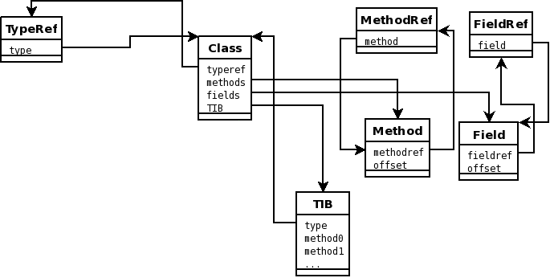
Loading modified classes ...

Slide 20
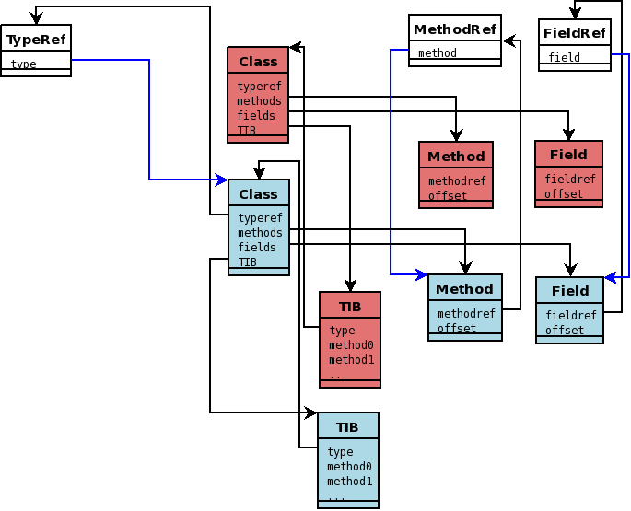
Loading modified classes ...

Slide 21
Transform all objects
Objects updated to refer to new TIB
Allocate space for new version, if necessary
Invoke jvolve_transform() to change state
Implemented on top of Stop-the-world Semispace copying collector

Slide 22
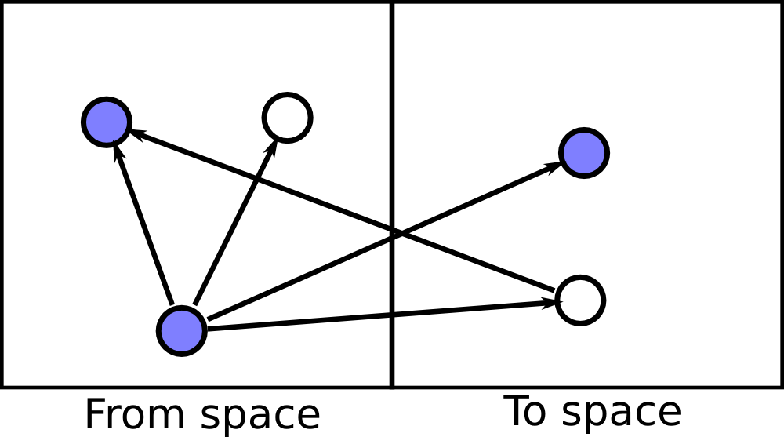
Restrictions on Transformation function
public class User {
...
public static void jvolve_class() { ... }
public static void jvolve_object(User to,
v_1_3_1_User from) {
...
}
}

Slide 23
Future enhancements
Use On Stack Replacement to allow active methods to be updated
Support the Opt-compilier by recognizing changes to inlined methods
Examine other models of DSU, like lazy object updates

Slide 24
Outline
Introduction
Updating model in Jvolve
VM-supported DSU
Applications
Conclusion

Slide 25
Applications
Jetty webserver
  11 versions, 5.1.0 through 5.1.10, 1 ½ years
  45 KLOC
  Did not handle 2 versions
JavaEmailServer, 10 versions, 1.2.1 though 1.4, spanning 2 years (4 KLOC)
  10 versions, 1.2.1 through 1.4, 2 years
  4 KLOC
  Did not handle 1 version

Slide 26
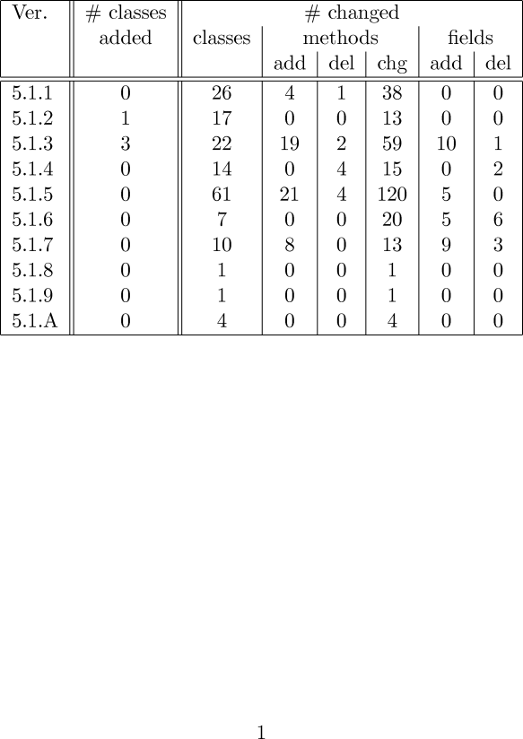
Jetty

Slide 27
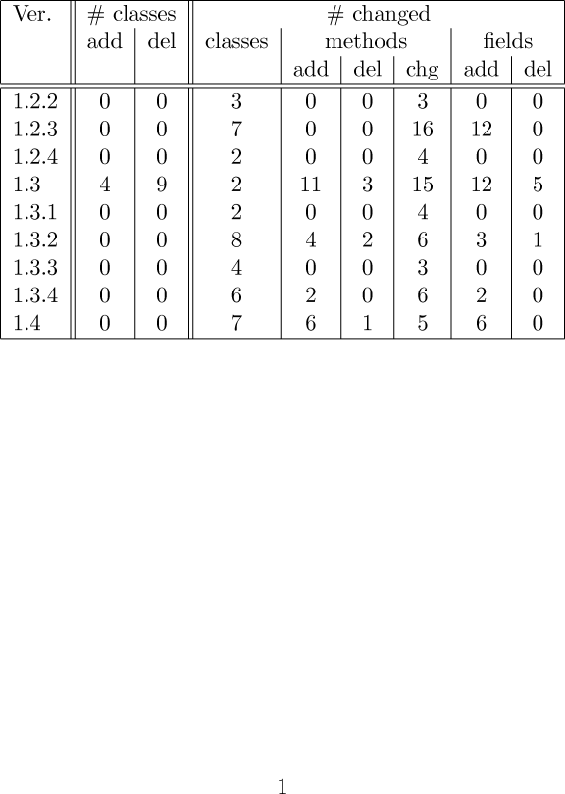
JavaEmailServer

Slide 28
Changes that we could not handle
2 versions of Jetty
  Update preparation tool does not handle changes to anonymous inner classes
1 version of JavaEmailServer
  Update, rewrote the entire configuration framework of the server
  Removed a GUI tool for configuration

Slide 29
Performance overhead
No discernible overhead for normal execution
Only impact on execution time is the update pause time
  Comparable to GC pause time
Experiments on dual P4, 3 GHz, 2GB RAM, running JikesRVM 2.9.1 on Ubuntu

Slide 30
Jetty webserver performance
Used httperf to issue requests
Create 100 new connections / second (Jetty's saturation rate)
5 serial requests to 10 KB file per connection
Compared versions 5.1.9 and 5.1.10

Slide 31
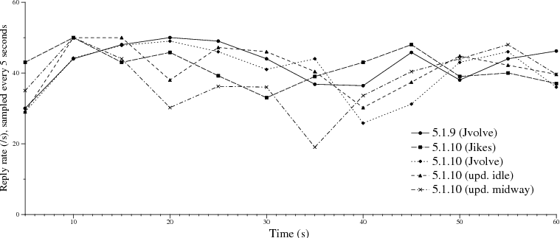
Jetty webserver performance

Slide 32
Jvolve Pause times
Jvolve runs a GC to transform objects
Pause time determined by
  Heap size
  # of objects transformed
Simple microbenchmark varying the # of objects tranformed

Slide 33
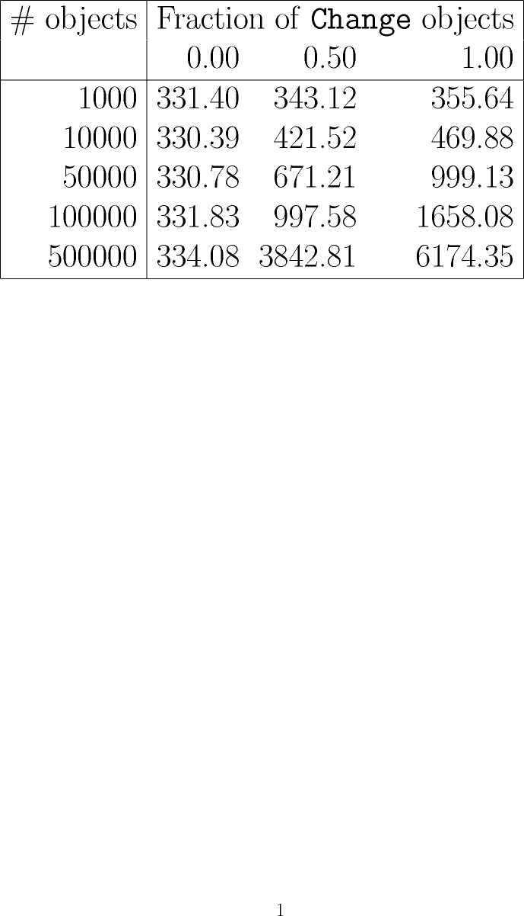
Jvolve Pause times

Slide 34
Outline
Introduction
Updating model in Jvolve
VM-supported DSU
Applications
Conclusion

Slide 35
Conclusion
Jvolve, a VM with support for DSU
Powerful enough to support many common changes in practice
Allowed updates to year-and-a-half's worth of releases of Jetty webserver and Javaemailserver
Builds on top of VM services, no overhead

