Slide 1

Digital logic
Synchronous Sequential Logic Circuit
Chapter 5 Dr. Fei Chao
Associate Professor
Cognitive Science Department
School of Information Science and Technology
Xiamen University
fchao@xmu.edu.cn

Slide 2
Outline:
 Basic concepts sequential logic circuits;
 Analysis and design method of synchronous sequential logic circuit;
 Typical examples.

Slide 3
5 ．1 Introduction
5.1.1 Definition, structure and characteristics of sequential logic circuits
1. Definition
If the stable output signal generated by the logic circuit at any time is not only related to the input signal of the circuit at that moment, but also related to the past input signal of the circuit, it is called a sequential logic circuit.

Slide 4
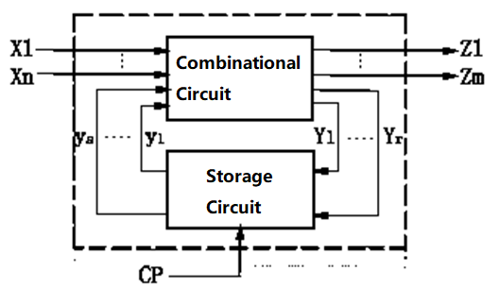
II. Structure
The sequential logic circuit is composed of a combinational circuit and a storage circuit, and the two parts are connected into one whole entity through a feedback loop.
In the figure, CP is a clock pulse signal, and whether it exists depends on the type of the sequential logic circuit.

Slide 5
The state of a sequential logic circuit, y₁,…，y_{s} is the result of the storage circuit remembering the past input signal, which changes with the action of the external signals.
Concepts of the Present State and Next State:
When studying logic circuit’s functions, the state at a certain moment is usually called the “present state"，written as y^{n}，its abbreviation form is y；
In a current state, the new state that arrives after the external signal changes is called the “next state"，written as y^{n+1} .

Slide 6
III. Features
☆The circuit is composed of a combination circuit and a storage circuit, and has a function of memorizing past inputs;
☆A feedback loop is included in the circuit, and the function of the circuit is related to "timing/sequence" through feedback;
☆The output of the circuit is determined by the input and state of the circuit at the time (memory of past inputs).

Slide 7
5. 1 .2 Categories of sequential logic circuits
I. Classified by the working modes of logic circuit
According to the working mode of the circuit, the sequential logic circuit can be divided into two types: (1) synchronous sequential logic circuit and (2) asynchronous sequential logic circuit.
1. Synchronous sequential logic circuit
（1）Features：There is a unified timing signal in the circuit, the memory device uses a clock controlled flip-flop, and the circuit state is simultaneously converted under the control of the clock pulse, that is, the change of the circuit state depends on the input signal and the clock pulse signal.

Slide 8
（2）Present state and next state The present state and the next state in the synchronous sequential circuit are based on a certain clock pulse. Present state--refers to the state of the circuit before the clock pulse acts.
Next state—the state in which the circuit arrives after the clock pulse is applied.
Note：The next state of the previous pulse is the present state of the next pulse!
（3）Requirements of the clock pulse Pulse width: The flip-flop must be reliably flipped;
Pulse frequency: It must be ensured that the circuit pulse response caused by the previous pulse is completely completed before the latter pulse arrives.
2. Asynchronous sequential logic circuit
The storage circuit of the asynchronous sequential logic circuit can be composed of a flip-flop or a delay element. There is no unified clock signal synchronization in the circuit, and the change of the input signal of the circuit will directly lead to the change of the state of the circuit.

Slide 9
II. Classified by input dependent relationships of circuit output
According to whether the output of the circuit is directly related to the input, the sequential logic circuit can be divided into the Mealy type and Moore type, such two types of modes.
1．Mealy types logic circuit: If the output of the sequential logic circuit is a function of the circuit input and the state of the circuit, it is called a Mealy type sequential logic circuit.
2．Moore type logic circuit：If the output of the sequential logic circuit is only a function of the state of the circuit, it is called a Moore-type sequential logic circuit.

Slide 10
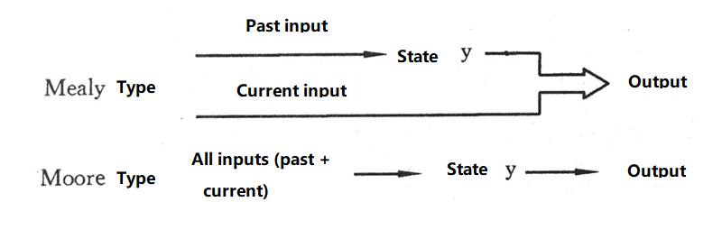
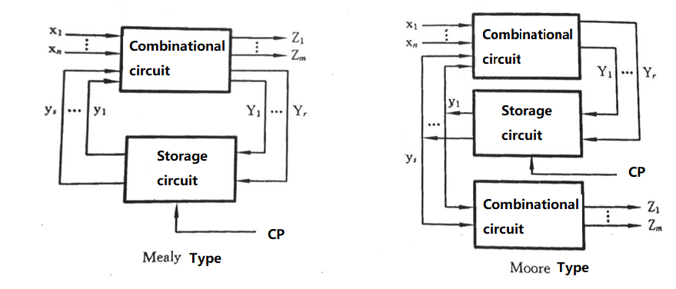

Slide 11
III. Classified by input signal form
The input signal of the sequential logic circuit can be a pulse signal or a level signal. Depending on the form of the input signal, the sequential logic is usually divided into two types: pulse type and level type.

Slide 12
5.1.3 Description method of synchronous sequential logic circuit
I. Logical function expression
The structure and function of the synchronous sequential circuit can be described by three sets of logic function expressions.
1．Output function expression：is a set of expressions that reflect the relationship between circuit output Z and input x and state y.
Z_{i} = f_{i}(x₁，…，x_{n} ,y₁,…，y_{s}) i=1,2,…,m（Mealy type)
Z_{i} = f_{i}(y₁，…，y_{s}) i=1,2,…,m（Moore type）

Slide 13
2．Expression of excitation equation： the excitation equation, also known as control function, it reflects the relationship between the input Y of the memory circuit and the external input x and the circuit state y. Its function expression is Y_{j} = g_{j}(x₁，…，x_{n},y₁,…，y_{s}) j =1,2,…,r
3．Next state function expression：The next state function is used to reflect the relationships between the next state y^{(n+1)} excitation equation Y and circuit present state y，which is related to the flip-flop type. Its function expression is

y _{l}^{n+1} = k_{l}(Y_{j}，y_{l}) j=1,2,…,r ；l =1,2 ,…，s

Slide 14
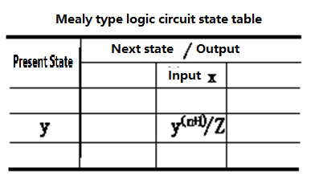
II. state table
State table：A table reflecting the relationship amongst the output Z, next statey^{n+1} and circuit input x, present state y，so it is called state table.
The format of the Mealy type synchronous timing circuit status table is as shown in the following table.
In the table, the number of columns = the number of all combinations of values entered;
The number of rows = The number of state combinations for the flip-flops.

Slide 15
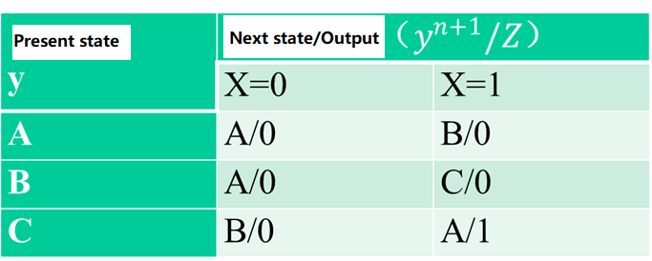
Example of the state table Assume that a state table of a synchronous sequential circuit is as follows

Slide 16
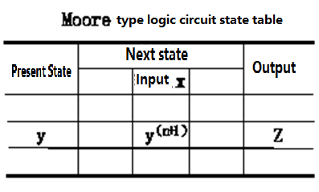
The format of the Moore type circuit status table is shown in the table below.
The state table is a commonly used tool in the analysis and design of synchronous sequential circuits. It clearly shows the state and output of the synchronous sequential circuit under different input and present states.

Slide 17
Example of the Moor type state table
Present State y | Next State |  | Output Z
 | X=0 | X=1
A | C | B | 0
B | B | C | 1
C | B | A | 0

Slide 18
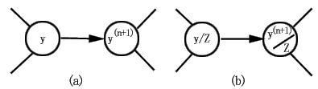
III. State Diagram
State Diagram：is a directed graph that reflects the state transition law of the synchronous sequential circuit and the corresponding input and output values.
The state diagram of the Mealy type circuit is shown in Fig. (a). In the figure, each circle indicates a state; around the directed arrow, we need to list the input and its corresponding output of the input and the state.
x/z
x
The form of the Moore-type circuit state diagram is shown in Figure (b). The circuit output is marked under the state inside the circle, indicating that the output is only related to the state.

Slide 19
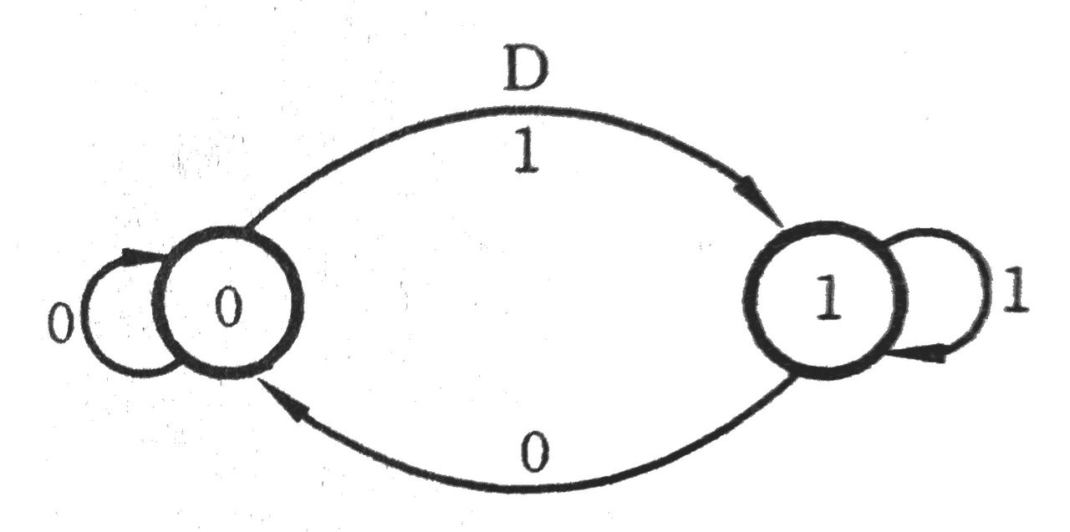
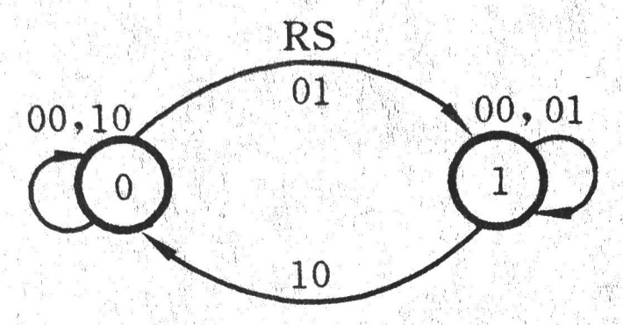
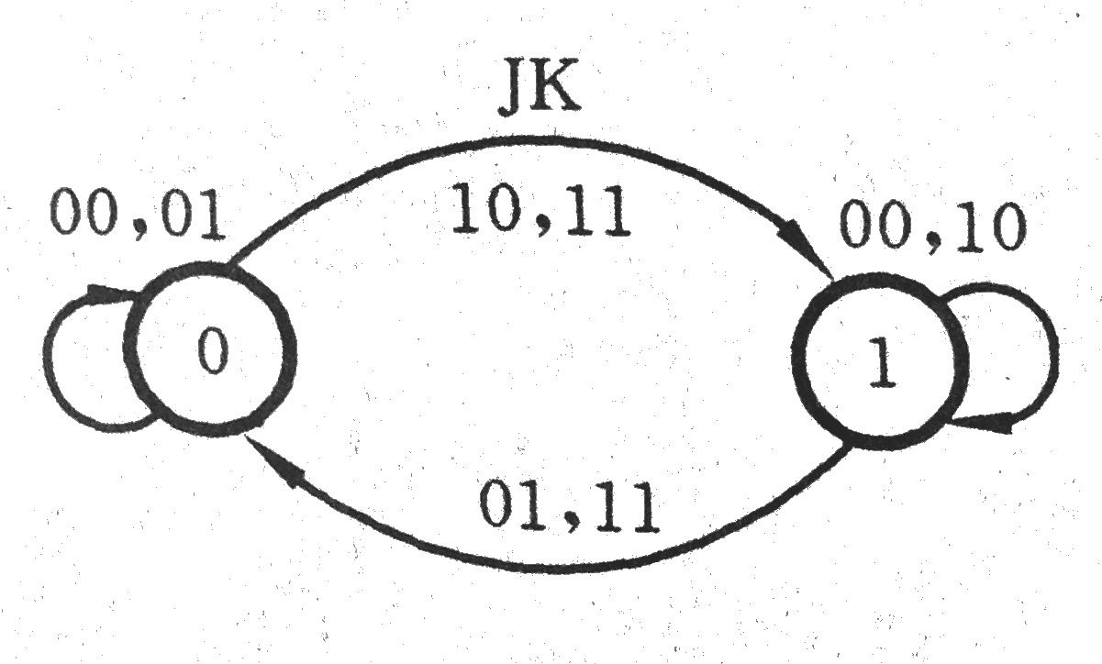
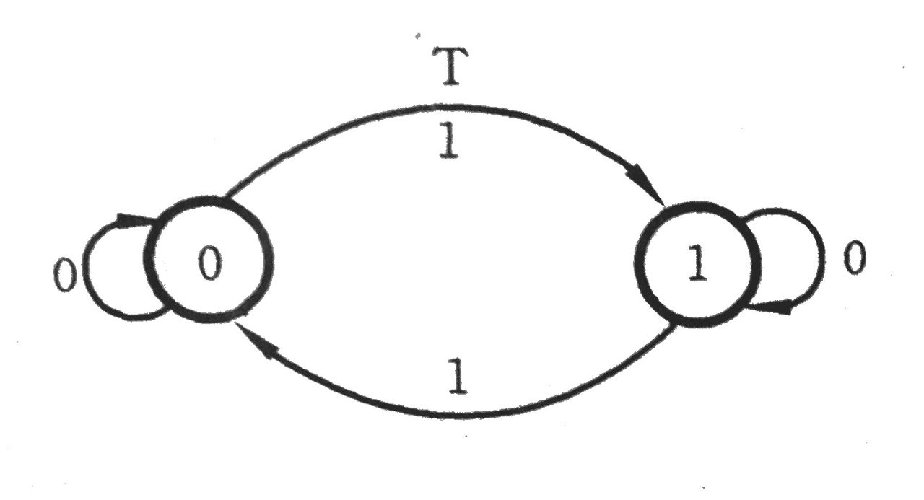
State diagrams of the flip-flops

Slide 20
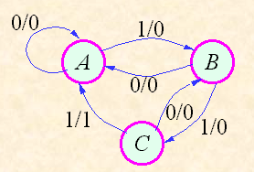
Examples Assume that the state transition table of a synchronous sequential circuit is as follows

Slide 21
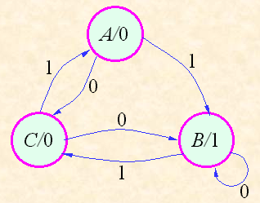
Present y | Next |  | Output Z
 | X=0 | X=1
A | C | B | 0
B | B | C | 1
C | B | A | 0

Slide 22
VI. Timing diagram
The time diagram is a waveform diagram showing the correspondence between the values of the input signal, the output signal, and the circuit state at each time, and is also commonly referred to as an operation waveform diagram. On the time chart, the timing of the circuit state transition can be visually represented.

