Slide 1

Digital logic
Synchronous Sequential Logic Circuit
Chapter 5.2 Dr. Fei Chao
Associate Professor
Cognitive Science Department
School of Information Science and Technology
Xiamen University
fchao@xmu.edu.cn

Slide 2
5.2 Synchronous sequential logic analysis
5.2.1 Analysis methods and steps
Common methods are tabular and algebraic analysis methods
I. General steps of the tabular analysis method
1．List the output function and the excitation function expression.

2．List the circuit state truth table with the flip-flop function table.
3．List the state table and state diagram (take a timing diagram if necessary).

4．Summarize the logic functions of the circuit.

Slide 3
II. General steps of the algebraic analysis method
1．List output function expressions and excitation function expressions.

2．Substitute the excitation function expression into the excitation equation of the flip-flop, and deriving the next state equations of the circuit.
3．List a state table and a state diagram (take a timing diagram if necessary).
4．Summarize the logic functions of the circuit.
It can be seen that the two methods differ only in the second step, and the analysis can be flexibly selected according to specific problems.

Slide 4
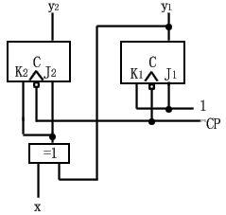
5.2.2 Example
Q: Use the tabular method to analyze the synchronous sequential logic shown in the figure below.
A: The output of this circuit is the state variable, so this circuit is a special case of the Moore type circuit.
1. List the output function and the excitation function expression.
J₁=K₁=1 ；J₂=K₂=x⊕y₁

Slide 5
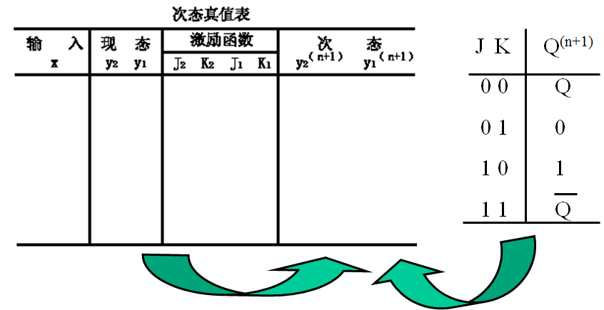
2．List the circuit state truth table with the flip-flop function table.
Next state truth table
Input
Present
Ext. fun.
Next state

Slide 6
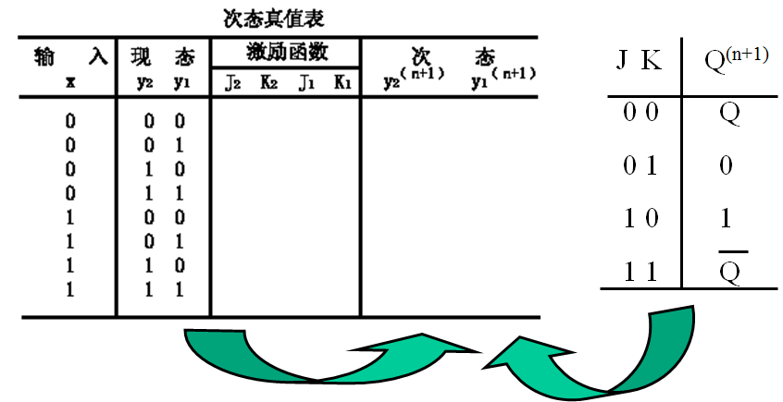
2．List the circuit state truth table with the flip-flop function table.
Next state truth table
Input
Present
Ext. fun.
Next state

Slide 7
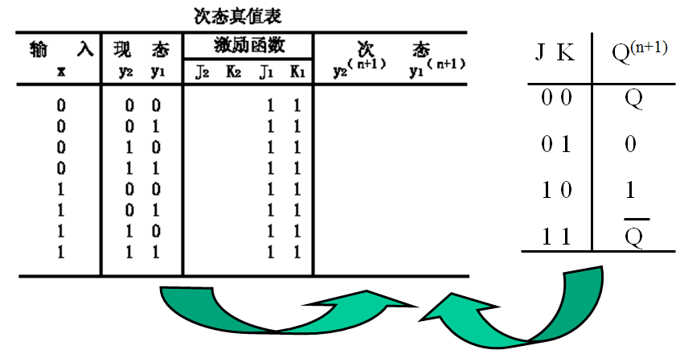
2．List the circuit state truth table with the flip-flop function table.
J₁=K₁=1 ；J₂=K₂=x⊕y₁
Next state truth table
Input
Present
Ext. fun.
Next state

Slide 8
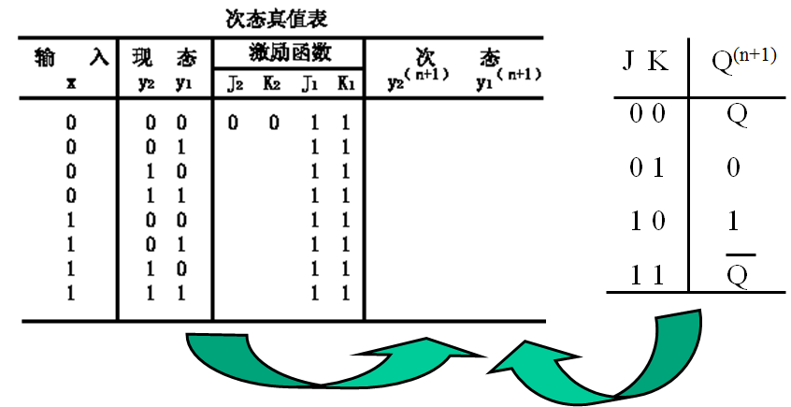
2．List the circuit state truth table with the flip-flop function table.
J₁=K₁=1 ；J₂=K₂=x⊕y₁
Next state truth table
Input
Present
Ext. fun.
Next state

Slide 9

2．List the circuit state truth table with the flip-flop function table.
J₁=K₁=1 ；J₂=K₂=x⊕y₁
Next state truth table
Input
Present
Ext. fun.
Next state

Slide 10
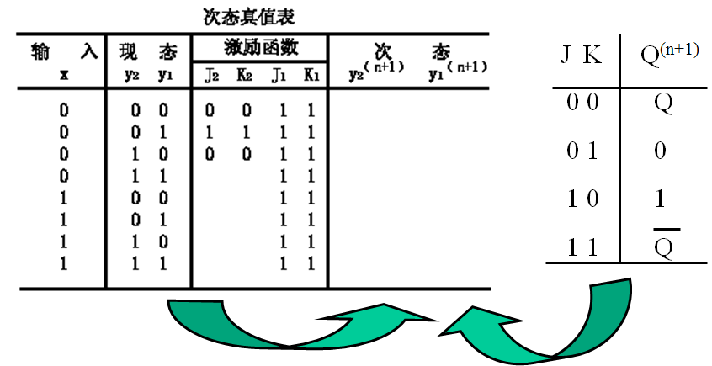
2．List the circuit state truth table with the flip-flop function table.
J₁=K₁=1 ；J₂=K₂=x⊕y₁
Next state truth table
Input
Present
Ext. fun.
Next state

Slide 11

2．List the circuit state truth table with the flip-flop function table.
J₁=K₁=1 ；J₂=K₂=x⊕y₁
Next state truth table
Input
Present
Ext. fun.
Next state

Slide 12

2．List the circuit state truth table with the flip-flop function table.
Next state truth table
Input
Present
Ext. fun.
Next state

Slide 13

2．List the circuit state truth table with the flip-flop function table.
J₁=K₁=1 ；J₂=K₂=x⊕y₁
Next state truth table
Input
Present
Ext. fun.
Next state

Slide 14

2．List the circuit state truth table with the flip-flop function table.
J₁=K₁=1 ；J₂=K₂=x⊕y₁
Next state truth table
Input
Present
Ext. fun.
Next state

Slide 15

2．List the circuit state truth table with the flip-flop function table.
J₁=K₁=1 ；J₂=K₂=x⊕y₁
Next state truth table
Input
Present
Ext. fun.
Next state

Slide 16
2．List the circuit state truth table with the flip-flop function table.
Next state truth table
Input
Present
Ext. fun.
Next state

Slide 17

2．List the circuit state truth table with the flip-flop function table.
Next state truth table
Input
Present
Ext. fun.
Next state

Slide 18
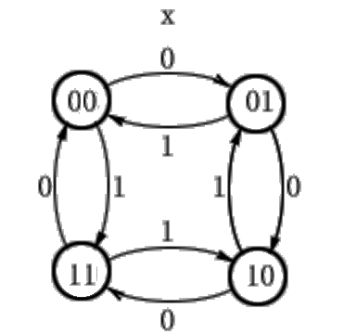
3． List the state table and state diagram
State table
Present state
y₂ y₁
Next State y₂^{(n+1)}y₁^{(n+1）}
X=0
X=1
0 0
0 1
1 0
1 1
0 1
1 0
1 1
0 0
1 1
0 0
0 1
1 0

Slide 19
4．Summarize the logic functions of the circuit.
According to the state diagram, the circuit is a 2-bit binary number reversible counter.
If x=0，the reversible counter performs the increment 1 calculation, the count sequence is
00 01 10 11
If x=1，the reversible counter performs the derement 1 calculation, the count sequence is
00 01 10 11

Slide 20
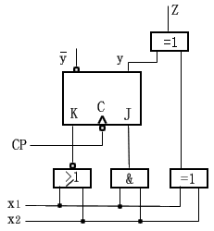
Q: Try to use the algebraic method to analyze the logic function of the sequential logic circuit shown in the figure below.

Slide 21
Q: Try to use the algebraic method to analyze the logic function of the sequential logic circuit shown in the figure below.
A: The circuit consists of a J-K flip-flop and four logic gates.
It has to input x₁and x₂，
an output, Z.
The output Z is directly related to the input and state and belongs to the Mealy type circuit.
1． List output function expressions and excitation function expressions

Slide 22
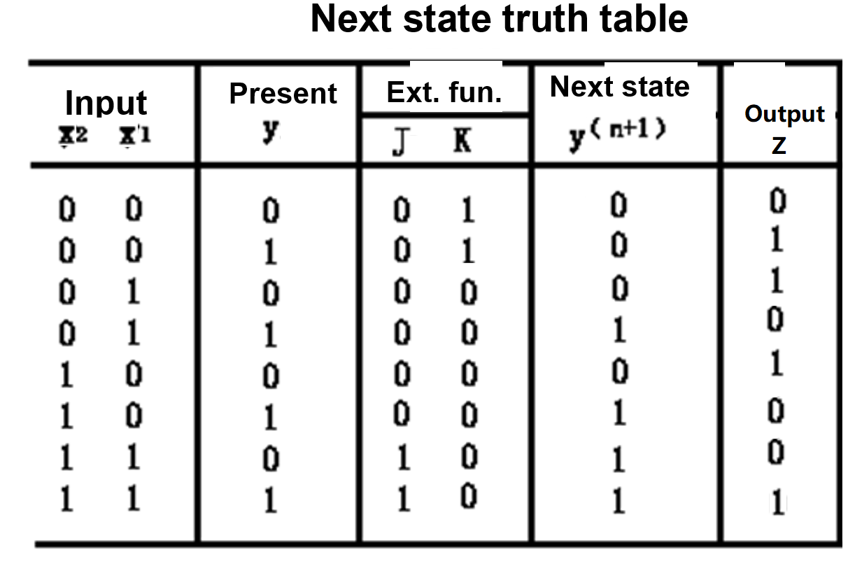
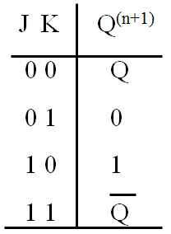
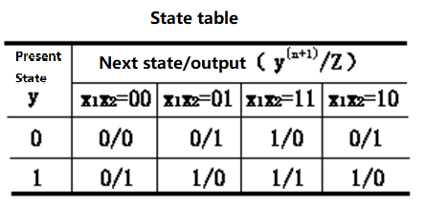

Slide 23
2．Substitute the excitation function expression into the excitation equation of the flip-flop, and derive the next state equations of the circuit.
The circuit’s storage circuit has only one flip-flop, so the circuit has only one next state equation.
According to the next state equation of the J-K flip-flop and the excitation function expression of the circuit, the next state equation of the circuit can be derived as follows:

Slide 24

3．List the state table and state diagrams based on the next state equations and output function expressions
Based on the next state equations and output function expressions ， we can list the state table and state diagrams:
0
1

Slide 25
4． Summarize the logic functions of the circuit.
Assume the initial state of the circuit is“0”，Input array of x₁ is 00110110，input array of x₂ is 01011100. According to the state diagram, the output and state response sequence of the circuit can be as follows:
Clock ticks：1 2 3 4 5 6 7 8
Input x₁： 0 0 1 1 0 1 1 0
Input x₂： 0 1 0 1 1 1 0 0
State y： “0”
Output Z ：
0
1

Slide 26
4． Summarize the logic functions of the circuit.
Assume the initial state of the circuit is“0”，Input array of x₁ is 00110110，input array of x₂ is 01011100. According to the state diagram, the output and state response sequence of the circuit can be as follows:
Clock ticks：1 2 3 4 5 6 7 8
Input x₁： 0 0 1 1 0 1 1 0
Input x₂： 0 1 0 1 1 1 0 0
State y： “0” 0 0 0 1 1 1 1
Output Z ： 0 1 1 0 0 1 0 1
0
1

Slide 27
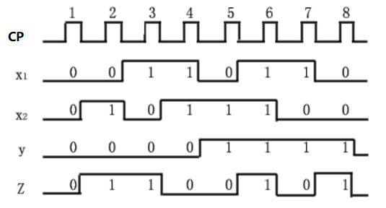
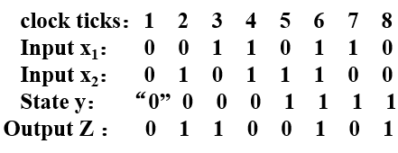
According to the state response sequence, a timing diagram can be made as follows：
Analysis of the timing diagram shows that the circuit implements the function of serial adder, where x₁ is the summand，x₂ is the addend，They are input sequentially in the order of from low position to high position. The carry generated by each addition is saved by the flip-flop to participate in the next addition, and the output Z outputs serial numbers from low to high.

Slide 28
5.3 Design of synchronous sequential logic circuit
The design of the synchronous sequential logic circuit is to design a sequential logic circuit that can realize its logic function according to specific logic requirements. Obviously, design is the inverse of the analysis, i.e.:
Analysis
Logic
circuit
Logic function
Design
The goal of synchronous sequential logic circuit design is to achieve the predetermined logic requirements with as few flip-flops and logic gates as possible!

Slide 29
The general steps of the design are as follows:
1．Draw basic state diagram and basic state table；
2．State reduction，to obtain the reduced state table；
3．State assignment，to obtain the reduced binary state table；
4．Select flip-flops，and find the simplest expression of the excitation function and the output function; ；
5．Draw the logic diagram

Slide 30
5.3.1 Draw basic state diagram and basic state table
The basic state diagram and the basic state table are the most primitive abstractions of the design requirements. Establishing the correct basic state diagram and state table is the most critical step in the design of synchronous sequential circuits.
Generally, the following aspects should be considered when forming the basic state diagram.：
I. Determine the circuit type
Mealy type？ Moore type？
II. Set a initial state 
The state of the sequential logic circuit before the input signal begins to act is called the initial state.

Slide 31
III. Add a new state based on the how much information the circuit must remember

The number of states in the synchronous sequential circuit depends on the amount of information that must be remembered and distinguished.
IV. Determine the output of the circuit at each moment
When establishing the basic state diagram, the output values at each moment must be determined.
In the Moore type circuit, the corresponding output in each state must be indicated;
in the Mealy type circuit, the output value from each state under different inputs must be indicated.

Slide 32
Example: A sequence detector has an input x and an output Z. Input x is a string of random binary codes. When “011” appears in the input sequence, output Z produces a 1 output, usually Z outputs 0. Typical input and output sequences are as follows.
Input x: 1 0 1 0 1 1 1 0 0 1 1 0
Output Z: 0 0 0 0 0 1 0 0 0 0 1 0
Try to make the basic state diagram and the basic state table of the sequence detector.
A: 1. Assumed that the logic function of the sequence detector is implemented by Mealy type synchronous sequential logic circuit.
Assume:
State A------Initial state of the circuit；
State B------ Indicates that the first signal "0" in the sequence "011" has been received;
State C------Indicates that the first two digits of "01" in the sequence "011" have been received;
State D------ Indicates that the sequence "011" has been received.

Slide 33
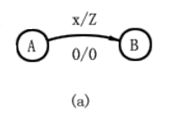
The basic state diagram can be drawn as follows: 0

Slide 34
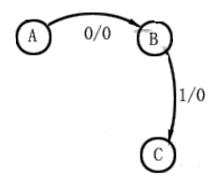
The basic state diagram can be drawn as follows：01

Slide 35
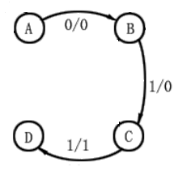
The basic state diagram can be drawn as follows: 011

Slide 36
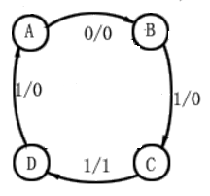
The basic state diagram can be drawn as follows: 011 1

Slide 37
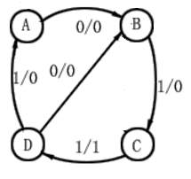
The basic state diagram can be drawn as follows: 011 0

Slide 38
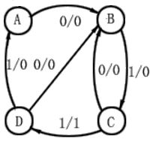
The basic state diagram can be drawn as follows: 010

Slide 39
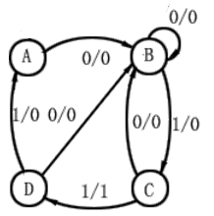
The basic state diagram can be drawn as follows: 00

Slide 40
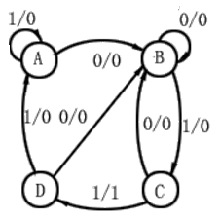
The basic state diagram can be drawn as follows: 1

Slide 41
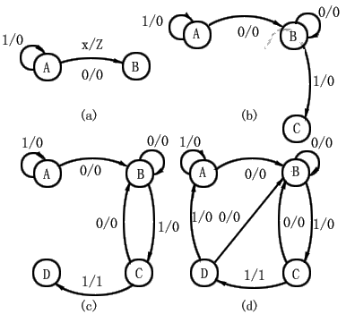
The basic state diagram can be drawn as follows:

Slide 42
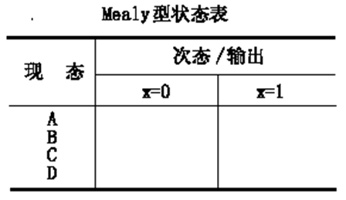
The corresponding basic state table is：
Mealy type state table
Next state/Output
Present state

Slide 43
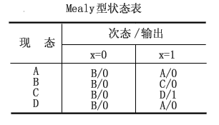
The corresponding basic state table is：
Mealy type state table
Next state/Output
Present state

Slide 44
Question:
A sequence detector has an input x and an output Z. Input x Enter a string of random binary codes. When “101” appears in the input sequence, output Z produces a 1 output, otherwise Z outputs 0. Typical input and output sequences are as follows.
x: 1 0 0 0 0 1 0 1 0 1 0 0 1 0 1
Z: 0 0 0 0 0 0 0 1 0 1 0 0 0 0 1

Slide 45
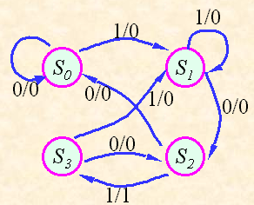

Slide 46
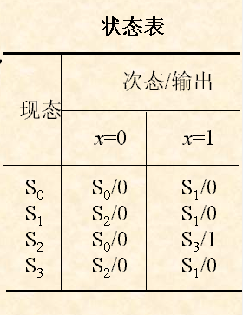
state table
Next state/Output
Present state

Slide 47
2．It is assumed that the logic function of the sequence detector is implemented by Moore type synchronous sequential logic circuit.
Since the circuit output is completely dependent on the state, there is no direct connection to the input. When making a state diagram, the output should be marked in a circle that represents each state.
Let the initial state of the circuit be A, and use states B, C, and D to indicate that 0, 01, and 011 sent from input x have been received. Obviously, according to the meaning of the question, the circuit output is 1 only when in state D, and the output is 0 in other states.

Slide 48
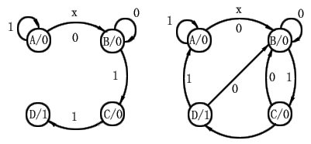
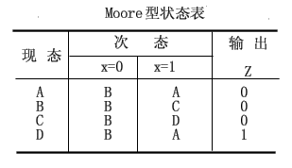
The basic state diagram of the Moore type is constructed as follows:
1
The corresponding basic state table is shown in the table below.
Moor type state table
Next state
Output
Present state

Slide 49
Example: A synchronous sequential circuit for detonation control is designed, which has an input x and an output Z. Usually input x is always 0. Once detonation is required, four 1 signals are continuously input from x (not interrupted by 0), and the circuit receives a fourth 1 and generates a 1 signal ignition detonation at the output Z. The circuit is detonated together with the detonation. The device was destroyed. Try to establish the Mealy state diagram and state table for the circuit.
（What is the practical significance of the problem? ---------- Construction safety!）
A: Analysis: This circuit is actually a "1111" sequence detector for special locations. It differs from the general sequence detector in two ways:
1. The input has a constraint condition, that is, once the input appears 1, it must be 4 continuous 1s that are not interrupted by 0;
2. After receiving four 1s, the detonation signal generated by the output makes the circuit self-destruct, so there is no next state problem at this time.

Slide 50
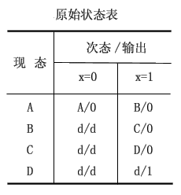
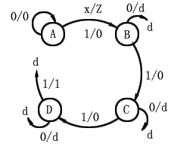
Assume：State A---the initial state of the circuit；
State B---Indicates that the first 1 input was received；
State C---Indicates that 2 consecutive 1 inputs have been received；
State D---Indicates that 3 consecutive 1 inputs have been received.
According to the meaning of the question, the Mealy-type original state diagram and the original state table of the circuit can be obtained as follows. In the figure and table, "d" is used to indicate the indeterminate next state or the indeterminate output.
Basic state table
Next state/Output
Present state

Slide 51
Note that:
In the sequential circuit design, state simplification utilizes the arbitrariness of indeterminate next states and uncertain outputs in the state table, which often makes the design simpler. This is similar to a combinational circuit design that contains don’t care terms, but is a bit more complicated to manipulate.

