Slide 1

CST 205 Digital logic
Synchronous Sequential Logic Circuit
Chapter 5.3 Dr. Fei Chao
Associate Professor
Cognitive Science Department
School of Information Science and Technology
Xiamen University
fchao@xmu.edu.my

Slide 2
5.3.2 State reduction
What is state reduction? The so-called state reduction refers to the use of some reduction technique to eliminate redundant state from the basic state table, and obtain a state table that can correctly describe a given logic function and minimize the number of states involved. This state table is called a modified state table or reduced state table.
Objective：Simplify the circuit structure. The number of states directly determines how many flip-flops are needed in the circuit. Let the number of states be n and the number of flip-flops required be m, then the following relationship should be satisfied: 2^{m} ≥ n ＞ 2 ^{m-1}
Methods: Common methods include observation method, output classification method, and implicant chart method. The most commonly used methods are discussed below – the observation method and implication chart method.

Slide 3
I. 、 Reduction of completely specified state table
1．Concepts
(1) State equivalence
Please pay attention to three points: definition, determine methods and properties.
①Definition
Assume the states S_{i} and S_{j} are the two states of the completely specified table; for all the possible input combinations, all the response sequence from states S_{i} and S_{j} are fully identical. Then, we can say that states S_{i} and S_{j} are equivalent, written as (S_{i}，S_{j})，it is also called states S_{i} and S_{j a} as one equivalent pair.

Slide 4
② Determine method
For all the input combinations, S_{i} and S_{j} are the two present states of the fully complete basic state table，the conditions that S_{i} and S_{j} are equivalent to each other, must satisfy the following two conditions：

First , the output must be identical；

Second，the next state must belong to one of the following sub-conditions:
a. the next states are identical ；
b. the next states are symmetric；
c. the next states are cyclic or points to an equivalent pare.

Slide 5
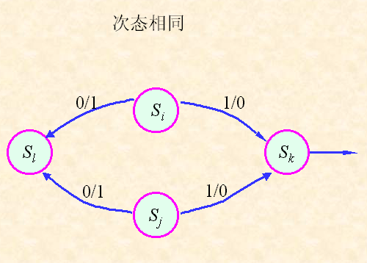
The next states are identical
next states are identical

Slide 6
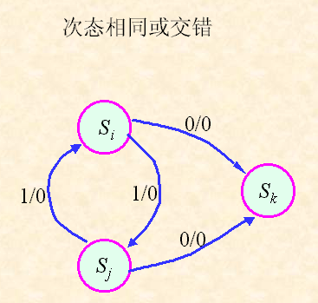
The next states are symmetric
next states are symmetric or identical

Slide 7
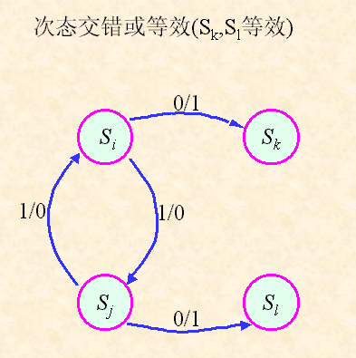
The next states are symmetric
next states are symmetric or identical (S_{k} and S_{l} are equivalent)

Slide 8
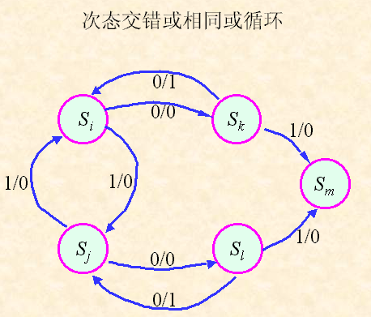
The next states are cyclic or points to an equivalent pare
next states are symmetric, cyclic or points to an equivalent pare

Slide 9
③ Properties:
Equivalent state has the transitivity, i.e., if S₁ and S₂ are equivalent, as well as, S₂ and S₃ are equivalent, then, S₁ and S₃ must be equivalent, written as:
(S₁，S₂)，(S₂，S₃) (S₁，S₃)
(2)Equivalent class
Equivalent class：A collection of states that are equivalent to each other. Any two states in the same equivalent class are equivalent. E.g, in term of (S₁，S₂) and (S₂，S₃), we can have (S₁，S₃)，so that:
S₁、S₂、S₃ belongs to one class of state，written as { S₁，S₂，S₃}，i.e.,
(S₁，S₂) ，(S₂，S₃) { S₁，S₂，S₃}

Slide 10
(3) maximum equivalent class
The so-called maximum equivalent class refers to the equivalent class that is not included in any other equivalent class.
In other words, if an equivalent class is not a subset of any other equivalent class, then the equivalent class is called the largest equivalent class.
The reduction process of the basic state table is to find all the maximum equivalent classes in the table, and then merge the states in each of the maximum equivalent classes into one new state, thus obtaining a minimized state table.
The number of states after reduction is equal to the number of maximum equivalent classes！

Slide 11
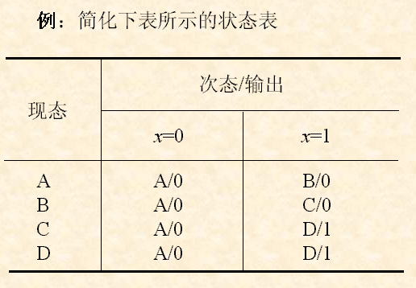
2．State reduction
(1) Observation method
Example: Reduce the basic state table
Next state/Output
Present state

Slide 12
Identical output:
A and B, C and D
For all the input combinations, C and D have the same next states. Thus, C and D are equivalent.
For X=1, the next states of A and B cannot satisfy the three subconditions. Thus, A and B are NOT equivalent.
The maximum equivalent classes are {A}, {B}, {C, D},
Example: Reduce the basic state table
Next state/Output
Present state

Slide 13
2．2．State reduction
(1) General steps for implication chart method
Obtain maximum equivalent classes
Draw unfilled implication chart
Find the state equivalent pares
1
2
3
Obtain modified state table
State merge
5
4
① Draw unfilled implication chart
The implicant chart is a rectangular triangle step-like grid, each square in the table represents a state pair。

Slide 14
② Find the state equivalent pares
Sequence comparison: according to the order of the implicant chart from the upper to the lower, from the left to the right, all "state pairs" are checked and compared one by one in turn from the basic state table, and the results are labeled in the corresponding squares in the implicant chart.
The comparison results are labeled as follows：
Equivalent ------- Fill“∨”in the corresponding square；
Inequivalent----- Fill“×” in the corresponding square；
Rely on other state pares---- Fill the relied state pares in the corresponding square.
Correlation comparison: Refer to the state check for those pairs, which have not been determined to be equivalent, at the time of sequence comparison. Until their relied state pares can be determined, we can determine their states are equivalent or not equivalent.

Slide 15
③Obtain maximum equivalent classes
After finding all the equivalent pairs in the basic state table, we can use the transitivity of the equivalent states to find the maximum equivalent class.
④State merge, make a modified state table
Combine all the states in each of the maximum equivalent classes into one state to get a modified state table that is equivalent to the basic state table.

Slide 16
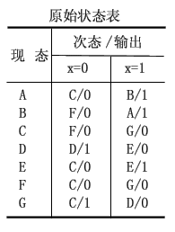
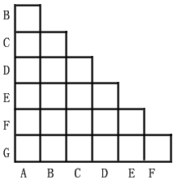
(2)Example:
Q: Reduce the following basic state table
A: ① Draw unfilled implication chart
The given basic state table has 7 states, according to the rules for filling implicant chart, the unfiled implicant chart frame can be drawn as follows.
basic state table
Present State
Next state/output

Slide 17
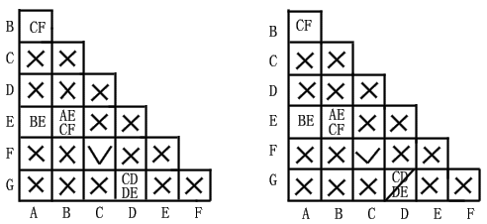
② Find the state equivalent pares
According to the judgment standard of the equivalent state, each state pair is checked in turn, and the result of the sequence comparison can be obtained as shown in Fig (a).
The results of the correlation comparison are shown in Fig (b).
basic state table
Present State
Next state/output
图(a)
图(b)
Fig
Fig

Slide 18
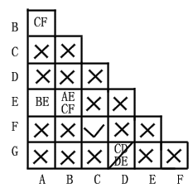
It can be seen from the result that the seven states in the basic state table have four equivalent pairs:
(A，B)，(A，E)， (B，E)，(C，F)。

Slide 19
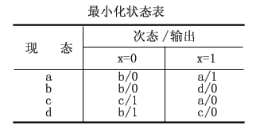
③Obtain the maximum equivalent classes
In terms of the obtained equivalent pairs and the definition of the maximum equivalent class, the seven states can merge to four maximum equivalent classes, {A,B,E},{C,F},{D},{G} .
④Merge the states and obtain the modified state table
Let {A,B,E}----a、{C,F}---b、{D}---c、{G}---d，substitute them into the basic state table，then we can obtain the modified state table:
Basic state table
Modified state table
Present State
Next state/output
Present State
Next state/output

Slide 20
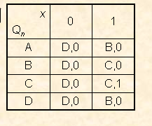
Practise-State Reduction with the implicant chart
例

Slide 21
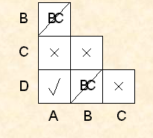
Practise-Answer
例

Slide 22
II. Reduction of the incomplete specified state
The reduction of the incomplete specified state introduces the concept of a compatible state. See the textbook for details!

Slide 23
5.3.3 State assignment
State assignment: refers to the state indicated by letters or numbers in the reduce state table, specifying a binary code to form a binary state table. State assignment are also called state coding.
The task of the state assignment：

①Determine the length of the state code (ie the number of bits in the binary code, or the required number of flip-flops);

②Look for an optimal or secondary-optimal state allocation scheme, so as to make the designed sequential circuit the easiest.

Slide 24
1. Determine the number of bits in the binary code
Let the state of the modified state table be N, and the length of the state code be m, then the relationship between the state number N and the state code length m is
2^{m-1} < N ≤ 2^{m}
For example, if the state number of a state table is N = 7, the number of bits in the binary code should be m = 3 when the state is assigned. Or the number of state variables is 3.
II. Determine the state assignment scheme
There are many kinds of correspondences between states and codes. In general, the number of state allocation schemes that may occur when allocating N states with 2^{m} combinations of m-bit binary codes，K_{s} is
eg，when N = 4, m= 2，K _{S} = 24。

Slide 25
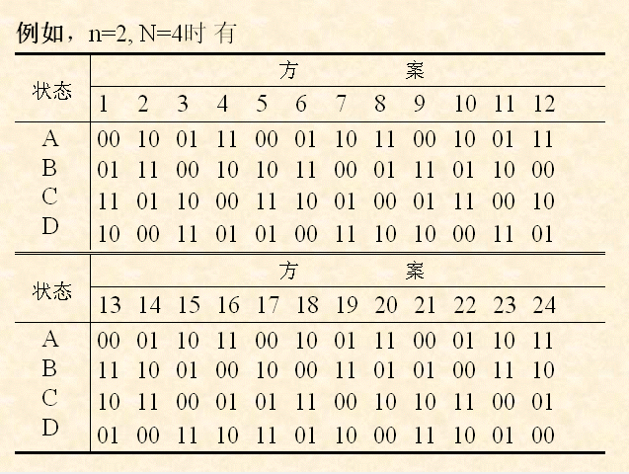
Example: when n=2, N=4, we have
solutions
States
solutions
States

Slide 26
A common method is called the adjacent assignment method.
The basic idea of the adjacent assignment method is to make the excitation function and the output function in the adjacent position of the "1" square on the Karnaugh map as much as possible, so as to facilitate the excitation function and the output function. simple.

Slide 27
The principle principle of the adjacent assignment method is as follows:
① If the next state is the same, then the present state should be adjacent. (ie, under the same input conditions, the present state with the same next state should be allocated adjacent binary code as much as possible;)
② For the same present states, their next states should be adjacent. (ie, under the adjacent input conditions, the next state of the same present state should be assigned adjacent code as much as possible ;)
③ If the output is the same, then the present states should be adjacent. (ie, the present state with the same output for each input value should be assigned to the adjacent binary code as much as possible .)
Some state tables often have situations where three principles cannot be met at the same time. At this time, it can be considered in order of priority from ① to ③.
In addition, the initial state is generally assigned the "0" state in consideration of the actual operating state of the circuit.

Slide 28
III. Example
Q: Assign binary code for the following state table (set A to the initial state).
Present state | Next state/Output
 | x=0 | x=1
A | C/1 | B/0
B | A/0 | A/1
C | A/1 | D/1
D | D/1 | C/0
A: In the state table shown, the number of states is N = 4, so the length of the state code should be m=2. That is, the function of implementing the state table requires two flip-flops.

Slide 29
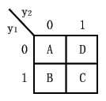
According to the code assignment principle of the adjacent method, the adjacent relationship of the four states is as follows:
Based on Rule ①，States B and C should be assigned the adjacent binary codes；
Based on Rule ②，States B and C, A and D, C and D should be assigned the adjacent binary codes ；
Based on Rule ③，State A and D should be assigned the adjacent binary codes .
Collectively considering ①~③，State assignments are required to satisfy B and C, A and D, C and D adjacent.
In order to intuitively assign the codes, the Karnaugh map is usually used as a tool for state assignment.
Present state | Next state/Output
 | x=0 | x=1
A | C/1 | B/0
B | A/0 | A/1
C | A/1 | D/1
D | D/1 | C/0
Assume states are presented by y₂y₁，And assign A to "0", an assignment scheme that satisfies the above-mentioned neighbor relationship as shown in the right figure. That is, the state codes of states A, B, C, and D are sequentially 00, 01, 11, and 10 of y2y1.

Slide 30
The states A, B, C, and D in the state table are replaced by codes 00, 01, 11, and 10, respectively, to obtain a binary state table of the state table as shown in the table below.
Present state | Next state/Output
 | x=0 | x=1
A | C/1 | B/0
B | A/0 | A/1
C | A/1 | D/1
D | D/1 | C/0
Present state y₂y₁ | Next state/y₂^{(n+1)}y₁^{(n+1)}/Output
 | x=0 | x=1
00 | 11/0 | 01/0
01 | 00/0 | 00/1
11 | 00/1 | 10/1
10 | 10/0 | 11/0
Note：There are usually many options for meeting the assignment principle, and the designer can choose one of them.

Slide 31
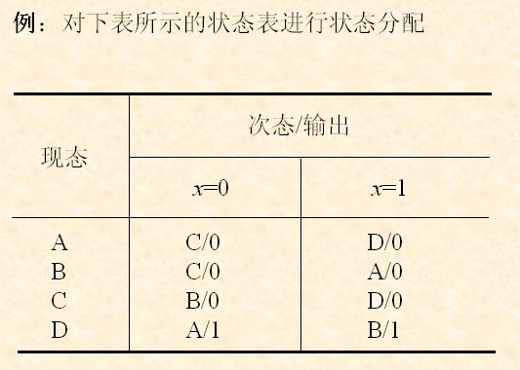
Practice
Example: Assign binary states for the following state table.
next State/output
Present State

Slide 32
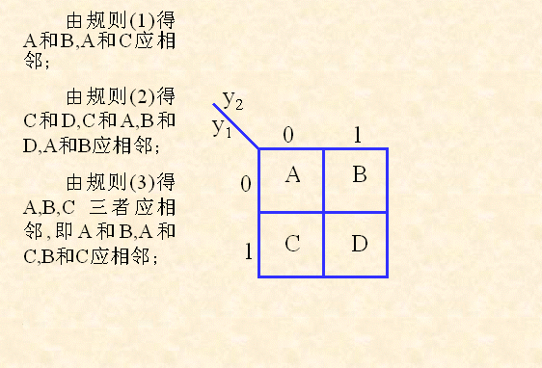
Answer:
Based on Rule ①，States A and B, A and C, should be assigned the adjacent binary codes；
Based on Rule ②，States C and D, C and A, B and D, A and B should be assigned the adjacent binary codes ；
Based on Rule ③，State A, B and C should be assigned the adjacent binary codes . i.e., State A and B, A and C, B and C should be adjacent.

Slide 33
5.3.4 Determine the excitation and output functions and draw a logic diagram
Task: According to the binary state table and the excitation table of the selected flip-flops, find the excitation function expression of the flip-flops and the output function expression of the circuit, and simplify it; so as to construct a logic circuit that implements a given logic function with appropriate logic gates and selected flip-flops.

Slide 34
Flip-flop excitation table
The excitation table of a flip-flop device illustrates the flip-flop reacts to the input (excitation) from a present state to a next state. In this table, the present state and the next state are used as independent variables, and the input is used as the dependent variables. The excitation table for the filp-flop can be derived from the flip-flop’s function table.

Slide 35
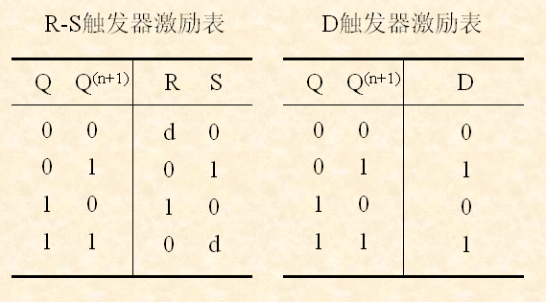
Flip-flop excitation table
Flip-flop excitation table
Flip-flop excitation table

Slide 36
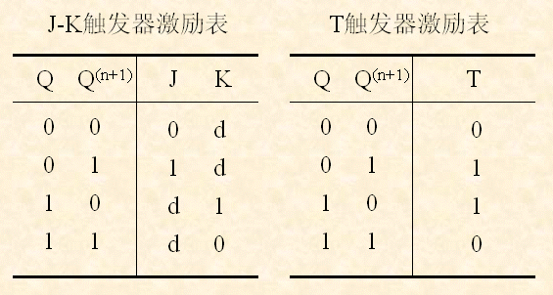
Flip-flop excitation table
Flip-flop excitation table
T Flip-flop excitation table

Slide 37
According to the binary state table and the flip-flop excitation table, the simplest expression for the excitation function and the output function is generally divided into two steps:
●List the excitation and output function truth tables；
●Write the simplest expression after simplifying the Karnaugh maps.
Example: The following binary state table functions are implemented with J-K flip-flops and appropriate logic gates.
Present state y₂y₁ | Next state y₂^{(n+1)}y₁^{(n+1)}/Output
 | x=0 | x=1
00 | 11/0 | 01/0
01 | 00/0 | 00/1
10 | 01/0 | 11/0
11 | 00/1 | 10/1

Slide 38
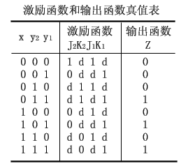
A: The truth table for the excitation and output functions can be listed according to the given binary state table and the excitation table for the J-K flip-flop as shown in the table to the right.
Present state y₂y₁ | Next state y₂^{(n+1)}y₁^{(n+1)}/Output
 | x=0 | x=1
00 | 11/0 | 01/0
01 | 00/0 | 00/1
10 | 01/0 | 11/0
11 | 00/1 | 10/1
Excitation and Output function truth table
Excitation
Output
QQ^{(n+1)}
J K
0 0
01
10
11
0 d
1 d
d 1
d 0

Slide 39
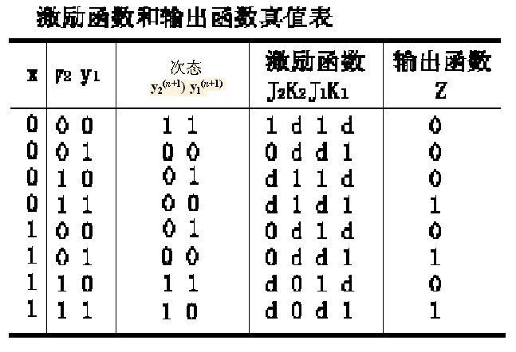
Excitation and Output function truth table
QQ^{(n+1)}
J K
Next state
Excitation
Output
0 0
01
10
11
0 d
1 d
d 1
d 0
Pre y₂y₁ | Next y₂^{(n+1)}y₁^{(n+1)}/output
 | x=0 | x=1
00 | 11/0 | 01/0
01 | 00/0 | 00/1
10 | 01/0 | 11/0
11 | 00/1 | 10/1

Slide 40
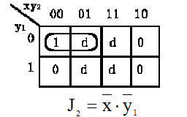
Excitation and Output function truth table
Excitation
Output

Slide 41
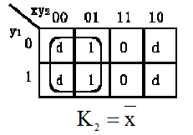
Excitation and Output function truth table
Excitation
Output

Slide 42
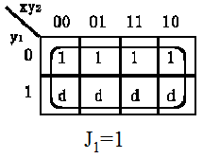
Excitation and Output function truth table
Excitation
Output

Slide 43
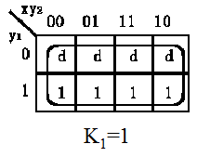
Excitation and Output function truth table
Excitation
Output

Slide 44
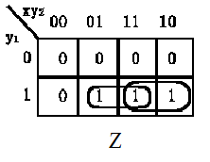

Excitation and Output function truth table
Excitation
Output

Slide 45
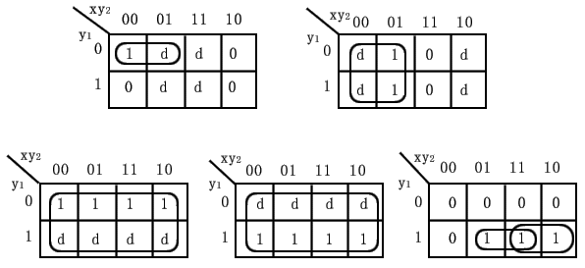
Based on the Karnaugh, the truth table can be used to make the excitation and output functions is shown below.
J₁=1
K₁=1
Z

Slide 46
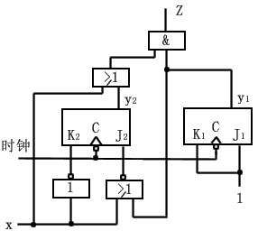
The simplified expressions of the excitation and output functions obtained by simplification are as follows:
The corresponding logic circuit diagram is shown below.
CP

Slide 47
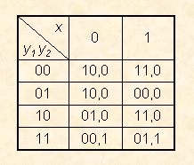
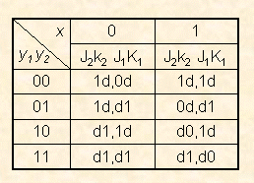
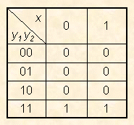
Example: Using the JK flip-flops to implement the binary state table shown in the table below, try to write the excitation and output functions.
QQ^{(n+1)}
J K
0 0
01
10
11
0 d
1 d
d 1
d 0

Slide 48
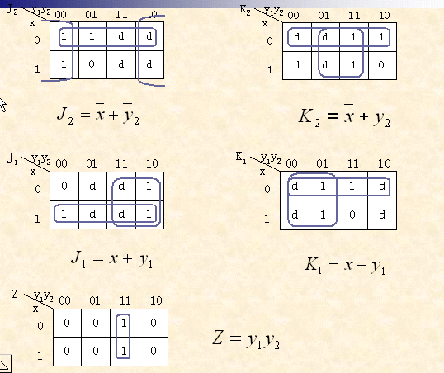

Slide 49
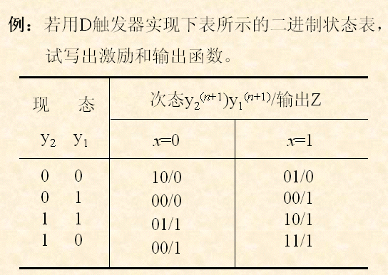
Example: Use the D flip-flops to implement the binary state table, please list the excitation and output functions
Present state
Next state
Output Z

Slide 50
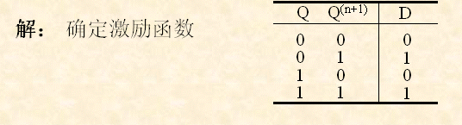
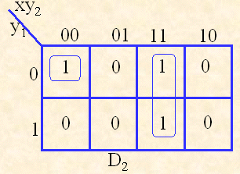
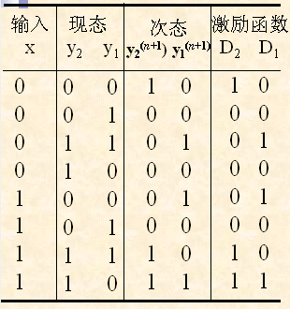
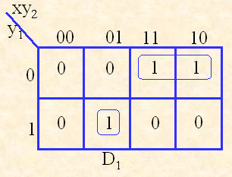
A: Determine the excitation function
Input Present Next Excitation

Slide 51
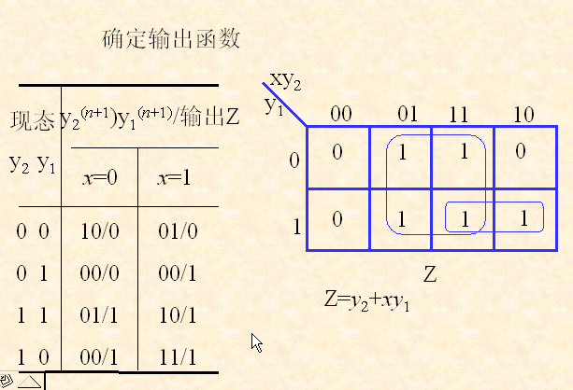
Determine the output function
Present state
Output Z

Slide 52
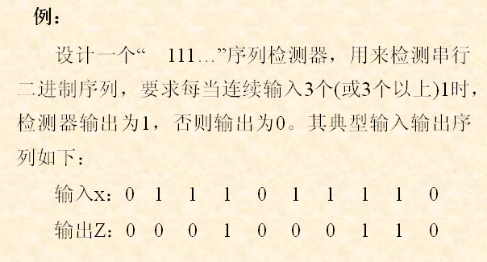
5.4 Synchronous sequential logic circuit design example
Example:
Design a “111” sequence detector, to check a sequence of binary numbers. When we have three continuous 1s, the output is 1; otherwise, the output is 0. the typical input/output are list as follows:
Input
Output

Slide 53
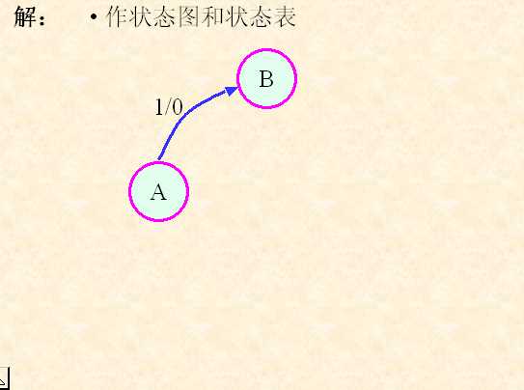
A: basic state diagram and state table

Slide 54
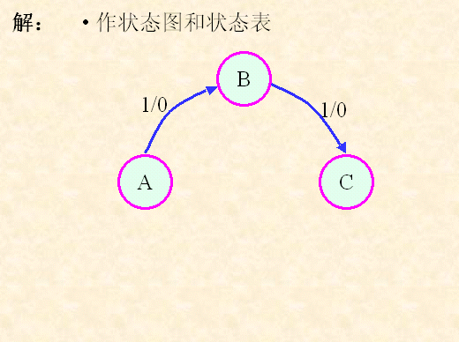
A: basic state diagram and state table

Slide 55
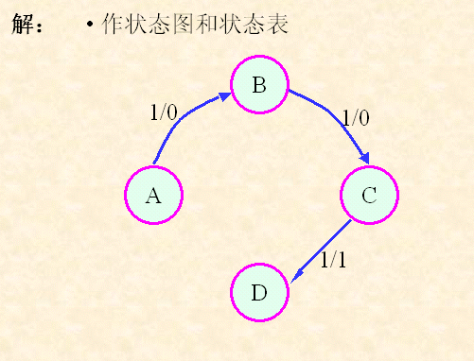
A: basic state diagram and state table

Slide 56
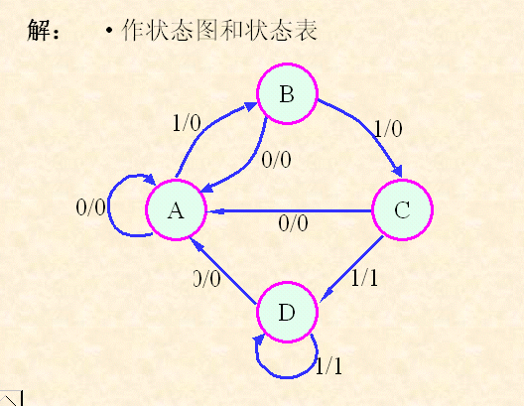
A: basic state diagram and state table

Slide 57
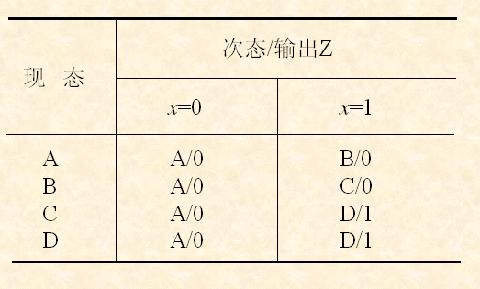
A: basic state diagram and state table
Next state/Output Z
Present State

Slide 58
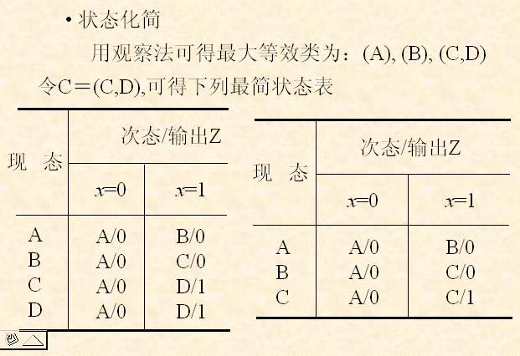
State reduction
The maximum equivalent classes are: {A}, {B}, {C,D}
Let C to represent {C,D}, we can have the following table
Next state/Output Z
Present
State
Next state/Output Z
Present
State

Slide 59
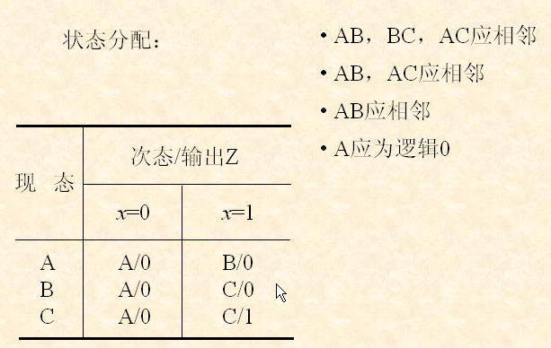
A and B, B and C, A and C should be adjacent;
A and B, A and C should be adjacent;
A and B should be adjacent;
A should be assigned as 0;
State Assignment:
Next state/Output Z
Present
State

Slide 60
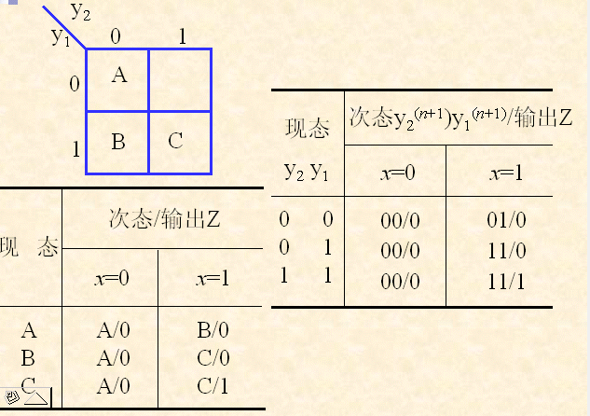
Present
State
Next state/Output Z
Next state/Output Z
Present
State

Slide 61
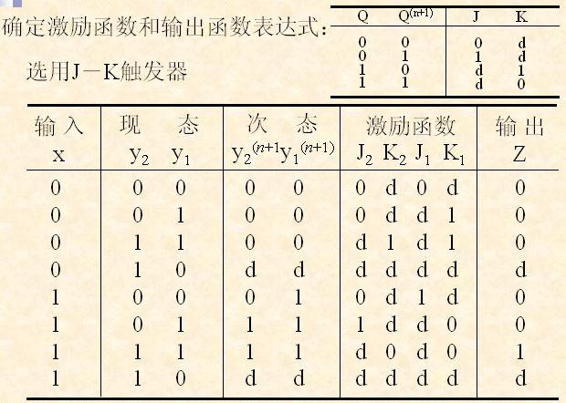
Determine the excitation function and output function expressions;
Use the JK flip-flops
Input Present Next state Excitation Output Z

Slide 62
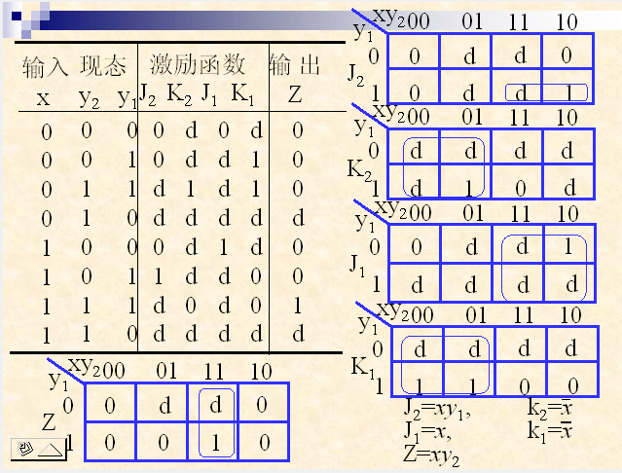
Input Present Excitation Output Z

Slide 63
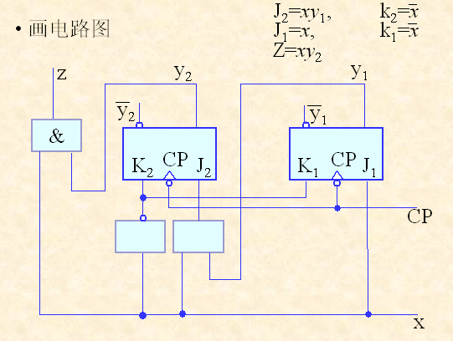
Draw the logic circuit diagram

