Slide 1
Parsing

Slide 2
outline
what’s parsing
CYK parsing
Chart parsing
Earley parsing
Introduction to PCFG
Probabilistic Chart parsing

Slide 3
参考文献
nlu, fsnlp, slp有关章节
Eugene Charniak的文章：
http://www.cs.brown.edu/people/ec/
Michael Collins的文章：
http://www.ai.mit.edu/people/mcollins/publications.html
Dan Bikel的文章:
http://www.cis.upenn.edu/~dbikel/
Eisner的文章：three new probabilistic models for dependency parsing

Slide 4
什么是句法分析
定义：判断单词串是否属于某个语言(recognition)，如果是，则给出其（树）结构(parsing)。
句法分析假设有结构的某种表示.这一般用文法(grammar)来刻画.常见的是短语结构文法(chomsky hierarchy),其中最常用的是上下文无关文法(CFG)
分析算法当然取决于文法,但是CFG的分析算法研究得比较成熟,需要重点掌握

Slide 5
CFG的定义
CFG defined by 4 parameters (N; T; P; S)
N : set of nonterminal symbols
T: set of terminal symbols N ∩ T = Ø;
P : set of productions of the form A → β where A ∈ N and β is a string of symbols B_{i} with B_{i} ∈ (N ∩ T)
S: designated start symbol

Slide 6
一个简单的CFG
S --> NP VP det --> the
NP --> det n n --> man
NP --> det n PP n --> girl
VP --> v NP n --> telescope
VP --> v NP PP v --> saw
PP --> p NP p --> with

Slide 7
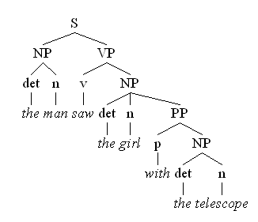
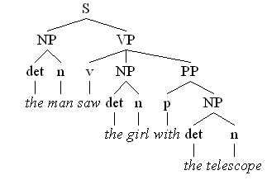
Two different parse trees for the sentence “the man saw the girl with the telescope”
The girl has the telescope
The man has the telescope

Slide 8
文法和歧义
由于语言的线性结构及简约原则,自然语言充满歧义.这是与人工(一般是形式)语言的主要差别.分析算法必须考虑到这一点
给定一种文法体系，如CFG，文法的写作也是重要的。要考虑到减少不必要的歧义,又要保证理解的自然性。非歧义的语言可以有歧义的文法。有歧义的语言只有歧义的文法。

Slide 9
Processing strategies
Top-down vs bottom-up processing
Depth-first vs breadth-first search
Left-to-right vs right-to-left scanning
Deterministic vs nondeterministic parsing

Slide 10
所谓自顶向下分析法也就是先构造句法树的根结点，再逐步向下扩展，直到叶结点； 所谓自底向上分析法也就是先构造句法树的叶结点，再逐步向上合并，直到根结点。
Top - Down
s
s -> np, vp
s -> pron, vp
s -> John, vp
s -> John, v, np
s -> John, hit, np
s -> John, hit, det,n
s -> John, hit, the,n
s -> John, hit, the,cat
Bottom - Up
John, hit, the, cat
pron, hit, the, cat
pron, v, the, cat
pron, v, det, cat
pron, v, det, n
np, v, det, n
np, v, np
np, vp
s

Slide 11
处理策略
自顶向下、自底向上是两种控制策略
深度优先和广度优先是搜索策略，都适用两种控制策略.就是在探索多种可能性时选择的排队策略(栈或队列)
自左至右和自右至左(甚至“中间开花”)是常用的两种扫描策略.
当文法没有二义性时,甚至假设句子理解没有二义性时,可以采用确定性算法(无回溯)，如程序语言中的LR文法;对自然语言一般不行，因此常用概率算法

Slide 12
CYK 算法
只适用于CNF(Chomsky Normal Form)文法
all rules have one of the following two forms: A→a A→BC

Slide 13
Recognition of CNF：the CYK algorithm
用一个3维数组来来记住分析状态。对识别，定义P[i,j+1,A] = true iff A =>wi … wj
for k := 1 to slen do
foreach A -> w_{k} do P[k,k+1,A] := true
for span := 2 to slen – 1 do
for start := 1 to slen – 1 do
{ end := start + span;
for k := start + 1 to end – 1 do
foreach rule A -> B C do
P[start,end,A] |= P[start,k,B] P[k,end,C]
}
if P[1,slen+1,S]=true then sentence is well-formed
改变P的数据结构为指针，就可以做分析而不是识别

Slide 14
例子：语言{a^{n}b^{n}}的CNF文法
S → ε | AB | XB
X → AT
T → AB | XB
A → a
B → b
Is x = aaabb in L(G )
Is x = aaabbb in L(G )

Slide 15
例子
分析过程画在表格中
end at start at | 1: aaabbb | 2: aaabbb | 3: aaabbb | 4: aaabbb | 5: aaabbb | 6: aaabbb
0:aaabbb
1:aaabbb
2:aaabbb
3:aaabbb
4:aaabbb
5:aaabbb

Slide 16
例子
1. Variables for length 1 substrings.
end at start at | 1: aaabbb | 2: aaabbb | 3: aaabbb | 4: aaabbb | 5: aaabbb | 6: aaabbb
0:aaabbb | A
1:aaabbb |  | A
2:aaabbb |  |  | A
3:aaabbb |  |  |  | B
4:aaabbb |  |  |  |  | B
5:aaabbb |  |  |  |  |  | B

Slide 17
例子
2. Variables for length 2 substrings.
end at start at | 1: aaabbb | 2: aaabbb | 3: aaabbb | 4: aaabbb | 5: aaabbb | 6: aaabbb
0:aaabbb | A | -
1:aaabbb |  | A | -
2:aaabbb |  |  | A | S,T
3:aaabbb |  |  |  | B | -
4:aaabbb |  |  |  |  | B | -
5:aaabbb |  |  |  |  |  | B

Slide 18
例子
3. Variables for length 3 substrings.
end at start at | 1: aaabbb | 2: aaabbb | 3: aaabbb | 4: aaabbb | 5: aaabbb | 6: aaabbb
0:aaabbb | A | - | -
1:aaabbb |  | A | - | X
2:aaabbb |  |  | A | S,T | -
3:aaabbb |  |  |  | B | - | -
4:aaabbb |  |  |  |  | B | -
5:aaabbb |  |  |  |  |  | B

Slide 19
例子
4. Variables for length 4 substrings.
end at start at | 1: aaabbb | 2: aaabbb | 3: aaabbb | 4: aaabbb | 5: aaabbb | 6: aaabbb
0:aaabbb | A | - | - | -
1:aaabbb |  | A | - | X | S,T
2:aaabbb |  |  | A | S,T | - | -
3:aaabbb |  |  |  | B | - | -
4:aaabbb |  |  |  |  | B | -
5:aaabbb |  |  |  |  |  | B

Slide 20
例子
5. Variables for length 5 substrings.
end at start at | 1: aaabbb | 2: aaabbb | 3: aaabbb | 4: aaabbb | 5: aaabbb | 6: aaabbb
0:aaabbb | A | - | - | - | X
1:aaabbb |  | A | - | X | S,T | -
2:aaabbb |  |  | A | S,T | - | -
3:aaabbb |  |  |  | B | - | -
4:aaabbb |  |  |  |  | B | -
5:aaabbb |  |  |  |  |  | B

Slide 21
例子
6. Variables for aaabbb. ACCEPTED!
end at start at | 1: aaabbb | 2: aaabbb | 3: aaabbb | 4: aaabbb | 5: aaabbb | 6: aaabbb
0:aaabbb | A | - | - | - | X | S,T
1:aaabbb |  | A | - | X | S,T | -
2:aaabbb |  |  | A | S,T | - | -
3:aaabbb |  |  |  | B | - | -
4:aaabbb |  |  |  |  | B | -
5:aaabbb |  |  |  |  |  | B

Slide 22
Chart Parsing
General Principles:
A Bottom-Up parsing method
– Construct a parse starting from the input symbols
– Build constituents from sub-constituents
– When all constituents on the RHS of a rule are matched, create a constituent for the LHS of the rule
The Chart is a data structure that allows storing of partial analyses, so that they can be shared. (like dynamic programming)

Slide 23

chart example
John likes Mary
S-> NP VP VP -> v NP
NP -> John | Mary v -> likes

Slide 24
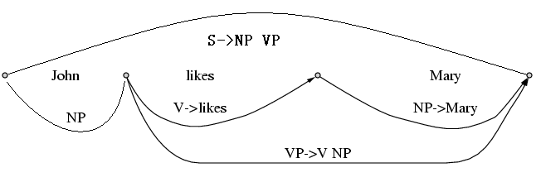

Slide 25
点规则
当考虑自左至右分析时，引入点规则表明分析的状态。
点规则由四部分组成：
（1）上下文无关文法规则
（2）圆点·（圆点左边的部分是已分析的，右边是待分析的）
（3）整数i : 起点（已分析子串的起点）
（4）整数j : 终点（已分析子串的终点） i≤j
比如：S → NP·VP <1,4>
表示在寻找 S 的过程中，在词 1 到 4 之间已发现一个 NP, 期望下面有一个 VP

Slide 26
如果点不在产生式的最右部，在分析中称为“活动弧”
chart parsing 就是活动弧中的点不断右移，不断产生不活动弧，又不断产生新的活动弧的过程
点规则在编译原理书上也称为项（item）

Slide 27
Chart Parsing
Data structures used by the algorithm:
– The Key: the current constituent we are attempting to “match”
– An Active Arc: a grammar rule that has a partially matched RHS
– The Agenda: Keeps track of newly found unprocessed constituents
– The Chart: Records processed constituents (non-terminals) that span substrings of the input

Slide 28
Chart Parsing
parsing input x = x₁…x_{n}
For i=1 to n do
1. Find all POS of the current word = x_{i}
2. Initialize Agenda with all POS of the word: C<p_{i},p_{i+1}>
3. Pick a Key C< p_{j},p_{k} > from the Agenda
4. For each grammar rule of form A → CX₁…X_{m}, add A → • CX₁…X_{m}< p_{j} ,p_{j}> to the list of active arcs
5. Extend any existing active arcs with the Key
6. Add LHS constituents of newly completed rules to the Agenda
7. Add the Key to the Chart
8. If Agenda not empty – go to (3), else go to (1)
9. Find all the constituents S<1,n+1>

Slide 29
Chart Parsing
Extending Active Arcs with a Key:
Each Active Arc has the form:
A → X₁…•C…X_{m} < p_{i},p_{j}>
- A Key constituent has the form: C →…• <p_{j},p_{k}>
- When processing the Key C →…• <p_{j},p_{k}>, we search the active arc list for an arc A → X₁…•C…X_{m}< p_{i},p_{j}>, and then create a new active arc A → X₁…C • …X_{m} < p_{i},p_{k}>
- If the new active arc is a completed rule: A → X₁…C • < p_{i},p_{k}>,
then we add A → … • < p_{i},p_{k}> to the Agenda
- After “using” the key to extend all relevant arcs, it is entered into the Chart

Slide 30
extending an active arc:合并规则
A→α•Bβ<i:j>, B→γ•<j:k> ➔
A→αB•β<i:k>
简单地说就是把点往右移一格。

Slide 31
Chart Parsing - Example
The Grammar:
(1) S → NP VP
(2) NP → ART ADJ N
(3) NP → ART N
(4) NP → ADJ N
(5) VP → AUX VP
(6) VP → V NP

Slide 32
Chart Parsing - Example
The input:
“x = The large can can hold the water”
POS of Input Words:
the: ART
large: ADJ
can: N, AUX, V
hold: N, V
water: N, V

Slide 33
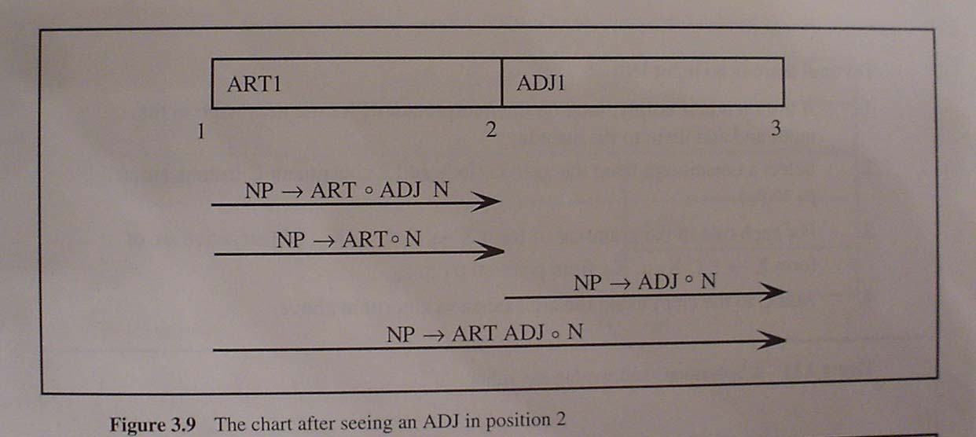
The large can can hold the water

Slide 34
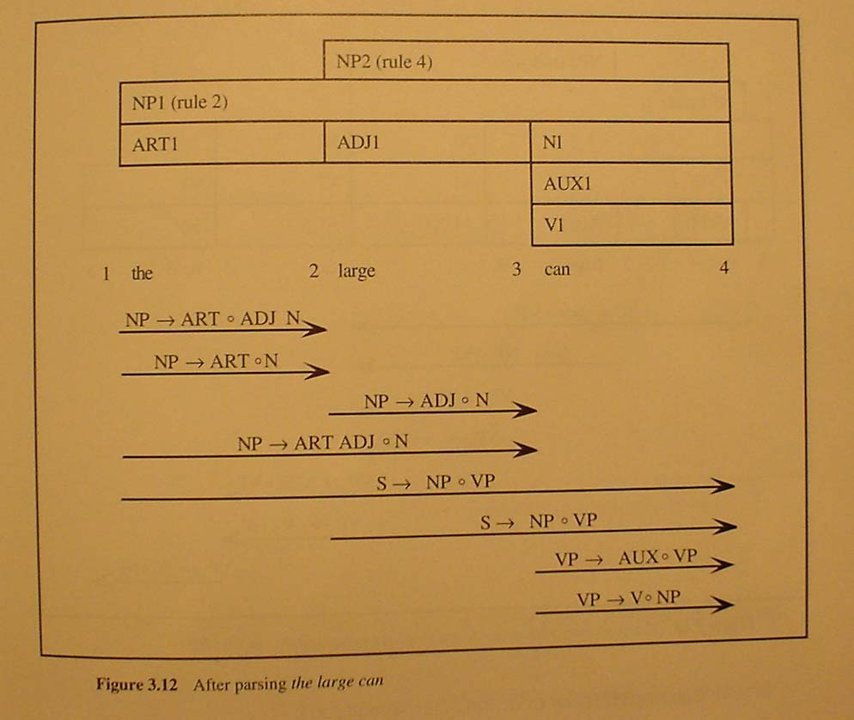
The large can can hold the water

Slide 35
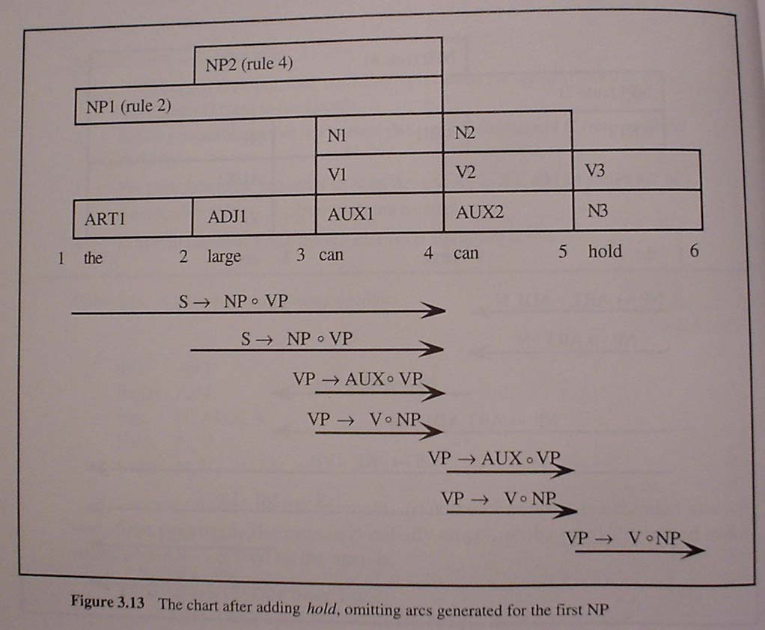
The large can can hold the water

Slide 36
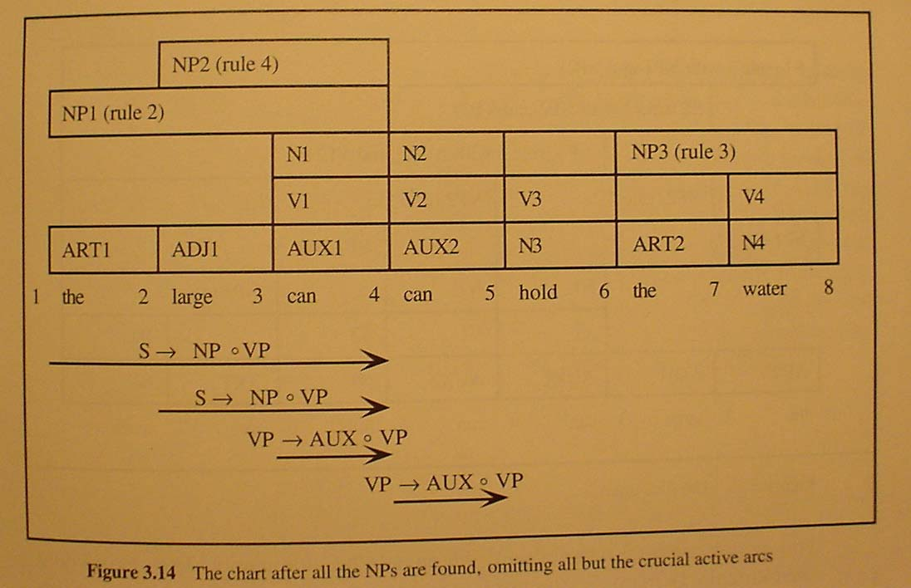
The large can can hold the water

Slide 37
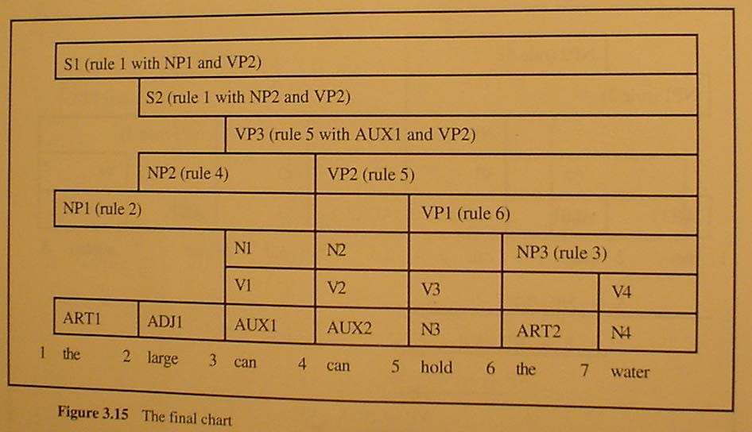
The final Chart

Slide 38
how is agenda organized?
as a stack
as a queue

Slide 39
blind parsing
adding an active arc may be blind and useless
the large can can hold hold the water
the arc AUX==>.can is added and extended, as are V =>.can;
Vp=> .AUX VP, VP =>.V NP ......
but there is no derivation S==>ARJ ADJ AUX β

Slide 40
so a lot of useless constituents are generated, though only once (cf. may be generated many times if backtracking )

Slide 41
bottom up charting parsing can be guided by done top-down filtering
this is called “Earley parsing” because Earkey first described it.

Slide 42
Earley 分析算法
把自顶向下的预测能力和自底向上的数据驱动结合起来.
只有当活跃弧可以被预测到，才生成。

Slide 43
implementation of earley parsing as top-down (predicative) chart parser
For each non-terminal A, define First(A) = the set of all leftmost non-terminals derivable from A (包括A)
Compute in advance First(A) for all non-terminals A
When processing the key C<p_{j},p_{k}> we look for grammar rules that form an active arc A → •C X₂…X_{m}< p_{j} ,p_{j}>
Add the active arc only if A is predicted: there already exists an active arc B → X₁…•D…X_{m}<p_{k} , p_{j}> such that A ∈ First(D)
初始活跃弧: arcs of the form A → • C X₂…X_{m}<1,1>, A ∈ First(S)

Slide 44
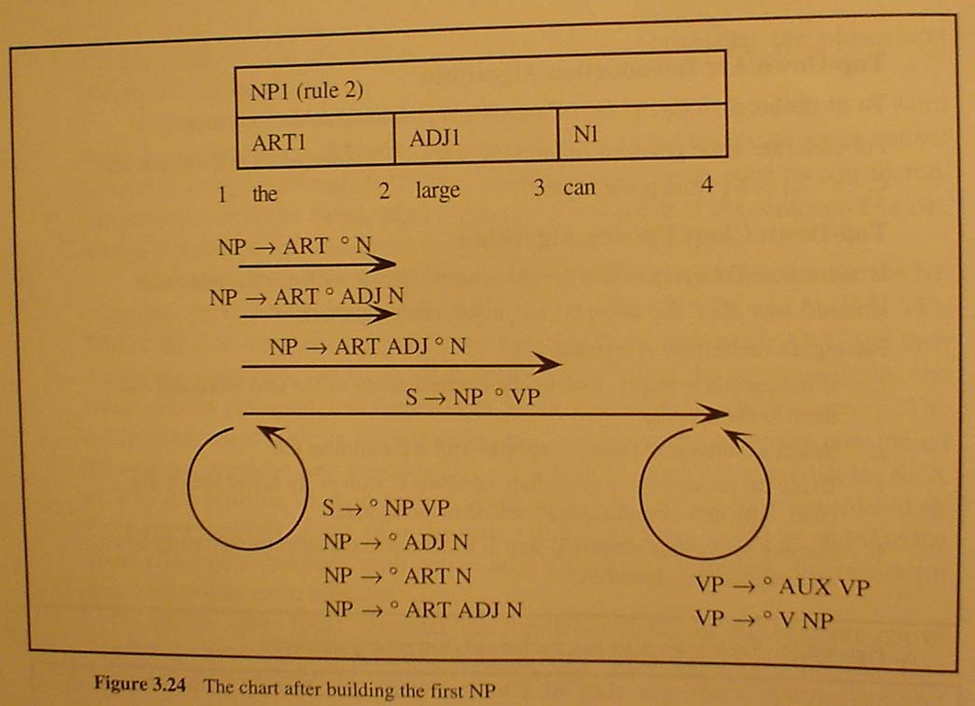
Earley chart Parser - Example

Slide 45
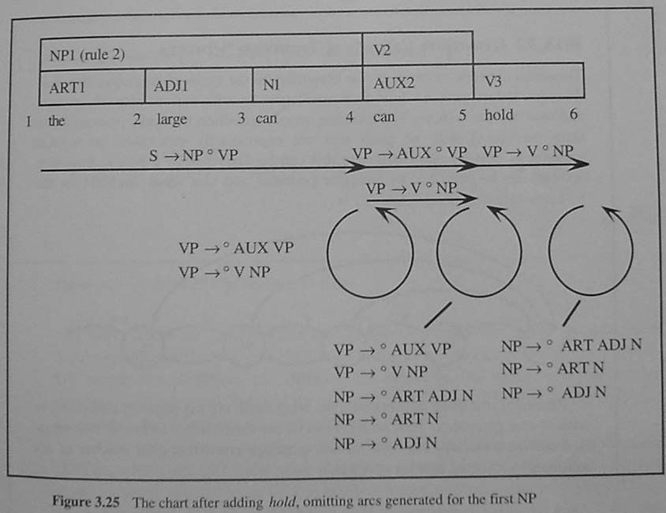
The large can can hold the water

Slide 46
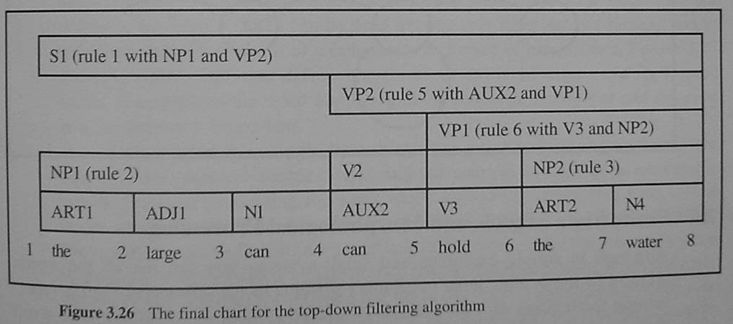
The large can can hold the water

Slide 47
Earley算法优点
自顶向下预测，同时自底向上匹配单词，效率很高，与LR(1)相比，一样具有有效前缀性质，但是没有预计算功能(非表驱动)
Earley算法可以对任意CFG进行分析，但是LR处理的只是LR(k)文法

Slide 48
用nltk做chart parsing
CFG的表示
Import nltk
grammar = nltk.CFG.fromstring("""
S -> NP VP
NP -> ART ADJ N | ART N | ADJ N
VP -> AUX VP | V NP
ART -> 'the'
ADJ -> 'large'
N -> 'can' | 'hold' | 'water'
AUX -> 'can'
V -> 'can' | 'hold' | 'water'
""")
tokens = ['the', 'large', 'can', 'can', 'hold', 'the', 'water']

Slide 49
parser = nltk.ChartParser(grammar, trace=1)
for tree in parser.parse(tokens):
print(tree)
tree.draw()
(S
(NP (ART the) (ADJ large) (N can))
(VP (AUX can) (VP (V hold) (NP (ART the) (N water)))))

Slide 50
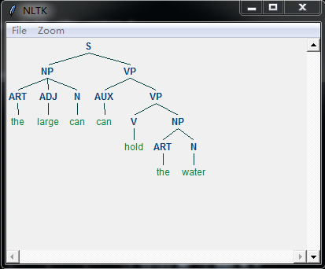
nltk中实现了多种chartparser类，包括TopDownChartParser, BottomUpChartParser, EarleyChartParser等

Slide 51
作业
熟悉nltk中的chartparser。多用些文法及其例子试试。
下载我写的一个chart parser. 能否自己实现一个？

Slide 52
Probabilistic CFG
Probabilistic/Stochastic CFG (PCFG or SCFG)
PCFG has extra parameter (N; T; P; S; D)
D: function that assigns probabilities to each rule in P
A → β [p]
p 是 (A → β) 的概率
Note that p for all expansions of a nonterminal A must sum to 1

Slide 53
Use of PCFG
We use probabilities to disambiguate parses
Choose most likely parse from multiple parses

Slide 54
P(T,S)
n is a node in parse tree
r(n) is the rule that expands n
P(S|T) = 1, since a parse tree T yields sentence S

Slide 55
PCFG
S→ NP VP 1
VP→ v NP 0.7
VP → v NP PP 0.3
NP → det n 0.4
NP → det n PP 0.6
PP → p NP 1
Lexicon
det → the 1
n → man 0.4
n → girl 0.3
n → telescope 0.3
v → saw 1
p → with 1

Slide 56
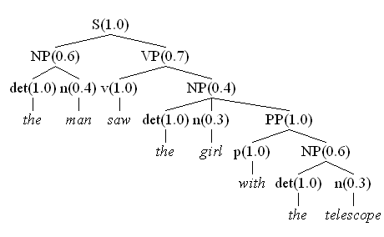
P(Tree1) = 1.0 x 0.6 x 1.0 x 0.4 x 0.7 x 1.0 x 0.4 x 1.0 x 0.3 x 1.0 x 1.0 x 0.6 x 1.0 x 0.3
= 0.0036288

Slide 57
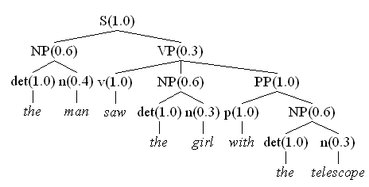
P(Tree2) = 1.0 x 0.6 x 1.0 x 0.4 x 0.3 x 1.0 x 0.6 x 1.0 x 0.3 x 1.0 x 1.0 x 0.6 x 1.0 x 0.3
= 0.0023328

Slide 58
PCFG 真的有用吗？
PCFG可以让我们选择分析树。
但是我们从上一个例子（在不同的上下文应该选择不同的分析树）看到，对一个具体的例子，PCFG选择的不一定正确。

Slide 59
PCFG的缺陷
PCFG中，分析树的概率只和树中的规则有关。规则的概率和上下文无关。是一种简化的数学模型。
PCFG无法描述自然语言句法规则的两种现象
结构相关性
词汇相关性

Slide 60
Structural Dependencies
E.g. Syntactic subject of a sentence tends to be a pronoun
Subject tends to realize the topic of a sentence
Topic is usually old information
Pronouns are usually used to refer to old information
So subject tends to be a pronoun
In Switchboard corpus:
91% of subjects in declarative sentences are pronouns
66% of direct objects are lexical (nonpronominal)

Slide 61
同一个非终结符在不同的位置的推导概率不一样。比如，代词多用于主语位置而不是宾语位置。又如，在双宾语结构中，第一个宾语一般是简单宾语。

Slide 62
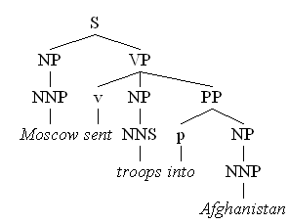
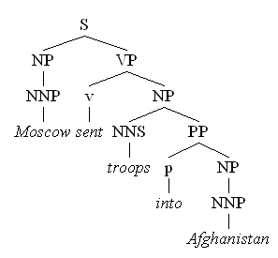
Lexical Dependencies
Two parse trees for the sentence “Moscow sent troops into Afghanistan”
句法规则的推导依赖于具体单词（再比如rely on等搭配）。
Correct parse
Incorrect parse
Notes:
The verb send subcategorises for a destination, which could be a PP headed by “into”

Slide 63
一句话，自然语言是上下文相关的。概率的计算也应该与上下文有关。这说明PCFG只是一个非常粗糙的概率模型，不一定适合描述自然语言。也许我们需要PCSG？（思考）

Slide 64
Getting the Probabilities
From an annotated database
E.g. the Penn Treebank
To get the probability for a particular VP rule just count all the times the rule is used and divide by the number of VPs overall
Simple?

Slide 65
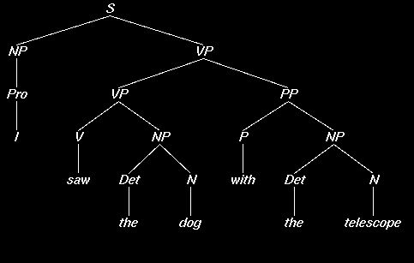
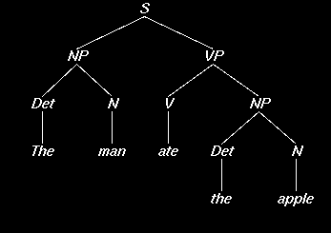
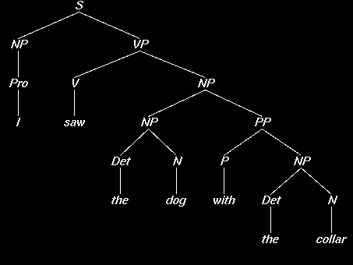
S → NP VP
3
NP → Pro
2
NP → Det N
6
NP → NP PP
1
VP → V NP
VP → VP PP
PP → P NP
3
1
2

Slide 66
S → NP VP
3
/ 3 = 1.0
NP → Pro
2
/ 9 = 0.22
NP → Det N
6
/ 9 = 0.67
NP → NP PP
1
/ 9 = 0.11
VP → V NP
VP → VP PP
PP → P NP
3
/ 4 = 0.75
1
/ 4 = 0.25
2
/ 2 = 1.0

Slide 67
S → NP VP
1.0
NP → Pro
0.22
NP → Det N
0.67
NP → NP PP
0.11
VP → V NP
VP → VP PP
PP → P NP
0.75
0.25
1.0

Slide 68
Evaluating Parsing Accuracy
A treebank also makes evaluation easier
Few sentences are assigned a completely correct parse by any currently existing parsers. Rather, evaluation is done in terms of the percentage of correct constituents.
[Label, Start, Finish]
A constituent is a triple, all of which must be in the true parse for the constituent to be marked correct.

Slide 69
Evaluating Constituent Accuracy
Let C be the number of correct constituents produced by the parser over the test set, M be the total number of constituents produced, and N be the total in the correct version
Precision = C/M
Recall = C/N
Both are important measures.

Slide 70
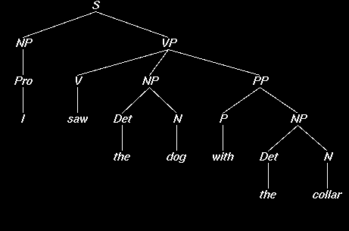
Parser Evaluation Using the Penn Treebank
Labeled Precision and Recall of constituents
Our parser says: The Treebank says:

Slide 71
Counting Constituents
S 1 7 S 1 7
NP 1 1 NP 1 1
VP 2 7 VP 2 7
NP 3 4 NP 3 7
PP 5 7 NP 3 4
NP 6 7 PP 5 7
NP 6 7

Slide 72
Parsing Results [Charniak]
Method Prec/Rec
[average]
PCFG 75%

Slide 73
Implementing PCFG on chart parsing
Bottom-up dynamic programming approach
Assign probabilities to constituents as they are completed and placed in the table
Use the max probability for each constituent going up the tree
We can also add nbest parsing easily

Slide 74
Using the Maxima
suppose we want calculate P(NP)
what if there are multiple NPs for the span of text in question (i to j)?
Take the max!
probs for other kinds of constituents for the same span are also calculated, of course
N words w₁…w_{n}
Array α[i,j,A] holds the maximum probability for a constituent with non-terminal A spanning words w_{i+1}…w_{j}
Maximum probability parse will be α[0,n,S]

Slide 75
Better PCFG: lexicalized parsing
To do better, it is necessary to condition probabilities on the actual words of the sentence. This makes the probabilities much tighter:
p(V NP NP|VP) = 0.00151
p(V NP NP|VP(said)) = 0.00001
p(V NP NP|VP(gave)) = 0.01980

Slide 76
Heads
Make use of notion of the head of a phrase, e.g.
The head of an NP is its noun
The head of a VP is its verb
The head of a PP is its preposition
Phrasal heads
Define most important characteristics of the phrase
Can ‘take the place of’ whole phrases, in some sense
Phrases are generally identified by their heads

Slide 77
a parse with heads marked

Slide 78
How to get p(V NP NP|VP(gave)) ?
count the number of times rule (VP -> V NP NP) is used where the head of V is “gave” and divide it by the number of times “gave” is used as the head of VP in a treebank
P(VP → VB NP NP | VP(gave))
= C(VP(gave) → VB NP VP)/ Σ_{β} C(VP(gave) → β)
it captures the notion of subcategorization of “gave”

Slide 79
other lexical preferences
consider pp-attachment: determine whether a preposition modifies a preceding noun or a verb.
Consider:
Ate spaghetti with gusto
Ate spaghetti with marinara
The affinity of gusto for eat is much larger than its affinity for spaghetti
On the other hand, the affinity of marinara for spaghetti is much higher than its affinity for ate

Slide 80
But not a Head Probability Relationship
Note the relationship here is more distant and doesn’t involve a headword since gusto and marinara aren’t the heads of the PPs
Vp (ate)
Vp(ate)
Np(spag)
Vp(ate)
Pp(with)
np
Pp(with)
v
np
v
Ate spaghetti with gusto
Ate spaghetti with marinara

Slide 81
so we need a more general model:
P(rule|context)
where the context can be: head, parent’s head, grandparent’s head, ...
not only heads, anything useful may be conditioned upon
this is getting context-sensitive!

Slide 82
Lexicalized Probabilities [charniak]
p(prices | n-plural) = .013
p(prices | n-plural, NP) = .013
p(prices | n-plural, NP, S) = .025
p(prices | n-plural, NP, S, v-past) = .052
p(prices | n-plural, NP, S, v-past, fell) = .146

Slide 83
Parsing Results [Charniak]
Method Prec/Rec
PCFG 75%
PCFG with lexicalization 87.5%

Slide 84
How to evaluate
Wall Street Journal (WSJ) section
50,000 sentences, 1 million words
POS tags and constituent trees
Divided in sections
Training: sections 2 – 21 (~40,000 sentences)
Testing: section 23 (~2,400 sentences)
Development: section 22

Slide 85
nltk和pcfg
grammar = nltk.PCFG.fromstring("""
S -> NP VP [1.0]
VP -> v NP [0.7]
VP -> v NP PP [0.3]
NP -> det n [0.4]
NP -> det n PP [0.6]
PP -> p NP [1]
det -> 'the' [1]
n -> 'man' [0.4]
n -> 'girl' [0.3]
n -> 'telescope' [0.3]
v -> 'saw' [1]
p -> 'with' [1]
""")

Slide 86
nltk和pcfg
viterbi_parser = nltk.ViterbiParser(grammar)
for tree in viterbi_parser.parse(['the','man', 'saw','the','girl','with','the', 'telescope']):
print(tree)
(S
(NP (det the) (n man))
(VP
(v saw)
(NP
(det the)
(n girl)
(PP (p with) (NP (det the) (n telescope)))))) (p=0.0024192)

Slide 87
几个开源的pcfg parser
Charniak parser
Collins parser
Stanford parser
Berkeley parser

Slide 88
Charniak parser
Charniak做了一辈子parser：https://cs.brown.edu/~ec/
https://github.com/BLLIP/bllip-parser

Slide 89
Collins parser
Collins是个天才
http://www.cs.columbia.edu/~mcollins/code.html

Slide 90
Stanford的分析器
目前很好的句法分析器之一:
Dan Klein and Christopher D. Manning. 2003. Accurate Unlexicalized Parsing.
Dan Klein and Christopher D. Manning. 2003. Fast Exact Inference with a Factored Model for Natural Language Parsing.
http://nlp.stanford.edu/software/lex-parser.shtml

Slide 91
Berkeley的分析器
目前最好的句法分析器
但在中文树库的准确率（F值）只有83%，比英文树库的结果差很多
http://tomato.banatao.berkeley.edu:8080/parser/parser.html

Slide 92
作业
阅读nltk.ViterbiParser的源代码
下载、运行并研究Collins, 或Charniak,或Stanford，或Berkeley的分析器。

