Slide 1
Bayesian networks
Chapter 14
Section 1 – 5

Slide 2
Outline
Syntax
Semantics
Parameterized distributions
Inferences in Bayesian networks
  Exact inference by enumeration
  Exact inference by variable elimination
  Approximate inference by stochastic simulation
  Approximate inference by Markov chain Monte Carlo

Slide 3
Probabilistic Graphical Models
Directed Graph
  Bayesian networks, Bayes nets, Belief nets, HMMs, Dynamic Bayes nets, etc.
Undirected Graph
  Markov Random Fields, Markov networks, Boltzmann Machine
PGM = Structured Multivariate Statistics

Slide 4
Bayesian networks
A Bayesian network is a directed graph in which each node is a random variable and arcs are for dependence among variables. Also called belief network.
Syntax:
  a set of nodes, one per variable
  a directed, acyclic graph (link ≈ "directly influences")
  a conditional distribution for each node given its parents:
    P (X_{i} | Parents (X_{i}))
In the simplest case, conditional distribution represented as a conditional probability table (CPT) giving the distribution over X_{i} for each combination of parent values

Slide 5

Example
Topology of network encodes conditional independence assertions:
Weather is independent of the other variables
Toothache and Catch are conditionally independent given Cavity

Slide 6
Naïve Bayes as a Bayes Net
Naïve Bayes is a simple Bayes Net
Y
…
X₁
X₂
X_{n}
Priors P(Y) and conditionals P(X_{i}|Y) for Naïve Bayes provide CPTs for the network.

Slide 7
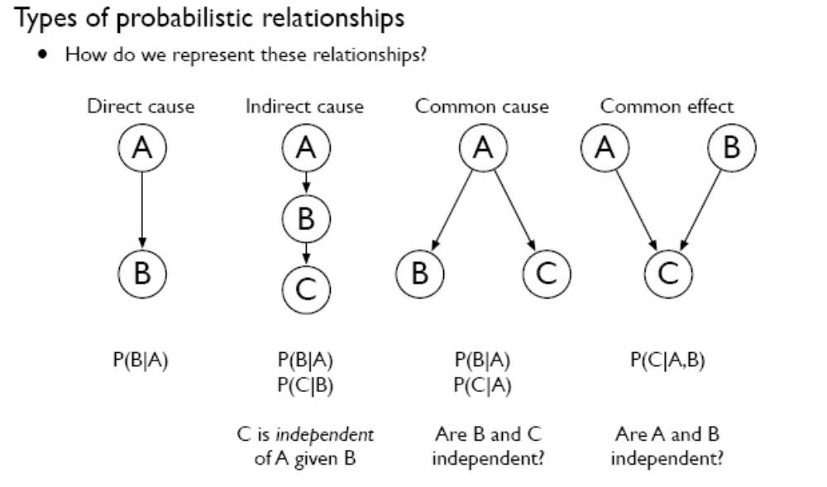

Slide 8
Example
I'm at work, neighbor John calls to say my alarm is ringing, but neighbor Mary doesn't call. Sometimes it's set off by minor earthquakes. Is there a burglar?
Variables: Burglary, Earthquake, Alarm, JohnCalls, MaryCalls
Network topology reflects "causal" knowledge:
  A burglar can set the alarm off
  An earthquake can set the alarm off
  The alarm can cause Mary to call
  The alarm can cause John to call

Slide 9
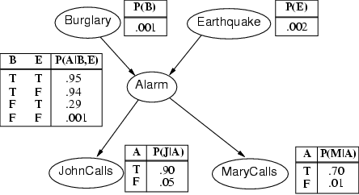
Example contd.

Slide 10
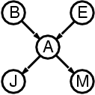
Compactness
A CPT for Boolean X_{i} with k Boolean parents has 2^{k} rows for the combinations of parent values
Each row requires one number p for X_{i} = true
(the number for X_{i} = false is just 1-p)
If each variable has no more than k parents, the complete network requires O(n · 2^{k}) numbers
I.e., grows linearly with n, vs. O(2^{n}) for the full joint distribution
For burglary net, 1 + 1 + 4 + 2 + 2 = 10 numbers (vs. 2⁵-1 = 31)

Slide 11
Semantics
The full joint distribution is defined as the product of the local conditional distributions:
P (X₁, … ,X_{n}) = π_{i = 1} P (X_{i} | Parents(X_{i}))
e.g., P(j ∧ m ∧ a ∧ ¬b ∧ ¬e)
= P (j | a) P (m | a) P (a | ¬b, ¬e) P (¬b) P (¬e)
n

Slide 12
Constructing Bayesian networks
1. Choose an ordering of variables X₁, … ,X_{n}
2. For i = 1 to n
  add X_{i} to the network
  P (X_{i} | Parents(X_{i})) = P (X_{i} | X₁, ... X_{i-1})
This choice of parents guarantees:
P (X₁, … ,X_{n}) = π_{i =1} P (X_{i} | X₁, … , X_{i-1}) (chain rule)
= π_{i =1}P (X_{i} | Parents(X_{i})) (by construction)
However, choosing a bad ordering can lead to bad Bayesian networks!
  select parents from X1, … ,Xi-1 such that
n
n

Slide 13
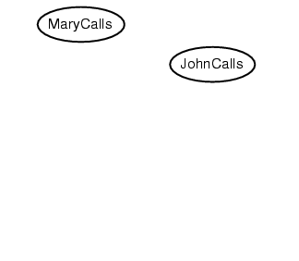
Example
Suppose we choose the ordering M, J, A, B, E
P(J | M) = P(J)?

Slide 14
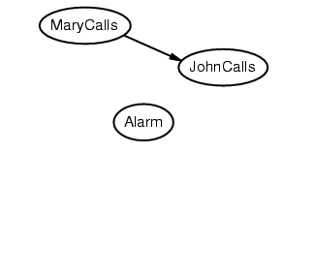
Example
Suppose we choose the ordering M, J, A, B, E
P(J | M) = P(J)?
P(A | J, M) = P(A | J)? P(A | J, M) = P(A)?
No

Slide 15
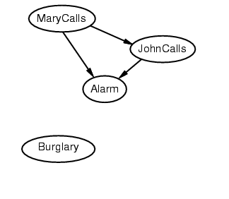
Example
Suppose we choose the ordering M, J, A, B, E
P(J | M) = P(J)? No
P(A | J, M) = P(A | J)? P(A | J, M) = P(A)? No
P(B | A, J, M) = P(B | A)?
P(B | A, J, M) = P(B)?

Slide 16
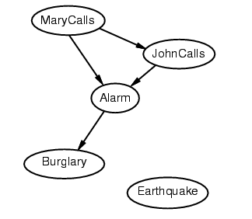
Example
Suppose we choose the ordering M, J, A, B, E
P(J | M) = P(J)?No
P(A | J, M) = P(A | J)? P(A | J, M) = P(A)? No
P(B | A, J, M) = P(B | A)? Yes
P(B | A, J, M) = P(B)? No
P(E | B, A ,J, M) = P(E | A)?
P(E | B, A, J, M) = P(E | A, B)?

Slide 17
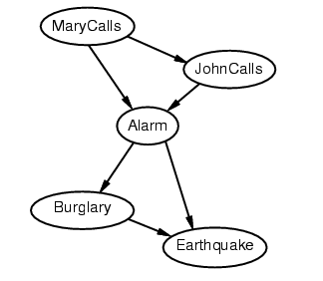
Example
Suppose we choose the ordering M, J, A, B, E
P(J | M) = P(J)?No
P(A | J, M) = P(A | J)? P(A | J, M) = P(A)? No
P(B | A, J, M) = P(B | A)? Yes
P(B | A, J, M) = P(B)? No
P(E | B, A ,J, M) = P(E | A)? No
P(E | B, A, J, M) = P(E | A, B)? Yes

Slide 18
Example contd.
Deciding conditional independence is hard in noncausal directions
(Causal models and conditional independence seem hardwired for humans!)
Network is less compact: 1 + 2 + 4 + 2 + 4 = 13 numbers needed

Slide 19
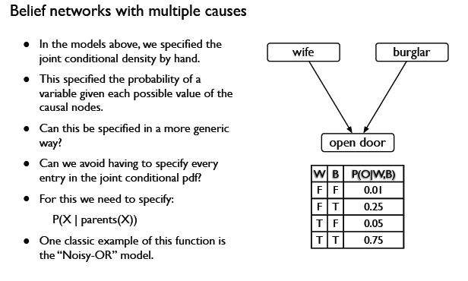

Slide 20
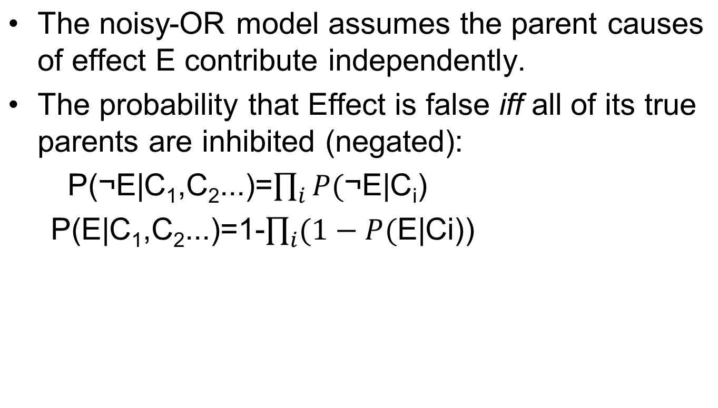
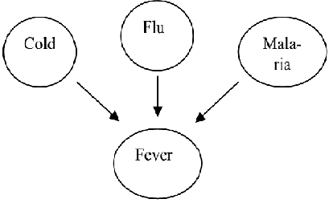
Noisy-OR

Slide 21
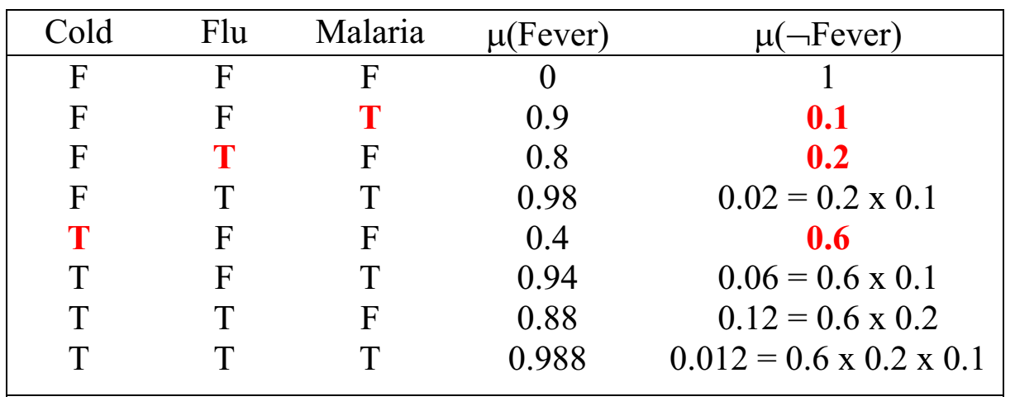
Negated (inhibition) causes ¬C do not have any influence on Effect E:
  P(¬Fever|Flu&Malaria&¬Cold)
  = P(¬Fever|Flu)xP(¬Fever|Malaria)
  =0.2 x 0.1
To represent a Noisy-OR CPT, we need only specify the inhibition probability for each parent node.

Slide 22
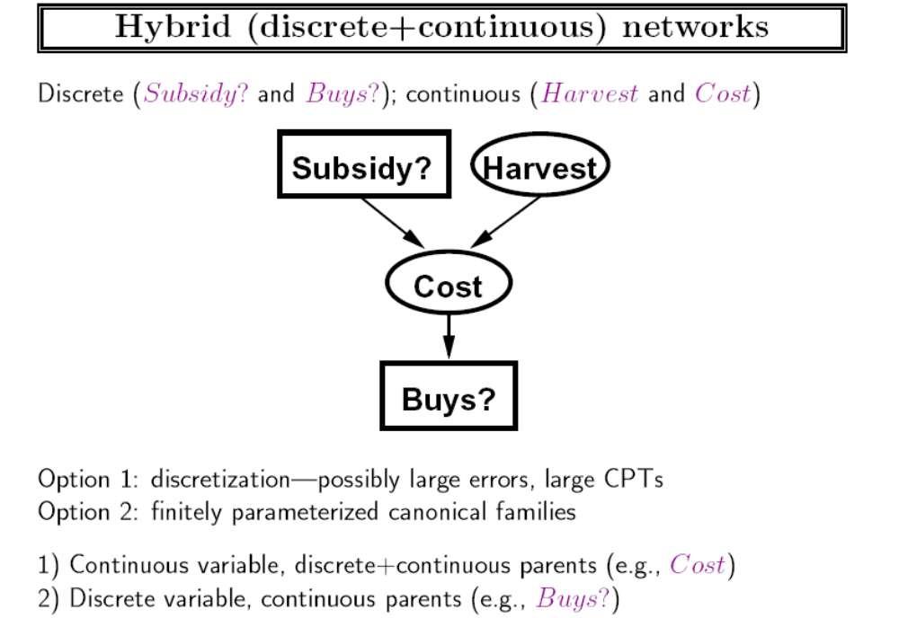

Slide 23
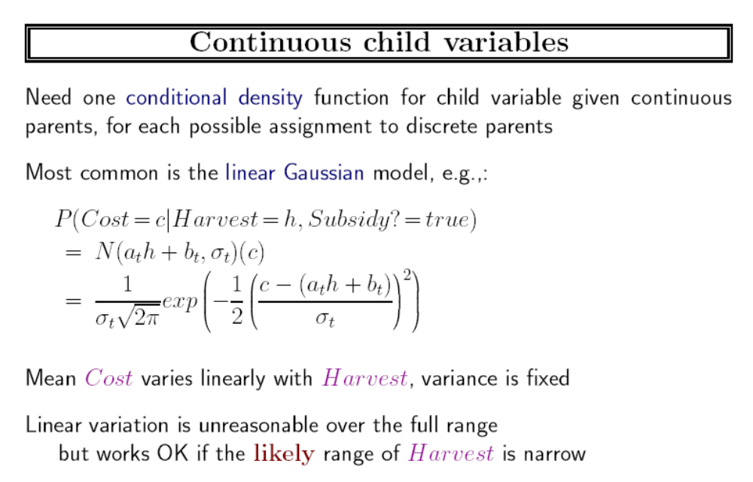

Slide 24
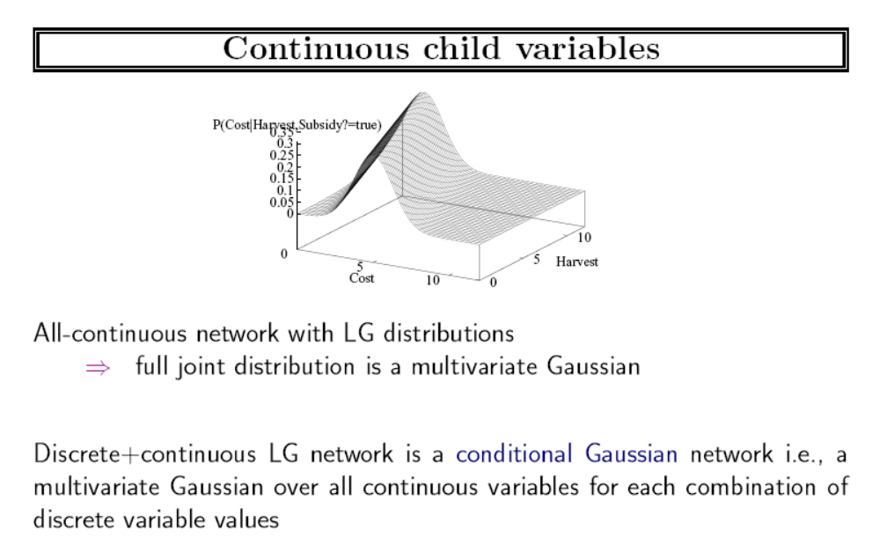

Slide 25
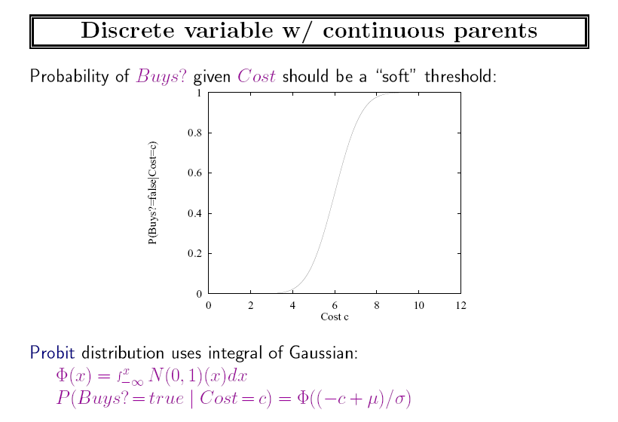

Slide 26
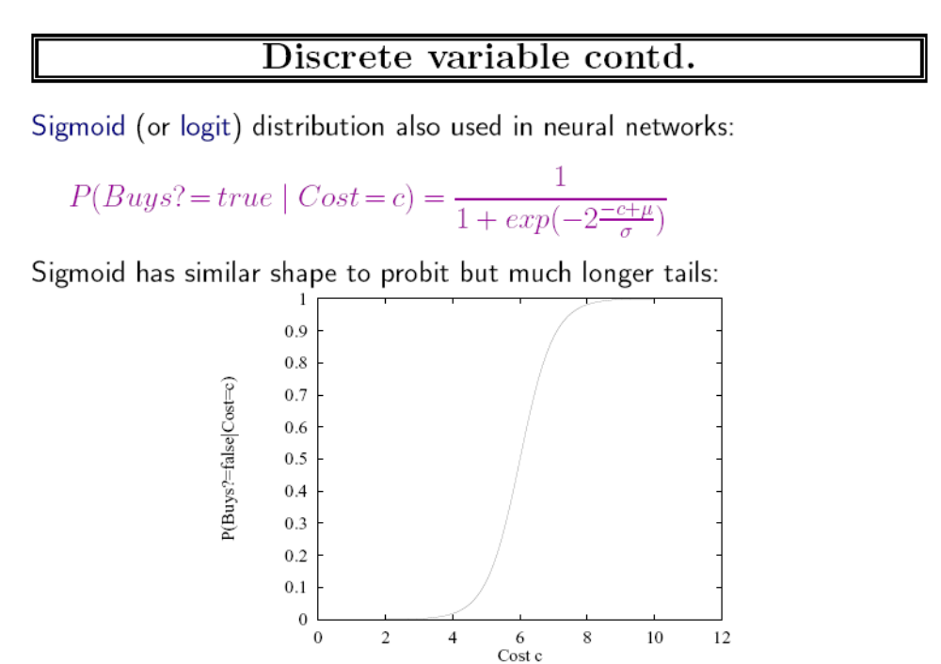

Slide 27
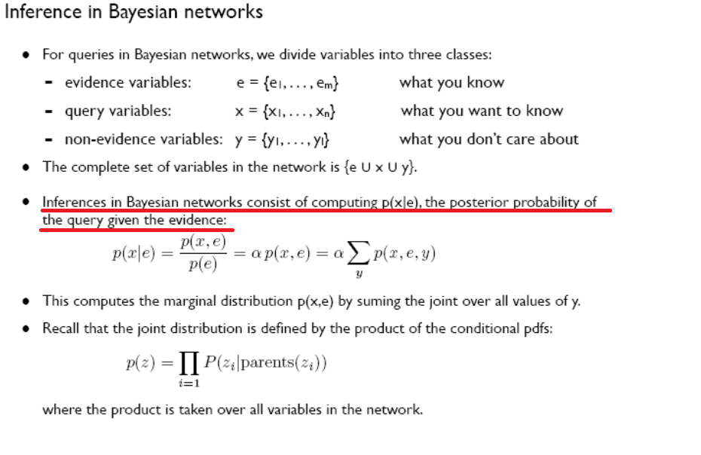

Slide 28
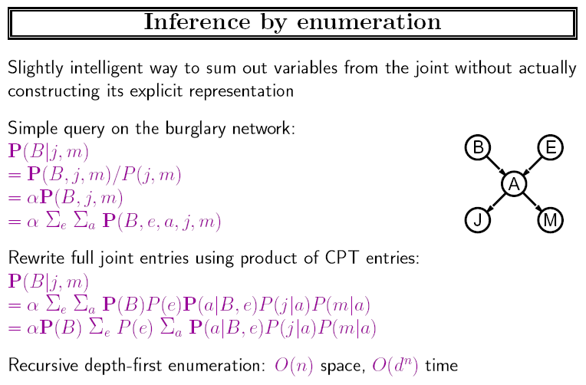

Slide 29
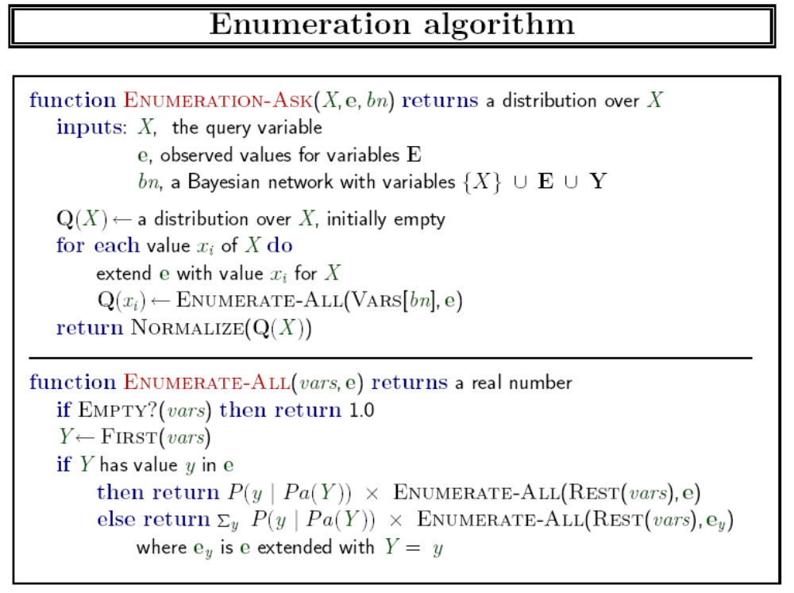

Slide 30
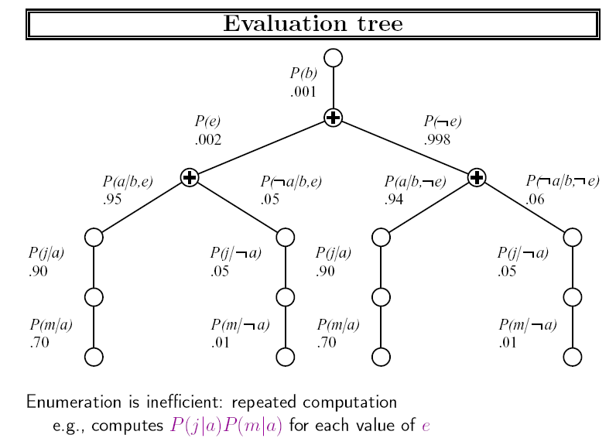

Slide 31
如何避免重复计算
我推荐用hash表实现的cache法
  原理
    enumerate-all 返回时把结果记录在hash表：hash(vars || e)=value
    然后enumerate-all 开始时增加:
    if ((value = hash(vars || e)) != NULL) return value;
变量消去法

Slide 32
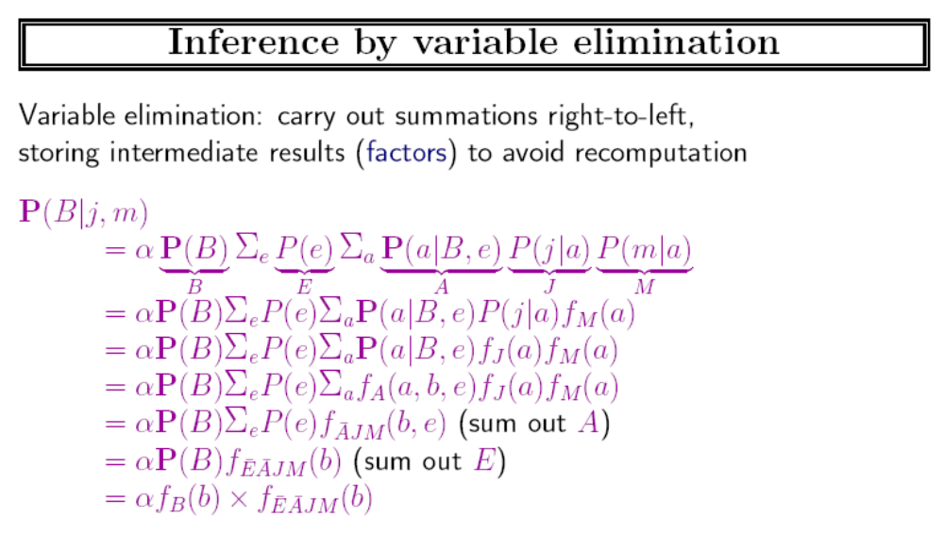

Slide 33
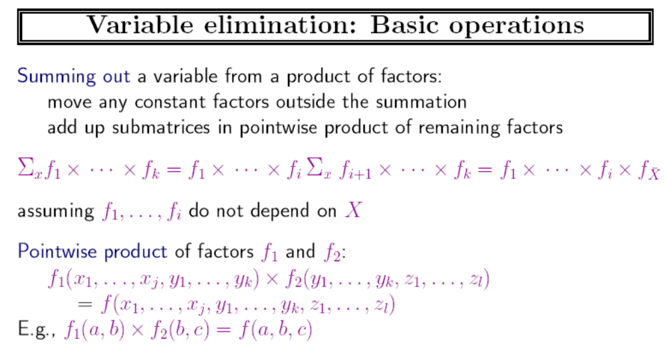

Slide 34
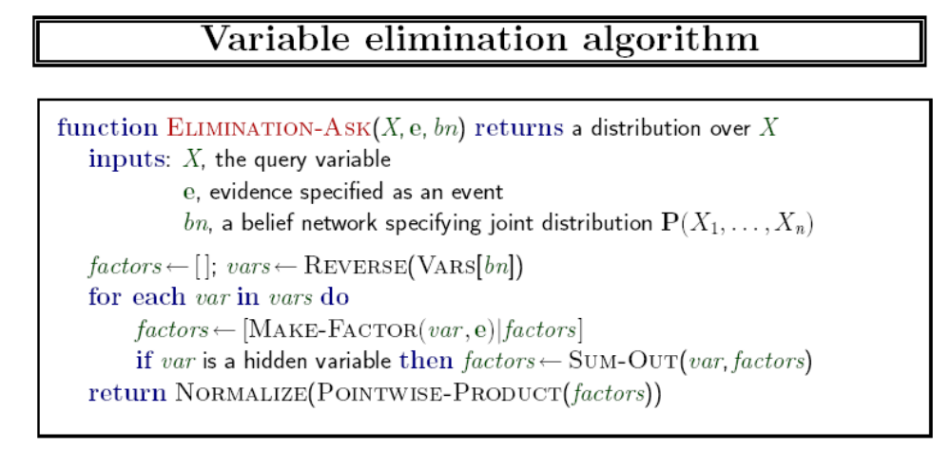

Slide 35
变量消去法实例
Network:
We want to compute P(dyspnea) 呼吸困难
Visit to
Asia
Smoking
Tuberculosis
Lung Cancer
Abnormality
in Chest
Bronchitis
X-Ray
Dyspnea

Slide 36

V
S
Initial factors
Need to eliminate: v,s,x,t,l,a,b
T
L
A
B
X
D

Slide 37
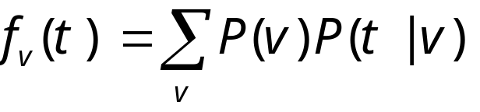
V
S
We want to compute P(d)
Need to eliminate: v,s,x,t,l,a,b
Initial factors
T
L
A
B
X
D
Eliminate: v
Compute:
Note: f_{v}(t) = P(t)
In general, result of elimination is not necessarily a probability term

Slide 38
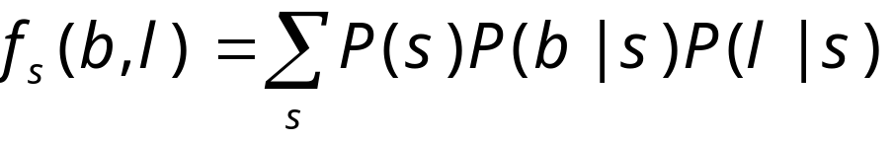
V
S
We want to compute P(d)
Need to eliminate: s,x,t,l,a,b
Initial factors
T
L
A
B
X
D
Eliminate: s
Compute:
Summing on s results in a factor with two arguments f_{s}(b,l)
In general, result of elimination may be a function of several variables

Slide 39
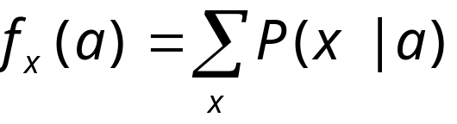
V
S
We want to compute P(d)
Need to eliminate: x,t,l,a,b
Initial factors
T
L
A
B
X
D
Eliminate: x
Compute:
Note: f_{x}(a) = 1 for all values of a !!

Slide 40
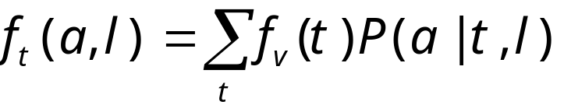
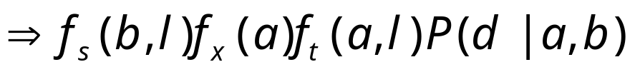
V
S
We want to compute P(d)
Need to eliminate: t,l,a,b
Initial factors
T
L
A
B
X
D
Eliminate: t
Compute:

Slide 41
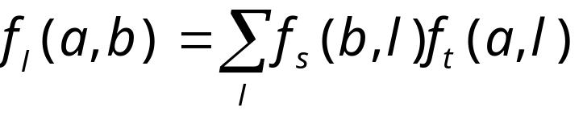
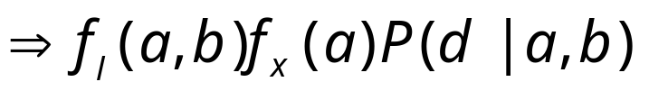
V
S
We want to compute P(d)
Need to eliminate: l,a,b
Initial factors
T
L
A
B
X
D
Eliminate: l
Compute:

Slide 42

V
S
We want to compute P(d)
Need to eliminate: b
Initial factors
T
L
A
B
X
D
Eliminate: a,b
Compute:

Slide 43
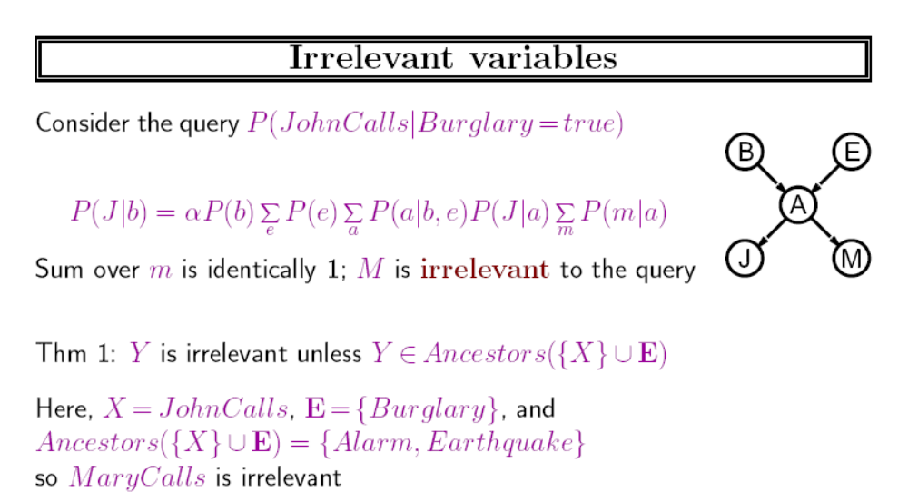

Slide 44
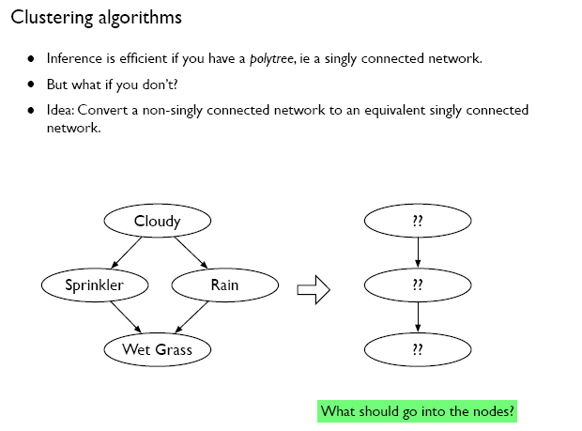

Slide 45
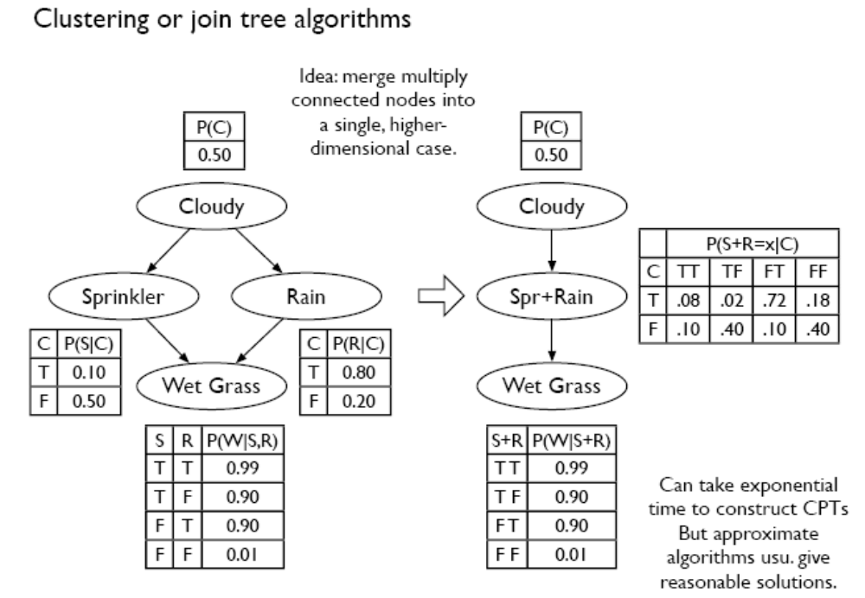

Slide 46
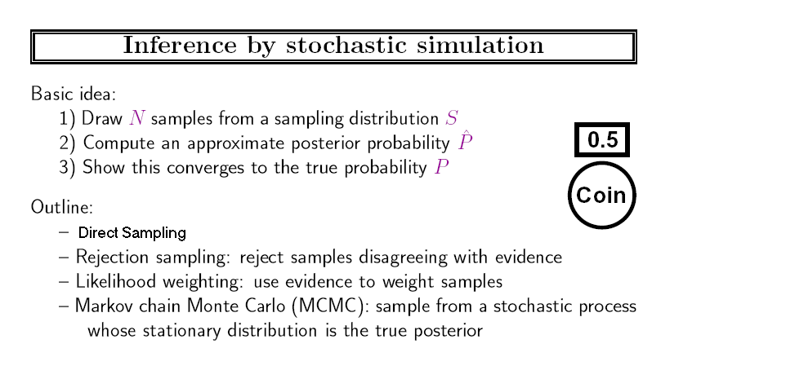

Slide 47
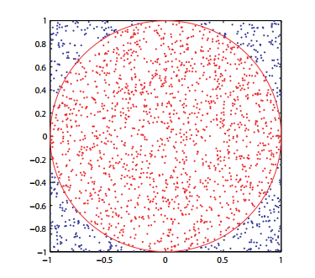
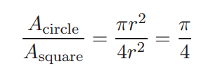
采样的例子：π的计算
计算机采样：也称为Monte Carlo
采样需要用随机数发生器，比如上图需要一个产生0-1间的随机数发生器

Slide 48
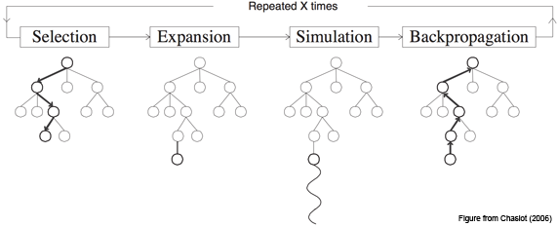

Monte Carlo Tree Search
这是在棋类游戏中经常采用的一种随机树搜索算法
选择使以下公式最大的一着
其中vi=wi/ni ,赢的次数/总访问次数，为节点的估值，N为节点的父节点的访问次数。是exploitation和exploration的结合

Slide 49
采样的计算机实现举例
假设我们要采样一个概率分布为<0.4762,0.5238> (分别为true,false的概率)
的布尔变量，可以由计算机生成一个随机数q∈[0,1] ，假设生成的随机数q=0.0389，因 0.4762 > 0.0389，
所以，采样结果为真

Slide 50
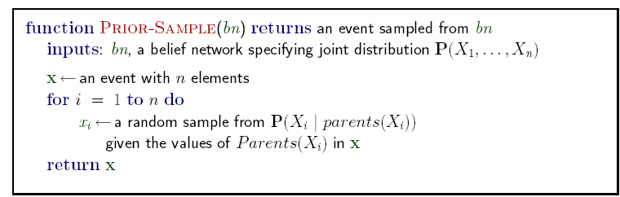
直接采样

Slide 51
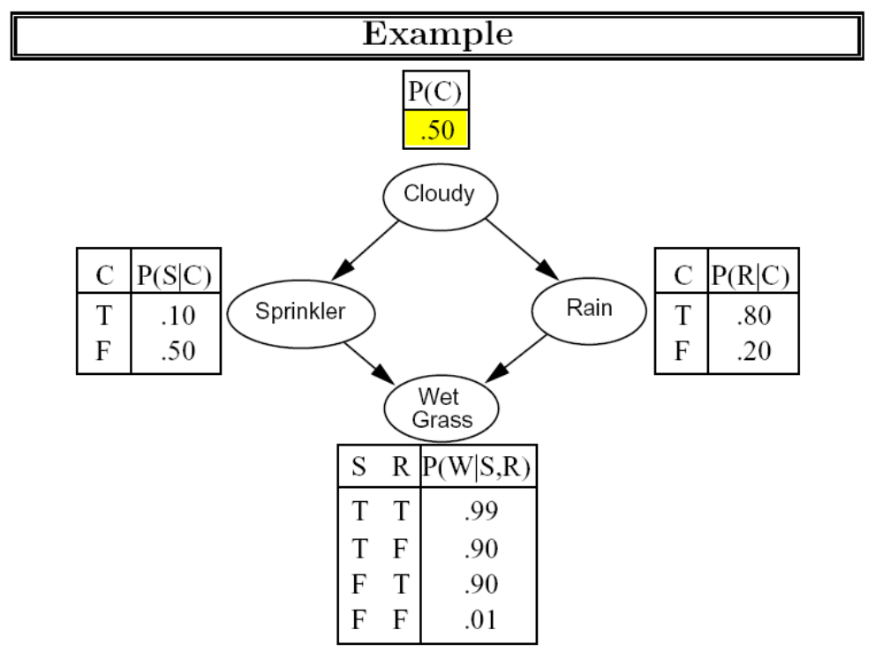

Slide 52
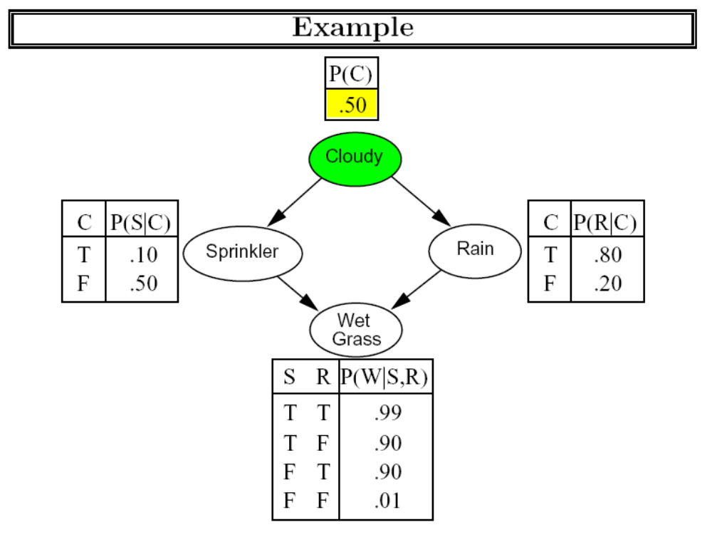

Slide 53
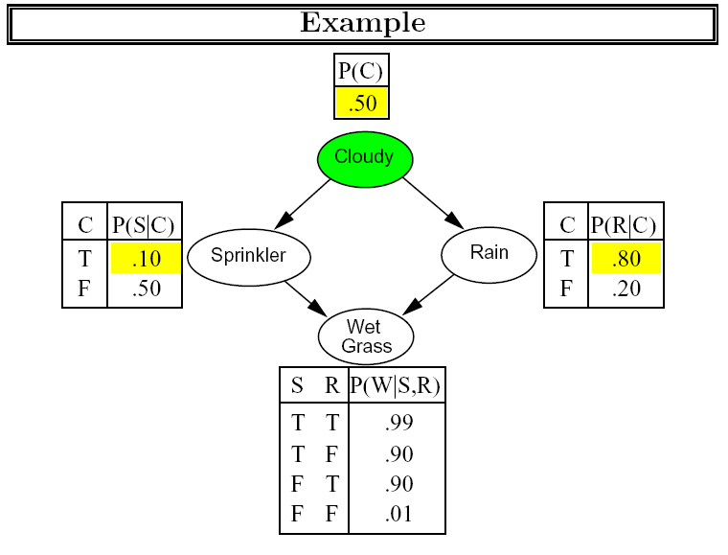

Slide 54
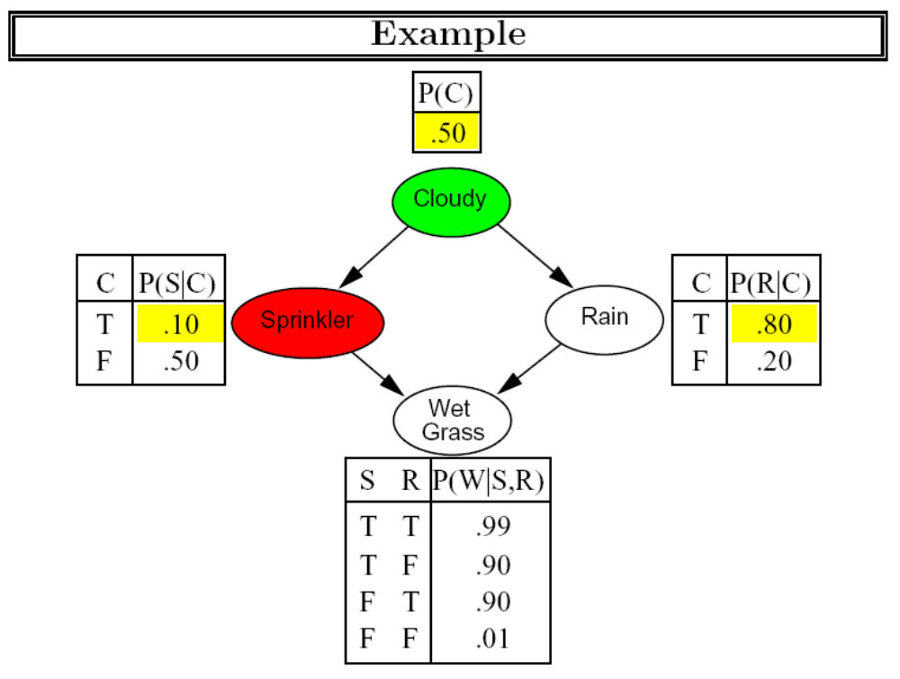

Slide 55
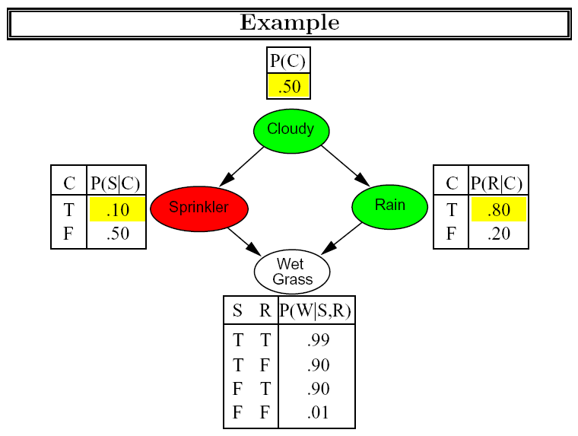

Slide 56
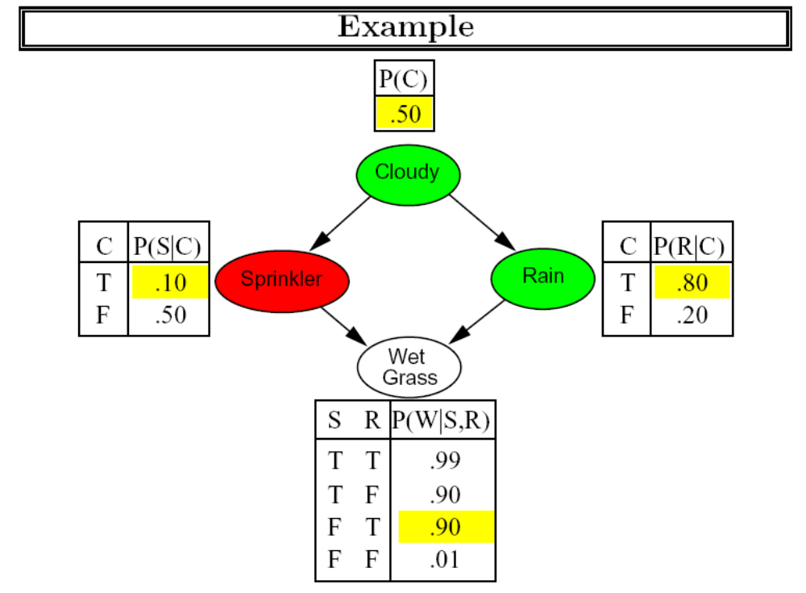

Slide 57
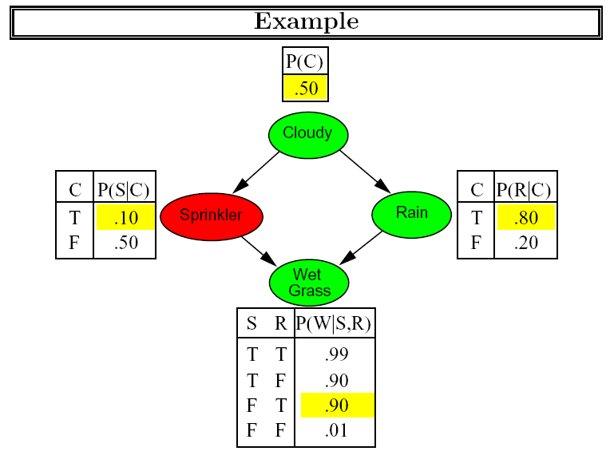

Slide 58
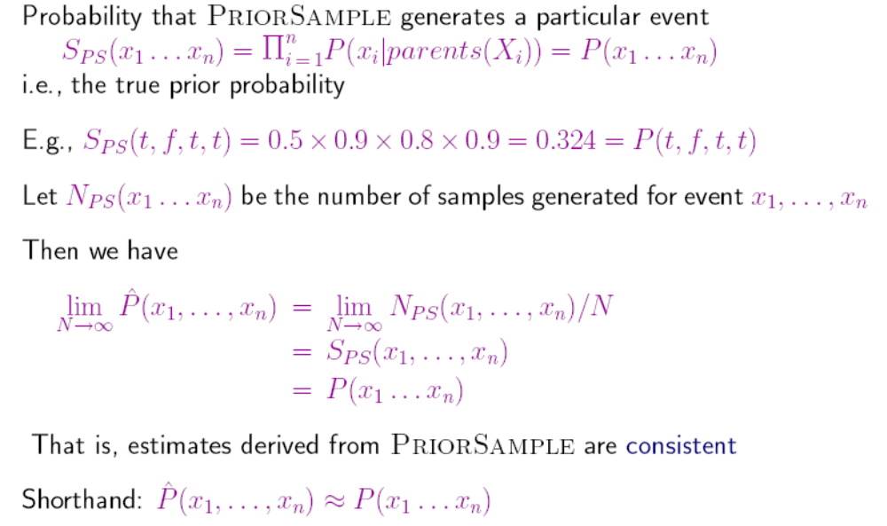
直接采样

Slide 59
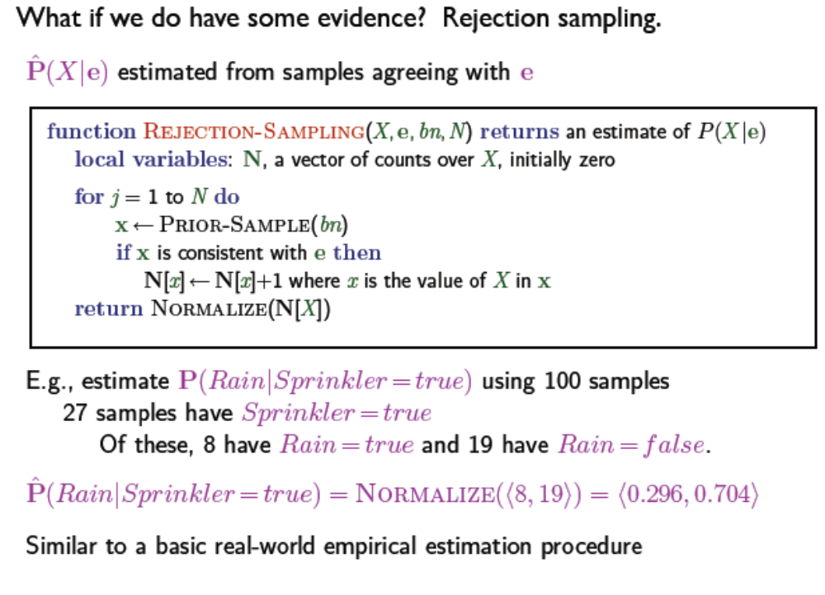
注意：当采样结果与证据不符时，不算！

Slide 60
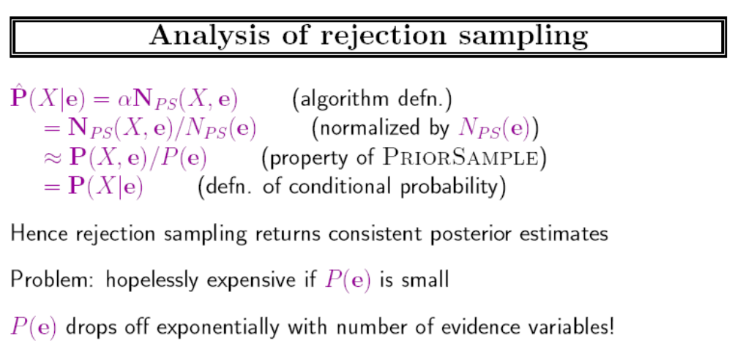

Slide 61
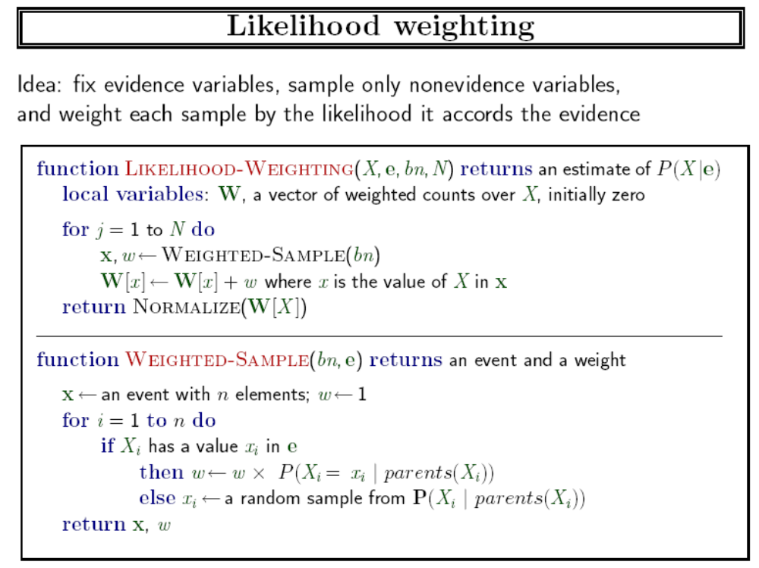

Slide 62


Slide 63


Slide 64


Slide 65


Slide 66


Slide 67


Slide 68


Slide 69
MCMC采样
两个MC意思不同：
  第一个是Markov Chain
  第二个是Monte Carlo
下面介绍的一种MCMC采样也称为Gibbs采样

Slide 70
Markov Chain
A stochastic process, or sometimes random process, is a collection of random variables, representing the evolution of some system of random values over time.
A Markov chain, named after Andrey Markov, is a mathematical system that undergoes transitions from one state to another on a state space. It is a random process usually characterized as memory limited

Slide 71



马尔可夫链的数学描述
马尔可夫链是一种简化的随机过程，假设一个状态只依赖于前一状态（称为马尔可夫性质）
稳态 Stationary:
转移概率与时间点无关
Chapman-Kolomogrov equation

Slide 72



定义probability transition matrix P，其元素P(i,j)正是状态间的转移概率，则
故
一般地

Slide 73

Markov chain may reach a stationary distribution
几个术语：
  Irreducibility(不可约): every state is eventually reachable from any start state (with non-zero probability)
  Aperiodicity(非周期性): the chain doesn’t get caught in cycles;
  The Markov process is ergodic (遍历各态) if it is both irreducible and aperiodic

Slide 74
the Markov blanket （马尔可夫覆盖）for a node in a Bayesian network is the set of nodes composed of its parents, its children, and its children’s other parents. （两圆圈之间的区域）
性质：给定其马尔可夫覆盖，节点X条件独立于贝叶斯网络中所有其它节点。
U₁
U_{m}
X
Z_{1j}
Z_{nj}
Y₁
Y_{n}

Slide 75


Slide 76
Gibbs采样
按照马尔可夫链的马尔可夫覆盖的转移概率进行采样
Gibbs sampling is applicable when the joint distribution is not known explicitly or is difficult to sample from directly, but the conditional distribution of each variable is known and is easy (or at least, easier) to sample from. The Gibbs sampling algorithm generates an instance from the distribution of each variable in turn, conditional on the current values of the other variables.

Slide 77


Slide 78


Slide 79
MCMC算法执行过程示例：
P(C)
0.50
Cloudy
C | P(S)
t f | 0.10 0.50
C | P(R)
t f | 0.80 0.20
Sprinkler
Rain
S R | P(W)
t t t f f t f f | 0.99 0.90 0.90 0.00
Wet
Grass
【要求】：计算P(Rain | Sprinkler = true, WetGrass = true)的概率

Slide 80
MCMC算法执行步骤：
  证据变量Sprinkler, WetGrass固定为true
  隐变量Cloudy和查询变量Rain随机初始化，例如， Cloudy = true, Rain = false，初始状态为：[C=true, S=true, R=false, W=true]
  反复执行如下步骤：
  （1） 根据Cloudy的马尔可夫覆盖(MB)变量的当前值，对Cloudy采样，即根据P(Cloudy|Sprinkler= true, Rain=false)来采样：
  P(C|S, ~R) = P(C,S,~R) / P(S, ~R) = P(C)P(S|C)P(~R|C) / [P(C)P(S|C)P(~R|C)+P(~C)P(S|~C)P(~R|~C)]
  =(0.5×0.1×0.2) / [0.5×0.1×0.2+0.5× 0.5×0.8]=0.04762

Slide 81
假设采样结果为：Cloudy = false。故新的当前状态为：
  [C=false, S=true, R=false, W=true]
（2） 根据Rain节点的马尔可夫覆盖(MB)变量的当前值，对Rain采样，即根据P(Rain | Cloudy = false, Sprinkler = true, WetGrass = true)来采样。假设采样结果为：Rain = true。故新的当前状态为：
  [C=false, S=true, R=true, W=true]
  【注】： 上述过程中所访问的每一个状态都是一个样本，能对查询变量Rain的估计有贡献。

Slide 82
  （3）重复上述步骤，直到所要求的访问次数N。
  若为true, false的次数分别为n₁, n₂，则查询解为：
  Normalize(<n₁, n₂>) = < n₁ /N, n₁ /N>
  若上述过程访问了20个Rain=true的状态和60个Rain = false的状态，则所求查询的解为<0.25, 0.75>。

Slide 83
采样和burn in
一个马尔可夫链需要经过多次的状态转移过程采用达到一个稳定状态，这时候采样才比较接近真实的分布。此过程称为burn in。一般可通过丢弃前面的N个采样结果来达到burn in。

Slide 84
贝叶斯网络学习
放到机器学习部分再讨论

Slide 85

Pomegranate
一个高效的概率建模Python工具包
支持概率模型
  一般混合模型
  隐马尔可夫模型
  贝叶斯网络
  贝叶斯分类器
由2个硕士生研发！
https://github.com/jmschrei/pomegranate

Slide 86
Summary
Bayesian networks provide a natural representation for (causally induced) conditional independence
Topology + CPTs = compact representation of joint distribution
Generally easy for domain experts to construct
Canonical distributions (e.g., noisy-OR) = compact representation of CPTs
Continuous variables => parameterized distributions (e.g., linear Gaussian)

Slide 87
Summary
Exact inference by variable elimination:
  polytime on polytrees, NP-hard on general graphs
  space = time, very sensitive to topology
Approximate inference by LW, MCMC:
  LW does poorly when there is lots of (downstream) evidence
  LW, MCMC generally insensitive to topology
  Convergence can be very slow with probabilities close to 1 or 0
  Can handle arbitrary combinations of discrete and continuous variables

Slide 88
课外阅读
阅读以下文献：
  Adnan Darwiche, Bayesian Networks, communications of the acm, 2010, 53(12)
  C. Andrieu et al. Jordan. An introduction to MCMC for machine learning. Machine Learning, 2003, 5: 5-43.
阅读以下参考书： W. R. Gilks, 1995 : Markov Chain Monte Carlo in Practice

Slide 89

作业
阅读网络文献，了解什么是Gibbs Sampling，并知道如何实现。

