Slide 1
时序概率推理
Chapter 15
Section 1 – 5

Slide 2
内容大纲
时间和不确定性
时序模型中的推理
隐马尔可夫模型
Kalman滤波器
动态贝叶斯网络
语音识别

Slide 3
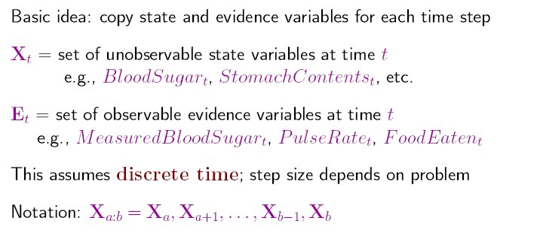
时间与不确定性
动态世界中随机变量的取值随时间而变
例子：糖尿病人的各种诊断指标

Slide 4
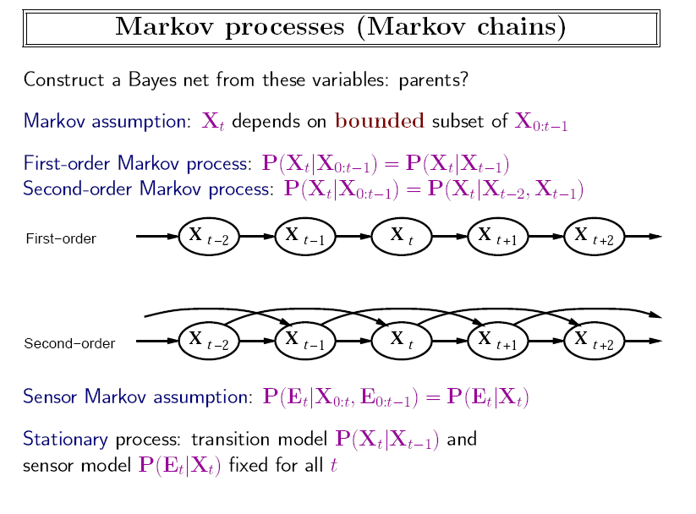
与t无关
Notes:
与t无关

Slide 5
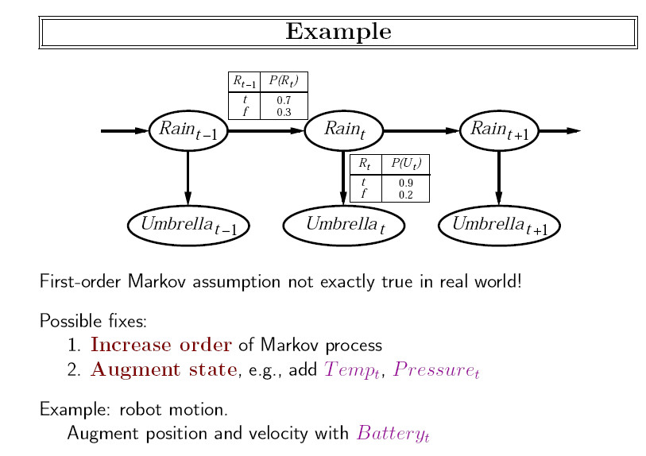

Slide 6
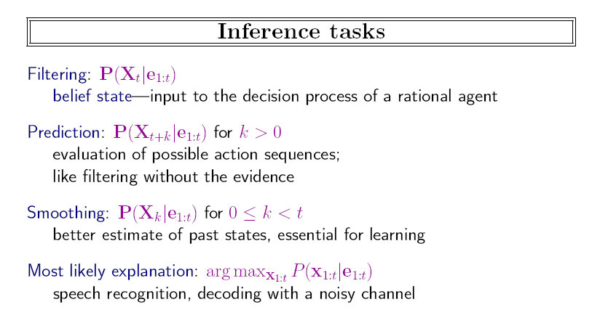
为什么叫filtering

Slide 7
为什么叫filtering
Filtering:去伪存真。
术语源于信号处理。

Slide 8
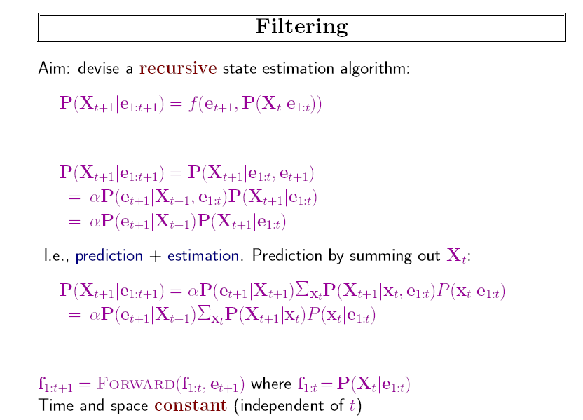
前一项是sensor，后一项是预测
连续分布用积分代替累加
“Forward message”

Slide 9
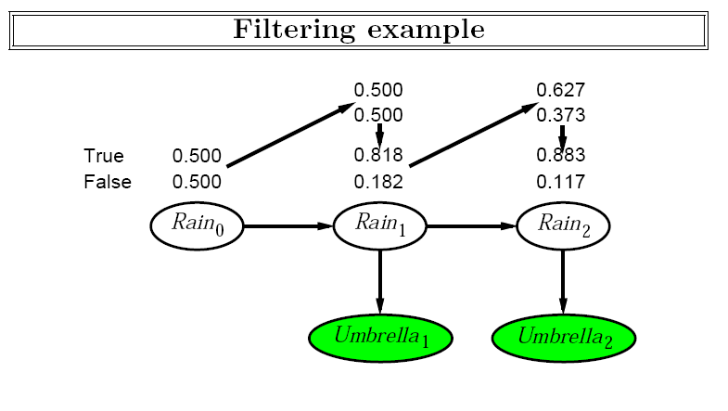
P(R1|u1)=αP(R1)P(u1|R1)= α<0.5,0,5><0.9,0.2>= α<0.45,0.1> =<0.818,0.182>
P(R2|u1)=∑_{r1}P(R2|r1)P(r1|u1)= <0.7,0.3>*0.818+<0.3,0.7>*0.182=<0.627,0,373>
P(R2|u1,u2)=αP(u1)P(R2|u1)P(u2|R2,u1)= αP(R2|u1)P(u2|R2) =α<0.63,0.37><0.9,0.2>= α<0.565,0.075>=<0.883,0.117>

Slide 10
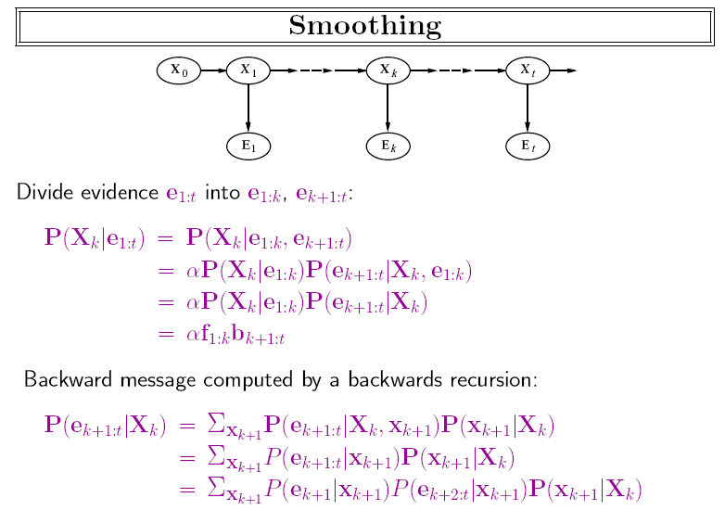

Slide 11
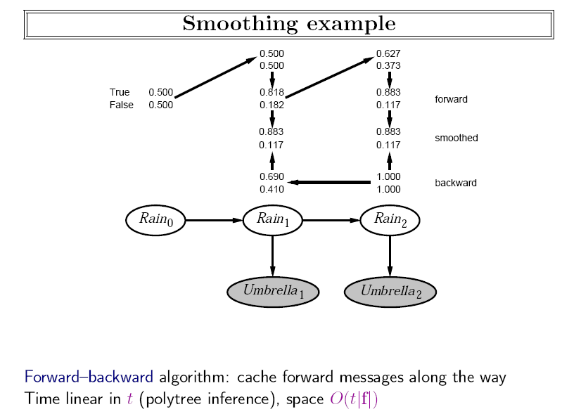
P(u2|R1)
=∑_{r2}P(r2|R1)P(u2|r2)=<0.7,0.3>0.9+
<0.3,0.7>0.2
=<0.69,0.41>
P(R1|u1,u2)
= α P(R1|u1)P(u2|R1)
= α <0.818,0.182>*
<0.69,0.41>
=<0.883,0.117>

Slide 12
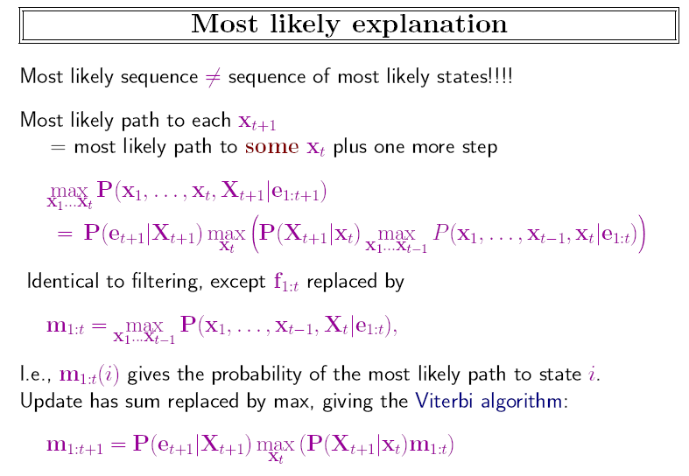
最有用！

Slide 13
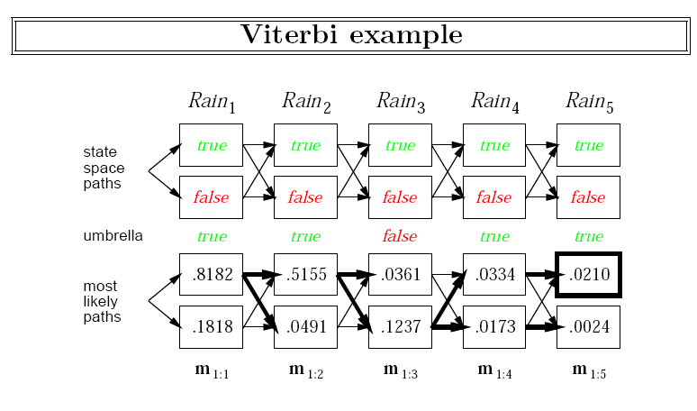

Slide 14
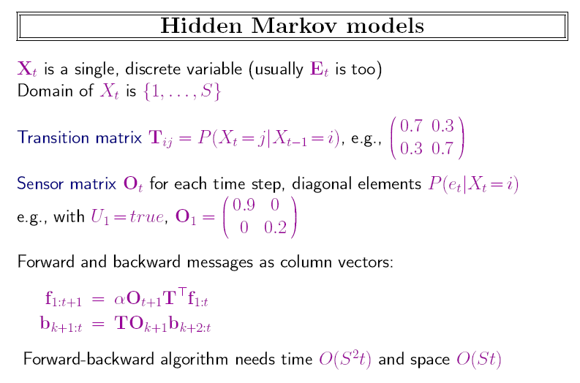

Slide 15
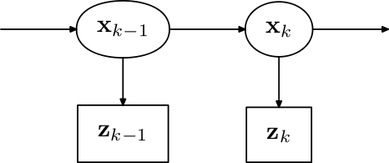
Bayes Filter
对连续随机变量的filter，又称为Bayes Filter
x:状态, z:度量（=证据e）, u:控制
  p(z_{t} |x_{0:t}, z_{1:t−1}, u_{1:t}) = p(z_{t} |x_{t})
  p(x_{t}|u_{t},x_{t-1}) = p(x_{t}|x_{t-1})

Slide 16
Bayes Filter
预测
p(x_{t}|z_{1:t-1}) = ∫p(x_{t}|x_{t-1})P(x_{t-1}|z_{1:t-1})dx_{t-1}
滤波
根据贝叶斯公式：
p(x_{t}|z_{1:t}) = αp(z_{t} |x_{t}) p(x_{t}|z_{1:t-1})

Slide 17
Bayes Filter
常见Bayes滤波器
  卡尔曼滤波器(Kalman filter)： 假设随机变量服从多元正态分布（multivariate normal distributions )
  粒子滤波器(particle filter)：一种基于顺序蒙特卡洛的技术，使用一组离散点对概率密度函数进行建模

Slide 18
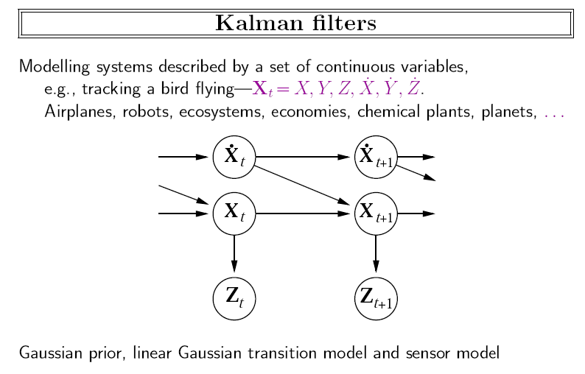

Slide 19
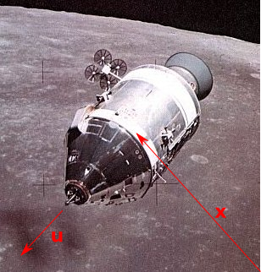
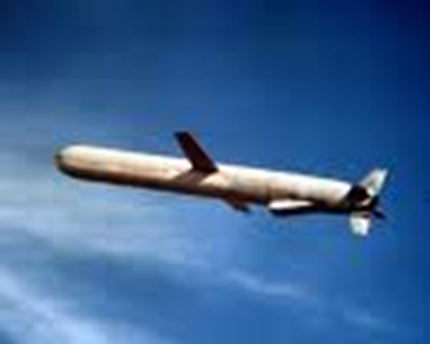
Application of Kalman Filter
NASA Apollo navigation and U.S. Navy’s Tomahawk missile

Slide 20
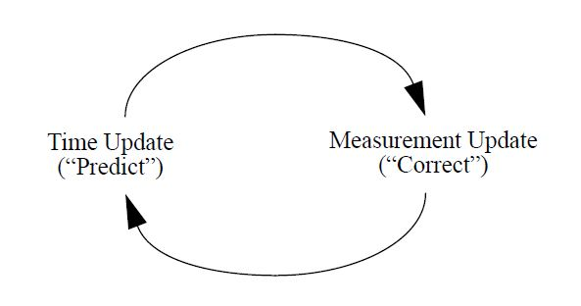
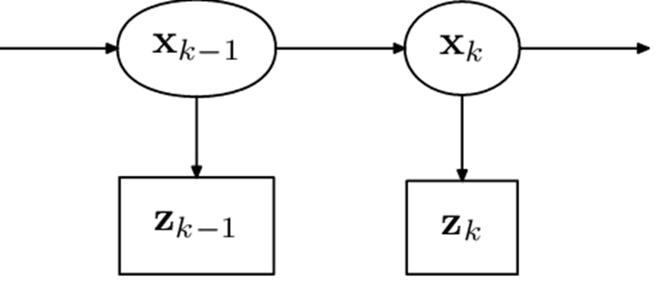
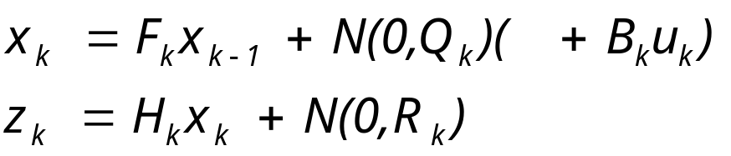
卡尔曼滤波：马尔科夫假设+线性高斯分布
Hidden Markov Model
Kalman filtering
The predict phase uses the state estimate from the previous timestep to produce an estimate of the state at the current timestep. This predicted state estimate is also known as the a priori state estimate. In the update phase, the current a priori prediction is combined with current observation information to refine the state estimate. This improved estimate is termed the a posteriori state estimate.

Slide 21
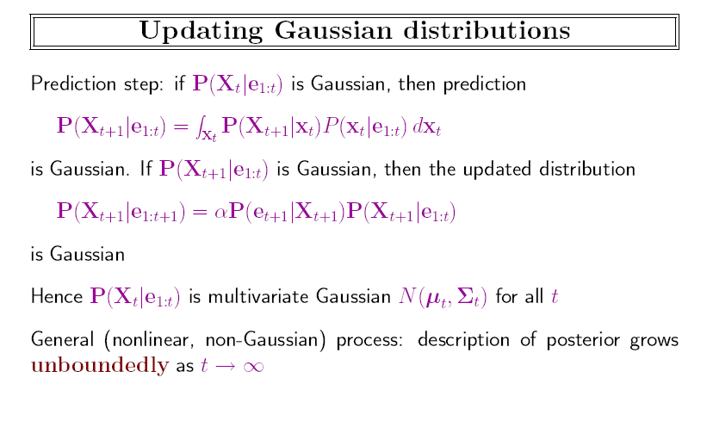

Slide 22
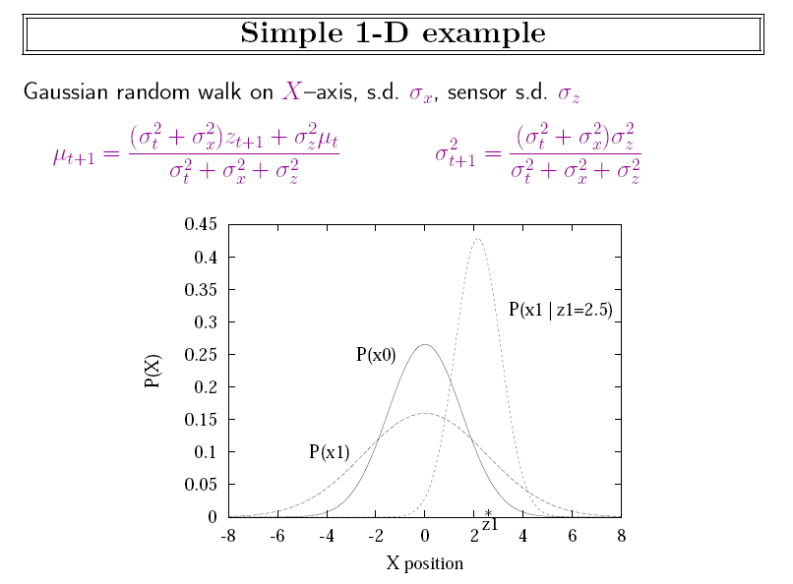

Slide 23
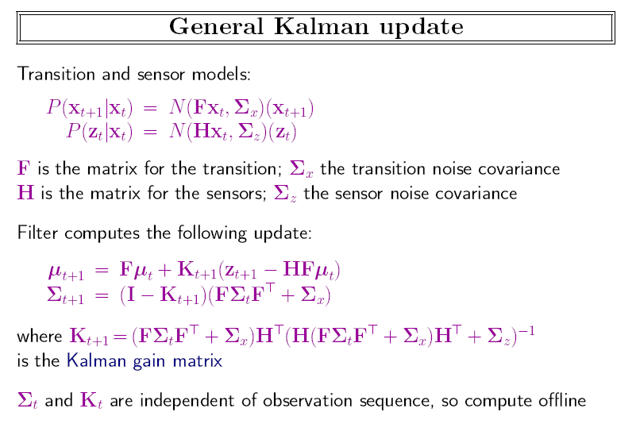

Slide 24
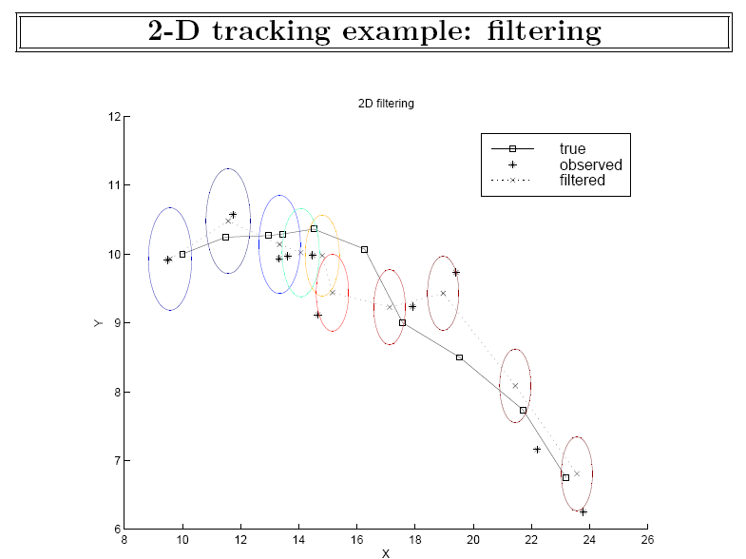

Slide 25
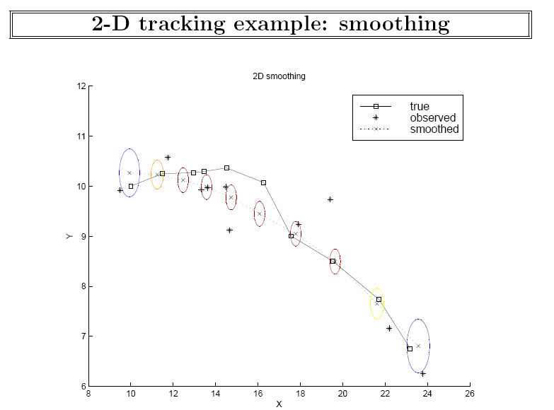

Slide 26
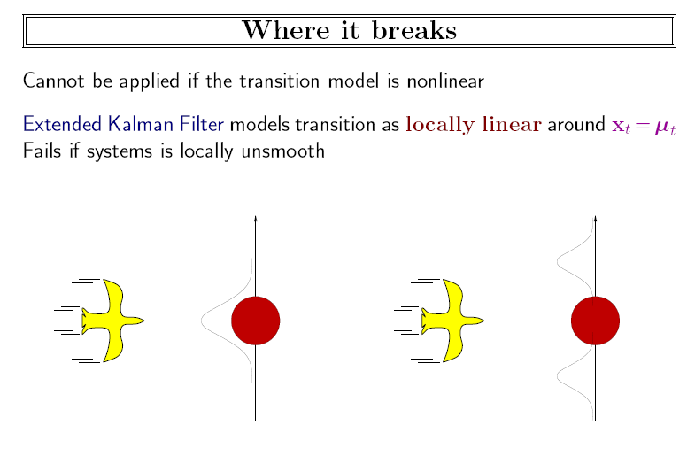

Slide 27
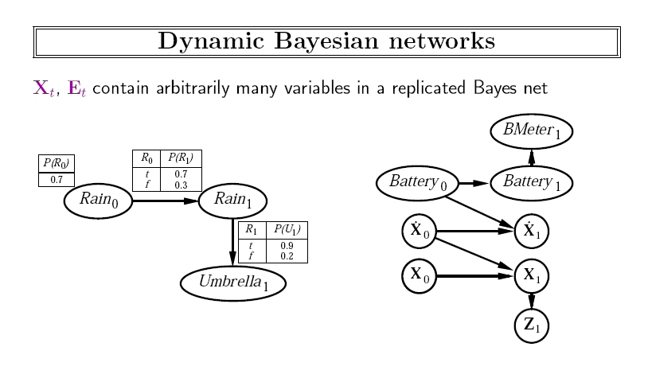
随机变量以时间索引的贝叶斯网络

Slide 28
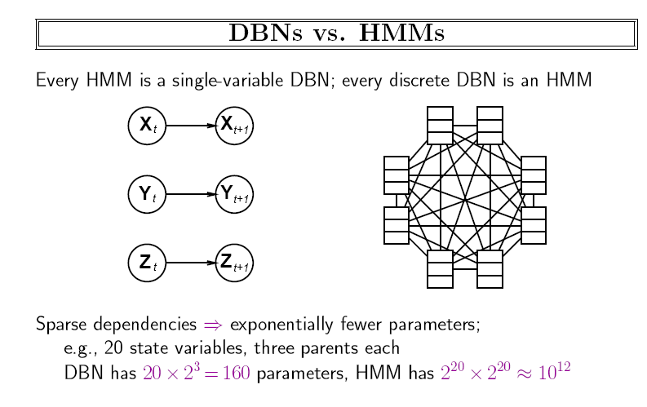

Slide 29
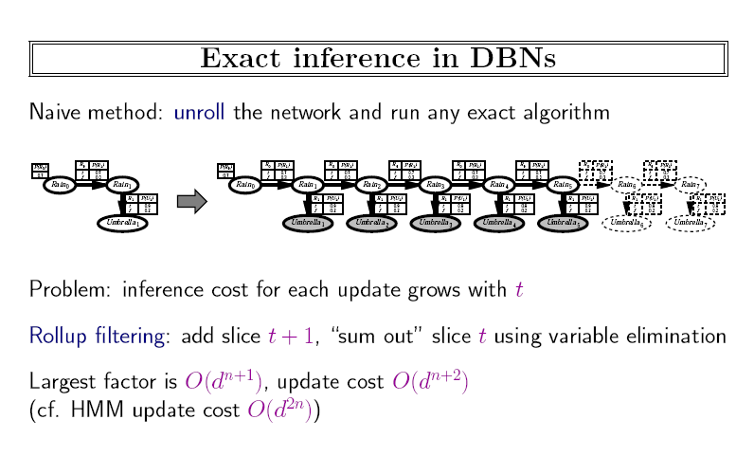

Slide 30
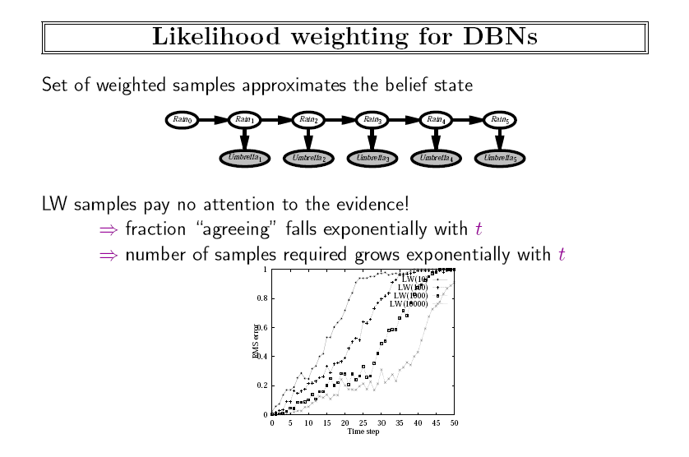
Particle filtering

Slide 31
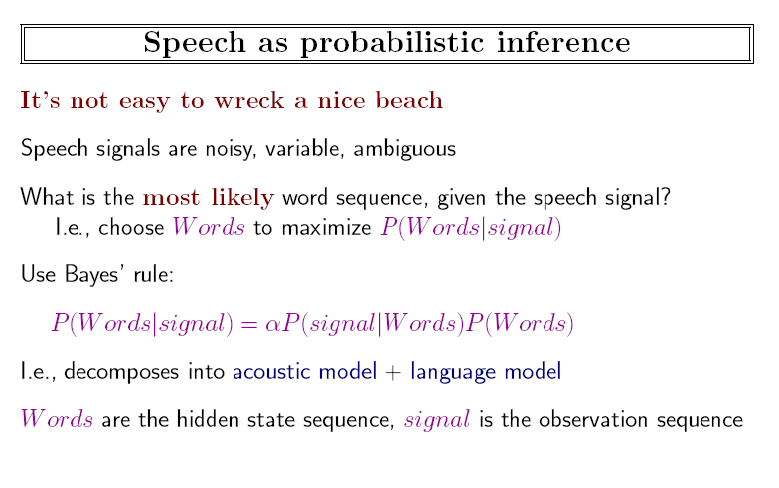

Slide 32
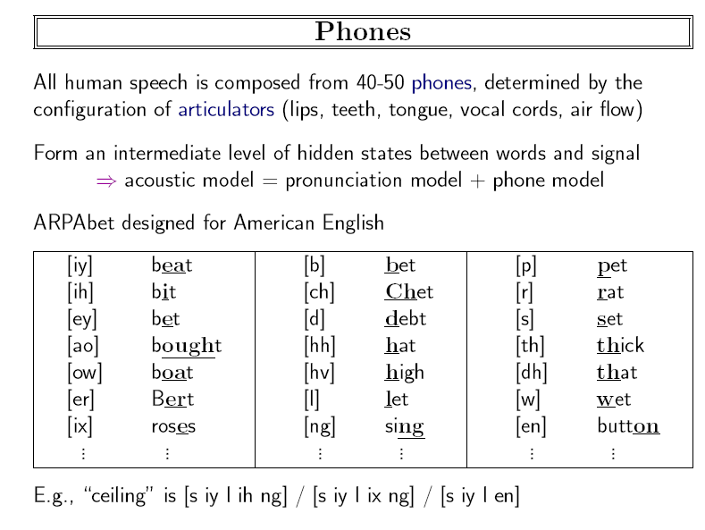

Slide 33
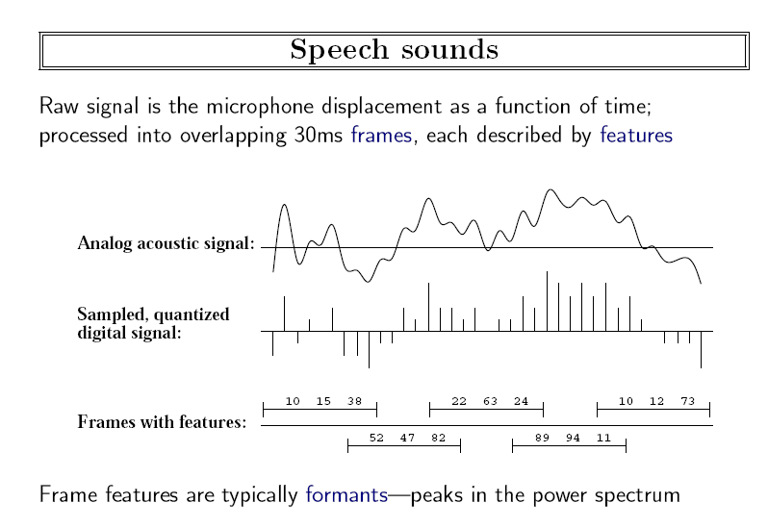

Slide 34
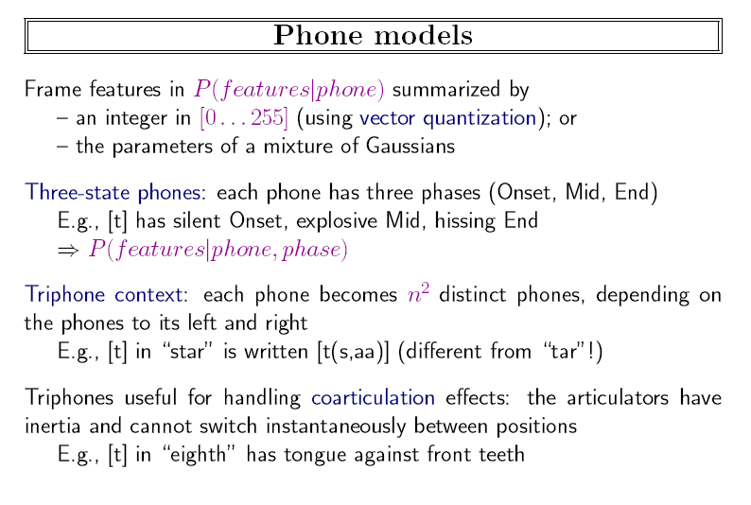
3n³

Slide 35
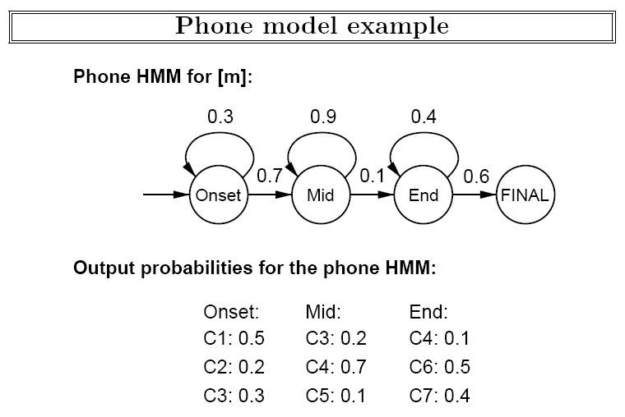

Slide 36
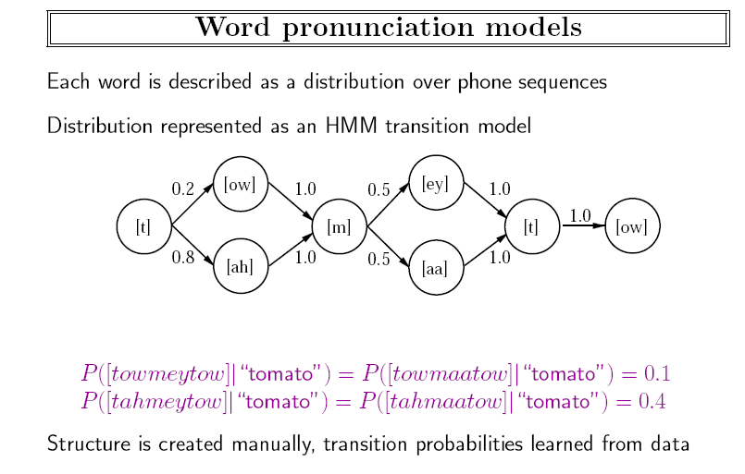

Slide 37
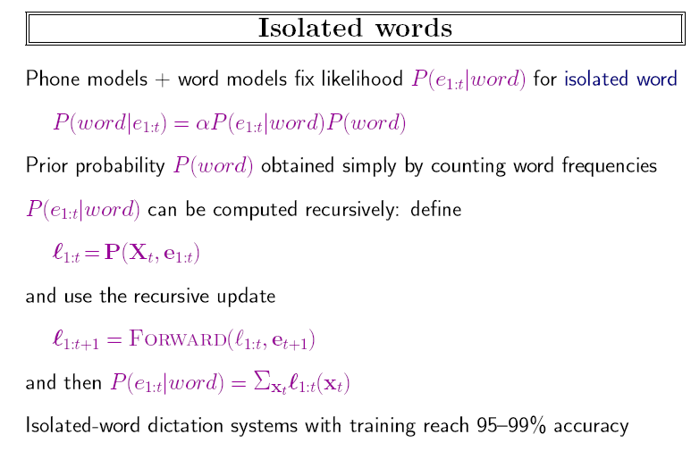
Each word has many state sequences: “tomato”

Slide 38
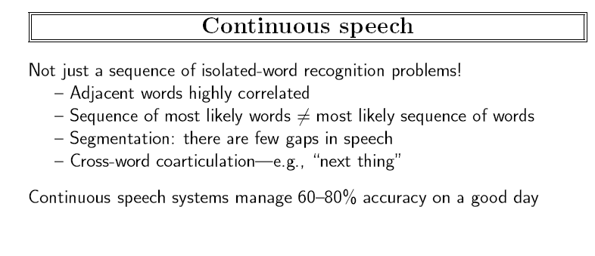

Slide 39
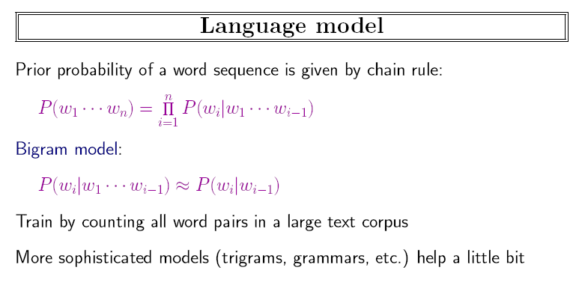

Slide 40
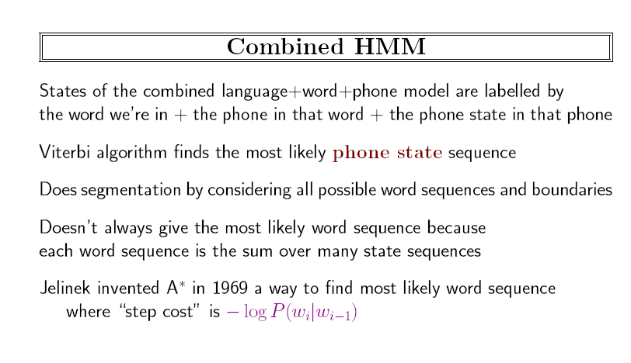


Slide 41
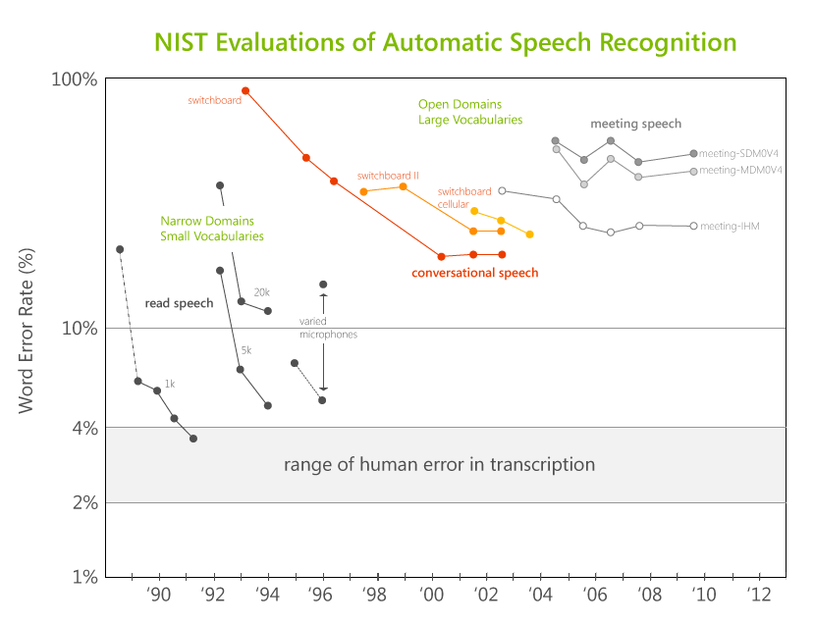

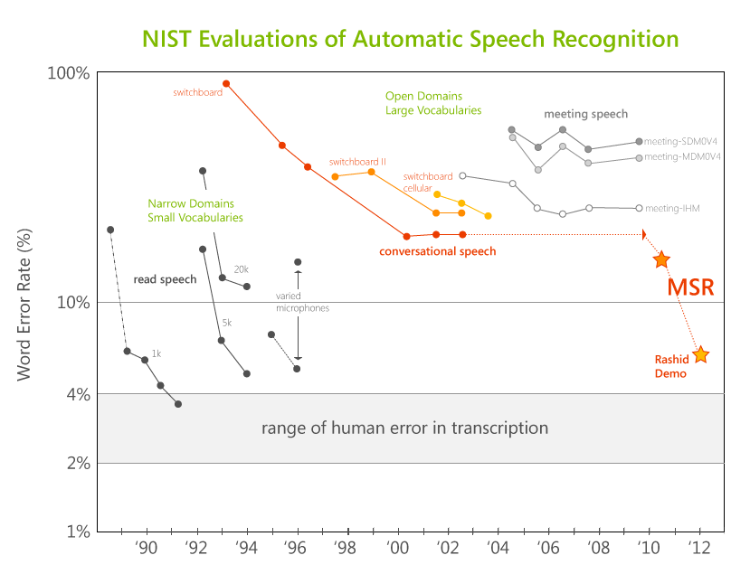
Automatic Speech Recognition via deep NN
After no improvement for 10+ years by the research community…
…MSR reduced error from ~23% to <15% (and under 7% for Rick’s demo)!
Li Deng (MSRR), Dong Yu (MSRR), & Geoffrey Hinton (Utoronto);
Frank Seide (MSRA)
Notes:
These advances have been achieved through the application of deep neural networks. We will explain a little bit about how DNNs work and why they might be important, but first let’s take a look at the stunning impact on speech recognition.
The US government has been funding R&D in speech recognition for over 25 years, and as part of its research programs conducts tests of the effectiveness of the best systems. This graph shows the results of these tests, from 1988 to 2011, with the measure of effectiveness being the Word Error Rate (WER). In the early years, the best speech systems worked only in very narrow domains, such as air travel planning. While narrow, very good performance could be achieved, on par with human capability.
But in open-domain situations, such as meeting transcription and television news captioning, the results have not been so good. Consider the very important Switchboard benchmark, which today is the standard used by the research community. In the late 1990’s there was good progress, but for the past decade this plateaued and in all systems the research showed essentially no progress.
In joint research with the University of Toronto, by applying deep learning to speech recognition we achieved last year an astounding improvement in error rate. This made all the difference for the demo in China. In fact, for Rick’s speech, the speech recognition system exhibited an error rate of less than 7%!

Slide 42
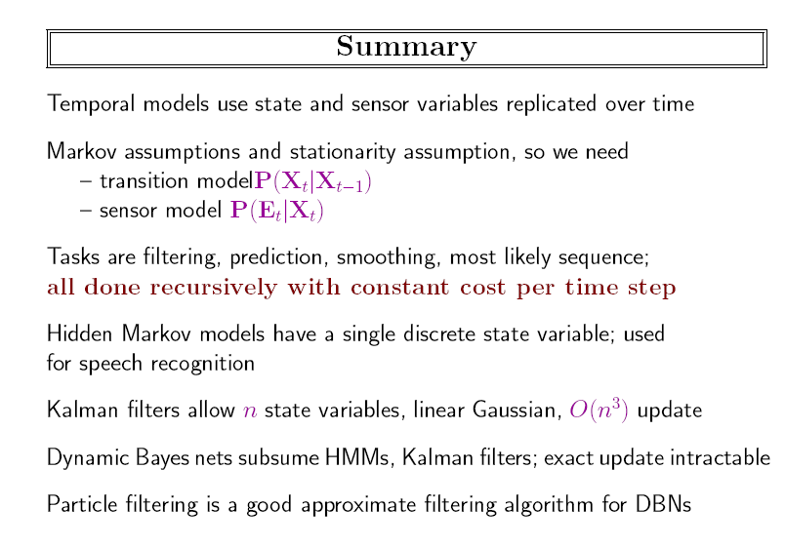

Slide 43
论文选读
Greg Welch and Gary Bishop,卡尔曼滤波器介绍
Sebastian THRUN等， PROBABILISTIC ROBOTICS

Slide 44
作业
15.2 In this exercise, we examine what happens to the probabilities in the umbrella world in the limit of long time sequences.
  a. Suppose we observe an unending sequence of days on which the umbrella appears. Show that, as the days go by, the probability of rain on the current day increases monotonically toward a fixed point. Calculate this fixed point.
  b. Now consider forecasting further and further into the future, given just the first two umbrella observations. First, compute the probability P(r_{2+k}1|u1,u2) for k=1 .. 20 and plot the results. You should see that the probability converges towards a fixed point. Prove that the exact value of this fixed point is 0.5.

Slide 45
projects
手写体识别
  在识别之前可以用卡尔曼滤波进行平滑
语音识别
  可采用kaldi, 或微软的cntk

