Slide 1
复杂决策
Chapter 17

Slide 2
内容大纲
序列决策
值迭代
策略迭代

Slide 3
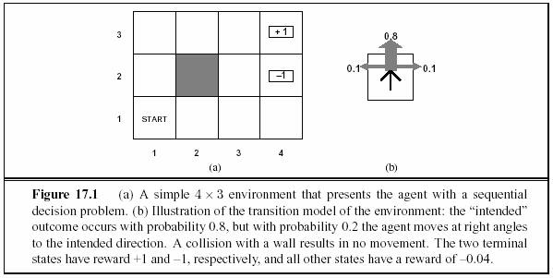
Robot Example
Imagine a robot with only local sensing
  Traveling from A to B
  Actions have uncertain
  results – might move at
  right angle to desired
  We want robot to “learn”
  how to navigate in this
  room
Sequential Decision Problem

Slide 4
Markov decision processes (MDP)
Initial State
  S₀
Transition Model
  T (s, a, s’)
    How does Markov property apply here?
    Uncertainty is possible
Reward Function
  R(s)
    For each state

Slide 5
Building a policy
Specify a solution for any initial state
  Construct a policy that outputs the best action for any state
    policy = π
    Action in state s = π(s) recommended by policy
  Complete policy covers all potential input states
  Optimal policy, π*, yields the highest expected utility
    Why expected?
      Transitions are stochastic

Slide 6
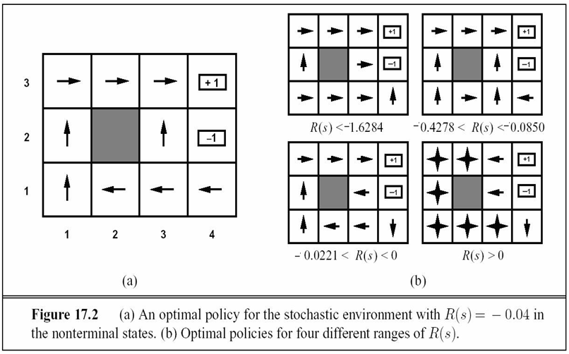
Example solutions
-
-
-
-

Slide 7
Attributes of optimality
We wish to find policy that maximizes the utility of agent during lifetime
  Maximize U([s₀, s₁, s₂, …, s_{n})]
But is length of lifetime known?
  Finite horizon – number of state transitions is known
    After timestep N, nothing matters
  U([s₀, s₁, s₂, …, s_{n})] = U([s₀, s₁, s₂, …, s_{n,} s_{n+1}, s_{n+k})] for all k>0
  Infinite horizon – always opportunity for more state transitions

Slide 8
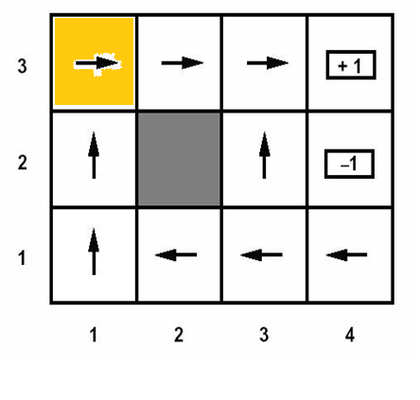
Time horizon
Consider spot (3, 1)
  Let horizon = 3
  Let horizon = 8
  Let horizon = 20
  Let horizon = inf
  Does π* change?
Nonstationary optimal policy

Slide 9
Evaluating state sequences
Assumption
  State preferences are stationary
Additive Rewards
  U[(a, b, c, …)] = R(a) + R(b) + R(c) + …
Discounted Rewards
  U[(a, b, c, …)] = R(a) + γR(b) + γ²R(c) + …
  γ is the discount factor between 0 and 1
    What does this mean?

Slide 10
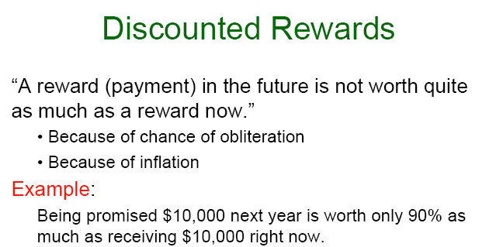

Slide 11

Evaluating infinite horizons
How can we compute the sum of infinite horizon?
  U[(a, b, c, …)] = R(a) + R(b) + R(c) + …
  If discount factor, γ, is less than 1
    note R_{max} is finite by definition of MDP

Slide 12
Evaluating infinite horizons
How can we compute the sum of infinite horizon?
  If the agent is guaranteed to end up in a terminal state eventually – proper policy
    We’ll never actually have to compare infinite strings of states
    We can allow γ to be 1

Slide 13
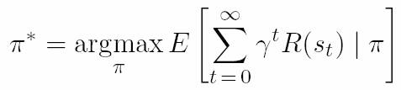
Evaluating a policy
Each policy, π, generates multiple state sequences
  Uncertainty in transitions according to T(s, a, s’)
Policy value is an expected sum of discounted rewards observed over all possible state sequences

Slide 14
Building an optimal policy
Value Iteration
  Calculate the utility of each state
  Use the state utilities to select an optimal action in each state
  policy is simple – go to the state with MEU
  state utilities must be accurate
    Through an iterative process correct utility values are assigned to the state

Slide 15
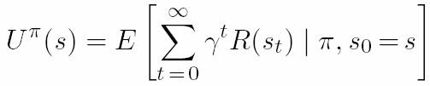
Utility of states
The utility of a state s is…
  the expected utility of the state sequences that might follow it
    The subsequent state sequence is a function of π(s)
The utility of a state given policy π is…

Slide 16
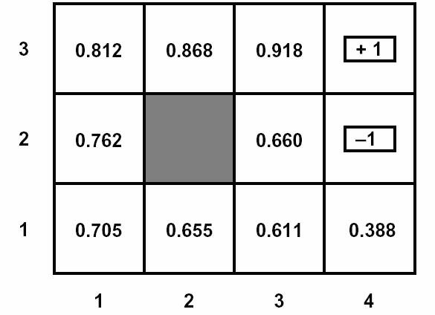
Example
Let γ = 1 and R(s) = -0.04
Notice:
  Utilities higher near goal
  reflecting fewer –0.04
  steps in sum

Slide 17

Restating the policy
Go to state with maximum expected utility
    state with highest utility may have low probability of being reached
    Function of available actions, transition function, resulting states

Slide 18

Putting pieces together
the utility of a state was:
The policy is maximum expected utility
Therefore, utility of a state is the immediate reward for that state and expected utility of next state

Slide 19
Bellman equation
Much cheaper to evaluate:
Instead of:
Richard Bellman invented the top equation
  (1957)

Slide 20
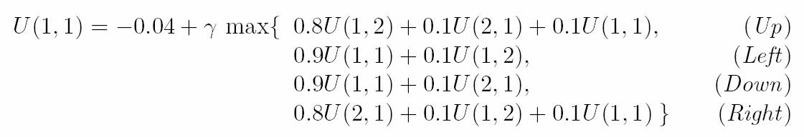
Example of Bellman Equation
Revisit 4x3 example
Utility at cell (1, 1)
Consider all outcomes of all possible actions to select best action and assign its expected utility to value of next-state in Bellman equation

Slide 21
Using Bellman Equations to solve MDPs
Consider a particular MDP
  n possible states
  n Bellman equations (one for each state)
  n equations have n unknowns (U(s) for each state)
    n equations and n unknowns… I can solve this, right?
    No, because of nonlinearity caused by max( )
    We’ll use an iterative technique

Slide 22
Iterative solution of Bellman equations
  Start with arbitrary initial values for state utilities
  Update the utility of each state as a function of its neighbors
  Repeat this process until an equilibrium is reached

Slide 23

Bellman Update
  Iterative updates look like this
  After infinite Bellman updates, we are guaranteed to reach an equilibrium that solves Bellman equations
  The solutions are unique
  The corresponding policy is optimal
    utilities for states near goal will settle quickly and their neighbors in turn will settle
    Information is propagated through state space via local updates

Slide 24
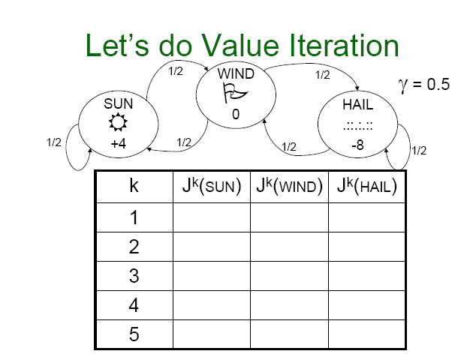

Slide 25
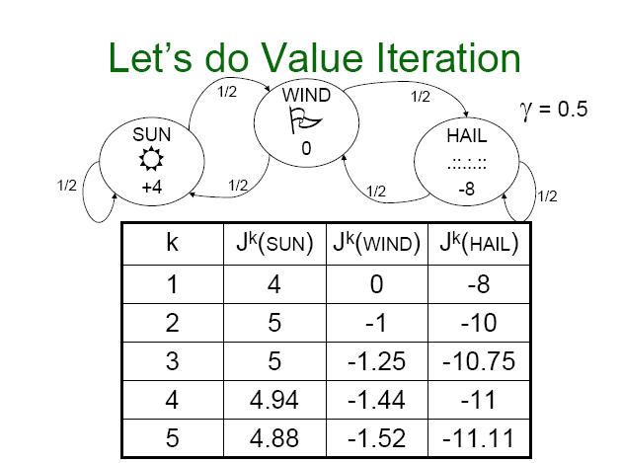

Slide 26
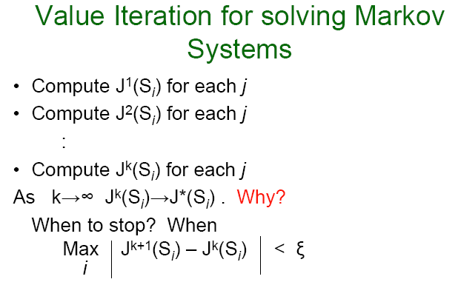

Slide 27
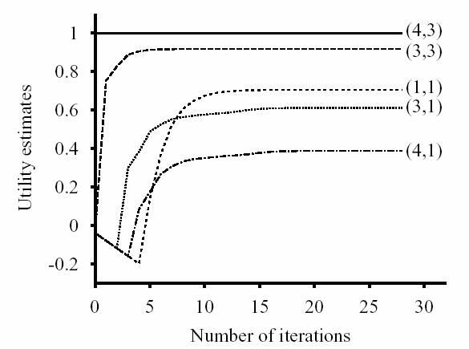
Convergence of value iteration
证明收敛性需要用到收缩函数（contraction function)的概念

Slide 28
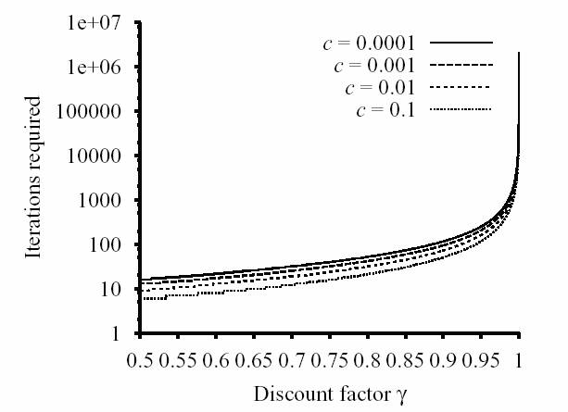
Convergence of value iteration
How close to optimal policy is it after i Bellman updates?
  Book shows how to calculate error at time i as a function of the error at time i –1 and discount factor γ
    Mathematically rigorous due to contraction functions
最大误差ε=c*R_{max}
||U_{i+1}-U_{i}||<ε(1-γ)/ γ

Slide 29
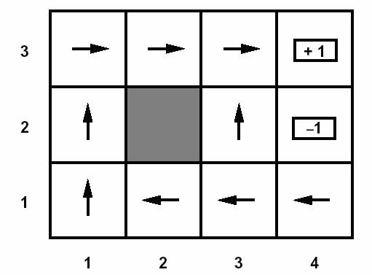
Policy Iteration
Imagine someone gave you a policy
  How good is it?
    Assume we know γ and R
    Eyeball it?
    Try a few paths and see
    how it works?
    Let’s be more precise…

Slide 30

Policy iteration
Checking a policy
  Just for kicks, let’s compute a
  utility (at this particular iteration
  of the policy, i) for each state
  according to Bellman’s equation

Slide 31
Policy iteration
Checking a policy
  But we don’t know U_{i}(s’)
  No problem
    n Bellman equations
    n unknowns
    equations are linear
  We can solve for the n unknowns
  in O(n³) time using standard
  linear algebra methods

Slide 32

Policy iteration
Checking a policy
  Now we know U(s) for all s
  For each s, compute
    This is the best action
    If this action is different
    update the policy if necessary

Slide 33

Policy Iteration
Often the most efficient approach
  But state spaces must be small: O(n³)
  Approximations are possible
    Rather than solve for U exactly, approximate with a speedy iterative technique – modified policy iteration
    Explore (update the policy of) only a subset of total state space
      Don’t bother updating parts you think are bad

Slide 34
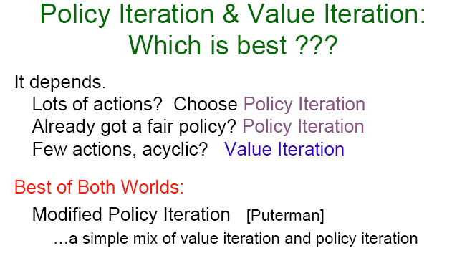

Slide 35
Modeling Environments with Markov Models
Type of Markov Models
State | Passive | Active
Fully Observable | Markov Model | Markov Decision Process (MDP)
Hidden | Hidden Markov Model | Partially Observable Markov Decision Process (POMDP)

Slide 36
POMDP
A discrete-time POMDP models the relationship between an agent and its environment. Formally, a POMDP is a 7-tuple {S,A,T,R, γ , Ω ,O }, where
  S is a set of states,
  A is a set of actions,
  T is a set of conditional transition probabilities between states: T(s’|s, a), s, s’ ∈ S
  R:S x A → R is the reward function,
  γ ∈ [0,1] is the discount factor for R(s,a).
  Ω is a set of observations,
  O is a set of conditional observation probabilities: O(o|s’,a), o∈ Ω

Slide 37
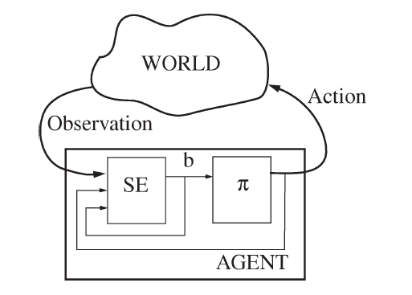
求解POMDP
引入信念状态(belief sate), 即原状态的概率分布， b(s)表示状态s在信念状态b的概率
POMDP的策略π就是从信念状态到最佳动作的映射
状态估算器（State Estimator) 根据动作、当前观察值、前一信念状态来更新信念状态

Slide 38
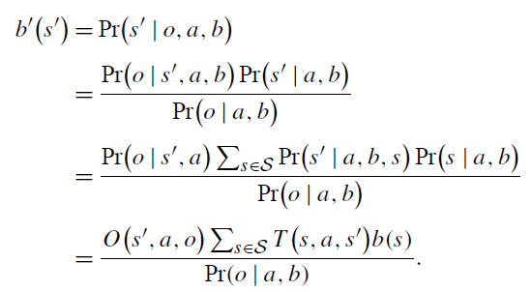

求解POMDP
初始信念状态为某个概率分布
信念状态：给定老信念状态b、动作a、观察值o来更新新的信念状态b’：
分母可以看作是一个归一化因子

Slide 39

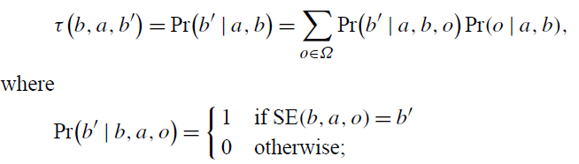

求解POMDP
把原POMDP可看作为连续空间的信念MDP：
状态集：即信念状态的集合，如原来有n个状态，则 （无限集 ）
状态转移
Reward函数：
动作、γ与原问题相同。

Slide 40
求解POMDP
虽然把POMDP问题，转换为了MDP问题，但连续空间 MDP不像离散空间MDP那么容易。
采用值迭代的具体求解算法可参考Planning and acting in partially observable stochastic domains,” Artificial Intelligence, vol. 101, no. 1–2, pp. 99–134, May 1998
后人提出了更多的解法，如Monte-Carlo Tree Search.

Slide 41
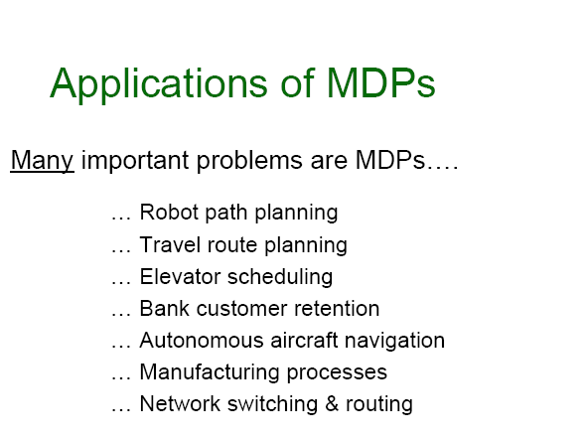

Slide 42
MDP求解工具
Github上有不少的工具包，如
  https://github.com/pemami4911/POMDPy

Slide 43
作业
17.5 Sometimes MDPs are formulated with a reward function R(s, a) that depends on the action taken or a reward function R(s, a, s’) that also depends on the outcome state. Write the Bellman equations for these formulations.

