Slide 1
Learning from Observations
Chapter 18

Slide 2
Outline
Learning agents
Inductive learning
Decision tree learning
Measuring learning performance
Ensemble learning

Slide 3
Learning
Learning is essential for unknown environments,
  i.e., when the designer lacks omniscience
Learning is useful as a system construction method,
  i.e., expose the agent to reality rather than trying to write it down
Learning modifies the agent's decision mechanisms to improve performance

Slide 4
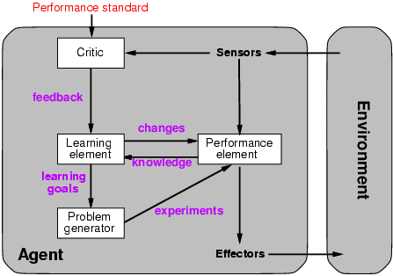
Learning agents

Slide 5
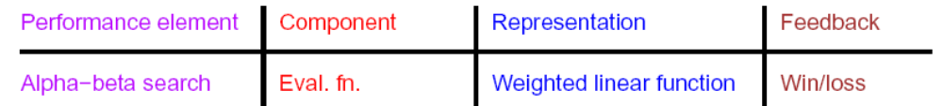
Learning element
Design of a learning element is affected by
  Which components of the performance element are to be learned
  What feedback is available to learn these components
  What representation is used for the components
Type of feedback:
  Supervised learning: correct answers for each example
  Unsupervised learning: correct answers not given
  Reinforcement learning: only final rewards are given in a mdp

Slide 6



Formalization of Learning
training examples
z_{i} being examples sampled from an unknown stochastic process P(Z)
In supervised learning,
We learn a function f(X) to predict Y
  Regression: Y is a real-valued scalar or vector, and we measure the effectiveness of the learning by a loss function: L(f, Z)=||f(X)-Y||² (squared error)
  Classification: Y is an integer or a label,
  loss function: the negative conditional
  log-likelihood

Slide 7
Formalization of Learning
In unsupervised learning, we are learning a function which helps to characterize the unknown distribution P(Z). Types of unsupervised learning include:
  Clustering (k-means, Gaussian mixture models, etc)
  Self-organizing map (SOM)
  Principal component analysis (PCA)
  …

Slide 8
Other types of learning
Semi-supervised learning
Bootstrapping
Co-training
Weakly supervised learning
Deep learning
……

Slide 9
Other types of learning
Semi-supervised learning
  Semi-supervised learning is a class of supervised learning tasks and techniques that also make use of unlabeled data for training – typically a small amount of labeled data with a large amount of unlabeled data.
  Given a set of independently identically distributed labeled examples and unlabeled examples, semi-supervised learning attempts to make use of this combined information to surpass the classification performance that could be obtained either by discarding the unlabeled data and doing supervised learning or by discarding the labels and doing unsupervised learning.

Slide 10
Other types of learning
Bootstrapping
  Bootstrapping, also called self-training, starts with a few training examples, trains a classifier, and uses thought-to-be positive examples as yielded by this classifier for retraining. As the set of training examples grows, the classifier improves, provided that not too many negative examples are misclassified as positive, which could lead to deterioration of performance.

Slide 11
Other types of learning
Co-training
  Co-training is a semi-supervised learning technique that requires two complementary and conditionally independent views of the data.
  Co-training first learns a separate classifier for each view using any labeled examples. The most confident predictions of each classifier on the unlabeled data are then used to iteratively construct additional labeled training data.

Slide 12
Other types of learning
Weakly supervised learning
  学术界对这个词语的使用并不一致。我认为，弱监督学习是指用简单的label或少量的指导（监督）而进行的机器学习。因为label简单，所以可以得到大量的样本；因为指导少，所以可以得到可靠的分类。

Slide 13
Other types of learning
Deep learning
  Deep learning (also known as deep structured learning, hierarchical learning or deep machine learning) is a branch of machine learning based on a set of algorithms that attempt to model high level abstractions in data by using a deep graph with multiple processing layers, composed of multiple linear and non-linear transformations.
  Deep learning is not so deep as it is also called representation learning sometimes

Slide 14
Learning styles
transduction or transductive learning
  直推式学习。reasoning from observed, specific (training) cases to specific (test) cases.
  Learning by analogy
induction or inductive learning
  归纳学习。reasoning from observed training cases to general rules

Slide 15
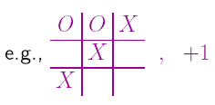
Inductive learning
Simplest form: learn a function from examples
f is the target function
An example is a pair (x, f(x))
Problem: find a hypothesis h
  such that h ≈ f
  given a training set of examples
(This is a highly simplified model of real learning:
  Ignores prior knowledge
  Assumes examples are given)

Slide 16
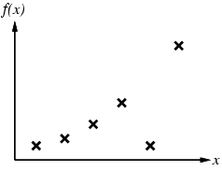
Inductive learning method
Construct/adjust h to agree with f on training set
(h is consistent if it agrees with f on all examples)
E.g., curve fitting:

Slide 17
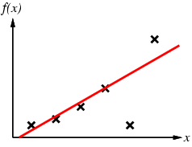
Inductive learning method
Construct/adjust h to agree with f on training set
(h is consistent if it agrees with f on all examples)
E.g., curve fitting:

Slide 18
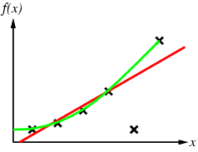
Inductive learning method
Construct/adjust h to agree with f on training set
(h is consistent if it agrees with f on all examples)
E.g., curve fitting:

Slide 19
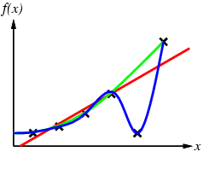
Inductive learning method
Construct/adjust h to agree with f on training set
(h is consistent if it agrees with f on all examples)
E.g., curve fitting:

Slide 20
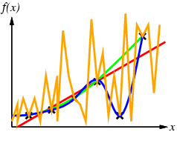
Inductive learning method
Construct/adjust h to agree with f on training set
(h is consistent if it agrees with f on all examples)
E.g., curve fitting:

Slide 21
Inductive learning method
Construct/adjust h to agree with f on training set
(h is consistent if it agrees with f on all examples)
Ockham’s razor: prefer the simplest hypothesis consistent with data
E.g., curve fitting:

Slide 22
Generalization from different representations
Learning is only as good as its generalization ability, so we prefer inductive learning.
Local representation vs. Distributed representation
  N as one 1 and N-1 0’s vs binary representation
  Distributed representation is far more powerful
Deep learning is powerful as it uses distributed representation

Slide 23
Learning decision trees
Problem: decide whether to wait for a table at a restaurant, based on the following attributes:
  Alternate: is there an alternative restaurant nearby?
  Bar: is there a comfortable bar area to wait in?
  Fri/Sat: is today Friday or Saturday?
  Hungry: are we hungry?
  Patrons: number of people in the restaurant (None, Some, Full)
  Price: price range ($, $$, $$$)
  Raining: is it raining outside?
  Reservation: have we made a reservation?
  Type: kind of restaurant (French, Italian, Thai, Burger)
  WaitEstimate: estimated waiting time (0-10, 10-30, 30-60, >60)

Slide 24
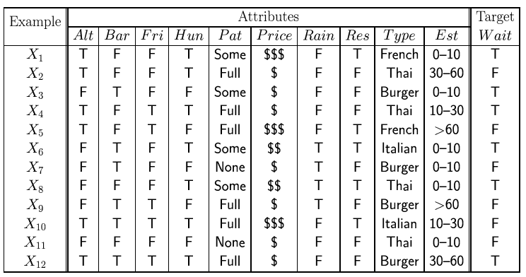
Attribute-based representations
Examples described by attribute values (Boolean, discrete, continuous)
E.g., situations where I will/won't wait for a table:
Classification of examples is positive (T) or negative (F)

Slide 25
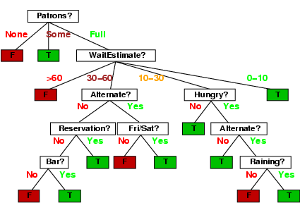
Decision trees
One possible representation for hypotheses
E.g., here is the “true” tree for deciding whether to wait:

Slide 26
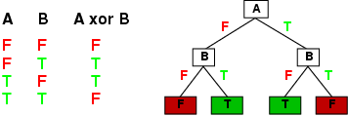
Expressiveness
Decision trees can express any function of the input attributes.
E.g., for Boolean functions, truth table row → path to leaf:
Trivially, there is a consistent decision tree for any training set with one path to leaf for each example (unless f is nondeterministic in x) but it probably won't generalize to new examples
Prefer to find more compact decision trees

Slide 27
Hypothesis spaces
How many distinct decision trees with n Boolean attributes?

Slide 28
Hypothesis spaces
How many distinct decision trees with n Boolean attributes?
= number of Boolean functions

Slide 29
Hypothesis spaces
How many distinct decision trees with n Boolean attributes?
= number of Boolean functions
= number of distinct truth tables with 2^{n} rows

Slide 30
Hypothesis spaces
How many distinct decision trees with n Boolean attributes?
= number of Boolean functions
= number of distinct truth tables with 2^{n} rows = 2^{2n}

Slide 31
Hypothesis spaces
How many distinct decision trees with n Boolean attributes?
= number of Boolean functions
= number of distinct truth tables with 2^{n} rows = 2^{2n}
E.g., with 6 Boolean attributes, there are 18,446,744,073,709,551,616 trees

Slide 32
Hypothesis spaces
How many distinct decision trees with n Boolean attributes?
= number of Boolean functions
= number of distinct truth tables with 2^{n} rows = 2^{2n}
E.g., with 6 Boolean attributes, there are 18,446,744,073,709,551,616 trees
Decision trees are bad for some kinds of functions
Parity function
Majority function

Slide 33
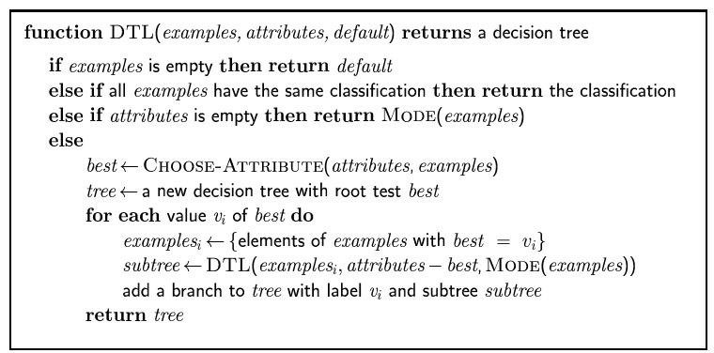
Decision tree learning
Aim: find a small tree consistent with the training examples
Idea: (recursively) choose "most significant" attribute as root of (sub)tree
MODE: Majority-Value 众数

Slide 34
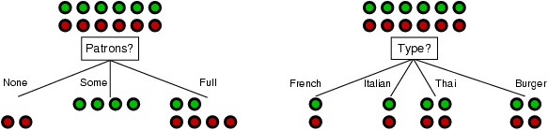
Choosing an attribute
Idea: a good attribute splits the examples into subsets that are (ideally) "all positive" or "all negative"
Patrons? is a better choice

Slide 35
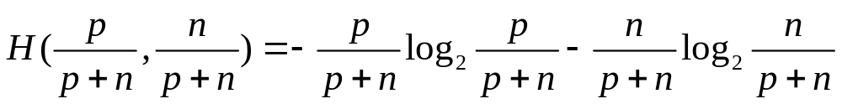
Using information theory
To implement Choose-Attribute in the DTL algorithm
Information Content (Entropy):
H(P(v₁), … , P(v_{n})) = Σ_{i=1} -P(v_{i}) log₂ P(v_{i})
单位：位
For a training set containing p positive examples and n negative examples:

Slide 36
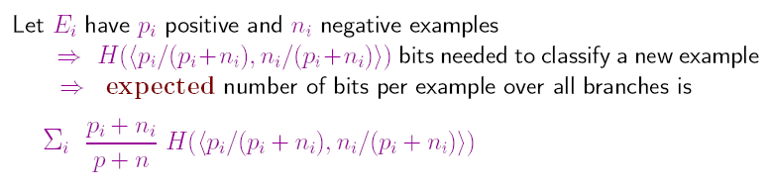
A chosen attribute A divides the training set E into subsets E₁, … , E_{v} according to their values for A, where A has v distinct values.
这就是区分所有实例所需要的平均信息量

Slide 37
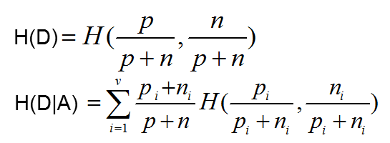
Information gain
特征A对训练数据集D的信息增益IG(D,A)定义为
  IG(D,A)=H(D) – H(D|A)
Information Gain is the reduction in entropy from the attribute test: we should choose the attribute with the largest IG

Slide 38
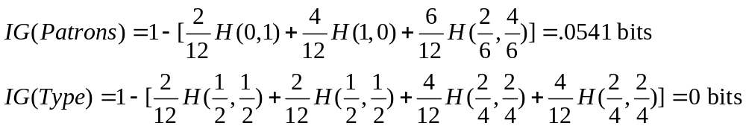
Information gain
For the training set, p = n = 6, I(6/12, 6/12) = 1 bit
Consider the attributes Patrons and Type (and others too):
Patrons has the highest IG of all attributes and so is chosen by the DTL algorithm as the root

Slide 39
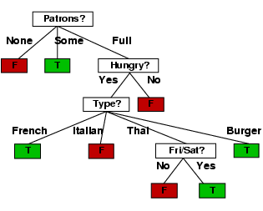
Example contd.
Decision tree learned from the 12 examples:
Substantially simpler than “true” tree---a more complex hypothesis isn’t justified by small amount of data

Slide 40

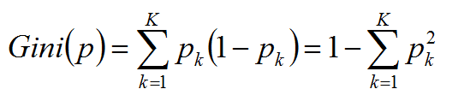
其他选择属性的指标
信息增益率：
IG_{r}(D,A) = IG(D,A) / H(A)
基尼指数
P_{k}：根据A划分后属于类k的概率

Slide 41
决策树的类型
IG: ID3
IGr: C4.5
Gini + 2分类：CART

Slide 42
噪声和过拟合
决策树的问题：
  属性相同，分类不同，无法得到决策树 - 噪声
    Majority classification
  决策树依赖于偶然属性 – 过拟合
    戴眼镜对男女的分类
这两个问题是任何学习算法面临的问题
  噪声问题可采用数据清洗：如cutoff
  过拟合问题可引入先验假设或采用regularization (在不降低训练集误差下增强泛化能力)

Slide 43
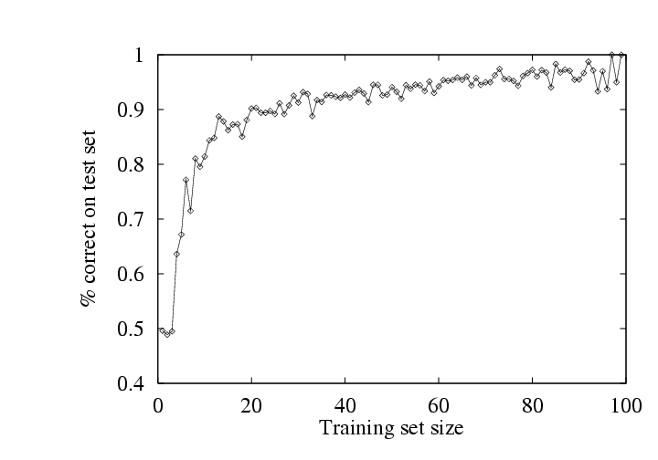
Performance measurement
How do we know that h ≈ f ?
  Use theorems of computational/statistical learning theory
  Try h on a new test set of examples
    (use same distribution over example space as training set)
Learning curve = % correct on test set as a function of training set size

Slide 44
k-fold cross-validation
split the data into k equal subsets. We then perform k rounds of learning; on each round 1/k of the data is held out as a test set and the remaining examples are used as training data. The average test set score of the k rounds should then be a better estimate than a single score. Popular values for k are 5 and 10—enough to give an estimate that is statistically likely to be accurate, at a cost of 5 to 10 times longer computation time.

Slide 45
Leave-one-out cross-validation
Suppose there are n instances. using 1 observations as the validation set and the remaining n-1 observations as the training set. Repeat the experiment n-1 times.

Slide 46
集成学习
Aggregation of predictions of multiple classifiers (learners) with the goal of improving accuracy.
Many weak classifiers ➔ strong classifier
两类集成学习
  同构集成 ： multiple learners (hypotheses) come from the same base learner (homogenous learners)
  异构集成：multiple classifier systems (heterogeneous learners)

Slide 47
Intuitions why this would work
Majority vote
Suppose we have 5 completely independent classifiers…
  If accuracy is 70% for each
    10 (.7^3)(.3^2)+5(.7^4)(.3)+(.7^5)
    =83.7% majority vote accuracy
  101 such classifiers
    99.9% majority vote accuracy

Slide 48
Common Types of Ensemble
Homogeneous
  Bootstrap Aggregating （Bagging）
  Boosting
Heterogeneous
  Stacking：Multiple levels of learners

Slide 49
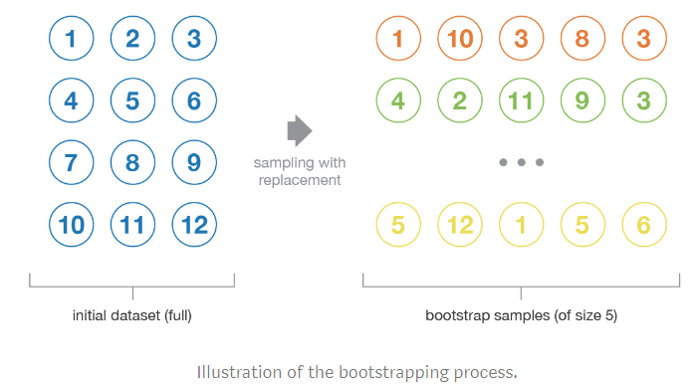
Bagging
Train a group of classifiers on bootstrap samples created by randomly sampling instances with replacement from the initial data. Ideally, samples should be representative and iid.

Slide 50
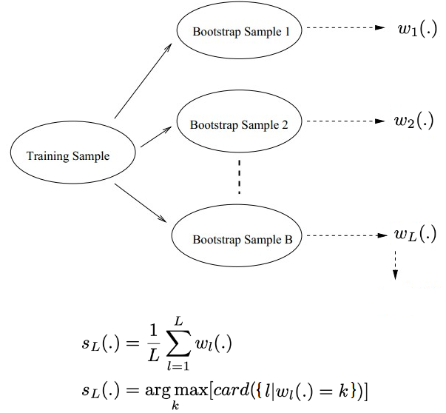
Bagging
用于回归问题的简单平均
用于分类问题的多数投票

Slide 51
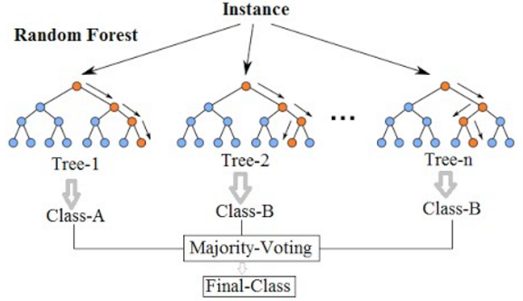
Random Forest
  Random Forest can be regarded as bagging whose base learners are decision trees, and features are also sampled and only a random subset of them is used to build the tree.

Slide 52
Boosting
  Assume a base hypothesis (classifier). Make examples currently misclassified more important (or less, if lots of noise). Then find a new hypothesis. Finally combine the hypotheses…
Types
AdaBoost(Adaptive Boosting, R. Scharpire, Y. Freund, ICML, 1996):
Combine many low-accuracy classifiers ( weak learners) to create a high-accuracy classifier (strong learners )
BrownBoost, SmoothBoost, GradientBoost, XGABoost…

Slide 53
基本思想
  从一组“弱”分类器（准确率>0.5）得到一个“强”分类器
一个基分类器
从一个“弱”分类器得到另一个“弱”分类器
  对每个实例给一个权重
  对于被分类器正确分类的例子，减少权重，错误分类的例子，增加权重
  重新训练得到新的“弱”分类器
最后用（加权）多数投票法得到最终的“强”分类器

Slide 54
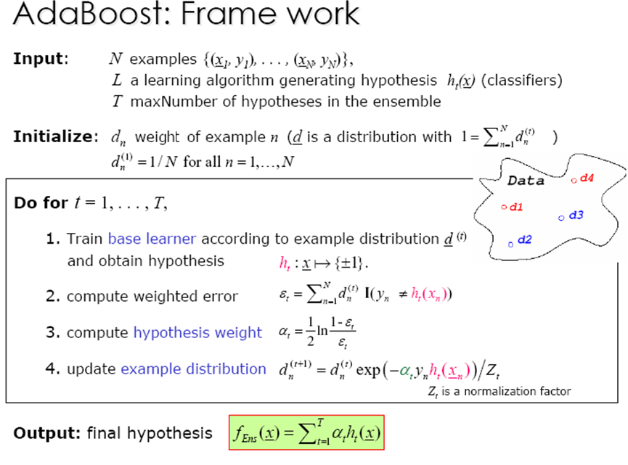

Slide 55
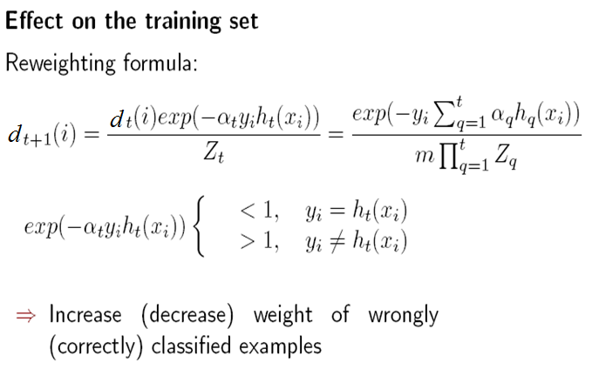
调整权重
In this way, AdaBoost “focused on” the informative or “difficult” examples.

Slide 56
Bagging v.s. boosting
in bagging methods, several instance of the same base model are trained in parallel on different bootstrap samples and then aggregated in some kind of “averaging” process. Base models with low bias but high variance are well adapted for bagging
in boosting methods, several instance of the same base model are trained sequentially such that later models can adapt to the weaknesses of the previous models. Weak learners with low variance but high bias are well adapted for boosting

Slide 57
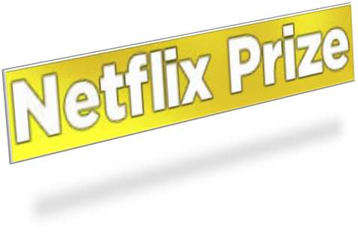
Ensemble Learning in Practice:
A Look at the Netflix Prize
http://www.netflixprize.com/
October 2006
  Training data is a set of users and ratings (1,2,3,4,5 stars) those users have given to movies.
  Predict what rating a user would give to any movie
$1 million prize for a 10% improvement over Netflix’s current method (MSE[mean square error] = 0.9514,)

Slide 58
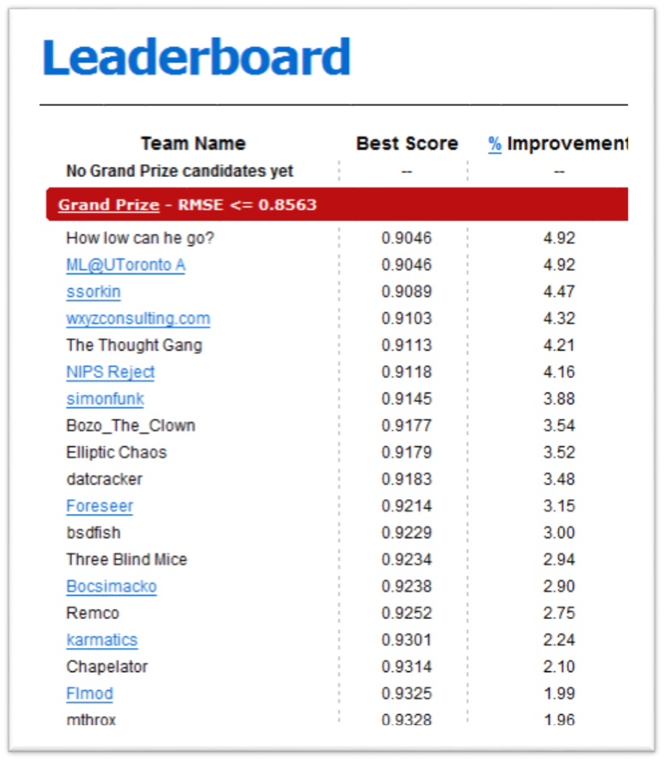
Just three weeks after it began, at least 40 teams had bested the Netflix method
Top teams showed about 5% improvement
From the Internet Archive.
Notes:
Thru the power of the Internet archive.

Slide 59
结果
On September 21, 2009 the team “BellKor’s Pragmatic Chaos” was awarded the $1M Grand Prize
http://www.netflixprize.com//community/viewtopic.php?id=1537

Slide 60
IBM and Xprize open $5M A.I. competition to tackle humanity’s greatest challenges (JUNE 23, 2016)
For other AI competitions and prizes, see https://en.wikipedia.org/wiki/Competitions_and_prizes_in_artificial_intelligence

Slide 61
Summary
Learning needed for unknown environments, lazy designers
Learning agent = performance element + learning element
For supervised learning, the aim is to find a simple hypothesis approximately consistent with training examples
Decision tree learning using information gain
Learning performance = prediction accuracy measured on test set
……

Slide 62
作业
In the recursive construction of decision trees, it sometimes occurs that a mixed set of positive and negative examples remains at a leaf node, even after all the attributes have been used. Suppose that we have p positive examples and n negative examples.
  Show that the solution used by DECISION-TREE-LEARNING, which picks the majority classification, minimizes the absolute error over the set of examples at the leaf.
  Show that returning the class probability p/(p+n) minimizes the sum of squared errors.

Slide 63
课程设计
尝试用AdaBoost进行图像识别，如人脸等。

