Slide 1
Statistical Learning Methods
Chapter 20
Section 1 – 4

Slide 2
Outline
Bayesian learning
  Maximum a posteriori and maximum likelihood learning
Learning with Complete Data
  Bayes net learning
    ML parameter learning with complete data
    Naïve Bayes Classifier
Learning with hidden variables: EM algorithm
Instance-based Learning

Slide 3
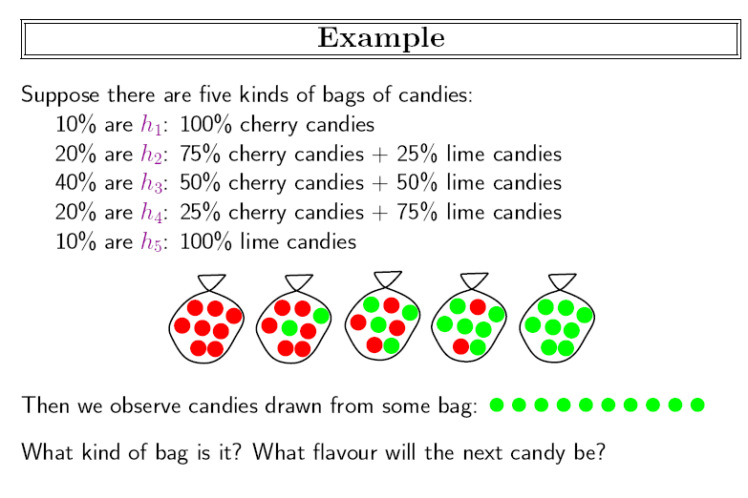

Slide 4
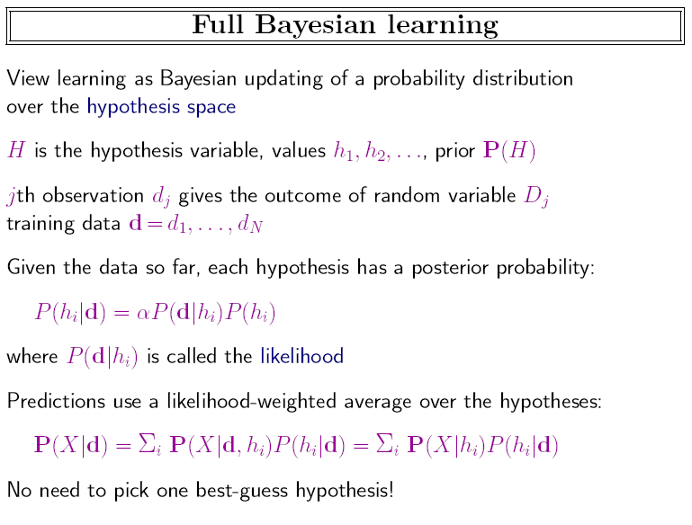

Slide 5
P(X|d,h_{i})=P(X|h_{i})？
仅当observations are i.i.d. (independent, and identically distributed) 独立同分布
换句话说，对前面的例子而言，每次拿了糖是要放回去的。
根据独立性：P(d|hi) = ΠjP(dj|hi)

Slide 6
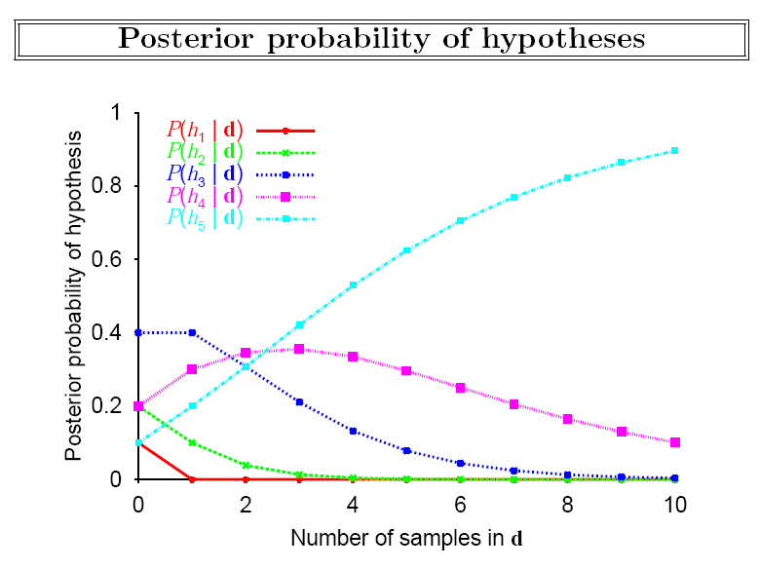

Slide 7
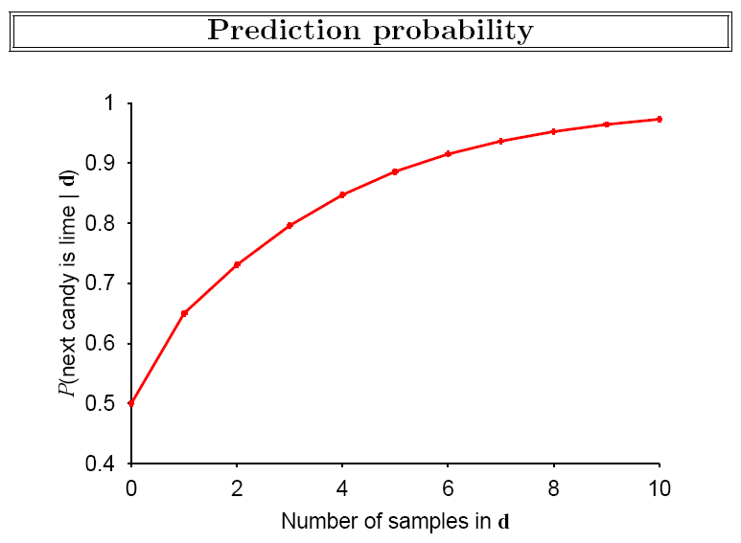

Slide 8
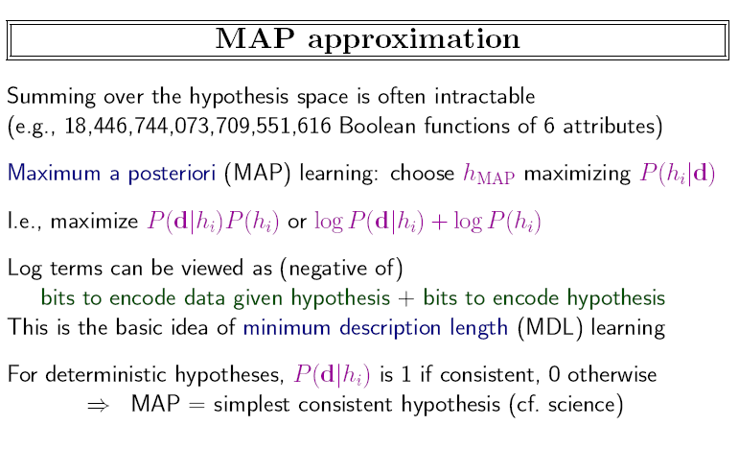
  True （MAP) hypothesis eventually dominates the Bayesian prediction – the feature of Bayesian learning

Slide 9
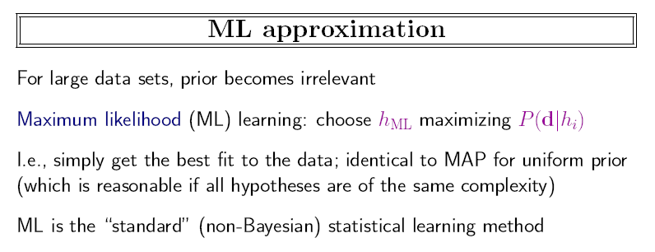

Slide 10
Learning with Complete Data
Parameter learning - to find the numerical parameters for a probability model whose structure is fixed
Data are complete when each data point contains values for every variable in the model
Maximum-likelihood parameter learning
  discrete model
  continuous model

Slide 11
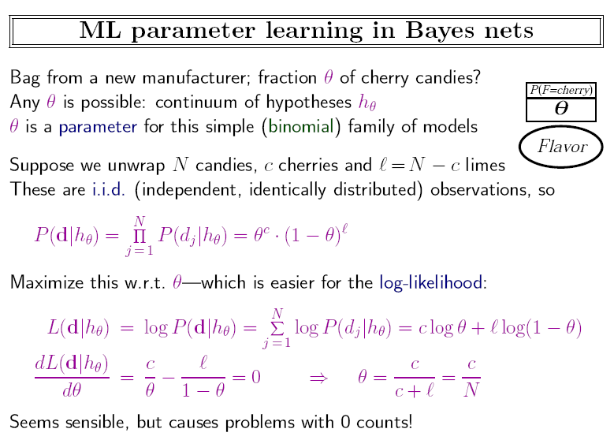
    Various tricks are used to avoid this problem. One is to assign count = 1 instead of 0 to each event

Slide 12
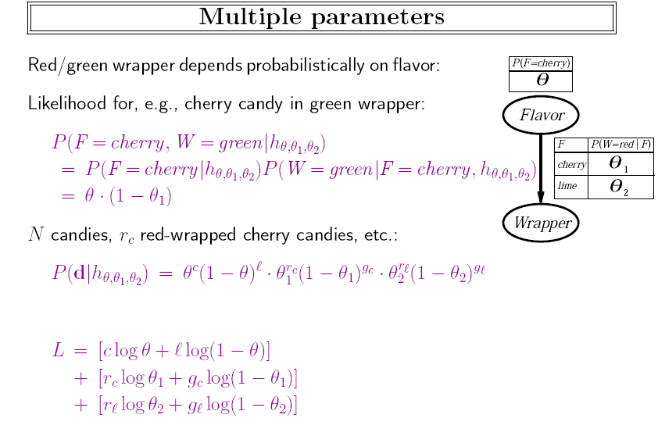

Slide 13
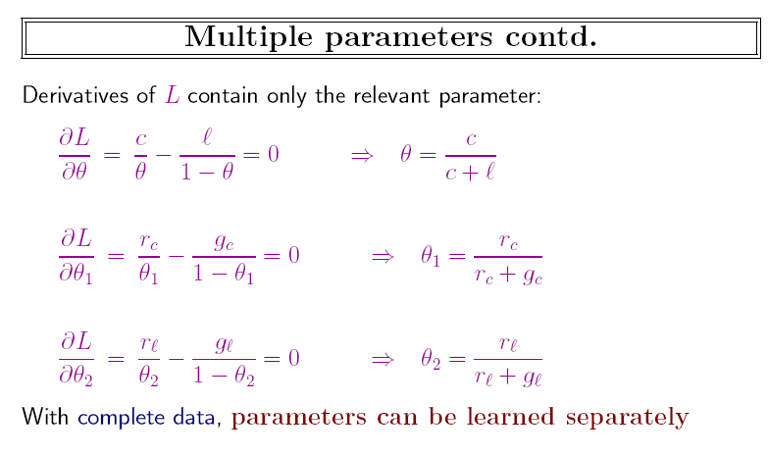

Slide 14


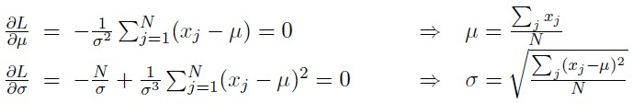
ML Learning: continuous models
Assume single variable Gussian:
Let the observed values be x₁,…x_{N}. Loglikihood is:
使其导数为0，可得：

Slide 15
General ML Parameter learning
1. Choose a parameterized family of models to describe the data
  requires substantial insight and sometimes new models
2. Write down the likelihood of the data（似然函数） as a function of the parameters because we are maximizing it
3. Write down the derivative of the log likelihood w.r.t. each parameter
4. Find the parameter values such that the derivatives are zero
  may be hard/impossible; modern optimization techniques help
当然，这种做法的前提是似然函数是凸函数

Slide 16
Naïve Bayes Classifier
The most basic Bayesian network model used in machine learning (学过了）
It assumes that the attributes are conditionally independent of each other, given class
A deterministic prediction can be obtained by choosing the most likely class
  P(C|x₁,x₂,…,x_{n}) = αP(C) Π_{i} P(x_{i}|C)

Slide 17
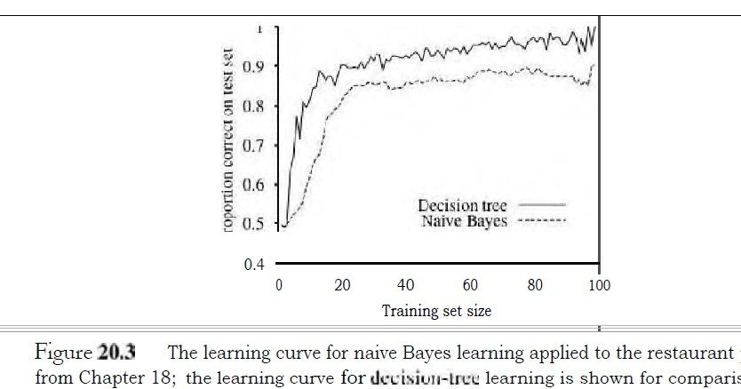
Naïve Bayes Classifier
NBC has no difficulty with noisy data
  For binary classification with n attributes, there are just 2n+1 parameters, no search is required for finding h_{ML}
P(c),P(xi|c),P(xi|~c)

Slide 18



MAP Parameter learning
采用 作为优化的目标函数而不是
置 求出参数
  may be hard/impossible; modern optimization techniques help
一般，可选共轭分布函数（如Beta分布，高斯分布）作为先验分布，以简化计算
当数据不够多时，可采取这种做法

Slide 19
Learning with Hidden Variables
Many real-world problems have hidden variables which are not observable in the data available for learning.
Question: If a variable (disease) is not observed, why not construct a model without it?
Answer: Hidden variables can dramatically reduce the number of parameters required to specify a Bayesian network. This results in the reduction of needed amount of data for learning.

Slide 20
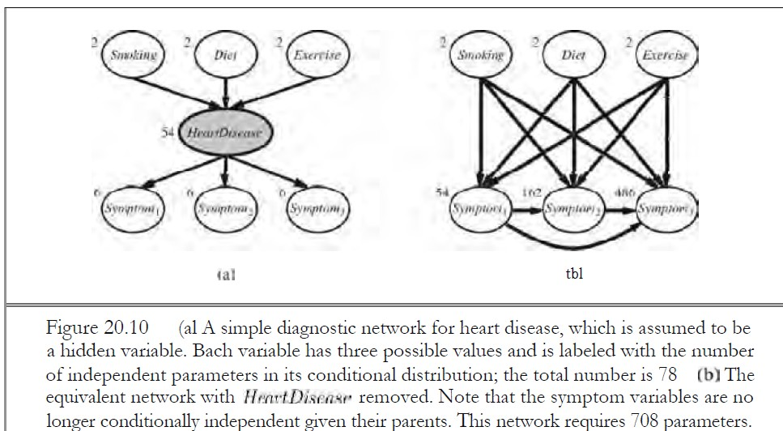
Hidden parameters reduces 708 parameters to 78

Slide 21
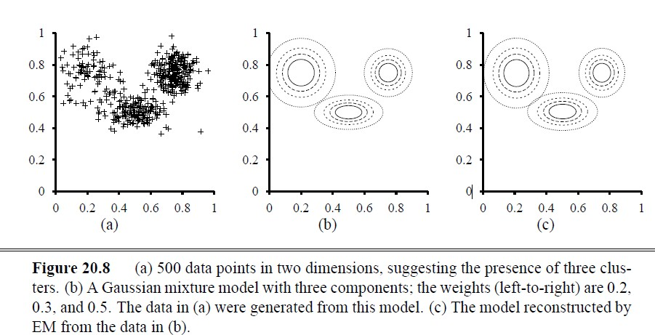
EM: Learning mixtures of Gaussians
The unsupervised clustering problem (Fig 20.8 with 3 components):

Slide 22
EM: Learning mixtures of Gaussians
The unsupervised clustering problem (Fig 20.8 with 3 components): P(x) = Σ^{k}_{i=1}P(C=i)P(x|C=i)
  If we knew which component generated each x_{j}, we can get μ,σ of c_{i}
  If we knew the parameters of each component, we know which c_{i} x_{j} should belong to.
  However, we do not know either, …
EM – expectation and maximization
  Pretend we know the parameters of the model and then to infer the probability that each x_{j} belongs to each component; iterate until convergence.

Slide 23
EM steps
For the mixture of Gaussians, initialize the mixture model parameters arbitrarily; and iterate the following
  E-step: Compute
  p_{ij} = P(C=i|x_{j}) = αP(x_{j}|C=i)P(C=i)
    P(C=i) = p_{i} = Σ_{j} p_{ij}
  M-step: Compute the new
  μ_{i} = Σ_{j} (p_{ij}/p_{i})x_{j},
  Σ_{i} = Σ_{j} (p_{ij}/p_{i} )(x_{j}- μ_{i})(x_{j}- μ_{i})^{T}
P_{ij}: the probability that datum x_{j} was generated by component i

Slide 24
Why is it called EM?
E-step computes the expected value p_{ij} of the hidden indicator variables Z_{ij}, where Z_{ij} is 1 if x_{j} was generated by i-th component, 0 otherwise
M-step finds the new values of the parameters that maximize the log likelihood of the data, given the expected values of Z_{ij}

Slide 25
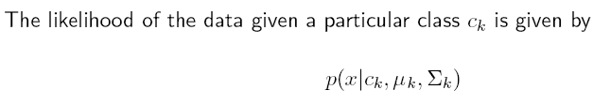
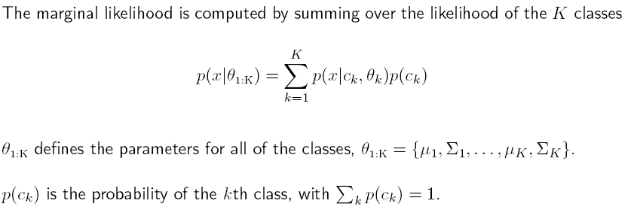
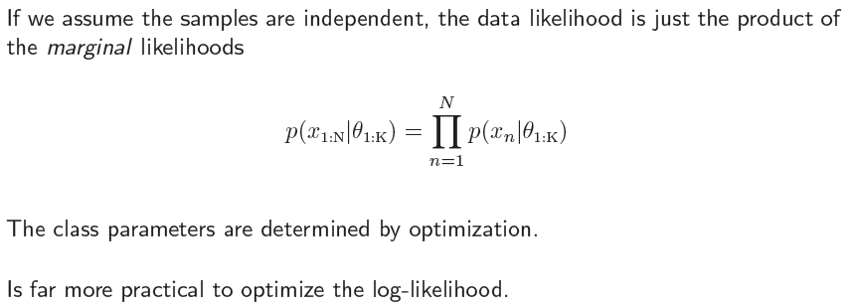

Slide 26
EM: Learning mixtures of Gaussians
The unsupervised clustering problem (Fig 20.8 with 3 components):
Fig 20.8(c) is learned from Fig. 20.8(a)

Slide 27
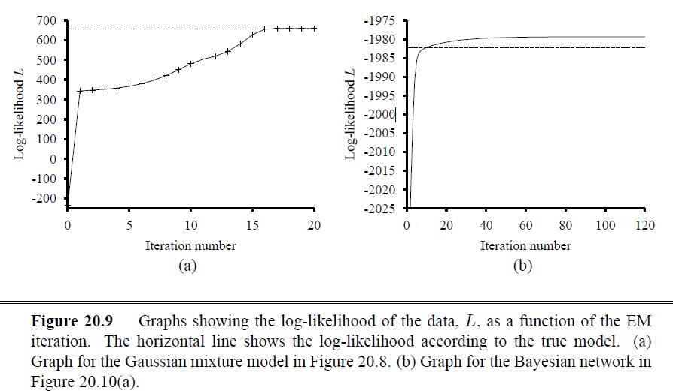
EM increases the log likelihood of the data at each iteration, reaching a local maximum in likelihood

Slide 28
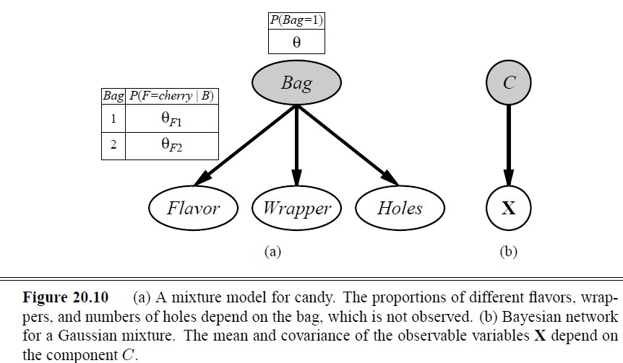
EM: Learning Bayesian networks with hidden variables
Fig 20.10: two bags of mixed candies described by 3 features: Flavor, Wrapper, and Hole

Slide 29
EM: Learning Bayesian networks with hidden variables
Fig 20.10: two bags of mixed candies described by 3 features: Flavor, Wrapper, and Hole
  The candy distribution is described by a naïve Bayes: the features are independent, given the bag
  The parameters are: Θ – the probability that a candy from bag 1; Θ_{F1} and Θ_{F2} – the probabilites that the flavor is cherry given that a candy from bag 1 and bag2; Θ_{W1} and Θ_{W2} for red wrapper from bag1 and bag 2; and Θ_{H1} and Θ_{H2} that the candy has a hole from bag1 and bag2.

Slide 30
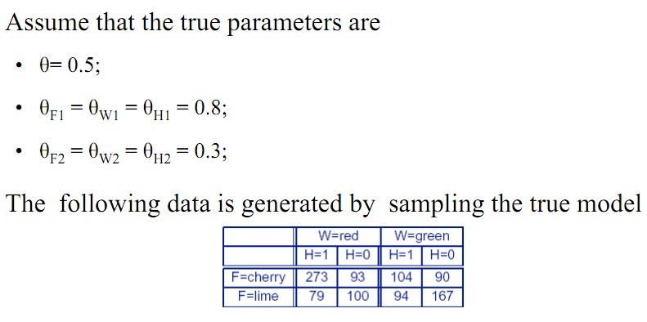
一共1000 颗糖

Slide 31
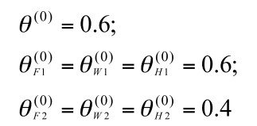
EM iteration
Randomly initialize parameters. Here, we simply set:

Slide 32
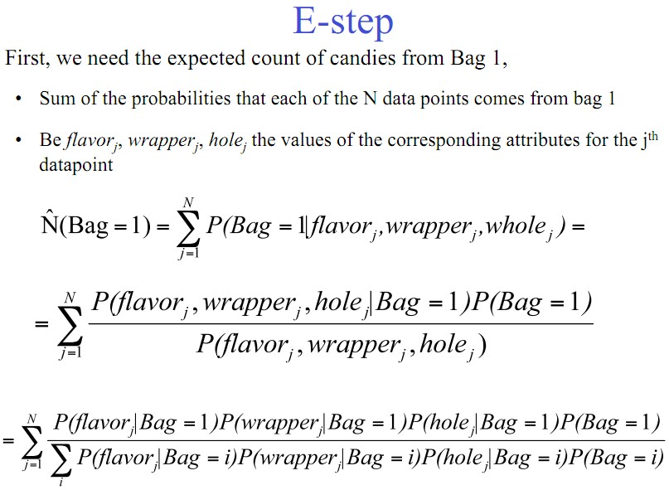

Slide 33
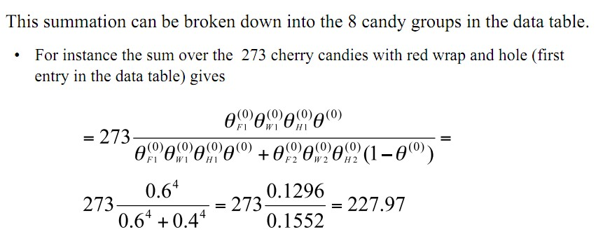

Slide 34
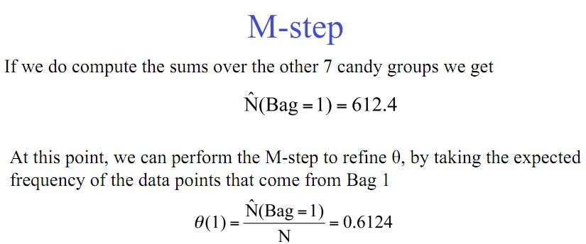

Slide 35

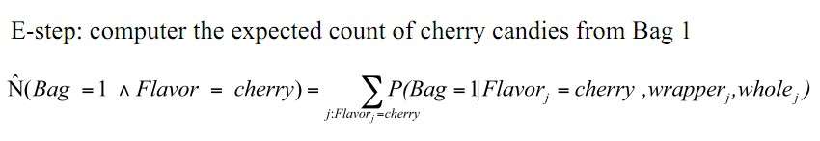
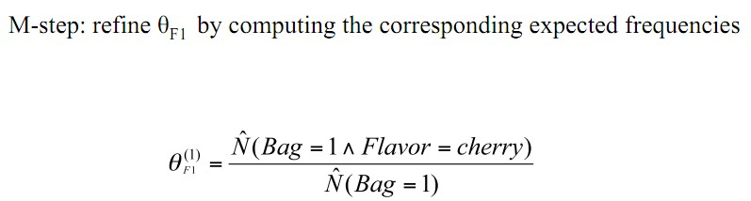

Slide 36
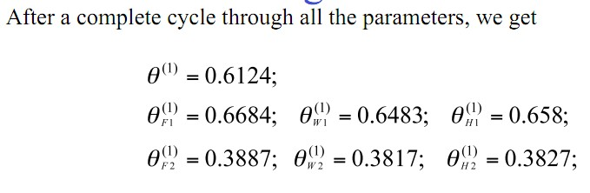
the log likelihood increases with each EM iteration

Slide 37
EM is unsupervised learning
A general algorithm for learning model parameters from incomplete data.
The algorithm starts from randomly initialized information to solve the learning problem, and then refines this initial guess by cycling through two basic steps
  Expectation (E): update the data with predictions generated via the current model
  Maximization (M): given the updated data, infer the Maximum Likelihood (or MAP model) (This is the same step that we described when learning parameters for fully observable networks ) estimate of the parameters
It can be shown that EM increases the log likelihood of the data at any iteration, but EM can only achieve a local maximum

Slide 38
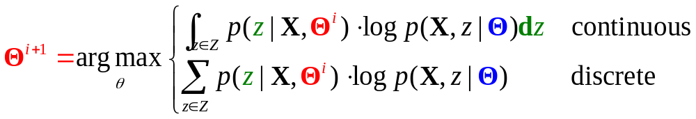
General form of EM algorithm
E-Step: computation of the summation, which is the expectation of the log likelihood of the “completed” data with respect to the distribution P(z|X,ϴ^{i}), which is the posterior over the hidden variables z, given the data
M-Step: the maximization of this expected log likelihood with respect to the parameters

Slide 39
EM算法用处挺广
其实，我们前面讲HMM时提到的HMM参数训练算法（一般称为Baum-Welch算法）也是EM算法的一种特例。
很多AI论文经常用到EM算法。
但是，EM算法只能得到局部最优模型。

Slide 40
Instance-based Learning
Parametric vs. nonparametric learning
  Parametric learning
    Learning focuses on fitting the parameters of a restricted family of probability models to an unrestricted data set
    Parametric learning methods are often simple and effective, but can oversimplify what’s really happening
  Nonparametric learning
    Nonparametric learning allows the hypothesis complexity to grow with the data
    Instance-based Learning is nonparametric as it constructs hypotheses directly from the training data.

Slide 41
Nearest-neighbor models
The key idea: Neighbors are similar
  Density estimation example: estimate x’s probability density by the density of its neighbors
How to define neighborhood N
  If too small, no data points
  If too big, density is the same everywhere
  A solution is to define N to contain k points, where k is large enough to ensure a meaningful estimate
    For a fixed k, the size of N varies (密度大的地方，N小；密度小的地方，N需要很大)
    For most low-dimensional data, k is usually between 5-10

Slide 42
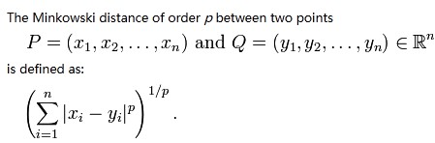
K-NN for a given query x
Which data point is nearest to x?
  We need a distance metric, D(x1, x2)
  Euclidean distance D_{E} is a popular one
  Minkowski distance
  When each dimension measures something different, it is inappropriate to use D_{E} ;Important to standardize the scale for each dimension
    Mahalanobis distance is one solution (scale-invariant)
  Discrete features should be dealt with differently
    Hamming distance (the number of positions at which the corresponding symbols are different, between two strings of equal length)
  P=1: Manhattan distance
  P=2: Euclidean distance

Slide 43
利用K-NN分类
选择x的k-NN
根据其k-NN的多数类别确定x的类别

Slide 44
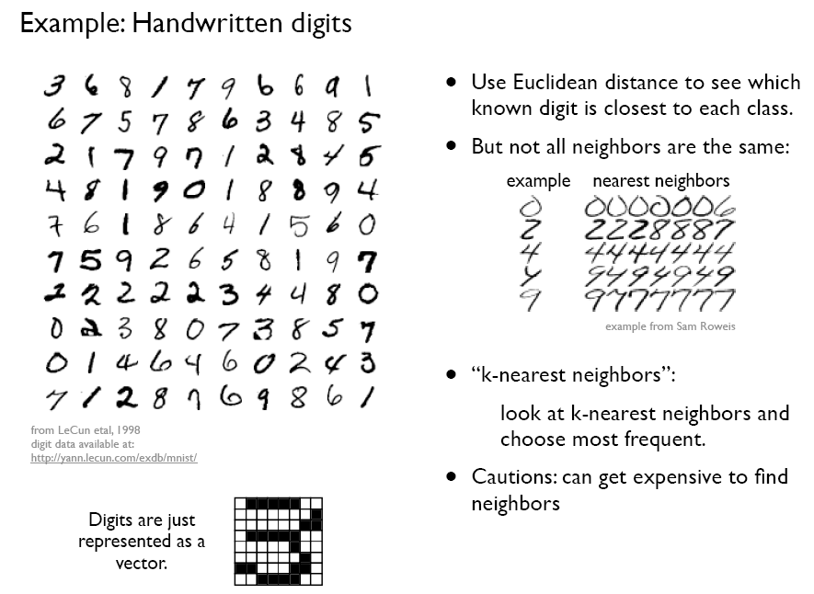

Slide 45
K-NN优缺点
优点：
  定义好距离以后,容易实现，性能不错
缺点：
  对大数据集，距离计算费时
  不适用于高维数据
    The nearest neighbors are usually a long way away!
      A d-dimensional hypercube of side b ≤ 1, its volume is b^{d}, given N data points, for each neighborhood to have k points, how big is b?
      b^{d} =k/N, so b=(k/N)^{1/d}
      If d = 100, k = 10, N=1,000,000 then b=0.89
    Curse of dimensionality

Slide 46
论文选读
MORITZ BLUME：EXPECTATION MAXIMIZATION: A GENTLE INTRODUCTION

Slide 47
Summary
Full Bayesian learning gives best possible predictions but is intractable
MAP learning balances complexity with accuracy on training data
Maximum likelihood assumes uniform prior, OK for large data sets
NBC learning is simple and quite good
EM can find local maximum likelihood solutions for hidden variables.
Instance-based models (e.g. K-NN) is non-parametric learning

