Slide 1
Reinforcement Learning
Chapter 21

Slide 2
Outline
Concepts
Passive Learning
DU/ADP/TD
Active Learning
Exploration vs. Exploitation
Q-learning
TD-Q Learning
Functional Approximation of States

Slide 3
Reinforcement Learning
Reinforcement learning:
Learning as a result of interaction between an agent and the external environment
No teacher
Learning based on rewards
Goal-oriented learning
Examples
Game playing: player knows whether it win or lose, but not know how to move at each step

Slide 4
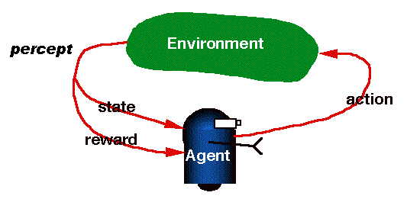
RL is learning from interaction
stochastic and partially observable

Slide 5
RL model
Each percept is enough to determine the State(the state is accessible)
The agent can decompose the reward component from a percept.
The agent task: to find a optimal policy, mapping states to actions, that maximize long-run measure of the reinforcement
Can be modeled as an MDP model!

Slide 6
Relation to MDPs
Feedback can be provided at the end of the sequence of actions, or more frequently.
Compare chess and ping-pong.
No complete model of environment.
Transitions may be unknown.
Reward function may be unknown.

Slide 7
Reinforcement Learning vs. Supervised Learning
 | 训练数据 | 输出 | 训练目标
Supervised Learning System | desired (target) outputs | 任务相关 | 最小化误差(target output – actual output)
RL System | rewards / penalties | 动作 | 最大化reward
训练数据
学习系统
输入
输出

Slide 8
RL examples
Grid World (机器人房间）
Game playing
Elevator Dispatching
Robot-soccer
Stock investing
……

Slide 9
Elevator Dispatching
Crites and Barto, 1996
10 floors, 4 elevator cars
STATES: button states; positions, directions, and motion states of cars; passengers in cars & in halls
ACTIONS: stop at, or go by, next floor
REWARDS: roughly, –1 per time step for each person waiting
Conservatively about 10²² states

Slide 10
Passive Reinforcement Learning
Assume fully observable environment.
Passive learning:
Policy is fixed (behavior does not change).
The agent learns how good each state is. That is, to learn the utility function
Similar to policy evaluation, but:
Transition function and reward function are unknown.
Also called value function in many books

Slide 11
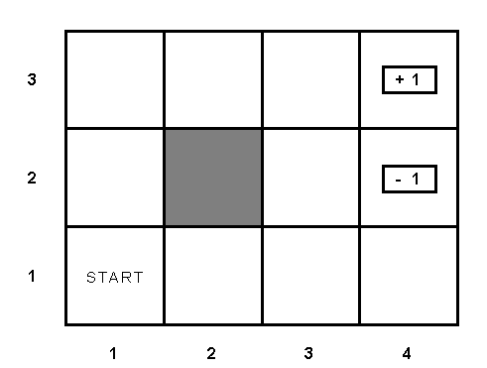
Example environment

Slide 12
Passive learning scenario
Agent executes trials in the environment using its policy (Monte Carlo method)
The agent see the sequences of state transitions and associated rewards
The environment generates state transitions and the agent perceive them
e.g (1,1)_{-0.04} →(1,2) _{-0.04} →(1,3) _{-0.04} →(2,3) _{-0.04} →(3,3) _{-0.04} →(4,3)[+1]
(1,1) _{-0.04}→(1,2) _{-0.04} →(1,3) _{-0.04} →(1,2) _{-0.04} →(1,3) _{-0.04} →(1,2) _{-0.04} →(1,1) _{-0.04} →(2,1) _{-0.04} →(3,1) _{-0.04} →(4,1) _{-0.04} →(4,2)[-1]
Key idea: updating the utility value using the given training sequences.

Slide 13
Direct Utility Estimation
Reward to go[累计奖励] of a state
the sum of the rewards from that state until a terminal state is reached
idea: use observed reward to go of the state as the direct evidence of the actual expected utility of that state
Learning utility function directly from trials
Similar to inductive learning:
Learning a function on states using samples.

Slide 14
DU updating
function DU-UPDATE (U, trial, N ) return an updated U
{ reward-to-go ← 0
for each s in trials (starting from end) do
N[s]++；
reward-to-go ← reward-to-go + REWARS[s]
U[s] = RUNNING-AVERAGE (U[s], reward-to-go, N[s])
end
}
function RUNNING-AVERAGE (U[s], reward-to-go, N[s] )
U[s] = [ U[s] * (N[s] – 1) + reward-to-go ] / N[s]

Slide 15
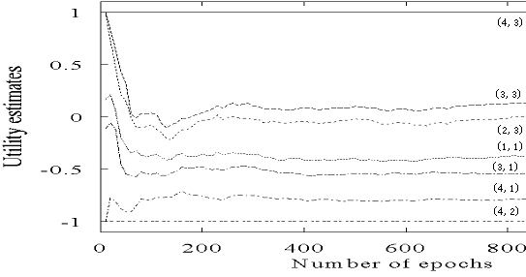
DU updating algorithm in passive learning
Drawback:
Ignores correlations between utilities of neighboring states.
Converge very slowly to correct utilities values (requires a lot of sequences)
for our example, >1000!

Slide 16
Adaptive Dynamic Programming
Learns transitions by ML estimation.
Plugs values into Bellman equations.
Solves equations with linear algebra, or policy iteration to get utilities.
Problem:
Intractable for large number of states，e.g. backgammon: 10⁵⁰ equations, with 10⁵⁰ unknowns.

Slide 17
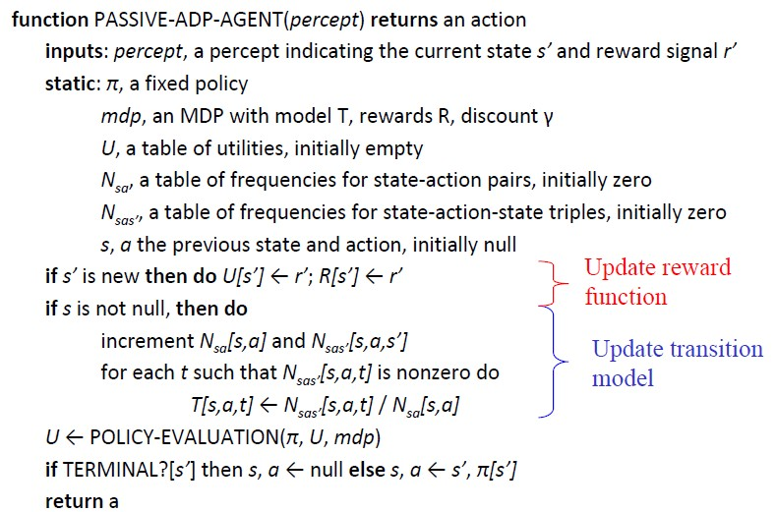
Passive-adp-agent

Slide 18
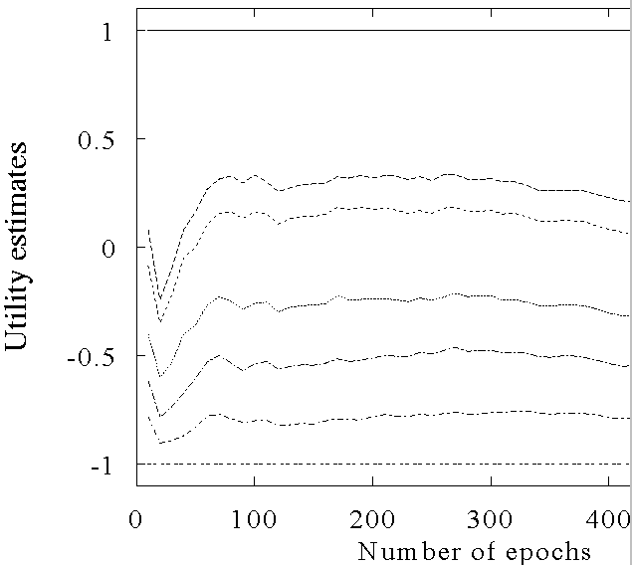
ADP learning curves
(4,3)
(3,3)
(2,3)
(1,1)
(3,1)
(4,1)
(4,2)

Slide 19
Temporal Difference learning
key idea:
adjust the estimated utility value of the current state based on its immediate reward and the estimated value of the next state.
The updating rule
α is the learning rate parameter
when α is a function that decreases as the number of times a state has been visited increases, U(s) converges to the correct value.

Slide 20
Passive-td-agent
Function PASSIVE-TD-AGENT(percept) returns an action
inputs: percept, a percept indicating the current state s’ and reward signal r’
static: π, a fixed policy
U, a table of utilities, initially empty
Ns, a table of frequencies for states, initially zero
s, a, r, the previous state, action, and reward, initially null
if s’ is new then U[s’] ←r’
if s is not null then do
increment Ns[s]
U[s] ← U[s] +α(Ns[s])(r+γU[s’] – U[s])
if terminal?[s’] then s,a,r ← null else s,a,r ← s’, π[s’],r’
return a

Slide 21
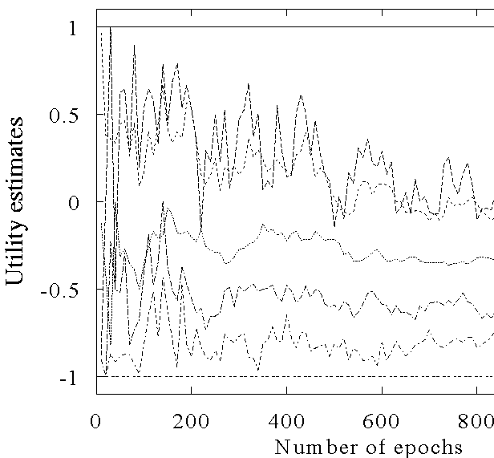
The TD learning curve
(4,3)
(2,3)
(2,2)
(1,1)
(3,1)
(4,1)
(4,2)

Slide 22
ADP vs TD
ADP:
ADP algorithm converges far faster than TD learning. That is because it use the information from the model of the environment.
ADP is intractable for large state space
In each step, update U for all states
TD
TD updates observed successor rather than all successors
TD is slower in convergence, but much simpler computation per observation

Slide 23
Passive learning v.s. Active learning
Passive learning
Policy is fixed, so action is fixed in a state
The agent simply watches the world going by and tries to learn the utilities of being in various states
Active learning
The agent does not simply watch, but also acts
Learns the policy, that is, the optimal action in each state

Slide 24
Model based v.s.Model free approaches
the environment model—the transition function T(s,a,s’)
two approaches
Model based approach RL:
learn the model, and use it to derive utilities
e.g Adaptive dynamic learning(ADP) approach
Model free approach RL:
derive the utilities without learning the model.
e.g DU and Temporal difference approach

Slide 25
Active Reinforcement Learning
Using ADP learning, utilities of states and transition probabilities are learned.
Those utilities and transitions can be plugged into Bellman equations.
Then choose optimal action

Slide 26
Active Reinforcement Learning
Using ADP learning, utilities of states and transition probabilities are learned.
Those utilities and transitions can be plugged into Bellman equations.
Problem
Bellman equations give optimal solutions given correct utility and transition functions.
ADP learning produces approximate estimates of those functions.

Slide 27
Greedy Agent
在尝试若干次以后，Agent可以对转移概率，对每个状态的Utility作出相对准确的估计
但是，如果就凭这些估算的Utility，来求出“最优”策略，并以此指导以后的行动，那可能是并非最优的。这称为“贪心”Agent。
鄂尔多斯的富翁与“雾霾”的成因：煤？

Slide 28
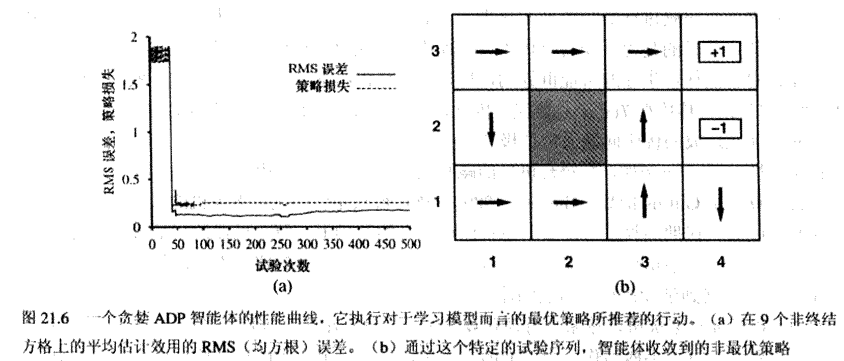
Optimal policy is not learned!

Slide 29
Exploration in Active learning
An action has two kinds of outcome
Gain rewards on the current experience tuple (s,a,s’)
Affect the percepts received, and hence the ability of the agent to learn the true model

Slide 30
Exploration/Exploitation
A trade off when choosing action between
its immediately well-being(reflected in its current utility estimates using the what we have learned) - exploitation
its long term good(exploring more about the environment help it to behave optimally in the long run) - exploration
You can’t exploit all the time; you can’t explore all the time. We need both.
Just like human in the real world! People need to decide between
Continuing in a comfortable existence
Or striking out into the unknown in the hopes of discovering a new and better life

Slide 31
Exploration in Active learning
the agent should be more explorative when it has little idea of the environment, and more greedy when it has a model that is close to being correct
In a given state, the agent should give some weight to actions that it has not tried very often.
While tend to avoid actions that are believed to be of low utility
Implemented by exploration function f(u,n):
assigning a higher utility estimate to relatively unexplored action state pairs
Chang the updating rule of value function to
U⁺ denote the optimistic estimate of the utility

Slide 32
Exploration in Active learning
One kind of definition of f(u,n)
if n< Ne
u otherwise
is an optimistic estimate of the best possible reward obtainable in any state
The agent will try each action-state pair(s,a) at least Ne times
The agent will behave initially as if there were wonderful rewards scattered all over around– optimistic .
采用了exploration以后，房间机器人可在比较少的尝试以后，成功地找到最优策略!

Slide 33
Q learning
Q learning: learns utility function on (state, action) pairs.
Define Utility as Q-value function
Q-value function updating rule
Model required

Slide 34
TD-Q learning
TD-Q learning is model-free (no transition)
Key idea
Combine Q learning with temporal difference approach
The updating rule
Rule to chose the action to take
changed to

Slide 35
TD-Q-learning-agent
Function TD-Q-learning-AGENT(percept) returns an action
inputs: percept, a percept indicating the current state s’ and reward signal r’
static: Q, a table of action values indexed by state and action
N_{sa}, a table of frequencies for state-action pairs, initially zero
s, a, r, the previous state, action, and reward, initially null
if s is not null then do
increment N_{sa}[s,a]
Q[a,s] ← Q[a,s] +α(N_{sa}[s,a])(r+γ max_{a’}Q[a’,s’] – Q[a,s])
if terminal?[s’] then s,a,r ← null else
s,a,r ← s’, argmax_{a’} f(Q[a’,s’],N_{sa}[s’,a’]), r’
return a
f: exploration function

Slide 36


Generalization in Reinforcement Learning
So far we assumed that all the functions learned by the agent (U, T, R, Q) are tabular forms—
i.e.. It is possible to enumerate state and action spaces.
In case it is not, use generalization techniques to deal with large state or action space.
Function approximation techniques. Eg. an estimated utility function for game playing can be represented as a weighted linear function of a set of board features f₁………f_{n}:
Even in grid world, for state (x, y), we can have

Slide 37
Generalization in Reinforcement Learning
Enormous compression is achieved by a function representation which allows the learning agents to generalize from states it has visited to states it has not visited
the most important aspect: it allows for inductive generalization over input states.
Therefore, such method is said to perform input generalization

Slide 38


Generalization in Reinforcement Learning
The weights can be updated after each trial (online learning)
Error function
Gradient update to decrease error
u_{j}(s): observed total award from s onward in the jth trial
Widrow-Hoff rule (delta rule)

Slide 39
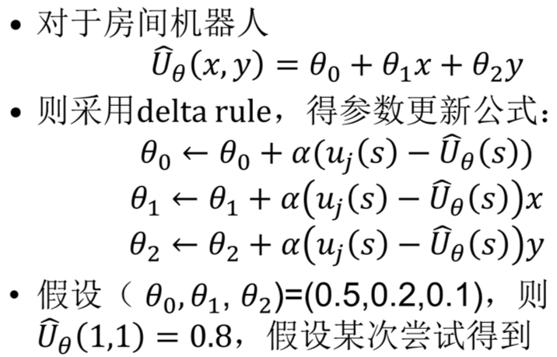
Reinforcement Learning: grid world
$$u_{j}\left(1,1\right)=0.4,则θ_{0}θ_{1}θ_{2}都减少0.4α$$

Slide 40
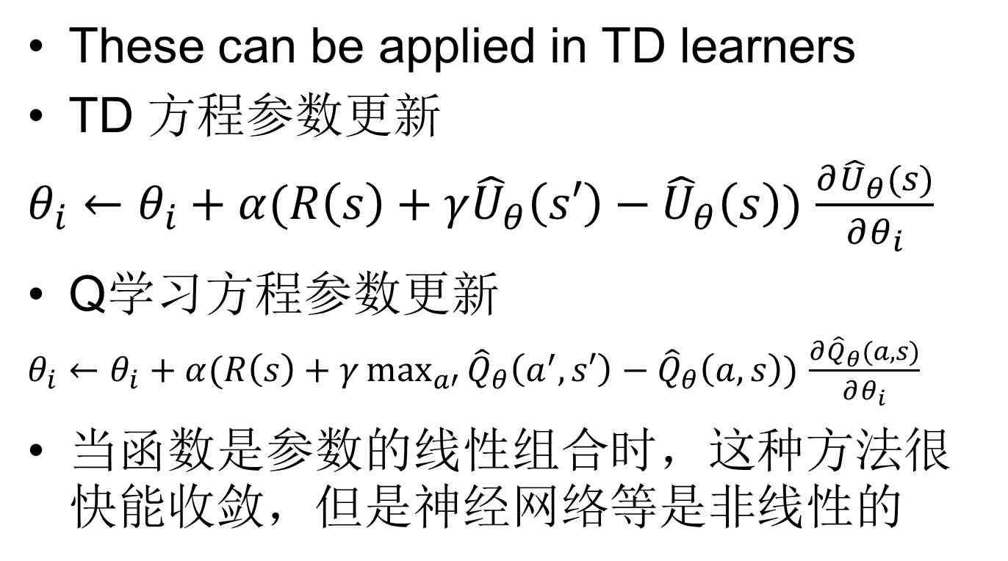
Generalization in Reinforcement Learning

Slide 41
Learning Parametric Utility Functions For Checkers
Approach
First Significant application of reinforcement learning
Samuel’s first learning program was completed in 1955 and demonstrated on television in 1956.
Used weighted linear functions of 16 terms.

Slide 42
Learning Parametric Utility Functions For Backgammon
Approach
TD-Gammon(1992) was a straightforward combination of the TD algorithm and nonlinear function approximation using a multi-layer neural network trained by backpropagating TD errors.
Let the system play against itself.
Result (after 300,000 games, a few weeks):
Program competitive with best players in the world.

Slide 43
Reinforcement Learning进展
把深度学习和强化学习结合起来：
V Mnih et al： Playing Atari with Deep Reinforcement Learning，2013，arxiv.org
V Mnih et al: Human Level Control Through Deep Reinforcement Learning. Nature 2015.
Matthew Lai, Giraffe: Using Deep Reinforcement Learning to Play Chess. Sept. 2015
Google提出GORILA: GOOGLE REINFORCEMENT LEARNING ARCHITECTURE
有关内容放到深度学习一起讲

Slide 44
Summary
RL is necessary for agents in unknown environments
Passive Learning: Evaluate a given policy
Direct utility estimate by supervised learning
ADP learns a model and solves linear system
TD only updates estimates to match successor state
Active Learning: Learn an optimal policy
ADP using proper exploration function
Q-learning using model-free TD approach
Function approximation necessary for real/large state spaces

Slide 45
论文选读
Richard Sutton 关于强化学习的教材。电子版： http://incompleteideas.net/book/the-book.html
Google收购了AI公司DeepMind，请阅读他们发表的有关强化（深度）学习的最新论文：http://deepmind.com/publications.html

