Slide 1
神经网络和深度学习介绍
史晓东

Slide 2
Outline
生物神经系统
人工神经元及神经网络
Learning with artificial neural networks
深度神经网络
深度强化学习

Slide 3
生物神经系统
生物的神经系统是一个有高度组织和相互作用的数量巨大的细胞组织群体（人类大脑的神经细胞大约在10¹¹一10¹³个左右）。神经细胞也称神经元，是神经系统的基本单元，它们按不同的结合方式构成了复杂的神经网络。通过神经元及其联接的可塑性，使得大脑具有学习、记忆和认知等各种智能。

Slide 4
神经元
Dendrites树突
Axon 轴突
Soma (cell body) 细胞体
Synapses突触
The information transmission happens at the synapses.

Slide 5
信息传导过程
Neurons work by processing information. They receive and provide information in form of spikes.
The spikes travelling along the axon of the pre-synaptic neuron trigger the release of neurotransmitter substances at the synapse.
The neurotransmitters cause excitation or inhibition in the dendrite of the post-synaptic neuron.
The integration of the excitatory and inhibitory signals may produce spikes in the post-synaptic neuron.
The contribution of the signals depends on the strength of the synaptic connection.

Slide 6
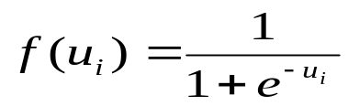

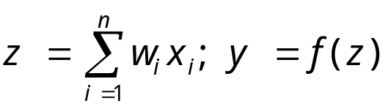
Artificial neurons
synaptic strength are translated as weights
f(•)称为激励（激活）函数(activation function)，一般用S形函数，如logistic（也称为sigmoid）或tanh函数：
x₁
x₂
x₃
…
x_{n-1}
x_{n}
w₁
输出
w₂
输入
y
w₃
.
.
.
w_{n-1}
w_{n}
The McCullogh-Pitts model （1943）

Slide 7
Artificial neural networks
隐层（可以有多层）
Input
Output
An artificial neural network is composed of many artificial neurons that are linked together according to a specific network architecture. The objective of the neural network is to transform the inputs into meaningful outputs.

Slide 8
神经网络分类
前馈神经网络 feed-forward
反馈神经网络 feed-back

Slide 9
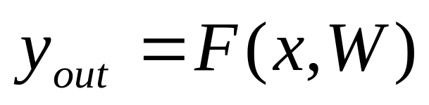
Neural network mathematics
Neural network: input / output transformation
W is the matrix of all weight vectors.

Slide 10
Neural network tasks
classification
approximation
prediction
control
These can be reformulated in general as FUNCTION APPROXIMATION tasks.
Approximation: given a set of values of a function g(x) build a neural network that approximates the g(x) values for any input x.

Slide 11
Neural network approximation
Task specification:
  Data: set of value pairs: (x^{t}, y_{t}), y_{t}=g(x^{t}) + z_{t}; z_{t} is random measurement noise.
  Objective: find a neural network that represents the input / output transformation (a function) F(x,W) such that F(x,W) approximates g(x) for every x

Slide 12
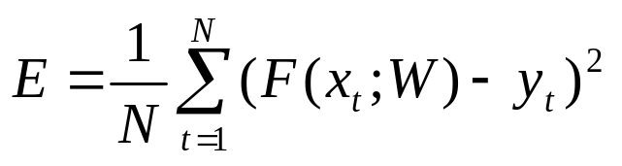
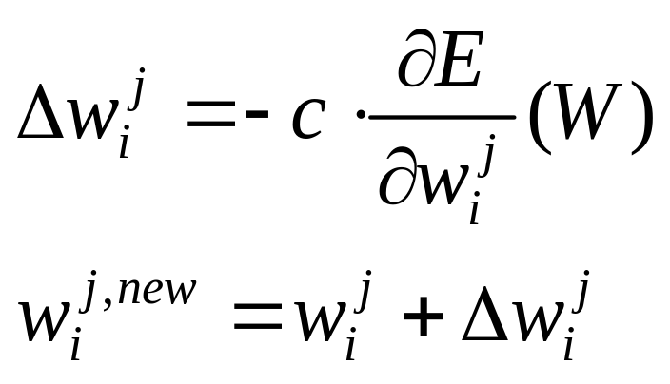
Learning to approximate
优化方法：梯度下降法 (Gradient Descent)
Error measure (loss function), e.g.:
Mean squared error
Rule for changing the synaptic weights
是不是和Temporal Difference
Learning 非常类似？
c is the learning parameter (usually a constant, but can be adjusted dynamically)

Slide 13
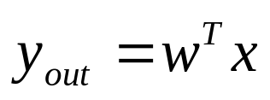
最简单的神经网络：感知器
Perceptron （1957）: Multi-Layer Perceptron (MLP):
y_{out}
x
y_{out}
x

Slide 14
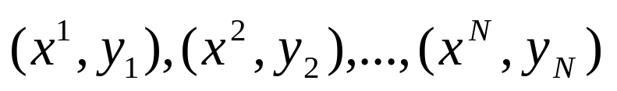
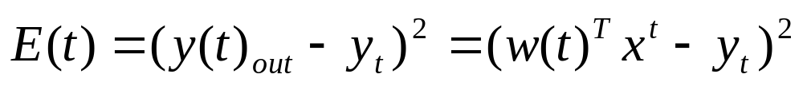
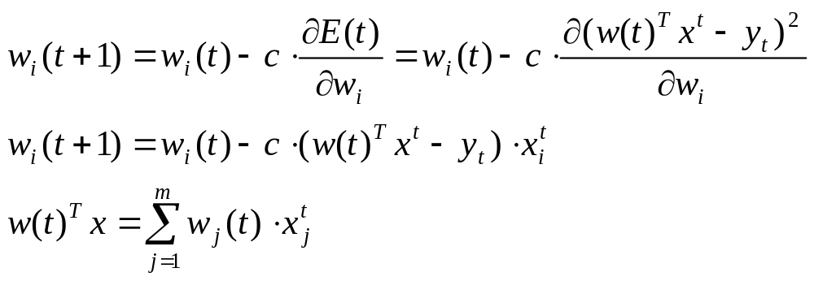
Learning with a perceptron
Perceptron:
Data:
Error:
Learning:

Slide 15
单层感知器的局限
A perceptron is able to learn a linear function only.只能学习一个线性分类器，连xor函数都无法表示（线性不可分）
In 1969, Minsky and Papert published a book called “Perceptrons” that analysed what they could do and showed their limitations. Many people thought these limitations applied to all neural network models, so NN research dwindled.

Slide 16
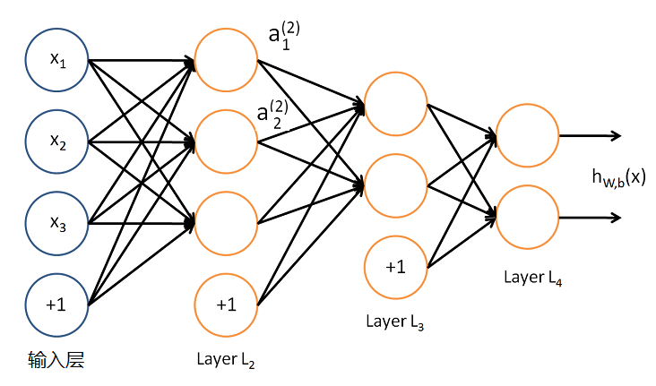



多层神经网络的学习
bias
输入
第l层的神经元i的激活（输出）
神经网络针对输入x的输出，W，b是权重(weight)和偏置(bias)

Slide 17
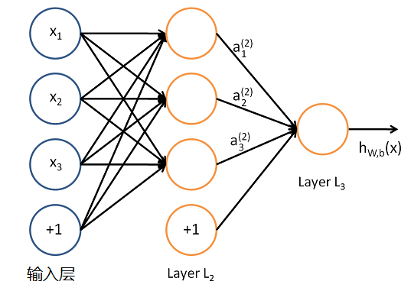

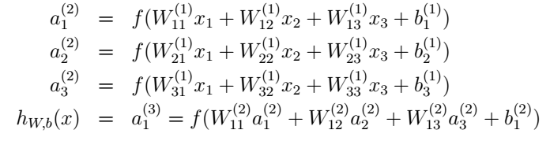
第l+1层的神经元i到
第l层的神经元j的权重

Slide 18



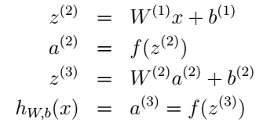
设
则上述方程可写作
我们可进一步把激活函数推广到向量（按元素应用），则上述方程可写作：
对输入层：

Slide 19
Learning with backpropagation
多层网络，采用逐层反向传播算法:
  calculate first the changes for the synaptic weights of the output neuron;
  calculate the changes backward starting from the last hidden layer, and propagate backward the local error terms.
80年代中期，BP算法被David Rumelhart、Geoffrey Hinton及Ronald Williams、David Parker和Yann LeCun独立发现，并获得了广泛的注意，引起了人工神经网络领域研究的第二次热潮。其实该算法早在1974年由Paul Werbos在研究如何训练一般网络的学习算法时就提出。

Slide 20
反向传播算法
第1阶段：激励传播
  每次迭代中的传播环节包含两步：
    （前向传播阶段）将训练输入送入网络以获得激励响应；
    （反向传播阶段）将激励响应同训练输入对应的目标输出求差，从而获得隐层和输出层的响应误差。
第2阶段：权重更新
  对于每个突触上的权重，按照以下步骤进行更新：
    将输入激励和响应误差相乘，从而获得权重的梯度；
    将这个梯度乘上一个比例并取反后加到权重上。
  这个比例（百分比）将会影响到训练过程的速度和效果，因此称为“学习率”。梯度的方向指明了误差扩大的方向，因此在更新权重的时候需要对其取反，从而减小误差。
第1和第2阶段可以反复循环迭代，直到网络对输入的响应输出达到满意的预定目标为止。

Slide 21

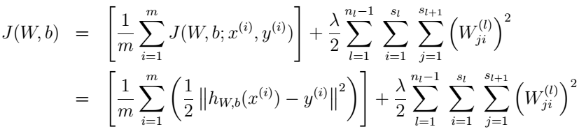
BP算法推导
设定误差项(也称loss/cost损失/代价函数)为
这是常用的均方误差（mean-squared error）。
m个实例的训练集的总误差
Weight decay 正则项，避免过拟合

Slide 22
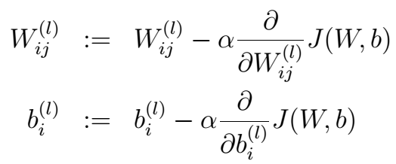
我们采用梯度下降法来进行参数W，b的学习：
需要求偏导数，其中α是学习率。

Slide 23
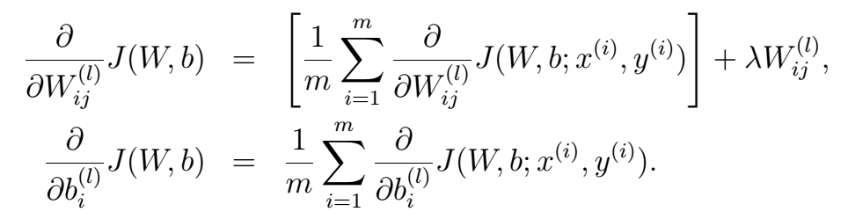

Slide 24
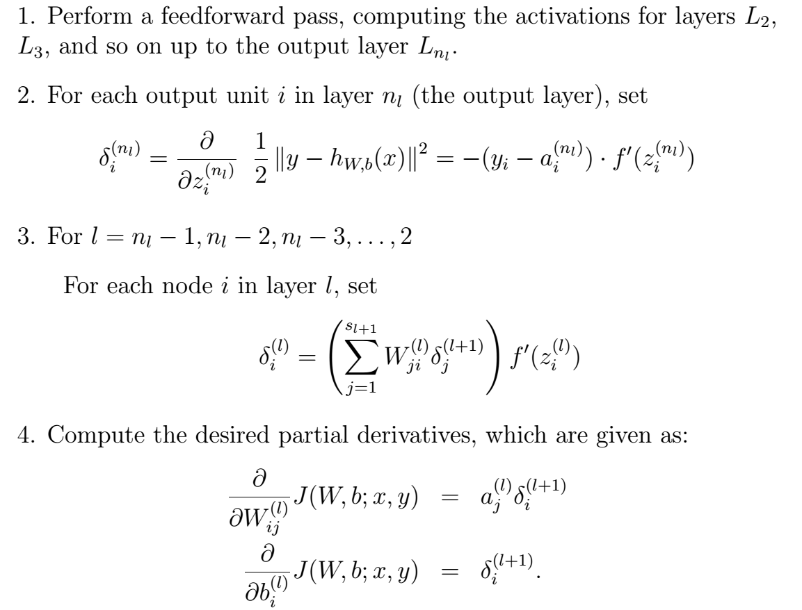

BP算法
误差项
误差项
误差项
误差项=使用以
作为输入的节点
的加权平均误差

Slide 25
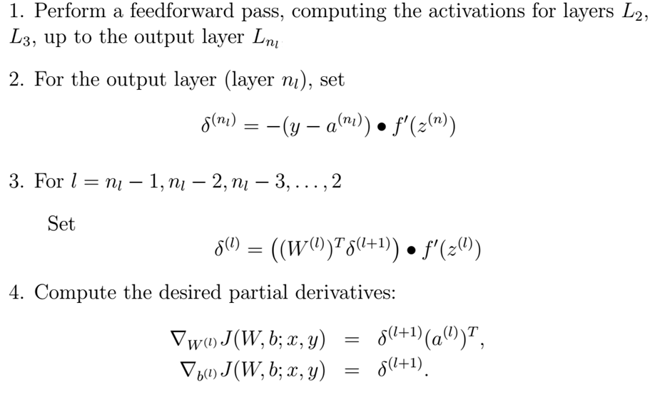

BP算法（向量化描述）
如激励函数为sigmoid函数：

Slide 26
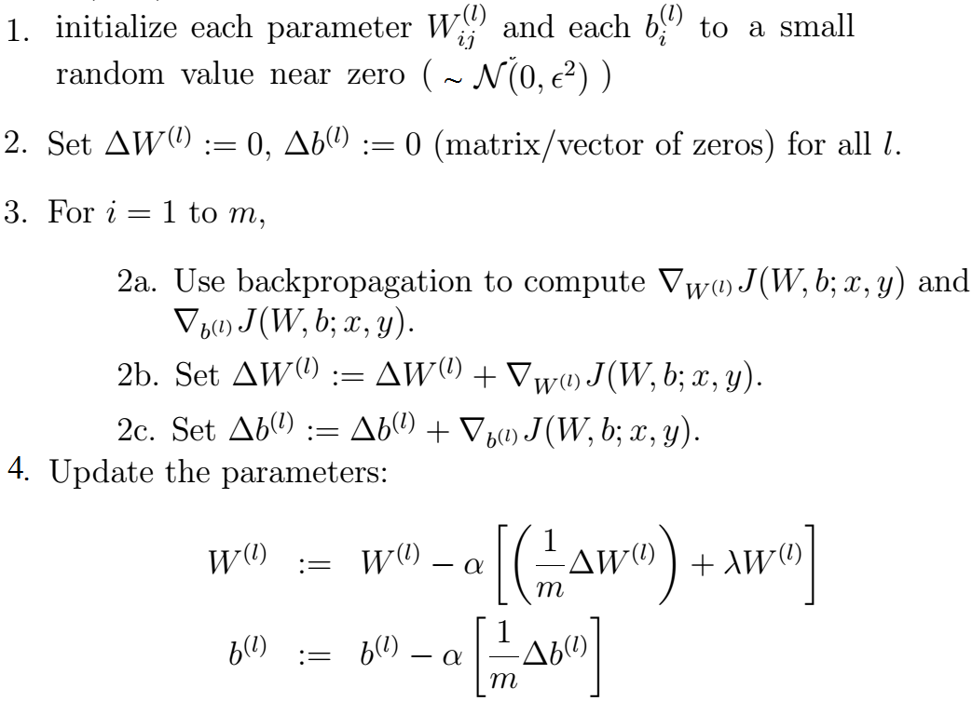
神经网络参数学习算法
m为训练实例的个数

Slide 27

关于loss/cost函数
Loss函数是一个可微函数，度量神经网络输出与真实结果的差距，是一个标量，即前面所称的误差项
如采用sigmoid函数为激活函数
可见权值学习的速度是与误差成正比的，所以这个loss函数常被采用！

Slide 28
关于loss/cost函数
但当输出是一个概率分布时，常采用交叉熵（coss-entropy）来表示神经网络的loss函数。
两个概率分布的交叉熵定义为（对离散概率分布p，q）：
其中，一般p为(未知)真实分布，q为模型

Slide 29

关于loss/cost函数
在常见的逻辑回归（logistic regression）分类模型中，分类输出是表示2分类（用y∈{0,1}表示）的概率.设
则
假设有N个实例，则loss函数为：

Slide 30

关于loss/cost函数
对于N硬分类问题，因为真实结果（ground truth)总是某类的概率为1，其他类的概率为0，loss函数可以简化为
其中 为模型对于真实结果的那类的估算的概率。就这么简单！

Slide 31
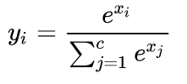
关于loss/cost函数
通过采用softmax函数，可以把任何实数输出为一个概率分布：
这种情况下，softmax可以作为最后的输出层。

Slide 32
关于loss/cost函数
实际使用时，特别当训练数据不足时，loss函数常带有一个正则化项，以防止过拟合。

Slide 33
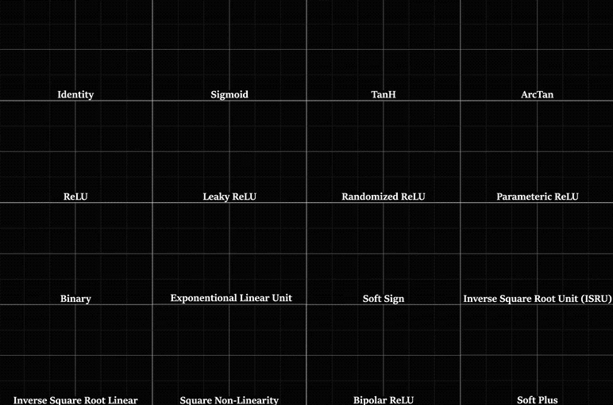
关于激活函数
有多种激活函数

Slide 34

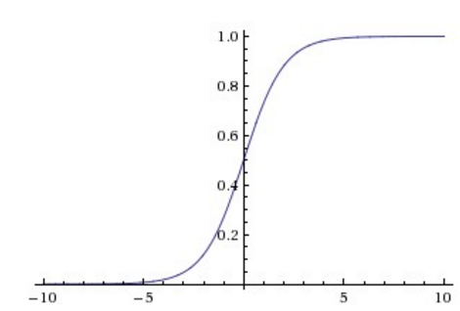
关于激活函数
Sigmoid
Sigmoid容易饱和，并且当输入非常大或者非常小的时候，神经元的梯度就接近于0
Sigmoid 的输出不是0均值的

Slide 35

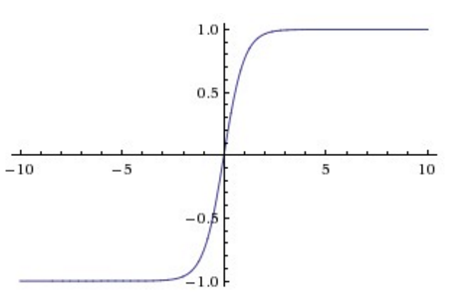
关于激活函数
Tanh
tanh的输出是0均值的，但仍容易饱和，并且当输入非常大或者非常小的时候，神经元的梯度就接近于0

Slide 36




关于激活函数
Relu
Noisy Relu
Leaky Relu
ELU
GELU
改进了前面的激活函数的一些问题

Slide 37
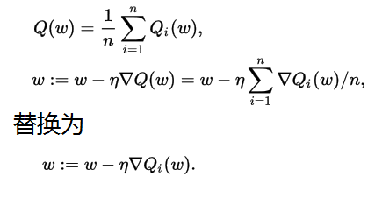
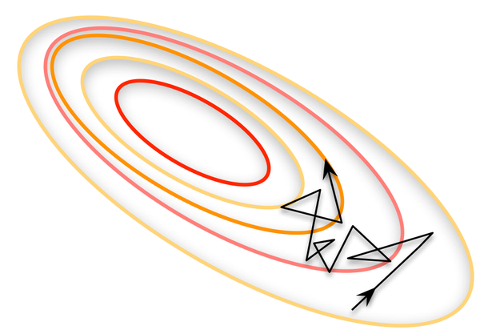
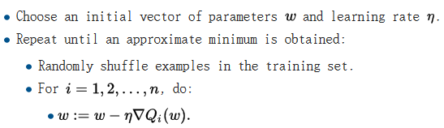
Stochastic gradient descent
把Full Batch Learning
太慢且收敛难，所以用Mini-batch: 每次处理若干实例
Q 为误差项，n为实例个数
每处理一个实例就更新一次参数

Slide 38
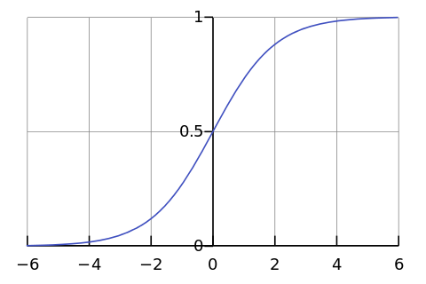

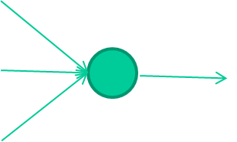
神经网络学习演示
-0.06
W1
W2
f(x)
-2.5
W3
1.4

Slide 39
-0.06
2.7
-8.6
f(x)
-2.5
0.002
x = -0.06×2.7 + 2.5×8.6 + 1.4×0.002 = 21.34
1.4

Slide 40
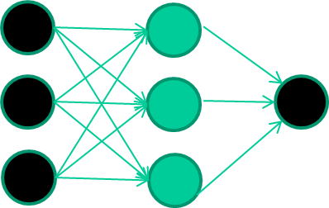
A dataset
Fields class
1.4 2.7 1.9 0
3.8 3.4 3.2 0
6.4 2.8 1.7 1
4.1 0.1 0.2 0
etc …

Slide 41
Training the neural network
Fields class
1.4 2.7 1.9 0
3.8 3.4 3.2 0
6.4 2.8 1.7 1
4.1 0.1 0.2 0
etc …

Slide 42
Training data
Fields class
1.4 2.7 1.9 0
3.8 3.4 3.2 0
6.4 2.8 1.7 1
4.1 0.1 0.2 0
etc …
Initialise with random weights

Slide 43
Training data
Fields class
1.4 2.7 1.9 0
3.8 3.4 3.2 0
6.4 2.8 1.7 1
4.1 0.1 0.2 0
etc …
Present a training pattern
1.4
2.7
1.9

Slide 44
Training data
Fields class
1.4 2.7 1.9 0
3.8 3.4 3.2 0
6.4 2.8 1.7 1
4.1 0.1 0.2 0
etc …
Feed it through to get output
1.4
2.7 0.8
1.9

Slide 45
Training data
Fields class
1.4 2.7 1.9 0
3.8 3.4 3.2 0
6.4 2.8 1.7 1
4.1 0.1 0.2 0
etc …
Compare with target output
1.4
2.7 0.8
0
1.9 error 0.8

Slide 46


Training data
Fields class
1.4 2.7 1.9 0
3.8 3.4 3.2 0
6.4 2.8 1.7 1
4.1 0.1 0.2 0
etc …
Adjust weights based on error
1.4
2.7 0.8
0
1.9 error 0.8

Slide 47
Training data
Fields class
1.4 2.7 1.9 0
3.8 3.4 3.2 0
6.4 2.8 1.7 1
4.1 0.1 0.2 0
etc …
Present a training pattern
6.4
2.8
1.7

Slide 48
Training data
Fields class
1.4 2.7 1.9 0
3.8 3.4 3.2 0
6.4 2.8 1.7 1
4.1 0.1 0.2 0
etc …
Feed it through to get output
6.4
2.8 0.9
1.7

Slide 49
Training data
Fields class
1.4 2.7 1.9 0
3.8 3.4 3.2 0
6.4 2.8 1.7 1
4.1 0.1 0.2 0
etc …
Compare with target output
6.4
2.8 0.9
1
1.7 error -0.1

Slide 50
Training data
Fields class
1.4 2.7 1.9 0
3.8 3.4 3.2 0
6.4 2.8 1.7 1
4.1 0.1 0.2 0
etc …
Adjust weights based on error
6.4
2.8 0.9
1
1.7 error -0.1

Slide 51
Training data
Fields class
1.4 2.7 1.9 0
3.8 3.4 3.2 0
6.4 2.8 1.7 1
4.1 0.1 0.2 0
etc …
And so on ….
6.4
2.8 0.9
1
1.7 error -0.1
Repeat this thousands, maybe millions of times – each time
taking a random training instance, and making slight
weight adjustments
Algorithms for weight adjustment are designed to make
changes that will reduce the error

Slide 52
Training data
Fields class
1.4 2.7 1.9 0
3.8 3.4 3.2 0
6.4 2.8 1.7 1
4.1 0.1 0.2 0
etc …
Compare with target output
6.4
2.8 0.9
1
1.7 error -0.1

Slide 53
Training data
Fields class
1.4 2.7 1.9 0
3.8 3.4 3.2 0
6.4 2.8 1.7 1
4.1 0.1 0.2 0
etc …
Adjust weights based on error
6.4
2.8 0.9
1
1.7 error -0.1

Slide 54
Training data
Fields class
1.4 2.7 1.9 0
3.8 3.4 3.2 0
6.4 2.8 1.7 1
4.1 0.1 0.2 0
etc …
And so on ….
6.4
2.8 0.9
1
1.7 error -0.1
Repeat this thousands, maybe millions of times – each time
taking a random training instance, and making slight
weight adjustments
Algorithms for weight adjustment are designed to make
changes that will reduce the error

Slide 55
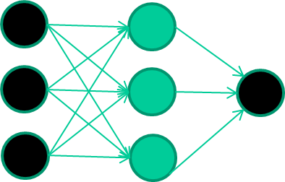
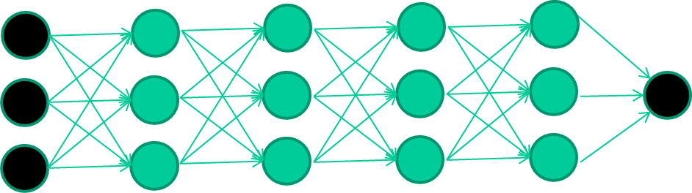
深度神经网络
什么叫深度神经网络？和多层神经网络有何差别？
  形式上，深度神经网络和多层神经网络没有差别
  但是，多层神经网络的训练问题一直没有很好的解决
  容易训练 难以训练

Slide 56
BP算法的问题
梯度消失问题
  误差从输出层反向传播时，在每一层都要乘以该层的激励函数的导数。
  当我们使用 logistic 函数或 tanh 函数时，其导数
  为 σ′(x) = σ(x)(1 − σ(x)) ∈ [0, 0.25]
  tanh′(x) = 1 − (tanh(x))² ∈ [0, 1]
  我们可以看到， 这些函数导数的值域都小于 1。这样误差经过每一层传递都会不断衰减。当网络层数很深时，梯度就会不停的衰减，甚至消失，使得整个网络很难训练。这就是所谓的梯度消失问题（Vanishing Gradient Problem），也叫梯度弥散。
梯度爆炸问题

Slide 57
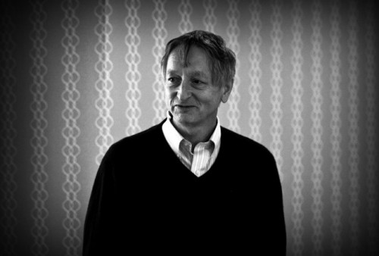
大神Hinton来了…
Hinton and Salakhutdinov [2006] 发现多层前馈神经网络可以先通过逐层预训练，再用反向传播算法进行精调的方式进行有效学习。(Reducing the Dimensionality of Data with Neural Networks. Science Vol. 313)
Toronto Univ./Google

Slide 58
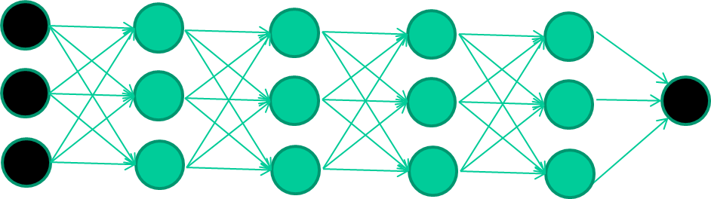
The new way to train multi-layer NNs…

Slide 59
The new way to train multi-layer NNs…
Train this layer first

Slide 60
The new way to train multi-layer NNs…
Train this layer first
then this layer

Slide 61
The new way to train multi-layer NNs…
Train this layer first
then this layer
then this layer

Slide 62
The new way to train multi-layer NNs…
Train this layer first
then this layer
then this layer
then this layer

Slide 63
The new way to train multi-layer NNs…
Train this layer first
then this layer
then this layer
then this layer
finally this layer

Slide 64
The new way to train multi-layer NNs…
EACH of the (non-output) layers is trained to be an auto-encoder
Basically, it is forced to learn good features that describe what comes from the previous layer

Slide 65
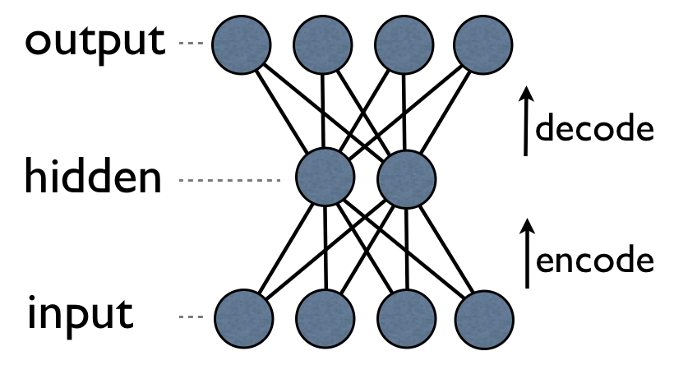
an auto-encoder is trained, with an absolutely standard weight-adjustment algorithm to reproduce the input

Slide 66
an auto-encoder is trained, with an absolutely standard weight-adjustment algorithm to reproduce the input
Note that the number of ‘hidden layer’ units is fewer than the inputs, which forces the hidden layer units to become good feature detectors

Slide 67
自编码器
自编码器使得自动特征表示成为可能，所以深度学习也称为表示学习(representation learning)。
这使得机器学习中的费力、不完备、带有偏见的手工特征描述(Feature Engineering)不再完全必要（真的吗？）
当然，自编码器不是唯一的非监督预训练手段（受限玻尔兹曼机/RBM，contrastive estimation …)

Slide 68
intermediate layers are each trained to be auto encoders (or similar)

Slide 69
Final layer trained to predict class based on outputs from previous layers

Slide 70
预训练不是唯一解决办法
梯度消失问题的其他解决办法
  新型网络如LSTM（Long Short-Term Memory)
  采用其他激活函数有可能避免此问题（如ReLU)
  快速GPU使得可以采用较小的学习率，从而在一定程度上避免梯度消失问题，使得训练较深的神经网络成为可能

Slide 71
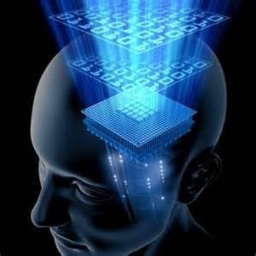
为什么要深度神经网络？
大脑是深度的
多层网络在描述有些问题时会带来复杂性的急剧降低！(Hastad,1987)
  N位的奇偶函数用2层网络需要指数级神经元
深度神经网络的表达能力更加强
  层与层不同。不同的层表示不同的抽象层次，能表示不同的特征（及其组合）。深度是必要的！

Slide 72
深度与表达能力
隐层数目 | 能力
0 | 只能表示线性可分函数。如单层感知器
1 | 可近似模拟任何连续函数，但可能需要指数级的神经元
>=2 | 可进行自动特征表示学习，深度增加可极大减少神经元的数目

Slide 73
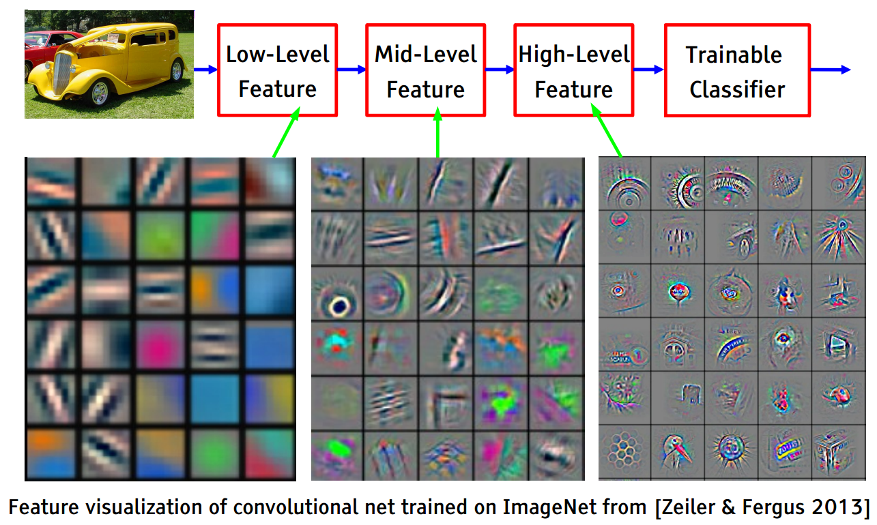
from Lecun

Slide 74
多种深度神经网络
前馈神经网络(FFN)
  Autoencoders，Denoising autoencoders，Restricted Boltzmann machines (=>DBNs)
卷积神经网络(CNN)
循环神经网络RNN(Recurrent)
  LSTM
  GRU
递归神经网络RNN(Recursive)
  Recursive autoencoders，Recursive neural tensor networks
生成对抗网络(GAN)
残差网络(ResNet)
神经图灵机(NTM)
脉冲神经网络(Spike neural network)

Slide 75
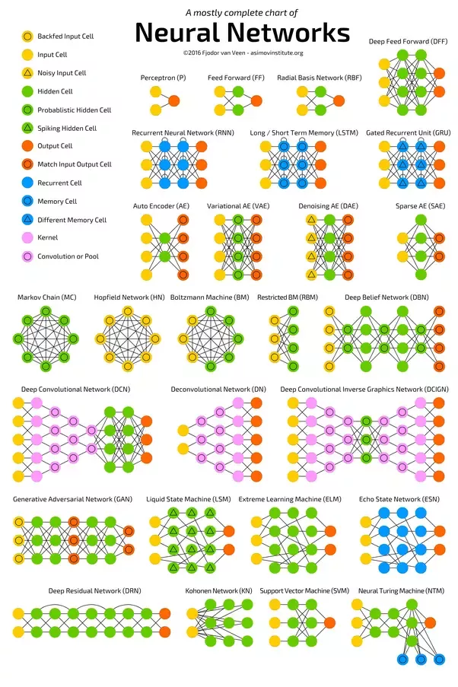

Slide 76

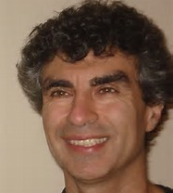
convolutional neural network
In 1995, Yann LeCun and Yoshua Bengio introduced the concept of convolutional neural networks.

Slide 77
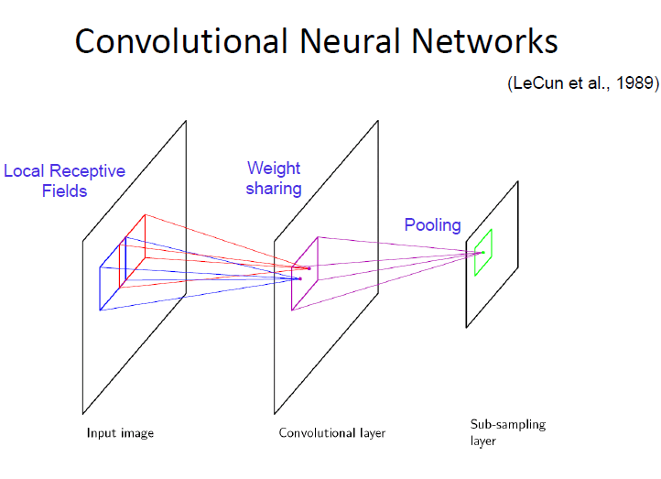

Slide 78
Convolution: local feature extractor using filters (kernels), neurobiologically motivated by the findings of locally sensitive and orientation-selective nerve cells in the visual cortex.
Weight sharing: reduce parameters drastically
Pooling (or aggregation): subsample the small rectangular blocks to produce a single output (汇流/汇聚，“池化”）, reducing the spatial resolution of each feature map
  Max pooling
  Average pooling

Slide 79
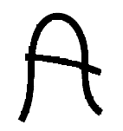
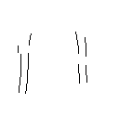
Feature extraction
-1
0
1
Convolve with
Threshold
-1
0
1
-1
0
1
w11
w12
w13
w11
w12
w13
w21
w22
w23
w21
w22
w23
w31
w32
w33
w31
w32
w33

Slide 80
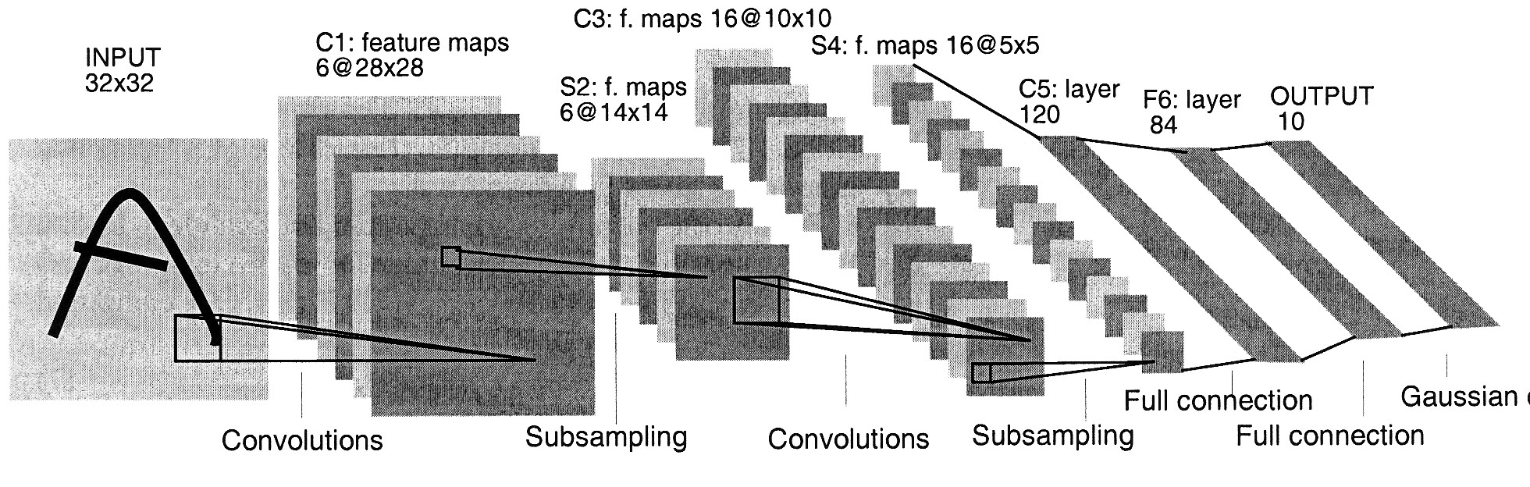
LeNet5

Slide 81
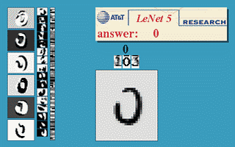
Convolutional Neural Networks are designed to recognize visual patterns directly from pixel images with minimal reprocessing. They can recognize patterns with extreme variability (such as handwritten characters), and with robustness to distortions and simple geometric transformations. LeNet-5 is a convolutional network designed for handwritten and machine-printed character recognition.
http://yann.lecun.com/exdb/lenet/

Slide 82
The power of CNNs
Mike O'Neill designed a CNN achieving 99.26% accuracy on the MNIST database (Consisting of 60,000 hand written digits uniformly distributed over 0-9) in 2006.
A team led by Alex Krizhevsky (with Geoffrey Hinton, University of Toronto) won the ImageNet Large Scale Visual Recognition Challenge 2012 using a CNN (called AlexNet later).
A CNN-based Machine Translation by Facebook achieved the state-of-the-art in May 2017
AlphaGo uses CNN to evaluate value/policy.

Slide 83
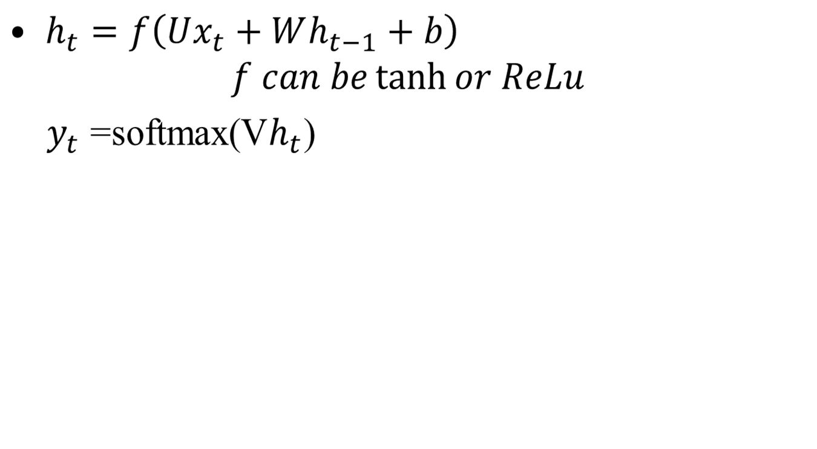
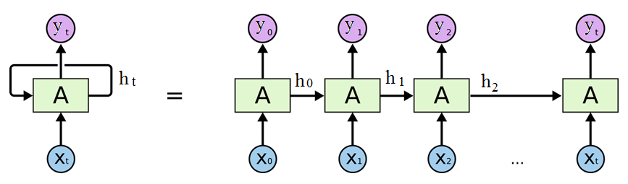
recurrent neural network
循环神经网络

Slide 84
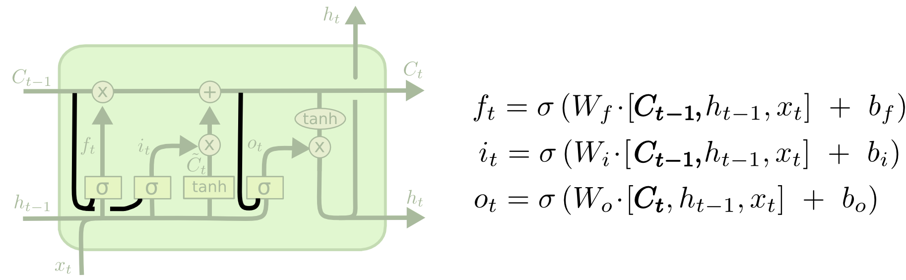
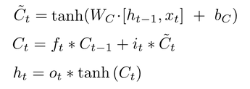
More advanced RNN
LSTM (Long Short Term Memory networks –introduced by Hochreiter & Schmidhuber (1997))：引入短时记忆，并用三个门来控制记忆，解决长距离依赖问题

Slide 85
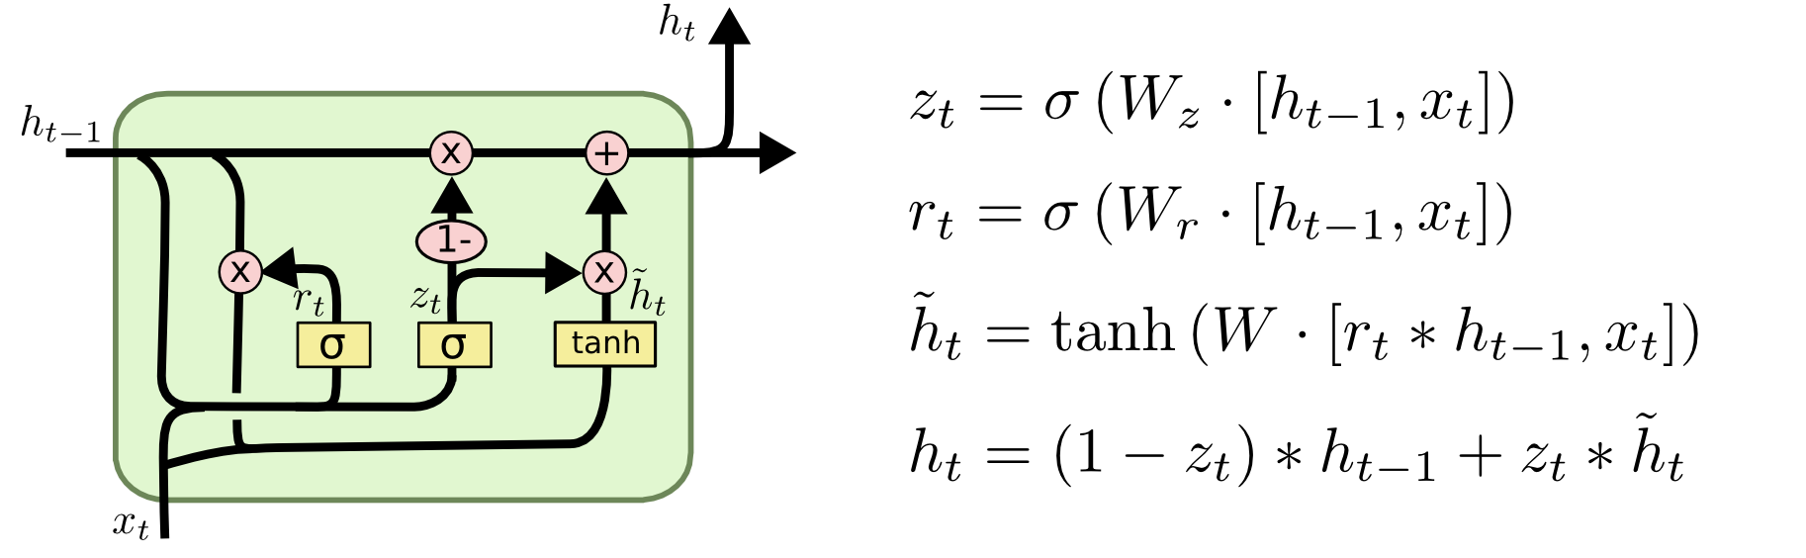
More advanced RNN
GRU (Gated Recurrent Unit): a simplified version of LSTM introduced by Cho, et al. (2014). It combines the forget and input gates into a single “update gate.” It also merges the cell state and hidden state.

Slide 86
生成对抗网络
“The coolest idea in deep learning in the last 20 years.” — Yann LeCun on GANs.
生成模型(generative models)有很多好处：
  Simulate possible futures for planning
  Generative models can be trained with missing data
    Semi-supervised learning
  Multi-modal outputs
  Realistic generation tasks

Slide 87
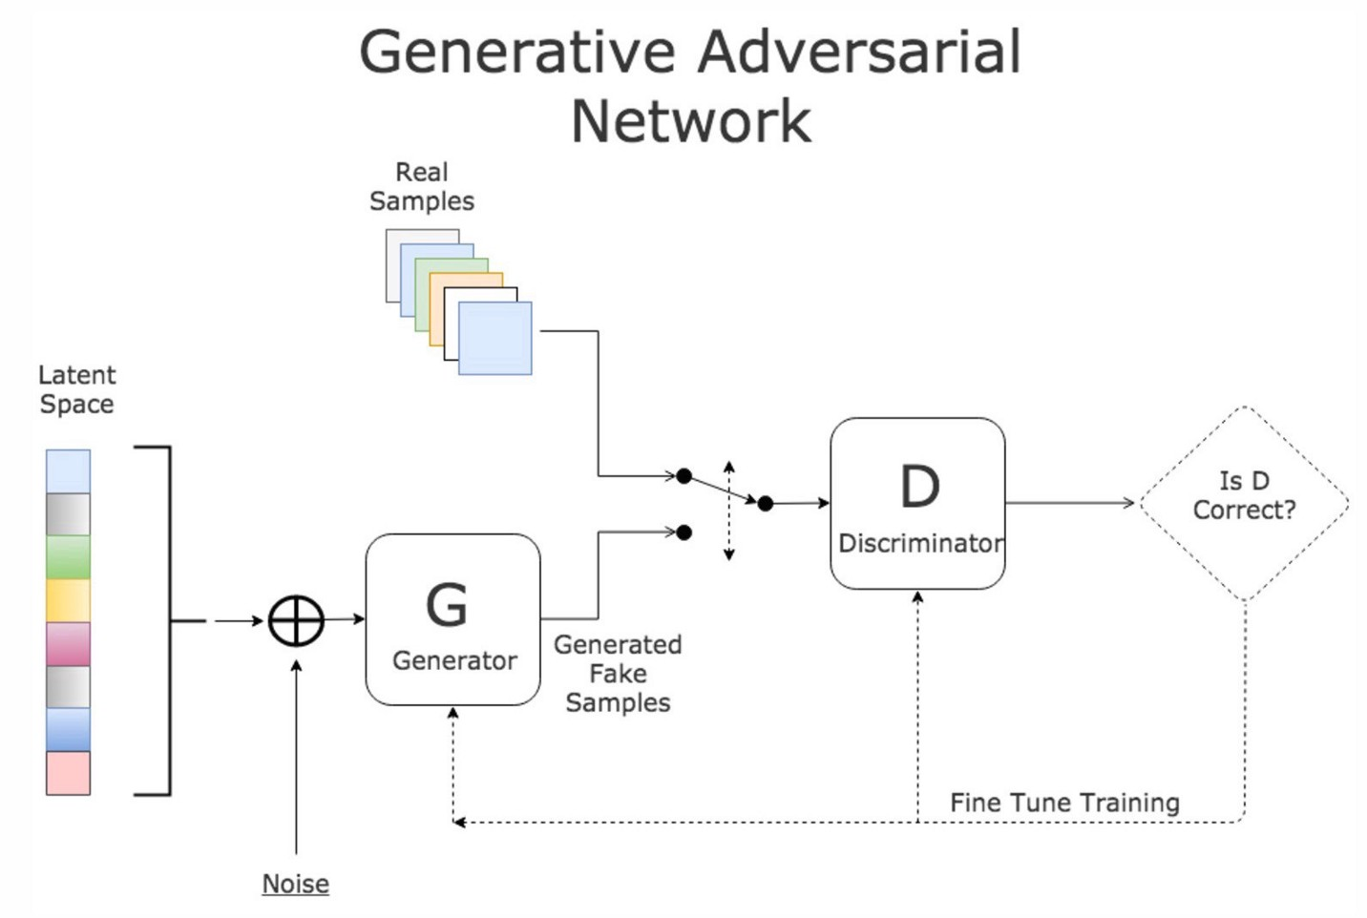



Slide 88
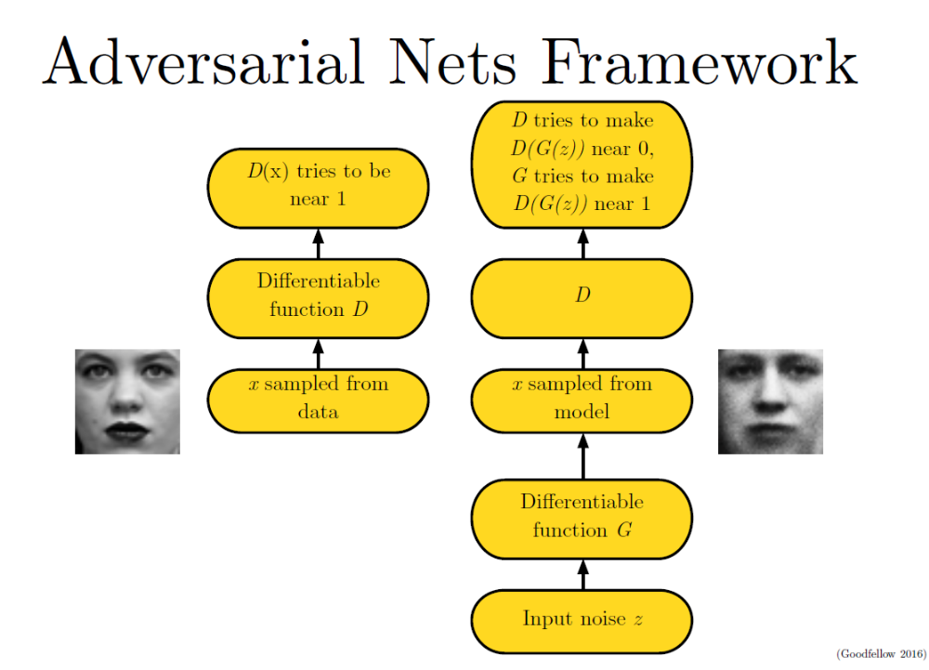

Slide 89


Cost 函数
区分器(discriminator)的cost函数为：
生成器(generator)的cost函数可设为：
因为这是一个零和游戏，也称为minimax游戏

Slide 90
Heuristic, non-saturating game
In the minimax game, the discriminator minimizes a cross-entropy, but the generator maximizes the same cross-entropy. This is unfortunate for the generator, because when the discriminator successfully rejects generator samples with high confidence, the generator's gradient vanishes.
To solve this problem, one approach is to continue to use cross-entropy minimization for the discriminator while the cost for the generator then becomes:

Slide 91

Heuristic, non-saturating game
In the minimax game, the generator minimizes the log-probability of the discriminator being correct. In this game, the generator maximizes the log-probability of the discriminator being mistaken.
This version of the game is heuristically motivated, rather than being motivated by a theoretical concern. The sole motivation for this version of the game is to ensure that each player has a strong gradient when that player is “losing” the game.
In this version of the game, the game is no longer zero-sum.

Slide 92


Slide 93

From: https://medium.com/ai-society/gans-from-scratch-1-a-deep-introduction-with-code-in-pytorch-and-tensorflow-cb03cdcdba0f

Slide 94

Deep Convolutional Generative Adversarial Network

Slide 95

CycleGan: Unpaired Image-to-Image Translation
https://arxiv.org/pdf/1703.10593.pdf

Slide 96

GAN可以生成非常逼真的图像

Slide 97
深度强化学习
We seek a single agent which can solve any human-level task
  RL defines the objective
  DL gives the mechanism
  RL + DL = general intelligence = AGI
  David Silver, Google DeepMind

Slide 98
深度强化学习
Use deep neural networks to represent
  Utility (also called Value) function
  Policy
  Model (agent’s representation of the environment)
And stochastic gradient descent can be used to optimize loss function
下面简单介绍一下Utility的深度学习

Slide 99

Q-Networks

Slide 100

Q-learning

Slide 101


Slide 102


Slide 103


Slide 104
AlphaGo
AlphaGo 包含了Value、Policy两个深度网络，采用CNN
AlphaGo 的改进版AlphoGo Zero中只有一个网络，也没有用人类知识来初始化Policy网络，完全采用了强化学习来优化网络！

Slide 105
深度学习方兴未艾！
这几年似乎不谈深度学习，论文都很难发表了。
到底什么才是“深”，值得研究！
  2012年，AlexNet 在ImageNet首次使用深度学习，完胜其它团队，5+3层
  2014年，Google做了22层成为冠军
  2015年，来自微软的ResNet做到152层
  2016年，商汤夺冠，做到1207层
Deepness is not just depth of networks

Slide 106
对深度学习的质疑
张钹院士：深度学习触及天花板
  深度学习突破来自大数据、算力、算法
  深度学习任务成功的5大要素：大数据、确定性、完全信息、静态可预测、特定领域
Judea Pearl：All the impressive achievements of deep learning amount to just curve fitting.
  Correlation is not Causation.
  To Build Truly Intelligent Machines, Teach Them Cause and Effect

Slide 107
深度学习：我的若干观点
深度学习的成就有目共睹，但其能力的进一步提高，必须解决什么叫“抽象” ！特征表示学习是否叫抽象？不完全是！How can a deep neural network model successive abstractions?
  By enforcing sensible constraints? Hard
要重视深度神经网络的可视化和可解释性
  可视化便于理解深度网络
  有人的可视化实验表明，多个层次的抽象程度没有明显差别，只是特征表示不同
  可解释性

Slide 108
深度学习：我的若干观点
如何表示真正的语义知识？
  各种对抗攻击表示，目前深度学习的特征表示学习没有学习到真正的语义知识！
网络如何表示先验知识？
要重视Memory的表示
强化学习可以在更多地方发挥作用！

Slide 109
值得探索的深度网络
图神经网络
  Graph Embedding
因果网络
  深度贝叶斯网络
  How can a deep neural network model procedural knowledge?
动态神经网络
带有存储的深度神经网络
深度结构网络（非权重网络）

Slide 110
快速上手：预训练模型的使用
训练完整的深度学习模型，需要大数据、强算力，学生/学校并不具备
采用迁移学习的思想，预训练+微调的方法
数
据
集
大
小
从头开始训练 | 微调预训练模型
冻结预训练模型下层， 微调预训练模型上层 | 微调预训练模型输出层
数据相似度

Slide 111
深度神经网络工具
有很多深度学习工具，如Theano, TensorFlow, deeplearning4j, Torch, Pytorch, Keras…
其中很多工具用Python写。
可参见https://en.wikipedia.org/wiki/Comparison_of_deep_learning_software

Slide 112
深度神经网络的若干侧面
调参需要高超的技巧
  Nonlinear function (ReLU…)
  Error function and regularization
  Learning rate (Momentum, AdaGrad, Adam, …)
  Dropout
  Normalization (Input Scaling, batch Normalization, Layer Normalization…)
  Positional Encoding
  …

Slide 113
深度学习的几个问题
端到端的学习
Attention的用处
Dropout的意义

Slide 114
What is End-to-end Learning?

Slide 115
E2E learning
E2E learning means learning the direct relationship between the input and complex output. (Some ML classifiers assign simple labels, but not all)
E2E 学习是级联模型的融合
Parsing, and machine translation are typical e2e learning tasks

Slide 116
Advantages of E2E learning
E2E learning can directly capture the objective of their ultimate task instead of minimizing some criterion such as negative log-likelihood, for the true cost of the system (the optimization objective evaluated on actual instantiations in the real world) may benefit from a model that actually attains worse overall likelihood, but makes more accurate predictions over certain manifolds of the underlying space.
Priya L. Donti et al, Task-based End-to-end Model Learning in Stochastic Optimization, NIPS 2017

Slide 117
The importance of Global meaning representation
Learning complex mappings in a E2E setting can benefit tremendously if we can learn a global meaning representation of the input.
This is why LSTMs (with a meaning representation component C_{t}) are more powerful and why the encoding-->global meaning -->decoding is better than simple locality-based approaches like syntax based machine translation by parsing.
  Enc-dec as an implementation of e2e

Slide 118
E2E and Multi-task Learning
Meaningful Multi-task Learning tasks can help learn a better global meaning representation, as the auxiliary tasks can be seen as a regularizer. It is especially useful when E2E learning has a scarcity of data while the auxiliary task is more data-rich.

Slide 119
What is Attention and why do we need it?

Slide 120
Attention的重要性
Attention plays a very important role in human perception
Attention导致高效的信息利用（90:10法则），与Markov性质有一定关联

Slide 121
Some Features of Attention
Attention is selective: I can’t attend to everything that’s going on around me
Attention is divisible: I can pay attention to multiple things (multi-task)
Attention can shift voluntary: I can consciously switch attention from one thing to another
Attention can shift involuntarily: Sometimes my attention is drawn to something, whether I want to or not

Slide 122
Example: A Cocktail Party
Suppose you are at a Cocktail Party, with many conversations taking place around you.
  Selective Attention: you can’t attend to all conversations at once
  Divisible Attention: you can converse while getting a drink at the same time
  Voluntary Attention Shift: you can consciously shift your attention from one conversation to another
  Involuntary Attention Shift: you suddenly hear your name being spoken by some people across the room

Slide 123

Credit: https://distill.pub/2016/augmented-rnns/

Slide 124

Use of attention in nmt
encoder decoder

Slide 125

Use of attention in image captioning
Credit: https://distill.pub/2016/augmented-rnns/

Slide 126
Transformer：Attention is all you need
Innovations
  Scaled dot product and Multi-Head (Self) Attention
  Positional Encoding
State-of-the-art nmt
First used in nmt (called Transformer), now used in ASR, Image Captioning, language model pre-training…
是LSTM的替代

Slide 127

Transformer model architecture
N=6

Slide 128
Dropout简介
来自Geoffrey Hinton

Slide 129
Two ways to average models
MIXTURE: We can combine models by averaging their output probabilities:
PRODUCT: We can combine models by taking the geometric means of their output probabilities:
Model A: .3 .2 .5
Model A: .3 .2 .5
Model B: .1 .8 .1
Model B: .1 .8 .1
Combined .2 .5 .3
Combined .03 .16 .05 /sum

Slide 130
Dropout: An efficient way to average many large neural nets (http://arxiv.org/abs/1207.0580)
Consider a neural net with one hidden layer.
Each time we present a training example, we randomly omit each hidden unit with probability 0.5.
So we are randomly sampling from 2^H different architectures.
  All architectures share weights.

Slide 131
Dropout as a form of model averaging
We sample from 2^H models. So only a few of the models ever get trained, and they only get one training example.
  This is as extreme as bagging can get.
The sharing of the weights means that every model is very strongly regularized.
  It’s a much better regularizer than L2 or L1 penalties that pull the weights towards zero.

Slide 132
But what do we do at test time?
We could sample many different architectures and take the geometric mean of their output distributions.
It’s better to use all of the hidden units, but to halve their outgoing weights.
  This exactly computes the geometric mean of the predictions of all 2^H models.

Slide 133
What if we have more hidden layers?
Use dropout of 0.5 in every layer.
At test time, use the “mean net” that has all the outgoing weights halved.
  This is not exactly the same as averaging all the separate dropped out models, but it’s a pretty good approximation, and its fast.
Alternatively, run the stochastic model several times on the same input.
  This gives us an idea of the uncertainty in the answer.

Slide 134
What about the input layer?
It helps to use dropout there too, but with a higher probability of keeping an input unit.
  This trick is already used by the “denoising autoencoders” developed by Pascal Vincent, Hugo Larochelle and Yoshua Bengio.
  对输入采用dropout能在一定程度上消除噪音，对语音识别应该有用，但是对机器翻译的用处还需要进一步探讨
    Is pretty nice nicer then nice?
    If you study, then some day you will know more than I do about artificial intelligence

Slide 135
How well does dropout work?
The record breaking object recognition net developed by Alex Krizhevsky uses dropout and it helps a lot.
If your deep neural net is significantly overfitting, dropout will usually reduce the number of errors by a lot.
  Any net that uses “early stopping” can do better by using dropout (at the cost of taking quite a lot longer to train).
If your deep neural net is not overfitting you should be using a bigger one!

Slide 136
Another way to think about dropout
If a hidden unit knows which other hidden units are present, it can co-adapt to them on the training data.
  But complex co-adaptations are likely to go wrong on new test data.
  Big, complex conspiracies are not robust.
If a hidden unit has to work well with combinatorially many sets of co-workers, it is more likely to do something that is individually useful.
  But it will also tend to do something that is marginally useful given what its co-workers achieve.

Slide 137
论文选读
Y. Bengio, Learning Deep Architectures for AI, Foundations and Trends in Machine Learning, 2(1), pp.1-127, 2009.
Ian Goodfellow, Aaron Courville, and Yoshua Bengio. Deep learning. Book in preparation for MIT Press, 2015. http://goodfeli.github.io/dlbook/
Ian Goodfellow: NIPS 2016 Tutorial: Generative Adversarial Networks
Attention in Neural Networks and How to Use It. http://akosiorek.github.io/ml/2017/10/14/visual-attention.html

