Slide 1
Philosophical Foundations
Chapter 26

Slide 2
Outline
Turing Test
Weak AI
Strong AI
Ethics of AI

Slide 3
Motivation
Philosophers: “Can machines think?”
Turing: Can machines behave like a human?
  The Turing Test.
  (Computing Machinery and Intelligence)

Slide 4
The Imitation Game
Turing described a simple party game which involves three players. Player A is a man, Player B is a woman and Player C is a interrogator
The set up is such that Player C is unable to see either of A or B and can only communicate with them using written media

Slide 5
The Imitation Game (contd…)
By asking questions of player A and player B, player C tries to determine which of the two is the man, and which of the two is the woman
Turing proposed that player A be replaced with a computer

Slide 6
The machine is intelligent if
in Turing’s words:
“the interrogator decides wrongly as often when the game is played [with the computer] as he does when the game is played between a man and a woman, then it can be argued that the computer is intelligent”

Slide 7
目前人工智能的很多应用，基本都是以图灵测试作为判断标准。
也就是说，如果某人工智能程序具有类似人的某方面的能力（比如下棋），那么我们说该程序是智能的。

Slide 8
Weaknesses of the test
It only tests if the subject resembles a human being
It will fail to test for intelligence under two circumstances:
It tests for many behaviors that we may not consider intelligent, such as the susceptibility to insults or the temptation to lie.

Slide 9
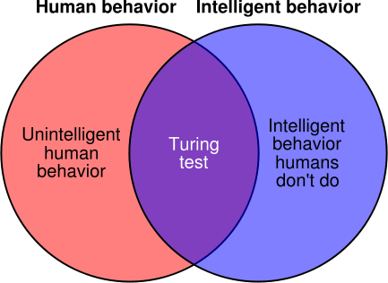
Weaknesses of the test (contd…)
2. It fails to capture the general properties of intelligence, such as the ability to solve difficult problems or come up with original insights.
Image Courtesy: Wikipedia Commons

Slide 10
Weak AI
Can machines think? => Can machines act intelligently?
The assertion that machines could possibly act intelligently is called “weak AI” hypothesis by philosophers

Slide 11
Objections against Intelligent Machines
The argument from disability
The mathematical objection
The argument from informality

Slide 12
The argument from disability
“A machine can never do X”
X according to Turing: be kind, learn from experience, do something new, differentiate between right and wrong, fall in love...

Slide 13
The argument from disability contd...
Some of them have been achieved over the years. Eg. Machines today do learn from experience.
Fact: Automated programs are used to grade GMAT essay questions.
May be over the years machines can do the rest of “X's”.

Slide 14
The Mathematical Objection
Machines are formal systems limited by incompleteness theorem. Eg. They cannot establish the truth of Gödel sentence. (true but not provable)
Humans have no such limitation.
“Humans are superior to machines”

Slide 15
The Mathematical Objection (contd...)‏
Problems with the claim:
Godels Theorem applies only to formal systems powerful enough to do arithmetic.
Applies to Turing Machines and not to computers.
Turing Machines have infinite memory but computers don’t.

Slide 16
The Mathematical Objection (contd...)‏
An agent should not be ashamed if truth of some sentence cannot be established.
Eg: Lucas cannot consistently assert that this sentence is true.
Even if computers have limitations on what they can prove, there is no evidence that humans are immune from those limitations.

Slide 17
The argument from informality
Human behavior is far too complex to be captured by any simple set of rules
Computers can do no more than follow a set of rules.
So they cannot generate behavior as intelligent as that of humans.
The inability to capture everything in a set of logical rules is called the “qualification problem” in AI.

Slide 18
The argument from informality (contd...)‏
No one has any idea of incorporating background knowledge into learning process.
This claim has been proved to be wrong.
Eg. Learning algorithms today use background knowledge.

Slide 19
The argument from informality (contd...)‏
Learning requires prior identification of relevant inputs and correct outputs.
This claim has been proved to be wrong.
Eg. Unsupervised learning has been accomplished today.

Slide 20
The argument from informality (contd...)‏
Brain can direct its sensors to seek information and process it according to current situation.
Research is being done over this field and partial success has been achieved.

Slide 21
Strong AI
Machine can be said to have posses Strong AI if it could do whatever human brain could do in every possible way. Should posses casual powers of brain.
Have consciousness, self awareness, understanding, feel emotions, dream, think etc.,
No body cares about Strong AI.
Pass the Turing test doesn’t imply actually thinking, but still might be simulating thinking.

Slide 22
Argument from consciousness
Jefferson’s Lister Oration for 1949, “Not until a machine can write a sonnet or compose a concerto because of thoughts and emotions felt, and not by the chance fall of symbols, could we agree that machine equals brain – that is not only write it but know that it had written it. No mechanism could feel (and not merely artificially signal, an easy contrivance) pleasure at its successes, grief when its valves fuse, be warmed by flattery, be made miserable by its mistakes, be charmed by sex, be angry or depressed when it cannot get what it wants”.
Should have Consciousness

Slide 23
Polite convention
No direct evidence of other people mental states.
Let’s accept that everyone thinks.

Slide 24
What is mind ?
Artificial urea is urea, artificial insemination is insemination, artificial simulation of chess game is a chess game, artificial simulation of addition is addition but artificial monalisa is not monalisa, artificial simulation of storm is not storm, artificial scotch is not scotch.
Artificial mind ?
Depends upon definition of mental states.
  Theory of functionalism.
  Biological naturalism theory (Mental state is a result of neural activity).

Slide 25
Mind body problem
Dualist theory – soul is different from body. René Descartes. Ghost in a machine !!
Monist theory – mind and body are same:
Only thing that is proven to exists is matter.
Searle – “brain cause mind”.
Free will – materialist deal with it.

Slide 26
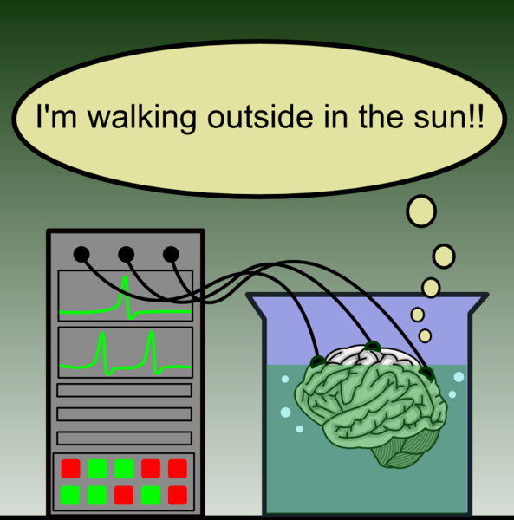
Brain in a vat

Slide 27
Brain in a vat
Mental state that “I need a pizza” are they same in both worlds ?
  Wide content – omniscient outside observer.
  Narrow content – internal subjective view.
Qualia (觉知)– difference between human beings and zombies.

Slide 28
Brain prosthesis experiment
Replace each neuron by electronic devices slowly one by one.
What happens to consciousness ?
Functionalist – consciousness remains
Biological naturalist – consciousness vanishes.
Brain computer interface (BCI)

Slide 29
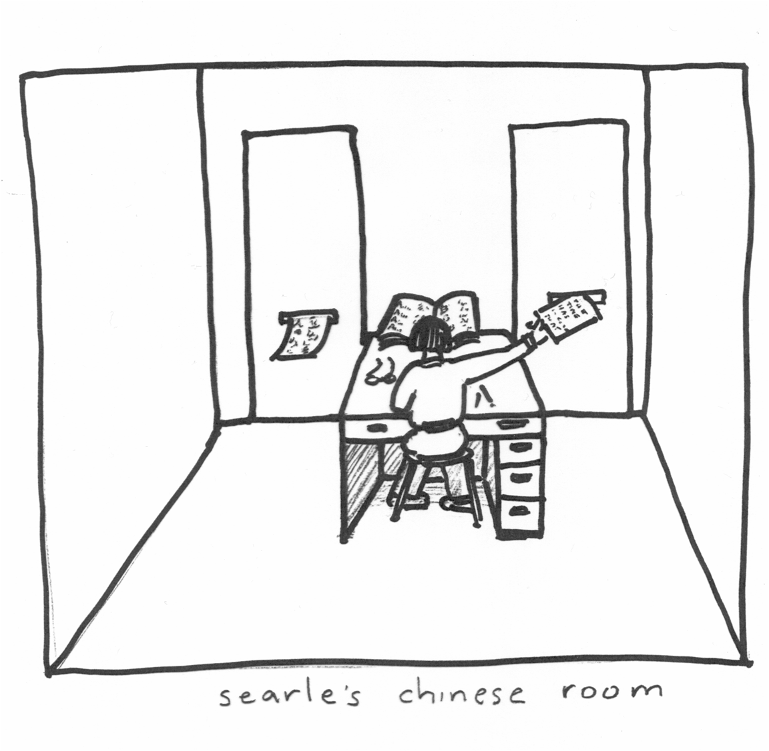
Chinese room problem

Slide 30
Chinese room problem
Against strong AI.
Searle’s axioms:
1) Minds have mental contents; specifically, they have semantic contents.
2) Computer programs are entirely defined by their formal, or syntactical, structure.
3) Syntax is not sufficient for semantics
4)Brains cause minds.

Slide 31
Ethics in Artificial Intelligence
Is it worth asking the question – “Can there be an ethical AI?”
Intrusion of machines in our life.
  ATM
  Autopilot system in aero planes
Singularity
Transhumanism

Slide 32
雨果对机器人的看法
…

Slide 33
周昌乐要造的机器人
…

