Slide 1
Solving problems by searching
Chapter 3

Slide 2
Outline
Problem-solving agents
Problem types
Problem formulation
Example problems
Basic search algorithms

Slide 3

Problem-solving agents
是一种goal-oriented agent

Slide 4

Example: Romania

Slide 5
Example: Romania
On holiday in Romania; currently in Arad.
Flight leaves tomorrow from Bucharest
Formulate goal:
  be in Bucharest
Formulate problem:
  states: various cities
  actions: drive between cities
Find solution:
  sequence of cities, e.g., Arad, Sibiu, Fagaras, Bucharest

Slide 6
Single-state problem formulation
A problem is defined by four items:
initial state e.g., "at Arad"
actions or successor function S(x) = set of action–state pairs
  e.g., S(Arad) = {<Arad → Zerind, Zerind>, … }
goal test, can be
  explicit, e.g., x = "at Bucharest"
  implicit, e.g., Checkmate(x)
path cost (additive)
  e.g., sum of distances, number of actions executed, etc.
  c(x,a,y) is the step cost, assumed to be ≥ 0
A solution is a sequence of actions leading from the initial state to a goal state

Slide 7
Selecting a state space
Real world is absurdly complex
  → state space must be abstracted for problem solving
(Abstract) state = set of real states
(Abstract) action = complex combination of real actions
  e.g., "Arad → Zerind" represents a complex set of possible routes, detours, rest stops, etc.
For guaranteed realizability, any real state “in Arad” must get to some real state "in Zerind"
(Abstract) solution =
  set of real paths that are solutions in the real world
Our abstraction should be "easier" to solve than the original problem

Slide 8

Vacuum world state space graph
states?
actions?
goal test?
path cost?

Slide 9
Vacuum world state space graph
states? dirt and robot location
actions? Left, Right, Suck, NoOp
goal test? no dirt at all locations
path cost? 1 per action

Slide 10

Example: The 8-puzzle
states?
actions?
goal test?
path cost?

Slide 11
Example: The 8-puzzle
states? locations of tiles
actions? move blank left, right, up, down
goal test? = goal state (given)
path cost? 1 per move
[Note: optimal solution of n-Puzzle family is NP-hard]

Slide 12
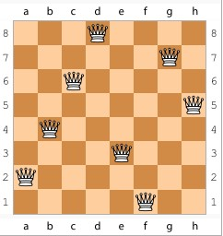
Example: 8皇后问题
问题的2种不同的形式化：
增量形式化: 每次增加一个皇后
完全状态形式化：八个都在棋盘上，移动使之不冲突

Slide 13

Tree search algorithms
Basic idea:
  offline, simulated exploration of state space by generating successors of already-explored states (a.k.a.~expanding states)

Slide 14

Tree search example

Slide 15

Tree search example

Slide 16

Tree search example
树搜索会产生重复节点

Slide 17

Implementation: general tree search

Slide 18

Implementation: states vs. nodes
A state is an (abstract representation of) a physical configuration
A node is a data structure constituting part of a search tree includes state, parent node, action, path cost g(x), depth
The Expand function creates new nodes, filling in the various fields and using the SuccessorFn of the problem to create the corresponding states.

Slide 19
Search strategies
A search strategy is defined by picking the order of node expansion
Strategies are evaluated along the following dimensions:
  completeness: does it always find a solution if one exists?
  time complexity: number of nodes generated
  space complexity: maximum number of nodes in memory
  optimality: does it always find a least-cost solution?
Time and space complexity are measured in terms of
  b: maximum branching factor of the search tree
  d: depth of the least-cost solution
  m: maximum depth of the state space (may be ∞)

Slide 20
Uninformed search strategies
Uninformed search strategies use only the information available in the problem definition
  Breadth-first search
  Uniform-cost search（应该叫min-cost search）
  Depth-first search
  Depth-limited search
  Iterative deepening search

Slide 21

Breadth-first search
Expand shallowest unexpanded node
  fringe is a FIFO queue, i.e., new successors go at end
Implementation:

Slide 22

Breadth-first search
Expand shallowest unexpanded node
  fringe is a FIFO queue, i.e., new successors go at end
Implementation:

Slide 23

Breadth-first search
Expand shallowest unexpanded node
  fringe is a FIFO queue, i.e., new successors go at end
Implementation:

Slide 24

Breadth-first search
Expand shallowest unexpanded node
  fringe is a FIFO queue, i.e., new successors go at end
Implementation:

Slide 25
Properties of breadth-first search
Complete? Yes (if b is finite)
Time? 1+b+b²+b³+… +b^{d} + b(b^{d}-1) = O(b^{d+1})
Space? O(b^{d+1}) (keeps every node in memory)
Optimal? Yes (if cost = 1 per step)
Space is the bigger problem (more than time)

Slide 26
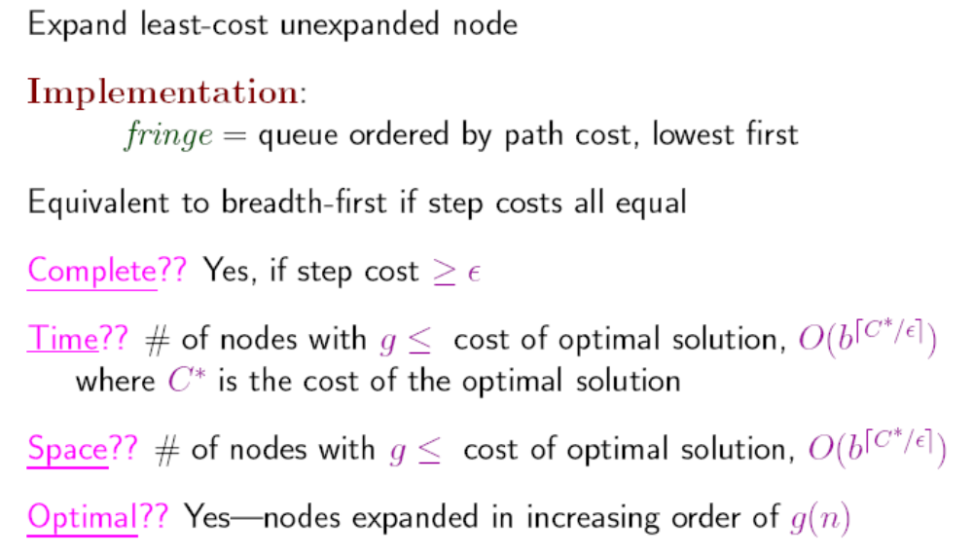
Uniform-cost search

Slide 27

Depth-first search
Expand deepest unexpanded node
  fringe = LIFO queue, i.e., put successors at front
Implementation:

Slide 28

Depth-first search
Expand deepest unexpanded node
  fringe = LIFO queue, i.e., put successors at front
Implementation:

Slide 29

Depth-first search
Expand deepest unexpanded node
  fringe = LIFO queue, i.e., put successors at front
Implementation:

Slide 30

Depth-first search
Expand deepest unexpanded node
  fringe = LIFO queue, i.e., put successors at front
Implementation:

Slide 31

Depth-first search
Expand deepest unexpanded node
  fringe = LIFO queue, i.e., put successors at front
Implementation:

Slide 32

Depth-first search
Expand deepest unexpanded node
  fringe = LIFO queue, i.e., put successors at front
Implementation:

Slide 33

Depth-first search
Expand deepest unexpanded node
  fringe = LIFO queue, i.e., put successors at front
Implementation:

Slide 34

Depth-first search
Expand deepest unexpanded node
  fringe = LIFO queue, i.e., put successors at front
Implementation:

Slide 35

Depth-first search
Expand deepest unexpanded node
  fringe = LIFO queue, i.e., put successors at front
Implementation:

Slide 36

Depth-first search
Expand deepest unexpanded node
  fringe = LIFO queue, i.e., put successors at front
Implementation:

Slide 37

Depth-first search
Expand deepest unexpanded node
  fringe = LIFO queue, i.e., put successors at front
Implementation:

Slide 38

Depth-first search
Expand deepest unexpanded node
  fringe = LIFO queue, i.e., put successors at front
Implementation:

Slide 39
Properties of depth-first search
Complete? No: fails in infinite-depth spaces, spaces with loops
  Modify to avoid repeated states along path
Time? O(b^{m}): terrible if m is much larger than d
  but if solutions are dense, may be much faster than breadth-first
Space? O(bm), i.e., linear space!
Optimal? No
  → complete in finite spaces

Slide 40

Depth-limited search
= depth-first search with depth limit l,
i.e., nodes at depth l have no successors
Recursive implementation:

Slide 41

Iterative deepening search

Slide 42

Iterative deepening search l =0

Slide 43

Iterative deepening search l =1

Slide 44

Iterative deepening search l =2

Slide 45

Iterative deepening search l =3

Slide 46
Iterative deepening search
Number of nodes generated in a depth-limited search to depth d with branching factor b:
N_{DLS} = b⁰ + b¹ + b² + … + b^{d-2} + b^{d-1} + b^{d}
Number of nodes generated in an iterative deepening search to depth d with branching factor b:
N_{IDS} = (d+1)b⁰ + d b¹ + (d-1)b² + … + 3b^{d-2} +2b^{d-1} + 1b^{d}
For b = 10, d = 5,
  N_{DLS} = 1 + 10 + 100 + 1,000 + 10,000 + 100,000 = 111,111
  N_{IDS} = 6 + 50 + 400 + 3,000 + 20,000 + 100,000 = 123,456
Overhead = (123,456 - 111,111)/111,111 = 11%

Slide 47
Properties of iterative deepening search
Complete? Yes
Time? (d+1)b⁰ + d b¹ + (d-1)b² + … + b^{d} = O(b^{d})
Space? O(bd)
Optimal? Yes, if step cost = 1

Slide 48
Bi-Directional
Breadth-First Search
1
S_{I}
3
4
8
9
10
11
12
13
…
5
6
7
2
S_{G}

Slide 49

Summary of algorithms

Slide 50

Repeated states
Failure to detect repeated states can turn a linear problem into an exponential one!

Slide 51
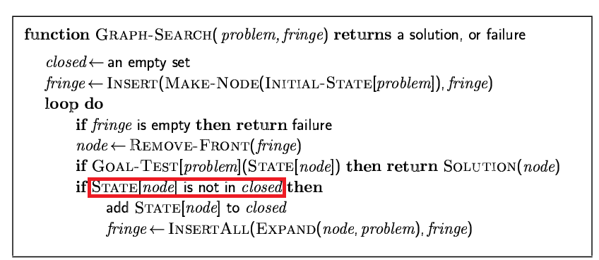
Graph search

Slide 52
Problem types
Deterministic, fully observable → single-state problem
  Agent knows exactly which state it will be in; solution is a sequence
Non-observable → sensorless problem (conformant problem)
  Agent may have no idea where it is; solution is a sequence
Nondeterministic and/or partially observable → contingency problem
  percepts provide new information about current state
  solution is a contingent (随机而动) plan or a policy
  often interleave search, execution
Unknown state space → exploration problem (“online”)
  belief states

Slide 53
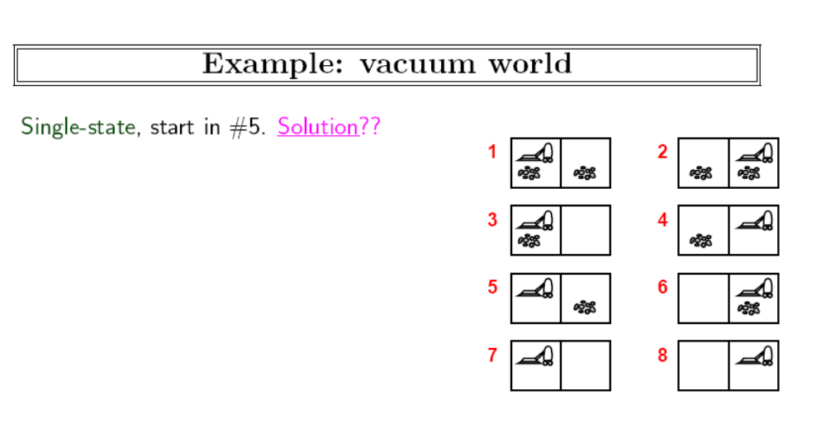

Slide 54
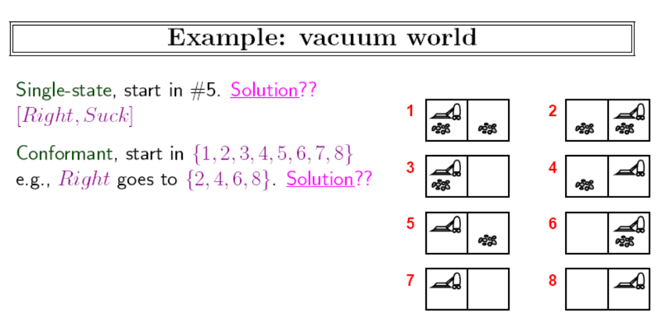

Slide 55
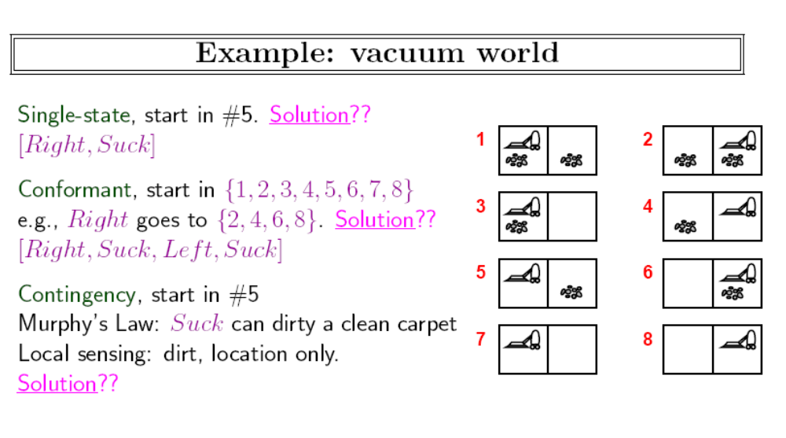

Slide 56
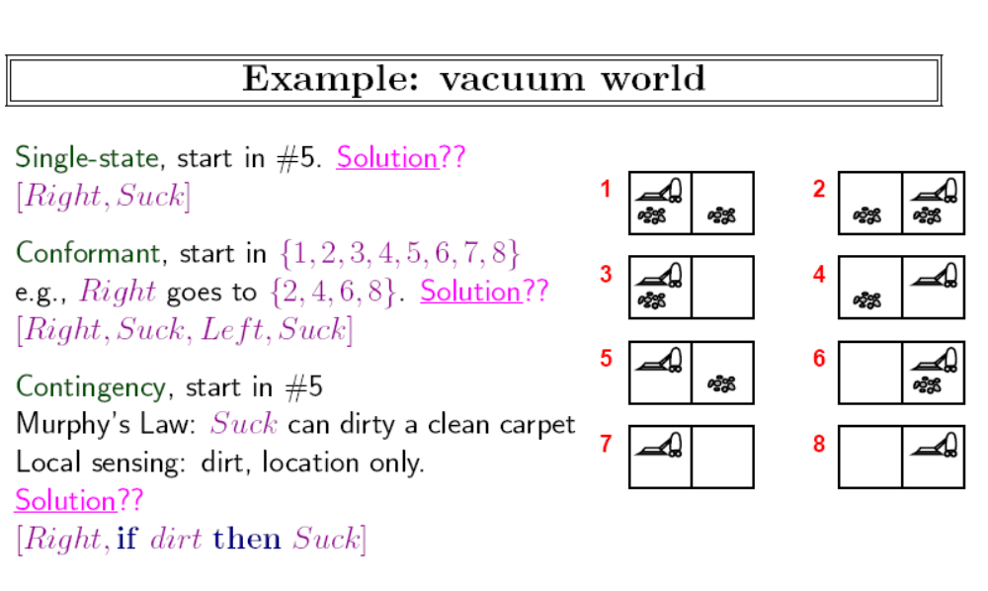

Slide 57
Summary
Problem formulation usually requires abstracting away real-world details to define a state space that can feasibly be explored
Variety of uninformed search strategies
Iterative deepening search uses only linear space and not much more time than other uninformed algorithms

Slide 58
作业
考虑一个状态空间，其初始编号为1，状态n的后继函数返回编号为2n与2n+1的两个状态。
  画出状态1到15的部分状态空间图。
  假设目标状态是11，列出用以下算法访问节点的顺序：广度优先搜索、深度限制为3的有限深度搜索和迭代加深搜索
  双向搜索是否适合该问题？如适合，详述其工作原理
  在双向搜索中每个方向上的分叉因子是什么？
  对(c)的回答是否能提出该问题的另一种形式化，使得你可以几乎不用搜索来求解从状态1到达目标状态的问题？

Slide 59
作业
有名的传教士和野人问题（Amarel，1968）：三个传教士和三个野人需从河的一边用一条只能载最多2个人的船渡到对岸。但是需保证任意时刻野人的个数不大于传教士个数（否则传教士会被野人吃掉）。
  精确地形式化该问题，画出完全的状态空间。
  用一个合适的搜索算法求该问题的最优解。检查重复状态是个好主意吗？
  既然该问题的状态空间如此简单，为何人们求解她却显得困难？

Slide 60
作业
编写一个程序，当输入两个网页的URL后，试着找到从一个网页到另一个网页的链接路径。什么样的搜索策略比较合适？双向搜索是好主意吗？能用搜索引擎实现一个前驱函数？

Slide 61
课外阅读
研究一下“数独”游戏：http://en.wikipedia.org/wiki/Sudoku
阅读论文：
Bruce Abramson, Moti Yung: Divide and Conquer under Global Constraints: A Solution to the N-Queens Problem. J. Parallel Distrib. Comput. 6(3): 649-662 (1989)

