Slide 1
Informed search algorithms
Chapter 4

Slide 2
Outline
Best-first search
Greedy best-first search
A* search
Heuristics
Local search algorithms
  Hill-climbing search
  Simulated annealing search
  Local beam search
  Genetic algorithms

Slide 3
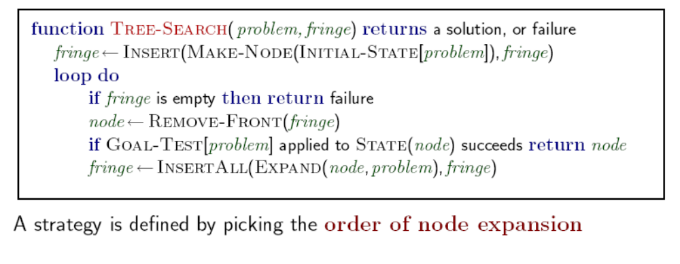
Review: Tree search

Slide 4
Best-first search
Idea: use an evaluation function f(n) for each node
  estimate of "desirability"
  Expand most desirable unexpanded node
Implementation:
Order the nodes in fringe in decreasing order of desirability
Special cases:
  greedy best-first search
  A* search

Slide 5

Romania with step costs in km

Slide 6
Greedy best-first search
Evaluation function f(n) = h(n) (heuristic)
= estimate of cost from n to goal
e.g., h_{SLD}(n) = straight-line distance from n to Bucharest
Greedy best-first search expands the node that appears to be closest to goal

Slide 7

Greedy best-first search example

Slide 8

Greedy best-first search example

Slide 9

Greedy best-first search example

Slide 10

Greedy best-first search example

Slide 11
Properties of greedy best-first search
Complete? No – can get stuck in loops, e.g., Iasi → Neamt → Iasi → Neamt → …
Complete in finite space with repeated-state checking
Time? O(bm), but a good heuristic can give dramatic improvement
Space? O(bm) -- keeps all nodes in memory
Optimal? No

Slide 12
A* search
Idea: avoid expanding paths that are already expensive
Evaluation function f(n) = g(n) + h(n)
g(n) = cost so far to reach n
h(n) = estimated cost from n to goal
f(n) = estimated total cost of path through n to goal

Slide 13

A* search example

Slide 14

A* search example

Slide 15

A* search example

Slide 16

A* search example

Slide 17

A* search example

Slide 18

A* search example

Slide 19
Admissible heuristics
A heuristic h(n) is admissible if for every node n,
0 ≤ h(n) ≤ h*(n), where h*(n) is the true cost to reach the goal state from n.
An admissible heuristic never overestimates the cost to reach the goal, i.e., it is optimistic
Example: hSLD(n) (never overestimates the actual road distance)
Theorem: If h(n) is admissible, A* using TREE-SEARCH is optimal

Slide 20

Optimality of A* (proof)
Suppose some suboptimal goal G₂ has been generated and is in the fringe. Let n be an unexpanded node in the fringe such that n is on a shortest path to an optimal goal G.
f(G₂) = g(G₂) since h(G₂) = 0
g(G₂) > g(G) since G₂ is suboptimal
f(G) = g(G) since h(G) = 0
f(G₂) > f(G) from above

Slide 21
Optimality of A* (proof)
Suppose some suboptimal goal G₂ has been generated and is in the fringe. Let n be an unexpanded node in the fringe such that n is on a shortest path to an optimal goal G.
f(G₂) > f(G) from above
h(n) ≤ h*(n) since h is admissible
g(n) + h(n) ≤ g(n) + h*(n)
f(n) ≤ f(G)
Hence f(G2) > f(n), and A* will never select G2 for expansion

Slide 22
A*的最有效是源于已知路径+未知路径估算的总体优化（比较 min-cost，greedy）
A*对于树搜索是最优的，对于图搜索则未必
  为了使算法最优，可以扩展图搜索算法使它丢弃重复路径中cost大的路径，或
  保证到达任何重复状态的最优路径总是第一条被选择：一致性启发函数。
Notes:
https://stackoverflow.com/questions/42142731/a-graph-search

Slide 23

Consistent heuristics
A heuristic is consistent if for every node n, every successor n' of n generated by any action a,
h(n) ≤ c(n,a,n') + h(n')
If h is consistent, we have
f(n') = g(n') + h(n')
= (g(n) + c(n,a,n')) + h(n')
≥ g(n) + h(n)
= f(n)
i.e., f(n) is non-decreasing along any path.
Theorem: If h(n) is consistent, A* using GRAPH-SEARCH is optimal

Slide 24

Optimality of A*
A* expands nodes in order of increasing f value
Gradually adds "f-contours" of nodes
Contour i has all nodes with f=f_{i}, where f_{i} < f_{i+1}

Slide 25
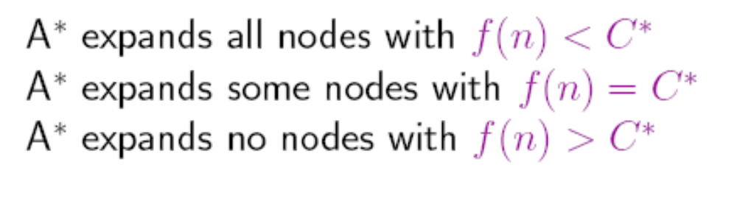
Properties of A*
Complete? Yes (unless there are infinitely many nodes with f ≤ f(G) )
Time? Exponential
Space? Keeps all nodes in memory
Optimal? Yes

Slide 26
即使A*搜索是完备的、最优的，但是对于大多数问题来说，处于目标等值线搜索空间内的节点数是解长度的指数函数（它在内存空间中保存了所有的节点），所以内存不够成了大问题。
    可以限制使用的存储。如类似IDS，我们可得到IDA*, 只是cutoff值是f-cost，而每次新的cutoff值是超过上次迭代的最小的f-cost (The lowest f-cost values of the nodes visited (not expanded) in the previous search is used as the new cut-off value in the next search)
改进算法： RBFS和MA* 等。

Slide 27
Recursive Best First Search (RBFS)
Idea: Try something like depth first search, but let’s not forget everything about the branches we have partially explored.
We remember the best f(n) value we have found so far in the branch we are abandoning.
Backing up f-cost value
  When a node n is expanded, computes f-cost values of its successors and recomputes f-cost values of n and all of n’s ancestors
Process of backing up
  Backed-up f-cost value of node n is the minimum f-cost value of its successors

Slide 28
Recursive Best-First Search
Description
  One of successors of node n has the smallest f-cost over all fringe nodes, it is expanded in turn, and so on.
  When another fringe node, n’, (not a successor of n) has the lowest value of f-cost
    backtracks to the lowest common ancestor, node k
    k_{n}: successor of node k on the path to n
    removes the subtree rooted at k_{n}, from fringe
    k_{n} becomes an fringe node with f-cost value equal to its backed-up value
    Search continues with that fringe node with the lowest f-cost value

Slide 29
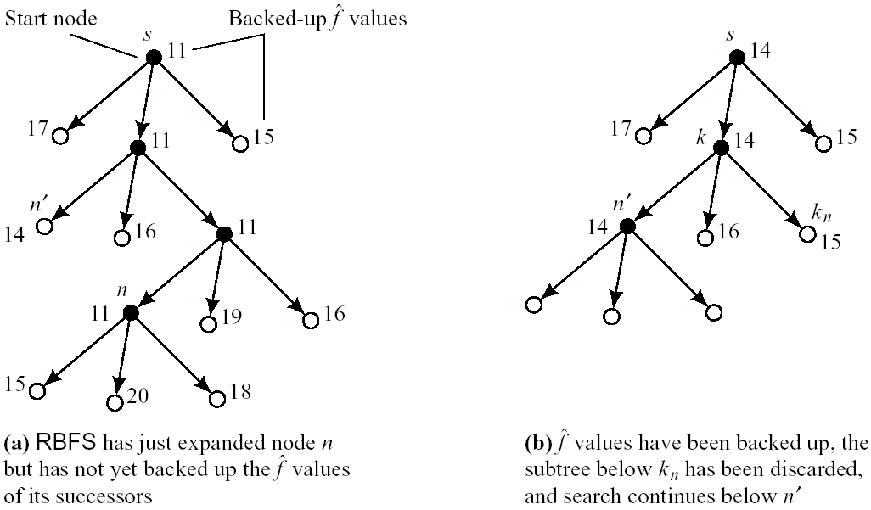
Recursive Best-First Search Example

Slide 30
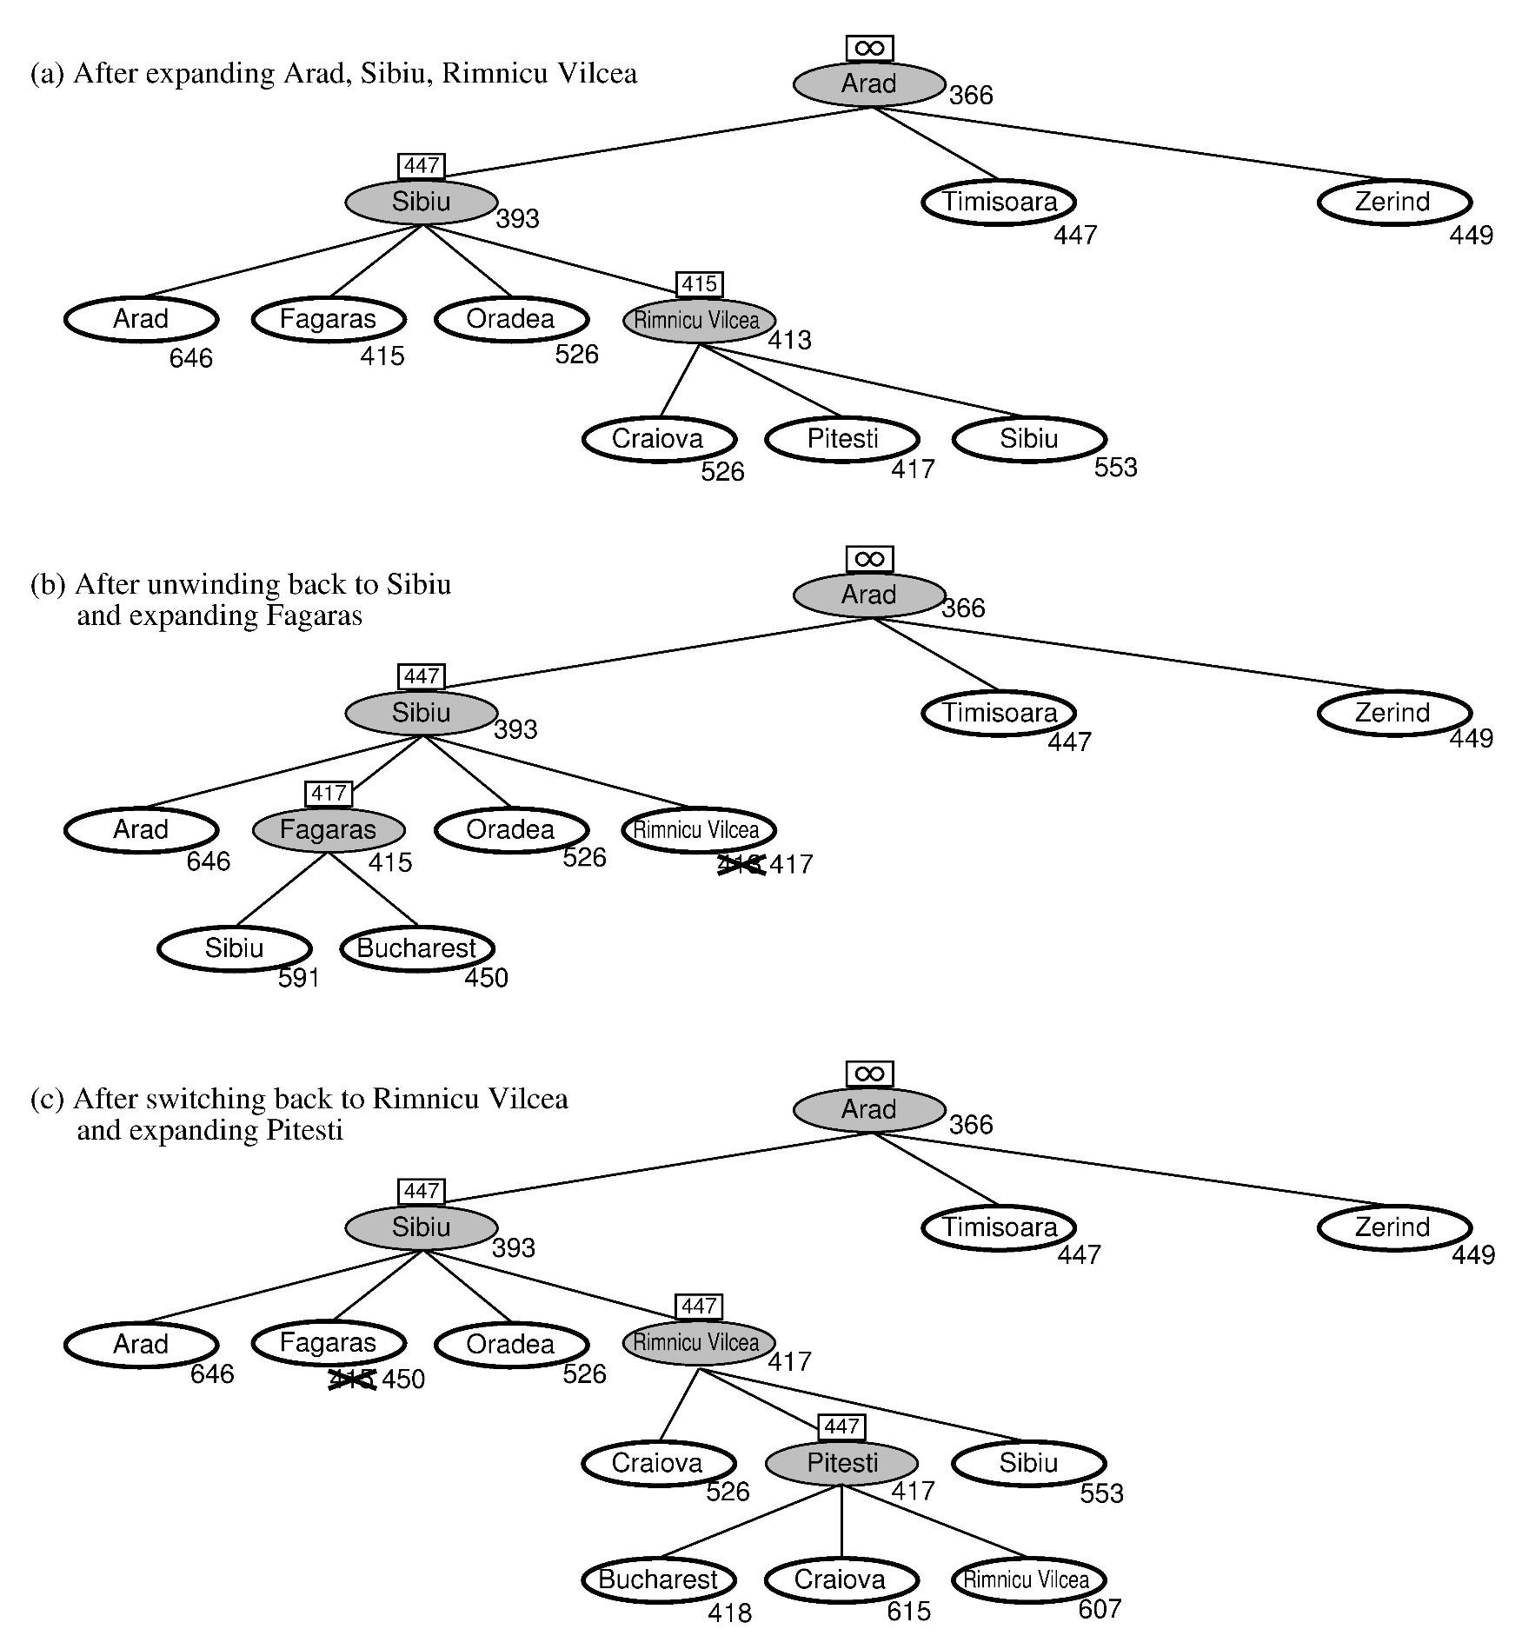
RBFS:
best alternative
over frontier nodes,
which are not children:
i.e. do I want to back up?
RBFS changes its mind
very often in practice.
This is because the
f=g+h become more
accurate (less optimistic)
as we approach the goal.
Hence, higher level nodes
have smaller f-values and
will be explored first.
Problem: We should keep
in memory whatever we can.

Slide 31
Simple Memory-bounded A* (SMA*)
This is like A*, but when memory is full we delete the worst node (largest f-value).
Like RBFS, SMA* backs up the value of the forgotten node to its parent.
If there is a tie (equal f-values) we delete the oldest nodes first.
SMA* finds the optimal reachable solution given the memory constraint.
Time can still be exponential.
A solution is not reachable
if a single path from root to goal
does not fit into memory

Slide 32

Admissible heuristics
E.g., for the 8-puzzle:
h₁(n) = number of misplaced tiles
h₂(n) = total Manhattan distance
(i.e., no. of squares from desired location of each tile)
h₁(S) = ?
h₂(S) = ?

Slide 33
Admissible heuristics
E.g., for the 8-puzzle:
h₁(n) = number of misplaced tiles
h₂(n) = total Manhattan distance
(i.e., no. of squares from desired location of each tile)
h₁(S) = ? 8
h₂(S) = ? 3+1+2+2+2+3+3+2 = 18

Slide 34
Dominance
If h₂(n) ≥ h₁(n) for all n (both admissible)
then h₂ dominates h₁
h₂ is better for search
Typical search costs (average number of nodes expanded):
d=12 IDS = 3,644,035 nodes
A*(h₁) = 227 nodes
A*(h₂) = 73 nodes
d=24 IDS = too many nodes
A*(h₁) = 39,135 nodes
A*(h₂) = 1,641 nodes

Slide 35
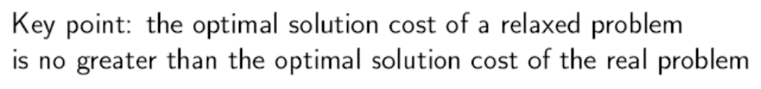
Relaxed problems
A problem with fewer restrictions on the actions is called a relaxed problem
If the rules are relaxed so that a tile can move to any adjacent square, then h₂(n) gives the shortest solution
The cost of an optimal solution to a relaxed problem is an admissible heuristic for the original problem
If the rules of the 8-puzzle are relaxed so that a tile can move anywhere, then h1(n) gives the shortest solution

Slide 36
subproblem
Admissible heuristics can also be derived from the solution cost of a subproblem of a given problem. The cost of the optimal solution of this subproblem is a lower bound on the cost of the complete problem. It turns out to be substantially more accurate than Manhattan distance in some cases.

Slide 37
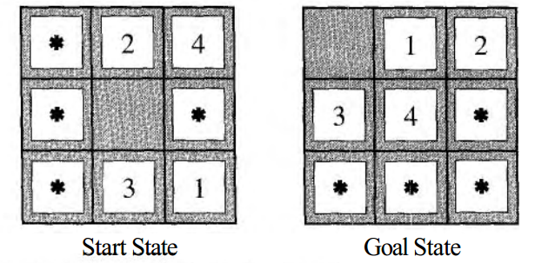
The idea behind pattern databases is to store these exact solution costs for every possible subproblem instance

Slide 38
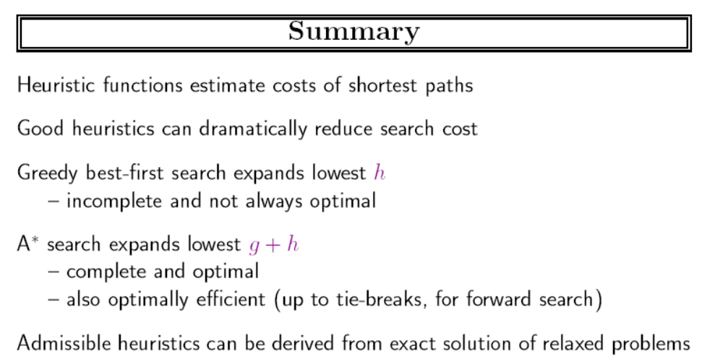

Slide 39
Local search algorithms
In many optimization problems, the path to the goal is irrelevant; the goal state itself is the solution
State space = set of "complete" configurations
Find configuration satisfying constraints, e.g., n-queens
In such cases, we can use local search algorithms
  keep a single "current" state, try to improve it

Slide 40

Example: n-queens
Put n queens on an n × n board with no two queens on the same row, column, or diagonal

Slide 41
局部搜索算法
爬山法搜索
模拟退火搜索
局部剪枝搜索
遗传算法

Slide 42

Hill-climbing search
"Like climbing Everest in thick fog with amnesia"

Slide 43

Hill-climbing search
Problem: depending on initial state, can get stuck in local maxima

Slide 44
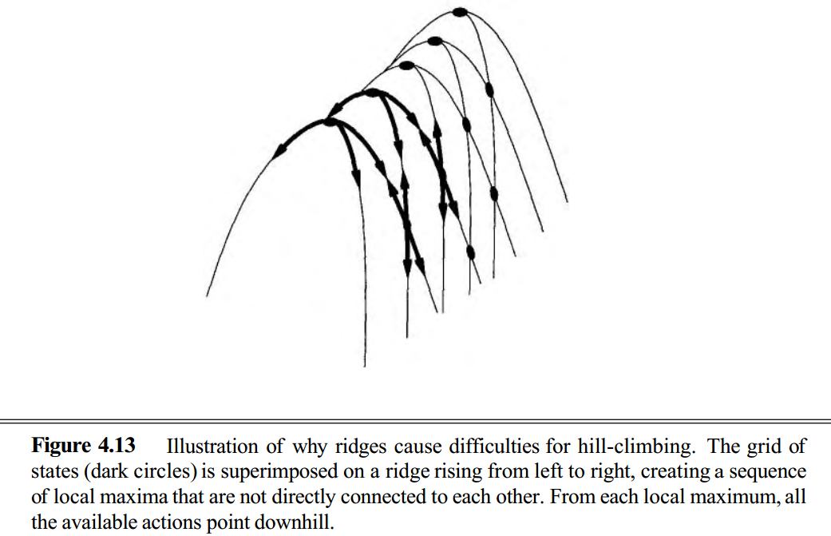
ridges

Slide 45

Hill-climbing search: 8-queens problem
h = number of pairs of queens that are attacking each other, either directly or indirectly
h = 17 for the above state

Slide 46

Hill-climbing search: 8-queens problem
A local minimum with h = 1

Slide 47
避免局部极值
随机重新开始
  完备的概率接近1
  但效率低下

Slide 48
Simulated annealing search
退火：为了增强金属和玻璃的韧性和硬度而先把它们加热到高温然后逐渐冷却的过程
Idea: escape local maxima by allowing some “bad” moves but gradually decrease their frequency
Help escaping the
local optima.
desired effect
Might pass global optima
after reaching it
adverse effect

Slide 49

Simulated annealing search

Slide 50
simulated annealing search
以某个概率改变后继：需要用到(0,1)之间随机数
温度下降策略：
  T[1]=Schedule[1] 使得 exp(-Δ/T[1])) ≈ 1
  T[k+1]= α•T[k], 其中α 为小于但接近1的常数.
One can prove: If T decreases slowly enough, then simulated annealing search will find a global optimum with probability approaching 1
Widely used in VLSI layout, airline scheduling, etc

Slide 51
Local beam search
Keep track of k states rather than just one
Start with k randomly generated states
At each iteration, all the successors of all k states are generated
If any one is a goal state, stop; else select the k best successors from the complete list and repeat.

Slide 52
Stochastic beam search
k states focus on a small region of state space
  缺乏多样化
Stochastic beams search: choose k successors randomly with good successor having high probability
自然选择：强者多生

Slide 53
Genetic algorithms
A successor state is generated by combining two parent states
Start with k randomly generated states (population)
A state is represented as a string over a finite alphabet (often a string of 0s and 1s)
Evaluation function (fitness function). Higher values for better states.
Produce the next generation of states by selection, crossover, and mutation

Slide 54
Simple Genetic Algorithm
{
  initialize population;
  evaluate population;
  while TerminationCriteriaNotSatisfied
  {
    select parents for reproduction;
    perform crossover and mutation;
    evaluate population;
  }
}

Slide 55
The GA Cycle
children
reproduction
modification
modified
children
parents
population
evaluation
evaluated children
deleted
members
discard

Slide 56

Genetic algorithms
Fitness function: number of non-attacking pairs of queens (min = 0, max = 8 × 7/2 = 28)
24/(24+23+20+11) = 31%
23/(24+23+20+11) = 29% etc

Slide 57

Genetic algorithms

Slide 58
Issues of GA
Choosing basic implementation issues:
  representation
  population size, mutation rate, ...
  selection, deletion policies
  crossover, mutation operators
Termination Criteria
Performance, scalability
Solution is only as good as the evaluation function (often hardest part)

Slide 59
作业
阅读书籍：
  K. A. De Jong, Evolutionary computation: a unified approach
4.1 Trace the operation of A* search applied to the problem of getting to Bucharest from Lugoj using the straight-line distance heuristic. That is, show the sequence of nodes that the algorithm will consider and the f, g, and h score for each node

Slide 60
4.8 The traveling salesperson problem (TSP) can be solved via the minimum spanning tree (MST) heuristic, which is used to estimate the cost of completing a tour, given that a partial tour has already been constructed. The MST cost of a set of cities is the smallest sum of the link costs of any tree that connects all the cities.
a. Show how this heuristic can be derived from a relaxed version of the TSP.
b. Show that the MST heuristic dominates straight-line distance.
c. Write a problem generator for instances of the TSP where cities are represented by random points in the unit square.
d. Find an efficient algorithm in the literature for constructing the MST, and use it with an admissible search algorithm to solve instances of the TSP.

