Slide 1
Constraint Satisfaction Problems
Chapter 5
Section 1 – 4

Slide 2
Outline
Constraint Satisfaction Problems (CSP)
Backtracking search for CSPs
Local search for CSPs
问题结构

Slide 3
Constraint satisfaction problems (CSPs)
Standard search problem:
CSP:
  goal test is a set of constraints specifying allowable combinations of values for subsets of variables
Allows useful general-purpose heuristics
state is defined by variables Xi with values from domain Di
state is a "black box“ – any data structure that supports successor function, heuristic function, and goal test

Slide 4

Example: Map-Coloring
Variables WA, NT, Q, NSW, V, SA, T
Domains D_{i} = {red,green,blue}
Constraints: adjacent regions must have different colors
e.g., WA ≠ NT, or (WA,NT) in {(red,green),(red,blue),(green,red), (green,blue),(blue,red),(blue,green)}

Slide 5

Example: Map-Coloring
Solutions are complete and consistent assignments, e.g., WA = red, NT = green,Q = red,NSW = green,V = red,SA = blue,T = green

Slide 6

Constraint graph
Binary CSP: each constraint relates two variables
Constraint graph: nodes are variables, arcs are constraints

Slide 7
Varieties of CSPs
Discrete variables
  finite domains:
    n variables, domain size d → O(d^{n}) complete assignments
    e.g., Boolean CSPs, incl. Boolean satisfiability (NP-complete)
  infinite domains:
    integers, strings, etc.
    e.g., job scheduling, variables are start/end days for each job
    need a constraint language, e.g., StartJob₁ + 5 ≤ StartJob₃
Continuous variables
  e.g., start/end times for Hubble Space Telescope observations
  linear constraints solvable in polynomial time by linear programming

Slide 8
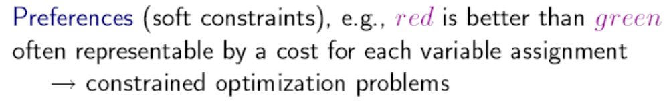
Varieties of constraints
Unary constraints involve a single variable,
  e.g., SA ≠ green
Binary constraints involve pairs of variables,
  e.g., SA ≠ WA
Higher-order constraints involve 3 or more variables,
  e.g., cryptarithmetic column constraints

Slide 9

Example: Cryptarithmetic
Variables: F T U W
R O X₁ X₂ X₃
Domains: {0,1,2,3,4,5,6,7,8,9}
Constraints: Alldiff (F,T,U,W,R,O)
  O + O = R + 10 · X₁
  X₃ = F, T ≠ 0, F ≠ 0
  X1 + W + W = U + 10 · X2
  X2 + T + T = O + 10 · X3

Slide 10
Real-world CSPs
Assignment problems
  e.g., who teaches what class
Timetabling problems
  e.g., which class is offered when and where?
Transportation scheduling
Factory scheduling
Notice that many real-world problems involve real-valued variables

Slide 11
Standard search formulation (incremental)
States are defined by the values assigned so far
Initial state: the empty assignment { }
Successor function: assign a value to an unassigned variable that does not conflict with current assignment
  → fail if no legal assignments
Goal test: the current assignment is complete
This is the same for all CSPs
Every solution appears at depth n with n variables
→ use depth-first search

Slide 12
Backtracking search
Variable assignments are commutative, i.e.,
[ WA = red then NT = green ] same as [ NT = green then WA = red ]
Only need to consider assignments to a single variable at each node
  b = d and there are d^{n} leaves
Depth-first search for CSPs with single-variable assignments is called backtracking search
Backtracking search is the basic uninformed algorithm for CSPs
Can solve n-queens for n ≈ 25

Slide 13

Backtracking search

Slide 14

Backtracking example

Slide 15

Backtracking example

Slide 16

Backtracking example

Slide 17

Backtracking example

Slide 18
Improving backtracking efficiency
General-purpose heuristics can give huge gains in speed:
  Which variable should be assigned next?
  In what order should its values be tried?
  Can we detect inevitable failure early?

Slide 19

Most constraining variable
Tie-breaker among most constrained variables
Most constraining variable:
  choose the variable with the most constraints on remaining variables
a.k.a. degree heuristic
(degree heuristic)

Slide 20

Most constrained variable
Most constrained variable:
  choose the variable with the fewest legal values
a.k.a. minimum remaining values (MRV) heuristic

Slide 21

Least constraining value
Given a variable, choose the least constraining value:
Combining these heuristics makes 1000 queens feasible
the one that rules out the fewest values in the remaining variables

Slide 22

Forward checking
Idea:
  Keep track of remaining legal values for unassigned variables
  Terminate search when any variable has no legal values
  仅检查已赋值结点的邻居

Slide 23

Forward checking
Idea:
  Keep track of remaining legal values for unassigned variables
  Terminate search when any variable has no legal values

Slide 24

Forward checking
Idea:
  Keep track of remaining legal values for unassigned variables
  Terminate search when any variable has no legal values

Slide 25

Forward checking
Idea:
  Keep track of remaining legal values for unassigned variables
  Terminate search when any variable has no legal values

Slide 26
Constraint propagation
Forward checking propagates information from assigned to unassigned variables, but doesn't provide early detection for all failures:
NT and SA cannot both be blue!
Constraint propagation repeatedly enforces constraints locally

Slide 27

Arc consistency
Simplest form of propagation makes each arc consistent
X →Y is consistent iff
  for every value x of X there is some allowed y

Slide 28

Arc consistency
Simplest form of propagation makes each arc consistent
X →Y is consistent iff
  for every value x of X there is some allowed y

Slide 29

Arc consistency
Simplest form of propagation makes each arc consistent
X →Y is consistent iff
  for every value x of X there is some allowed y
If X loses a value, neighbors of X need to be rechecked

Slide 30

Arc consistency
Simplest form of propagation makes each arc consistent
X →Y is consistent iff
  for every value x of X there is some allowed y
If X loses a value, neighbors of X need to be rechecked
Arc consistency detects failure earlier than forward checking
Can be run as a preprocessor or after each assignment

Slide 31

Arc consistency algorithm AC-3
Time complexity: O(n²d³)

Slide 32
智能回溯
对历时回溯的改进
  历时回溯：重新访问的是时间最近的决策点
智能回溯：回溯到导致失败的变量集合中的一个变量（该集合称为冲突集）
例子：
{Q, NSW, V, T, SA, WA, NT}
假设已产生赋值{Q=red, NSW=green, V=blue, T=red} ,给SA赋值导致失败，那么应该回溯到V而不是T。
实际上，实现智能回溯很繁琐

Slide 33
Local search for CSPs
Hill-climbing, simulated annealing typically work with "complete" states, i.e., all variables assigned
To apply to CSPs:
  allow states with unsatisfied constraints
  operators reassign variable values
Variable selection: randomly select any conflicted variable
Value selection by min-conflicts heuristic:
choose value that violates the fewest constraints
i.e., hill-climb with h(n) = total number of violated constraints

Slide 34
MIN-CONFLICTS算法
function MIN-CONFLICTS(csp, max_steps) return solution or failure
inputs: csp, a constraint satisfaction problem
max_steps, the number of steps allowed before giving up
current ← an initial complete assignment for csp
for i = 1 to max_steps do
if current is a solution for csp then return current
var ← a randomly chosen, conflicted variable from VARIABLES[csp]
value ← the value v for var that minimizes CONFLICTS(var,v,current,csp)
set var = value in current
return faiilure
与爬山法的差别：爬山法中，CONFLICTS一定减少，此处则未必

Slide 35

Example: 4-Queens
States: 4 queens in 4 columns (4⁴ = 256 states)
Given random initial state, can solve n-queens in almost constant time for arbitrary n with high probability (e.g., n = 10,000,000)
Actions: move queen in column
Goal test: no attacks
Evaluation: h(n) = number of attacks

Slide 36
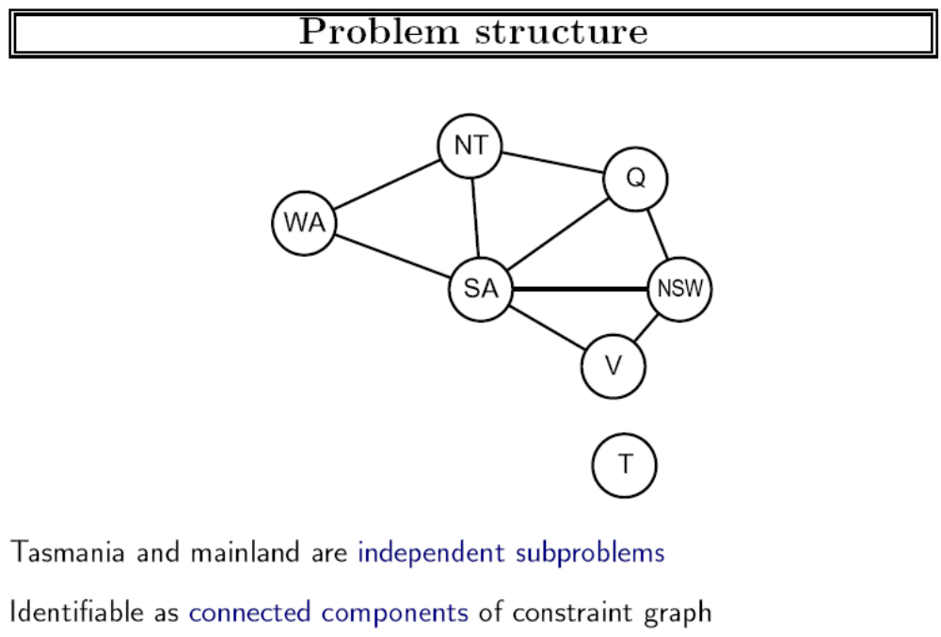

Slide 37
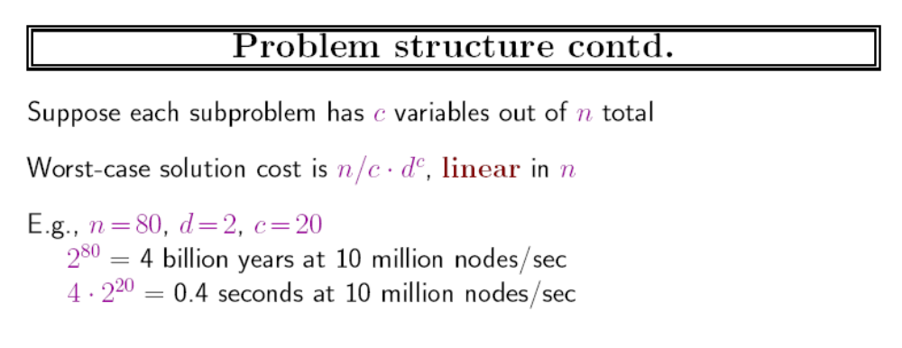

Slide 38
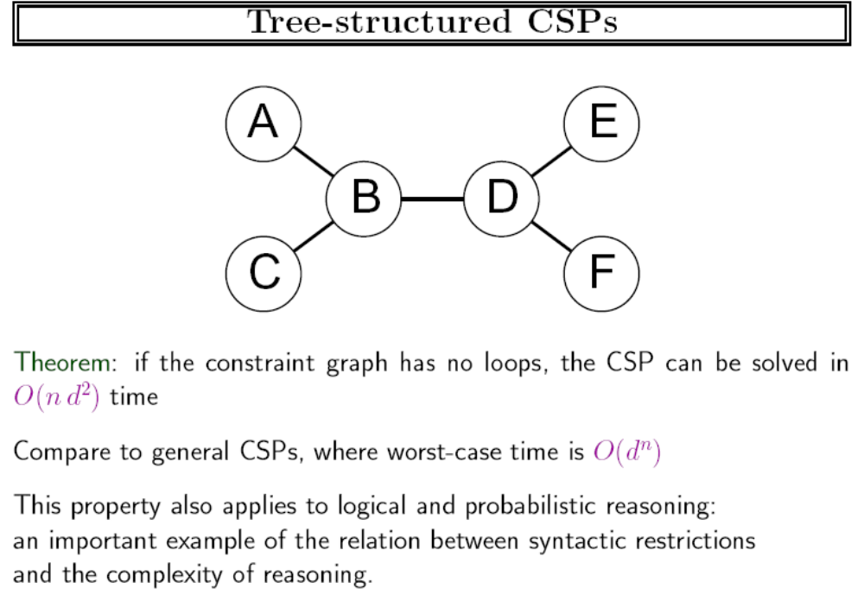

Slide 39
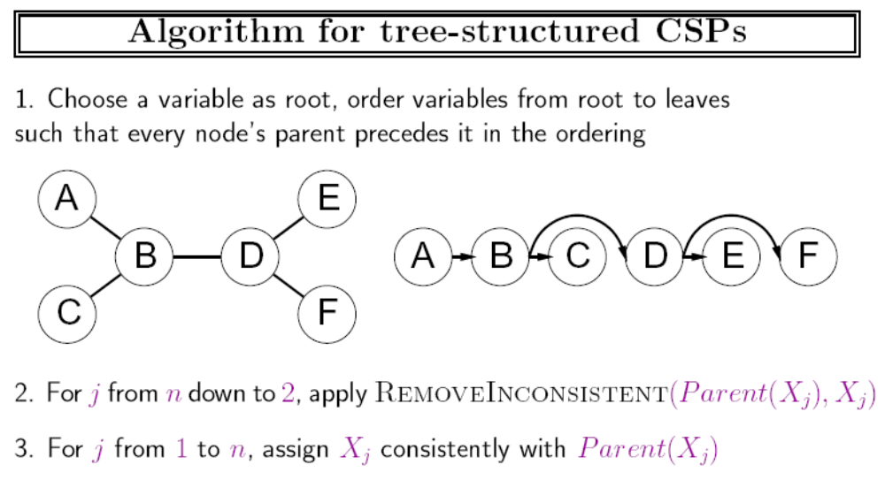

Slide 40
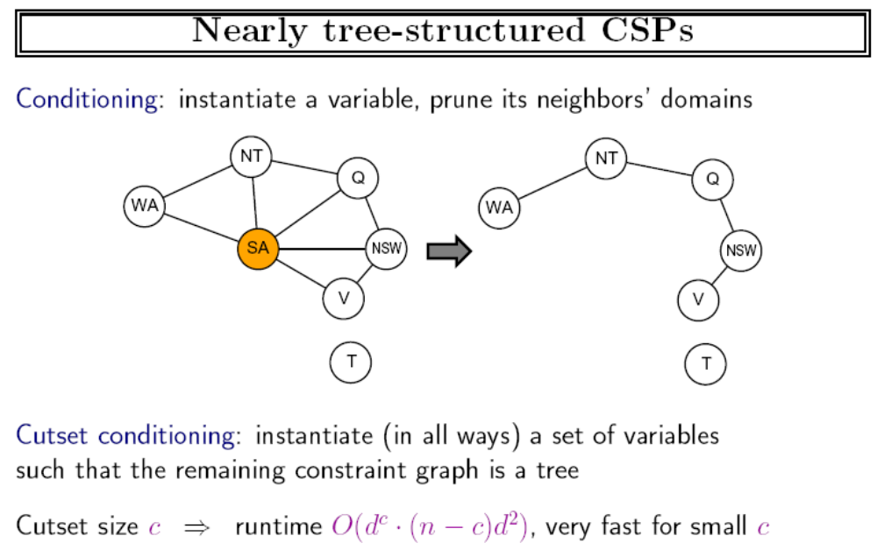

Slide 41
图的树分解
把约束图分解为相关联的子问题集
独立求解每个子问题
合并结果
Divide-and-Conquer

Slide 42
Summary
CSPs are a special kind of problem:
  goal test defined by constraints on variable values
Backtracking = depth-first search with one variable assigned per node
Variable ordering and value selection heuristics help significantly
Forward checking prevents assignments that guarantee later failure
Iterative min-conflicts is usually effective in practice
The CSP representation allows analysis of problem structure
Tree-structured CSPs can be solved in linear time
Constraint propagation (e.g., arc consistency) does additional work to constrain values and detect inconsistencies
states defined by values of a fixed set of variables

Slide 43
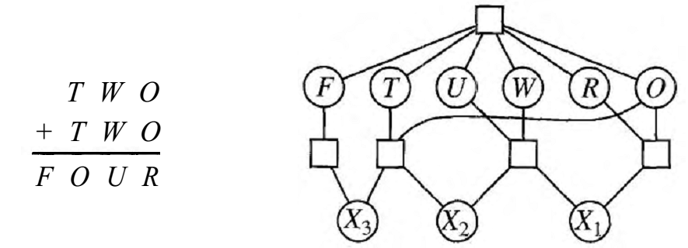
作业
5.6 采用手算、回溯、前向检查、MRV以及Least constraining value策略解密码算术问题：

Slide 44
作业
Consider the following logic puzzle: In five houses, each with a different color, live 5 persons of different nationalities, each of whom prefer a different brand of cigarette, a different drink, and a different pet. Given the following facts, the question to answer is ''Where does the zebra live, and in which house do they drink water?"
  The Englishman lives in the red house.
  The Spaniard owns the dog.
  The Norwegian lives in the first house on the left.
  Kools are smoked in the yellow house.
  The man who smokes Chesterfields lives in the house next to the man with the fox.
  The Norwegian lives next to the blue house.
  The Winston smoker owns snails.
  The Lucky Strike smoker drinks orange juice.
  The Ukrainian drinks tea.
  The Japanese smokes Parliaments.
  Kools are smoked in the house next to the house where the horse is kept.
  Coffee is drunk in the green house.
  The Green house is immediately to the right (your right) of the ivory house.
  Milk is drunk in the middle house.
Discuss different representations of this problem as a CSP. Why would one prefer one representation over another?

