Slide 1
HMM、词性标注 和 汉语分词

Slide 2
Outline
HMM
HMM POS tagging
汉语分词

Slide 3
隐马尔可夫（HMM）模型

Slide 4
this presentation is modified from slides on the Internet
http://ufo.cs.ccu.edu.tw/bioinformatics/
以及Dorr等人的讲义
Reference:
  A Tutorial on Hidden Markov Models and Selected Applications in Speech Recognition, L. R. Rabiner, Proceedings of the IEEE, Vol. 77, No. 2, 1989

Slide 5
Outline
Introduction
Markov Models
Hidden Markov Models
Forward/Backward Algorithms
Viterbi Algorithm

Slide 6
Introduction
马尔可夫过程是一类随机过程，可以用来描述自然界的一些现象。其基本假设就是马尔可夫性质。
随机过程举例
    Gaussian process, 泊松过程，布朗运动，Markov process, hidden Markov process

Slide 7
Markov property
In probability theory, a stochastic process has the Markov property if the conditional probability distribution of future states of the process, given the present state, depends only upon the current state, i.e. it is conditionally independent of the past states (the path of the process) given the present state.

Slide 8
Mathematically, if X(t), t > 0, is a stochastic process, the Markov property states that

Slide 9
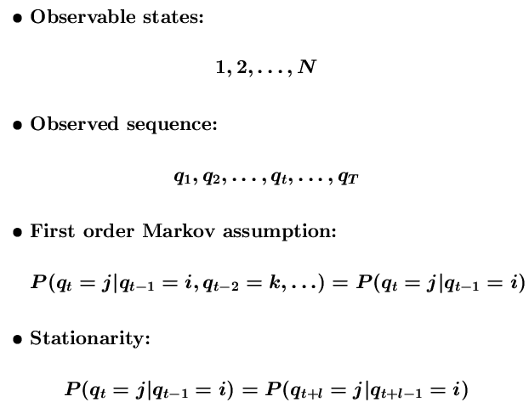
Markov Models

Slide 10
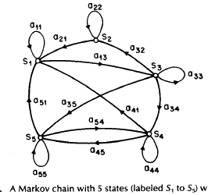
Markov Models可以用状态转换图描述
States are observable

Slide 11
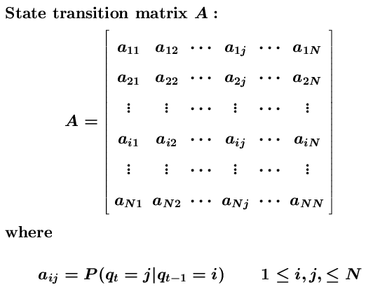

Markov Models

Slide 12
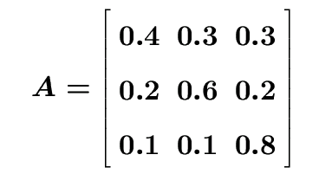
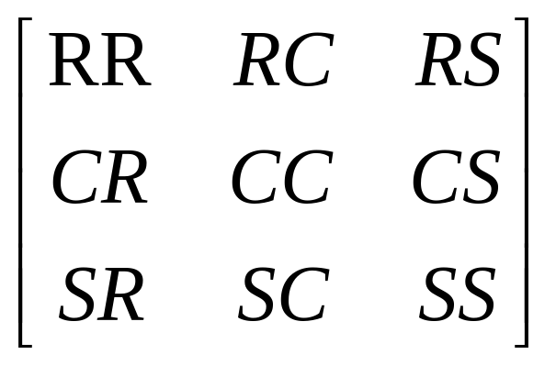
Weather Model
States
  R: Rainy, C: Cloudy, S: Sunny
State Transition Probability Matrix
What is the probability of observing O=SSRRSCS given that today is S?

Slide 13
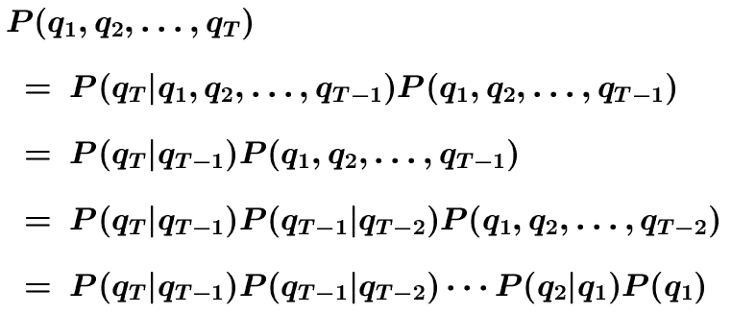
Weather Model
Basic Rule: P(A, B) = P(A|B)P(B)
Markov chain rule:
initial probability
π_{i} = P(q₁=i)

Slide 14
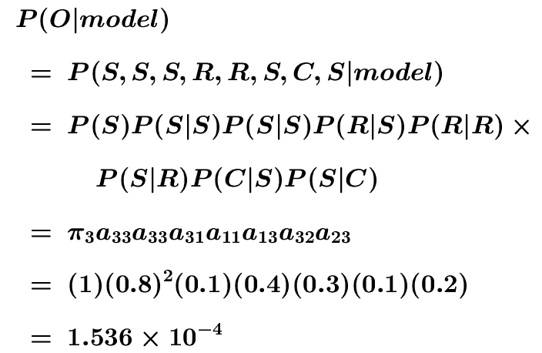
Weather Model
Observation Sequence O:
O = (S, S, S, R, R, S, C, S)
By Chain Rule

Slide 15
Hidden Markov Models
States are not observable
Observations are probabilistic functions of states
State transitions are still probabilistic

Slide 16
Coin Toss Models
Scenario: You are in a room with a barrier through which you cannot see that is happening. On the other side of barrier another person is performing a coin (or multiple coin) tossing experiment. He will only tell you the result of each coin flip.
The problem is how do we build a model to explain the observed sequence of heads and tails?

Slide 17

Coin Toss Models
Observation:a sequence of heads and tails
Build a HMM to explain the observed sequence
  What the states correspond to?
  How many states? (How many coins?)
  What are the parameters?

Slide 18


One-coin Model
observable 2-state Markov model: Each state corresponds to a side of the coin
P(H)

Slide 19
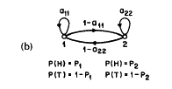

Two-coin Model
Each state corresponds to a biased coin
Hidden Markov Model
Transition matrix are estimated by a set of independent coin tosses

Slide 20
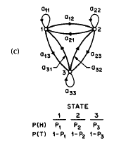

Three-coin Model

Slide 21
Model Selection
Which model best matches the actual observations?
1-coin model: 1 unknown parameter
2-coin model: 4 unknown parameters
3-coin model: 9 unknown parameters
Larger models may match better than smaller ones, but not necessary so
Practical considerations impose strong limitation on the size of models

Slide 22
球瓮模型
若干只瓮,每个瓮装彩球,多动的猴子被蒙住眼睛,选瓮摸球,给你看颜色,然后放回
问多少只瓮?多少种颜色的球?

Slide 23
Elements of a HMM
Q={1,2,…,N} : set of hidden states
V={1,2,…,M} : set of observation symbols
A: state transition probability matrix
  a_{ij} = P(q_{t+1}=j|q_{t}=i)
B: observation symbol probability
  b_{j}(k) = P(o_{t}=k|q_{t}=j)
π: initial state distribution
  π_{i} = P(q₁=i)
λ: the entire model λ=(A,B,π)

Slide 24
Sequence Generator
Given an HMM, how to generate a sequence of T observations? O=(o₁,o₂,…,o_{T})
Choose an initial state q₁ = S_{i} according to state distribution, and set t = 1
Choose O_{t}=v_{k} according to the symbol probability distribution in state S_{i}, i.e. b_{i}(k)
Transit to a new state q_{t+1}=S_{j} according to the state transition probability distribution for state S_{i}, i.e. a_{ij}
Set t = t+1; go to step 3 if t < T; otherwise terminate the procedure

Slide 25
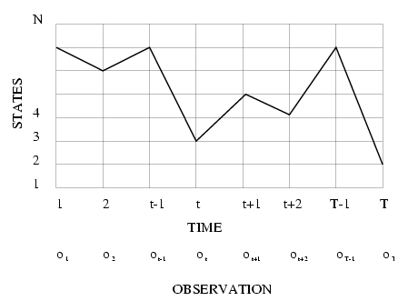
Execution of HMM
State sequence corresponds to a path in the grids

Slide 26
Three Basic Problems
compute the probability that the model generates the observation sequence
  model evaluation
find the optimal state sequence that generates the observation sequence
  hidden state discovery (tagging…)
learn an HMM that best fits the observation sequences
  HMM training

Slide 27
Basic Problem 1
Given observation O=(o₁,o₂,…,o_{T}) and model λ=(A,B,π), efficiently compute P(O|λ)
  P(O|λ) is the probability that O is produced by λ
  Hidden states complicates the probability evaluation
  Given two models λ₁ and λ₂, the probability (score) can be used to choose the better one
    λ_{i} models some protein family
    O denotes a protein
    find the most probable protein family for O

Slide 28
Basic Problem 2
Given observation O=(o₁,o₂,…,o_{T}) and model λ=(A,B,π), find the optimal state sequence q=(q₁,q₂,…,q_{T})
  to uncover the hidden part of the model; also called “decoding”
  Optimality criterion has to be decided (e.g. maximum likelihood)
  find “explanation” for the data
    O is the words
    find the POS tag of each word

Slide 29
Basic Problem 3
Given observation O=(o₁,o₂,…,o_{T}), estimate model parameters λ=(A,B,π) that maximizes P(O|λ)
  to train the model
  find the best parameters
  also called “learning”

Slide 30
Solution to Problem 1
Problem: compute P(o₁,o₂,…,o_{T}|λ)
Consider state sequence q=(q₁,q₂,…,q_{T})
P(O|λ) = Σ_{q} P(O|q,λ)P(q|λ)
  P(O|q,λ) = Π_{i=1,…,T}(o_{t}|q_{t},λ)
  = b_{q1}(o₁) b_{q2}(o₂)… b_{qT}(o_{T})
  Assume observations are independent of each other
  P(q|λ) = π_{q1}a_{q1q2}a_{q2q3}… a_{qT-1qT}
N^{T} state sequences each with O(T) time
  Complexity O(TN^{T})
  For N=5, T=100, TN^{T}=100x5¹⁰⁰ ~ 10⁷²

Slide 31
优化解法
采用动态规划（此处也称为Viterbi算法）可以以线性复杂度来得到P(O|λ)

Slide 32

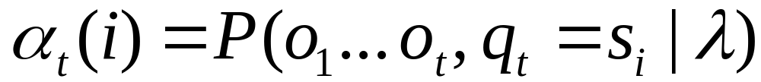
Forward Probabilities
What is the probability that, given an HMM , at time t the state is i and the partial observation o1 … ot has been generated?

Slide 33

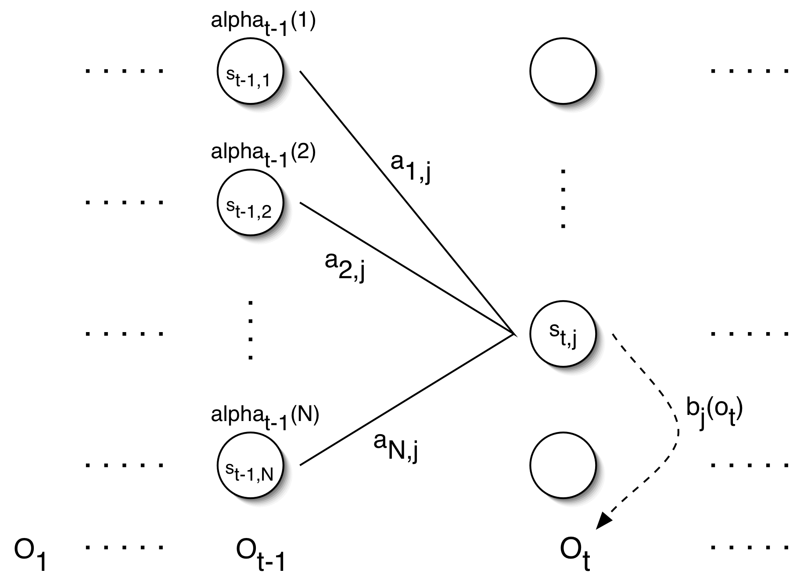
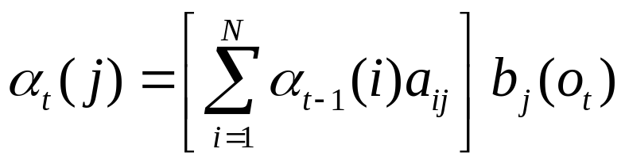
Forward Probabilities

Slide 34
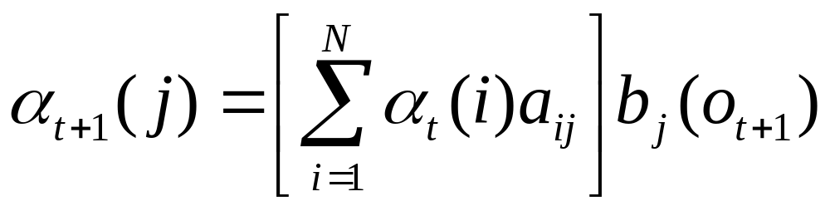
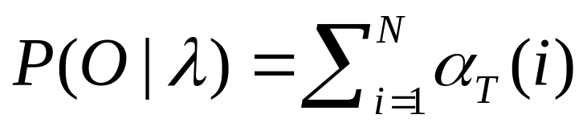
Forward Algorithm
forward variable α_{t}(i) = P(o₁,o₂,…,o_{t},q_{t}=i|λ)
α_{t}(i) is the probability of observing the partial sequence (o₁,o₂,…,o_{t}) such that state q_{t} is S_{i}
Initialization: α₁(i) = π_{i}b_{i}(o₁)
Induction:
Termination:
Complexity: O(N²T)

Slide 35
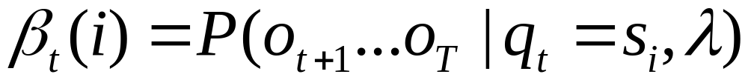
Backward Probabilities
Analogous to the forward probability, just in the other direction
What is the probability that given an HMM and given the state at time t is i, the partial observation o_{t+1} … o_{T} is generated?

Slide 36
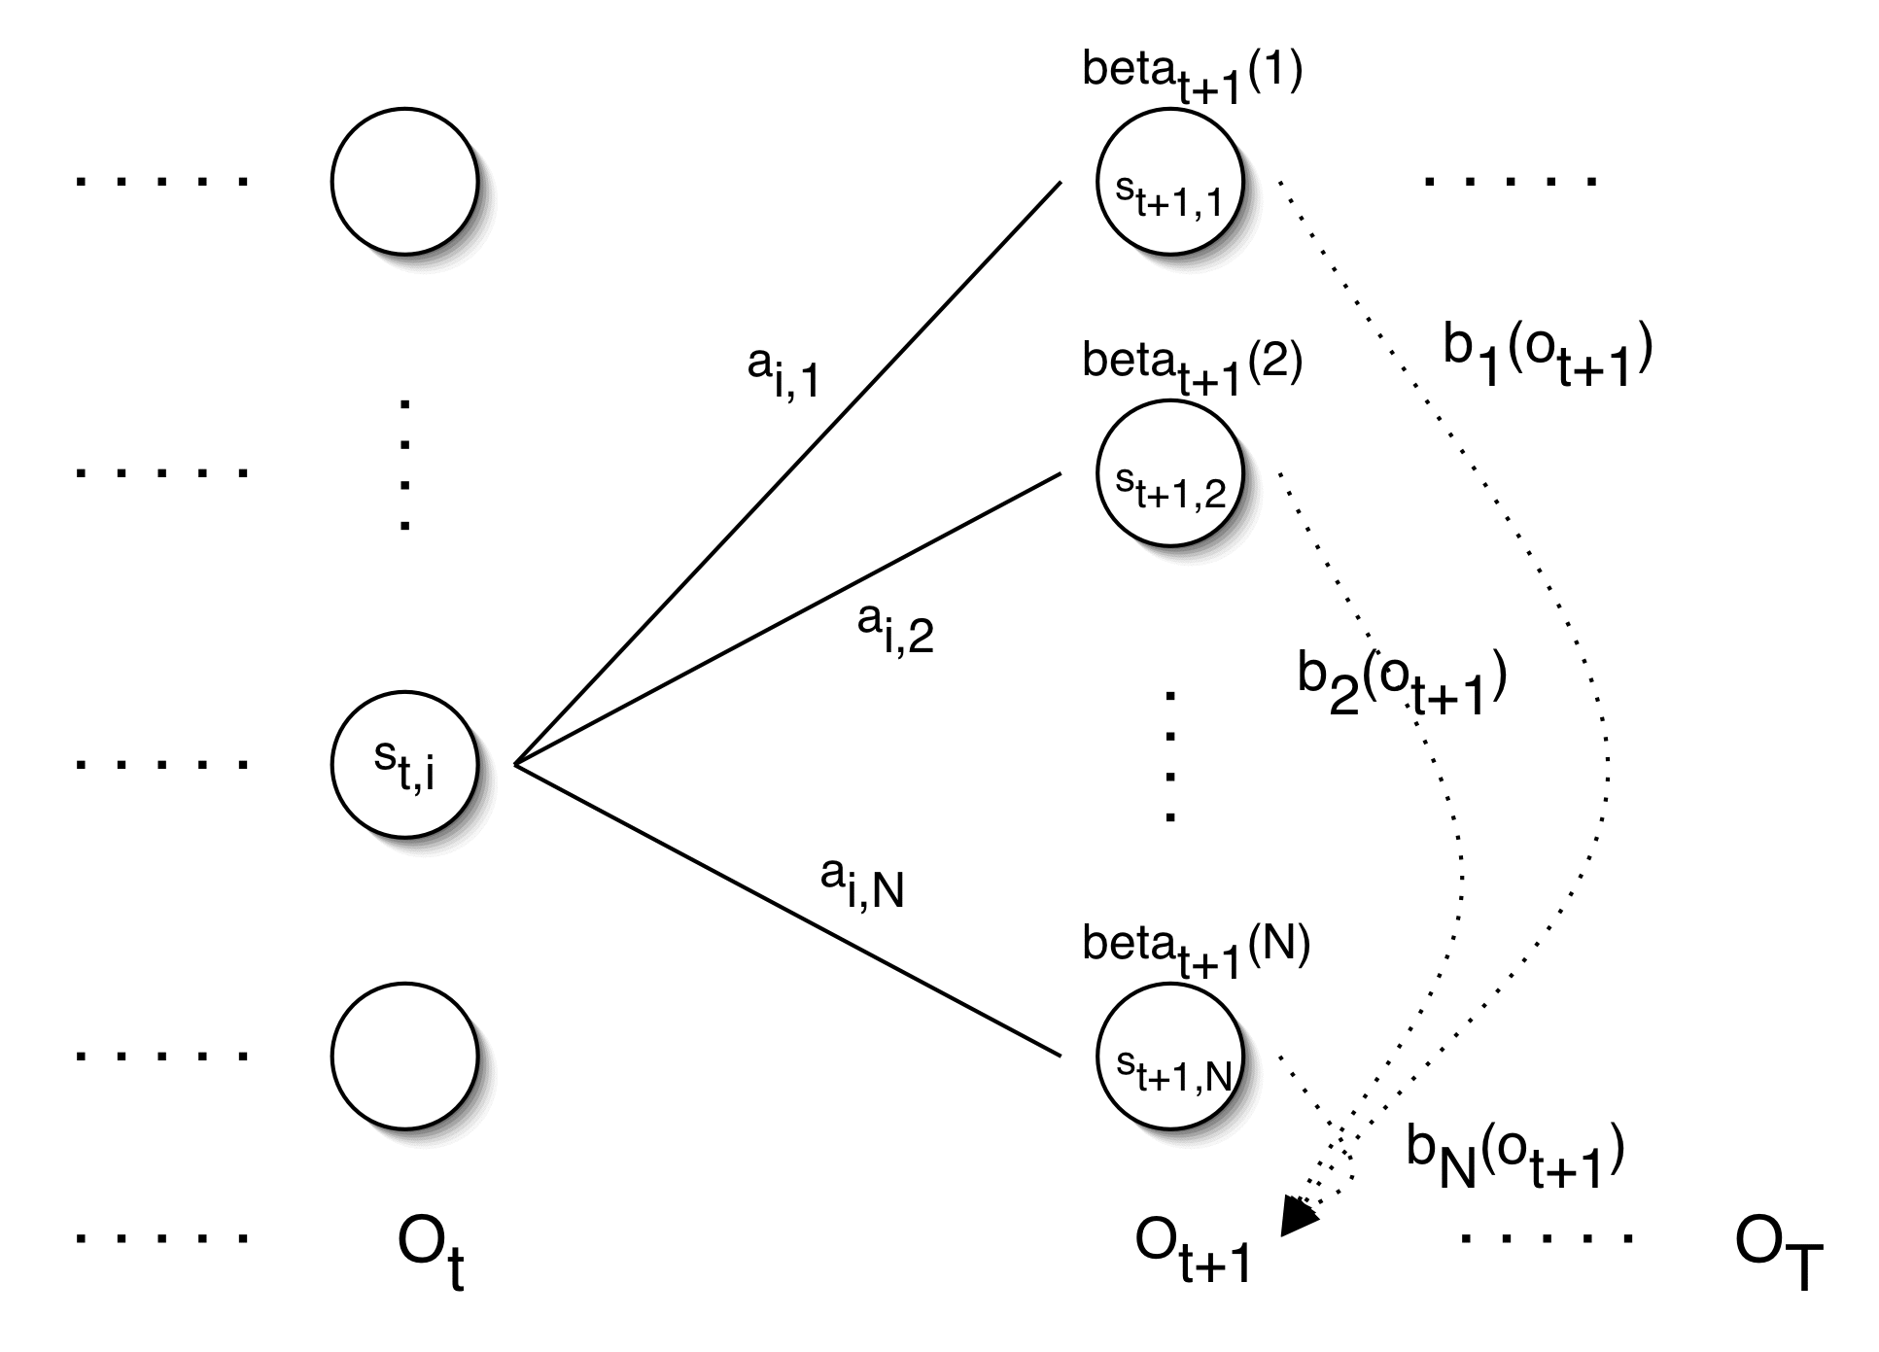
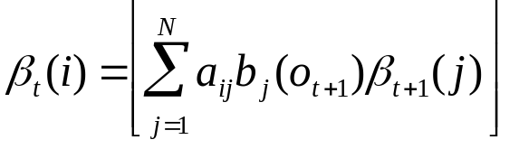
Backward Probabilities

Slide 37
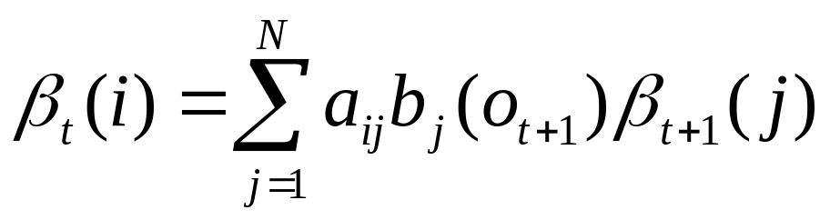
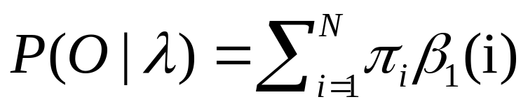
Backward Algorithm
backward variable
β_{t}(i) = P(o_{t+1},o_{t+2},…,o_{T}|q_{t}=i,λ)
β_{t}(i) is the probability of observing the partial sequence (o_{t+1},o_{t+2},…,o_{T}) such that state q_{t} is i
Initialization: β_{T}(i) = 1
Induction:
Termination:
Complexity: O(N²T)

Slide 38
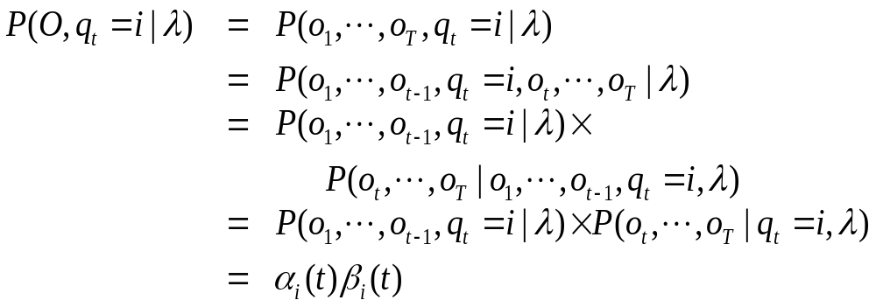
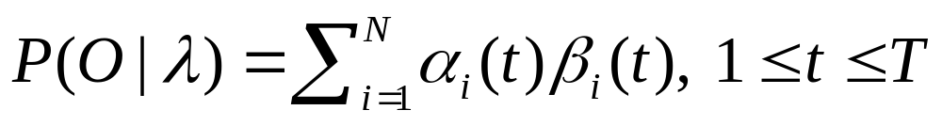
Combing Forward and Backward

Slide 39
Solution to Problem 2
Find the most likely path
Find the path that maximizes likelihood:
P(q₁,q₂,…,q_{T}|O,λ) which is equivalent to maximize P(q₁,q₂,…,q_{T},O|λ)
argmax q P(q|O, λ)
argmax q P(q, O|λ)/P(O|λ)
=argmax q P(q, O|λ)

Slide 40
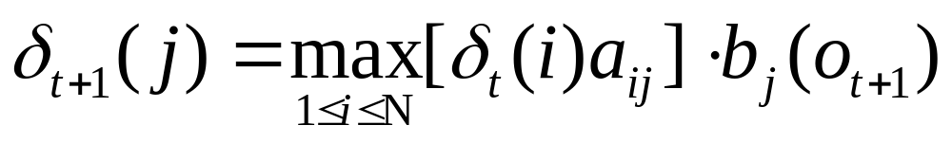
define
δ_{t}(i) is the highest prob. path ending at state i
by induction,

Slide 41
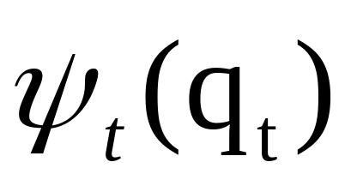
Viterbi Algorithm
过程与计算forward概率相似,只不过Σ运算改成了max运算。另外，增加以下函数来记住部分最佳路径

Slide 42




Viterbi Algorithm
Initialization:
Recursion:
Termination:
Path (state sequence) backtracking:

Slide 43

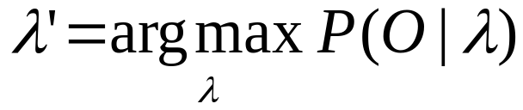

Solution to Problem 3
estimate λ=(A,B,π) to maximize P(O|λ)
Unfortunately, there is no known way to analytically find a global maximum, i.e., a model , such that
But it is possible to find a local maximum iteratively
Given an initial model λ , we can always find a model λ’, such that

Slide 44
Parameter Re-estimation
The algorithm is called the forward-backward (or Baum-Welch) algorithm
Using an initial parameter instantiation, the forward-backward algorithm iteratively re-estimates the parameters and improves the probability that given observations are generated by the new parameters

Slide 45

Parameter Re-estimation
Three parameters need to be re-estimated:
  Initial state distribution:
  Transition probabilities: a_{i,j}
  Emission probabilities: b_{i}(o_{t})

Slide 46
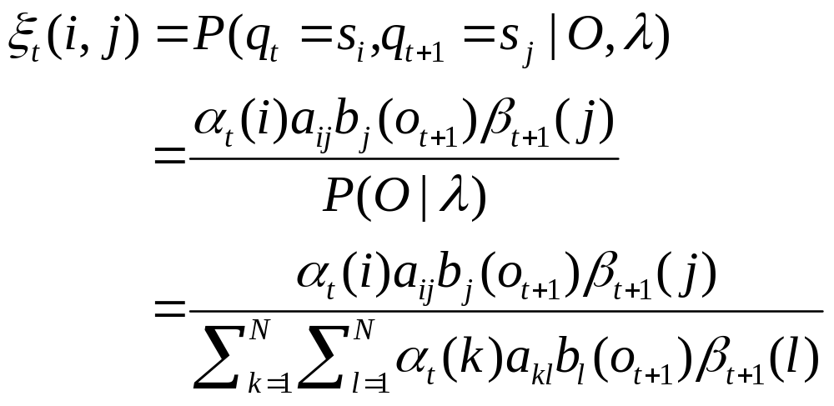
what is the probability of being in state i at time t, and in state j at time t+1?

Slide 47

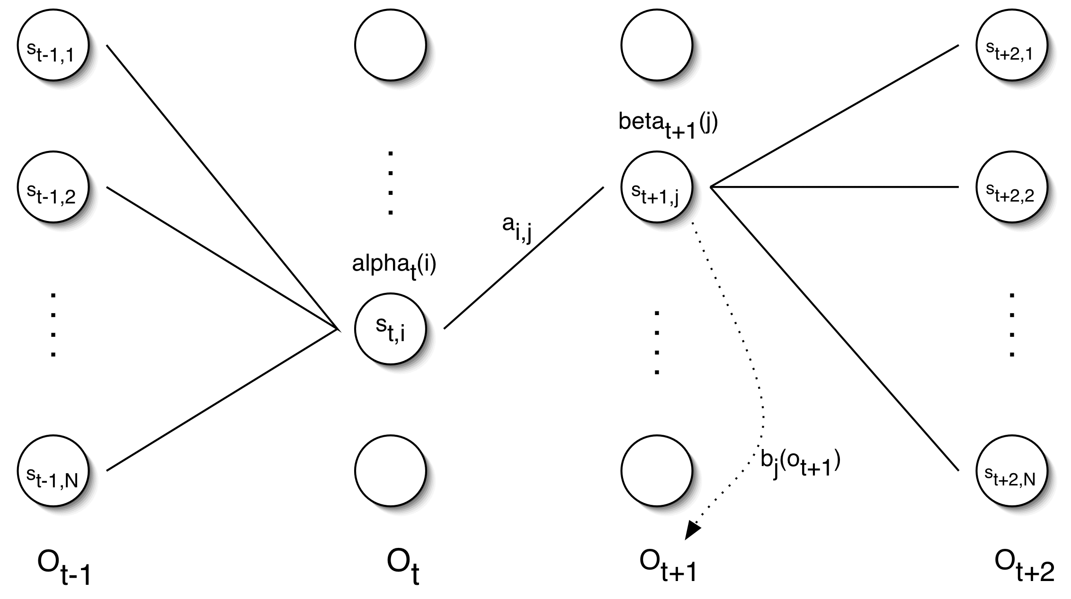
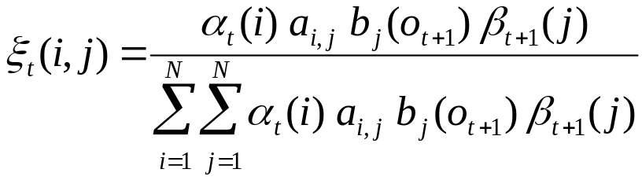
Re-estimating Transition Probabilities

Slide 48
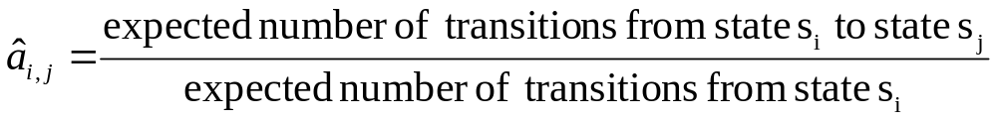
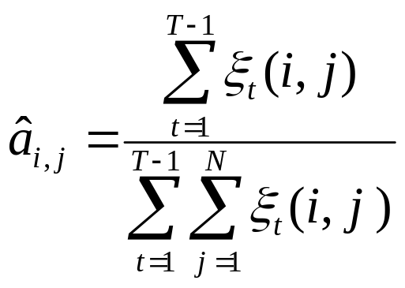
Re-estimating Transition Probabilities
The intuition behind the re-estimation equation for transition probabilities is
Formally:

Slide 49
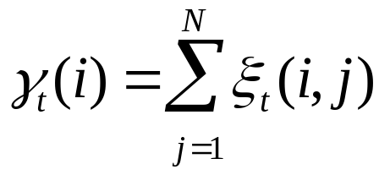
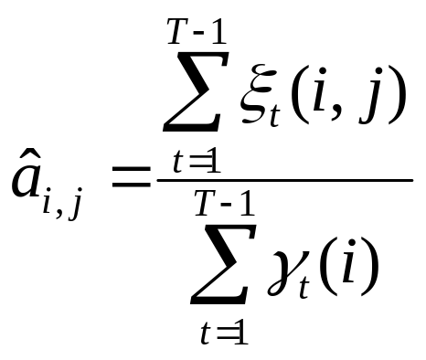
Re-estimating Transition Probabilities
Defining
As the probability of being in state s_{i}, given the complete observation O
We can say:

Slide 50
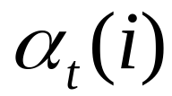


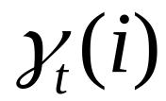
Review of Probabilities
Forward probability:
The probability of being in state s_{i}, given the partial observation o₁,…,o_{t}
Backward probability:
The probability of being in state s_{i}, given the partial observation o_{t+1},…,o_{T}
Transition probability:
The probability of going from state s_{i}, to state s_{j}, given the complete observation o₁,…,o_{T}
State probability:
The probability of being in state s_{i}, given the complete observation o₁,…,o_{T}

Slide 51

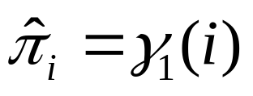
Re-estimating Initial State Probabilities
Initial state distribution: is the probability that s_{i} is a start state
Re-estimation is easy:
Formally:

Slide 52
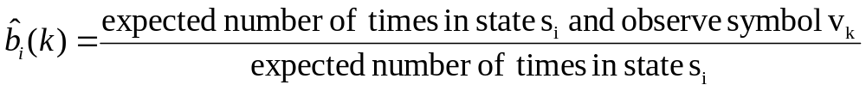
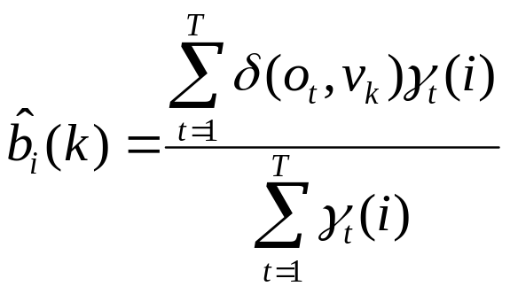

Re-estimation of Emission Probabilities
Emission probabilities are re-estimated as
Formally:
Where
Note that here is the Kronecker delta function and is not related to the in the discussion of the Viterbi algorithm!!

Slide 53

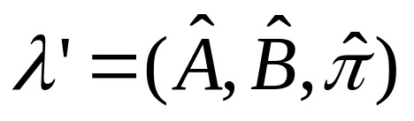
The Updated Model
Coming from we get to
by the following update rules:
P(O|λ’)>P(O|λ) 【参见Baum的论文】

Slide 54
BM 算法概要
输入：观察序列的集合
初始化：起始概率，转移概率，发射概率
重复：
  对每个序列，求其alpha, beta，序列的概率, a(i,j)估计，b(i,k)估计
  重新归一化a(i,j), b(i,k) 为转移概率和发射概率
  直至整个序列集合的概率和不再变化

Slide 55
Expectation Maximization
The forward-backward algorithm is an instance of the more general EM algorithm
  The E Step: Compute the forward and backward probabilities for a give model
  The M Step: Re-estimate the model parameters

Slide 56
HMM参数估计的简单办法
Baum-Welch算法只需要未标注的观察序列，不需要状态
假如我们有一个已经标注好观察值和状态序列的语料库,直接可以从该语料库计算出转移概率,输出概率,初始概率.
这样做的效果一般比Baum-Welch算法好
如果有标注语料和未标注语料，两者可以结合起来使用

Slide 57
HMM应用
语音识别
词性标注,我们马上讲
拼音输入法
生物计算，如DNA Sequence Modeling
......

Slide 58
exercises
阅读Rabiner的HMM教程

Slide 59
实验2
设计一个基于HMM（或扩充的HMM）的汉字（或日文、藏文）拼音输入法程序。具体要求见网上说明。

Slide 60
词性标注
问题描述：给定一个符号串，每个符号是某个类的集合中的一类，确定最可能的类别串。
同类问题：
  拼音汉字转换
  语音识别
  汉字注音

Slide 61
What is POS tagging good for?
Speech synthesis:
  How to pronounce “lead”?
  INsult inSULT
  OBject obJECT
  OVERflow overFLOW
  DIScount disCOUNT
  CONtent conTENT
Stemming for information retrieval
  Knowing a word is a N tells you it gets plurals
  Can search for “aardvarks” get “aardvark”
Can make parsing easier

Slide 62
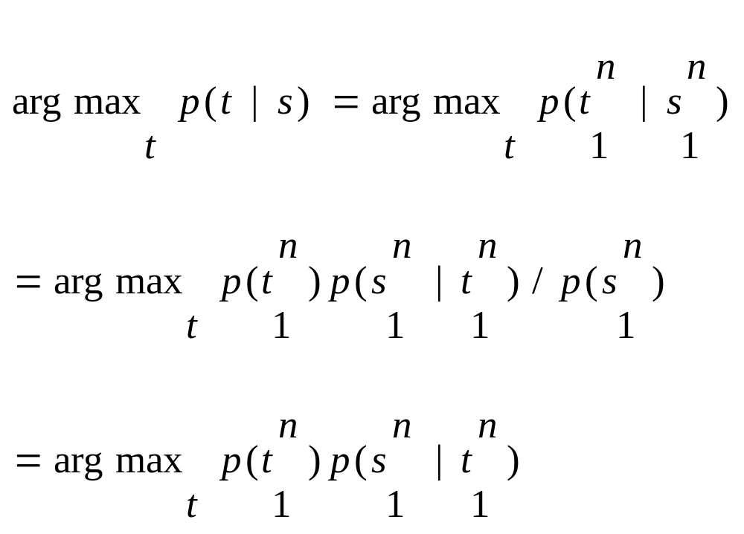
找出最好的标注串
The tagger finds the most probable tag sequence (t) given the sentence (s)

Slide 63
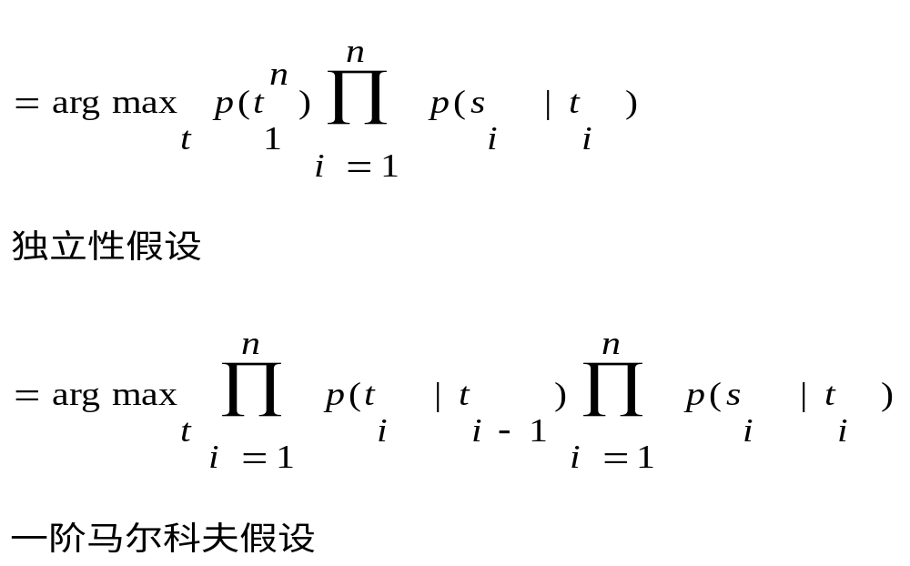

Slide 64
HMM模型
如果采用一阶马尔可夫假设，就成为HMM模型；但是可以采用二阶马尔可夫假设，这就不是经典的HMM模型
HMM模型来做词性标注，状态就是词性,观察值是单词. P(t_{i}|t_{i-1})称为词性转移概率， P(s_{i}|t_{i})称为单词生成概率

Slide 65
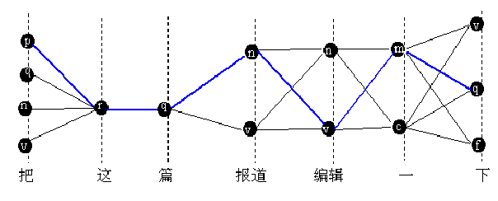
蓝色的是最优路径

Slide 66
动态规划算法求解（Viterbi算法）
最大概率问题转化为最短路径问题（取对数，负之）
需要知道P(ti|ti-1), P(si|ti)。如果有已经标注好的语料库，可以从中估计
需要增加<s> </s>，使概率计算更精确

Slide 67
词性标注历史回顾
1960-70年代，Brown语料库，87个标记
1990年代，Penn Treebank，45个标记（9个标点符号）
1990年代，BNC语料库，61个标记
1990年代，北大人民日报语料库，26个标记，现在2003版增加了到105个标记

Slide 68
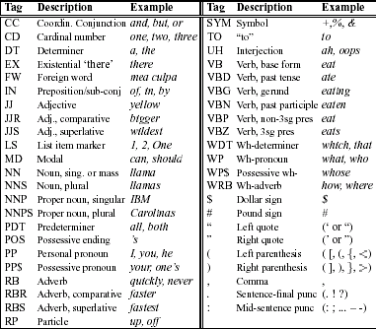
Penn tagset

Slide 69
词性标注的评价
精确率precision：正确标记数/产生标记数
召回率recall：正确标记数/标准标记数
F-measure: 2*precision*recall/(precision+recall)
目前HMM做词性标注的准确率约97%

Slide 70
统计方法的评价的说明
100%准确率是终极目标，但是在许多情况难以达到
人的准确率可能是一个上限，统计方法一般不可能超过拥有大量知识的人
  但是AlphaGo战胜了李世石！
底线（baseline）是下限，比如，就词性标注而言，选择最可能的词性，就能达到90%准确率，这就是下限，不能比这还差！

Slide 71
汉语的分词标注
可以先分词，后标注
分词和标注也可以一起进行：这样做的好处是错误不会传播. 联合优化!
计算概率时允许所有可能的切分方式

Slide 72
词图
HMM的格(Trellis)变成了“词图”
画：“结合成分子”的词图
结 合 成 分 子

Slide 73
词图
画词图时，找出所有可能的词,包括未登录词
动态规划算法仍然适用

Slide 74
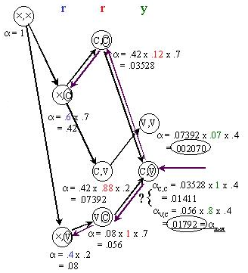
N-best计算
保留n个最佳结果，而不是1个
最优解：VCV；次优解：CCV

Slide 75
N-Best结果
p
n
a
n
n
-1 | 6.98
c
v
d
v
v

Slide 76
p
00 | 14.62
n
a
n
n
-1 | 6.98
c
00 | 12.28
v
d
v
v
00 | 18.22

Slide 77
p
00 | 14.62
n
10 | 19.87
00 | 21.65
20 | 25.89
a
n
n
-1 | 6.98
c
00 | 12.28
v
d
v
v
00 | 18.22

Slide 78
p
00 | 14.62
n
10 | 19.87
00 | 21.65
20 | 25.89
a
n
n
-1 | 6.98
c
00 | 12.28
v
10 | 20.86
00 | 23.9
20 | 27.61
d
v
v
00 | 18.22

Slide 79
p
00 | 14.62
n
10 | 19.87
00 | 21.65
20 | 25.89
a
00 | 32.42
01 | 34.2
10 | 36.16
n
n
-1 | 6.98
c
00 | 12.28
v
10 | 20.86
00 | 23.9
20 | 27.61
d
v
v
00 | 18.22

Slide 80
p
00 | 14.62
n
10 | 19.87
00 | 21.65
20 | 25.89
a
00 | 32.42
01 | 34.2
10 | 36.16
n
n
-1 | 6.98
c
00 | 12.28
v
10 | 20.86
00 | 23.9
20 | 27.61
d
00 | 29.38
01 | 31.16
10 | 31.38
v
v
00 | 18.22

Slide 81
p
00 | 14.62
n
10 | 19.87
00 | 21.65
20 | 25.89
a
00 | 32.42
01 | 34.2
10 | 36.16
n
10 | 44.59
00 | 44.88
11 | 46.37
n
-1 | 6.98
c
00 | 12.28
v
10 | 20.86
00 | 23.9
20 | 27.61
d
00 | 29.38
01 | 31.16
10 | 31.38
v
10 | 37.47
11 | 39.25
12 | 39.47
v
00 | 18.22

Slide 82
p
00 | 14.62
n
10 | 19.87
00 | 21.65
20 | 25.89
a
00 | 32.42
01 | 34.2
10 | 36.16
n
10 | 44.59
00 | 44.88
11 | 46.37
n
-1 | 6.98
c
00 | 12.28
v
10 | 20.86
00 | 23.9
20 | 27.61
d
00 | 29.38
01 | 31.16
10 | 31.38
v
10 | 37.47
11 | 39.25
12 | 39.47
v
00 | 18.22

Slide 83
p
00 | 14.62
n
10 | 19.87
00 | 21.65
20 | 25.89
a
00 | 32.42
01 | 34.2
10 | 36.16
n
10 | 44.59
00 | 44.88
11 | 46.37
n
-1 | 6.98
c
00 | 12.28
v
10 | 20.86
00 | 23.9
20 | 27.61
d
00 | 29.38
01 | 31.16
10 | 31.38
v
10 | 37.47
11 | 39.25
12 | 39.47
v
00 | 18.22

Slide 84
p
00 | 14.62
n
10 | 19.87
00 | 21.65
20 | 25.89
a
00 | 32.42
01 | 34.2
10 | 36.16
n
10 | 44.59
00 | 44.88
11 | 46.37
n
-1 | 6.98
c
00 | 12.28
v
10 | 20.86
00 | 23.9
20 | 27.61
d
00 | 29.38
01 | 31.16
10 | 31.38
v
10 | 37.47
11 | 39.25
12 | 39.47
v
00 | 18.22

Slide 85
N-Best Search结果
1)收入/n 和/c 生活/n 进一步/d 提高/v 37.47
2)收入/n 和/p 生活/n 进一步/d 提高/v 39.25
3)收入/n 和/c 生活/v 进一步/d 提高/v 39.47

Slide 86
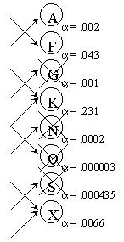
近似解：剪枝Pruning加快速度
在每一个时刻，如果Trellis上的状态过多，怎么办？
答案是剪枝：
1、按α(与最小路径代价的比值)的阈值剪枝， α太低的路径不再继续搜索
2、按状态的数量剪枝，超过多少个状态就不再扩展了『最多保留n个状态，n<N』

Slide 87
词类合理吗?
词性标注问题算法主要用到了局部上下文
许多同类的词其语境很不一样，如北大原来的标注集中，代词分为一类，包括
  人称代词
  疑问代词
  指示代词
显然不合理。因此，如果代词周围的词有多个词性，显然无法利用不同代词的区别特性

Slide 88
一次试验
将原来北大的代词分成8类，重新训练，结果标注的正确率和召回率都有所提高
宋柔称属于某个类别的词，但是与该类中的大多数此相比具有特异性的词为边缘词。
类分得太细，则训练数据需求越大。
北大的词性标注集,从最初的几十,增加到100多,据说目前已经有几百个标记(2006.10)

Slide 89
Latent Annotation
让机器利用统计特性自动进行分类。
  白硕：《语言学知识的计算机辅助发现》
  目前这方面有一些最新的进展。
分类必须依据某种优化指标进行，比如
  熵的最小化
  最小描述长度（MDL）

Slide 90
分词和合字
把句子分成词，也可反过来看：把字合成词
序列标注问题
  我/S 是/S 一/S 个/S 老/B 师/E
  S B I E 分别表示单独成词、词头、词中、词尾
  这样把分词问题看作字的序列标注问题，可采用多种依赖复杂特征函数进行序列标注的机器学习算法解决（如ME, CRF）
  这种方法能较好地处理OOV，而且性能比分词算法有一定提高

Slide 91
深度学习与分词
避免人工选取特征函数，采用深度学习的方法自动生成特征：把特征用词向量统一表示
有关论文
  Xiaoqing Zheng et al, Deep Learning for Chinese Word Segmentation and POS Tagging.

Slide 92
分词与大数据
分词在大规模网络文本上的性能仍然不佳
  微博分词
孙茂松：利用自然标注

Slide 93
segtag
这是2003年写的分词程序。目前仍然是比较好用的分词工具之一。
segtag演示

Slide 94
作业
阅读nltk的HiddenMarkovModelTrainer，明白如何训练一个HMM的tagger。
滨州树库的标注集中,IN既表示介词，也表示连词，我认为不合理。试通过改变训练语料库，区分IN-prep和IN-conj，重新训练nltk的HMM tagger（或你自己写的tagger）。通过准确率和召回率的变化来验证或驳斥我的假设。

