Slide 1
Lexical Analysis
史晓东 (Mandel)
mandel@xmu.edu.cn
Textbook: Compilers: Principles, Techniques, and Tools

Slide 2
Outline
词法分析器和token
automatic construction of a scanner: lex
  用正规表达式表达token
藏文拼写检查
自然语言词法分析
Summary
Exercises

Slide 3
What is a lexical analyzer (scanner)?
A scanner groups input characters into tokens
  token
  input type value
  identifier x
  equal =
  identifier x
  star *
  x = x * (acc+123) left-paren (
  identifier acc
  plus +
  integer 123
  right-paren )

Slide 4
What is a token?
token: a name for a set of input strings with a specific role. 是语言的基本单位,相当于自然语言的单词.
types of tokens
  Punctuation ( ) ; , [ ]
  Operators + - ** :=
  Keywords begin end if
  Identifiers Square_Root
  String literals “hello this is a string”
  Character literals ‘x’
  Numeric literals 123 4.23e+2

Slide 5
几个名词
Token，包含类型和值
Lexeme，表示token代表的值在源程序中的具体形式 （instance）
Pattern, token所具有的模式，一般用正规表达式来表示

Slide 6
token is <type, value>
type can be represented by an integer or an enum;属性一般用指向符号表的指针来表示
position = initial + rate * 60的记号和属性值：
⟨id，指向符号表中position条目的指针⟩
  ⟨assign _ op， NULL⟩
  ⟨id，指向符号表中initial条目的指针⟩
  ⟨add_op，+⟩
  ⟨id，指向符号表中rate条目的指针⟩
  ⟨mul_ op, *⟩
  ⟨num，整数值60⟩

Slide 7
Examples of nontokens
Comment
Preprocessor directive
Macro
Whitespaces

Slide 8
one consideration
Character set of the input program
  ASCII
  ISO Latin-1
  ISO 10646 (Unicode, utf16 or utf8)
  Others (EBCDIC, JIS, etc)
现在的编译器一般都支持 Unicode编码的 源代码（如utf8）

Slide 9
other things a scanner will do
skips comments and whitespace;
records the position (line, column) of every token (e.g., for error reporting).
recognizes and processes special directives (such as the #include <stdio.h> directive in C) and macros

Slide 10
how to structure a scanner?
as a separate pass: convert entire file to a file of tokens
Parser calls lexical analyzer: the usual way
  Get next token when it is needed
  This approach avoids extra I/O
get next character
get token
scanner
parser
AST
source file
token
Symbol Table

Slide 11
Implementing Lexical Analyzers
Different approaches:
  手工构造：Programming it in a language such as C, using the I/O facilities of the language. (easy and efficient)
  自动生成：Using a scanner generator, e.g., lex or flex. This automatically generates a lexical analyzer from a high-level description of the tokens. (easiest to implement; usually efficient)
  我们只讲后者

Slide 12
自动构造词法分析器 automatic construction of scanner： Scanner generators
Input: a scanner specification
  describes every token using Regular Expressions (REs)
    eg, the RE
    [a-z][a-zA-Z0-9]*
    recognizes all identifiers with at least one alphanumeric letter whose first letter is lower-case alphabetic
  handles whitespaces and resolve ambiguities
Output: the actual scanner (source code)

Slide 13
Translate REs into a finite state automaton
Done in three steps:
  translate REs into an NFA
  translate the NFA into DFA
    以上两步可以合成一步
  optimize the DFA (optional)
Convert finite state automaton into code
You will use a scanner generator called lex for the compiler project

Slide 14
lex：词法分析程序生成器
Lesk 1975年实现，unix的标准命令
有人移植到了windows
linux上有一个功能几乎相同的flex
说明文档http://dinosaur.compilertools.net/
lex
lex源程序
lex.yy.c

Slide 15
lex源程序的格式
声明部分
%%
规则部分
%%
辅助过程
关键是中间的规则部分

Slide 16
lex的规则
r₁ action₁
r₂ action₂
..
r_{n} action_{n}
每个r是一个正规表达式，动作一般是c语言程序。表示匹配该表达式后，应该执行的代码。这些代码都放在一个叫做yylex的函数里面。

Slide 17
Lex的变量
yylval：token的值
yytext：token的lexeme
yyleng：lexeme的长度
Lex新增了一些正规表达式的符号。请阅读其文档。

Slide 18
lex程序的例子
%%
"=" { return EQ; }
"<=" { return LE; }
"*" { return MULT; }
"(" { return LPAREN; }
":=" { return ASSIGN; }
"IF" { return IF; }
"WHILE" { return WHILE; }
"DO" { return DO; }
[0-9]+ { yylval = atoi(yytext); return NUMBER; }
[a-z] { yylval = yytext[0] - 'a'; return NAME; }
[ \n\t] |
"//".*\n { ; }
. { yyerror("illegal token"); }

Slide 19
主要的工作是用Regular expression 来描述 token
标志符:
  [_a-zA-Z][_a-zA-Z0-9]*
C语言的浮点数
假设digits 表示正则定义[0-9]+
({digits}”.”[0-9]*)|([0-9]*”.”{digits})
(1. .2 1.2 都是合法的浮点数)

Slide 20
lex虽然经常用来自动生成词法分析器,但是也可以用来做文本处理工作
例：计算英文单词个数的lex 程序
int nword=0;
%%
[a-zA-Z]+ nword++;
我们看行不行？现场演示
flex wordcount.l
bcc32 –ewordcount.exe lex.yy.c
wordcount <lex.yy.c

Slide 21
Lex解决冲突
两个办法：
  最长匹配原则: if v.s. if8
  当两个正则表达式都匹配同一个符号时,在前面的表达式优先
例如,识别关键词的表达式要放在识别标志符的表达式的前面
有关其他冲突解决（如用“/”表示lookahead）请参见lex文档

Slide 22
深入学习lex
lex是一个非常有用的工具，大家要掌握,一定要读完文档
同时，编写几个程序试一试
lex是自动分析器生成器yacc的伴侣
已经被移植到其他语言，如pascal
你们在编写自己的编译器时可以用lex

Slide 23

用lex来做藏文拼写检查
西藏是一个美丽的地方，藏文是一种非常有特色的语言

Slide 24
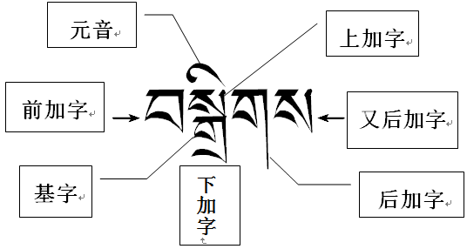
藏文音节构成
一个藏文单词由若干音节构成，每个音节是二维结构，不仅横向排列，还纵向叠加组合（“穿鞋带帽”）

Slide 25

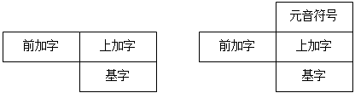

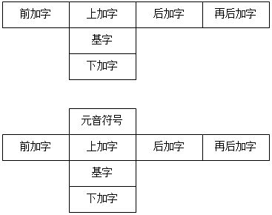
藏文的37种基本拼写结构
藏文拼写结构5
藏文拼写结构16

Slide 26
书写lex规则
/*正规定义，注意名字要顶格写！*/
b1 \xe0\xbd\x80
/* ཀ */
x1 \xe0\xbe\x90
/* ྐ */
b2 \xe0\xbd\x81
/* ཁ */
b3 \xe0\xbd\x82
……

Slide 27
书写lex规则
/* G2-34：由前加字、上加字、基字、下加字和元音符号以及基字和元音符号同时拼写构成，如 བསྐྱིའོ */
s34 {s7}{b23}{OO}
/* G2-35：由前加字、基字和元音符号以及基字和元音符号同时拼写构成，如 དཔེའི */
s35 {s8}{b23}{OO}
……

Slide 28
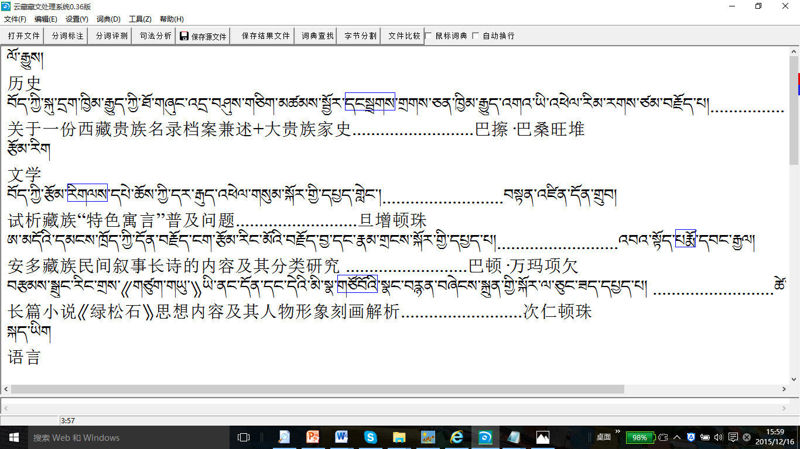
把拼写检查集成到藏文分词

Slide 29
自然语言词法分析简介
词法分析一般以句子为单位。因此假定一段文本已经被切分为若干句子。
定义：确定句子中每个单词及其属性，称为词法分析。
最重要的属性是词性。对黏着型语言，还需要分析其形态变化（形态分析）。
两个重要问题：分词（tokenization / word segmentation）、词性标注（tagging）。词性分析器一般称为tagger。

Slide 30
采用正则表达式进行分词
>>> text = 'That U.S.A. poster-print costs $12.40... '
>>> re.findall(r'(?:\w|\.|-)+|\S(?:\w|\.)*', text)
['That', 'U.S.A.', 'poster-print', 'costs', '$12.40...']

Slide 31
采用nltk进行分词和标注
>>> text = 'That U.S.A. poster-print costs $12.40...'
>>> print(word_tokenize(text))
['That', 'U.S.A.', 'poster-print', 'costs', '$', '12.40', '...']
>>> nltk.pos_tag(word_tokenize(text))
[('That', 'DT'), ('U.S.A.', 'NNP'), ('poster-print', 'NN'), ('costs', 'NNS'), ('$', '$'), ('12.40', 'CD'), ('...', ':')]

Slide 32
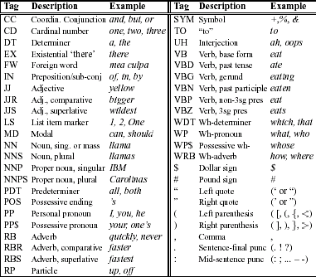
Penn tagset

Slide 33
自动标注简介
Baseline：假设我们知道每个词的最可能词性，那么可直接用这个词性标注该词。你做的分析器不可能比baseline还差！
根据上下文可更精确地确定一个词的词性，如我们知道冠词后面可接名词，那么 a book中的book是名词而不是动车。根据前面几个词的信息来标注当前词词性，称为n-gram 标注器。只根据前面一个词，称为2元标注器。Baseline相当于1元。

Slide 34
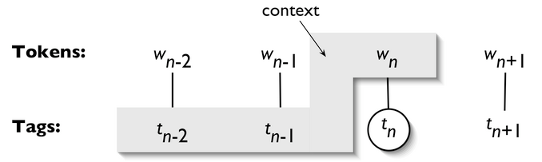
一个简单的3元标注器示例
所谓3元，是指当前词w_{n}的词性，受到前面两个词的词性的影响，一般用概率P(t_{n}|t_{n-2},t_{n-1})来表示

Slide 35
训练集和测试集
一般，把语料分为训练集和测试集。常按9：1划分。训练集和测试集是独立同分布的！
我们从已经标注的语料中训练n元标注器。用测试集测试其正确率。

Slide 36
>>> from nltk.corpus import brown
>>> brown_sents = brown.sents(categories='news')
>>> brown_tagged_sents = brown.tagged_sents(categories='news')
>>> size = int(len(brown_tagged_sents) * 0.9)
>>> size
4160
>>> train_sents = brown_tagged_sents[:size]
>>> test_sents = brown_tagged_sents[size:]

Slide 37
>>> bigram_tagger = nltk.BigramTagger(train_sents)
>>> bigram_tagger.tag(brown_sents[2007])
[('Various', 'JJ'), ('of', 'IN'), ('the', 'AT'), ('apartments', 'NNS'), ('are','BER'), ('of', 'IN'), ('the', 'AT'), ('terrace', 'NN'), ('type', 'NN'), (',', ','), ('being', 'BEG'), ('on', 'IN'), ('the', 'AT'), ('ground', 'NN'), ('floor', 'NN'), ('so', 'CS'), ('that', 'CS'), ('entrance', 'NN'), ('is', 'BEZ'), ('direct', 'JJ'), ('.', '.')]

Slide 38
>>> unseen_sent = brown_sents[4203]
>>> bigram_tagger.tag(unseen_sent)
[('The', 'AT'), ('population', 'NN'), ('of', 'IN'), ('the', 'AT'), ('Congo', 'NP'), ('is', 'BEZ'), ('13.5', None), ('million', None), (',', None), ('divided', None), ('into', None), ('at', None), ('least', None), ('seven', None), ('major', None), ('``', None), ('culture', None), ('clusters', None), ("''", None), ('and', None), ('innumerable', None), ('tribes', None), ('speaking', None), ('400', None), ('separate', None), ('dialects', None), ('.', None)]
>>> bigram_tagger.evaluate(test_sents)
0.10226253363899133

Slide 39
数据稀疏问题
Notice that the bigram tagger manages to tag every word in a sentence it saw during training, but does badly on an unseen sentence. As soon as it encounters a new word (i.e., 13.5), it is unable to assign a tag. It cannot tag the following word (i.e., million) even if it was seen during training, simply because it never saw it during training with a None tag on the previous word. Consequently, the tagger fails to tag the rest of the sentence. Its overall accuracy score is very low。
As n gets larger, the specificity of the contexts increases, as does the chance that the data we wish to tag contains contexts that were not present in the training data. This is known as the sparse data problem, and is quite pervasive in NLP.

Slide 40
accuracy and the coverage
上下文越多，越精确
上下文越多，越稀疏

Slide 41
合并标注器：回退
One way to increase the accuracy is to use the more accurate algorithms when we can, but to back off to algorithms with wider coverage when necessary.
  >>> t0 = nltk.DefaultTagger('NN')
  >>> t1 = nltk.UnigramTagger(train_sents, backoff=t0)
  >>> t2 = nltk.BigramTagger(train_sents, backoff=t1)
  >>> t2.evaluate(test_sents)
  0.845011462174823

Slide 42
实现
大家可以自己去参考nltk的源代码，了解n元标注器的实现
下一堂课我们将介绍一个更为强大的标注模型：隐马尔可夫模型

Slide 43
Summary
key concepts:
scanner; token; lex/flex;
tagger, n-gram tagger

Slide 44
习题
阅读nltk.BigramTagger的训练程序

Slide 45
实验1
编写c-- 语言的词法分析器。关于c-- 语言可参考我网站上的说明.请采用lex. 请编写实验报告.
为了测试词法分析器的正确性,可以对照网站上的测试实例. 通过了才能上交实验报告.

