Slide 1


TITLE
Presenter：XXX
Group Members：XXX，XXX

Slide 2

01
BACKGROUND
02
METHODS
CONTENTS
03
RESULTS
04
CONCLUSION

Slide 3

PART·ONE
BACKGROUND
Notes:
首先是关于我个人的基本情况

Slide 4

BACKGROUND

Slide 5
PART·TWO
METHODS
Notes:
接下来是关于我的竞赛与项目经历

Slide 6
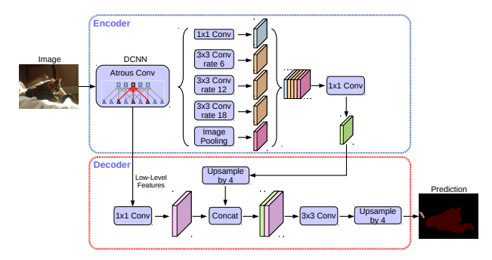
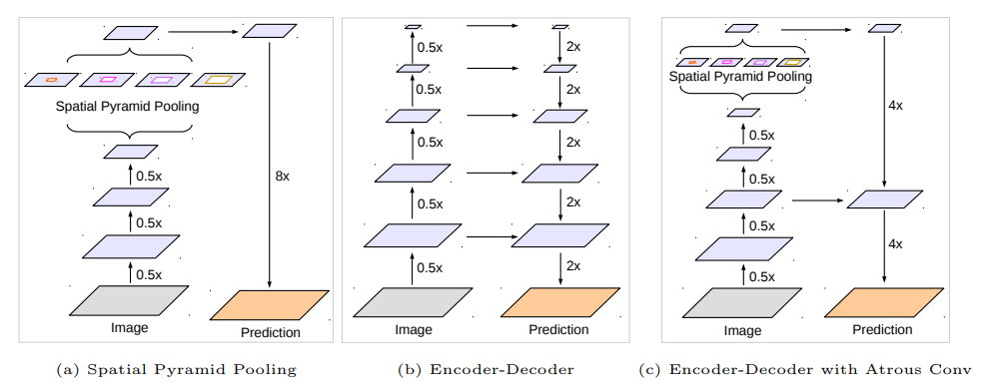
METHODS
XXXX
XXXXX
XXXXXXXXXXXXXX

Slide 7
PART·THREE
RESULTS

Slide 8
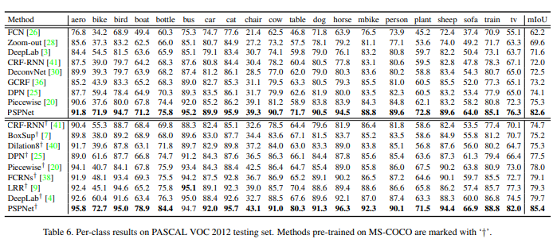
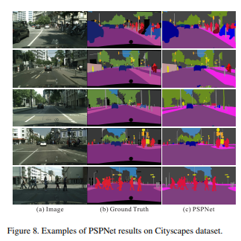
RESULTS
XXXXXXXXXXXXXXXXXXXXXXXXXX

Slide 9
PART·FOUR
CONCLUSION

Slide 10
CONCLUSION

Slide 11
THANK YOU

